Slide 1
MANDATORY ASSIGNMENT 2
AJ Motors
• Working distributed system · implementation and verification
• Ahmad Alkaseb · Jeppe Koch · Asger Bergøe · Laith Alkaseb
• https://github.com/AhmadAlkaseb/aj
AJ MOTORS / Technical review · 12 November 2026
01
Notes:
Current implementation presentation for Assignment 2. Evidence dates remain explicit.
Repository: https://github.com/AhmadAlkaseb/aj

Slide 2
MANDATORY ASSIGNMENT 2
What works locally?
• Catalogue, customer profiles, exclusive reservation and manual payment.
• Real REST/GraphQL frontend workflow and protected backend ownership.
• Actual local AI drafts; bounded PDF confirmation work.
• Selected failure/recovery scenarios and persistent demonstration data.
AJ MOTORS / Technical review · 12 November 2026
02
Notes:
Report 1, 2 and 4; EVIDENCE.md. Avoid promising production HA or universal fault coverage.
Repository: https://github.com/AhmadAlkaseb/aj

Slide 3
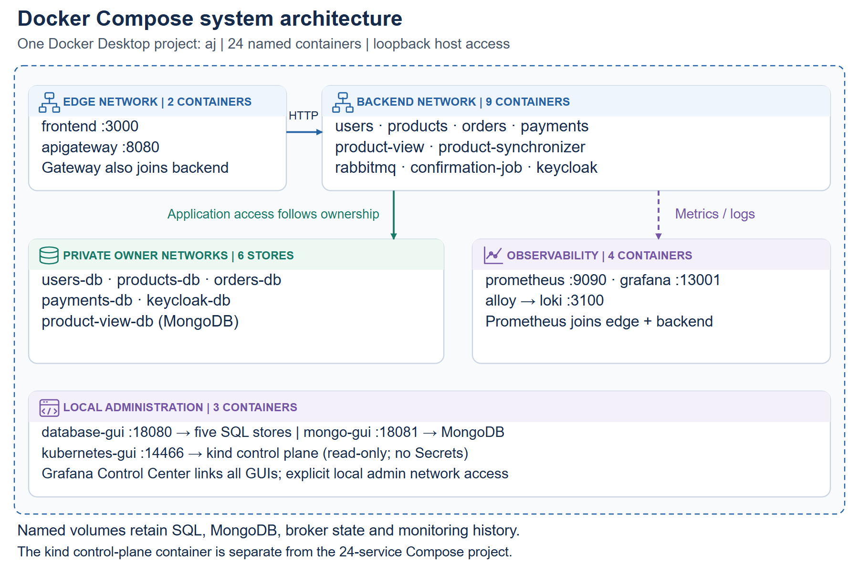
MANDATORY ASSIGNMENT 2
Compose development architecture
• 24 named services under aj; persistent owner stores and shared local administration.
AJ MOTORS / Technical review · 12 November 2026
03
Notes:
Report 3.1. Adminer/Mongo Express have explicit local admin network access. kind control plane is separate.
Repository: https://github.com/AhmadAlkaseb/aj

Slide 4
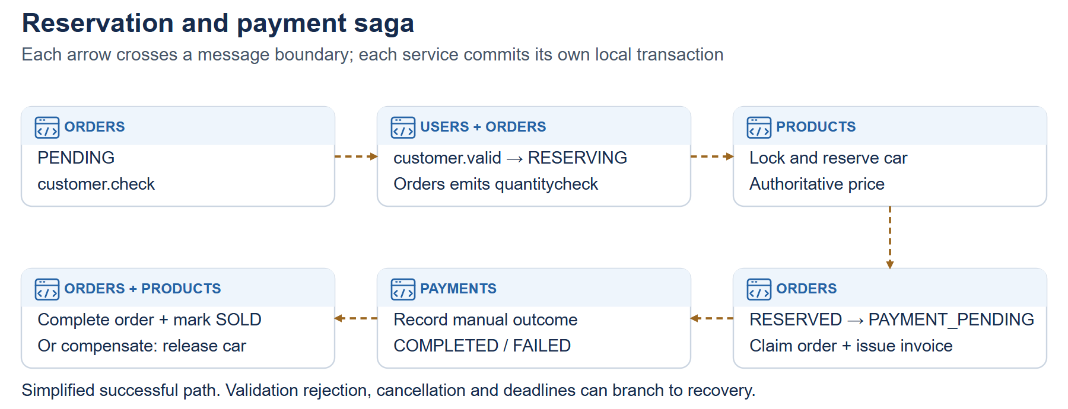
MANDATORY ASSIGNMENT 2
Asynchronous cooperation
• Order → customer validation → inventory reservation → payment outcome.
• Failure/cancellation compensates eligible stock.
• Backend cooperation fixture starts private stores, broker and four owners.
• No UI or gateway is required for the dedicated cooperation scenario.
AJ MOTORS / Technical review · 12 November 2026
04
Notes:
Report 2.3 and 4.4. Durable queues, retained saga state and outbox/inbox recover selected failures.
Repository: https://github.com/AhmadAlkaseb/aj

Slide 5
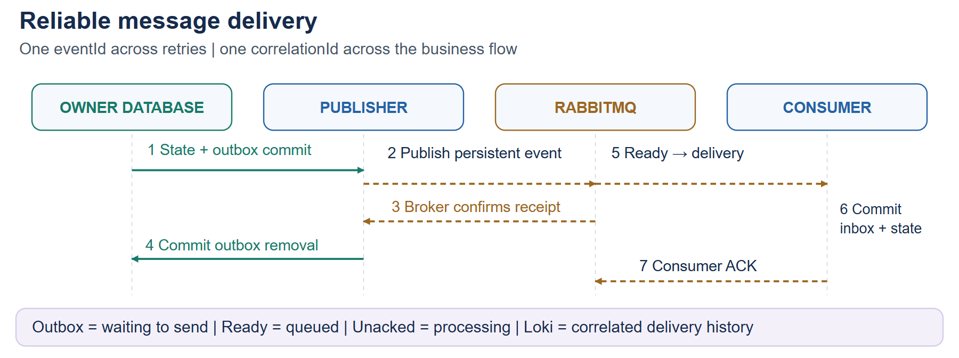
MANDATORY ASSIGNMENT 2
Delivery and failure visibility
• Outbox: waiting to send; Ready: waiting in broker; Unacked: processing.
• Publisher confirmation differs from consumer acknowledgement.
• Correlated metadata links requests, events and logs without payload secrets.
AJ MOTORS / Technical review · 12 November 2026
05
Notes:
Report 2.4.7. Fast deliveries can occur between metrics scrapes; use correlated logs for observed history.
Repository: https://github.com/AhmadAlkaseb/aj

Slide 6
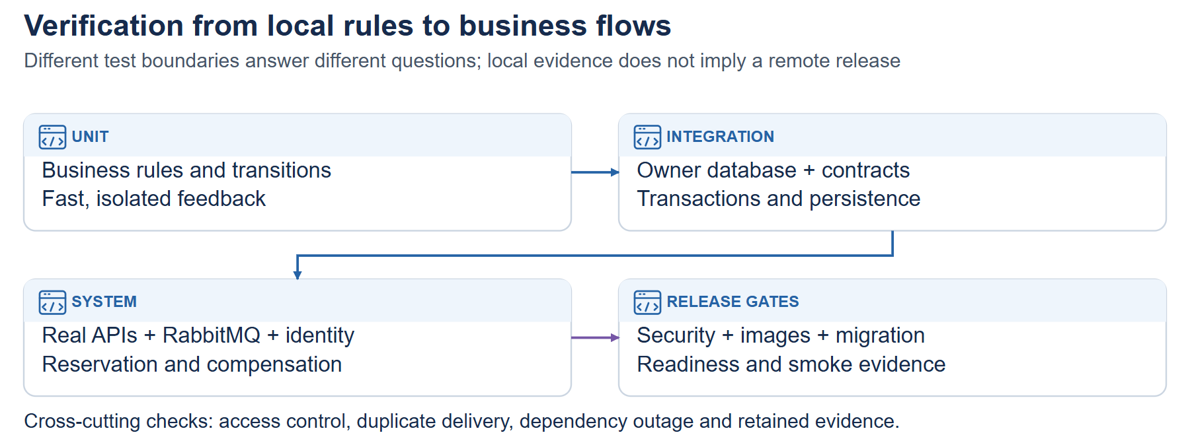
MANDATORY ASSIGNMENT 2
Testing and CI gates
• Unit, API/database/message integration and backend cooperation are separate.
• Change-aware CI skips unrelated work; required failures block dependants.
• 47 local Python policy/deployment/federation tests passed at review.
• GitHub-hosted execution remains unverified without account authentication.
AJ MOTORS / Technical review · 12 November 2026
06
Notes:
Report 4. Java results are separately dated; no remote run ID is invented.
Repository: https://github.com/AhmadAlkaseb/aj

Slide 7
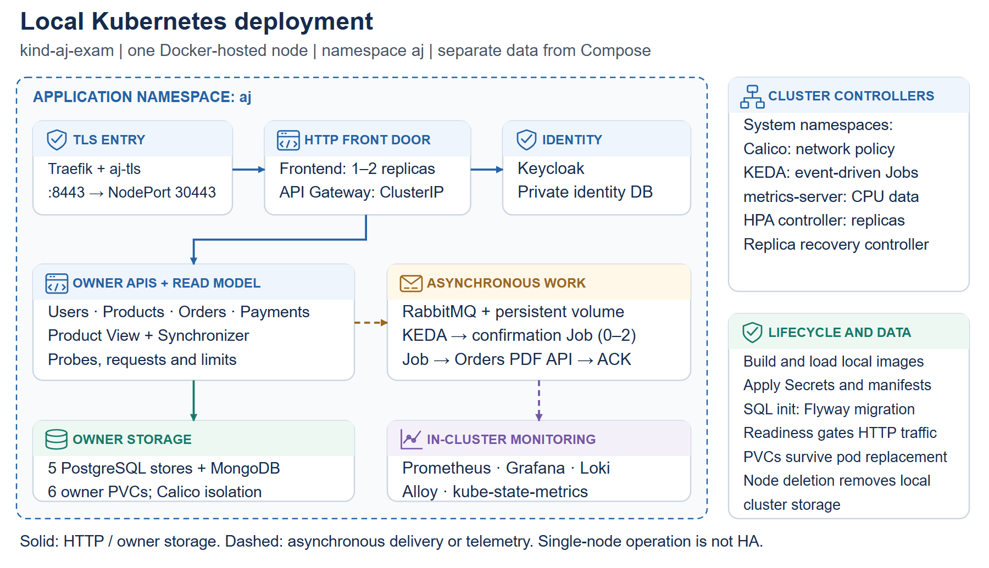
MANDATORY ASSIGNMENT 2
Kubernetes deployment
• Active demo: TLS ingress, owner PVCs, migration gates, HPA and KEDA Jobs.
• Standby: Headlamp reads resources while Compose serves the application.
• Single-node simulation is not host-failure high availability.
AJ MOTORS / Technical review · 12 November 2026
07
Notes:
Report 3.2. Previous active-runtime evidence is different from current standby status.
Repository: https://github.com/AhmadAlkaseb/aj

Slide 8
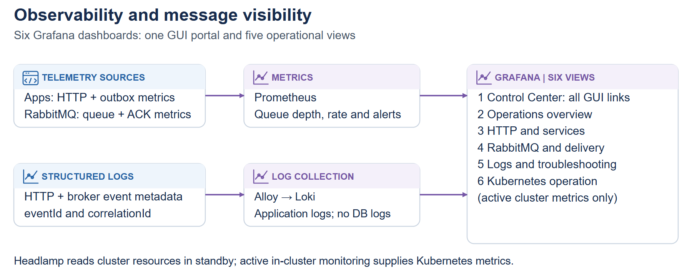
MANDATORY ASSIGNMENT 2
Monitoring and GUI portal
• Grafana Control Center links SQL/Mongo/Kubernetes and all operations tools.
• Six dashboards; metrics + logs + RabbitMQ delivery status.
• Local browser checks passed all database GUIs and read-only Headlamp.
AJ MOTORS / Technical review · 12 November 2026
08
Notes:
Report 3.2.3; GUI checker confirmed nodes readable and Secrets denied. Common local admin is not enterprise SSO.
Repository: https://github.com/AhmadAlkaseb/aj

Slide 9
MANDATORY ASSIGNMENT 2
Deployment plan and delivery
• AKS cloud plan includes identity, AI, stores, broker, jobs and observability.
• Installation and verification instructions are included in the report.
• Remaining external inputs: owned OAuth app, real login and authentic contributions.
• Upload PowerPoint, report and repository link to itsLearning.
AJ MOTORS / Technical review · 12 November 2026
09
Notes:
Report Appendices B–E and submission README. Actual cloud deployment is not required.
Repository: https://github.com/AhmadAlkaseb/aj

