Slide 1
Detecting AI-Generated Arabic Abstracts
Ahmed Alofi

Slide 2
Introduction
Problem: Rising threat of AI-generated academic content in Arabic
Solution: Scalable detection pipeline with 95.69% accuracy
Platform: Apache Spark on CentOS

Slide 3
Project Objectives
1 | Design distributed pipeline for Arabic text analysis
2 | Develop comprehensive Arabic preprocessing functions
3 | Engineer hybrid features (TF-IDF + stylometric)
4 | Train & evaluate 4 classification models
5 | Implement real-time streaming inference
6 | Analyze scalability on CentOS infrastructure

Slide 4
Dataset Overview
Source
The dataset is KFUPM-JRCAI/arabic-generated-abstracts loaded from Hugging Face.
Size and Structure
The raw dataset contains three splits (by_polishing, from_title, from_title_and_content). After flattening into a long format, the unified DataFrame contains 41,940 rows with four columns: abstract_text, source_split, generated_by, label..

Slide 5
Preprocessing Pipeline
Four-Stage Distributed Processing (Spark UDFs)
remove_diacritics
normalize_arabic # إ/أ/آ → ا
3. remove_stopwords # Filter common words
4. stem_arabic # ISRIStemmer root extraction

Slide 6
Feature Engineering
Feature Type | Specifics | Dimensionality
TF-IDF | HashingTF (10K features) + IDF | 10,000
F1 | Total character count | 1
F24 | Unique punctuation ratio | 1
Total | VectorAssembler output | 10,002

Slide 7
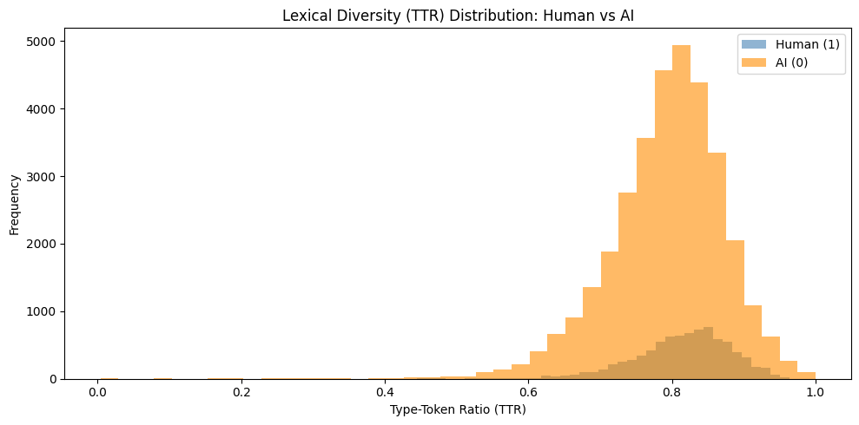
EDA
Type-Token Ratio (TTR) - Lexical Diversity

Slide 8
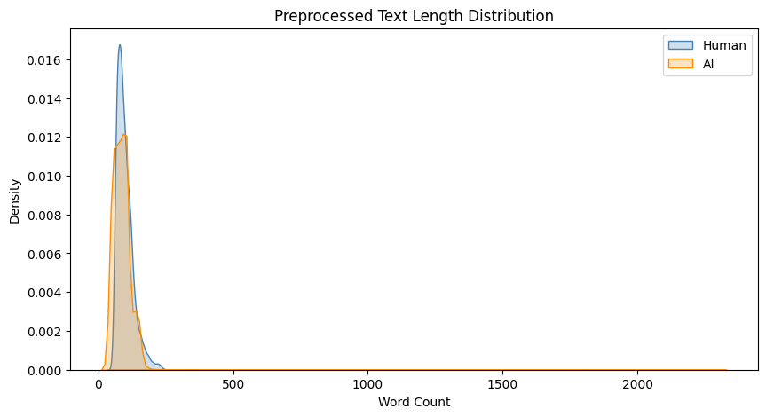
EDA
Text Length Distribution
Kernel density plot comparing word count distributions between human and AI texts

Slide 9
Models Evaluated
Four Classifiers Compared
Training split: 70% train (25,752) | 15% validation (5,373) | 15% test (5,400)
Model | Type | Key Parameters
Logistic Regression | Linear | maxIter=50, regParam=0.01
Linear SVM | Linear | maxIter=20, regParam=0.1
Random Forest | Ensemble | numTrees=100, maxDepth=10
Gradient Boosted Trees | Ensemble | maxIter=20

Slide 10
Results
Model | Accuracy | F1-Score | AUC-ROC
Linear SVM | 95.69% | 0.9547 | 0.9651
Logistic Regression | 95.57% | 0.9521 | 0.9674
GBT (XGBoost) | 94.39% | 0.9336 | 0.9522

Slide 11
Confusion Matrix
The model shows good performance with 35 false positives
Label | AI(pred) | Human (pred)
AI(0) | 4950 | 35
Human(1) | 268 | 147

Slide 12
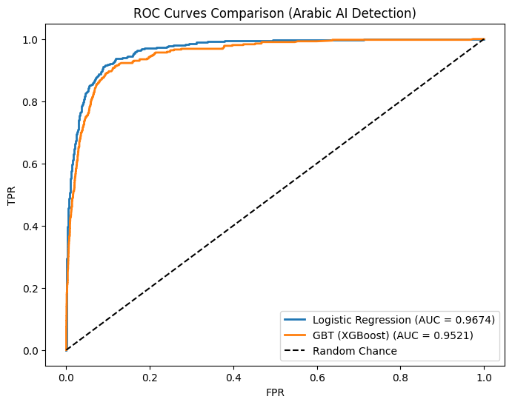
ROC Curves
The ROC curves show that Logistic Regression and GBT achieve excellent separation (AUC > 0.95), significantly outperforming random chance.

Slide 13
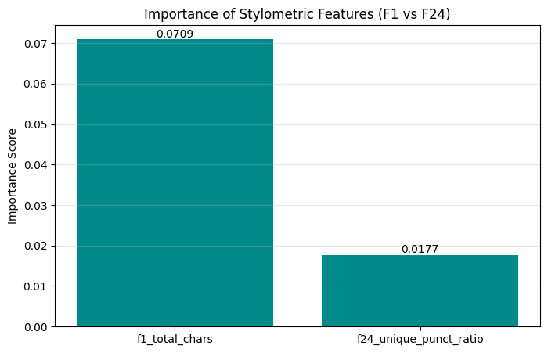
Feature Importance
For the GBT model, the two stylometric features showed the following importance scores:
F1 (Total Characters): Dominant importance
F24 (Unique Punctuation Ratio): Secondary importance

Slide 14
Streaming Implementation
Component | Technology
Stream engine | Spark Structured Streaming
Checkpointing | Fault-tolerant exactly-once
Output format | Parquet with partitioning

Slide 15
Summary
Successfully implemented distributed big data pipeline for Arabic AI-text detection
Linear SVM achieved 95.69% accuracy with F1-score of 0.9547
Hybrid features (TF-IDF + character count + punctuation ratio) are effective
Streaming capability enables real-time inference (50 records / 5 batches)
Scalability optimal at 4 partitions on CentOS (0.14 sec)

