Slide 1

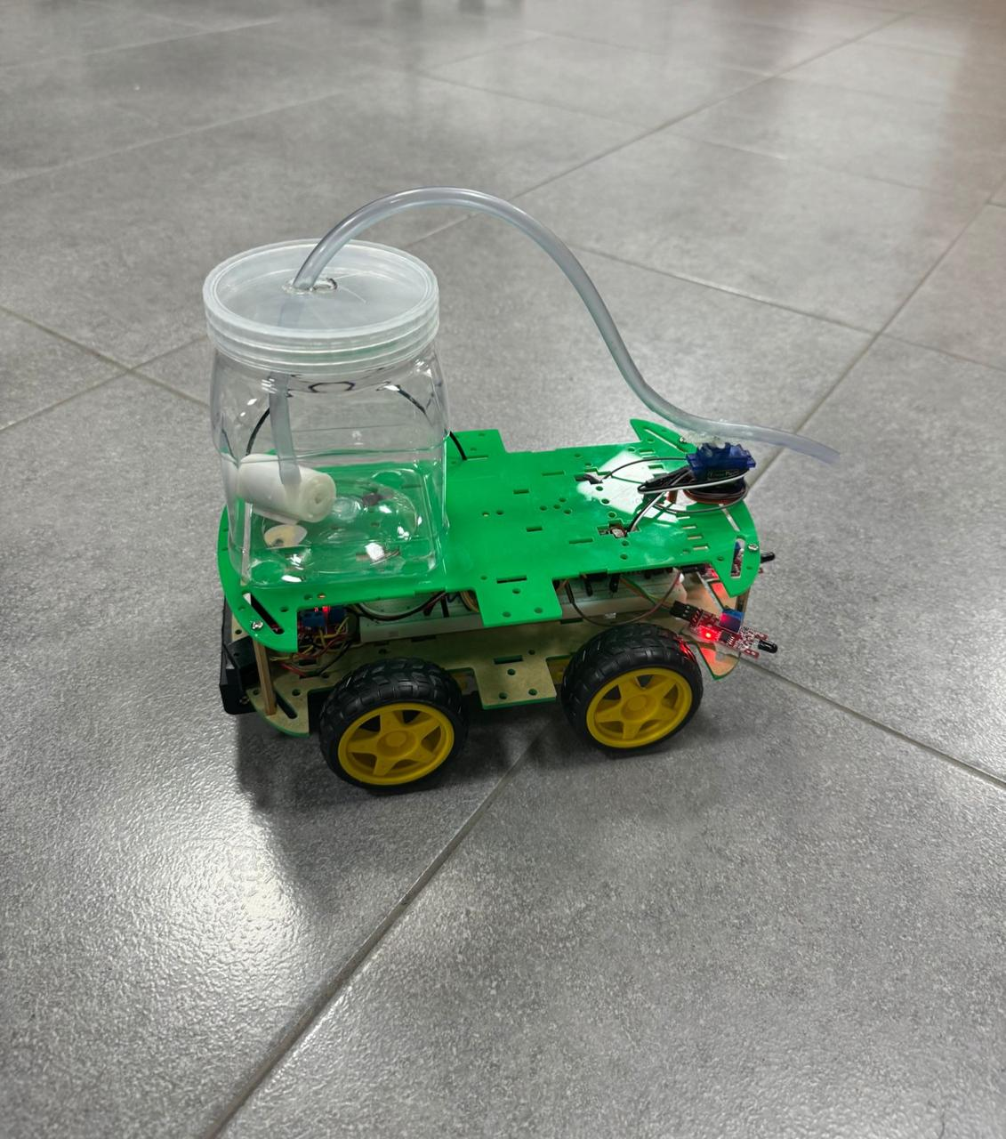
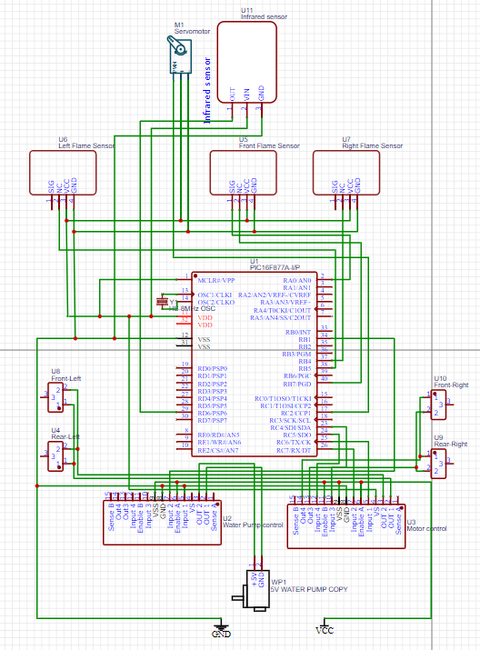
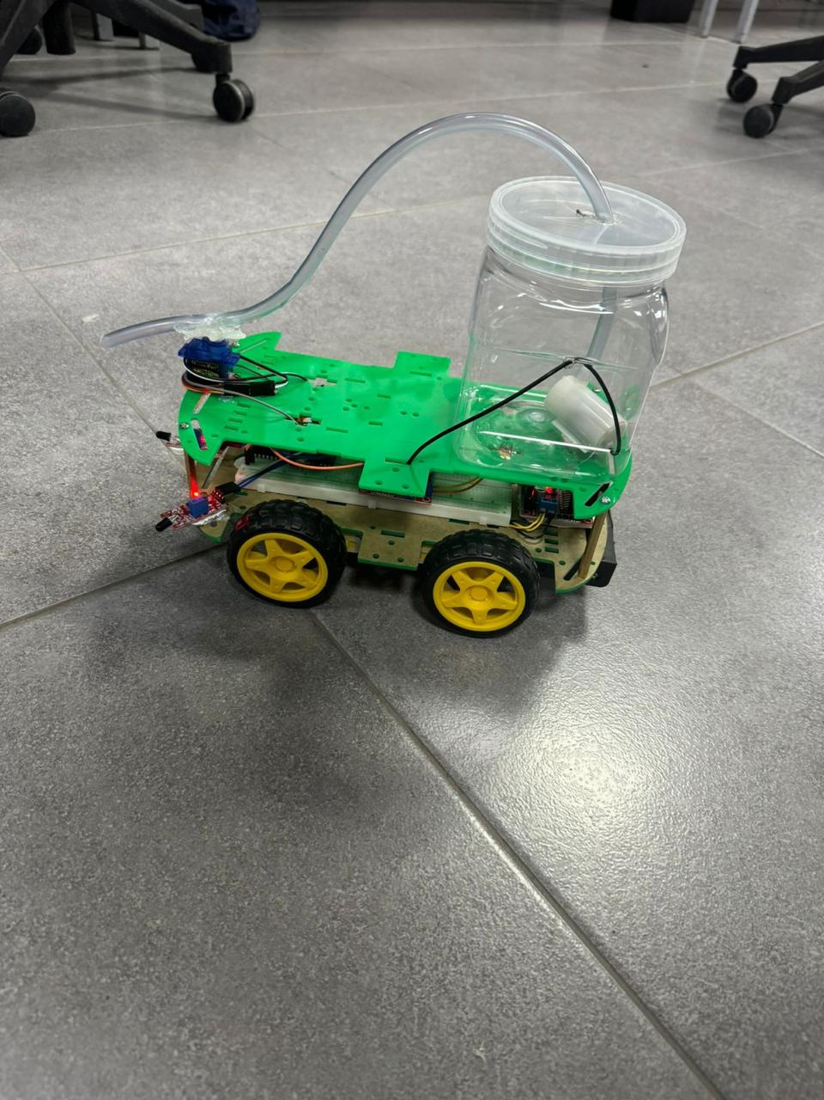
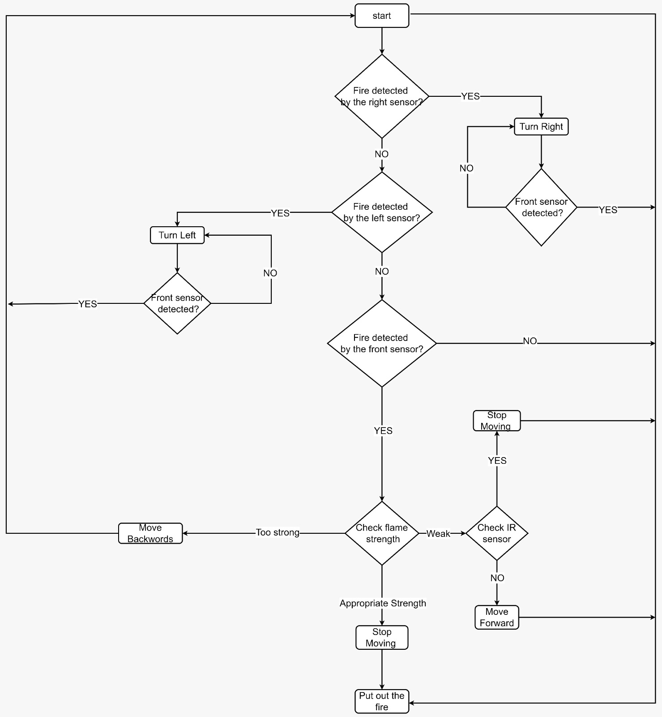
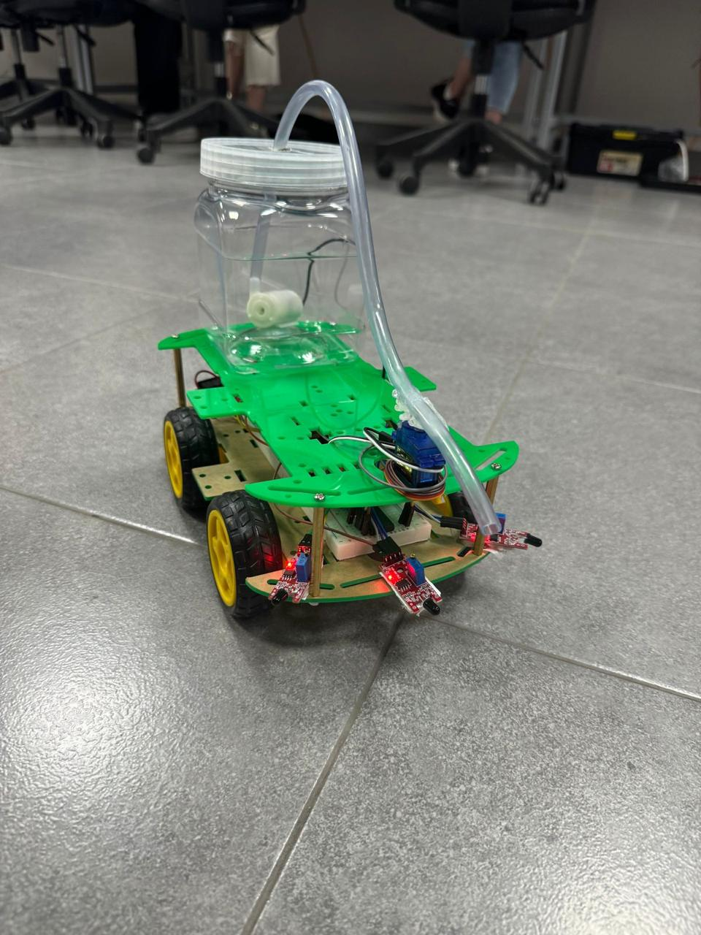
Fire Fighter Robot
Ali Qasem, Ahmad Alqam, Omar Qarqash
Supervisor: Dr. Belal H. Sababha & Dr. Anastassia Gharib
Embedded Systems Final Design Project, Spring 2024 King Abdullah II School of Engineering
Princess Sumaya University for Technology
Introduction
With the servo motor controlling the hose, this firefighting robot aims to autonomously navigate towards identified fires, move straight when confronting them, and precisely spray water when it gets near to the fire. Straight-line motions are protected against collisions with obstructions using an infrared sensor. Effective and cautious responses to a variety of firefighting circumstances are guaranteed by the integrated design. Three flame sensors, an infrared sensor, a PIC 16F877A microcontroller, three 3.7V batteries, and a water system with a tank, pump, and servo motor are all included in the smart firefighting vehicle.
Results
Figure 3.
Figure 4.
Figure 5.
Design
Hardware
Figure 1.
Software
Figure 2.
Conclusion
In conclusion, our fireman robot project effectively uses the PIC16F877A MCU to detect and react to flames. The robot navigates effectively by combining digital and analog flame sensors with precision motor control. The project provides a straightforward but efficient example of how automation might be used in real-world firefighting situations.

