Slide 1
Isolation and Protection in Operating Systems
2. Segmentation and Tasks in x86-64
Prof. Dr. Michael Schöttner
Dr. Fabian Ruhland
WiSe 26/27

Slide 2
x86-64: 64-Bit CPU Architecture
x86-64: Original name of AMD’s 64-bit extension to x86
  Sometimes abbreviated as x64
  Later replaced by AMD64
Intel licensed x86-64 from AMD
Intel 64 is Intel’s own label (for the same architecture)
  Minimal differences in instruction set compared to AMD64
  Completely different than the own IA-64 (Itanium) architechture
2. Segmentation and Tasks in x86-64

Slide 3
x86-64: 64-Bit CPU Architecture
CPU has 16 general purpose registers (all 64 bit wide)
Paging must be enabled
Segmentation strongly restricted
2. Segmentation and Tasks in x86-64

Slide 4
x86-64: CPU modes
Real Mode = 16 bit addressing
Protected Mode = 32 bit addressing (also called IA-32)
Long Mode = 64 Bit addressing (also called IA-32e)
  e meaning extension
  Used in the Intel manuals
  To differentiate against IA-64
(Compatibility Mode)
  Supporting Protected Mode applications in Long Mode
2. Segmentation and Tasks in x86-64

Slide 5
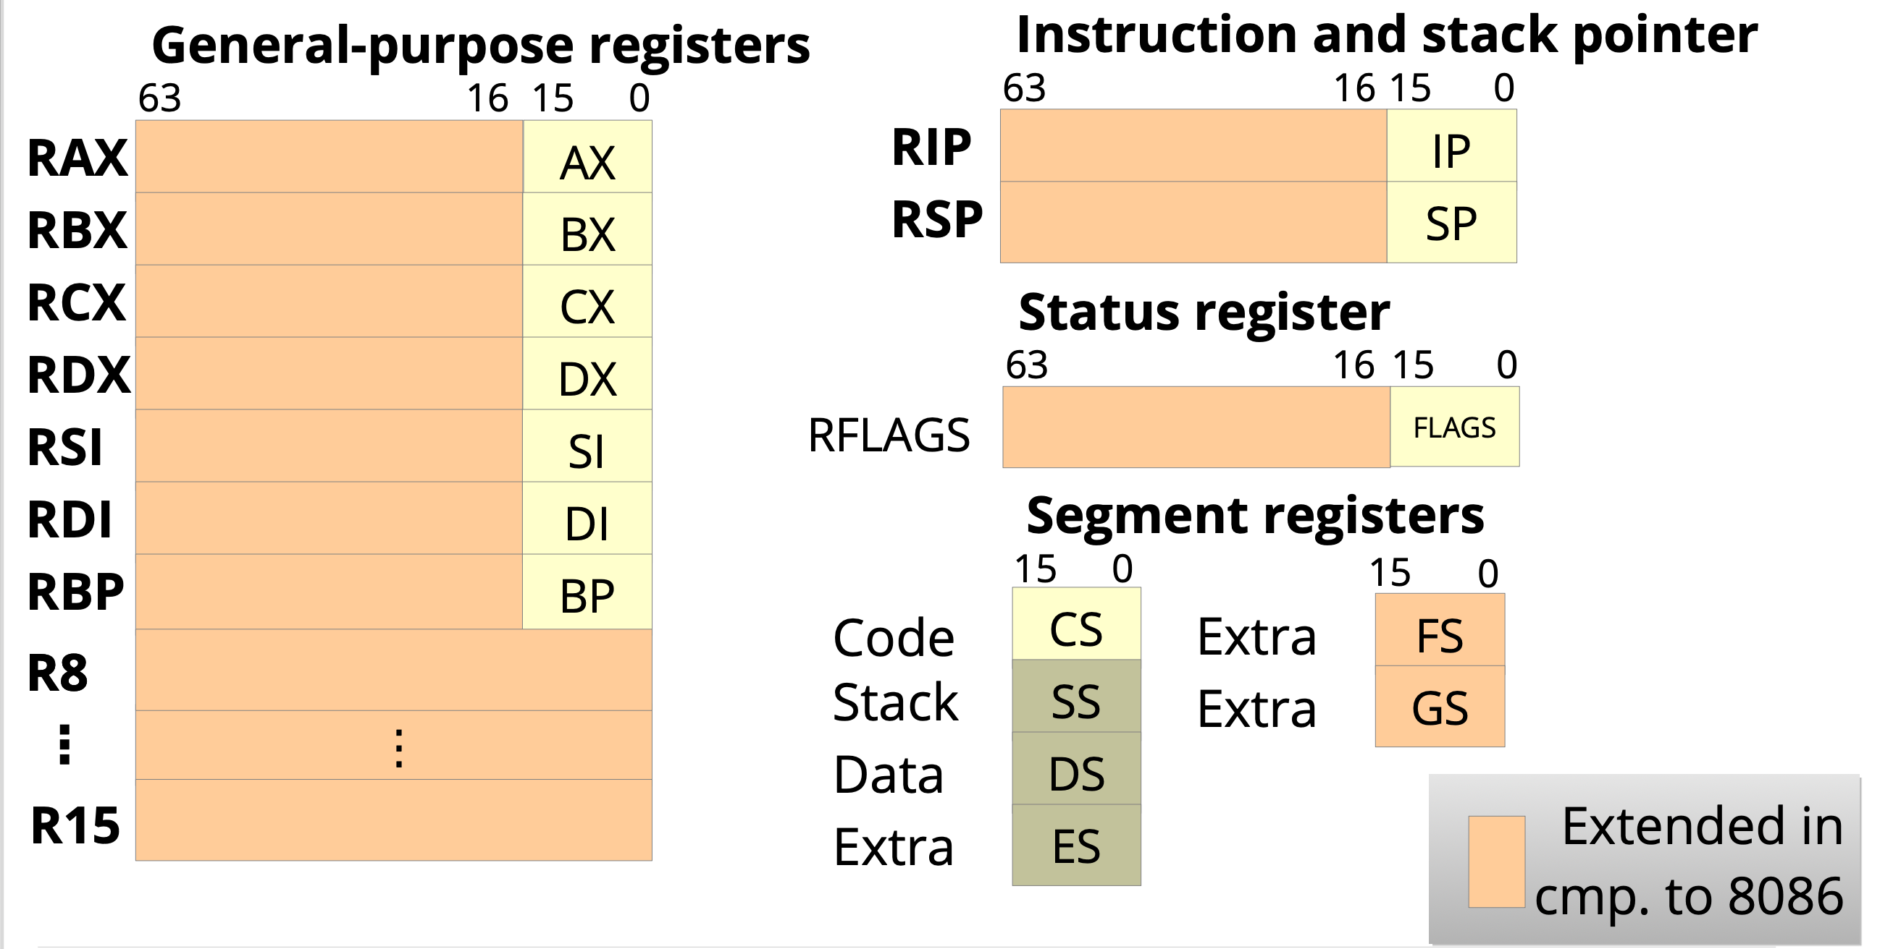
x86-64: Registers
Picture: Horst Schirmeier, TU Dresden
2. Segmentation and Tasks in x86-64

Slide 6
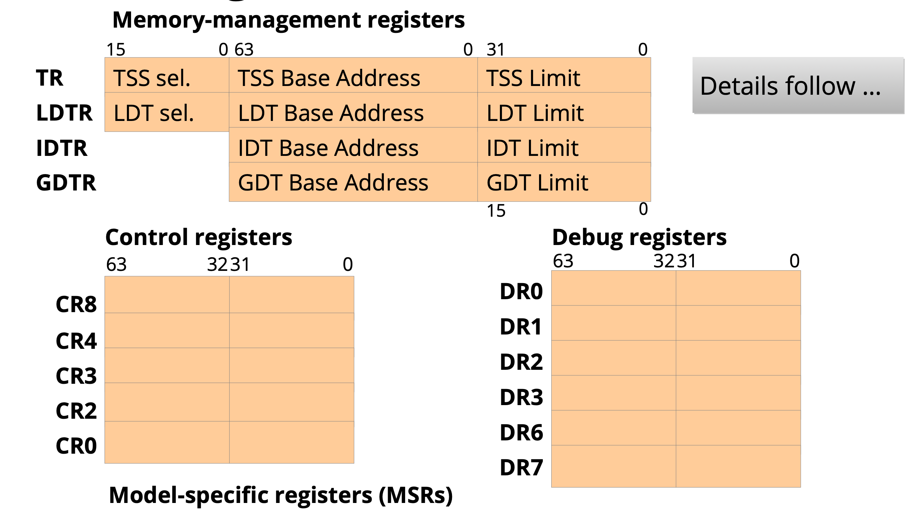
x86-64: Registers
Picture: Horst Schirmeier, TU Dresden
2. Segmentation and Tasks in x86-64

Slide 7
32-Bit Segmentation
Each segment has a start address and a length
Segment registers store segment selectors = Index into the GDT/LDT
  LDT was rarely used by operating systems
A program (in execution) consists of multiple memory segments
  At least CODE, DATA and STACK
Linear address is segment start address + effective address
  Effective address = Value in a general purpose register
2. Segmentation and Tasks in x86-64

Slide 8
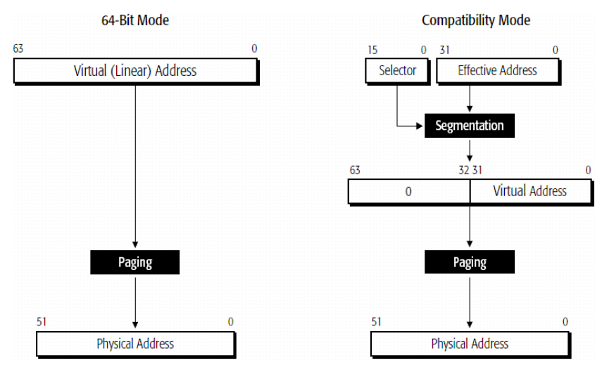
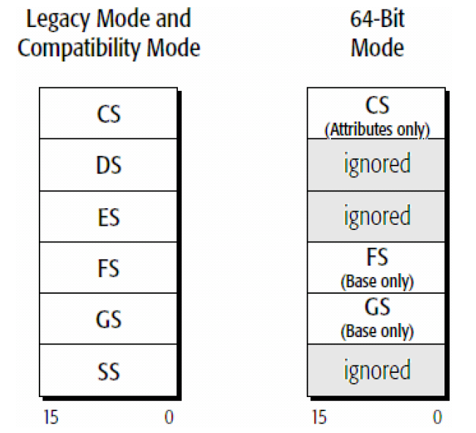
Long Mode: Segmentation
16-bit Selectors
Start addresses are ignored in almost all segments,
except FS and GS
No limit check; essentially only the ring number
in CS remains relevant (= CPL)
2. Segmentation and Tasks in x86-64

Slide 9
Protection
Goals:
  Protection against unauthorized memory accesses and code execution
  Protection against kernel crashes or crashes of other processes
Requirements: Coda and Data...
  are classified in regard to their trustability
  and this classification is enforced by the operating system, with the help of the process
2. Segmentation and Tasks in x86-64

Slide 10
Protection Rings
Each segment descriptor (Code/Data)
has two bits, determining which privilege
level the segment is assigned to
  Up to four privilege levels possible
  In practice, only two are used
Code
Code
Code
Code
3
2
1
0
Daten
Daten
Daten
Daten
2. Segmentation and Tasks in x86-64

Slide 11
Protection Rings
Smaller ring numbers grant more privileges
Ring 3 is meant for applications
  = User Mode
Ring 0 is meant for the OS
  = Kernel/Supervisor Mode
Application
OS
3
2
1
0
2. Segmentation and Tasks in x86-64

Slide 12
Protection Rings and Gates
Accessing memory of an inner ring is forbidden and
such accesses are prohibited by the MMU
  General Protection Fault
Code of an inner ring can only
be called via Gates
  Allow direct calls from ring 3
  to ring 0
Memory accesses and calls
to outer rings are always allowed
Gate
3
2
1
0
2. Segmentation and Tasks in x86-64

Slide 13
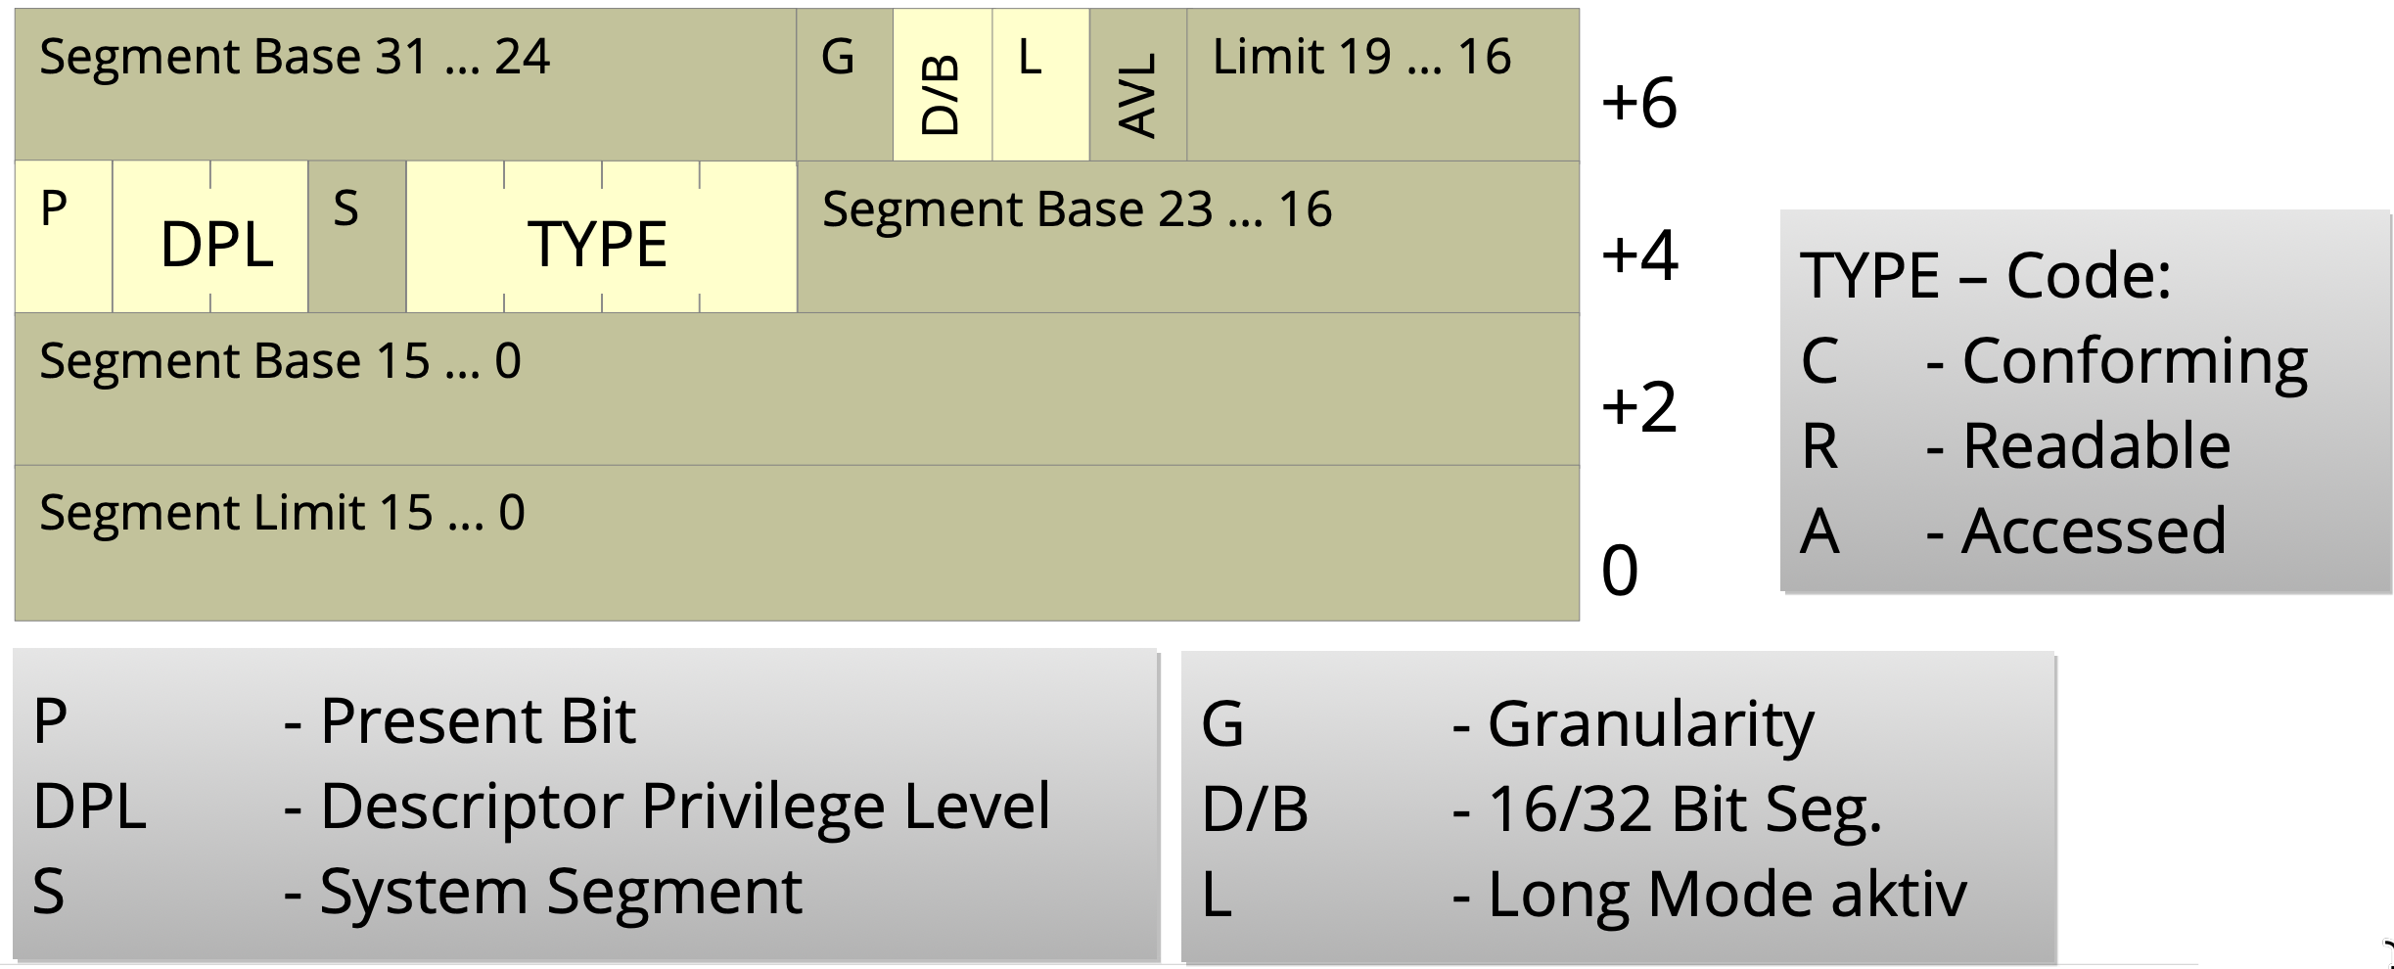
Segment Deskriptors
Are entries in the Global Descriptor Table (GDT) and allow code protection
  (IA-32: additional protection via limit (= end of segment))
  8 byte per entry (exception: system segments use 16 byte in x86_64)
TYPE
Code/Data
Read/Write
Non-/Conforming
System Segments
(Call Gate, Task
State Segment)
P Present Bit
DPL Descriptor Privilege Level
S System Segment
Bild von Volkmar Sieh / Daniel Lohmann, Uni Erlangen
2. Segmentation and Tasks in x86-64

Slide 14

Segment Selectors
Stored in 16-bit Segment Registers
Consist of an index into the GDT (13 bit)
and the requested privilege level (RPL)
Privilege Level Abbreviations:
  Requested Privilege Level (RPL) in a segment register
  Descriptor Privilege Level (DPL) in the correspoding descriptor
  Current Privilege Level (CPL) in the current value of the code segment register (bits 0 and 1)
  IOPL (2 bits) in FLAGS register: Determine the required privilege level to execute I/O instructions
If RPL > CPL the RPL is used → Privilege level can only be weakened by the RPL
2. Segmentation and Tasks in x86-64

Slide 15
Global Descriptor Table (GDT)
Only one for the whole OS (independent from the number of cores)
Global Descriptor Table Register (GDTR) points to the GDT
Typical GDT (also in HeineOS) →
  DPL = 0: Ring 0 (kernel mode)
  DPL = 3: Ring 3 (user mode)
Example: mov ds, 16 would trigger a General Protection Fault
if executed in user mode
TSSD: See next slides
GDT
TSSD, DPL=0
Data, DPL=3
32
Code, DPL=3
24
Data, DPL=0
16
Code, DPL=0
8
null
0
GDTR
2. Segmentation and Tasks in x86-64

Slide 16
Preview: Protection via Paging
In Long Mode the base address and limit of segments is ignored
→ Segmentation can no longer restrict memory acceses
Memory protection is done via Paging
→ We can allow/forbid user mode access for each 4 KiB page independently
Paging allows acces mode restrictions: read only, no execute, etc.
Paging is discussed in more detail in a later lecture (when we implement it)
2. Segmentation and Tasks in x86-64

Slide 17
Task State Segment (TSS)
We need on TSS per CPU core to use kernel/user mode
  TSS location is described by a TSS descriptor in the GDT
  The TSS descriptor is referenced by the Task Register (TR)
In 32-Bit Protected Mode the state of a CPU core (all registers, etc.) could be stored inside a TSS (used for hardware supported task switching)
→ Was rarely used and thus abandoned in Long Mode
In Long Mode the TSS only store Stacks and optionally the I/O Permission Bitmap
(see next slide)
2. Segmentation and Tasks in x86-64

Slide 18
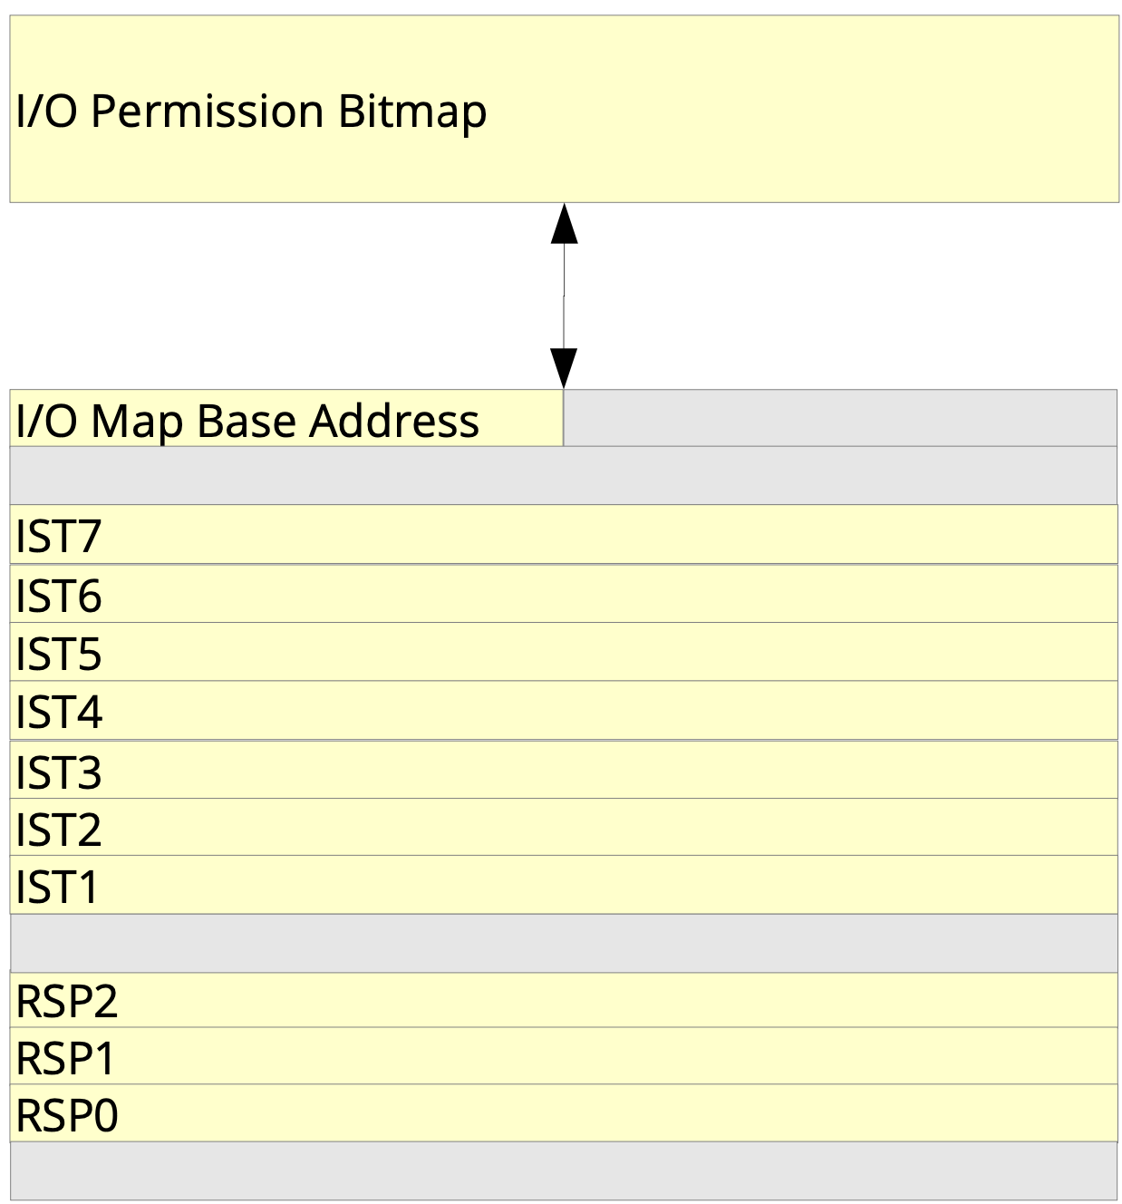
Long Mode: TSS
IST = Interrupt Stack Table
  Allows separate stacks for interrupt handlers (optional)
  IST number can be specified in entries inside the
  Interrupt-Descriptor Table (IDT)
RSP0, RSP1, RSP2
  Stack pointer für rings 0 to 2
  When the ring changes, the stack is switched and the
  CPU core finds the right stack pointer in the TSS
  Most operating systems only use two rings (0 and 3)
  so that only RSP0 is relevant (applies to HeineOS too)
RSP3?
  Missing? → No, it is automatically stored on the stack
  during a ring change through a call gate or
  interrupt gate (see later)
Bild von Horst Schirmeier, TU Dresden
2. Segmentation and Tasks in x86-64

Slide 19
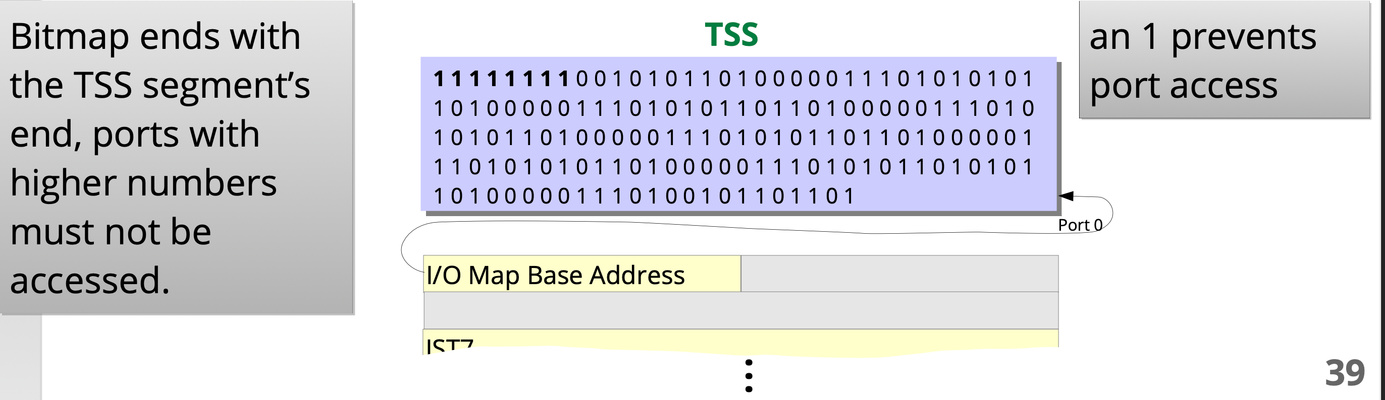
Long Mode: I/O-Permission Bitmap
Access protection for I/O-ports (only little relevance nowadays)
  I/O privilege level (IOPL) represented by two bits inside the RFLAGS register
  Port access is granted if CPL ≤ IOPL
  Otherwise, the I/O permission bitmap is used
    One bit for each port; if a bit is set, access is denied
Access protection for memory mapped I/O via page tables
Picture: Horst Schirmeier, TU Dresden
2. Segmentation and Tasks in x86-64

Slide 20
Long Mode: Task Switch
Task switching is done in the kernel, triggered by the timer interrupt
All registers are stored on the stack of the current thread
  This is the kernel stack, as the interrupt caused a switch to ring 0
  Additionally, all values of the TSS are stored on the stack (except RSP0)
    (In HeineOS, we do not store any TSS values, as we only use RSP0)
  Finally, RSP0 is saved in the Thread structure (residing in the kernel heap)
  The state of the next thread can be accessed loading the RSP0
  from its Thread structure
2. Segmentation and Tasks in x86-64

Slide 21
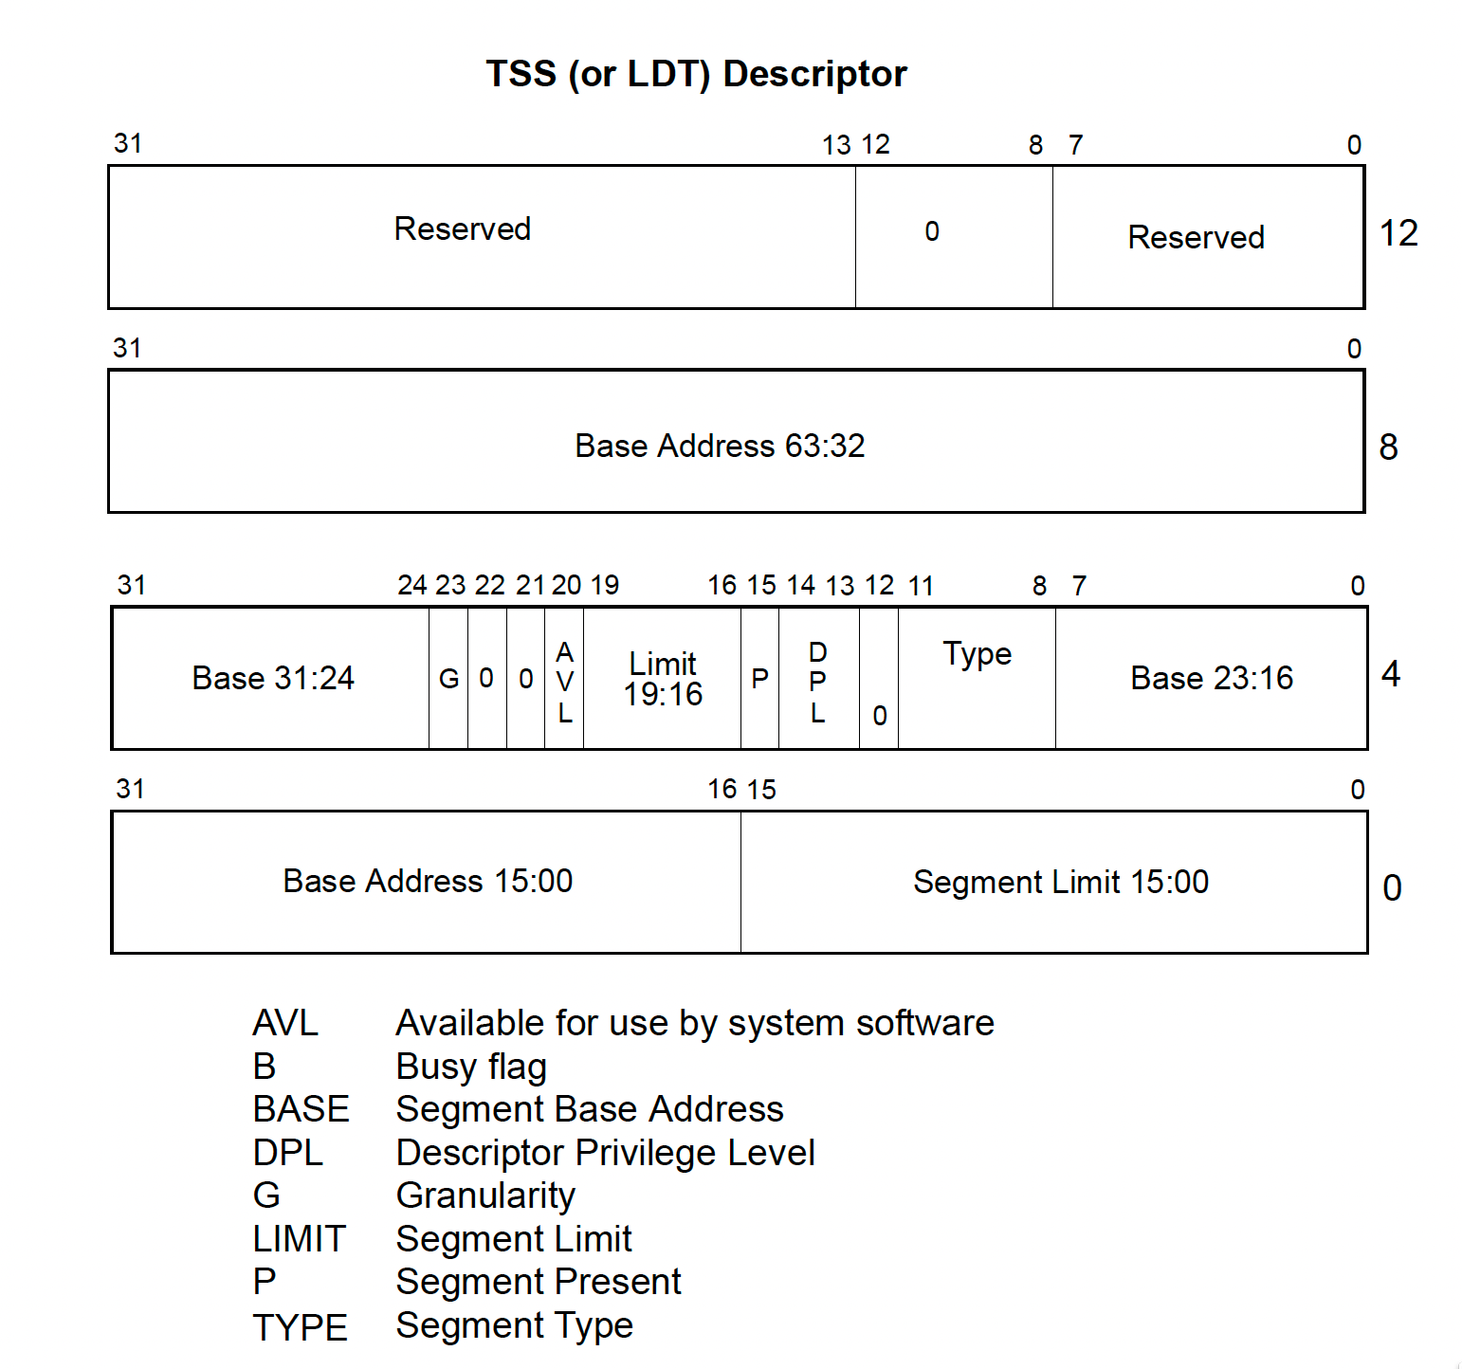
Task State Segment Descriptor (TSSD)
Stored in GDT
One entry per core
2. Segmentation and Tasks in x86-64

Slide 22
x86 Structures in HeineOS
Exceptions, IRQs, and Syscalls
IDT
TSS
Stacks
Isolation and protection
GDT
user- / kernel mode and TSS
Paging
TSSD, DPL=0
2. Segmentation and Tasks in x86-64

Slide 23
Summary
x86-64 architecture is complex
Rarely used features were removed
  Segmentation (mostly)
  Hardware support for task switching
Still backwards compatible
  Processor and cores still start up in Real Mode
Intel X86s wanted to simplify the architecture by removing a lot of
backward compatibility
  But, Intel has stopped working ont X86s
2. Segmentation and Tasks in x86-64

