Slide 1
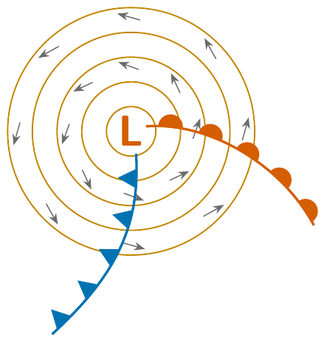
EGM305
Practical 3
Atmospheric moisture, atmospheric motion and weather map analysis
Every question, solved step by step
Notes:
Teaching deck for the EGM305 Practical 3 sheet. Every question of the sheet is answered step by step, in the order of the sheet. Figures were drawn for this deck; the companion PDF guide has the full explanations and practice problems.

Slide 2
What this deck covers
Part | Questions | Topic | Slides
I | Moisture Q1–Q6 | Mixing ratio, relative humidity, dew point (Table 1, Figure 3) | relative humidity · dew point
II | Motion Q1–Q11 | Pressure surfaces, geostrophic wind, friction (Figures 1–6) | forces · surfaces · geostrophic · friction
III | Map Q12–Q14 | Station models, streamlines, fronts, full analysis (Figures 7–10) | station model · streamlines · fronts
How each question is taught
• The question exactly as the sheet asks it
• The method in numbered steps; each step appears on its own slide, with the figure built up one step at a time
• The answer (green box), with a check that it is sensible
• Try it yourself sets with worked answers, and a final self-test
EGM305 Practical 3 · Overview
2
Notes:
The sheet numbers moisture questions 1-6, then motion questions restart at 1 and run to 11, then the map questions are 12-14. Naming them by part avoids confusion.

Slide 3
Three corrections to the printed answer key
1. Moisture Q6: the dew point is about 26 °C, not 25 °C
The sample holds 21.78 g/kg. Air at 26 °C can hold 21.73 g/kg; at 25 °C only 20.4 g/kg, so 25 °C would already be oversaturated.
2. Map Q12, model 1: the dew point is 21 °F, not 28 °F
The station model printed on the sheet shows 21 at the bottom left.
3. Table 1: two printed mixing ratios are typing slips
3.189 g/kg at 0 °C should be 3.840; 2.009 g/kg at −8 °C should be 2.099. They kink the curve of Figures 2 and 3 but no question uses these two rows.
The weather map stations were read from the printed figures; wind speeds are counted from the barbs, so they are approximate.
EGM305 Practical 3 · Overview
3
Notes:
The key was checked line by line against Table 1 and the figures. Everything else in the key is correct.

Slide 4
Part I: Moisture in the air
Mixing ratio, relative humidity and the dew point
Moisture Q1 to Q6

Slide 5
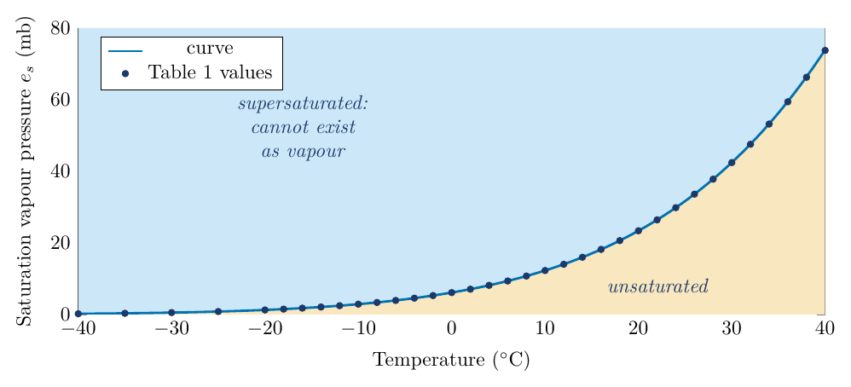
Vapour pressure and saturation
Each gas in air contributes a share of the pressure. For water vapour it is the vapour pressure, e.
Above liquid water, evaporation and condensation balance when the air is saturated: e reaches its upper limit, the saturation vapour pressure e_{s}.
e_{s} rises steeply with temperature:
• 6.1 mb at 0 °C
• 23.4 mb at 20 °C
• 73.8 mb at 40 °C
This is Figure 1 of the sheet: the Clausius–Clapeyron curve.
EGM305 Practical 3 · Part I · Moisture
5
Notes:
Water vapour contributes a share of the total pressure: the vapour pressure e. Evaporation and condensation balance at saturation, giving the saturation vapour pressure e_s, which rises steeply with temperature (Clausius-Clapeyron).

Slide 6
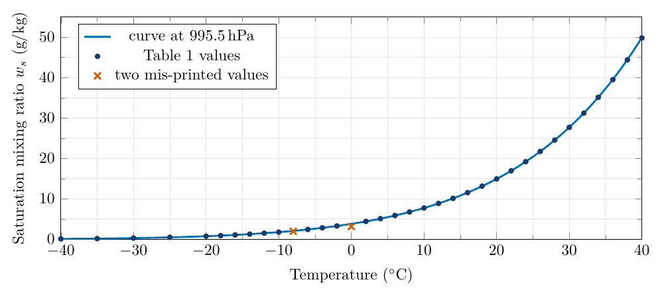
Mixing ratio and saturation mixing ratio
The mixing ratio w is the mass of water vapour per kilogram of dry air (g/kg).
When the air is saturated it is the saturation mixing ratio, w_{s}: the second number column of Table 1.
The two measures are linked:
Link
w ≈ 622 e / (p − e) g/kg
Table 1 fits p ≈ 995.5 hPa (not 1013): that pressure is used for every calculation here.
EGM305 Practical 3 · Part I · Moisture
6
Notes:
Mixing ratio = mass of vapour / mass of dry air, in g/kg. w = 622 e/(p-e) g/kg. Table 1 was evidently computed at about 995.5 hPa.

Slide 7
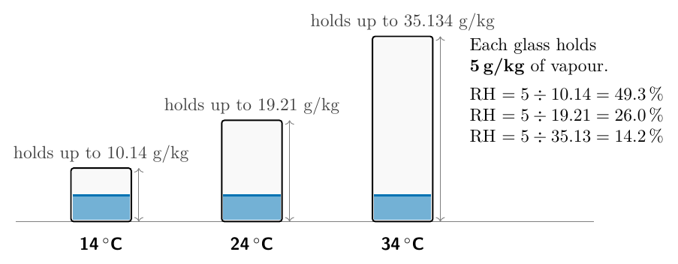
Relative humidity: how full is the glass?
Picture the air as a glass:
• size of the glass = saturation mixing ratio w_{s} at the air's temperature (warm air = big glass)
• water in the glass = the actual mixing ratio w
• relative humidity = how full the glass is
Relative humidity
RH = w / w_{s} × 100 %
(or RH = e / e_{s} × 100 %)
EGM305 Practical 3 · Part I · Moisture
7
Notes:
Glass picture: the size of the glass is the saturation mixing ratio at the air temperature; the water in it is the actual mixing ratio; RH is how full the glass is.

Slide 8
Reading Table 1: three skills
1. Look up a listed temperature: w_{s}(24 °C) = 19.21 g/kg.
2. Interpolate between rows for an unlisted temperature: w_{s}(25 °C) ≈ (19.21 + 21.734) / 2 = 20.47 g/kg (exact 20.44).
3. Look up backwards: given w, find the temperature at which w_{s} = w. That is a dew point.
T (°C) | e_{s} (mb) | w_{s} (g/kg)
0 | 6.108 | 3.840 (printed 3.189)
10 | 12.272 | 7.762
14 | 15.977 | 10.14
20 | 23.373 | 14.956
24 | 29.831 | 19.21
26 | 33.608 | 21.734
30 | 42.430 | 27.694
34 | 53.200 | 35.134
Rows used in the questions. The highlighted row is one of the two corrected values.
EGM305 Practical 3 · Part I · Moisture
8

Slide 9
Moisture Q1: relative humidity of five samples
The question
Using Table 1 and the expressions above, determine the saturation mixing ratio and calculate the relative humidity of the following air samples.
Temp. | Mixing ratio (g/kg) | RH (%)
14 °C | 5 | ?
14 °C | 9 | ?
24 °C | 5 | ?
24 °C | 2 | ?
34 °C | 7 | ?
Method: look up w_{s}, then RH = w / w_{s} × 100 %.
EGM305 Practical 3 · Part I · Moisture
9

Slide 10
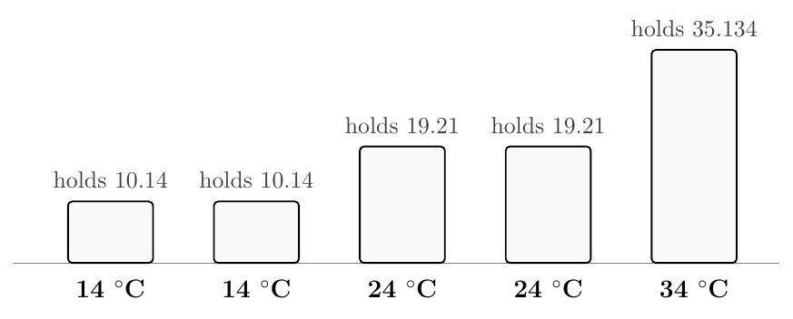
Moisture Q1: step 1 of 2
Look up w_{s} in Table 1 at each temperature: 14 °C → 10.14, 24 °C → 19.21, 34 °C → 35.134 g/kg. These are the sizes of the glasses.
1
EGM305 Practical 3 · Part I · Moisture
10
Notes:
The size of each glass is the saturation mixing ratio from Table 1.

Slide 11
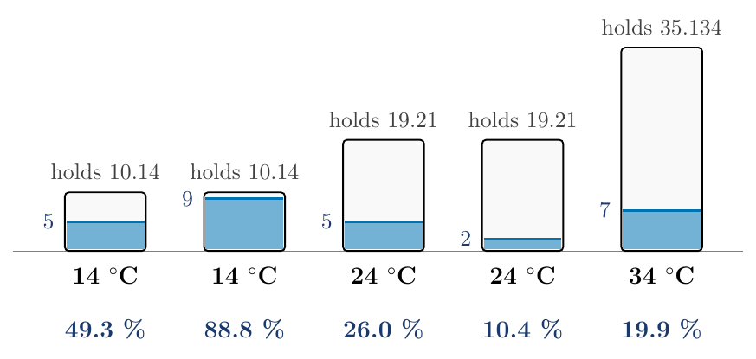
Moisture Q1: step 2 of 2
Look up w_{s} in Table 1 at each temperature: 14 °C → 10.14, 24 °C → 19.21, 34 °C → 35.134 g/kg. These are the sizes of the glasses.
1
RH = w ÷ w_{s} × 100: 5/10.14 = 49.3 %; 9/10.14 = 88.8 %; 5/19.21 = 26.0 %; 2/19.21 = 10.4 %; 7/35.134 = 19.9 %.
2
EGM305 Practical 3 · Part I · Moisture
11
Notes:
Divide the water by the size of the glass. Check: more vapour at the same temperature gives higher RH; the same vapour in warmer air gives lower RH.

Slide 12
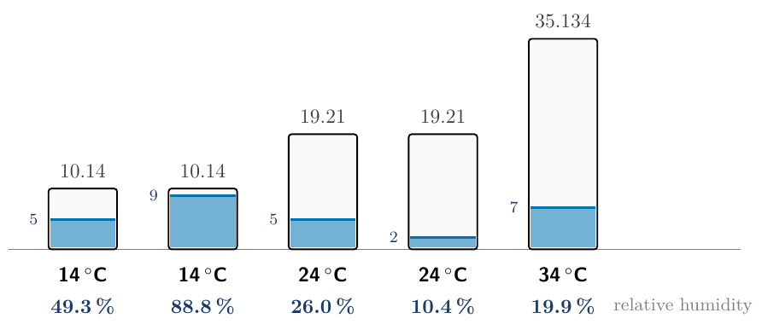
Moisture Q1: the answers
Answer
14 °C, 5 g/kg: 49.3 %
14 °C, 9 g/kg: 88.8 %
24 °C, 5 g/kg: 26.0 %
24 °C, 2 g/kg: 10.4 %
34 °C, 7 g/kg: 19.9 %
Check
Same temperature, more vapour → higher RH (49 → 89 %). Same vapour, warmer air → lower RH (49 % at 14 °C, 26 % at 24 °C).
EGM305 Practical 3 · Part I · Moisture
12

Slide 13
Moisture Q2: cold air heated in a house
The question
In the winter, cold air is brought into homes and heated. How is this going to change the humidity in the house?
Follow one parcel of air. Heating changes its temperature (the size of the glass) but adds no water.
EGM305 Practical 3 · Part I · Moisture
13

Slide 14
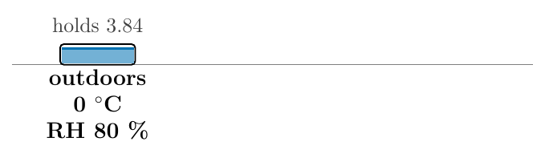
Moisture Q2: step 1 of 3
Outdoors: 0 °C, RH 80 %. Table 1 (corrected): w_{s}(0 °C) = 3.84 g/kg, so the air holds 0.80 × 3.84 = 3.07 g/kg.
1
EGM305 Practical 3 · Part I · Moisture
14
Notes:
Cold air holds little vapour.

Slide 15
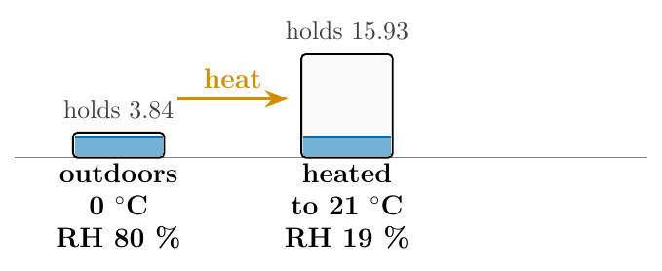
Moisture Q2: step 2 of 3
Outdoors: 0 °C, RH 80 %. Table 1 (corrected): w_{s}(0 °C) = 3.84 g/kg, so the air holds 0.80 × 3.84 = 3.07 g/kg.
1
Heat it to 21 °C with nothing added: w is still 3.07 g/kg, but w_{s}(21 °C) ≈ 15.9 g/kg. RH = 3.07 / 15.9 = 19 %.
2
EGM305 Practical 3 · Part I · Moisture
15
Notes:
The glass is now four times bigger but contains the same water.

Slide 16
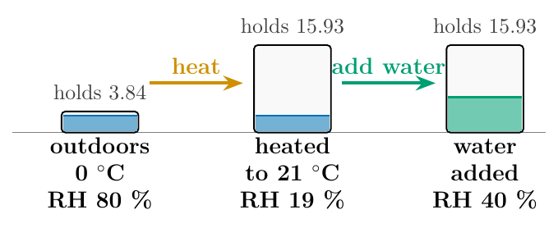
Moisture Q2: step 3 of 3
Outdoors: 0 °C, RH 80 %. Table 1 (corrected): w_{s}(0 °C) = 3.84 g/kg, so the air holds 0.80 × 3.84 = 3.07 g/kg.
1
Heat it to 21 °C with nothing added: w is still 3.07 g/kg, but w_{s}(21 °C) ≈ 15.9 g/kg. RH = 3.07 / 15.9 = 19 %.
2
To reach a comfortable 40 % you would need 0.40 × 15.9 = 6.4 g/kg: add 3.3 g of water to every kilogram of air.
3
EGM305 Practical 3 · Part I · Moisture
16
Notes:
This is why winter houses feel so dry: skin, lips, static electricity.

Slide 17
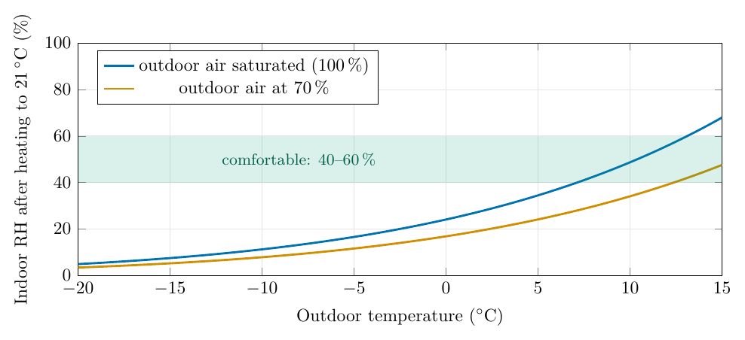
Moisture Q2: the answer
Answer
The humidity in the house drops significantly.
Cold air holds little vapour, so the outside air has a low mixing ratio. Heated without added water, the mixing ratio is unchanged but the capacity grows, so RH becomes very low (19 % in the example).
EGM305 Practical 3 · Part I · Moisture
17

Slide 18
Moisture Q3: who holds the most water vapour?
The question
Complete the ratios for the following air samples and rank from 1 (highest) to 5 (lowest) in order of actual water vapour content: (SMR × RH, e.g. 10.14 × 0.9 = 9.126).
Temp. | SMR (g/kg) | RH | w (g/kg) | Rank
14 °C | 10.14 | 90 % | ? | ?
20 °C | 14.956 | 60 % | ? | ?
24 °C | 19.21 | 40 % | ? | ?
30 °C | 27.694 | 40 % | ? | ?
34 °C | 35.134 | 30 % | ? | ?
Method: turn each RH back into an amount of vapour: w = w_{s} × RH, then rank.
EGM305 Practical 3 · Part I · Moisture
18

Slide 19
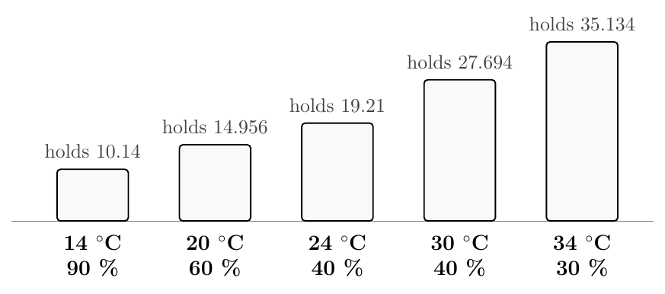
Moisture Q3: step 1 of 3
Look up w_{s} for each temperature: 10.14, 14.956, 19.21, 27.694, 35.134 g/kg: the sizes of the glasses.
1
EGM305 Practical 3 · Part I · Moisture
19
Notes:
Glass sizes.

Slide 20
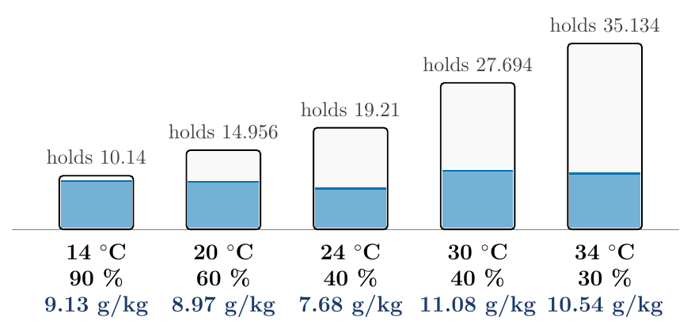
Moisture Q3: step 2 of 3
Look up w_{s} for each temperature: 10.14, 14.956, 19.21, 27.694, 35.134 g/kg: the sizes of the glasses.
1
w = w_{s} × RH: 10.14×0.9 = 9.126; 14.956×0.6 = 8.974; 19.21×0.4 = 7.684; 27.694×0.4 = 11.078; 35.134×0.3 = 10.54 g/kg.
2
EGM305 Practical 3 · Part I · Moisture
20
Notes:
Fill each glass to its RH. The level is now the real amount of water.

Slide 21
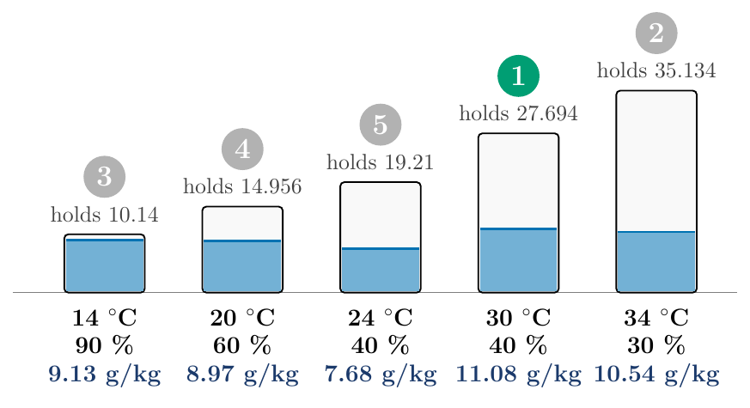
Moisture Q3: step 3 of 3
Look up w_{s} for each temperature: 10.14, 14.956, 19.21, 27.694, 35.134 g/kg: the sizes of the glasses.
1
w = w_{s} × RH: 10.14×0.9 = 9.126; 14.956×0.6 = 8.974; 19.21×0.4 = 7.684; 27.694×0.4 = 11.078; 35.134×0.3 = 10.54 g/kg.
2
Rank from the most vapour to the least: 30 °C (1), 34 °C (2), 14 °C (3), 20 °C (4), 24 °C (5).
3
EGM305 Practical 3 · Part I · Moisture
21
Notes:
The 14 °C sample is the 'dampest' (90 %) but only third.

Slide 22
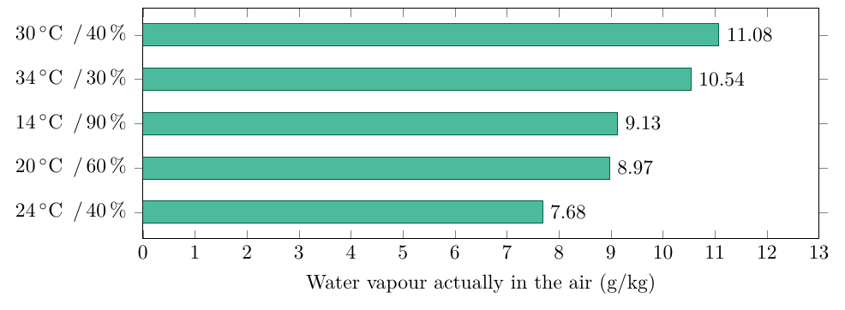
Moisture Q3: the answers
Answer
Mixing ratios: 9.126, 8.974, 7.684, 11.078, 10.54 g/kg
Ranks: 3, 4, 5, 1, 2
Common mistake
Ranking by RH would put 14 °C first. A small glass 90 % full holds less than a big glass 40 % full.
EGM305 Practical 3 · Part I · Moisture
22

Slide 23
Moisture Q4: the disadvantage of relative humidity
Answer
Relative humidity does not tell you how much water vapour is actually in the air.
Why?
• It depends on temperature as well as on the vapour: the same air has RH 49 % at 14 °C and 26 % at 24 °C (Q1).
• It changes through the day for no reason connected with moisture: the temperature rises after dawn, so RH falls.
• It cannot compare places: the 90 % sample in Q3 held less vapour than three drier-feeling ones.
Better measures: the mixing ratio and the dew point measure the vapour itself, and do not change when air is heated or cooled.
EGM305 Practical 3 · Part I · Moisture
23

Slide 24
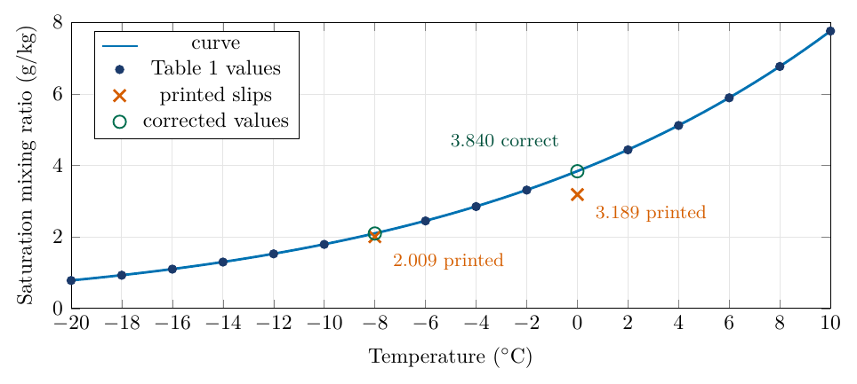
The two slips in Table 1
At 0 °C the table prints 3.189 g/kg, which is less than the 3.313 printed at −2 °C: impossible.
The formula at 995.5 hPa gives 3.840.
At −8 °C: printed 2.009, should be 2.099.
All other rows fit the formula to better than 0.1 %.
No question on the sheet uses these two rows (Q2 uses the corrected 0 °C value).
EGM305 Practical 3 · Part I · Moisture
24
Notes:
At 0 C the table prints 3.189, less than the 3.313 printed at -2 C: impossible, because saturation mixing ratio only increases with temperature. The formula gives 3.840. At -8 C 2.009 should be 2.099 (digits transposed).

Slide 25
Practice Set A: try it yourself
Practice Set A
A1. Air at 28 °C has a mixing ratio of 15 g/kg. Relative humidity?
A2. Air at 10 °C, RH 70 %. How much vapour per kilogram?
A3. P: 32 °C, RH 25 %. Q: 20 °C, RH 85 %. Which holds more vapour, and by how much?
A4. Air at 0 °C, RH 90 %, heated to 20 °C with no water added. New RH?
A5. Air at 24 °C, RH 50 %, cooled to 14 °C (no condensation). New RH?
A6. Interpolate w_{s} at 31 °C, then the mixing ratio of 31 °C air at RH 55 %.
EGM305 Practical 3 · Part I · Moisture
25
Notes:
Give students a few minutes, then reveal the next slide.

Slide 26
Practice Set A: answers
Answers
A1. w_{s}(28) = 24.557 → RH = 15/24.557 = 61 %.
A2. w_{s}(10) = 7.762 → w = 0.70 × 7.762 = 5.43 g/kg.
A3. P: 31.213 × 0.25 = 7.80 g/kg. Q: 14.956 × 0.85 = 12.71 g/kg. Q holds 4.91 g/kg more, though it is 12 °C cooler.
A4. w = 0.90 × 3.84 = 3.456; w_{s}(20) = 14.956 → RH = 23 %.
A5. w = 0.50 × 19.21 = 9.605; w_{s}(14) = 10.14 → RH = 94.7 %: nearly saturated.
A6. w_{s}(31) ≈ (27.694 + 31.213)/2 = 29.45 → w = 0.55 × 29.45 = 16.2 g/kg.
EGM305 Practical 3 · Part I · Moisture
26

Slide 27
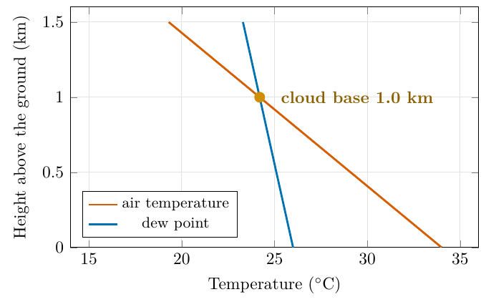
The dew point: cool the glass until it is full
Definition
The dew point T_{d} is the temperature to which an air sample must be cooled, without adding or removing water, to reach saturation: w_{s}(T_{d}) = w.
Three ways to find it (all agree):
• A. Graph (Figure 3): move left from the point until you meet the curve; read down.
• B. Table 1 backwards: bracket w between two rows; interpolate for T.
• C. Formula: e = wp/(622 + w), then invert e_{s}(T).
EGM305 Practical 3 · Part I · Moisture · Dew point
27
Notes:
Cool a sample with nothing added or removed: the vapour stays the same but the glass shrinks. At one temperature the glass is exactly full: the dew point.

Slide 28
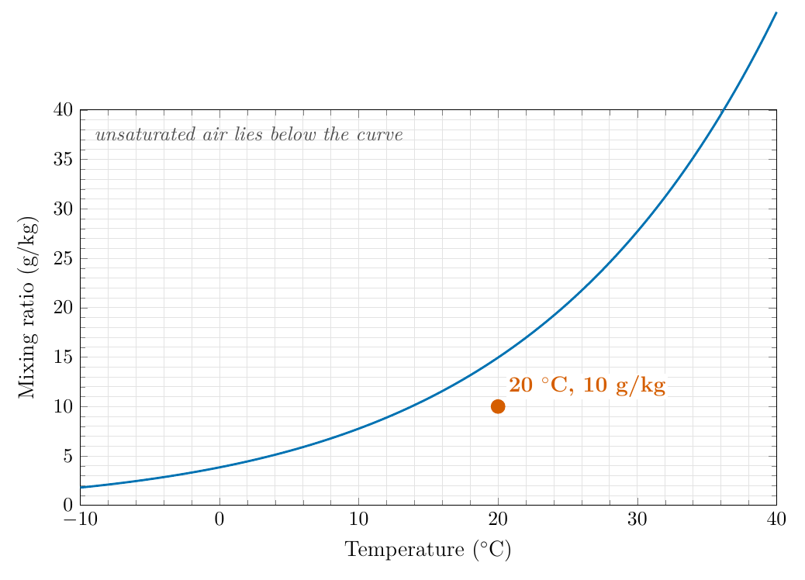
Moisture Q5: dew point of 20 °C air with 10 g/kg
The question
Consider a sample of air with a temperature of 20 °C and a mixing ratio of 10 g/kg. Plot this point on the graph below (Figure 3). Demonstrate on your graph to which temperature the sample needs to cool before it will reach saturation. This is the dew point temperature.
Cooling moves the point horizontally to the left: only the temperature changes.
EGM305 Practical 3 · Part I · Moisture · Dew point
28

Slide 29
Moisture Q5: step 1 of 4
Plot the point: 20 °C along the bottom, 10 g/kg up the side.
1
EGM305 Practical 3 · Part I · Moisture · Dew point
29
Notes:
20 degrees, 10 g/kg.

Slide 30
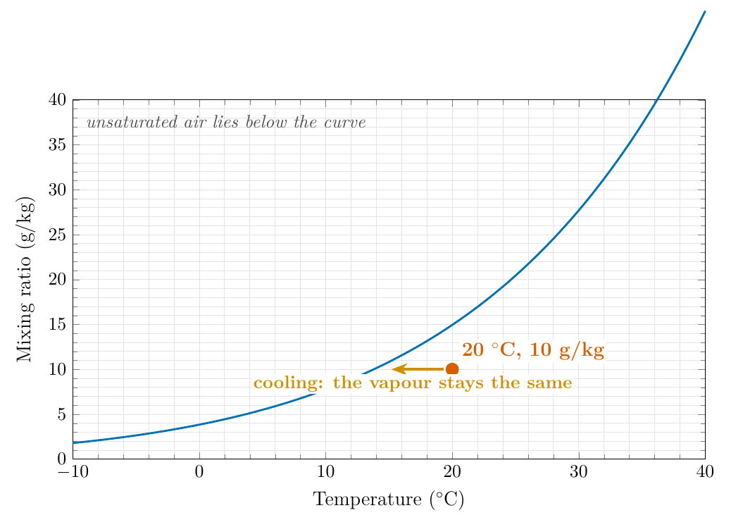
Moisture Q5: step 2 of 4
Plot the point: 20 °C along the bottom, 10 g/kg up the side.
1
Cool it: the vapour does not change, so the point moves left along the line at 10 g/kg.
2
EGM305 Practical 3 · Part I · Moisture · Dew point
30
Notes:
Nothing is added or removed, so the mixing ratio stays at 10.

Slide 31
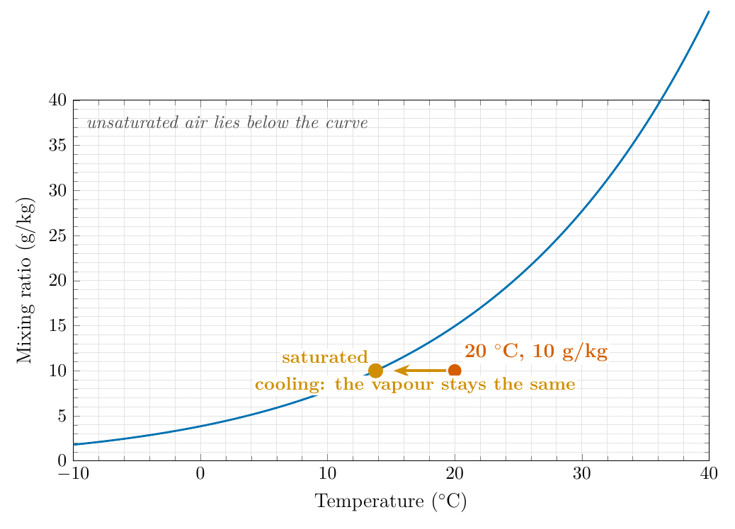
Moisture Q5: step 3 of 4
Plot the point: 20 °C along the bottom, 10 g/kg up the side.
1
Cool it: the vapour does not change, so the point moves left along the line at 10 g/kg.
2
Meet the curve: where the air holds all it can (w_{s} = 10 g/kg), it is saturated.
3
EGM305 Practical 3 · Part I · Moisture · Dew point
31
Notes:
Table 1: 12 C holds 8.882 and 14 C holds 10.14, so the curve is crossed just below 14 C.

Slide 32
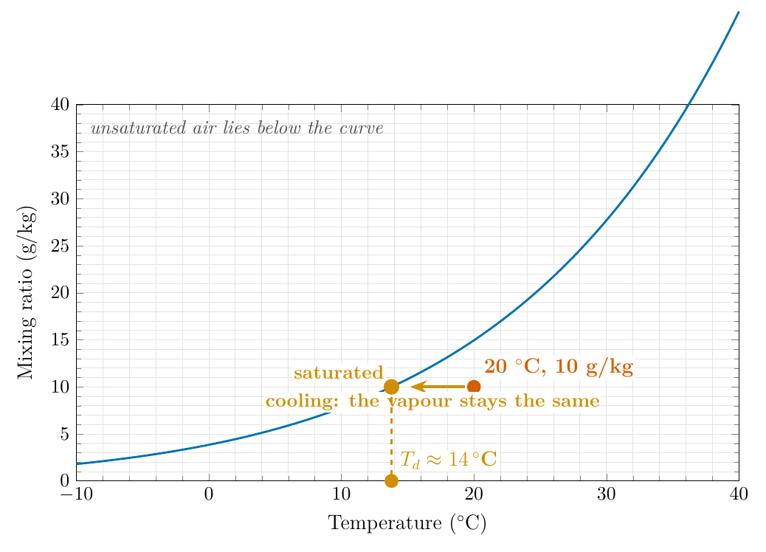
Moisture Q5: step 4 of 4
Plot the point: 20 °C along the bottom, 10 g/kg up the side.
1
Cool it: the vapour does not change, so the point moves left along the line at 10 g/kg.
2
Meet the curve: where the air holds all it can (w_{s} = 10 g/kg), it is saturated.
3
Read down to the temperature axis: the dew point is about 14 °C.
4
EGM305 Practical 3 · Part I · Moisture · Dew point
32
Notes:
13.8 C, about 14 C.

Slide 33
Moisture Q5: checking with Table 1 and the formula
Method B: Table 1 backwards
12 °C holds 8.882 g/kg; 14 °C holds 10.14 g/kg.
Fraction: (10 − 8.882)/(10.14 − 8.882) = 0.89
T_{d} ≈ 12 + 0.89 × 2 = 13.8 °C
Method C: formula
e = wp/(622 + w) = 10 × 995.5 / 632 = 15.75 hPa
Invert e_{s}(T) = 6.112 exp[17.67T/(T + 243.5)]:
T_{d} = 13.78 °C
Answer to Moisture Q5
The sample cools along the 10 g/kg line and meets the curve at about 14 °C (13.8 °C): its dew point.
Check: the dew point (14 °C) is below the air temperature (20 °C) ✓. At 14 °C the air could hold 10.14 g/kg, just above the 10 g/kg it has ✓.
EGM305 Practical 3 · Part I · Moisture · Dew point
33

Slide 34
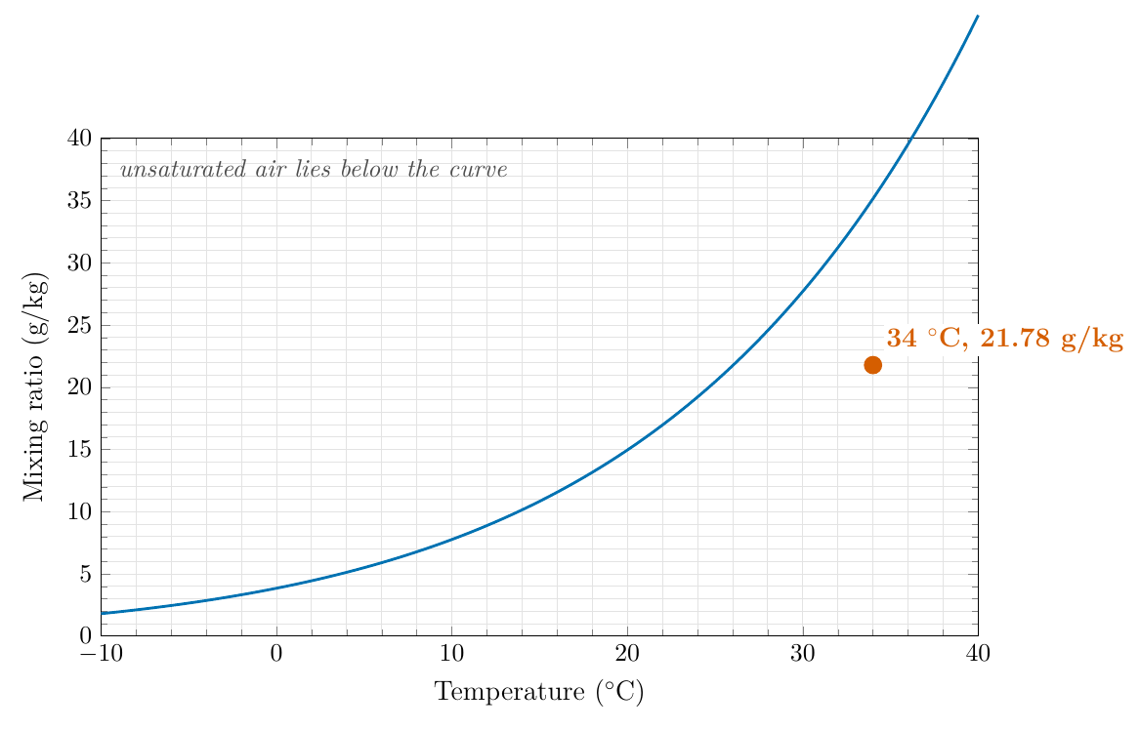
Moisture Q6: 34 °C and 62 % humidity
The question
Now consider an air sample with a temperature of 34 °C and a relative humidity of 62 %. What is its saturation mixing ratio? What is its mixing ratio? What is its dew point?
Three steps: Table 1, then RH, then the graph or Table 1 backwards.
EGM305 Practical 3 · Part I · Moisture · Dew point
34

Slide 35
Moisture Q6: step 1 of 5
Saturation mixing ratio at 34 °C (Table 1): 35.134 g/kg.
1
EGM305 Practical 3 · Part I · Moisture · Dew point
35
Notes:
Table 1 lookup.

Slide 36
Moisture Q6: step 2 of 5
Saturation mixing ratio at 34 °C (Table 1): 35.134 g/kg.
1
Mixing ratio: w = 35.134 × 0.62 = 21.78 g/kg.
2
EGM305 Practical 3 · Part I · Moisture · Dew point
36
Notes:
Multiply by RH.

Slide 37
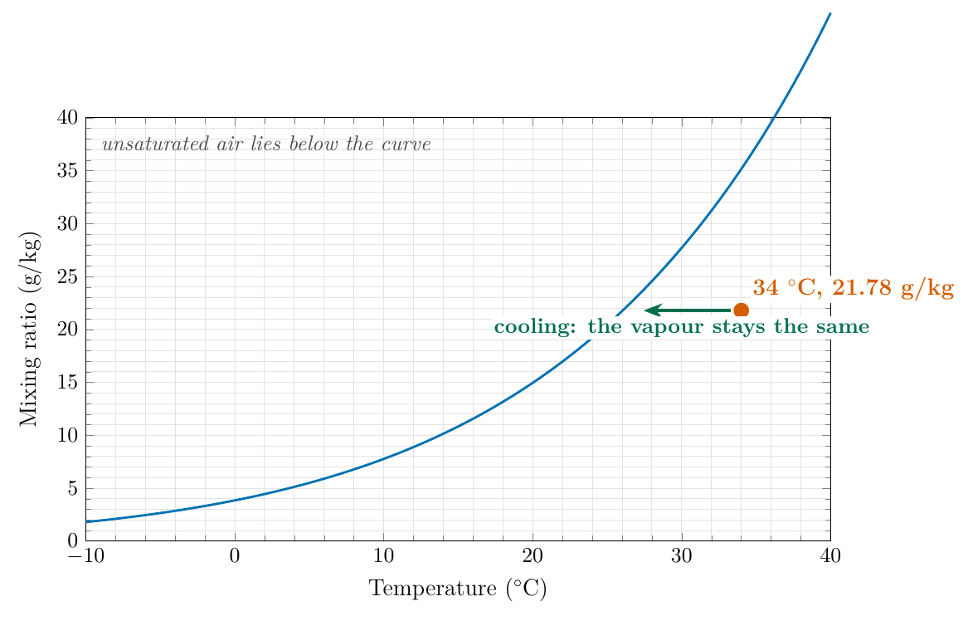
Moisture Q6: step 3 of 5
Saturation mixing ratio at 34 °C (Table 1): 35.134 g/kg.
1
Mixing ratio: w = 35.134 × 0.62 = 21.78 g/kg.
2
Plot the point (34 °C, 21.78 g/kg) and cool it: move left along the line.
3
EGM305 Practical 3 · Part I · Moisture · Dew point
37
Notes:
Plot and cool.

Slide 38
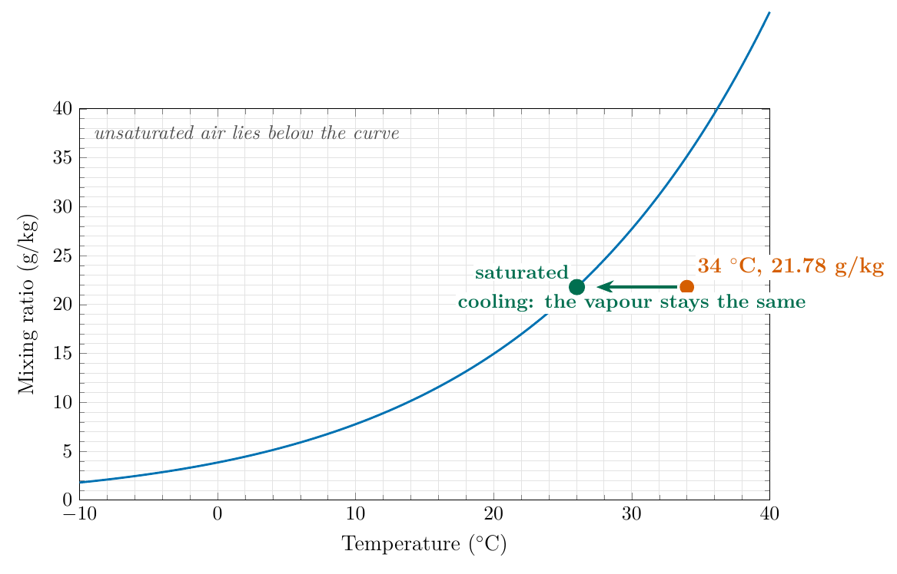
Moisture Q6: step 4 of 5
Saturation mixing ratio at 34 °C (Table 1): 35.134 g/kg.
1
Mixing ratio: w = 35.134 × 0.62 = 21.78 g/kg.
2
Plot the point (34 °C, 21.78 g/kg) and cool it: move left along the line.
3
Meet the curve where w_{s} = 21.78: Table 1 has 21.734 at 26 °C and 24.557 at 28 °C, so just above 26 °C.
4
EGM305 Practical 3 · Part I · Moisture · Dew point
38
Notes:
Bracket in Table 1: (21.78-21.734)/(24.557-21.734) = 0.016.

Slide 39
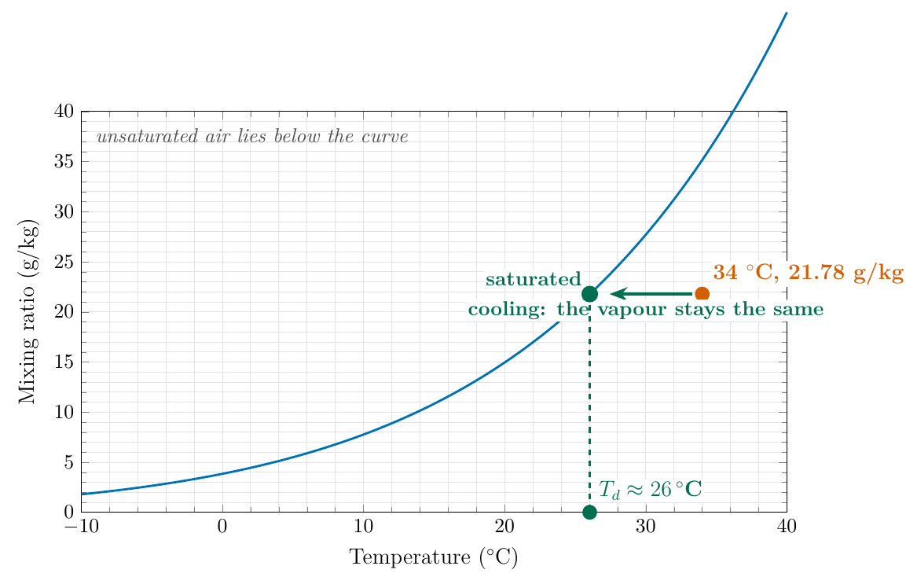
Moisture Q6: step 5 of 5
Saturation mixing ratio at 34 °C (Table 1): 35.134 g/kg.
1
Mixing ratio: w = 35.134 × 0.62 = 21.78 g/kg.
2
Plot the point (34 °C, 21.78 g/kg) and cool it: move left along the line.
3
Meet the curve where w_{s} = 21.78: Table 1 has 21.734 at 26 °C and 24.557 at 28 °C, so just above 26 °C.
4
Read down: T_{d} = 26 + 0.016 × 2 ≈ 26 °C.
5
EGM305 Practical 3 · Part I · Moisture · Dew point
39
Notes:
26.03 C.

Slide 40
Moisture Q6: the answer, and a correction to the key
Answer
Saturation mixing ratio 35.134 g/kg
Mixing ratio 35.134 × 0.62 = 21.78 g/kg
Dew point about 26 °C
The key says 25 °C. Why that cannot be right
• Table 1: at 25 °C air holds only ≈ 20.4 g/kg, less than 21.78: oversaturated (RH 107 %).
• Graph: the 21.78 g/kg line meets the curve at 26 °C, not 25 °C.
• Rule of thumb: RH ≈ 100 − 5(T − T_{d}); T_{d} = 26 gives 60 % (✓), T_{d} = 25 gives 55 %.
EGM305 Practical 3 · Part I · Moisture · Dew point
40
Notes:
At 25 C the table holds about 20.4 g/kg (interpolating 19.21 and 21.734 gives 20.47); the sample holds 21.78, which is more, so it would be oversaturated: RH 107 %.

Slide 41
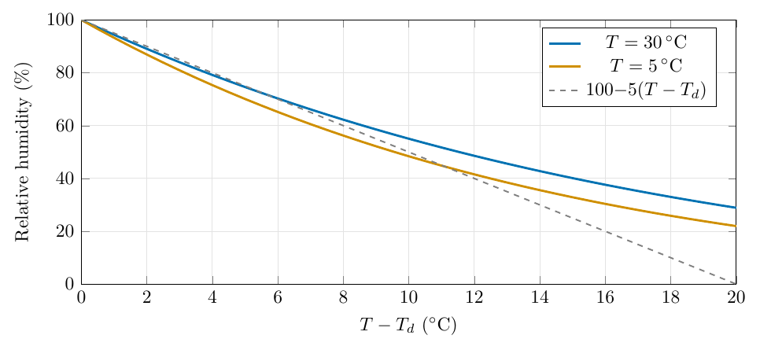
A quick check: the rule of thumb
Each degree by which the dew point lies below the temperature lowers RH by about 5 %.
Rule of thumb
RH ≈ 100 − 5 (T − T_{d})
Air at 80 % is about 4 °C above its dew point; at 50 % about 10 °C.
Good to a few percent for RH above ≈ 50 %.
EGM305 Practical 3 · Part I · Moisture · Dew point
41

Slide 42
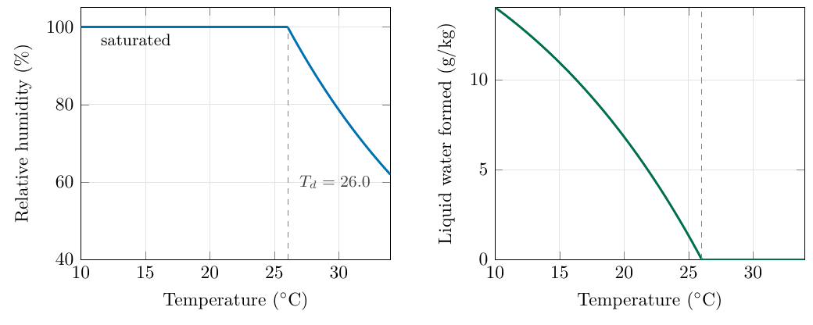
Below the dew point: what condenses?
Keep cooling the Q6 sample below 26 °C. The glass keeps shrinking, so the surplus must condense:
condensed water = w − w_{s}(T)
At 20 °C the air holds only 14.956 g/kg as vapour, so 21.78 − 14.956 = 6.8 g/kg has become liquid: dew, fog or cloud.
Condensation releases latent heat, which is why cloud keeps air warmer than it would otherwise be as it cools.
EGM305 Practical 3 · Part I · Moisture · Dew point
42

Slide 43
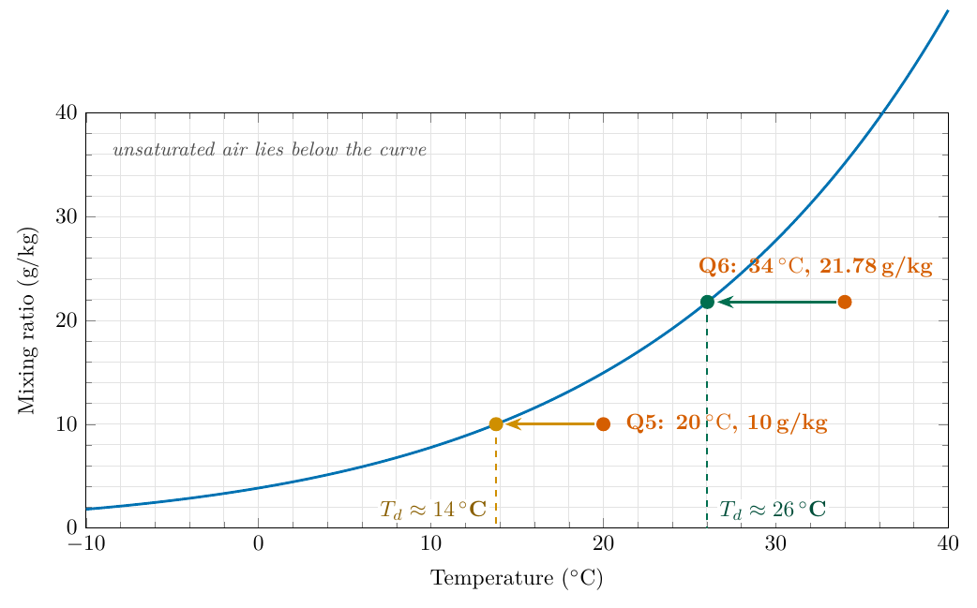
From dew point to cloud base
Rising air cools at 9.8 K/km; its dew point falls only 1.8 K/km. The gap closes at 8 K/km:
cloud base ≈ 125 × (T − T_{d}) metres
Q6 air: T − T_{d} = 8 °C → cloud base ≈ 1 000 m.
A day with T = 30 °C, T_{d} = 18 °C: gap 12 °C → about 1 500 m.
EGM305 Practical 3 · Part I · Moisture · Dew point
43

Slide 44
Practice Set B: try it yourself
Practice Set B
B1. 30 °C air, mixing ratio 12 g/kg: dew point (a) by Table 1, (b) by rule of thumb.
B2. 20 °C, RH 50 %: dew point?
B3. 28 °C, RH 40 %. Overnight it cools to 12 °C. Does dew form?
B4. Cloud base for T = 30 °C, T_{d} = 18 °C?
B5. 25 °C air with dew point 15 °C: mixing ratio and RH?
B6. The Q6 sample cooled to 20 °C: how much liquid water forms?
EGM305 Practical 3 · Part I · Moisture · Dew point
44
Notes:
Give students a few minutes, then reveal the next slide.

Slide 45
Practice Set B: answers
Answers
B1. (a) 16 °C holds 11.56, 18 °C holds 13.162 → T_{d} = 16 + 2(12 − 11.56)/1.602 = 16.6 °C. (b) RH = 43 %, so T − T_{d} ≈ 11.4 → 18.6 °C (rough).
B2. w = 0.5 × 14.956 = 7.478 g/kg; 8 °C holds 6.771, 10 °C holds 7.762 → T_{d} = 9.4 °C.
B3. w = 0.40 × 24.557 = 9.82 g/kg > 8.882 (capacity at 12 °C): yes, dew forms, once the air cools through 13.5 °C.
B4. 125 × (30 − 18) = 1 500 m.
B5. w = w_{s}(15 °C) = 10.83 g/kg; w_{s}(25) = 20.44 → RH = 53 %.
B6. 21.78 − 14.956 = 6.8 g/kg.
EGM305 Practical 3 · Part I · Moisture · Dew point
45

Slide 46
Part II: Atmospheric motion
Why the air moves, and why it moves the way it does
Motion Q1 to Q11

Slide 47
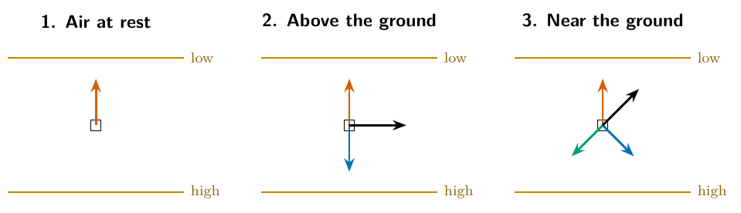
Three forces move the air
Wind is moving air, so forces act on it. Per unit mass, three horizontal forces matter:
• Pressure gradient force: starts the air moving, from high to low pressure
• Coriolis force: steers it, at right angles to the motion
• Friction: slows it near the ground, against the wind
If the three add up to zero the wind is steady. All of Part II is about what happens when they do.
EGM305 Practical 3 · Part II · Motion
47
Notes:
Newton's second law per unit mass. For the large-scale winds only three horizontal forces matter. If they sum to zero the wind is steady.

Slide 48
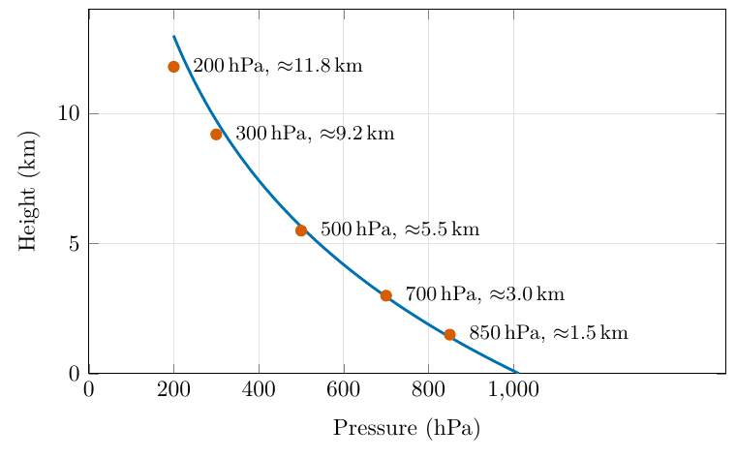
Pressure falls with height
Pressure is the weight of the air above. Climb, and there is less air above you:
• 1013 hPa at sea level
• 500 hPa at ≈ 5.5 km (half the atmosphere's mass lies below)
• 300 hPa at ≈ 9 km
The sheet's levels (850, 500, 300 hPa) are at about 1.5, 5.5 and 9 km.
EGM305 Practical 3 · Part II · Motion
48

Slide 49
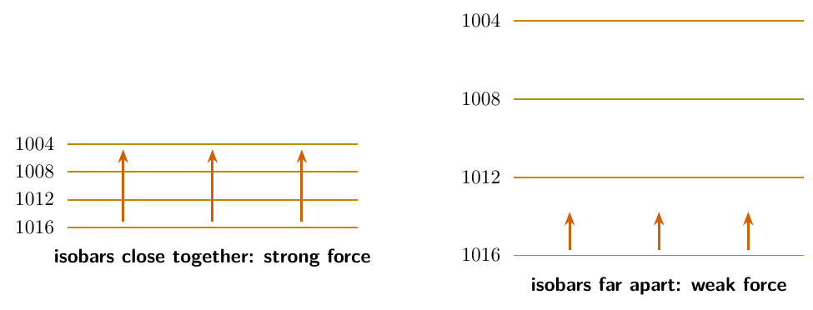
The pressure gradient force
Air is pushed from high to low pressure.
• Direction: high → low, at right angles to the isobars
• Size: proportional to the pressure difference; closer isobars = stronger force
Per unit mass
PGF = (1/ρ) × Δp/Δn
Example
4 hPa = 400 Pa over 200 km: PGF = (1/1.2) × 400/2×10⁵ = 1.7×10⁻³ m/s². In one hour: +6 m/s.
EGM305 Practical 3 · Part II · Motion
49

Slide 50
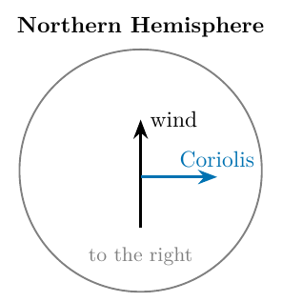
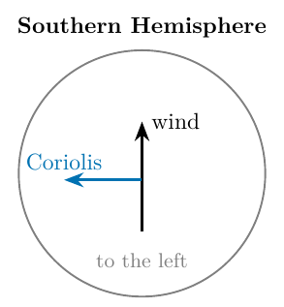
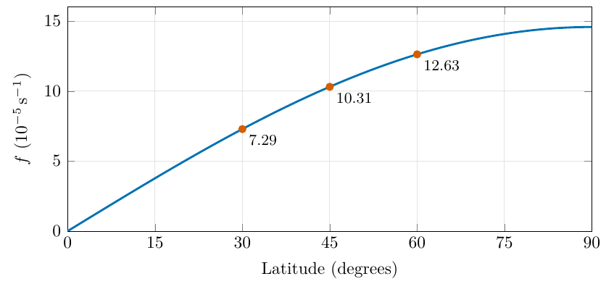
The Coriolis force
• Direction: at right angles to the motion: to the right in the Northern Hemisphere, to the left in the Southern
• Size: increases with wind speed and latitude: f V, with f = 2Ω sin φ (zero at the equator)
• It changes the direction of the wind, never its speed
EGM305 Practical 3 · Part II · Motion
50
Notes:
The Earth rotates, so we observe from a spinning frame; freely moving objects appear to curve. Zero at the equator because it depends on the vertical component of rotation, Omega sin(phi).

Slide 51
Friction, and the sheet's table completed
Friction acts opposite to the wind near the ground (trees, buildings, hills, waves) and matters mainly in the lowest 1–2 km.
Force | Direction | Magnitude
Pressure gradient | From higher to lower pressure, at right angles to the isobars | Proportional to the pressure difference between two points
Coriolis | At right angles to the airflow: to the right in the Northern Hemisphere, to the left in the Southern | Increases with wind strength and with latitude
Friction | Opposite to the direction of the airflow | Depends on surface characteristics that obstruct the airflow
EGM305 Practical 3 · Part II · Motion
51

Slide 52
Practice Set C: try it yourself
Practice Set C
C1. Two isobars 4 hPa apart and 100 km from each other: PGF per unit mass (ρ = 1.2 kg/m³)? Compare with the 200 km example.
C2. Coriolis parameter at 60° N, and the Coriolis acceleration on a 15 m/s wind.
C3. A wind blows northward in the Southern Hemisphere. Which way does the Coriolis force push it?
C4. Why are strong winds found where isobars are close together?
EGM305 Practical 3 · Part II · Motion
52
Notes:
Give students a few minutes, then reveal the next slide.

Slide 53
Practice Set C: answers
Answers
C1. (1/1.2) × 400/10⁵ = 3.3×10⁻³ m/s²: exactly twice the 200 km value.
C2. f = 2 × 7.292×10⁻⁵ × sin 60° = 1.26×10⁻⁴ s⁻¹; fV = 1.9×10⁻³ m/s².
C3. To the left of its motion: west.
C4. Close isobars = steep gradient = large pressure force; the Coriolis force (and friction) must grow to balance it, which needs a faster wind.
EGM305 Practical 3 · Part II · Motion
53

Slide 54
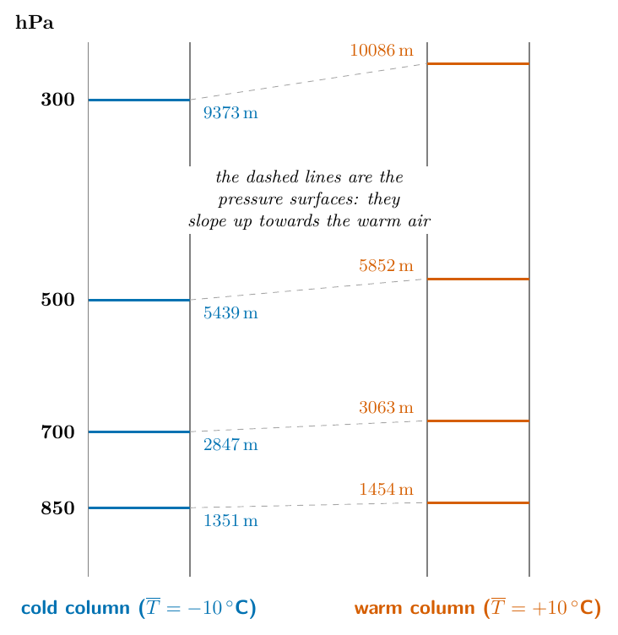
Pressure surfaces tilt: cold air is thin
A pressure surface (e.g. 500 hPa) is the height at which the pressure has dropped to that value.
It is low over cold air, high over warm air: cold air is dense, so the same pressure drop needs less height.
The slope grows with height.
Hypsometric equation
Δz = (R_{d} T̄ / g) ln(p₁/p₂)
Thickness ∝ mean temperature
EGM305 Practical 3 · Part II · Pressure surfaces
54
Notes:
Hypsometric equation: thickness proportional to mean temperature. The same pressure drop occupies less height in cold, dense air.

Slide 55
Motion Q1: plot the pressure surfaces
The question
Consider the two locations on the North American map in Figure 1. Following the example of 850 mb, plot the heights of the 500- and 300-mb pressure levels on Figure 2. Draw lines connecting the two points for each pressure level; label each line with the appropriate pressure value.
Level | Saskatoon | Monterrey
300 mb | 8700 m, −47 °C | 9500 m, −38 °C
500 mb | 5400 m, −25 °C | 5700 m, −12 °C
850 mb | 1360 m, −1 °C | 1500 m, 15 °C
EGM305 Practical 3 · Part II · Pressure surfaces
55

Slide 56
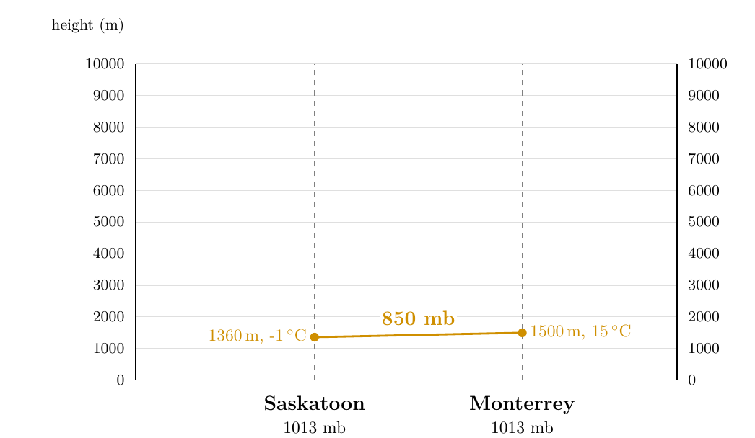
Motion Q1: step 1 of 3
The 850 mb line is given: 1360 m over Saskatoon to 1500 m over Monterrey.
1
EGM305 Practical 3 · Part II · Pressure surfaces
56
Notes:
Monterrey is the warm place and to the south.

Slide 57
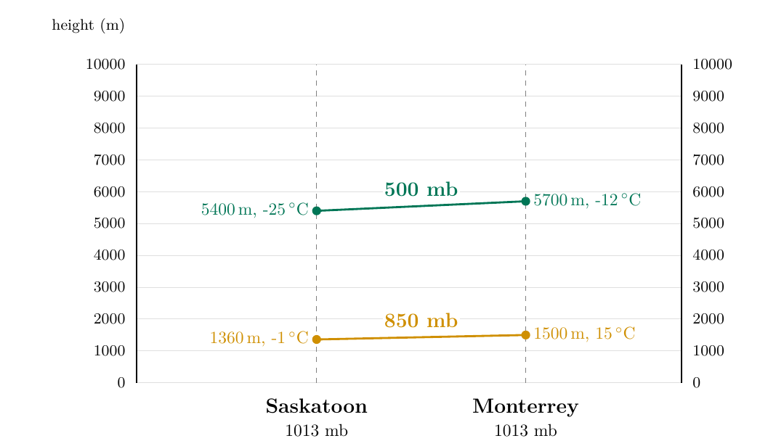
Motion Q1: step 2 of 3
The 850 mb line is given: 1360 m over Saskatoon to 1500 m over Monterrey.
1
Plot 500 mb: dots at 5400 m (Saskatoon) and 5700 m (Monterrey), joined by a straight line; label it 500 mb.
2
EGM305 Practical 3 · Part II · Pressure surfaces
57
Notes:
The 500 mb surface is 300 m higher over Monterrey.

Slide 58
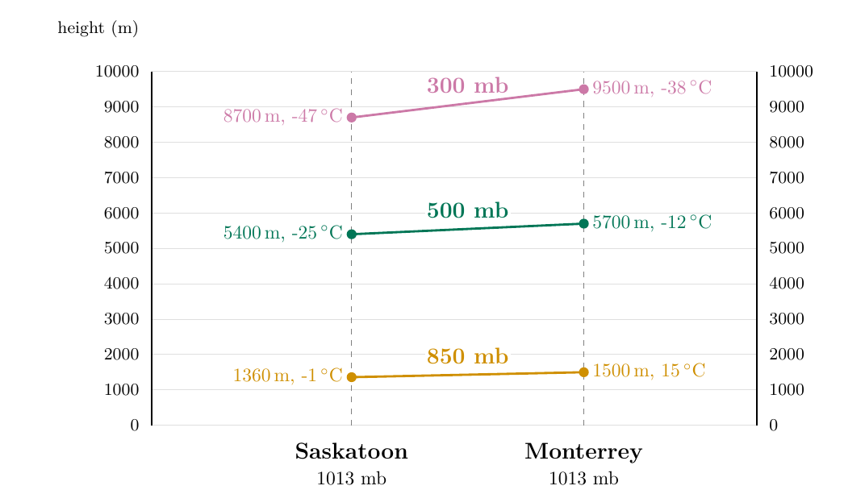
Motion Q1: step 3 of 3
The 850 mb line is given: 1360 m over Saskatoon to 1500 m over Monterrey.
1
Plot 500 mb: dots at 5400 m (Saskatoon) and 5700 m (Monterrey), joined by a straight line; label it 500 mb.
2
Plot 300 mb: dots at 8700 m and 9500 m, joined; label it 300 mb. Each line slopes up towards Monterrey, more steeply the higher you go.
3
EGM305 Practical 3 · Part II · Pressure surfaces
58
Notes:
The 300 mb surface is 800 m higher over Monterrey.

Slide 59
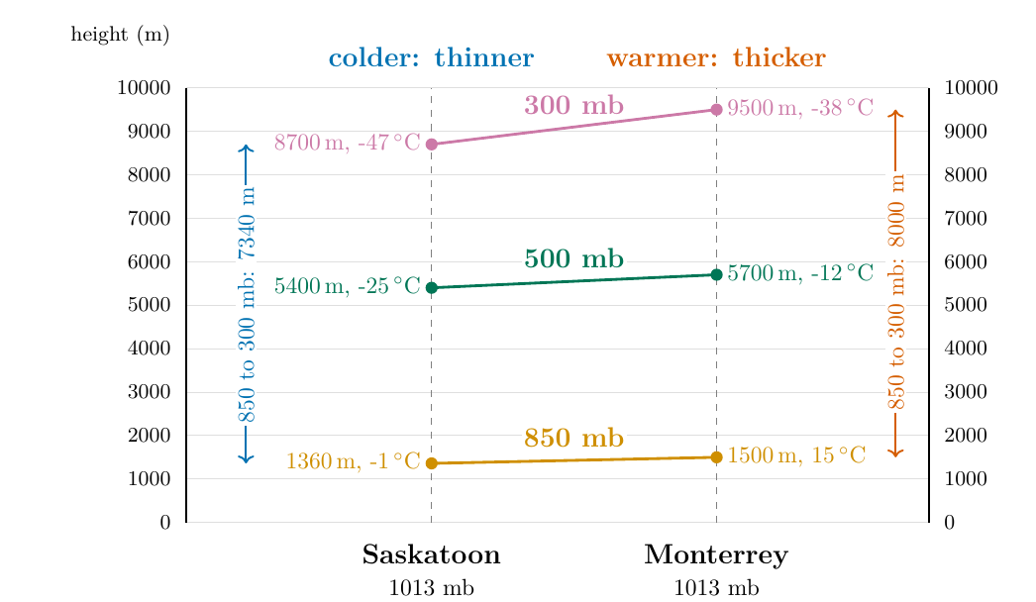
Motion Q2 and Q3: where does pressure fall fastest?
Q2: At which location does pressure decrease with height most rapidly?
Saskatoon. Its surfaces are lower: 500 mb is reached at 5400 m (not 5700 m), 300 mb at 8700 m (not 9500 m).
Q3: How does this relate to temperature?
Saskatoon is colder at each height (−1 vs 15 °C, −25 vs −12 °C, −47 vs −38 °C). Cold air is denser, so its column is thinner: pressure falls faster with height.
Check
850–300 mb thickness: Saskatoon 7340 m, Monterrey 8000 m (hypsometric equation: 7587 m and 7976 m).
EGM305 Practical 3 · Part II · Pressure surfaces
59

Slide 60
Motion Q4: which point has the higher pressure?
The question
Both points x and z are at 9000 m. Which point has the highest pressure? At 9000 m write an 'H' where you have the higher pressure; write an 'L' where you have the lower pressure. Then draw an arrow between the points showing the direction of the horizontal pressure gradient force at 9000 m.
Hint: pressure decreases with height.
EGM305 Practical 3 · Part II · Pressure surfaces
60

Slide 61
Motion Q4: step 1 of 5
Rule: below a pressure surface the pressure is higher than its value; above it, lower.
1
EGM305 Practical 3 · Part II · Pressure surfaces
61

Slide 62
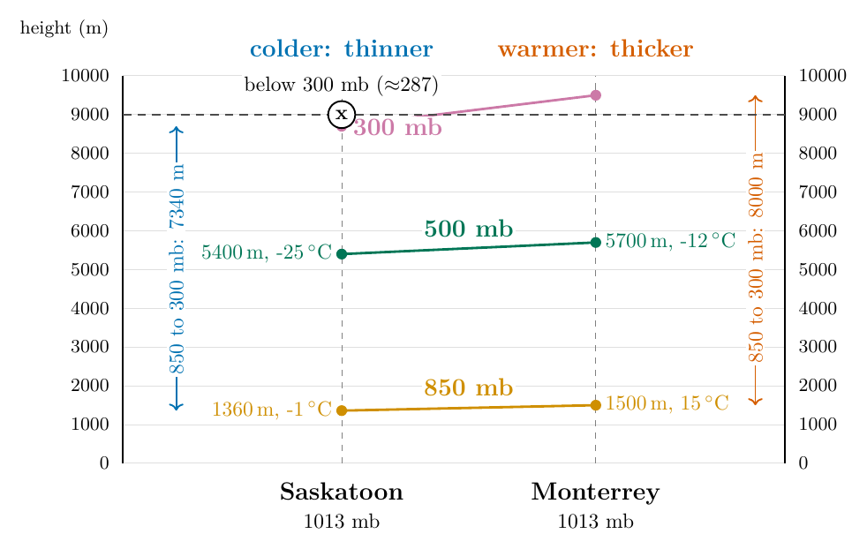
Motion Q4: step 2 of 5
Rule: below a pressure surface the pressure is higher than its value; above it, lower.
1
Point x (over Saskatoon): the 300 mb surface is at 8700 m, so x at 9000 m is above it: pressure < 300 mb (≈ 287).
2
EGM305 Practical 3 · Part II · Pressure surfaces
62

Slide 63
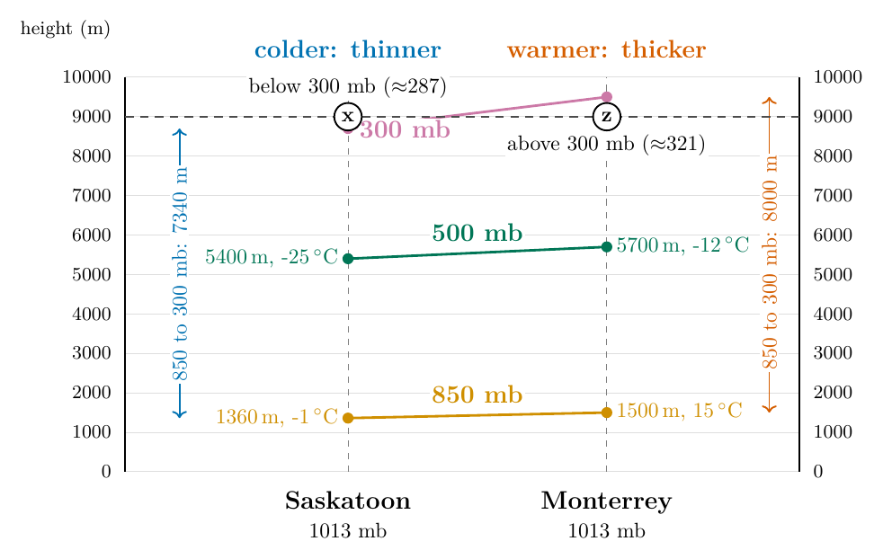
Motion Q4: step 3 of 5
Rule: below a pressure surface the pressure is higher than its value; above it, lower.
1
Point x (over Saskatoon): the 300 mb surface is at 8700 m, so x at 9000 m is above it: pressure < 300 mb (≈ 287).
2
Point z (over Monterrey): the 300 mb surface is at 9500 m, so z is below it: pressure > 300 mb (≈ 321).
3
EGM305 Practical 3 · Part II · Pressure surfaces
63

Slide 64
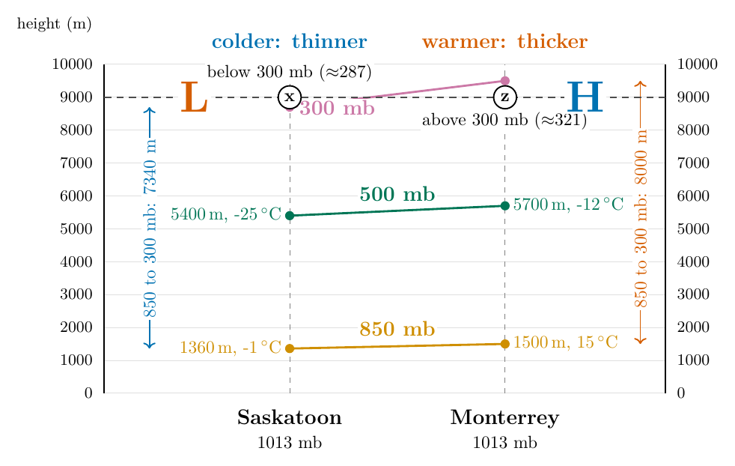
Motion Q4: step 4 of 5
Rule: below a pressure surface the pressure is higher than its value; above it, lower.
1
Point x (over Saskatoon): the 300 mb surface is at 8700 m, so x at 9000 m is above it: pressure < 300 mb (≈ 287).
2
Point z (over Monterrey): the 300 mb surface is at 9500 m, so z is below it: pressure > 300 mb (≈ 321).
3
Write H at z and L at x.
4
EGM305 Practical 3 · Part II · Pressure surfaces
64

Slide 65
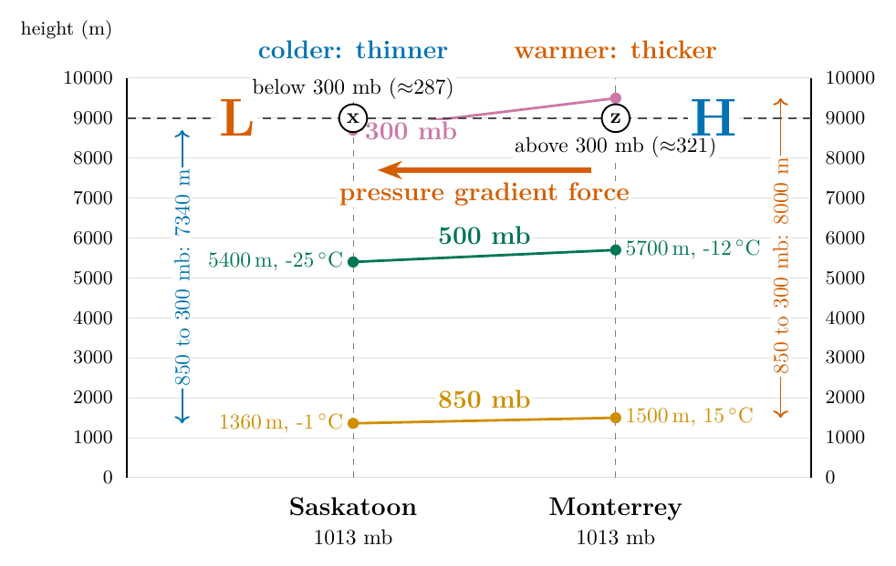
Motion Q4: step 5 of 5
Rule: below a pressure surface the pressure is higher than its value; above it, lower.
1
Point x (over Saskatoon): the 300 mb surface is at 8700 m, so x at 9000 m is above it: pressure < 300 mb (≈ 287).
2
Point z (over Monterrey): the 300 mb surface is at 9500 m, so z is below it: pressure > 300 mb (≈ 321).
3
Write H at z and L at x.
4
The pressure gradient force points from high to low: draw the arrow from z towards x (towards Saskatoon).
5
EGM305 Practical 3 · Part II · Pressure surfaces
65

Slide 66
Motion Q4: the answer
Answer
z has the higher pressure (below the 300 mb line).
Write H at z (Monterrey side) and L at x (Saskatoon side).
Draw the pressure gradient force from z towards x: towards Saskatoon.
EGM305 Practical 3 · Part II · Pressure surfaces
66

Slide 67
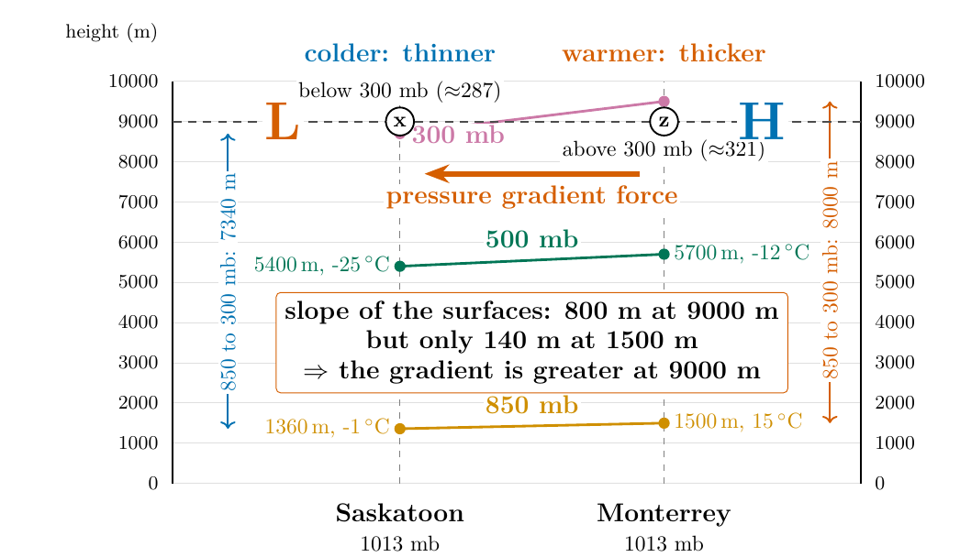
Motion Q5: where is the pressure gradient greater?
At 1500 m or at 9000 m? Compare how much the surfaces slope between the two places.
Surface | Slope between places
850 mb (≈ 1500 m) | 1500 − 1360 = 140 m
500 mb | 5700 − 5400 = 300 m
300 mb (≈ 9000 m) | 9500 − 8700 = 800 m
Answer
The gradient is greater at 9000 m: 800 m of slope against 140 m. (In pressure: ≈ 34 mb against 15 mb.)
EGM305 Practical 3 · Part II · Pressure surfaces
67

Slide 68
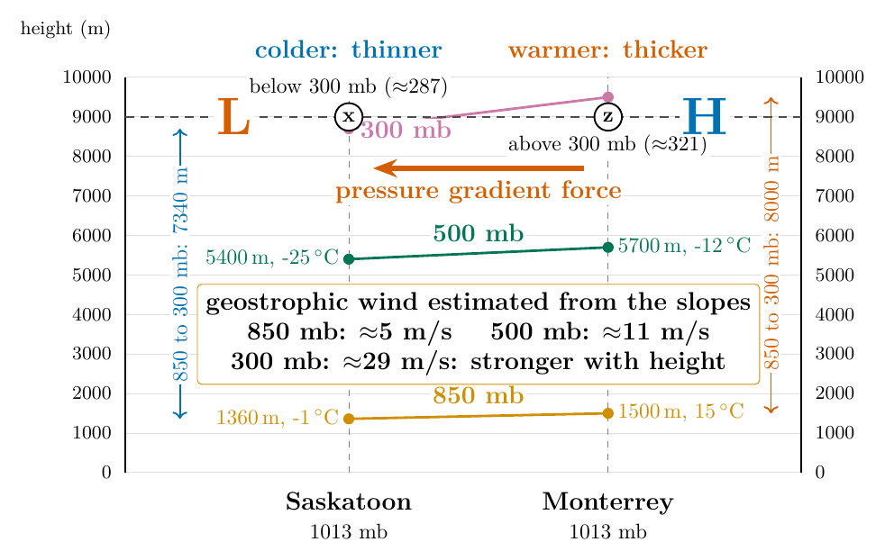
Motion Q6: what this means for the wind
Answer
Wind speeds at 9000 m should be greater than at 1500 m.
Geostrophic wind from the slope of a pressure surface:
V_{g} = (g / f) × (Δz / Δn)
Here Δn = 2 990 km, φ ≈ 39°, f = 9.16×10⁻⁵ s⁻¹:
• 850 mb: (9.81 / 9.16×10⁻⁵) × 140 / 2.99×10⁶ = 5.0 m/s
• 500 mb: × 300 → 10.7 m/s
• 300 mb: × 800 → 28.6 m/s
EGM305 Practical 3 · Part II · Pressure surfaces
68
Notes:
Thermal wind: the wind increases with height where the horizontal temperature gradient is large. The numbers are rough because only two places and rounded heights are used.

Slide 69
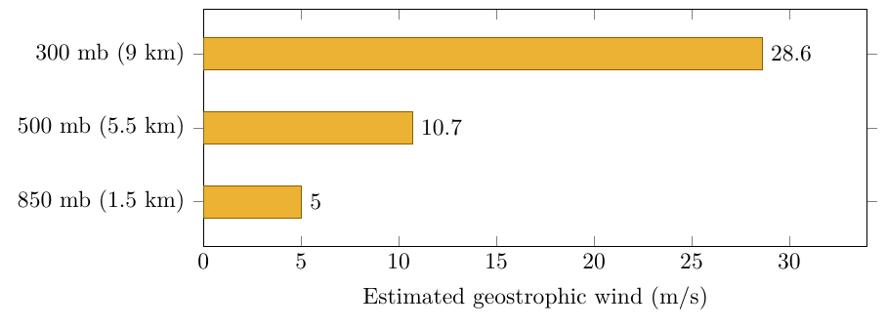
The thermal wind: why the jet stream is high up
The faster the temperature falls towards the pole, the faster the westerly winds aloft, and they strengthen with height.
If both columns have the same temperature, every surface is flat and there is no wind, however cold the air.
This is the thermal wind, and it puts the jet streams near 10 km above the zone of strongest temperature contrast.
Real winds at 300 mb are often 50–80 m/s: the sheet's two places and rounded heights give only the pattern.
EGM305 Practical 3 · Part II · Pressure surfaces
69

Slide 70
Practice Set D: try it yourself
Practice Set D
D1. Thickness of the 1000–500 hPa layer for mean temperatures of −10 °C and +10 °C; the difference.
D2. At 40° N the 500 hPa surface is at 5520 m over town A and 5640 m over town B, 800 km due south of A. Geostrophic wind, and from which direction?
D3. 500 mb heights are 5400 m at P and 5600 m at Q. Which has colder air beneath?
D4. The 500 hPa surface slopes up from north to south. Which way does the Northern Hemisphere wind blow?
EGM305 Practical 3 · Part II · Pressure surfaces
70
Notes:
Give students a few minutes, then reveal the next slide.

Slide 71
Practice Set D: answers
Answers
D1. 5339 m and 5745 m: the warm layer is 406 m thicker (≈ 20 m per degree).
D2. f = 9.37×10⁻⁵; V_{g} = (9.81/9.37×10⁻⁵) × 120/8×10⁵ = 15.7 m/s (≈ 30 kt). B (higher surface) is on the right of the wind: a westerly.
D3. P: colder column, thinner, lower pressure surfaces.
D4. Low heights to the north (left of the wind): the wind blows from west to east, a westerly.
EGM305 Practical 3 · Part II · Pressure surfaces
71

Slide 72
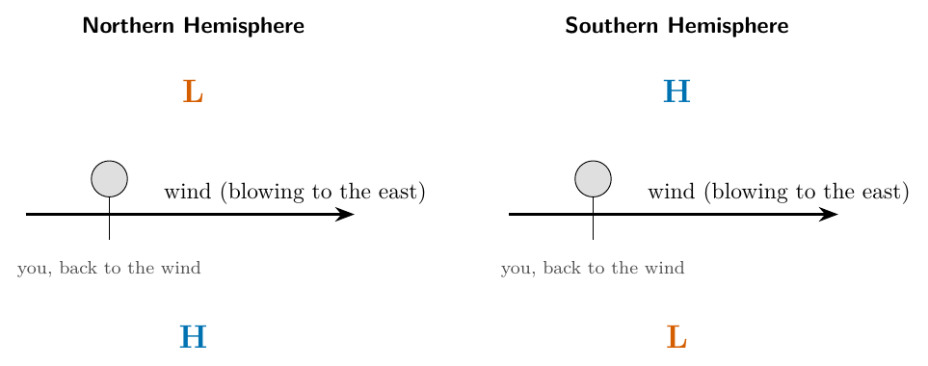
The geostrophic wind: two forces in balance
Definition
The geostrophic wind is the wind for which the pressure gradient force and the Coriolis force exactly balance. It blows along the isobars (or height contours).
The balance
(1/ρ) Δp/Δn = f V_{g}
V_{g} = (g / f) × (Δz / Δn)
Buys-Ballot: back to the wind, low pressure is on your left in the Northern Hemisphere, your right in the Southern.
EGM305 Practical 3 · Part II · Geostrophic wind
72
Notes:
High above the ground friction is negligible. If the pressure gradient force and the Coriolis force are equal and opposite, the wind is steady and blows along the isobars.

Slide 73
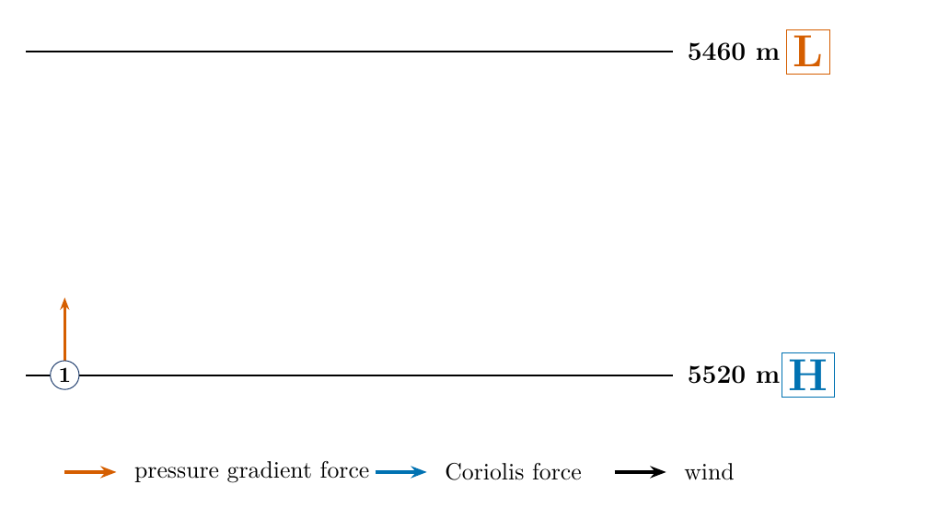
The four stages of Figure 3: stage 1
Stage 1: at rest. The parcel is on the high-pressure side. No motion, so no Coriolis force: only the pressure gradient force acts, towards low pressure (north).
1
EGM305 Practical 3 · Part II · Geostrophic wind
73
Notes:
Red arrow: pressure gradient force towards L.

Slide 74
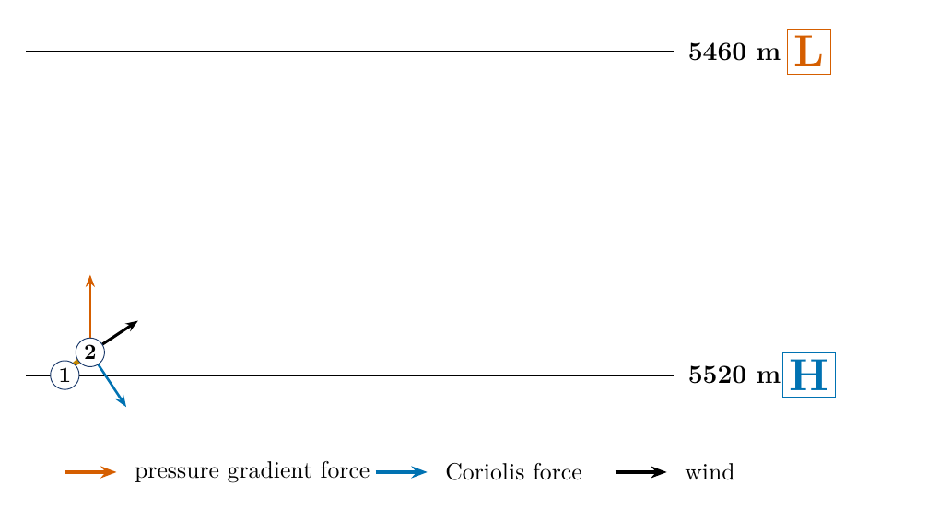
The four stages of Figure 3: stage 2
Stage 1: at rest. The parcel is on the high-pressure side. No motion, so no Coriolis force: only the pressure gradient force acts, towards low pressure (north).
1
Stage 2: moving north. As soon as it moves, the Coriolis force appears at right angles and to the right: towards the east. The path bends right.
2
EGM305 Practical 3 · Part II · Geostrophic wind
74
Notes:
Blue arrow appears: Coriolis, to the right of the motion.

Slide 75
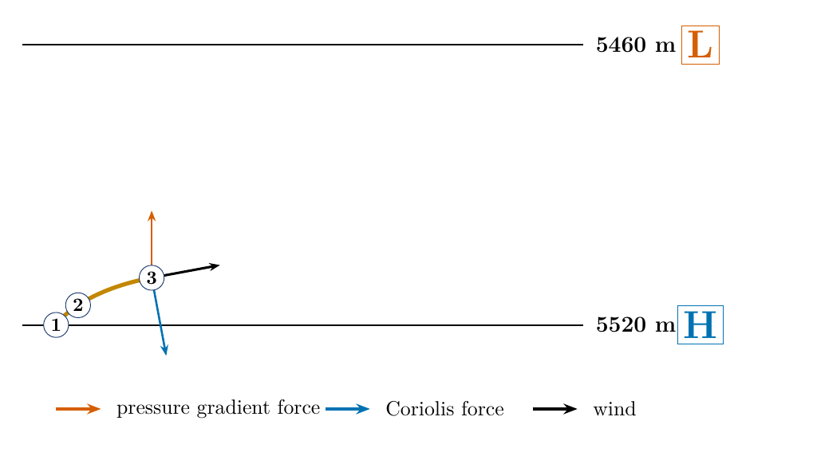
The four stages of Figure 3: stage 3
Stage 1: at rest. The parcel is on the high-pressure side. No motion, so no Coriolis force: only the pressure gradient force acts, towards low pressure (north).
1
Stage 2: moving north. As soon as it moves, the Coriolis force appears at right angles and to the right: towards the east. The path bends right.
2
Stage 3: moving north-east. The speed has grown, so the Coriolis force is larger and now points partly against the pressure force. The path keeps bending.
3
EGM305 Practical 3 · Part II · Geostrophic wind
75
Notes:
The wind turns towards the east.

Slide 76

The four stages of Figure 3: stage 4
Stage 1: at rest. The parcel is on the high-pressure side. No motion, so no Coriolis force: only the pressure gradient force acts, towards low pressure (north).
1
Stage 2: moving north. As soon as it moves, the Coriolis force appears at right angles and to the right: towards the east. The path bends right.
2
Stage 3: moving north-east. The speed has grown, so the Coriolis force is larger and now points partly against the pressure force. The path keeps bending.
3
Stage 4: moving east. Along the isobars the Coriolis force points exactly back towards the high, equal and opposite to the pressure force: balance, steady wind.
4
EGM305 Practical 3 · Part II · Geostrophic wind
76
Notes:
The forces balance; the path levels out.

Slide 77

Motion Q7 (Figure 3): Northern Hemisphere
The question
The geostrophic wind is one where the pressure gradient force equals the Coriolis force. Mark the side with the higher pressure with an 'H' and the side with the lower pressure with an 'L'.
The lines are labelled with the height of the 500 hPa surface: 5460 m (top) and 5520 m (bottom).
EGM305 Practical 3 · Part II · Geostrophic wind
77

Slide 78
Motion Q7 (Figure 3): step 1 of 4
Higher height = higher pressure: a pressure surface is higher where the pressure is higher.
1
EGM305 Practical 3 · Part II · Geostrophic wind
78
Notes:
Check the labels on the lines.

Slide 79

Motion Q7 (Figure 3): step 2 of 4
Higher height = higher pressure: a pressure surface is higher where the pressure is higher.
1
So the 5520 m line (bottom) is the high side: write H there; the 5460 m line (top) is the low side: L.
2
EGM305 Practical 3 · Part II · Geostrophic wind
79
Notes:
H bottom, L top.

Slide 80

Motion Q7 (Figure 3): step 3 of 4
Higher height = higher pressure: a pressure surface is higher where the pressure is higher.
1
So the 5520 m line (bottom) is the high side: write H there; the 5460 m line (top) is the low side: L.
2
Pressure gradient force from H to L: north (up the page).
3
EGM305 Practical 3 · Part II · Geostrophic wind
80
Notes:
F_pg points to L.

Slide 81

Motion Q7 (Figure 3): step 4 of 4
Higher height = higher pressure: a pressure surface is higher where the pressure is higher.
1
So the 5520 m line (bottom) is the high side: write H there; the 5460 m line (top) is the low side: L.
2
Pressure gradient force from H to L: north (up the page).
3
Coriolis force equal and opposite, to the right of the wind: south. The geostrophic wind blows east between them.
4
EGM305 Practical 3 · Part II · Geostrophic wind
81
Notes:
With the wind to the east the right-hand side is south: the Coriolis force points south.

Slide 82

Motion Q7 (Figure 4): Southern Hemisphere
The question
Now consider the Southern Hemisphere. Mark the side with the higher pressure with an 'H' and the side with the lower pressure with an 'L'. In Figure 4 draw the pressure gradient force and the Coriolis force acting on the box and the resulting geostrophic wind.
What changes: the Coriolis force acts to the left.
Heights: 5640 m (top) and 5580 m (bottom).
EGM305 Practical 3 · Part II · Geostrophic wind
82

Slide 83

Motion Q7 (Figure 4): step 1 of 4
H and L: the larger height is the high side: H at 5640 m (top), L at 5580 m (bottom).
1
EGM305 Practical 3 · Part II · Geostrophic wind
83
Notes:
Mirror image of Figure 3.

Slide 84

Motion Q7 (Figure 4): step 2 of 4
H and L: the larger height is the high side: H at 5640 m (top), L at 5580 m (bottom).
1
Pressure gradient force from H to L: down.
2
EGM305 Practical 3 · Part II · Geostrophic wind
84
Notes:
Force from H to L.

Slide 85

Motion Q7 (Figure 4): step 3 of 4
H and L: the larger height is the high side: H at 5640 m (top), L at 5580 m (bottom).
1
Pressure gradient force from H to L: down.
2
Coriolis force equal and opposite: up, towards H. (Check: an eastward wind has north on its left, and in the south the Coriolis force acts to the left: up ✓.)
3
EGM305 Practical 3 · Part II · Geostrophic wind
85
Notes:
Equal and opposite.

Slide 86

Motion Q7 (Figure 4): step 4 of 4
H and L: the larger height is the high side: H at 5640 m (top), L at 5580 m (bottom).
1
Pressure gradient force from H to L: down.
2
Coriolis force equal and opposite: up, towards H. (Check: an eastward wind has north on its left, and in the south the Coriolis force acts to the left: up ✓.)
3
The wind blows between them, to the east, with the low pressure on its right.
4
EGM305 Practical 3 · Part II · Geostrophic wind
86
Notes:
Low pressure on the right in the Southern Hemisphere.

Slide 87

Motion Q7: both answers
Answer
Figure 3 (north): H at 5520 m, L at 5460 m. F_{pg} north, Coriolis south, wind east, low pressure on its left.
Figure 4 (south): H at 5640 m, L at 5580 m. F_{pg} south, Coriolis north, wind east, low pressure on its right.
EGM305 Practical 3 · Part II · Geostrophic wind
87

Slide 88

How fast is the geostrophic wind?
Example: the lines of Figure 3
Lines 60 m apart and 500 km apart at 45° N:
f = 1.03×10⁻⁴ s⁻¹
V_{g} = 9.81 × 60 / (1.03×10⁻⁴ × 5×10⁵) = 11.4 m/s
= 22 knots = 41 km/h
Halve the spacing (300 km): 19 m/s.
Same spacing at 60° N: 9.3 m/s; at 30° N: 16.1 m/s.
Near the equator f → 0 and the formula fails.
EGM305 Practical 3 · Part II · Geostrophic wind
88

Slide 89
Practice Set E: try it yourself
Practice Set E
E1. 500 hPa height lines 5460 m and 5520 m are 400 km apart at 50° N. Geostrophic wind?
E2. Southern Hemisphere: 500 hPa heights 5600 m at 40° S and 5500 m at 50° S. Which way does the wind blow?
E3. At what latitude do the lines of Figure 3 (60 m in 500 km) give 20 m/s?
E4. A Northern Hemisphere pilot with the wind directly behind finds low pressure on the left. Consistent with Buys-Ballot?
EGM305 Practical 3 · Part II · Geostrophic wind
89
Notes:
Give students a few minutes, then reveal the next slide.

Slide 90
Practice Set E: answers
Answers
E1. f = 1.117×10⁻⁴; V_{g} = 9.81×60 / (1.117×10⁻⁴ × 4×10⁵) = 13.2 m/s (26 kt).
E2. Heights fall towards the pole, so the low is to the south = on the right of the wind: west to east.
E3. sin φ = gΔz/(2Ω V_{g} Δn) = 588.6/1458 = 0.404 → φ = 23.8°.
E4. Yes: back to the wind, low on the left is the Northern Hemisphere rule.
EGM305 Practical 3 · Part II · Geostrophic wind
90

Slide 91
Motion Q8: what does a slower wind do to the Coriolis force?
The question
Winds close to the earth's surface are also influenced by friction, which acts in a direction opposite to the wind, slowing the wind down. What effect will a reduction in surface wind speed have on the Coriolis force?
Recall: Coriolis force = f × V.
EGM305 Practical 3 · Part II · Friction
91

Slide 92
Motion Q8: the answer
Answer
The Coriolis force becomes weaker: it depends on the wind speed.
Slower wind → smaller Coriolis force; faster wind → greater deflection.
So what happens?
The pressure gradient force no longer has an equal Coriolis force to cancel it. The leftover pushes the wind across the isobars towards low pressure.
EGM305 Practical 3 · Part II · Friction
92

Slide 93
Near the ground: a balance of three forces
Wind parallel to the isobars would leave friction (along the isobars) with nothing to balance it.
The only way out: the wind turns towards low pressure, so that
• the pressure force has a component along the wind that cancels friction
• the Coriolis force, now tilted backwards, cancels the rest
Result: a slower wind that crosses the isobars towards low pressure.
EGM305 Practical 3 · Part II · Friction
93

Slide 94

Motion Q9: the forces in Figure 5
The question
Indicate with arrows the three forces acting on the Northern Hemisphere box in the diagram below (Figure 5): the pressure gradient in red, the Coriolis force in blue and friction in green. The black arrow shows the resulting force.
Isobars: 1012 mb (top) and 1016 mb (bottom). Which side is low pressure?
EGM305 Practical 3 · Part II · Friction
94

Slide 95

Motion Q9: step 1 of 5
Pressure gradient force (red): straight towards the lower pressure: up the page, at right angles to the isobars.
1
EGM305 Practical 3 · Part II · Friction
95
Notes:
Low pressure is at the top.

Slide 96

Motion Q9: step 2 of 5
Pressure gradient force (red): straight towards the lower pressure: up the page, at right angles to the isobars.
1
The wind (black): across the isobars towards low pressure, turned to the right: up and to the right (45° in this example).
2
EGM305 Practical 3 · Part II · Friction
96
Notes:
Friction turns the wind towards low pressure.

Slide 97

Motion Q9: step 3 of 5
Pressure gradient force (red): straight towards the lower pressure: up the page, at right angles to the isobars.
1
The wind (black): across the isobars towards low pressure, turned to the right: up and to the right (45° in this example).
2
Coriolis force (blue): at right angles to the wind, on its right: down and to the right.
3
EGM305 Practical 3 · Part II · Friction
97
Notes:
Right of the wind.

Slide 98

Motion Q9: step 4 of 5
Pressure gradient force (red): straight towards the lower pressure: up the page, at right angles to the isobars.
1
The wind (black): across the isobars towards low pressure, turned to the right: up and to the right (45° in this example).
2
Coriolis force (blue): at right angles to the wind, on its right: down and to the right.
3
Friction (green): directly opposite to the wind: down and to the left.
4
EGM305 Practical 3 · Part II · Friction
98
Notes:
Against the wind.

Slide 99

Motion Q9: step 5 of 5
Pressure gradient force (red): straight towards the lower pressure: up the page, at right angles to the isobars.
1
The wind (black): across the isobars towards low pressure, turned to the right: up and to the right (45° in this example).
2
Coriolis force (blue): at right angles to the wind, on its right: down and to the right.
3
Friction (green): directly opposite to the wind: down and to the left.
4
Check: join red, blue and green tip to tail: they close into a triangle. The forces cancel.
5
EGM305 Practical 3 · Part II · Friction
99
Notes:
Closed triangle: no net force. The black arrow is the wind, not a fourth force.

Slide 100
Motion Q9: the answer
Answer
Pressure gradient: up, towards 1012 mb
Wind (black): up and to the right
Coriolis: at right angles to the wind, down and to the right
Friction: opposite to the wind, down and to the left
The black arrow is not a force
In a steady wind the three forces cancel. The black arrow shows the wind, the direction the air moves when they balance.
EGM305 Practical 3 · Part II · Friction
100

Slide 101

How much does friction turn the wind?
Surface | k/f | Angle | V/V_{g}
No friction (high up) | 0 | 0° | 100 %
Open sea | 0.3 | 17° | 96 %
Flat grassland | 0.6 | 31° | 86 %
Forest or suburb | 1.0 | 45° | 71 %
Tall city | 1.5 | 56° | 55 %
Simple drag model
angle α = arctan(k/f)
speed V = V_{g} cos α
EGM305 Practical 3 · Part II · Friction
101
Notes:
Drag proportional to the wind with coefficient k; angle alpha = arctan(k/f); speed V = Vg cos(alpha).

Slide 102
Motion Q10: which system is which?
The question
Figure 6 shows winds circulating around surface high and low pressure centres in both the Northern and Southern Hemispheres. Label the correct hemispheres (Northern or Southern) and pressure system (high or low) for each of the four examples.
Two questions identify each system: does the air spiral in or out? Which way does it turn?
EGM305 Practical 3 · Part II · Friction
102

Slide 103

Motion Q10: a two-question key
System | Rotation | Spirals
Northern low | anticlockwise | in
Northern high | clockwise | out
Southern low | clockwise | in
Southern high | anticlockwise | out
Friction makes the air cross the isobars towards low pressure: in for a low, out for a high. The Coriolis force turns it right (north) or left (south).
EGM305 Practical 3 · Part II · Friction
103

Slide 104




Motion Q10 and Q11: Figure 6 completed
EGM305 Practical 3 · Part II · Friction
104
Notes:
Each panel shows the forces on the box at the south-east of the system: red pressure gradient force along the line to the centre, blue Coriolis at right angles to the wind, green friction against the wind, black the wind.

Slide 105
Motion Q10 and Q11: the answers
Q10: labels (in the order of Figure 6)
Top left: Northern Hemisphere low
Top right: Northern Hemisphere high
Bottom left: Southern Hemisphere low
Bottom right: Southern Hemisphere high
Q11: forces on one box in each system
Red along the line to (low) or from (high) the centre
Blue at right angles to the wind: right in the north, left in the south
Green opposite to the wind
Black wind: spirals in (low) / out (high)
The pattern is the same at every position round the system
EGM305 Practical 3 · Part II · Friction
105

Slide 106

Why it matters for weather
Air spirals in towards a low: more flows in at the bottom than flows out sideways, so the surplus must rise: convergence, cloud and rain.
Air spirals out from a high: air sinks from above to replace it, warming and drying: clear skies.
That is why lows bring cloud and rain and highs bring settled weather: the link to the weather map in Part III.
EGM305 Practical 3 · Part II · Friction
106

Slide 107
Practice Set F: try it yourself
Practice Set F
F1. Over grassland (k/f = 0.6) the geostrophic wind is 15 m/s. Surface wind speed and angle to the isobars?
F2. In a Southern Hemisphere low, which way does the air circulate, and does it spiral in or out?
F3. Air spirals outwards in an anticlockwise sense. Which hemisphere and which system?
F4. Over a city the surface wind is 6 m/s and the geostrophic wind above it 11 m/s. Estimate k/f.
EGM305 Practical 3 · Part II · Friction
107
Notes:
Give students a few minutes, then reveal the next slide.

Slide 108
Practice Set F: answers
Answers
F1. α = arctan 0.6 = 31°; V = 15 cos 31° = 12.9 m/s.
F2. Clockwise, spiralling in.
F3. Southern Hemisphere high.
F4. V/V_{g} = 6/11 = 0.55 = cos α → α ≈ 57° → k/f = tan 57° ≈ 1.5 (a tall-city value).
EGM305 Practical 3 · Part II · Friction
108

Slide 109
Part III: Weather map analysis
Reading station models, drawing streamlines,
locating fronts and analysing a whole map
Map Q12 to Q14

Slide 110

The station model
Every observation is drawn in a fixed layout round a circle:
• top left: air temperature (°F on the sheet)
• bottom left: dew point
• top right: pressure (3 digits)
• right, below: 3-hour pressure change + tendency symbol
• left: present weather
• circle: sky cover
• staff: wind
EGM305 Practical 3 · Part III · Station models
110
Notes:
About 10,000 stations measure up to 18 quantities. The WMO station model puts every quantity at a fixed position around a circle.

Slide 111
Decoding the pressure
The pressure rule
1. Put a decimal point before the last digit: 117 → 11.7
2. If the 3-digit number is less than 500, put 10 in front: 1011.7 hPa
3. If it is 500 or more, put 9 in front: 998 → 99.8 → 999.8 hPa
Printed | Decimal | < 500 or ≥ 500 | Prefix | Pressure
024 | 02.4 | < 500 | 10 | 1002.4 hPa
998 | 99.8 | ≥ 500 | 9 | 999.8 hPa
117 | 11.7 | < 500 | 10 | 1011.7 hPa
997 | 99.7 | ≥ 500 | 9 | 999.7 hPa
147 | 14.7 | < 500 | 10 | 1014.7 hPa
Sea-level pressure is almost always 950–1050 hPa, so the missing digits are never in doubt.
EGM305 Practical 3 · Part III · Station models
111

Slide 112

Temperature, dew point and sky cover
°F → °C: T(°C) = (T(°F) − 32) × 5/9
37 °F = 2.8 °C; 63 °F = 17.2 °C; 21 °F = −6.1 °C.
The gap T − T_{d} shows how close the air is to saturation: 3 °F = nearly saturated; 20 °F = dry.
Sky cover: the circle fills clockwise from the top, in tenths: empty = clear, half = 5/10, full = overcast, × = obscured.
EGM305 Practical 3 · Part III · Station models
112

Slide 113

Wind barbs
The staff points to where the wind comes from (like a weather vane). The barbs are at the free end:
• half barb 5 kt; full barb 10 kt; pennant 50 kt; no barb 1–2 kt; a ring and no staff = calm
To read one: follow the staff from the circle; the wind comes from that direction; add the barbs (10 + 10 + 5 = 25 kt). 1 kt = 0.514 m/s.
EGM305 Practical 3 · Part III · Station models
113
Notes:
The staff points to where the wind comes FROM. Barbs: half = 5 kt, full = 10 kt, pennant = 50 kt. No staff but a circle = calm.

Slide 114


Present weather and pressure tendency
The number beside the tendency symbol is the 3-hour pressure change in tenths of a hPa: +17 = up 1.7 hPa, −11 = down 1.1 hPa. Rapid falls warn of storms; rises usually bring improving weather.
EGM305 Practical 3 · Part III · Station models
114

Slide 115
Map Q12: decode the four station models
The question
Decode the information from each of the following station models: barometric pressure, temperature, dew-point temperature, sky coverage (in %), current weather, wind speed, wind direction, pressure change during the last 3 hours, pressure tendency.
Work down the list for each model, one field at a time: the next slides highlight each field in turn.
EGM305 Practical 3 · Part III · Station models
115

Slide 116

Map Q12, model 1: pressure, temperature, dew point
Model 1
Pressure 024 → 02.4 → 1002.4 hPa (below 500: prefix 10)
Temperature 37 °F (2.8 °C)
Dew point 21 °F (−6.1 °C)
The gap is 16 °F: dry air.
Correction: the key says 28 °F; the model shows 21.
EGM305 Practical 3 · Part III · Station models
116

Slide 117

Map Q12, model 1: sky cover, wind
Model 1
Sky cover: empty circle = 0 % (clear)
Wind: no staff, only a ring round the circle: calm
Model 1: 1002.4 mb · 37 °F · dew point 21 °F · 0 % · calm
RH ≈ 52 %
EGM305 Practical 3 · Part III · Station models
117

Slide 118

Map Q12, model 2: pressure, temperature, dew point
Model 2
Pressure 998 → 99.8 → 999.8 hPa (500 or more: prefix 9)
Temperature 63 °F (17.2 °C)
Dew point 60 °F (15.6 °C)
Only 3 °F below the temperature: very humid air.
EGM305 Practical 3 · Part III · Station models
118

Slide 119

Map Q12, model 2: sky cover and weather
Model 2
Sky cover: half-filled circle = 50 %
Current weather: the symbol R with a dot above = thunder with intermittent rain
No staff: calm
Model 2: 999.8 mb · 63 °F · dew point 60 °F · thunder with intermittent rain
RH ≈ 90 %
EGM305 Practical 3 · Part III · Station models
119

Slide 120

Map Q12, model 3: pressure, temperature, dew point
Model 3
Pressure 117 → 11.7 → 1011.7 hPa (below 500: prefix 10)
Temperature 43 °F (6.1 °C)
Dew point 20 °F (−6.7 °C)
EGM305 Practical 3 · Part III · Station models
120

Slide 121

Map Q12, model 3: sky cover and wind
Model 3
Sky cover: empty circle = 0 %
Wind: the staff points to the lower left, so the wind is from the south-west
Two full barbs and a half barb: 10 + 10 + 5 = 25 knots
EGM305 Practical 3 · Part III · Station models
121

Slide 122

Map Q12, model 3: pressure change and tendency
Model 3
The number +17 = +1.7 mb in 3 hours
The symbol rises to the right: pressure is rising
Model 3: 1011.7 mb · 43 °F · dew point 20 °F · 0 % · SW 25 kt · +1.7 mb, rising
EGM305 Practical 3 · Part III · Station models
122

Slide 123

Map Q12, model 4: pressure, temperature, dew point
Model 4
Pressure 997 → 99.7 → 999.7 hPa (500 or more: prefix 9)
Temperature 27 °F (−2.8 °C)
Dew point 20 °F (−6.7 °C)
EGM305 Practical 3 · Part III · Station models
123

Slide 124

Map Q12, model 4: sky cover, weather and wind
Model 4
Sky cover: filled circle = 100 % (overcast)
Current weather: two asterisks = continuous snow
Wind: the staff points to the upper left: from the north-west; two full barbs and a half barb: 25 knots
EGM305 Practical 3 · Part III · Station models
124

Slide 125

Map Q12, model 4: pressure change and tendency
Model 4
The number −11 = −1.1 mb in 3 hours
The symbol falls to the right: pressure is falling
Model 4: 999.7 mb · 27 °F · dew point 20 °F · 100 % · snow · NW 25 kt · −1.1 mb, falling
EGM305 Practical 3 · Part III · Station models
125

Slide 126
Map Q12: all four models decoded
 | Model 1 | Model 2 | Model 3 | Model 4
Barometric pressure (mb) | 1002.4 | 999.8 | 1011.7 | 999.7
Temperature (°F) | 37 | 63 | 43 | 27
Dew-point temperature (°F) | 21 | 60 | 20 | 20
Sky coverage (%) | 0 | 50 | 0 | 100
Current weather | – | thunder, interm. rain | – | continuous snow
Wind speed (knots) | calm | calm | 25 | 25
Wind direction (from) | – | – | south-west | north-west
Pressure change in 3 h (mb) | – | – | +1.7 | −1.1
Tendency | – | – | rising | falling
Stories: 1 = cold, dry, clear night · 2 = warm, humid, thundery · 3 = clear, windy, pressure rising · 4 = overcast, snowing, pressure falling (a depression arrives).
EGM305 Practical 3 · Part III · Station models
126

Slide 127



Practice Set G: try it yourself
Decode each model: pressure, temperature and dew point in °F and °C, relative humidity, sky cover, weather, wind, pressure change and tendency.
G1
G2
G3
EGM305 Practical 3 · Part III · Station models
127
Notes:
Give students a few minutes, then reveal the next slide.

Slide 128
Practice Set G: answers
Answers
G1. 150 → 15.0 → 1015.0 hPa; 72 °F (22.2 °C), dew point 65 °F (18.3 °C), RH ≈ 79 %; sky ≈ 25 %; wind from the south, 15 kt; +21 = up 2.1 hPa, rising then steady.
G2. 975 (≥ 500) → 97.5 → 997.5 hPa; 48 °F (8.9 °C), dew point 47 °F, RH ≈ 96 %; overcast; continuous rain; wind from the north-east, 35 kt; −32 = down 3.2 hPa, falling steadily.
G3. 084 (< 500) → 08.4 → 1008.4 hPa; 5 °F (−15 °C), dew point 3 °F, RH ≈ 91 %; sky 6/10; continuous drizzle; wind from the west, 10 kt; −4 = down 0.4 hPa.
EGM305 Practical 3 · Part III · Station models
128

Slide 129

Streamlines: lines parallel to the wind
A streamline is a line that is everywhere parallel to the wind.
• begins at an upwind station
• carries an arrow head downwind
• never crosses another streamline
Reading a barb: the staff points to where the wind comes from; the air moves away from the staff. Staff to the lower left = south-west wind = air heading north-east.
EGM305 Practical 3 · Part III · Streamlines
129
Notes:
A streamline is tangent to the wind everywhere. The staff points to where the wind comes from; the streamline runs the other way. Streamlines never cross.

Slide 130

Map Q13: draw the streamlines
The question
We can show wind flow patterns using streamlines, drawn parallel to the wind barbs used in the station model. Streamlines begin at an upwind location and are drawn as long lines with an arrow where the wind shifts abruptly (Figure 8). Complete the analysis below by drawing 5 to 6 streamlines to illustrate the general wind flow.
EGM305 Practical 3 · Part III · Streamlines
130

Slide 131
Map Q13: step 1 of 4
Look first. Dakotas to Texas: wind from the north-west. South (Arkansas to Alabama): from the south/south-west. North (Michigan, Wisconsin, Ohio): from the east/north-east.
1
EGM305 Practical 3 · Part III · Streamlines
131
Notes:
Region by region, which way is the wind coming from?

Slide 132

Map Q13: step 2 of 4
Look first. Dakotas to Texas: wind from the north-west. South (Arkansas to Alabama): from the south/south-west. North (Michigan, Wisconsin, Ohio): from the east/north-east.
1
The two examples already on the sheet (grey): north-west flow across Kansas into Oklahoma, and southerly flow from north Texas curving north and north-east.
2
EGM305 Practical 3 · Part III · Streamlines
132
Notes:
The sheet gives two examples.

Slide 133

Map Q13: step 3 of 4
Look first. Dakotas to Texas: wind from the north-west. South (Arkansas to Alabama): from the south/south-west. North (Michigan, Wisconsin, Ohio): from the east/north-east.
1
The two examples already on the sheet (grey): north-west flow across Kansas into Oklahoma, and southerly flow from north Texas curving north and north-east.
2
Start new lines upwind (Dakotas, Kansas, Texas, Mississippi, Indiana, Michigan). Follow each barb away from its staff and bend smoothly from station to station.
3
EGM305 Practical 3 · Part III · Streamlines
133
Notes:
Draw five or six lines starting upwind.

Slide 134
Map Q13: step 4 of 4
Look first. Dakotas to Texas: wind from the north-west. South (Arkansas to Alabama): from the south/south-west. North (Michigan, Wisconsin, Ohio): from the east/north-east.
1
The two examples already on the sheet (grey): north-west flow across Kansas into Oklahoma, and southerly flow from north Texas curving north and north-east.
2
Start new lines upwind (Dakotas, Kansas, Texas, Mississippi, Indiana, Michigan). Follow each barb away from its staff and bend smoothly from station to station.
3
Arrow heads at the downwind ends. All six lines curve anticlockwise and inwards towards one centre over Iowa and northern Illinois.
4
EGM305 Practical 3 · Part III · Streamlines
134
Notes:
The swirl is the signature of a Northern Hemisphere low.

Slide 135
Map Q13: what the streamlines show
Answer
Five or six smooth lines, each starting upwind and ending in an arrow.
North-westerly flow in the west, southerly in the south, easterly in the north: an anticlockwise swirl curving inwards.
The centre is a low; the lowest pressures (1002.4 and 1002.6 hPa) are at its centre.
Common mistakes
Arrow along the staff instead of away from it
Straight segments instead of smooth curves
Streamlines that cross
EGM305 Practical 3 · Part III · Streamlines
135

Slide 136
Practice Set H: try it yourself
Practice Set H
H1. Staff pointing east with one full barb and a half barb: from where, how strong, and which way does the streamline run?
H2. Staff pointing north with two full barbs: wind and streamline direction?
H3. Near a low: NE wind to the north, SE wind to the east, SW wind to the south. Clockwise or anticlockwise?
EGM305 Practical 3 · Part III · Streamlines
136
Notes:
Give students a few minutes, then reveal the next slide.

Slide 137
Practice Set H: answers
Answers
H1. From the east, 15 kt; the streamline runs towards the west.
H2. From the north, 20 kt; the streamline runs towards the south.
H3. NE wind blows to the SW, SE to the NW, SW to the NE: the air circles anticlockwise, as round a Northern Hemisphere low.
EGM305 Practical 3 · Part III · Streamlines
137

Slide 138

Air masses and fronts
An air mass is a huge body of air with nearly uniform temperature and humidity.
A front is the boundary between two unlike air masses. Look for a sharp change in:
• temperature
• moisture (dew point)
• wind direction (it turns clockwise as a front passes)
Cold front: blue line, triangles. Warm front: red line, semicircles. The symbols point the way the front moves.
EGM305 Practical 3 · Part III · Fronts
138
Notes:
An air mass is a large body of air with uniform temperature and humidity. A front is the boundary between two unlike air masses: found by a sharp change in temperature, moisture or wind direction.

Slide 139

Map Q14 (Figure 9): a low with two fronts
Figure 9 shows a low (L), a warm front curving east and a cold front trailing south-west, with four stations:
• A: north of the warm front
• B, C: in the warm sector
• D: behind the cold front
Stn | T (°F) | T_{d} (°F) | RH | Wind from
A | 56 | 53 | 90 % | ESE 10 kt
B | 68 | 63 | 84 % | S 10 kt
C | 70 | 64 | 81 % | SSW 10 kt
D | 50 | 38 | 63 % | WNW 20 kt
EGM305 Practical 3 · Part III · Fronts
139

Slide 140

Figure 9: reading the fronts, step 1
The warm sector (B, C): 68–70 °F, dew points 63–64 °F, RH above 80 %, wind from the south.
1
EGM305 Practical 3 · Part III · Fronts
140
Notes:
Warm, humid, southerly.

Slide 141

Figure 9: reading the fronts, step 2
The warm sector (B, C): 68–70 °F, dew points 63–64 °F, RH above 80 %, wind from the south.
1
Behind the cold front (D): 50 °F, dew point 38 °F (much drier), clear, wind from the west-north-west.
2
EGM305 Practical 3 · Part III · Fronts
141
Notes:
Cooler, drier, clear, north-westerly.

Slide 142

Figure 9: reading the fronts, step 3
The warm sector (B, C): 68–70 °F, dew points 63–64 °F, RH above 80 %, wind from the south.
1
Behind the cold front (D): 50 °F, dew point 38 °F (much drier), clear, wind from the west-north-west.
2
Crossing the cold front, C → D: temperature −20 °F, dew point −26 °F, wind turns clockwise ≈ 100° (SSW → WNW), pressure rises.
3
EGM305 Practical 3 · Part III · Fronts
142
Notes:
Everything changes at once at a front.

Slide 143

Figure 9: reading the fronts, step 4
The warm sector (B, C): 68–70 °F, dew points 63–64 °F, RH above 80 %, wind from the south.
1
Behind the cold front (D): 50 °F, dew point 38 °F (much drier), clear, wind from the west-north-west.
2
Crossing the cold front, C → D: temperature −20 °F, dew point −26 °F, wind turns clockwise ≈ 100° (SSW → WNW), pressure rises.
3
Crossing the warm front, A → B: temperature +12 °F, dew point +10 °F, wind turns clockwise ≈ 64° (ESE → S), rain gives way to near-clear.
4
EGM305 Practical 3 · Part III · Fronts
143
Notes:
Both fronts veer the wind: a clockwise shift.

Slide 144
What Figure 9 teaches
Answer
A front is marked by simultaneous changes of temperature, moisture and wind direction.
At both fronts the wind veers (turns clockwise).
The cold front brings the bigger changes in temperature and dew point; the warm front the continuous rain.
EGM305 Practical 3 · Part III · Fronts
144

Slide 145
Map Q14 (Figure 10): five jobs on one map
Using the map of Figure 10 (the same 34 stations as Figure 8, now with every number):
# | Job | What to look for
1 | Draw isobars at 4 mb intervals (1004, 1008, 1012 …) | Decode every pressure, interpolate, join equal values
2 | Label the low-pressure centre with an L | Where the isobars close round the lowest pressure
3 | Draw the warm and cold fronts | Sharp changes of temperature, dew point and wind
4 | Outline where cloud cover exceeds 75 % | Circles filled to 3/4 or more
5 | Shade the precipitation | Rain, snow or thunder symbols
EGM305 Practical 3 · Part III · Fronts
145
Notes:
Recommended order: pressures first, then isobars and the L, then fronts, then cloud and precipitation.

Slide 146

Step 0: decode every pressure
Apply the pressure rule at every station and write the full value next to it.
• below 500 → prefix 10
• 500 or more → prefix 9
Lowest: 1002.4 (stn 8) and 1002.6 (stn 9). Highest: 1019.4 (stn 34).
EGM305 Practical 3 · Part III · Fronts
146

Slide 147

Step 1: isobars every 4 mb: interpolate
For each pair of neighbouring stations: does a multiple of 4 lie between their pressures? If so, find where by proportion. Mark it. Join equal values with smooth curves.
Example: 1008 between stations 18 and 19
Station 18: 1004.4 hPa; station 19: 1009.9 hPa
(1008 − 1004.4) / (1009.9 − 1004.4) = 3.6 / 5.5 = 0.65
→ 65 % of the way from 18 to 19
Stations | Pressures | Isobar | Fraction
9 and 5 | 1002.6, 1008.8 | 1004 | 23 %
9 and 5 | 1002.6, 1008.8 | 1008 | 87 %
16 and 5 | 1006.9, 1008.8 | 1008 | 58 %
20 and 24 | 1011.1, 1014.9 | 1012 | 24 %
Rules for isobars
Smooth; never cross; never end inside the map; labelled.
EGM305 Practical 3 · Part III · Fronts
147
Notes:
Interpolation: fraction = (isobar value - first station) / (second station - first station).

Slide 148

Step 1: the isobars
The 1004 mb isobar closes round the lowest pressures; 1008 and 1012 follow it outwards; 1016 and 1020 lie to the east and south-east.
The 1000 mb isobar is not drawn: no station is that low.
EGM305 Practical 3 · Part III · Fronts
148

Slide 149

Step 2: the L
The low is where the isobars close round the lowest pressure: 1002.4 hPa (stn 8, northern Illinois) and 1002.6 hPa (stn 9, Iowa).
Write the L between them, in the middle of the innermost isobar, about 1002 hPa.
It is also the centre of the swirl of streamlines from Q13.
EGM305 Practical 3 · Part III · Fronts
149

Slide 150

Step 3: the fronts
Front | Stns | T (°F) | T_{d} (°F) | Wind from
cold | 16→17 | 45→60 | 40→55 | NW→SSW
cold | 22→23 | 42→61 | 36→57 | NW→SSW
cold | 25→28 | 48→66 | 38→59 | WNW→SW
cold | 31→32 | 52→63 | 50→61 | WSW→S
warm | 8→13 | 48→57 | 45→54 | NE→SSW
warm | 14→19 | 54→66 | 45→53 | E→S
warm | 10→20 | 46→66 | 43→55 | E→S
Cold side → warm side. A front lies where temperature, dew point and wind all change quickly.
Air-temperature colours (blue cold → red warm) show the warm sector at once.
EGM305 Practical 3 · Part III · Fronts
150
Notes:
Compare pairs of neighbouring stations: if they differ strongly in temperature, dew point and wind direction, a front lies between them.

Slide 151
Step 3: the fronts (answer)
Answer
Cold front (blue, triangles pointing east): from the L towards the south-south-west to Texas.
Warm front (red, semicircles pointing north-east): from the L east through Indiana and Ohio.
The warm sector lies between them, to the south-east.
EGM305 Practical 3 · Part III · Fronts
151

Slide 152

Step 4: cloud cover above 75 %
Stations with a circle filled to 3/4 or more (7–8 tenths, 9 tenths or overcast): 2, 3, 5, 6, 8, 9, 10, 11, 13, 14, 17, 19, 23, 28, 31, 32.
Draw a line round the group: a broad area wrapped round the low and tailing south-west along the cold front.
EGM305 Practical 3 · Part III · Fronts
152

Slide 153

Step 5: precipitation
Shade round every station with a rain symbol or thunder with rain: 2, 5, 6, 8, 9, 10, 11, 17, 18, 23.
A band north and east of the low, along the warm front, and a narrow band along the cold front in Missouri.
EGM305 Practical 3 · Part III · Fronts
153

Slide 154

Map Q14 complete
All five jobs
Isobars every 4 mb
L ≈ 1002 hPa over Iowa/Illinois
Cold front to the SSW, warm front to the east
Cloud > 75 % wrapped round the low
Rain north and east of the low and along the cold front
EGM305 Practical 3 · Part III · Fronts
154
Notes:
Isobars every 4 mb (orange), the L, the cold front (blue triangles), the warm front (red semicircles), cloud above 75 % (dashed outline), precipitation (blue shading). The fronts are an interpretation drawn from the temperature, dew point and wind contrasts.

Slide 155

Reading the finished picture
A text-book mid-latitude depression:
• the warm sector (dew points 55–64 °F, winds from the south) lies between the fronts
• the cold air behind is dry (22–38 °F dew points) and mostly clear
• cloud and rain lie on the fronts and near the low, where air is lifted
• the winds circle the low anticlockwise and cross the isobars towards low pressure
Is the wind consistent with the isobars?
Stations 9 and 5: 6.2 hPa over 216 km, f = 9.7×10⁻⁵:
V_{g} = 620 / (1.2 × 9.7×10⁻⁵ × 2.16×10⁵) ≈ 25 m/s (48 kt)
Observed 10–25 kt: friction cuts the surface wind to ½–⅔.
EGM305 Practical 3 · Part III · Fronts
155

Slide 156
Practice Set I: try it yourself
Practice Set I
I1. Stations X (1011.1 hPa) and Y (1014.9 hPa) are neighbours. Where does the 1012 mb isobar cross between them?
I2. A station: 61 °F, dew point 57 °F, SSW wind. A neighbour to its west: 42 °F, 36 °F, NW wind. What kind of front?
I3. P: 30 °F, dew point 28 °F, east wind, overcast, snow. Q to the south: 41 °F, dew point 38 °F, SE wind. Warm or cold front?
I4. Why is there no 1000 mb isobar on Figure 10?
EGM305 Practical 3 · Part III · Fronts
156
Notes:
Give students a few minutes, then reveal the next slide.

Slide 157
Practice Set I: answers
Answers
I1. (1012 − 1011.1)/(1014.9 − 1011.1) = 0.9/3.8 = 24 % of the way from X to Y.
I2. A cold front: temperature −19 °F, dew point −21 °F, wind turns clockwise SSW → NW as you cross it from east to west.
I3. A warm front: warmer, moister air (41/38 °F, SE wind) rides over colder air with an east wind where it is snowing; wind turns clockwise E → SE.
I4. No station reports as low as 1000 hPa (lowest 1002.4); an isobar is drawn only where the data support it.
EGM305 Practical 3 · Part III · Fronts
157

Slide 158
Putting it all together
Every answer on one page, the mistakes that cost marks,
a self-test and the formula sheet

Slide 159
Every answer: Moisture and Motion
Question | Answer
Moisture Q1 | RH = 49.3, 88.8, 26.0, 10.4, 19.9 %
Moisture Q2 | Humidity drops sharply: same vapour, much larger capacity when heated
Moisture Q3 | 9.126, 8.974, 7.684, 11.078, 10.54 g/kg → ranks 3, 4, 5, 1, 2
Moisture Q4 | RH does not tell how much vapour is actually in the air
Moisture Q5 | Dew point ≈ 14 °C (13.8)
Moisture Q6 | 35.134 g/kg; 21.78 g/kg; dew point ≈ 26 °C (key says 25)
Motion Q1 | 500 mb: 5400 → 5700 m; 300 mb: 8700 → 9500 m, sloping up to Monterrey
Motion Q2–Q3 | Saskatoon: colder at each height, thinner column
Motion Q4–Q6 | H at z, L at x, force z → x; gradient greater at 9000 m; wind stronger at 9000 m
Motion Q7 | N: H 5520, L 5460; S: H 5640, L 5580; F_{pg} to L, Coriolis to H, wind east
Motion Q8–Q11 | Coriolis weaker; red up, black up-right, blue down-right, green down-left; NL, NH, SL, SH
EGM305 Practical 3 · Wrap-up
159

Slide 160
Every answer: weather maps
Question | Answer
Map Q12 | Model 1: 1002.4, 37, 21, 0 %. Model 2: 999.8, 63, 60, thunder with intermittent rain. Model 3: 1011.7, 43, 20, 0 %, 25 kt SW, +1.7, rising. Model 4: 999.7, 27, 20, 100 %, snow, 25 kt NW, −1.1, falling
Map Q13 | Five or six smooth streamlines swirling anticlockwise and inwards round a centre over Iowa and Illinois
Map Q14 | Isobars every 4 mb; L ≈ 1002 over Iowa/Illinois; cold front to the SSW, warm front to the east; cloud > 75 % wrapped round the low; rain north and east of the low and along the cold front
EGM305 Practical 3 · Wrap-up
160

Slide 161
The mistakes that cost marks
1. Ranking by relative humidity instead of the actual mixing ratio (Moisture Q3).
2. Reading the dew point at the wrong temperature: the air must be able to hold at least its vapour there (Q6: 26, not 25).
3. H and L the wrong way round on the pressure surfaces: lower surface (colder column) = L.
4. Coriolis force on the wrong side: right in the north, left in the south, always at right angles to the wind.
5. Pressure gradient force pointing away from low pressure: it points towards low pressure.
6. Forgetting that a barb's staff points to where the wind comes from (Q12, Q13).
7. Mis-reading the pressure code: 998 is 999.8, not 1099.8 or 998.0.
8. Isobars that cross, or stop in the middle of the map.
EGM305 Practical 3 · Wrap-up
161

Slide 162
Self-test (1/2)
Try these first
T1. 20 °C air, 7.5 g/kg: RH?
T2. Cooled to 10 °C: RH and dew point?
T3. 35 °C at RH 30 % or 25 °C at RH 60%: which holds more vapour?
T4. Dew point of 30 °C air at RH 50 %, and the cloud base if lifted.
T5. Can the dew point exceed the temperature?
T6. Why do pressure surfaces slope down towards cold air?
T7. 300 mb surface: 8700 m over S, 9500 m over M. Force direction at 9000 m?
T8. Two 500 hPa height lines 90 m apart, 600 km apart, 35° N: V_{g}?
T9. Southern Hemisphere, wind towards the west: low pressure to the north or south?
T10. What does friction do to the speed and direction of the surface wind?
EGM305 Practical 3 · Wrap-up
162

Slide 163
Self-test (1/2): answers
Answers
T1. 7.5/14.956 = 50 %.
T2. w_{s}(10) = 7.762 → RH = 97 %; dew point = 9.5 °C.
T3. 35 °C: 0.30 × 37.3 = 11.2 g/kg; 25 °C: 0.60 × 20.5 = 12.3 g/kg: the 25 °C air.
T4. w = 13.85 g/kg → T_{d} = 18.8 °C; cloud base ≈ 125 × 11.2 = 1 400 m.
T5. No (in open air): oversaturated air condenses at once; at most T_{d} = T.
T6. Cold air is denser, so its column is thinner: the same pressure drop uses less height.
T7. From M towards S (z over M has the higher pressure).
T8. f = 8.37×10⁻⁵; V_{g} = 9.81 × 90 / (8.37×10⁻⁵ × 6×10⁵) = 17.6 m/s.
T9. To the north: low pressure is on the right of the wind in the south.
T10. (a) reduces the speed; (b) turns it across the isobars towards low pressure.
EGM305 Practical 3 · Wrap-up
163

Slide 164
Self-test (2/2)
Try these next
T11. Over land: surface wind 8 m/s crossing the isobars at 40°: geostrophic wind?
T12. Air spirals inward and clockwise: which hemisphere and system?
T13. Decode the pressure codes 087 and 962.
T14. Convert 50 °F and 14 °F to °C.
T15. A barb has two full barbs and one pennant: speed?
T16. Behind a front the temperature falls 18 °F and the wind turns clockwise SW → NW: which front?
T17. A staff points to the north-east: which way does the air move?
T18. 1012 mb lies between stations at 1009.6 and 1013.2 hPa: where?
T19. Why does a strong wind go with closely spaced isobars?
T20. What can relative humidity not tell you?
EGM305 Practical 3 · Wrap-up
164

Slide 165
Self-test (2/2): answers
Answers
T11. V = V_{g} cos α → V_{g} = 8 / cos 40° = 10.4 m/s.
T12. Southern Hemisphere low.
T13. 087 → 1008.7 hPa; 962 → 996.2 hPa.
T14. 50 °F = 10 °C; 14 °F = −10 °C.
T15. 2 × 10 + 50 = 70 knots.
T16. A cold front.
T17. Towards the south-west.
T18. (1012 − 1009.6)/(1013.2 − 1009.6) = 0.67: two thirds of the way from the lower to the higher station.
T19. A large pressure gradient force needs a large wind to balance it with the Coriolis force (and friction).
T20. How much vapour is actually in the air: it only compares it with the capacity at the present temperature.
EGM305 Practical 3 · Wrap-up
165

Slide 166
Formula sheet
Quantity | Formula
Saturation vapour pressure | e_{s}(T) = 6.112 exp[17.67 T / (T + 243.5)] hPa (T in °C)
Saturation mixing ratio | w_{s} = 622 e_{s} / (p − e_{s}) g/kg, p = 995.5 hPa
Relative humidity | RH = 100 w / w_{s} = 100 e / e_{s}; w = w_{s} × RH/100
Dew point | w_{s}(T_{d}) = w; RH ≈ 100 − 5 (T − T_{d}); cloud base ≈ 125 (T − T_{d}) m
Hypsometric equation | Δz = (R_{d} T̄ / g) ln(p₁/p₂)
Geostrophic wind | V_{g} = (1/ρf) Δp/Δn = (g/f) Δz/Δn; f = 2Ω sin φ, Ω = 7.292×10⁻⁵ s⁻¹
Wind with friction | α = arctan(k/f); V = V_{g} cos α
Units and codes | T(°C) = (T(°F) − 32) × 5/9; 1 kt = 0.514 m/s; pressure code: 10 if < 500, 9 if ≥ 500
EGM305 Practical 3 · Wrap-up
166

Slide 167
Thank you
Questions?
The companion PDF guide has the full explanations, derivations and practice problems.
Weather map stations were read from the printed figures: check any value against your sheet.

