Slide 1
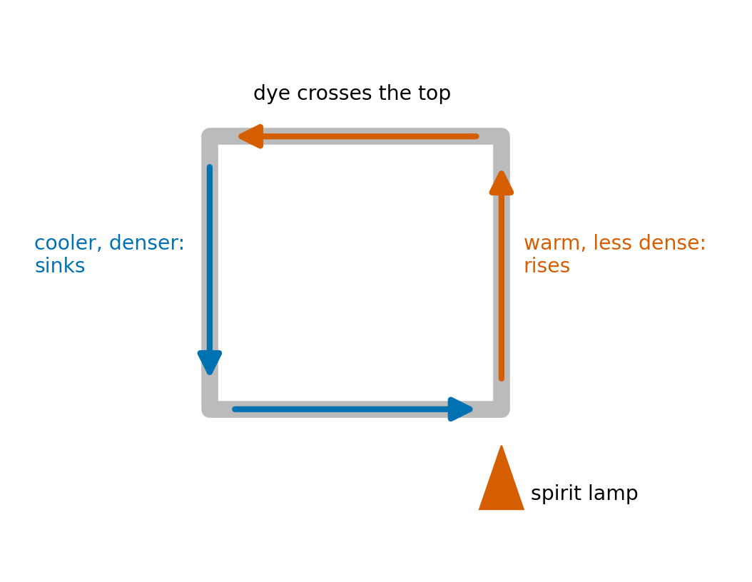
EGM305 · Weeks 8–11
Practical 4
Density, heat, pressure and buoyancy in the lab
What to do, what to predict, what you should see, and why
Notes:
Teaching deck for the Weeks 8-11 practicals. Every activity: steps, a prediction to write first, the expected result with worked numbers, and the atmosphere link. The lab card (6 pages) and Part IV of The Atmosphere have the full detail.

Slide 2
How the two sessions run
Session | Activity | What you do | Big idea
1 | 1.1A | black, white, shiny cans under a lamp | radiation
1 | 1.1B | touch wood, metal, cloth | conduction
1 | 1.1C | heat one side of a water loop, add dye | convection
1 | 1.2 | cold water, then ice, inside hot water | heat flow, latent heat
1 | 1.3A | lift a divider: salt v fresh, hot v cold | density, layers
1 | 1.3B | the teabag rocket | buoyancy of hot air
2 | 2.1 | balloons, marshmallow, cloud under vacuum | pressure, Boyle, cooling
2 | 2.2 | trim the Archimedes ball | Archimedes
2 | 2.3 | squeeze the Cartesian diver | pressure + buoyancy
EGM305 Practical 4 · Weeks 8–11 · Overview
2
Notes:
Teams of 3-4. Three experiments per session, 30-45 minutes each. Rotate jobs: reader, writer, hands. Water stands in for air because we can see it move with dye.

Slide 3
Write this for every experiment
Your lab book, seven headings
1. Aim, question or hypothesis, in one sentence
2. Materials and set-up: a labelled sketch
3. Method: the steps you actually did
4. Predictions: written *before* testing, each with a reason
5. Observations, measurements, calculations: numbers with units, a table, a graph
6. Conclusion and explanation: was the prediction right? which physics?
7. Example in the atmosphere or ocean
EGM305 Practical 4 · Weeks 8–11 · Overview
3
Notes:
This is what they are assessed on. Insist the prediction is written before testing.

Slide 4
Safety and etiquette
Safety
Lab coat buttoned, sensible shoes, long hair tied back
Stand while you work
Bags under benches, aisles clear
Flames: spirit lamp, matches, teabag only on the mat, away from hair and paper
Report every accident
Wash hands with soap at the end
Etiquette and what to bring
No spares: handle flasks, thermometers, balls gently
Phones, laptops, tablets off and in bags
Clean and return everything
Bring: lab book (squared), calculator, pencil, ruler, eraser, tea towel, lab coat
EGM305 Practical 4 · Weeks 8–11 · Overview
4
Notes:
Read out. Phones off is a firm rule: using one means leaving and being marked absent. There are no spare parts.

Slide 5
Numbers you will need
Quantity | Value
Density | ρ = m / V (1 g cm⁻³ = 1000 kg m⁻³)
Air, sea level, 15 °C | 1.225 kg m⁻³; ρ = p / (287 T)
Water 50 / 20 / 4 °C; sea water | 988 / 998 / 1000; 1020–1030 kg m⁻³
Heat to warm; latent heat | Q = m c ΔT (water 4186, air 1006 J kg⁻¹ °C⁻¹); Q = m L (334 / 2260 J g⁻¹)
Kelvin | T(K) = T(°C) + 273.15
Pressure; hydrostatic | p = F / A; p = ρ g z (10 m of sea ≈ 1 atm)
Boyle's law | p₁V₁ = p₂V₂
Archimedes | F_{b} = ρ_{fluid} V g; sinks if ρ_{object} > ρ_{fluid}
Radiation | E = σT⁴ (σ = 5.67×10⁻⁸); λ_{max} = 2898 / T μm
EGM305 Practical 4 · Weeks 8–11 · Overview
5
Notes:
Leave this up while they calculate. Remind them: kelvin in any formula with T to a power or in the gas law.

Slide 6
The four ideas
Density · heat and temperature · pressure · buoyancy

Slide 7
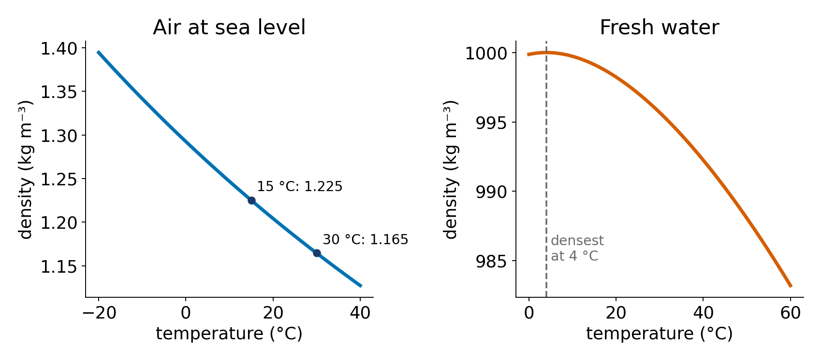
Density: warm air is light air
ρ = m / V: mass packed into a volume
Warming: molecules spread out → volume up, density down
Gas law: ρ = p / (R T); at 30 °C air is 5 % lighter than at 15 °C; at 300 °C, half
Water is densest at 4 °C; salt makes it denser
Dense fluid slides under light fluid → layers (stratification), cold fronts
EGM305 Practical 4 · Weeks 8–11 · Ideas
7
Notes:
rho = m/V. Heating spreads molecules apart: same mass, more volume, lower density. Water is densest at 4 C, so ice floats.

Slide 8
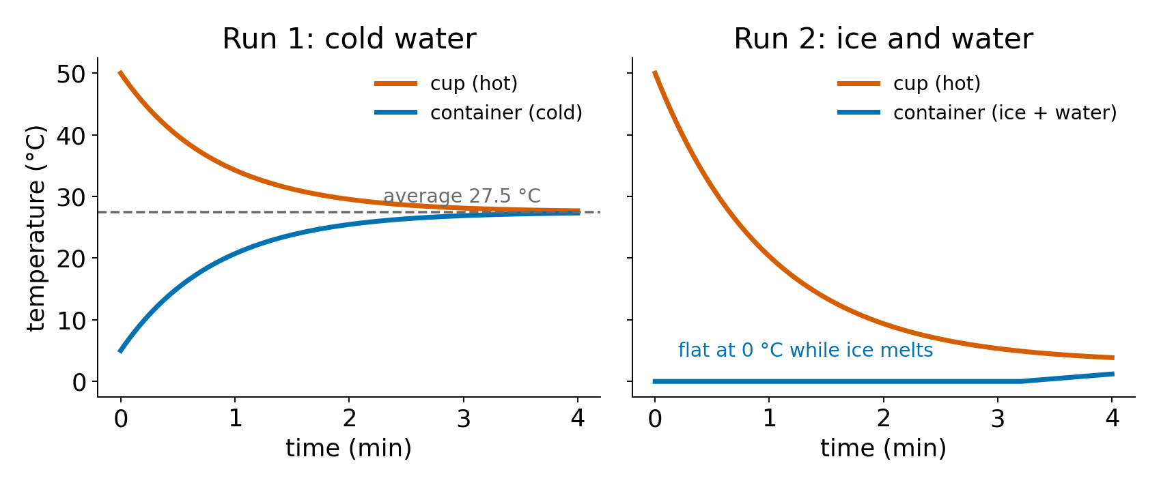
Heat and temperature: not the same thing
Definitions
Temperature: how hot (molecules' average motion)
Heat: energy moving from hot to cold, in joules
Water needs ~3400× more heat than air per volume to warm 1 °C
Moving heat
Radiation: no contact; E = σT⁴
Conduction: by contact; metals fast, air slow
Convection: the fluid moves; warm rises
Latent heat: melting 334 J g⁻¹ at constant 0 °C
EGM305 Practical 4 · Weeks 8–11 · Ideas
8
Notes:
Temperature = average molecular kinetic energy. Heat = energy moving because of a temperature difference. Three transfer modes. Latent heat changes state without changing temperature.

Slide 9
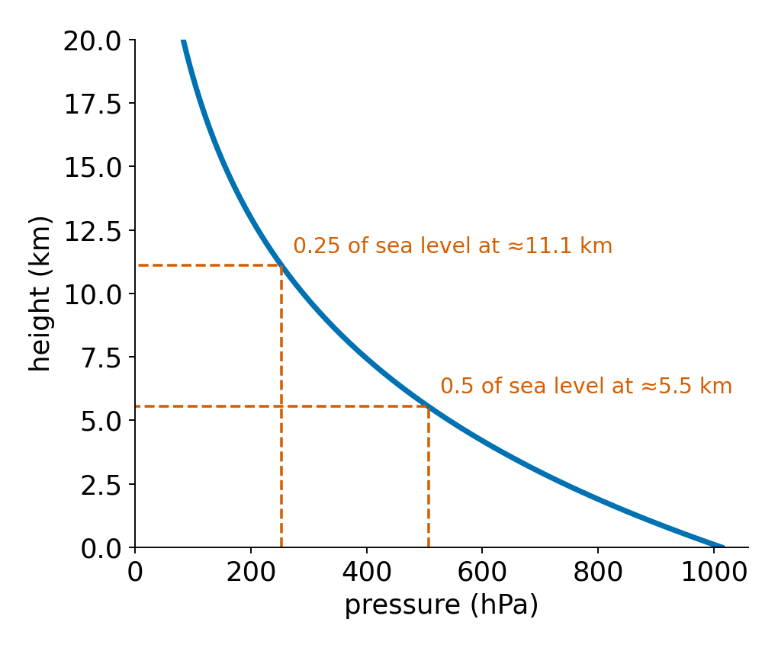
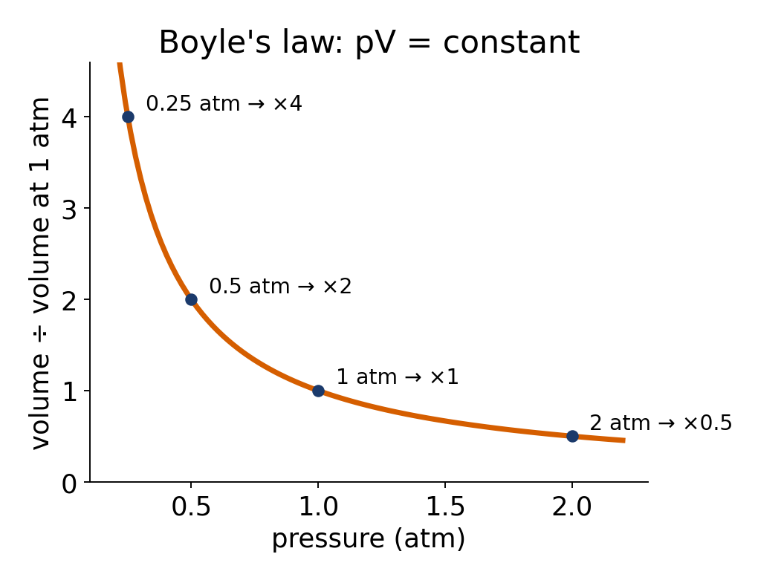
Pressure: force over area, falling with height
p = F / A; sea level ≈ 101 325 Pa = 1 atm
p = ρ g z: 10 m of sea water ≈ +1 atm
Air: halves every ≈5.5 km
Boyle: p₁V₁ = p₂V₂: half the pressure, twice the volume
Water hardly compresses
Expanding air cools: 293 K → 240 K at half pressure (no heat in)
EGM305 Practical 4 · Weeks 8–11 · Ideas
9
Notes:
p=F/A. Hydrostatic p=rho g z. Air pressure halves every ~5.5 km. Gases compress (Boyle), water barely. Fast expansion cools: the cloud mechanism.

Slide 10
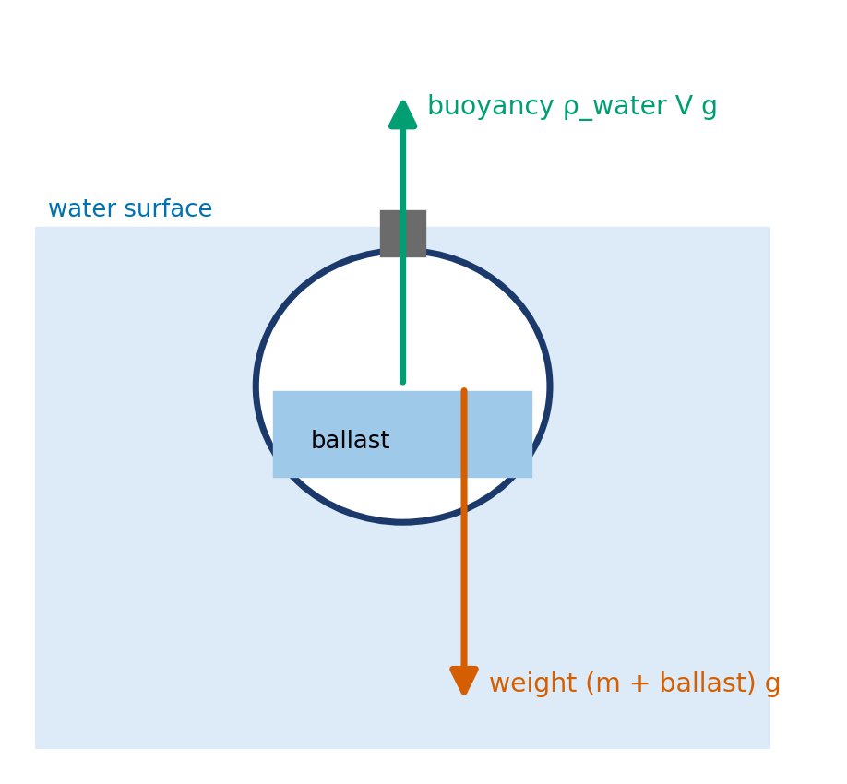
Buoyancy: lighter than your surroundings → rise
Buoyant force = weight of fluid displaced (Archimedes)
ΔF = V g (ρ_{object} − ρ_{fluid})
ΔF > 0 sinks · ΔF < 0 rises · ΔF = 0 hovers (neutral)
Air parcel 3 °C warmer than 290 K: a = 9.81 × 3/290 = 0.10 m s⁻² upward
Stable air: lifted parcel ends colder → sinks back. Unstable: ends warmer → keeps rising
EGM305 Practical 4 · Weeks 8–11 · Ideas
10
Notes:
Archimedes: buoyant force = weight of displaced fluid. Net force V g (rho_object - rho_fluid). In air this is stability: warm parcel rises.

Slide 11
Session 1
Radiation · conduction · convection · heat flow · density

Slide 12
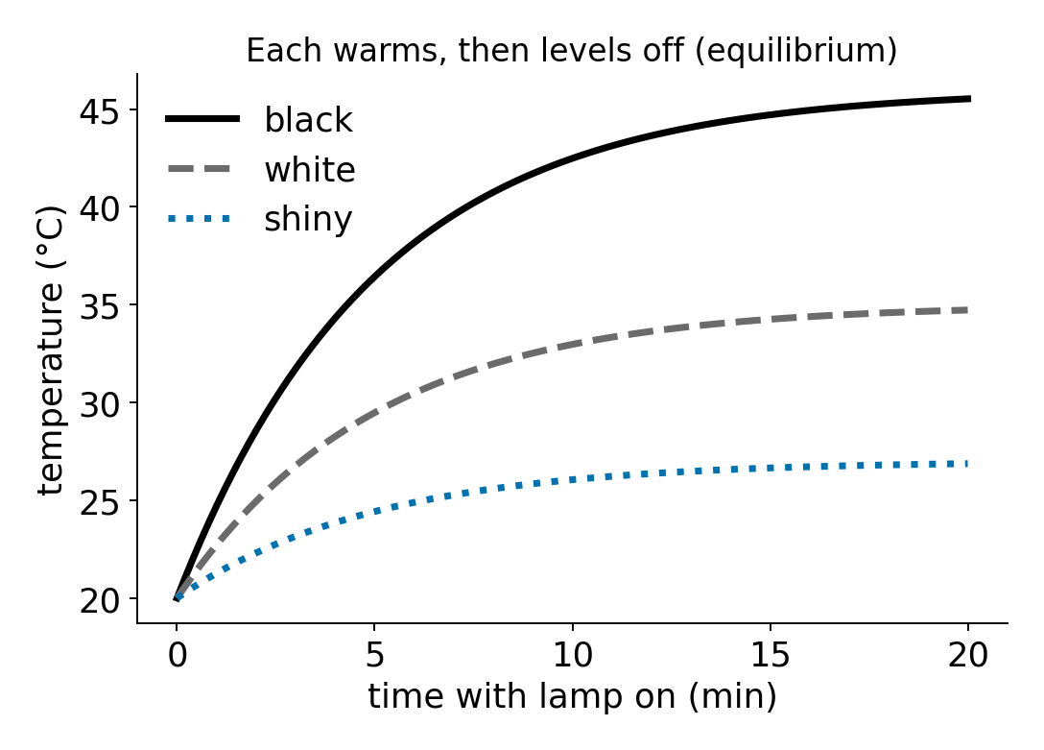
1.1A: Radiation: what you need
Materials
Three equal cans: black, white, shiny
A thermometer through each lid
One heat lamp
Ruler (equal distances)
Clock
EGM305 Practical 4 · Weeks 8–11 · Session 1
12
Notes:
Set up 1.1A. Point out each item; ask teams to sketch the set-up before starting.

Slide 13
1.1A: Radiation: what to do
Steps
1. Sketch the set-up
2. Put all three cans the same distance from the lamp
3. Record the start temperatures
4. Switch on; read each thermometer every minute for ~10 min
5. Plot temperature against time, one line per can
6. Answer: would they keep warming for ever?
EGM305 Practical 4 · Weeks 8–11 · Session 1
13
Notes:
Walk through the steps before teams start. Step 1: Sketch the set-up. Step 2: Put all three cans the same distance from the lamp. Step 3: Record the start temperatures. Step 4: Switch on; read each thermometer every minute for ~10 min. Step 5: Plot temperature against time, one line per can. Step 6: Answer: would they keep warming for ever?.

Slide 14
1.1A: predict before you test
Write in your lab book first
Will the three cans warm equally? Which fastest, which slowest, why?
If the lamp stays on for hours, will the temperature keep rising?
A good prediction has a reason
I predict that … because … (name the physics: density, heat flow, pressure or buoyancy)
EGM305 Practical 4 · Weeks 8–11 · Session 1
14
Notes:
Give teams two minutes to write a prediction AND a reason in their lab book before anyone tests. A wrong prediction with a reason is good science.

Slide 15
1.1A: what you should see, and why
What you should see
Black warms fastest, then white, then shiny
Each levels off: black highest
Why
Black absorbs most radiation, shiny reflects most (albedo)
A warmer can loses heat faster (σT⁴, conduction, convection) → equilibrium where absorbed = lost
Heat in by radiation; through the wall by conduction; inside by convection
Worked numbers
Lamp filament ≈2800 K → λ_{max} = 2898/2800 ≈ 1.0 μm (near infrared)
EGM305 Practical 4 · Weeks 8–11 · Session 1
15
Notes:
Reveal only after the teams have tested. Ask a team to explain in their own words before showing the physics.

Slide 16
1.1A: in the atmosphere
The same physics outside the lab
Albedo: snow and cloud reflect, ocean and forest absorb
Earth settles where absorbed sunlight = emitted infrared
Melting ice → darker surface → more warming (ice–albedo feedback)
Sun 6000 K peaks at 0.48 μm (visible); Earth 288 K at 10 μm (infrared)
What goes wrong / take care
Unequal distances: 10 % further ≈ 20 % less radiation
Don't touch hot cans; keep the lamp ≥30 cm away
EGM305 Practical 4 · Weeks 8–11 · Session 1
16
Notes:
Link to the lectures: ask where else the same process happens.

Slide 17
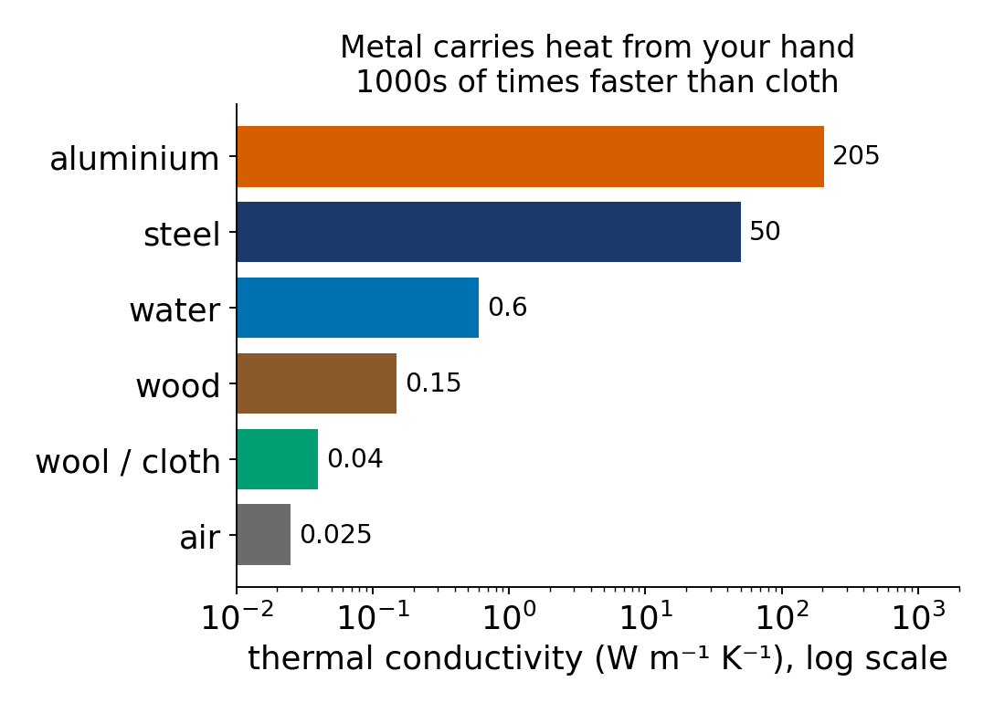
1.1B: Conduction: what you need
Materials
Wood, metal and cloth
All at room temperature for hours
EGM305 Practical 4 · Weeks 8–11 · Session 1
17
Notes:
Set up 1.1B. Point out each item; ask teams to sketch the set-up before starting.

Slide 18
1.1B: Conduction: what to do
Steps
1. Predict each object's temperature, without touching
2. Touch each one briefly
3. Rank them by how warm they feel
4. Explain the difference
EGM305 Practical 4 · Weeks 8–11 · Session 1
18
Notes:
Walk through the steps before teams start. Step 1: Predict each object's temperature, without touching. Step 2: Touch each one briefly. Step 3: Rank them by how warm they feel. Step 4: Explain the difference.

Slide 19
1.1B: predict before you test
Write in your lab book first
Are the three objects at the same temperature?
Will they feel the same? Which feels coldest, and why?
A good prediction has a reason
I predict that … because … (name the physics: density, heat flow, pressure or buoyancy)
EGM305 Practical 4 · Weeks 8–11 · Session 1
19
Notes:
Give teams two minutes to write a prediction AND a reason in their lab book before anyone tests. A wrong prediction with a reason is good science.

Slide 20
1.1B: what you should see, and why
What you should see
All are at room temperature
Yet metal feels coldest, cloth warmest
Why
Your hand (≈33 °C) loses heat to whatever it touches
Metal conducts heat away fast; wood and cloth slowly; cloth traps air
Skin senses the rate of heat flow, not temperature
EGM305 Practical 4 · Weeks 8–11 · Session 1
20
Notes:
Reveal only after the teams have tested. Ask a team to explain in their own words before showing the physics.

Slide 21
1.1B: in the atmosphere
The same physics outside the lab
Air conducts poorly: conduction matters only in the millimetres next to the ground
Sunny road heats the air touching it
Clear night: cold ground chills the lowest air → fog, frost
Above that thin layer, convection moves the heat
EGM305 Practical 4 · Weeks 8–11 · Session 1
21
Notes:
Link to the lectures: ask where else the same process happens.

Slide 22
1.1C: Convection: what you need
Materials
Convection loop (glass tube)
Food colouring, two colours
Pipette
Spirit lamp, matches
EGM305 Practical 4 · Weeks 8–11 · Session 1
22
Notes:
Set up 1.1C. Point out each item; ask teams to sketch the set-up before starting.

Slide 23
1.1C: Convection: what to do
Steps
1. Sketch the apparatus
2. Fill with water; no bubbles in the horizontal tubes
3. Predict the flow direction
4. Spirit lamp under the right column; wait 1–2 min
5. Add a few drops of dye at the top; watch
6. Move the lamp to the left; wait; add the second colour
EGM305 Practical 4 · Weeks 8–11 · Session 1
23
Notes:
Walk through the steps before teams start. Step 1: Sketch the apparatus. Step 2: Fill with water; no bubbles in the horizontal tubes. Step 3: Predict the flow direction. Step 4: Spirit lamp under the right column; wait 1–2 min. Step 5: Add a few drops of dye at the top; watch. Step 6: Move the lamp to the left; wait; add the second colour.

Slide 24
1.1C: predict before you test
Write in your lab book first
Right side warm, left side cool: which way will water flow through the top and bottom tubes?
What happens when you move the lamp to the other side?
A good prediction has a reason
I predict that … because … (name the physics: density, heat flow, pressure or buoyancy)
EGM305 Practical 4 · Weeks 8–11 · Session 1
24
Notes:
Give teams two minutes to write a prediction AND a reason in their lab book before anyone tests. A wrong prediction with a reason is good science.

Slide 25
1.1C: what you should see, and why
What you should see
Up the warm side, across the top, down the cool side, back along the bottom
Moving the lamp reverses the loop
Why
Warm water expands: 988 kg m⁻³ at 50 °C v 998 at 20 °C
Less dense → buoyant → rises; cool water sinks
A density difference drives a circulation: convection
EGM305 Practical 4 · Weeks 8–11 · Session 1
25
Notes:
Reveal only after the teams have tested. Ask a team to explain in their own words before showing the physics.

Slide 26
1.1C: in the atmosphere
The same physics outside the lab
Sea breeze: warm land, rising air, cool sea air flows in
Thunderstorm updrafts
Hadley cell: rises at the equator, sinks near 30°
Ocean overturning circulation
What goes wrong / take care
Bubbles block the horizontal tubes: refill
Keep sleeves and hair away from the flame
EGM305 Practical 4 · Weeks 8–11 · Session 1
26
Notes:
Link to the lectures: ask where else the same process happens.

Slide 27
1.2: Heat flow and latent heat: what you need
Materials
Small plastic container with lid (thermometer hole)
Nested polystyrene cups, marked line: equal volumes
Two digital thermometers
Hot tap water, ice-cold water, ice
Clamp
EGM305 Practical 4 · Weeks 8–11 · Session 1
27
Notes:
Set up 1.2. Point out each item; ask teams to sketch the set-up before starting.

Slide 28
1.2: Heat flow and latent heat: what to do
Steps
1. Draw the set-up with arrows for heat flow
2. Run 1: container full of ice-cold water (no ice); record T
3. Cup filled with hot water to the line; record T
4. Container into the cup; read both every 30 s for 4 min, stirring
5. Plot both curves on one graph
6. Run 2: container 60 % ice + 40 % water; repeat and plot
EGM305 Practical 4 · Weeks 8–11 · Session 1
28
Notes:
Walk through the steps before teams start. Step 1: Draw the set-up with arrows for heat flow. Step 2: Run 1: container full of ice-cold water (no ice); record T. Step 3: Cup filled with hot water to the line; record T. Step 4: Container into the cup; read both every 30 s for 4 min, stirring. Step 5: Plot both curves on one graph. Step 6: Run 2: container 60 % ice + 40 % water; repeat and plot.

Slide 29
1.2: predict before you test
Write in your lab book first
Run 1: what happens to each temperature? Where do they end?
Run 2 with ice: will the curves look the same? Why or why not?
A good prediction has a reason
I predict that … because … (name the physics: density, heat flow, pressure or buoyancy)
EGM305 Practical 4 · Weeks 8–11 · Session 1
29
Notes:
Give teams two minutes to write a prediction AND a reason in their lab book before anyone tests. A wrong prediction with a reason is good science.

Slide 30
1.2: what you should see, and why
What you should see
Run 1: curves meet near the average (≈27.5 °C)
Run 2: container stays at 0 °C while ice remains; ends ≈1 °C
Why
Heat lost by hot = heat gained by cold: T_{f} = (T_{h} + T_{c})/2 for equal masses
Melting absorbs 334 J g⁻¹ with no temperature change: latent heat
Worked numbers
Run 2: cup gives 100 × 4.186 × 50 = 20.9 kJ; melting 60 g ice needs 60 × 334 = 20.0 kJ
EGM305 Practical 4 · Weeks 8–11 · Session 1
30
Notes:
Reveal only after the teams have tested. Ask a team to explain in their own words before showing the physics.

Slide 31
1.2: in the atmosphere
The same physics outside the lab
Evaporation takes 2260 J g⁻¹ from the sea; condensing in cloud gives it back: powers storms
Melting sea ice holds polar water near 0 °C all summer
Water's huge heat capacity → mild coastal climates
Ice keeps a drink cold until it has all melted
What goes wrong / take care
Equal volumes (use the line)
Stir, or warm water floats on top and misleads the thermometer
Don't let the hot water cool while setting up
EGM305 Practical 4 · Weeks 8–11 · Session 1
31
Notes:
Link to the lectures: ask where else the same process happens.

Slide 32
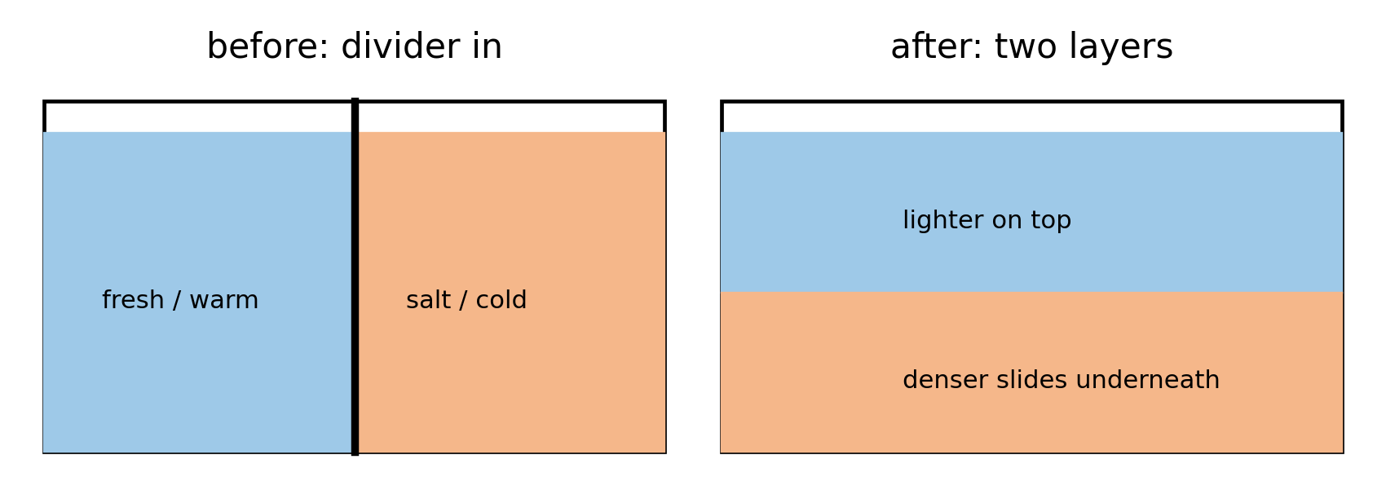
1.3A: Density: the divided tank: what you need
Materials
Tank with removable divider
Salt solution
Food colouring, two colours
Ice, beakers, scales
EGM305 Practical 4 · Weeks 8–11 · Session 1
32
Notes:
Set up 1.3A. Point out each item; ask teams to sketch the set-up before starting.

Slide 33
1.3A: Density: the divided tank: what to do
Steps
1. Tap water one side, salt solution the other, each coloured
2. Predict, then measure both densities: weigh, measure volume, ρ = m/V
3. Lift the divider; watch
4. Empty; repeat with hot and ice-cold water
5. After it settles, move a fingertip slowly down from the surface
6. Discuss: warming and melting sea ice and the ocean's layers
EGM305 Practical 4 · Weeks 8–11 · Session 1
33
Notes:
Walk through the steps before teams start. Step 1: Tap water one side, salt solution the other, each coloured. Step 2: Predict, then measure both densities: weigh, measure volume, ρ = m/V. Step 3: Lift the divider; watch. Step 4: Empty; repeat with hot and ice-cold water. Step 5: After it settles, move a fingertip slowly down from the surface. Step 6: Discuss: warming and melting sea ice and the ocean's layers.

Slide 34
1.3A: predict before you test
Write in your lab book first
What happens when the divider is lifted? Which liquid goes where, and why?
A good prediction has a reason
I predict that … because … (name the physics: density, heat flow, pressure or buoyancy)
EGM305 Practical 4 · Weeks 8–11 · Session 1
34
Notes:
Give teams two minutes to write a prediction AND a reason in their lab book before anyone tests. A wrong prediction with a reason is good science.

Slide 35
1.3A: what you should see, and why
What you should see
Salt (or cold) water slides under as a wedge
Fresh (or hot) water spreads over the top: two layers
Fingertip feels a sharp warm-to-cold boundary
Why
Denser fluid sinks beneath lighter: stratification
Salt 1025, fresh 998, hot 988, cold 1000 kg m⁻³
Worked numbers
Beaker 52.0 g; +100 mL salt solution = 154.5 g → ρ = 102.5/100 = 1.025 g cm⁻³
EGM305 Practical 4 · Weeks 8–11 · Session 1
35
Notes:
Reveal only after the teams have tested. Ask a team to explain in their own words before showing the physics.

Slide 36
1.3A: in the atmosphere
The same physics outside the lab
Cold front: dense cold air undercuts warm air, lifting it into cloud
Warm front: warm air rides up over cold
Sea breezes and katabatic winds are density currents
Ocean: warming + meltwater → stronger layers, less mixing
What goes wrong / take care
Salinity layers water only; in air density differences come from temperature and humidity
EGM305 Practical 4 · Weeks 8–11 · Session 1
36
Notes:
Link to the lectures: ask where else the same process happens.

Slide 37
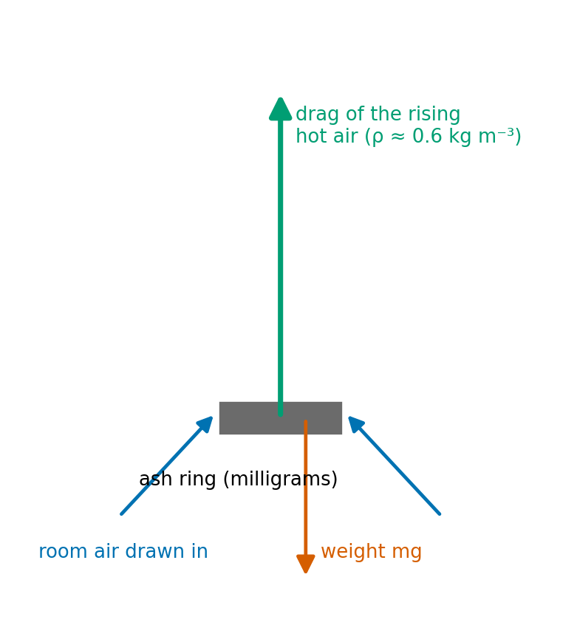
1.3B: The teabag rocket: what you need
Materials
Teabag (with a staple top)
Scissors
Matches or lighter
Non-flammable mat
EGM305 Practical 4 · Weeks 8–11 · Session 1
37
Notes:
Set up 1.3B. Point out each item; ask teams to sketch the set-up before starting.

Slide 38
1.3B: The teabag rocket: what to do
Steps
1. Cut off the stapled top
2. Tip out the tea
3. Open the bag into a cylinder
4. Stand it on the mat
5. Light the top
6. Watch; draw the forces on the ash
EGM305 Practical 4 · Weeks 8–11 · Session 1
38
Notes:
Walk through the steps before teams start. Step 1: Cut off the stapled top. Step 2: Tip out the tea. Step 3: Open the bag into a cylinder. Step 4: Stand it on the mat. Step 5: Light the top. Step 6: Watch; draw the forces on the ash.

Slide 39
1.3B: predict before you test
Write in your lab book first
What will the teabag do as it burns? What forces act on it?
A good prediction has a reason
I predict that … because … (name the physics: density, heat flow, pressure or buoyancy)
EGM305 Practical 4 · Weeks 8–11 · Session 1
39
Notes:
Give teams two minutes to write a prediction AND a reason in their lab book before anyone tests. A wrong prediction with a reason is good science.

Slide 40
1.3B: what you should see, and why
What you should see
It burns down quietly, then the ash lifts off and floats up
Why
Flame heats the air: at 300 °C air is half as dense as room air
Buoyant hot air rises; the ash weighs milligrams
Upward drag of the rising air > ash's weight → lift-off
EGM305 Practical 4 · Weeks 8–11 · Session 1
40
Notes:
Reveal only after the teams have tested. Ask a team to explain in their own words before showing the physics.

Slide 41
1.3B: in the atmosphere
The same physics outside the lab
Thermals that birds and gliders ride
Cumulus clouds over heated ground
Smoke and ash lofted by wildfires (pyrocumulus)
What goes wrong / take care
Only on the mat, away from paper and hair
Let the ash cool before clearing it
EGM305 Practical 4 · Weeks 8–11 · Session 1
41
Notes:
Link to the lectures: ask where else the same process happens.

Slide 42
Session 2
Pressure · Boyle's law · Archimedes · stability

Slide 43
2.1: Balloons, a marshmallow and a cloud: what you need
Materials
Three flasks with bungs
Vacuum pump
Balloons, water
Marshmallow, cherry tomato
Matches (for smoke)
EGM305 Practical 4 · Weeks 8–11 · Session 2
43
Notes:
Set up 2.1. Point out each item; ask teams to sketch the set-up before starting.

Slide 44
2.1: Balloons, a marshmallow and a cloud: what to do
Steps
1. Air balloon in flask 1, water balloon in flask 2 (inflate/fill it inside the flask)
2. Pump out flask 1; watch; let air back in
3. Repeat with the water balloon
4. Predict, then test the marshmallow and tomato
5. Let air back in; watch the marshmallow
6. Cloud: a little water + match smoke; pump out quickly
7. Remove the balloons for the next group
EGM305 Practical 4 · Weeks 8–11 · Session 2
44
Notes:
Walk through the steps before teams start. Step 1: Air balloon in flask 1, water balloon in flask 2 (inflate/fill it inside the flask). Step 2: Pump out flask 1; watch; let air back in. Step 3: Repeat with the water balloon. Step 4: Predict, then test the marshmallow and tomato. Step 5: Let air back in; watch the marshmallow. Step 6: Cloud: a little water + match smoke; pump out quickly. Step 7: Remove the balloons for the next group.

Slide 45
2.1: predict before you test
Write in your lab book first
What happens to each balloon when the air is pumped out?
Marshmallow and tomato: which changes, and why?
What happens to the temperature of expanding air?
What three things make a cloud?
A good prediction has a reason
I predict that … because … (name the physics: density, heat flow, pressure or buoyancy)
EGM305 Practical 4 · Weeks 8–11 · Session 2
45
Notes:
Give teams two minutes to write a prediction AND a reason in their lab book before anyone tests. A wrong prediction with a reason is good science.

Slide 46
2.1: what you should see, and why
What you should see
Air balloon swells, shrinks back; water balloon: no change
Marshmallow swells, then ends wrinkled and smaller; tomato hardly changes
A cloud appears on sudden expansion
Why
Boyle: p₁V₁ = p₂V₂, half the pressure ≈ twice the volume
Water barely compresses
Fast expansion cools air below its dew point; smoke gives nuclei
Worked numbers
Half pressure, no heat in: T = 293 × 0.5^0.286 = 240 K (a 53 °C drop)
EGM305 Practical 4 · Weeks 8–11 · Session 2
46
Notes:
Reveal only after the teams have tested. Ask a team to explain in their own words before showing the physics.

Slide 47
2.1: in the atmosphere
The same physics outside the lab
Rising air expands and cools ≈10 °C per km → clouds
Ears pop in climbing aircraft
Cloud recipe: moisture + nuclei + cooling by expansion
What goes wrong / take care
Flasks under vacuum: handle gently, no knocks
Don't over-inflate balloons inside the flask
EGM305 Practical 4 · Weeks 8–11 · Session 2
47
Notes:
Link to the lectures: ask where else the same process happens.

Slide 48
2.2: The Archimedes ball: what you need
Materials
Archimedes ball with stopper
60 mL syringe and tubing
Scales, calliper
Water; an unknown liquid
EGM305 Practical 4 · Weeks 8–11 · Session 2
48
Notes:
Set up 2.2. Point out each item; ask teams to sketch the set-up before starting.

Slide 49
2.2: The Archimedes ball: what to do
Steps
1. Weigh the ball (m); measure its diameter (V = 4/3 π r³)
2. Draw the forces on it
3. Calculate the ballast for neutral buoyancy: V_{b} = V − m/ρ
4. Test in water: draw water in with the syringe until it hovers
5. Repeat in the unknown liquid
6. Find the liquid's density: ρ = m / (V − V_{b})
EGM305 Practical 4 · Weeks 8–11 · Session 2
49
Notes:
Walk through the steps before teams start. Step 1: Weigh the ball (m); measure its diameter (V = 4/3 π r³). Step 2: Draw the forces on it. Step 3: Calculate the ballast for neutral buoyancy: Vb = V − m/ρ. Step 4: Test in water: draw water in with the syringe until it hovers. Step 5: Repeat in the unknown liquid. Step 6: Find the liquid's density: ρ = m / (V − Vb).

Slide 50
2.2: predict before you test
Write in your lab book first
How much ballast makes the ball hover with only the stopper above water?
If it needs more of the unknown liquid, is that liquid denser or lighter than water?
A good prediction has a reason
I predict that … because … (name the physics: density, heat flow, pressure or buoyancy)
EGM305 Practical 4 · Weeks 8–11 · Session 2
50
Notes:
Give teams two minutes to write a prediction AND a reason in their lab book before anyone tests. A wrong prediction with a reason is good science.

Slide 51
2.2: what you should see, and why
What you should see
Measured ballast close to the calculation (a little less: the stopper stays above)
More ballast needed → liquid denser
Why
Neutral: weight = buoyancy, m + ρV_{b} = ρV
ρ = m/(V − V_{b}): bigger V_{b} → smaller denominator → denser
Worked numbers
d = 7.00 cm → V = 179.6 cm³; m = 60.0 g → V_{b} = 179.6 − 60.1 = 119.5 mL; unknown needs 125.0 mL → ρ = 1.10 g cm⁻³
EGM305 Practical 4 · Weeks 8–11 · Session 2
51
Notes:
Reveal only after the teams have tested. Ask a team to explain in their own words before showing the physics.

Slide 52
2.2: in the atmosphere
The same physics outside the lab
An air parcel is neutrally buoyant when its density matches its surroundings
Weather balloons, research floats and submarines are trimmed the same way
What goes wrong / take care
Use the ball's volume, not its mass, for V
Subtract the stopper's volume for a closer match
EGM305 Practical 4 · Weeks 8–11 · Session 2
52
Notes:
Link to the lectures: ask where else the same process happens.

Slide 53
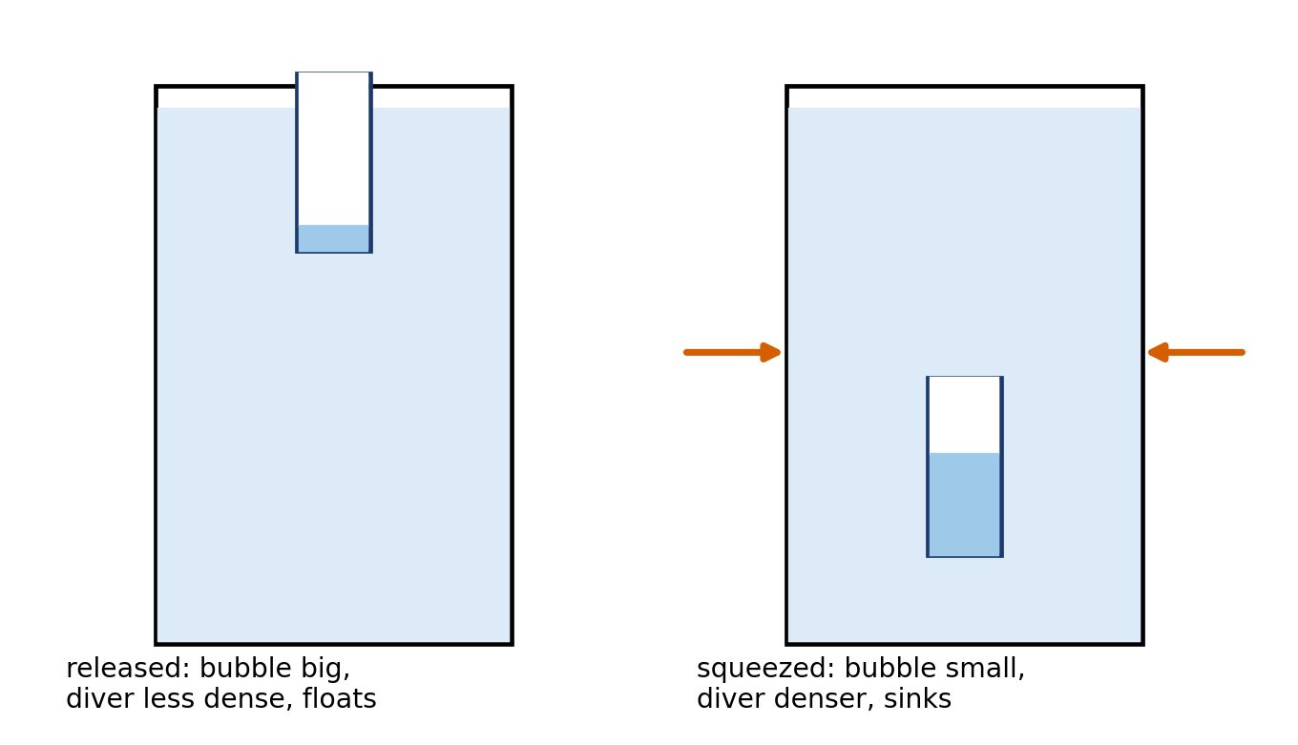
2.3: The Cartesian diver: what you need
Materials
Sealed plastic bottle full of water
Weighted pipette with an air bubble inside
EGM305 Practical 4 · Weeks 8–11 · Session 2
53
Notes:
Set up 2.3. Point out each item; ask teams to sketch the set-up before starting.

Slide 54
2.3: The Cartesian diver: what to do
Steps
1. Squeeze the bottle; watch the water level inside the pipette
2. Release
3. Try a gentle squeeze to make it hover
4. Draw the forces on the diver
EGM305 Practical 4 · Weeks 8–11 · Session 2
54
Notes:
Walk through the steps before teams start. Step 1: Squeeze the bottle; watch the water level inside the pipette. Step 2: Release. Step 3: Try a gentle squeeze to make it hover. Step 4: Draw the forces on the diver.

Slide 55
2.3: predict before you test
Write in your lab book first
Why does the diver sink when you squeeze? Why does it rise when you let go? (Think of the balloons.)
A good prediction has a reason
I predict that … because … (name the physics: density, heat flow, pressure or buoyancy)
EGM305 Practical 4 · Weeks 8–11 · Session 2
55
Notes:
Give teams two minutes to write a prediction AND a reason in their lab book before anyone tests. A wrong prediction with a reason is good science.

Slide 56
2.3: what you should see, and why
What you should see
Squeeze: water rises in the pipette, diver sinks
Release: it rises
Gentle squeeze: it hovers
Why
Squeeze raises the pressure → bubble compresses (Boyle) → water enters
Diver's average density > water → sinks (Archimedes); release reverses it
Worked numbers
Bubble 2.0 mL must shrink 0.05 mL to sink: pressure up 2.0/1.95 = 1.026 → +2.6 %
EGM305 Practical 4 · Weeks 8–11 · Session 2
56
Notes:
Reveal only after the teams have tested. Ask a team to explain in their own words before showing the physics.

Slide 57
2.3: in the atmosphere
The same physics outside the lab
The same pressure–volume–density link decides whether air rises or sinks: stability
Fish swim bladders, divers' buoyancy jackets
EGM305 Practical 4 · Weeks 8–11 · Session 2
57
Notes:
Link to the lectures: ask where else the same process happens.

Slide 58
Putting it together
All the answers · self-test · corrections

Slide 59
All the answers in one table
Activity | You should see | Because
1.1A | black > white > shiny, each levels off | albedo; equilibrium absorbed = lost
1.1B | metal feels coldest | skin senses heat-flow rate
1.1C | dye loops round; reverses | warm water less dense: convection
1.2 | meet at ≈27.5 °C; ice holds 0 °C | heat lost = gained; latent heat
1.3A | denser liquid slides under | stratification
1.3B | ash lifts off | hot air half as dense
2.1 | air balloon swells; cloud forms | Boyle; expansion cools
2.2 | ballast ≈ V − m/ρ | Archimedes
2.3 | squeeze → sinks | bubble compressed → denser
EGM305 Practical 4 · Weeks 8–11 · Wrap-up
59
Notes:
Use as a recap at the end of each session.

Slide 60
Self-test: try it yourself
Self-test
1. Density of air at 20 °C, 101 325 Pa?
2. Heat to melt 25 g of ice?
3. 200 g at 60 °C mixed with 100 g at 15 °C: final T?
4. A 3.0 L balloon taken from 1 to 0.6 atm: new volume?
5. Ball: V = 200 cm³, m = 50 g: water ballast to hover?
6. Parcel 2 °C colder than air at 280 K: which way, how fast?
EGM305 Practical 4 · Weeks 8–11 · Wrap-up
60
Notes:
Give students a few minutes, then reveal the next slide.

Slide 61
Self-test: answers
Answers
1. 101 325 / (287 × 293.15) = 1.204 kg m⁻³
2. 25 × 334 = 8350 J
3. (200×60 + 100×15)/300 = 45 °C
4. 3.0 × 1/0.6 = 5.0 L
5. 200 − 50/1.0 = 150 mL
6. Down, 9.81 × 2/280 = 0.07 m s⁻²
EGM305 Practical 4 · Weeks 8–11 · Wrap-up
61
Notes:
Answers worked from the formulas on the numbers slide.

Slide 62
Small corrections to the handbook
Worth knowing
Kelvin: T(K) = T(°C) + 273.15 (273.16 K is water's triple point)
Stefan–Boltzmann: σ = 5.67 × 10⁻⁸ W m⁻² K⁻⁴ (handbook: 5.7)
Water v air per volume: about 3400× more heat to warm 1 °C (handbook: about 4000)
Latent heat of vaporisation 2260 J g⁻¹ is at 100 °C; at sea-surface temperatures ≈2450
Activity 1.1C materials: "Matched" → Matches
EGM305 Practical 4 · Weeks 8–11 · Wrap-up
62
Notes:
None of these changes how the experiments run; mention if students quote the handbook values.

Slide 63
More detail
Where to read more
Lab card (6 pages, carry to the bench): ahmadammar.github.io/files/EGM305_Practical4_Lab_Card.pdf
The Atmosphere, Part IV (Chapters 31–38): every activity worked through, with graphs and a self-test: ahmadammar.github.io/teaching/atmosphere
Background: Ahrens, *Meteorology Today*; Karp-Boss et al. (2009), *Teaching Physical Concepts in Oceanography*
EGM305 Practical 4 · Weeks 8–11 · Wrap-up
63
Notes:
Point students to the lab card and the book.

