Slide 1
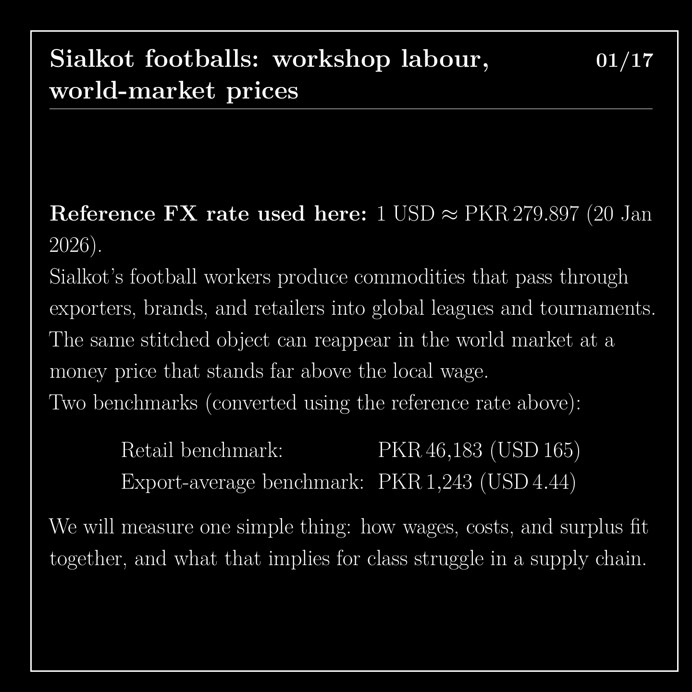
Notes:
This is a worked example about footballs stitched in Sialkot, Pakistan. Sialkot workers make commodities that move through exporters, brands and retailers into global tournaments. We start with two prices for that ball. Its retail price is about 46,183 rupees, or 165 dollars. Its average export value is about 1,243 rupees, or 4 dollars 44. All conversions use one exchange rate, dated 20 January 2026. We want to see how wages, costs and surplus fit together.

Slide 2

Notes:
First, where the numbers come from. They come from different sources and different years, and each is labelled. Pay and working time come from Bloomberg Businessweek in 2022. Export totals come from Reuters. Producer costs come from a study by Atkin and colleagues. So this is not the accounts of one firm in one year. It is a set of benchmarks, put together to make the class relation easier to see.

Slide 3
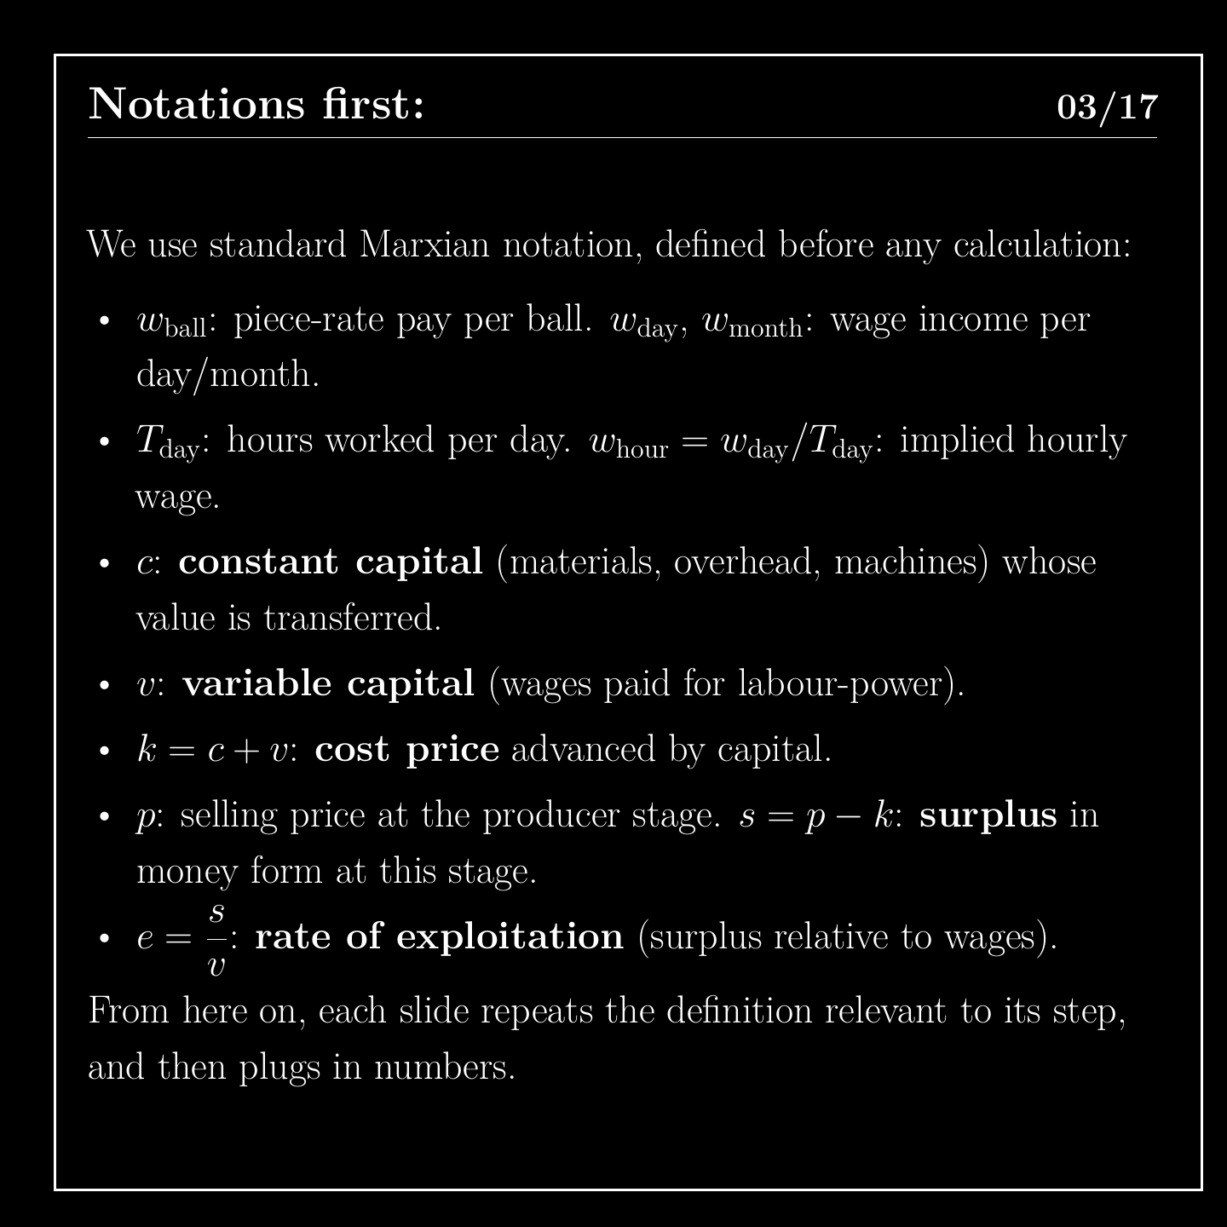
Notes:
Before calculating, we define the symbols. Constant capital, c, is the value of materials and machinery, which passes into the product. Variable capital, v, is what is paid in wages. Surplus value, s, is the new value beyond wages. Together, c plus v is the cost price, k. Each following slide repeats the definition it needs, then uses numbers.

Slide 4
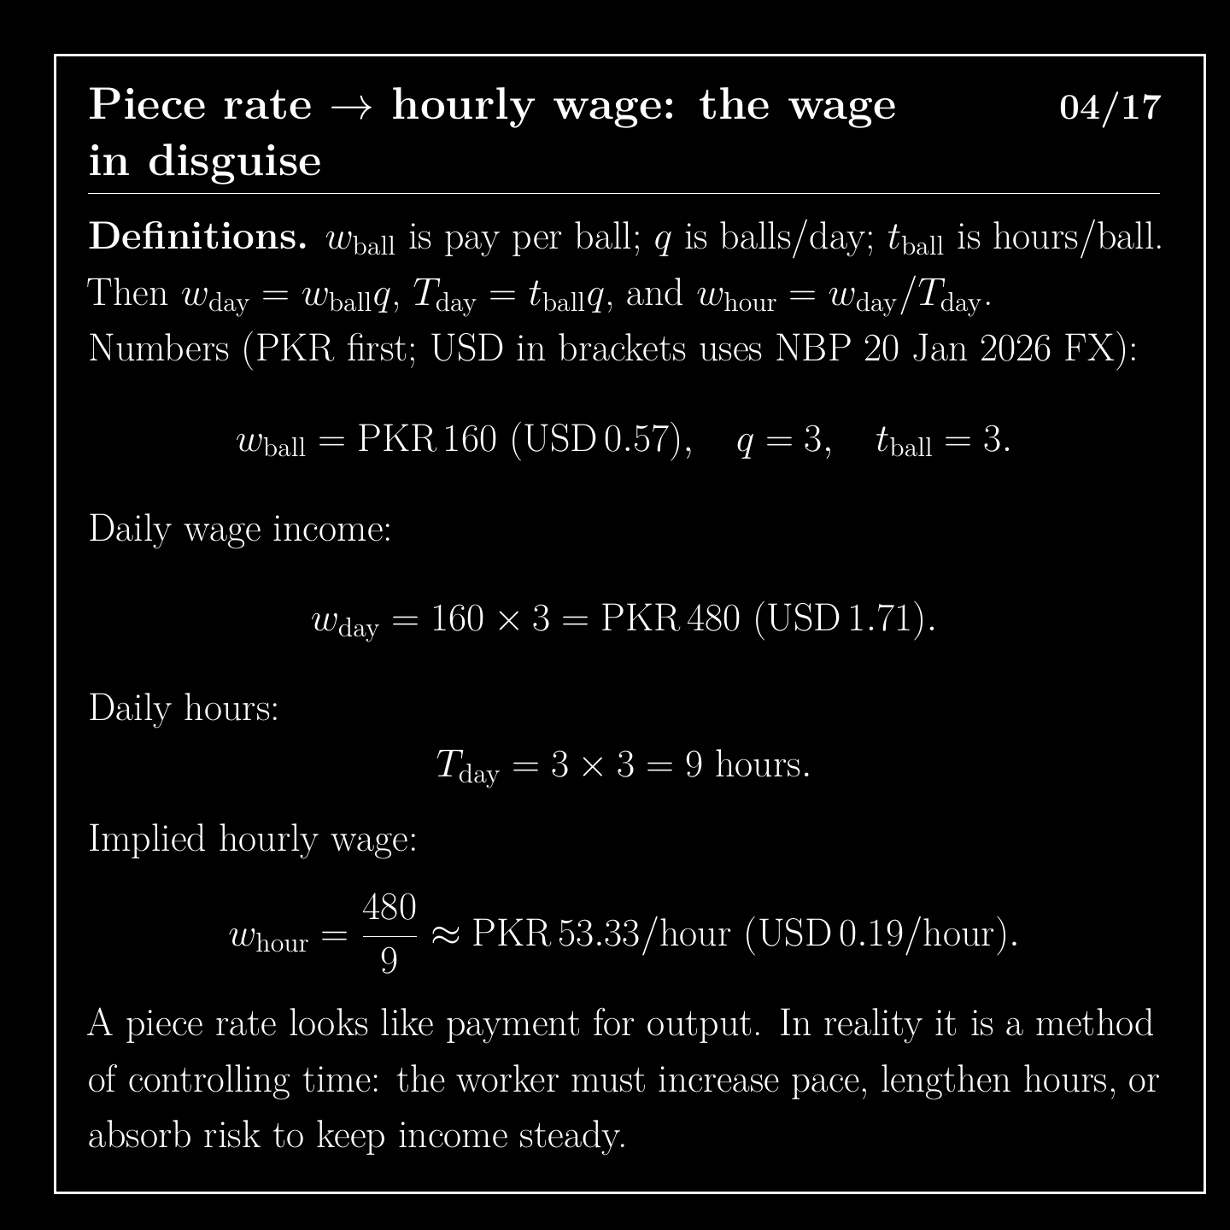
Notes:
A piece rate can be rewritten as a time wage. A stitcher earns 160 rupees for a ball that takes about three hours. Three balls a day gives 480 rupees for nine hours. That works out to about 53 rupees an hour. A piece rate looks like payment for output, yet it also controls time. To keep their income steady, the worker has to speed up, work longer or absorb the risk.

Slide 5
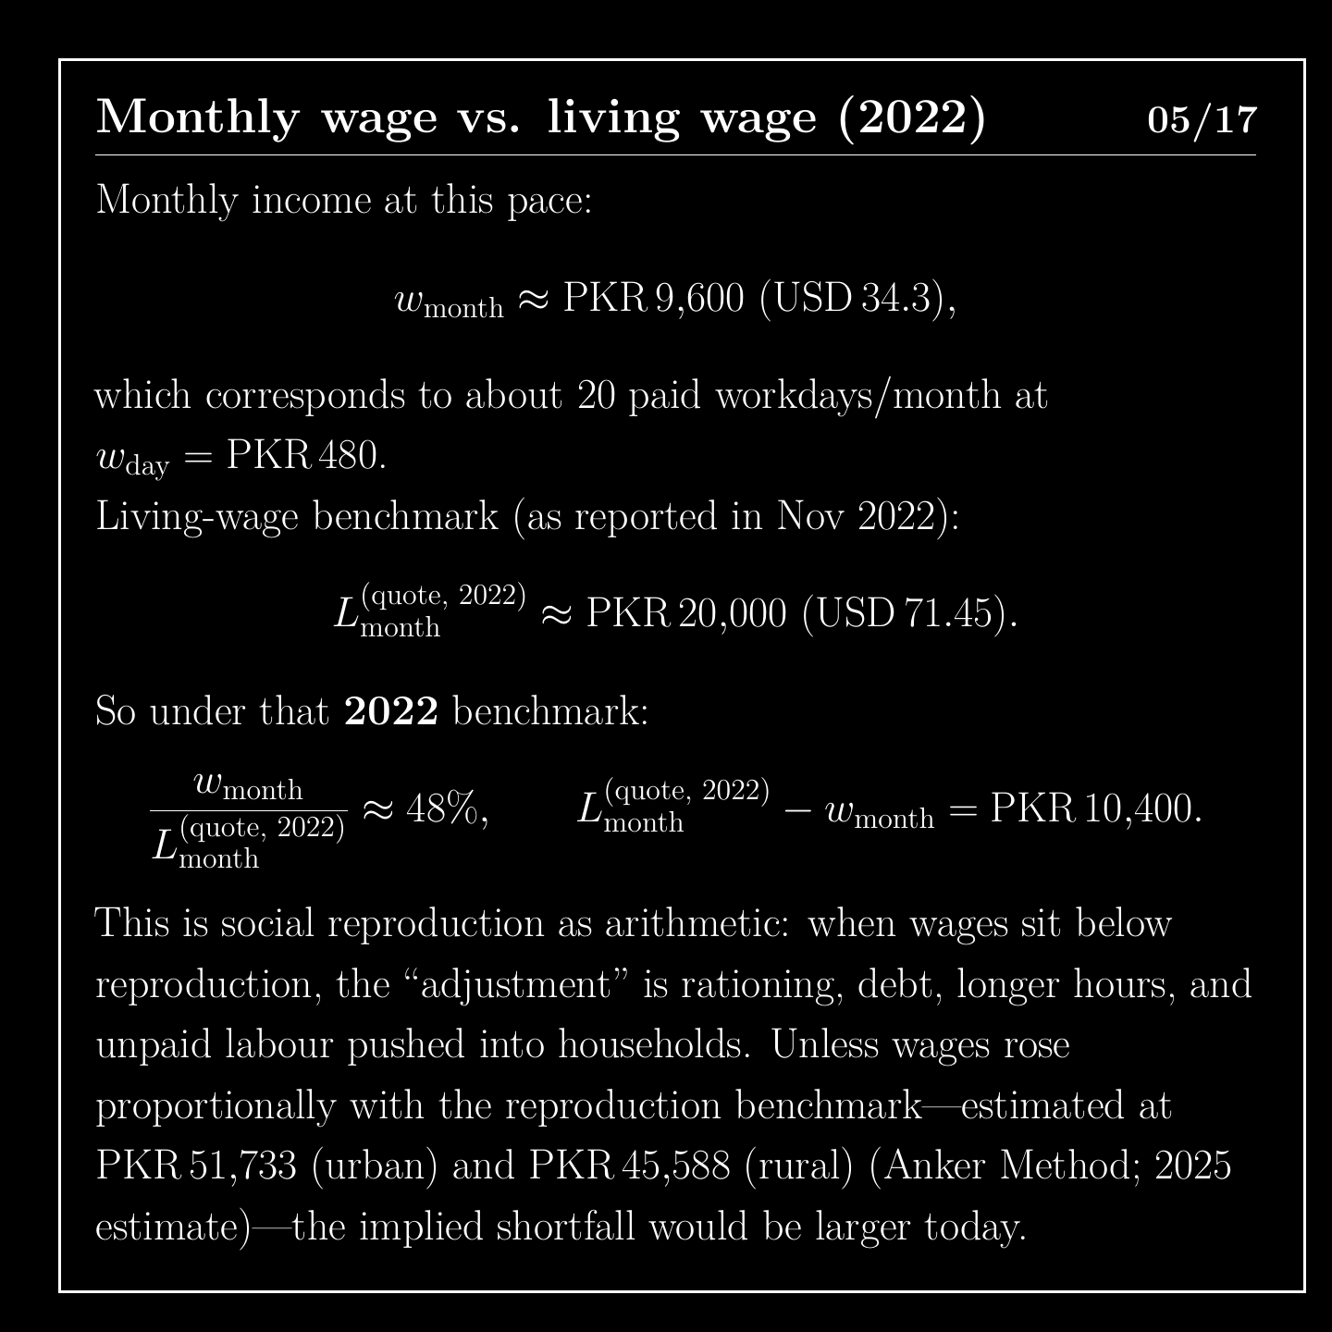
Notes:
Over about 20 paid days, that pace gives 9,600 rupees a month. The living-wage figure reported alongside it in 2022 was 20,000 rupees. So the wage is 48 percent of that benchmark, a gap of 10,400 rupees. More recent estimates are about 51,733 in cities and 45,588 in rural areas. When a wage falls below what it takes to live, the difference shows up as rationing, debt, longer hours and unpaid work in the household.

Slide 6
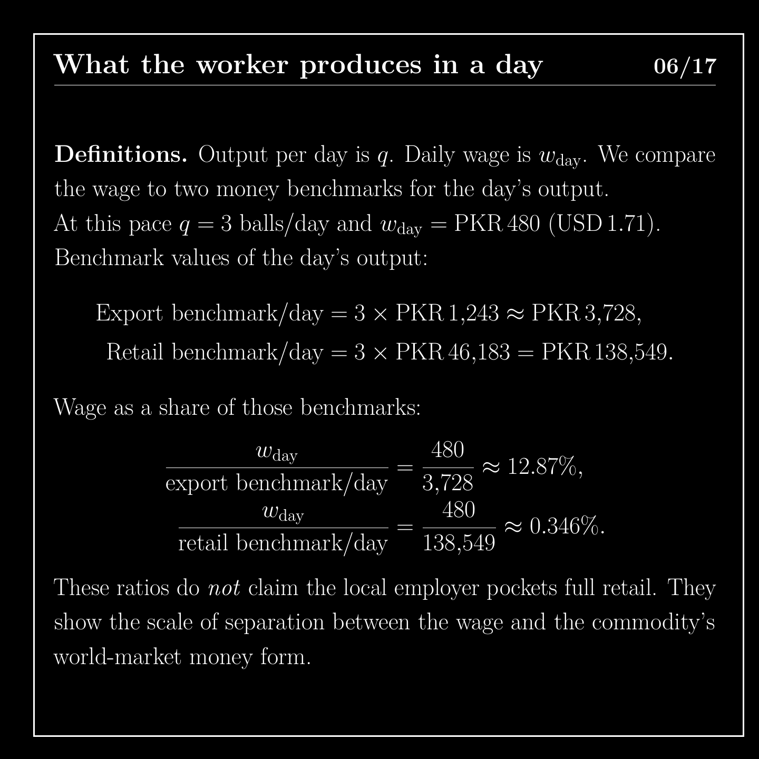
Notes:
Now compare a day's pay with the money value of a day's output. Three balls at the export average are worth about 3,728 rupees, and the wage is about 13 percent of that. Three balls at the retail benchmark are worth about 138,549 rupees, and the wage is about a third of one percent. This does not mean the local employer keeps the retail price. It shows how far the wage is from the commodity's world-market price.

Slide 7
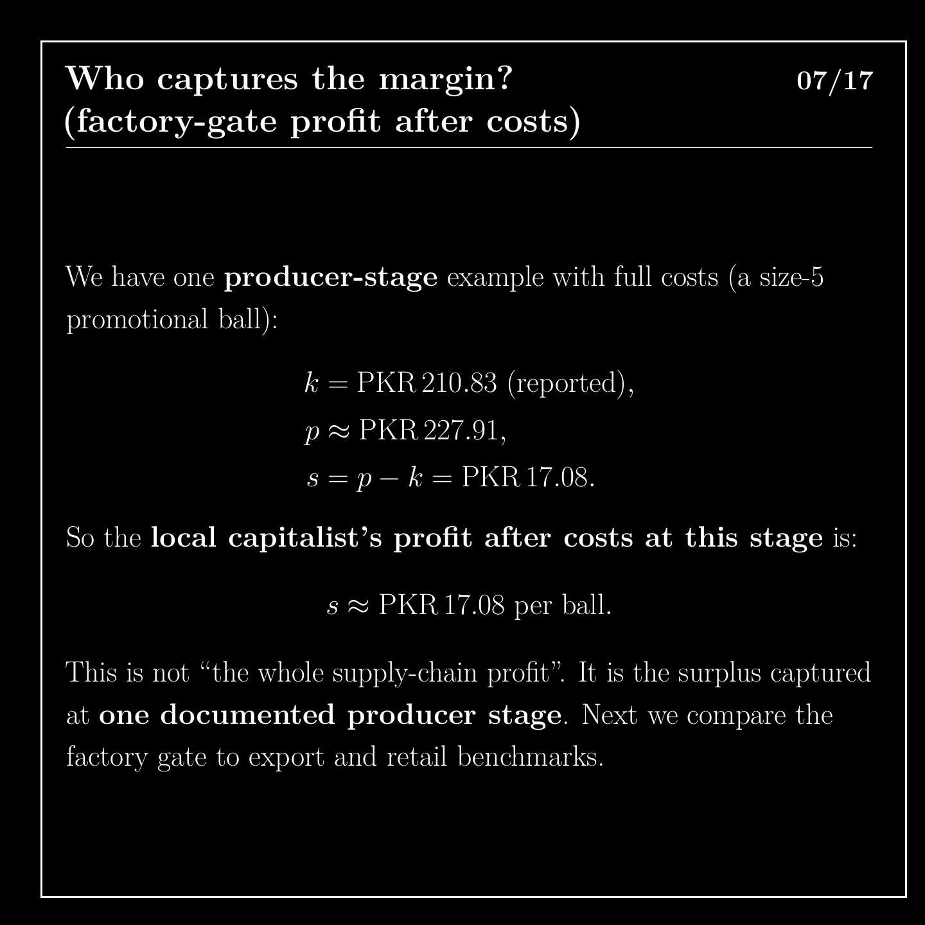
Notes:
So who captures the margin at the factory gate? For a size-five promotional ball, reported costs are about 211 rupees and the selling price is about 228 rupees. That leaves about 17 rupees of profit per ball. This is only the surplus at one documented producer stage, and it is not the profit of the whole supply chain.

Slide 8
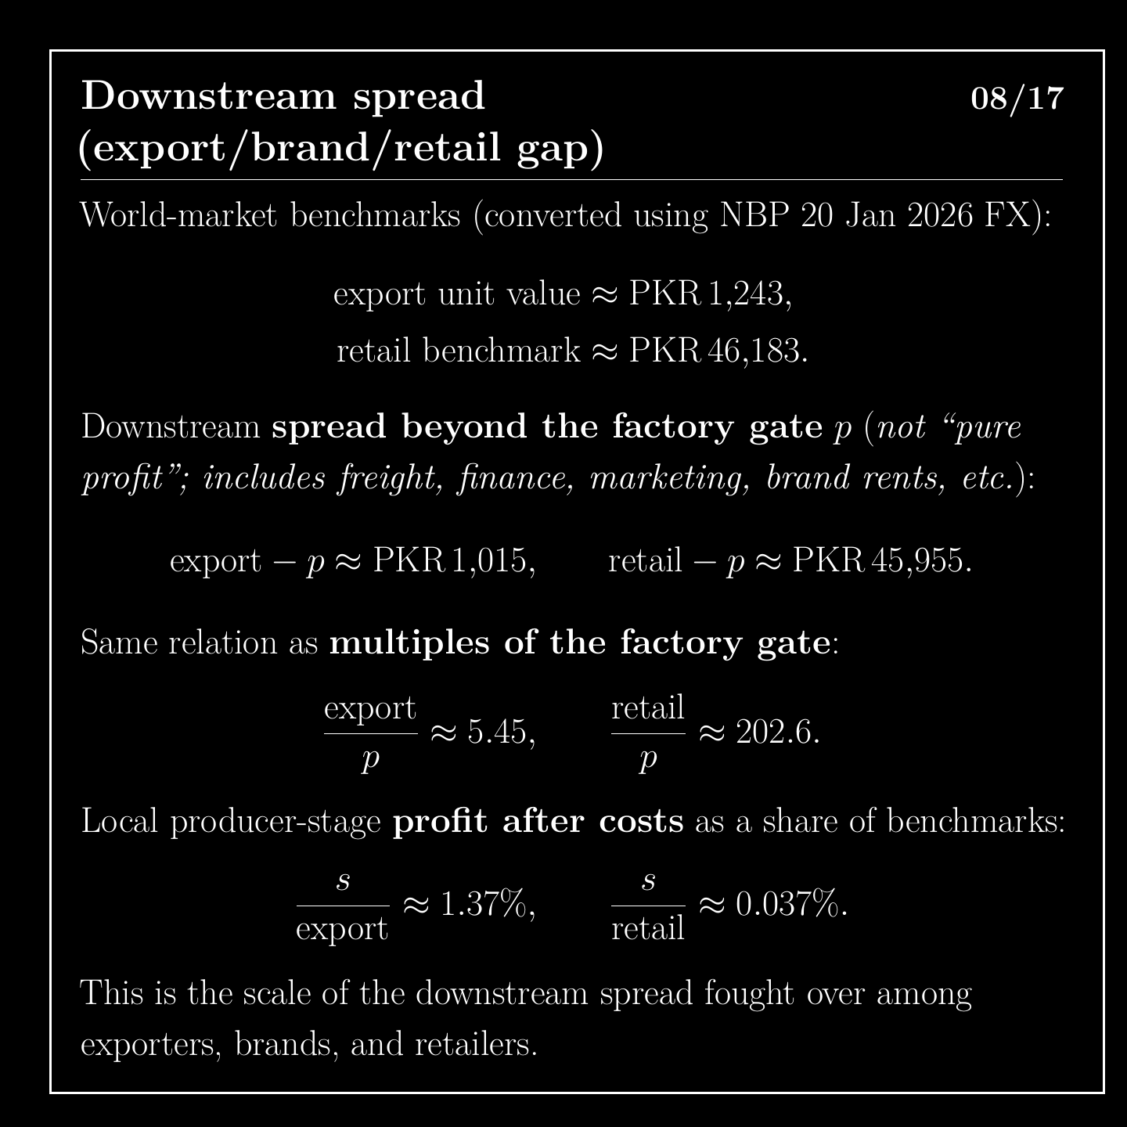
Notes:
Beyond the factory gate, the gap widens. The export value is about 5 times the factory price, and the retail benchmark is about 203 times. This spread is not pure profit. It includes freight, finance, marketing and brand rents, and it is what exporters, brands and retailers fight over.

Slide 9
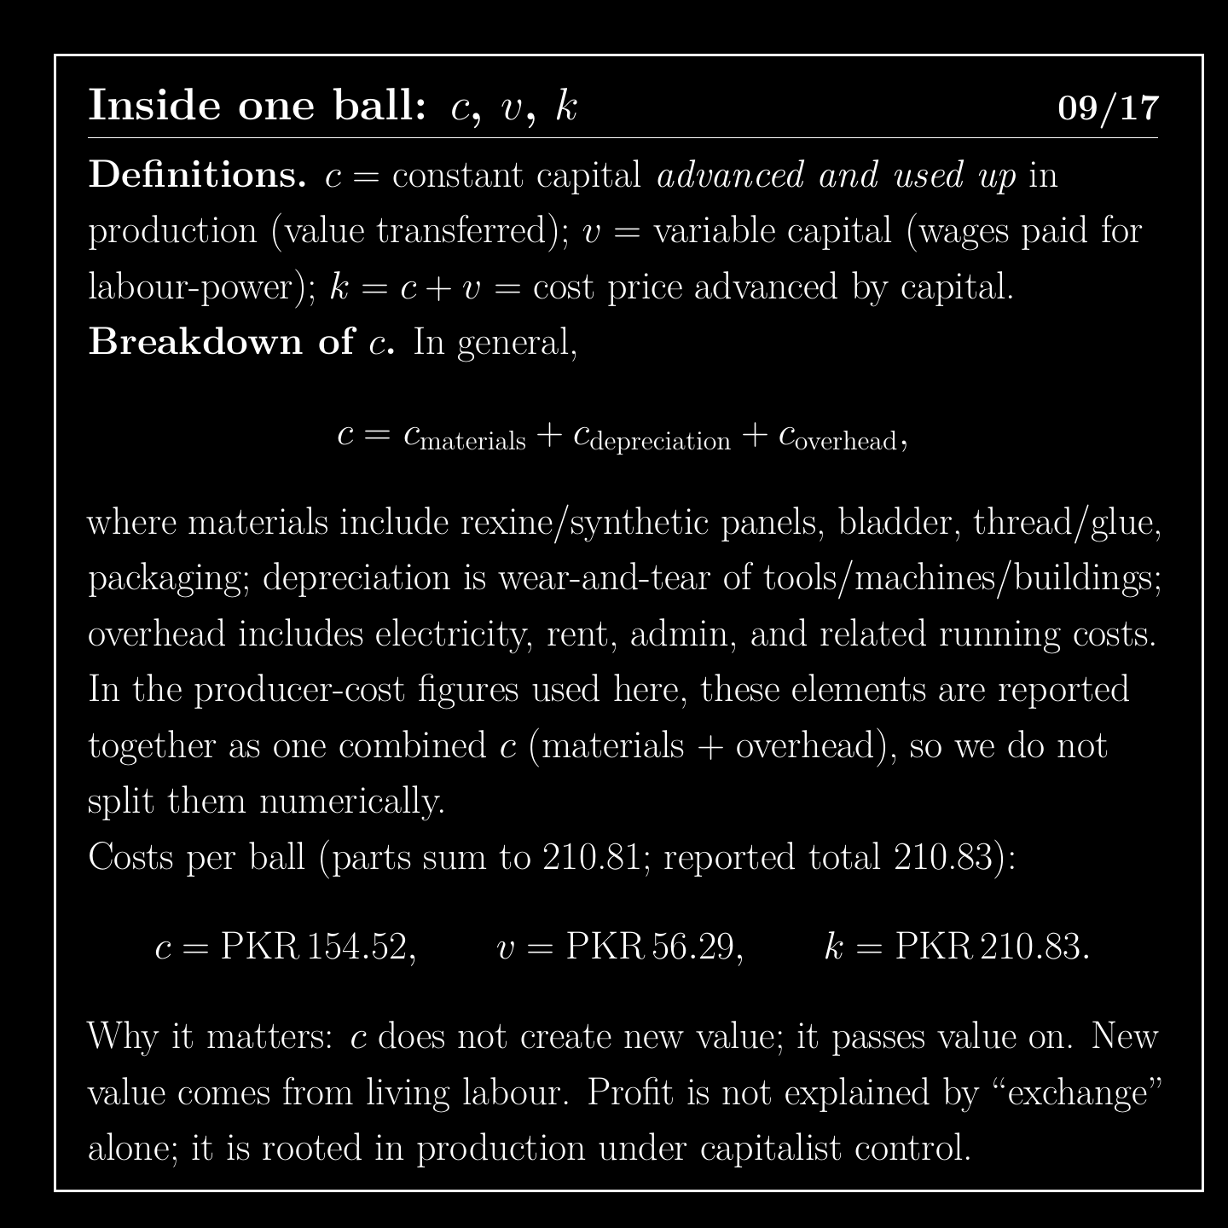
Notes:
Inside one ball, constant capital is about 154 rupees and variable capital is about 56 rupees. Added together, they come to 210.81. The source reports a total of 210.83, and the two cents is rounding in its table. In the Marxian account, materials and machinery pass on existing value, while new value comes from living labour.

Slide 10
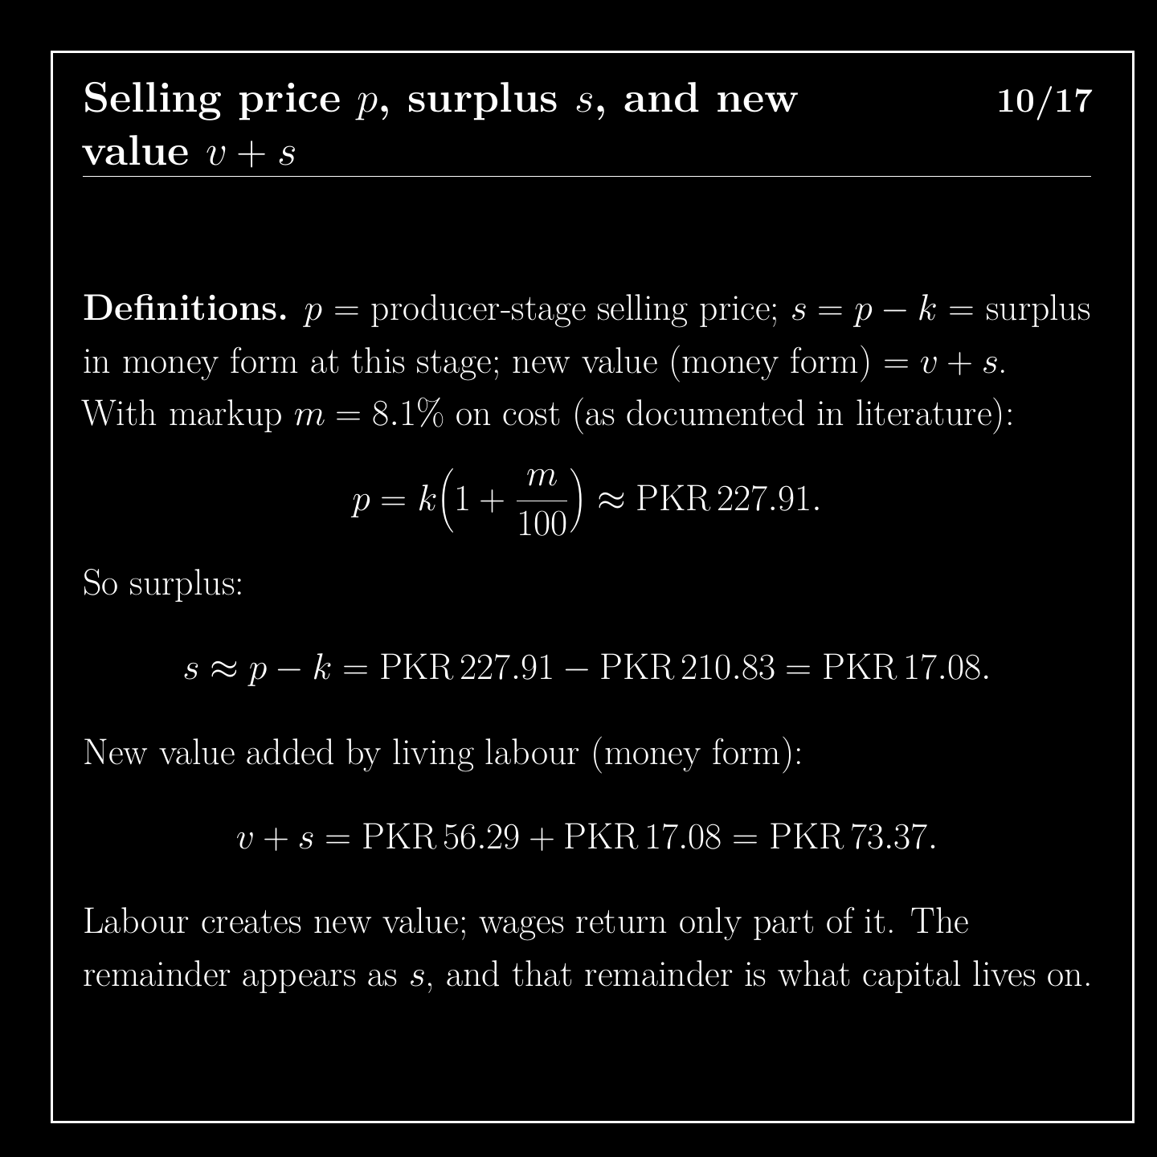
Notes:
The selling price comes from applying the reported 8.1 percent margin to the cost, which gives about 228 rupees. Subtract the cost and we get about 17 rupees as surplus in money form at this stage. Add wages of about 56 rupees, and the new value added at this stage is about 73 rupees.

Slide 11
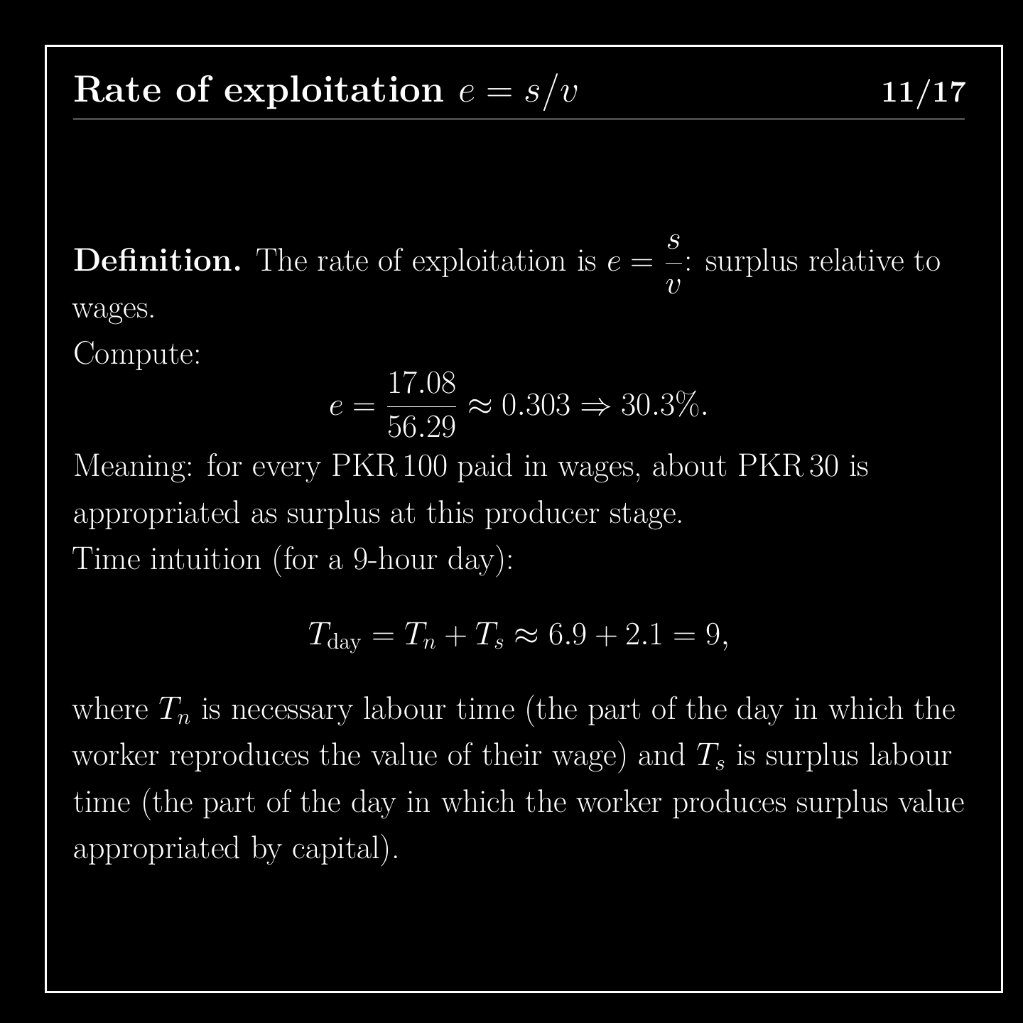
Notes:
The rate of exploitation compares surplus with wages. Here, 17 divided by 56 gives about 30 percent, or about 30 rupees for every 100 paid in wages. Read as a nine-hour day, that is roughly 6.9 hours replacing the wage and 2.1 hours of surplus. This is an accounting illustration at one stage, and a later slide explains its limits.

Slide 12
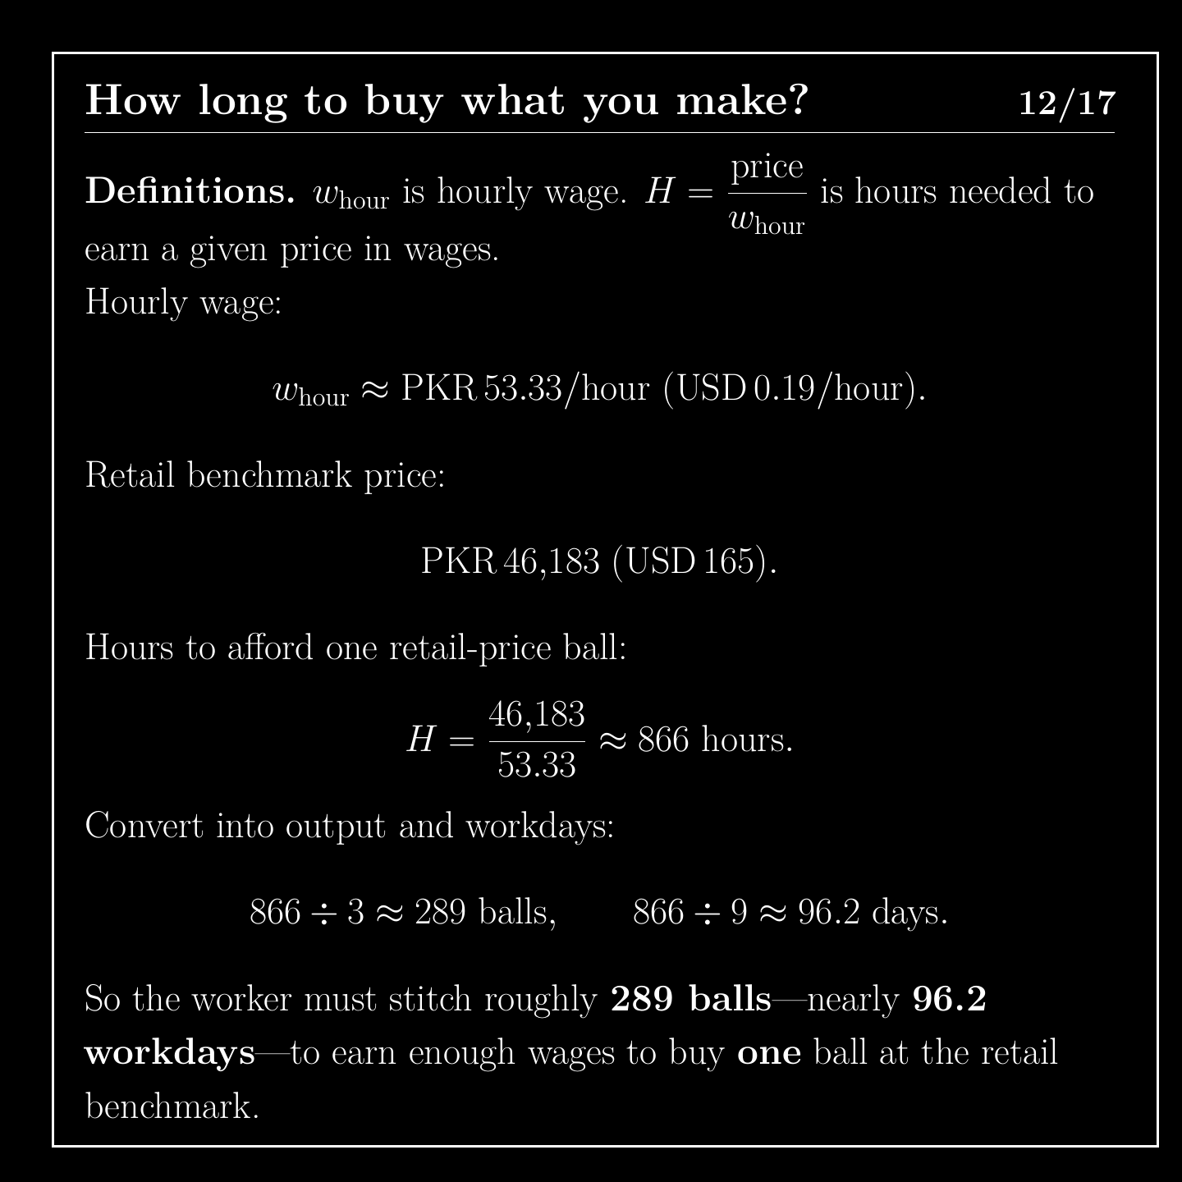
Notes:
How long would it take a worker to buy what they make? At about 53 rupees an hour, a ball at the retail benchmark costs about 866 hours of wages. That is about 289 balls stitched, or about 96 nine-hour days. One caution: the official match ball is a premium product, so this shows a gap in the market and not the cost of one worker's own ball.

Slide 13
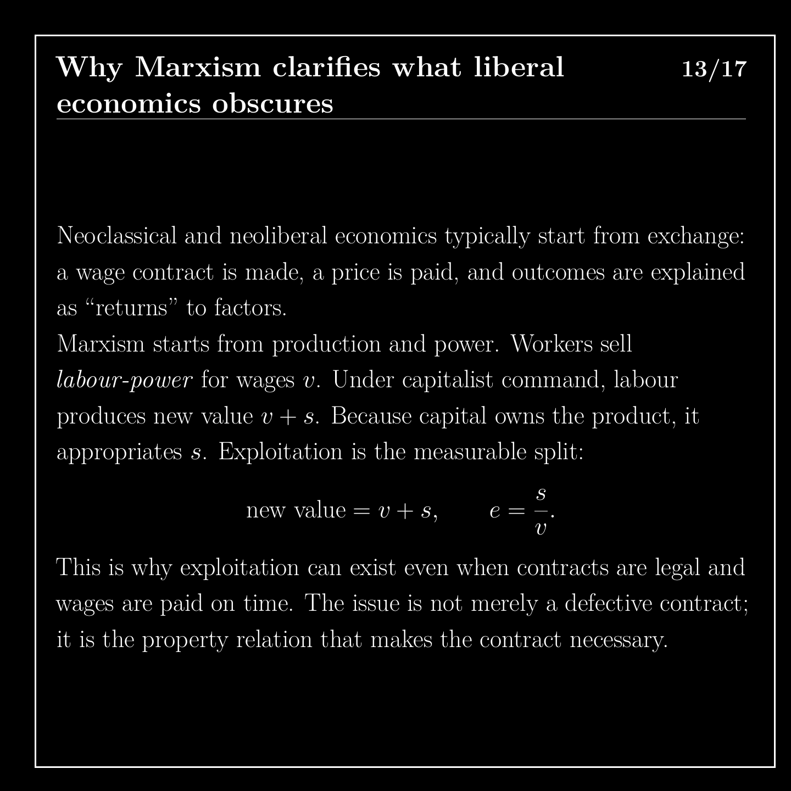
Notes:
Mainstream economics usually begins with exchange: a contract is signed, a wage is paid, and outcomes are explained as returns to factors. Marxism begins with production and power. Workers sell their capacity to work. Under capitalist control, their labour produces new value, and because capital owns the product, it takes the surplus. That is why exploitation can exist when contracts are legal and wages are paid on time.

Slide 14
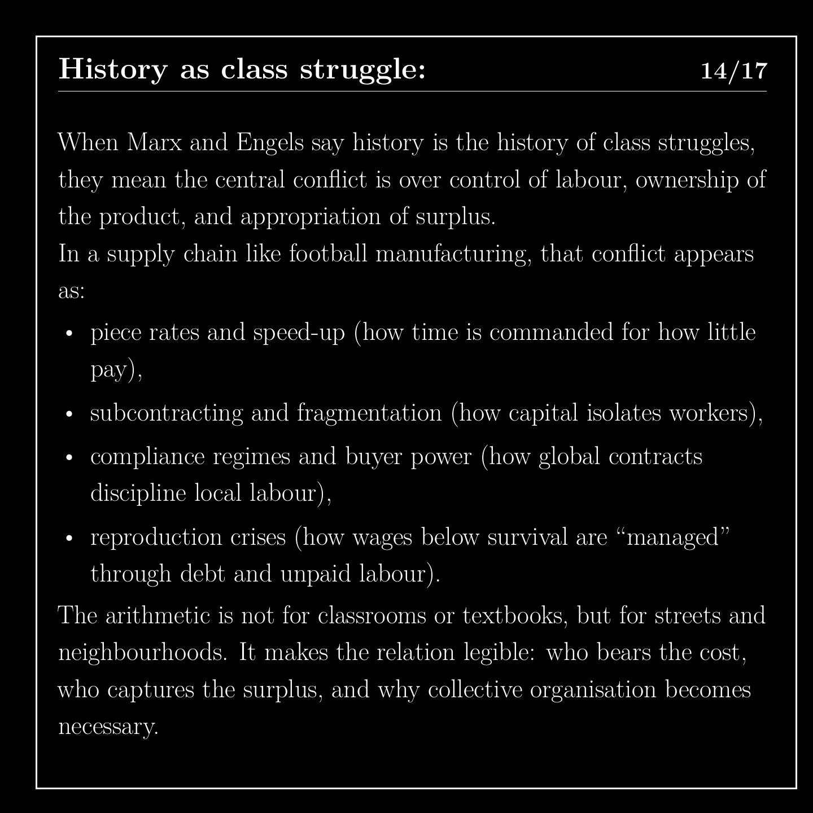
Notes:
When Marx and Engels describe history as class struggle, they mean conflict over who controls labour, who owns the product and who takes the surplus. In a supply chain, this shows up over pay rates and speed of work, in firms using the threat of relocation, and in costs pushed onto households. The arithmetic is meant to be used by people organising, because it makes visible who bears the cost and who takes the surplus.

Slide 15
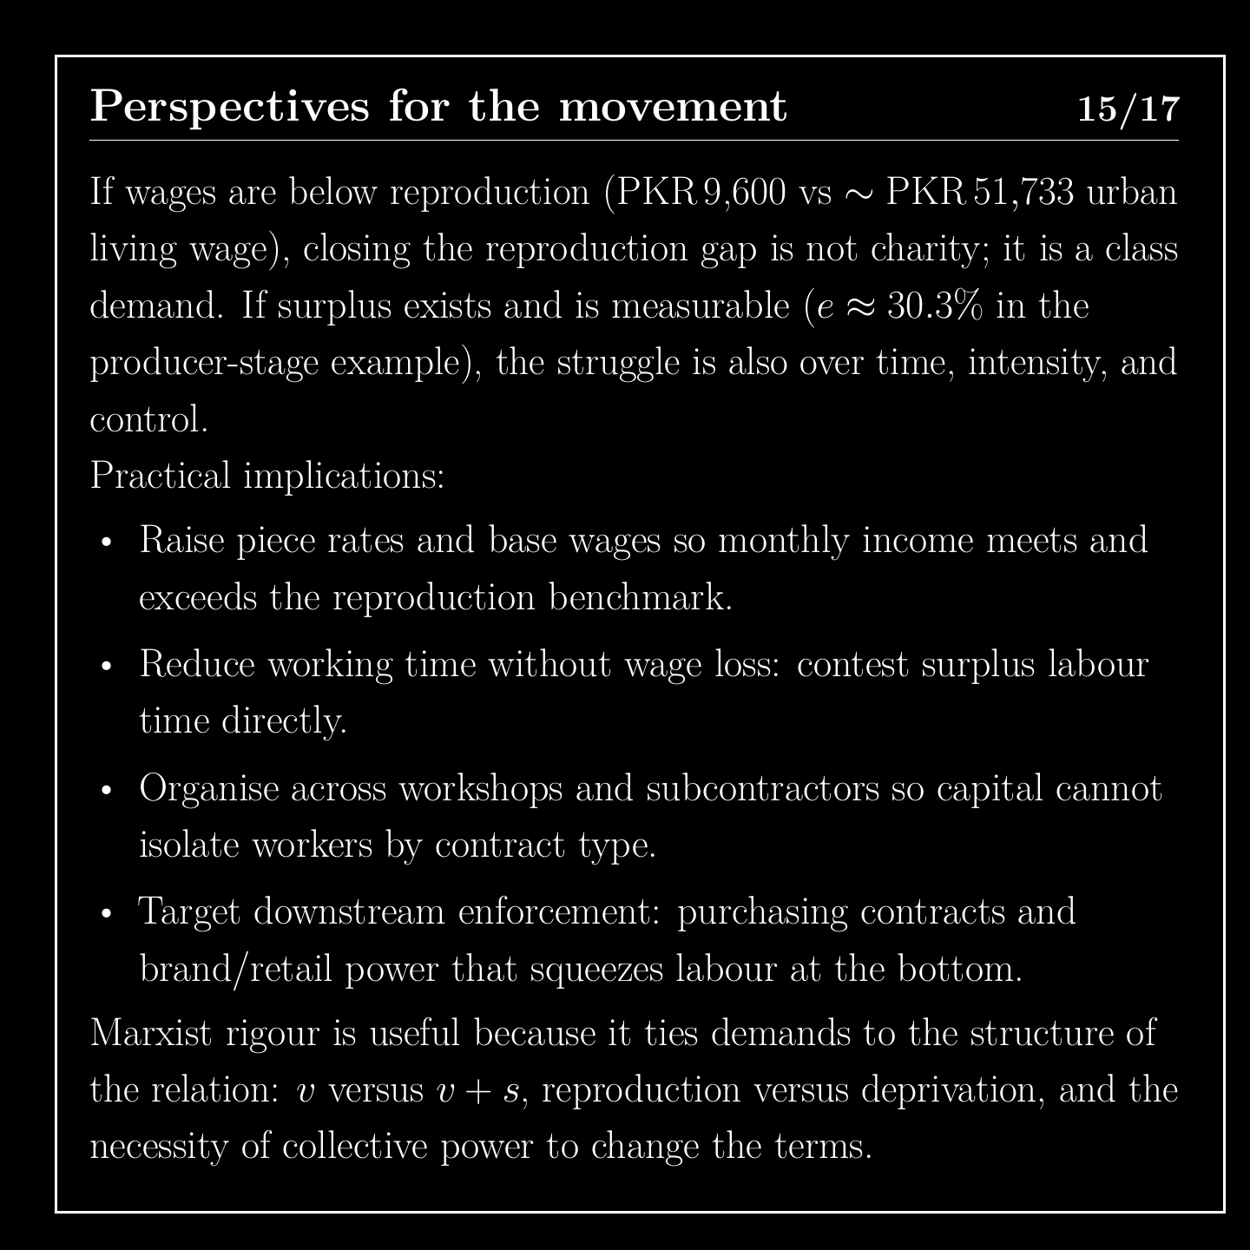
Notes:
So what follows for a movement? A wage of 9,600 rupees against an urban living wage of 51,733 makes closing that gap a class demand and not a request for charity. Surplus and time at work are also points of struggle. Workers can demand a wage above the living benchmark, limits on working time, equal rights across contract types, and pressure on the brands and retailers at the top of the chain.

Slide 16
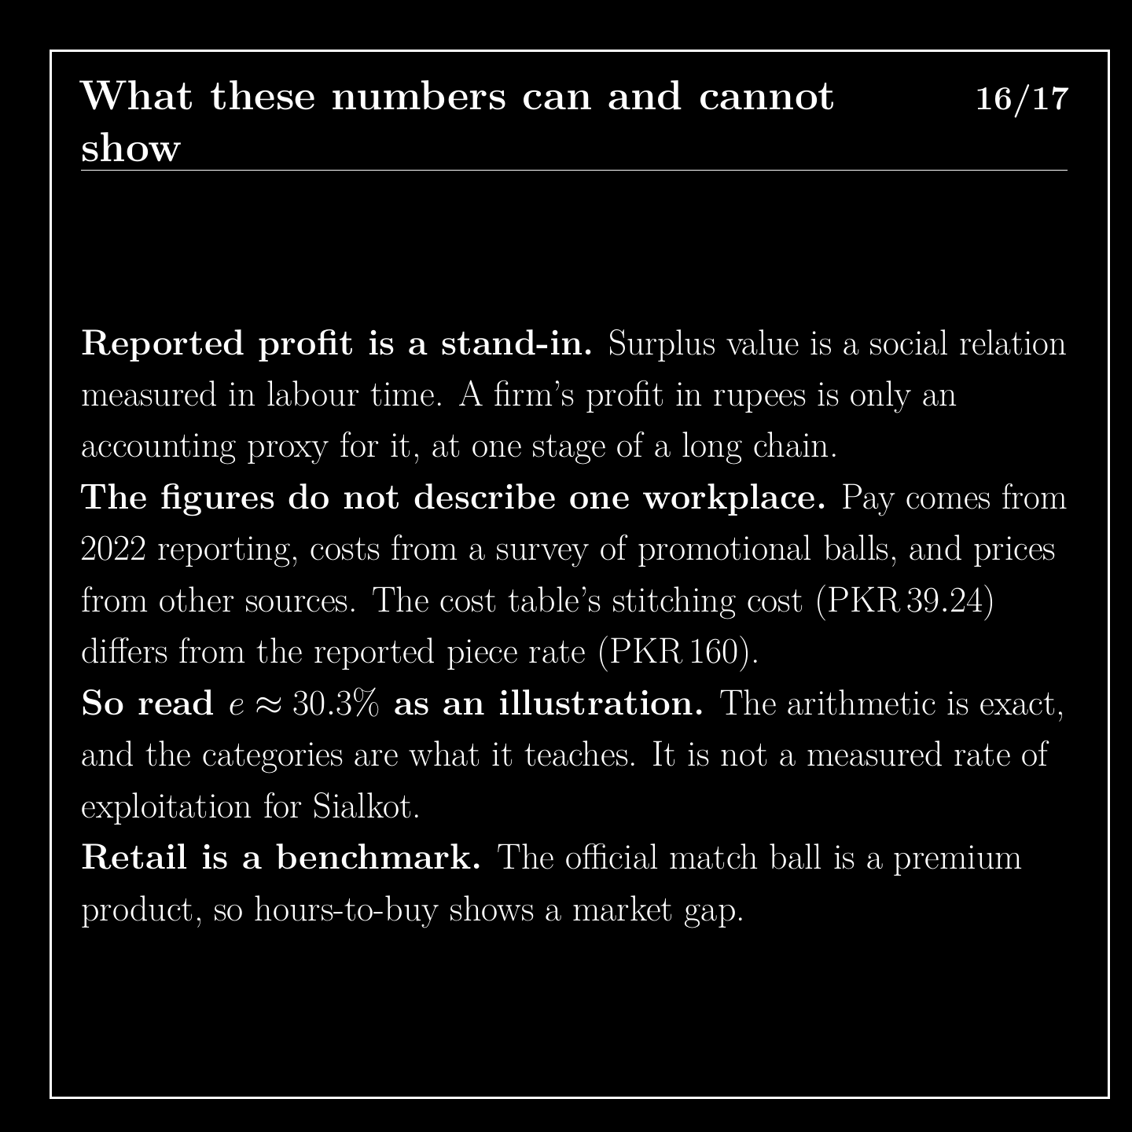
Notes:
These numbers have limits. Reported profit is only a stand-in for surplus value, because it leaves out what is produced and captured elsewhere in the chain. The pay figures and the cost figures come from different studies, years and balls, so they do not describe one workplace. The stitching cost in the cost table, about 39 rupees, differs from the reported pay of 160 rupees. The sums are correct, but the result is an illustration and not a measurement.

Slide 17
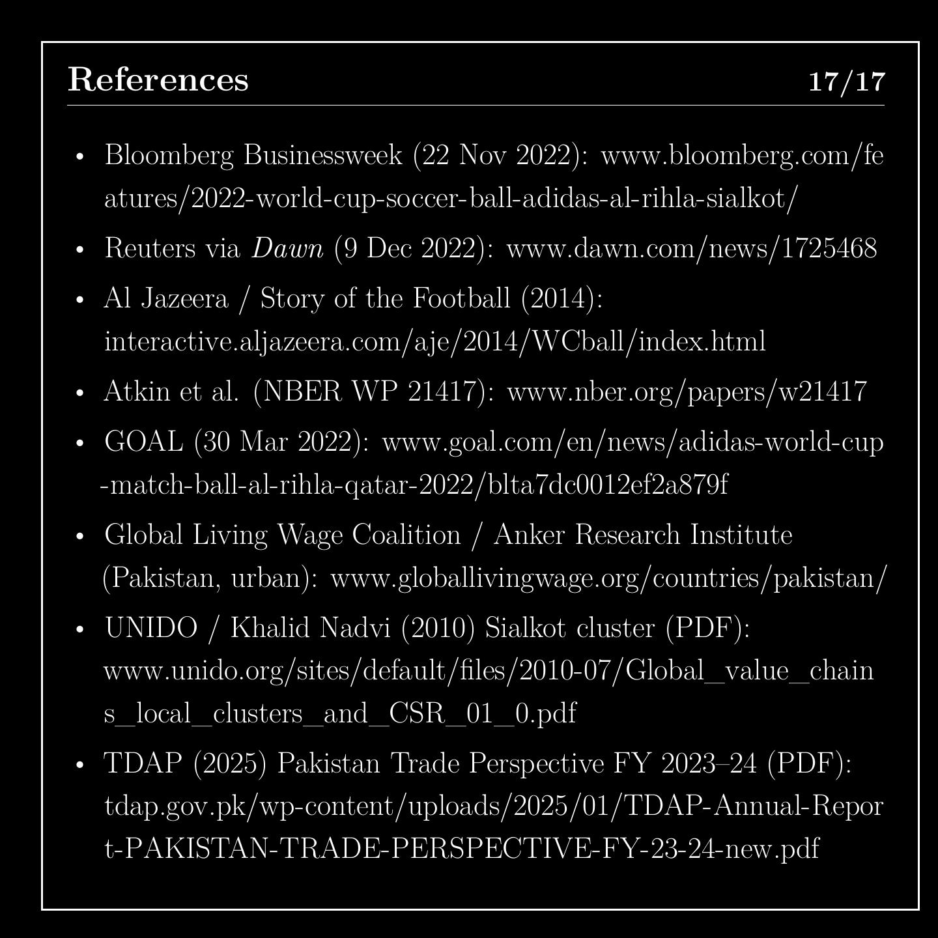
Notes:
The final slide lists the sources, so that anyone can check them. The full working is in the report, the same example appears in the pamphlet, and the project's website has the calculations, a spreadsheet and a place to report errors.

