Slide 1
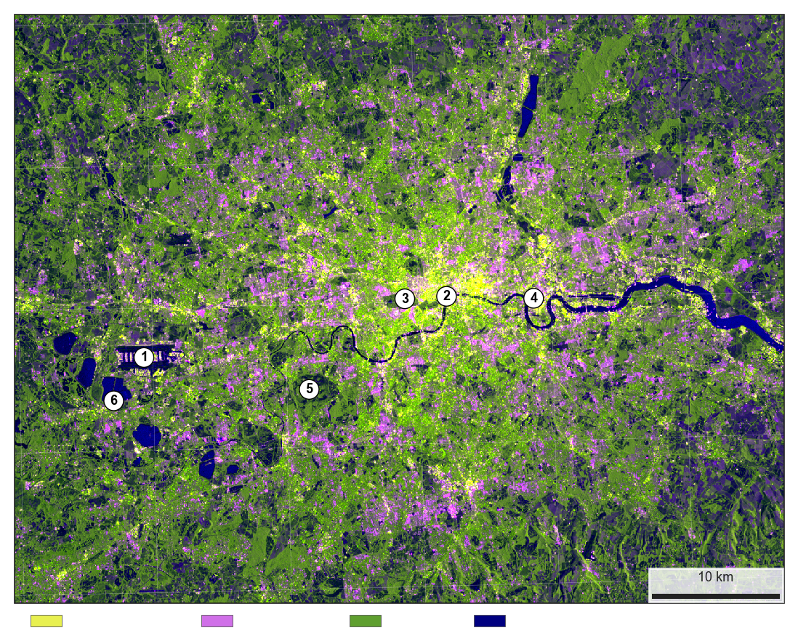
London, seen by radar
A year of satellite radar shown in colour. Dark is smooth; bright is rough or built.
Dense city
Built-up
Plants
Water
1
Heathrow: smooth runways
2
Thames: calm water looks dark
3
Hyde Park: grass, a dark gap
4
Canary Wharf: towers, strongest
return
5
Richmond Park: open grassland
6
Reservoir: very still water
Mean of 149 Sentinel-1 scenes, 2024, 40 m. Red VV, green VH, blue
VV minus VH; colour names are a guide. Copernicus Sentinel.
Ahmad Ammar | ahmadammar.github.io

