Slide 1
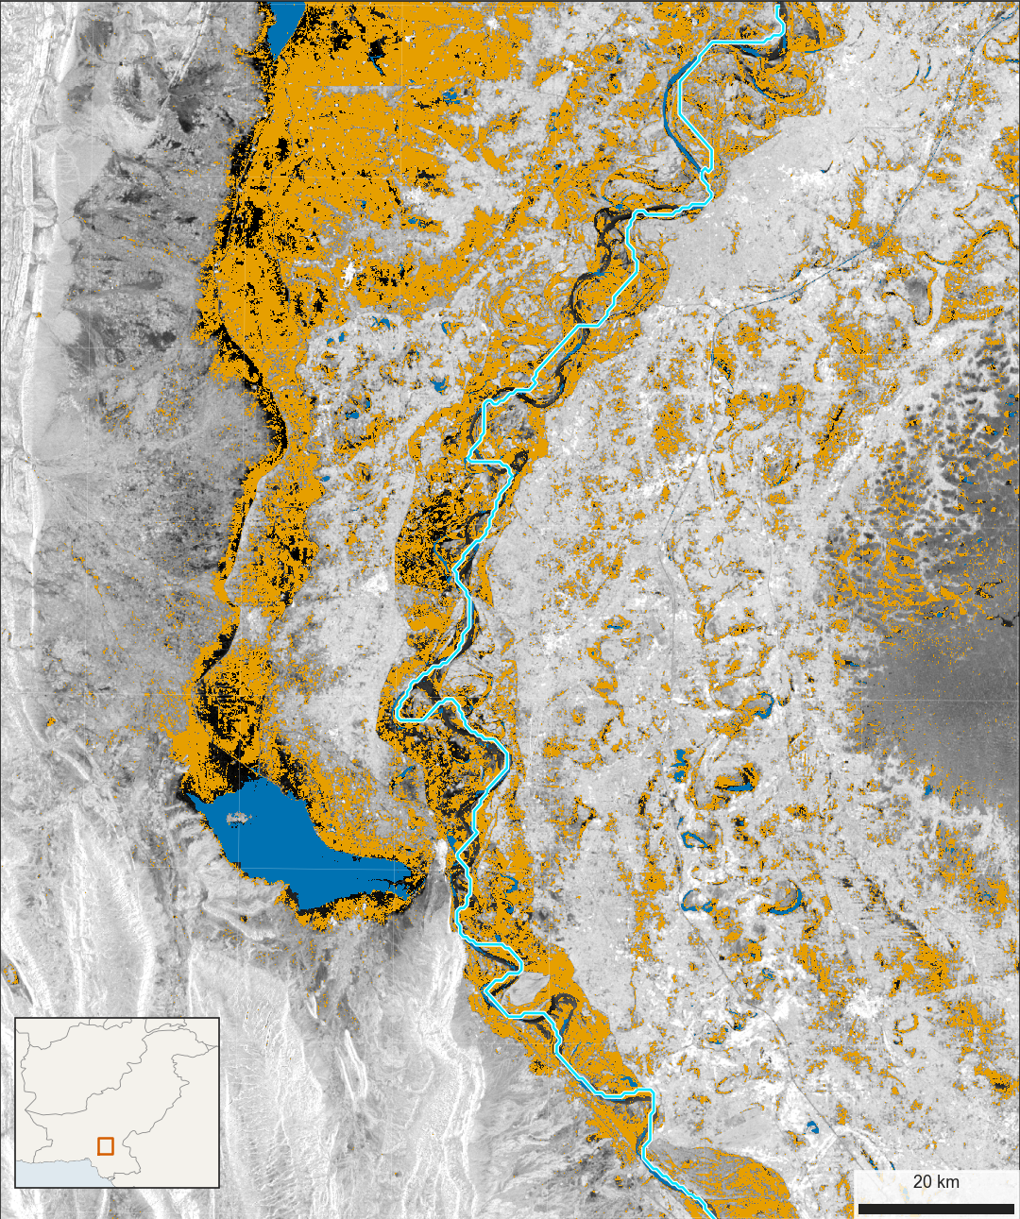
Sindh under water, 2022
Radar shows about 3,458 km² of flood here, September 2022. Unvalidated.
2
1
3
4
Flood
Usual water
Indus, generalised
Dark both years
1
Manchar Lake: new water spreads
along the hills
2
Dadu: higher ground amid the
flood
3
Sehwan: hills pinch the valley
4
Nawabshah: may include wet
fields
Sentinel-1 VV, Aug-Sep 2021 and 2022, 100 m. Water is below -14.1
dB (Otsu); flood is wet only in 2022, and water under 50% of the
time in JRC. Copernicus Sentinel; JRC; HydroRIVERS.
Ahmad Ammar | ahmadammar.github.io

