Slide 1
DEVOPS CAPSTONE
GitTogether
A teammate-finder for students, taken from a laptop to a monitored Kubernetes cluster on AWS
Ahmad Anzar
github.com/AhmadAnzar/GitTogether
Notes:
Introduce yourself and the project in one sentence. GitTogether is a web app where students find teammates. The capstone is about everything around the app: tests, a CI/CD pipeline with security scanning, infrastructure as code on AWS, Kubernetes, GitOps and monitoring. Today I will show each piece working, and the last part of the video is live on a real EKS cluster.

Slide 2
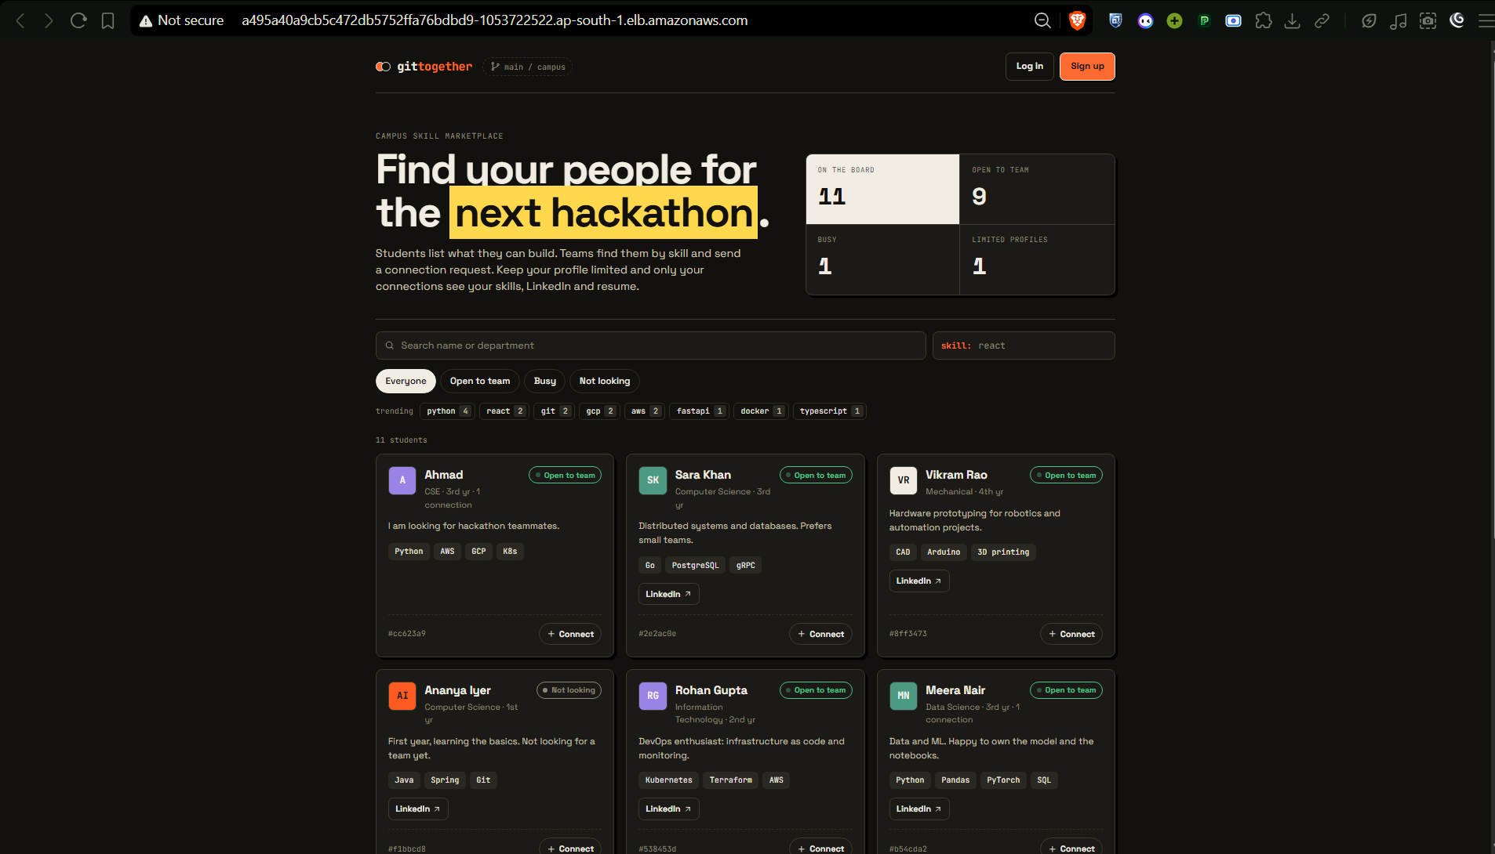
Find teammates for projects and hackathons
THE APP
Make a profile with skills and availability, browse students, send connection requests.
Notes:
The app is deliberately small so the focus stays on DevOps. Backend is FastAPI with Postgres, frontend is React served by nginx. This screenshot is the app running on EKS behind an AWS load balancer.

Slide 3
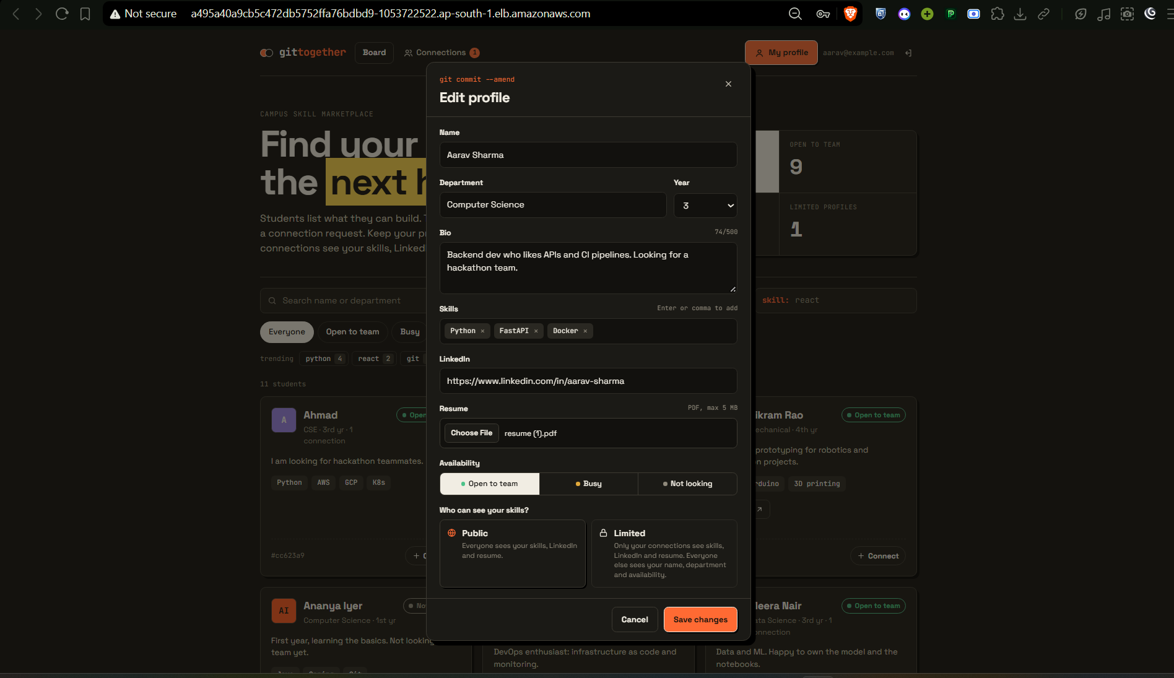
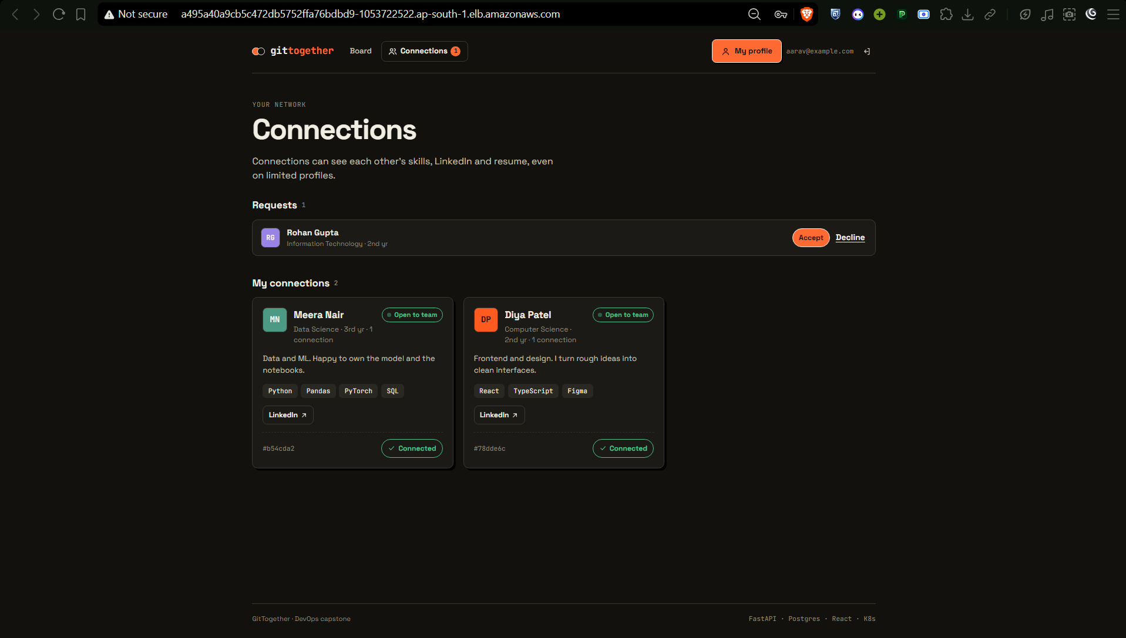
Profiles and connections
THE APP
Public profiles with skills and availability. Connection requests can be sent, accepted and tracked.
Notes:
Left, a student profile with skills, department and availability. Right, the connection requests: sent, received and accepted. This is the data the seed script creates for the live demo.

Slide 4
From git push to a running cluster
ARCHITECTURE
AWS ap-south-1 | Terraform: VPC (2 AZs) + EKS 1.35, 2 x m7i-flex.large
GitHub repo
main branch
Frontend
React + nginx
Browser
Load balancer
Traefik
ingress
GitHub Actions
CI pipeline
Backend FastAPI
HPA 2 to 5
PostgreSQL
+ gp3 volume
Prometheus + Grafana
scrape /metrics, dashboards
ArgoCD
auto-sync, prune, self-heal
watches the GitHub repo
GHCR
images tagged by SHA
pulled by the cluster
Nodes sit in private subnets. The load balancer and NAT gateway sit in public subnets.
Notes:
Read the diagram left to right. A push to GitHub triggers the Actions pipeline, which builds the images and pushes them to GHCR tagged with the commit SHA. Inside AWS, Terraform builds the VPC and the EKS cluster. Traffic comes in through a load balancer to the Traefik ingress, which routes slash to the frontend and slash api to the backend. The backend talks to Postgres on an EBS volume and autoscales between 2 and 5 replicas. Prometheus and Grafana monitor it, and ArgoCD keeps the cluster in sync with the Git repo.

Slide 5
What it is built with
TECH STACK
APP
QUALITY
SECURITY
CONTAINERS
React + Vite, FastAPI, SQLAlchemy, PostgreSQL
pytest with a 90% coverage gate, ruff, ESLint, Vitest
gitleaks, Trivy, Dependabot, CodeQL
Multi-stage Docker builds, non-root users
CI/CD
INFRASTRUCTURE
KUBERNETES
OPERATIONS
GitHub Actions, GHCR, SHA-tagged images
Terraform: VPC, EKS, KMS, IAM, Pod Identity
Helm, Traefik, HPA, Pod Security (restricted)
ArgoCD, Prometheus, Grafana
Notes:
This is the toolchain, grouped by purpose. Pick two or three to say out loud: FastAPI and React for the app, GitHub Actions with Trivy for the pipeline, Terraform for AWS, Helm and ArgoCD for deployment, Prometheus and Grafana for monitoring.

Slide 6
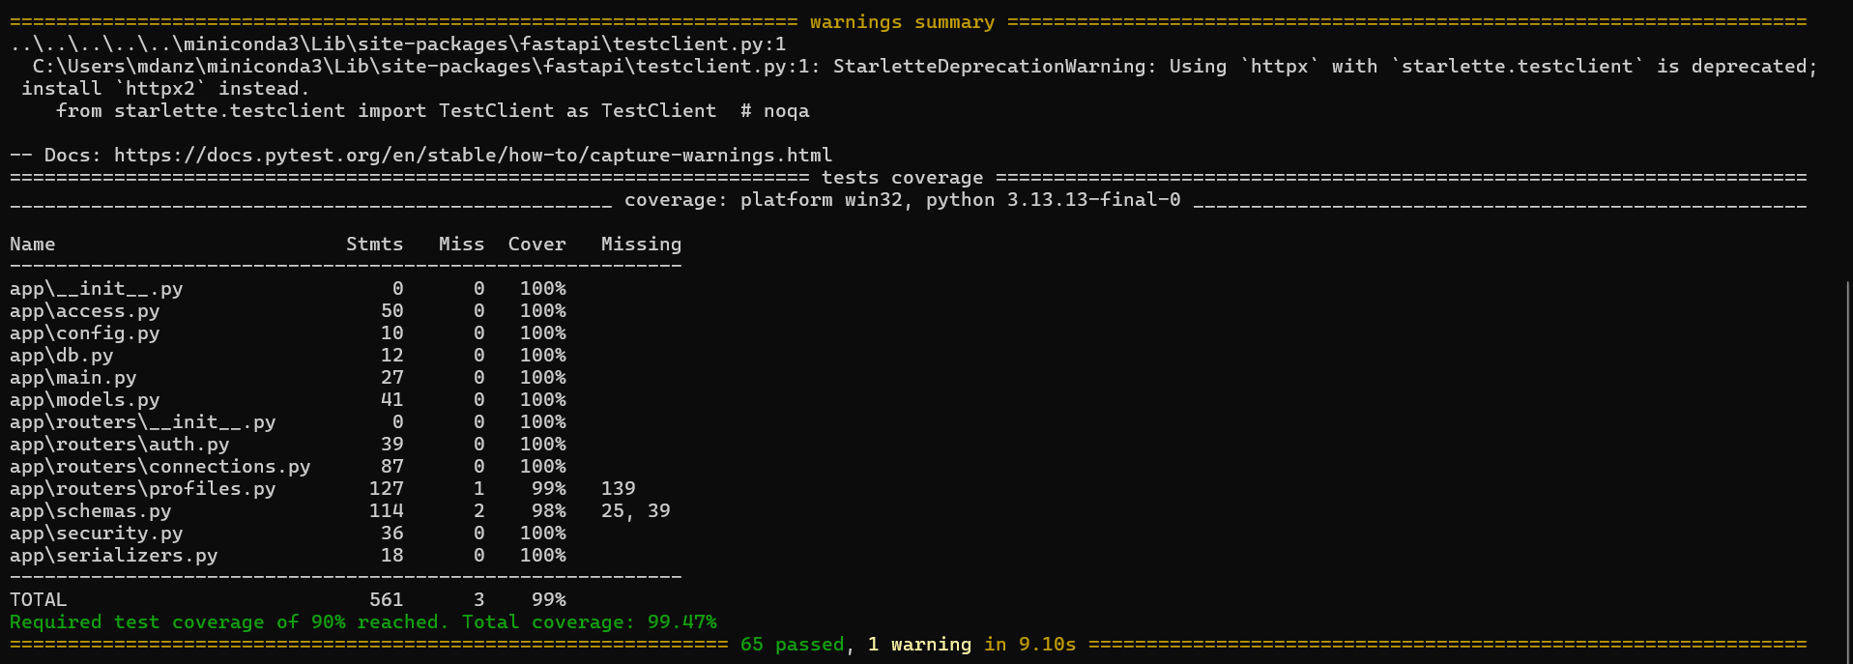
65 tests pass, 99% coverage
TESTING
65 passed, 99.47% coverage against a 90% gate, on a separate test database.
Notes:
The tests are the first quality gate. They run against a throwaway SQLite database, never the real one, and the pipeline stops if any test fails or coverage drops under 90 percent, so a broken image is never built or pushed. 65 tests pass with 99 percent coverage.

Slide 7
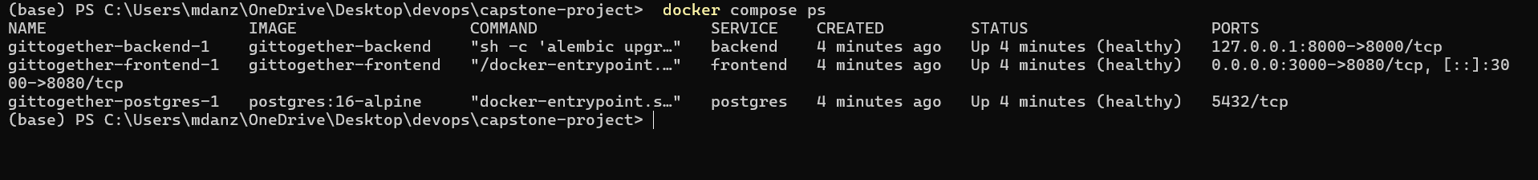
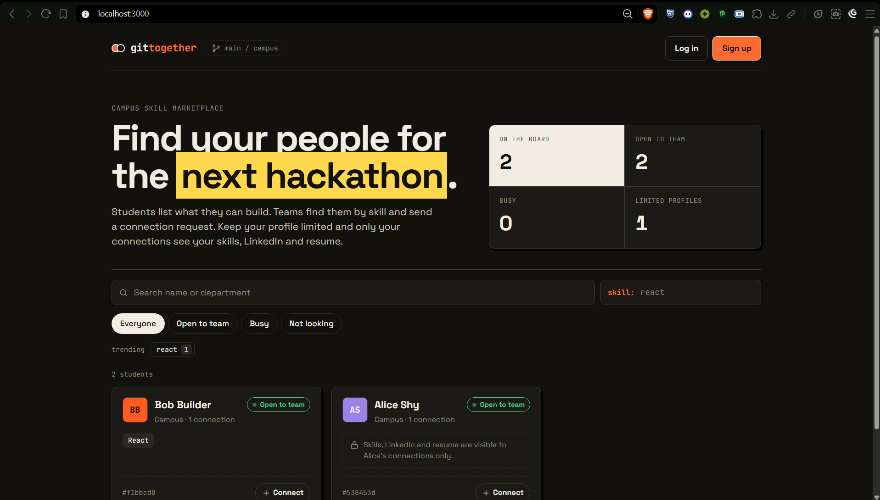
One command starts the whole stack
DOCKER
docker compose up --build: frontend, backend and Postgres, all healthy.
Notes:
Docker Compose starts the frontend, backend and Postgres with one command. All three report healthy, and the app is at localhost 3000. The frontend image is a multi-stage build with an nginx runtime, and both images run as non-root users.

Slide 8
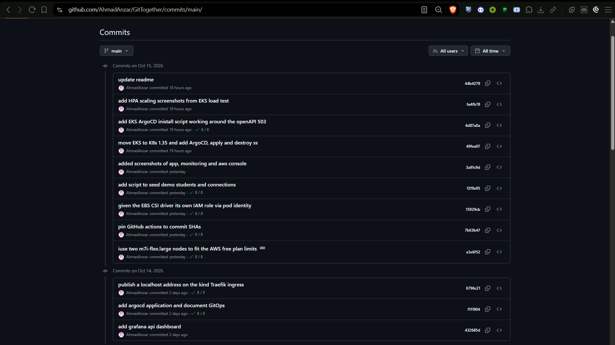
48 commits on a public repo
GIT
Specific commit messages on the main branch, with a green check on each pipeline run.
Notes:
The history on the main branch. Every push triggers the pipeline, and the green checks next to the commits are those runs. Commit messages describe the change, for example pinning the actions to commit SHAs or giving the EBS driver its own IAM role.

Slide 9
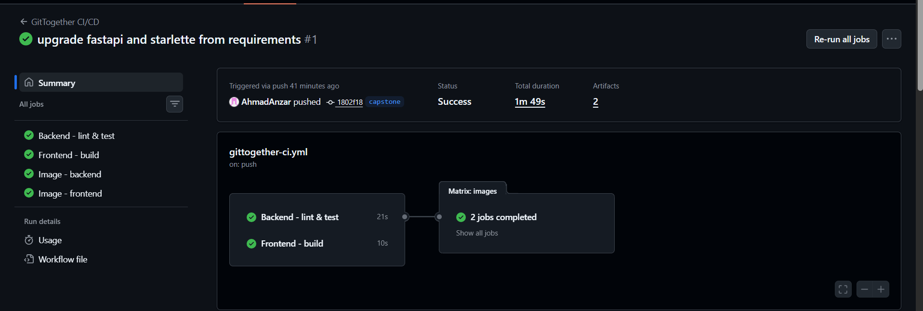
Every push is tested, scanned and published
CI/CD
Secret scan
Lint + tests
Terraform + Helm
Docker build
Trivy gate
Push to GHCR
65 backend tests, 90% coverage gate, 7 jobs, images tagged by commit SHA
Notes:
The pipeline runs on every push. It scans for secrets, lints and tests the backend and frontend, validates Terraform and Helm, scans the infrastructure code, then builds both images, scans them with Trivy and only then pushes them to GHCR. Third-party actions are pinned to full commit SHAs. In the video I will push a commit and watch it go green.

Slide 10
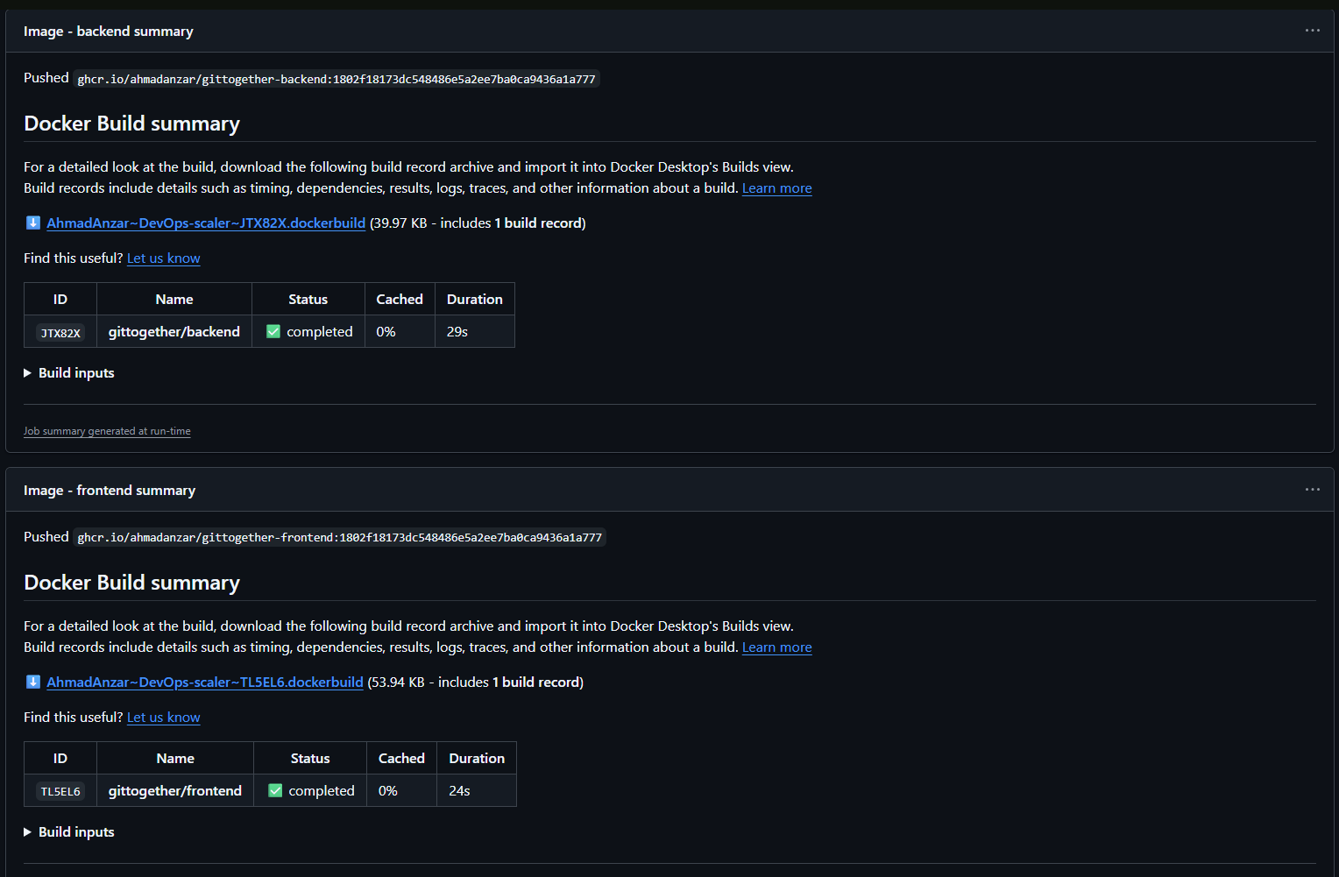
The run summary
CI/CD
Backend and frontend jobs in parallel, then one image job per component.
Notes:
The summary page of a successful run: the backend and frontend jobs run in parallel, then the matrix of image jobs builds, scans and pushes both images.

Slide 11
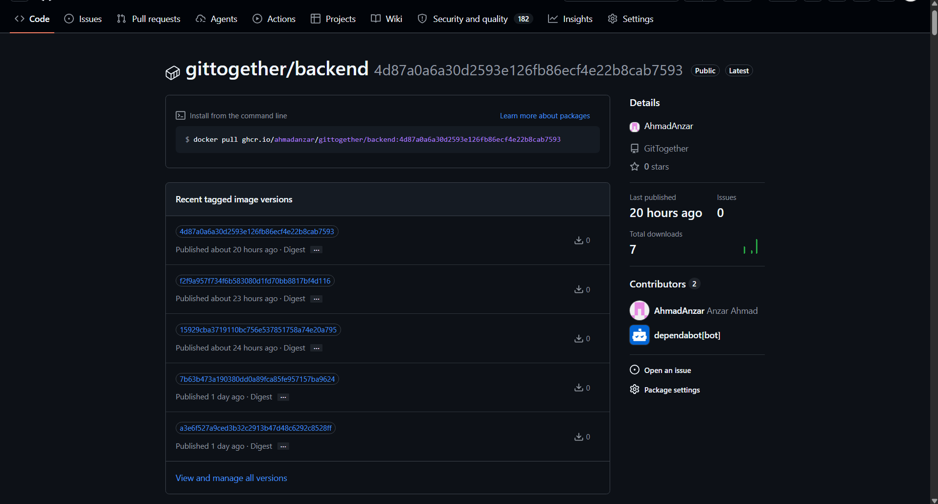
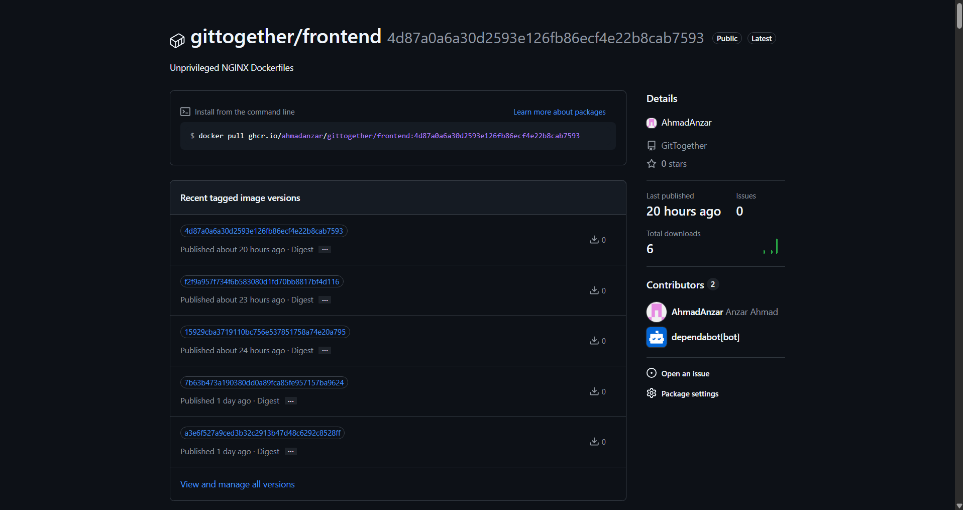
Images in the GitHub Container Registry
CI/CD
Tagged with the commit SHA, never latest, so every deployment traces back to a commit.
Notes:
The pipeline pushes both images to GHCR, tagged with the full commit SHA. The cluster pulls exactly these images, and the SHA tells you which commit built each one.

Slide 12
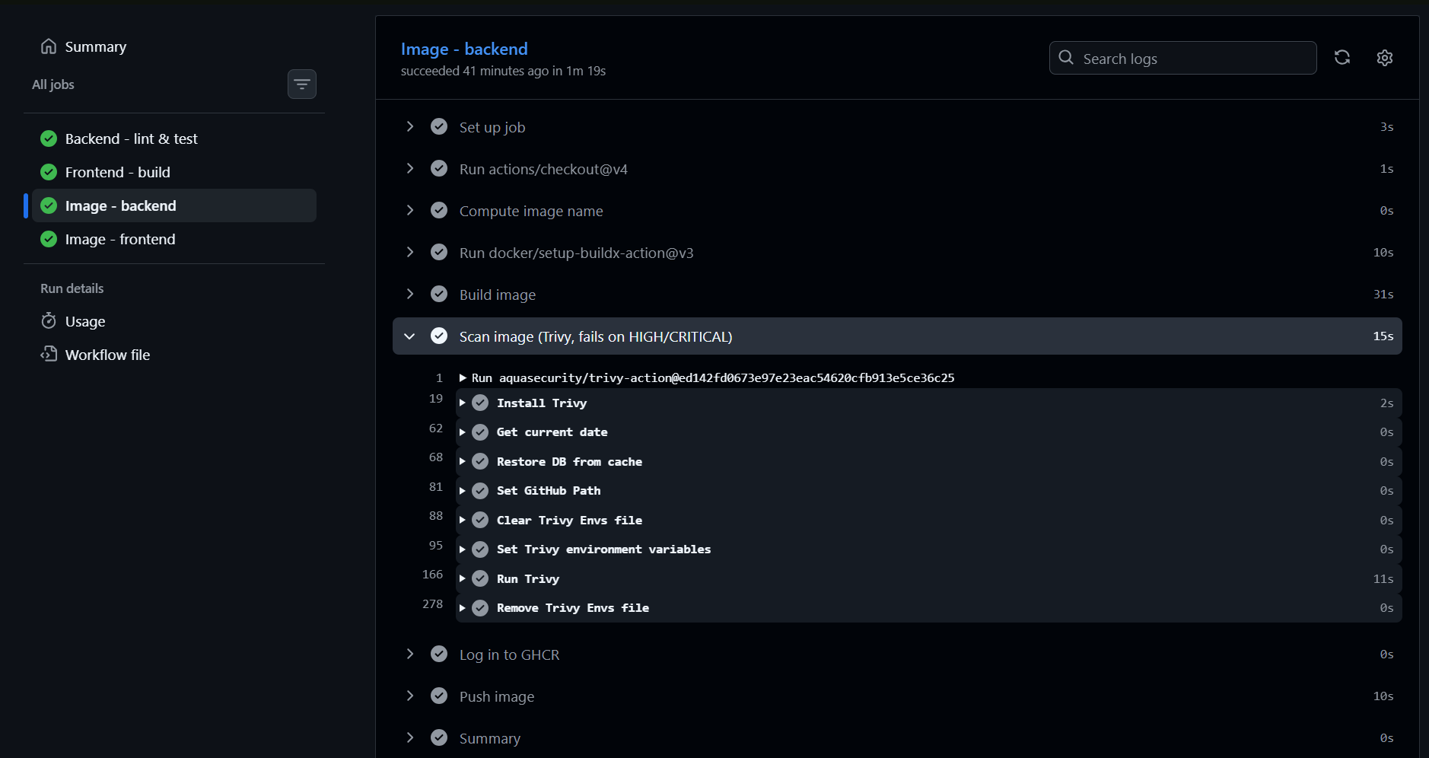
Trivy on the backend image
SECURITY
Fails the build on HIGH/CRITICAL. The first run found 3 HIGH CVEs in Starlette; upgrading fixed them.
Notes:
Trivy scans the operating system packages and the Python libraries in the image and fails the build on high or critical issues that have a fix. On its first run it found three high CVEs in Starlette, for example a denial of service through crafted Range headers. I upgraded FastAPI and Starlette and the scan came back clean.

Slide 13
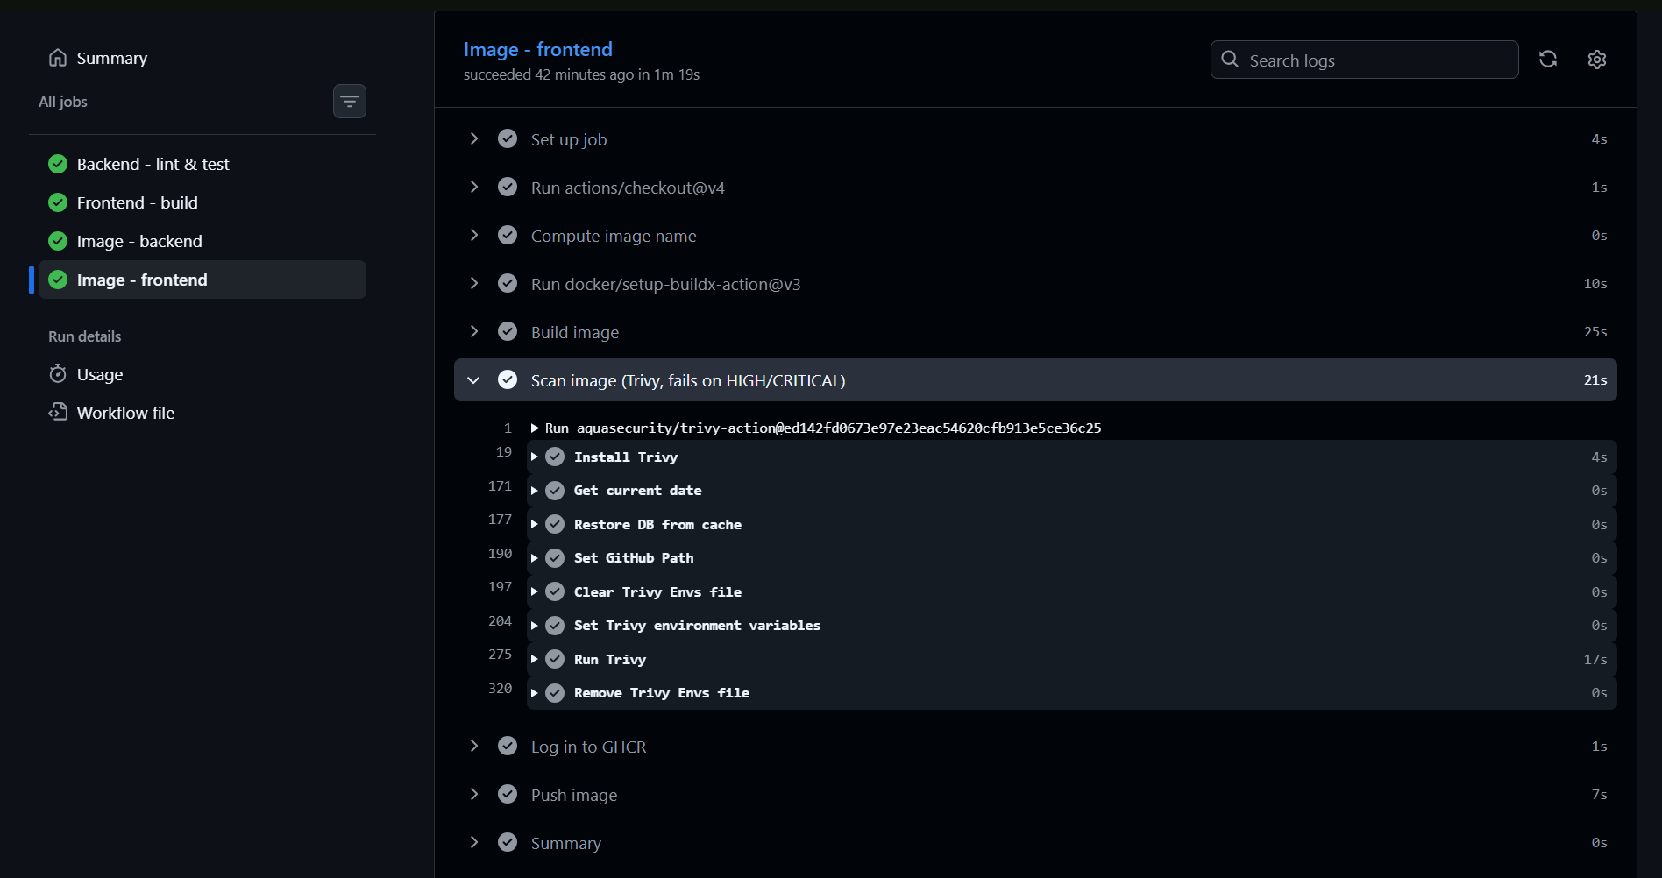
Trivy on the frontend image
SECURITY
41 issues in the old nginx base image, zero after moving to nginx-unprivileged 1.30.
Notes:
The frontend image had 41 issues in the old nginx 1.27 and Alpine 3.21 base. Moving to nginx-unprivileged 1.30 on Alpine, which also runs as non-root, brought it to zero. Containers also run as non-root, pods run under the restricted Pod Security standard, and secrets are encrypted with KMS.

Slide 14
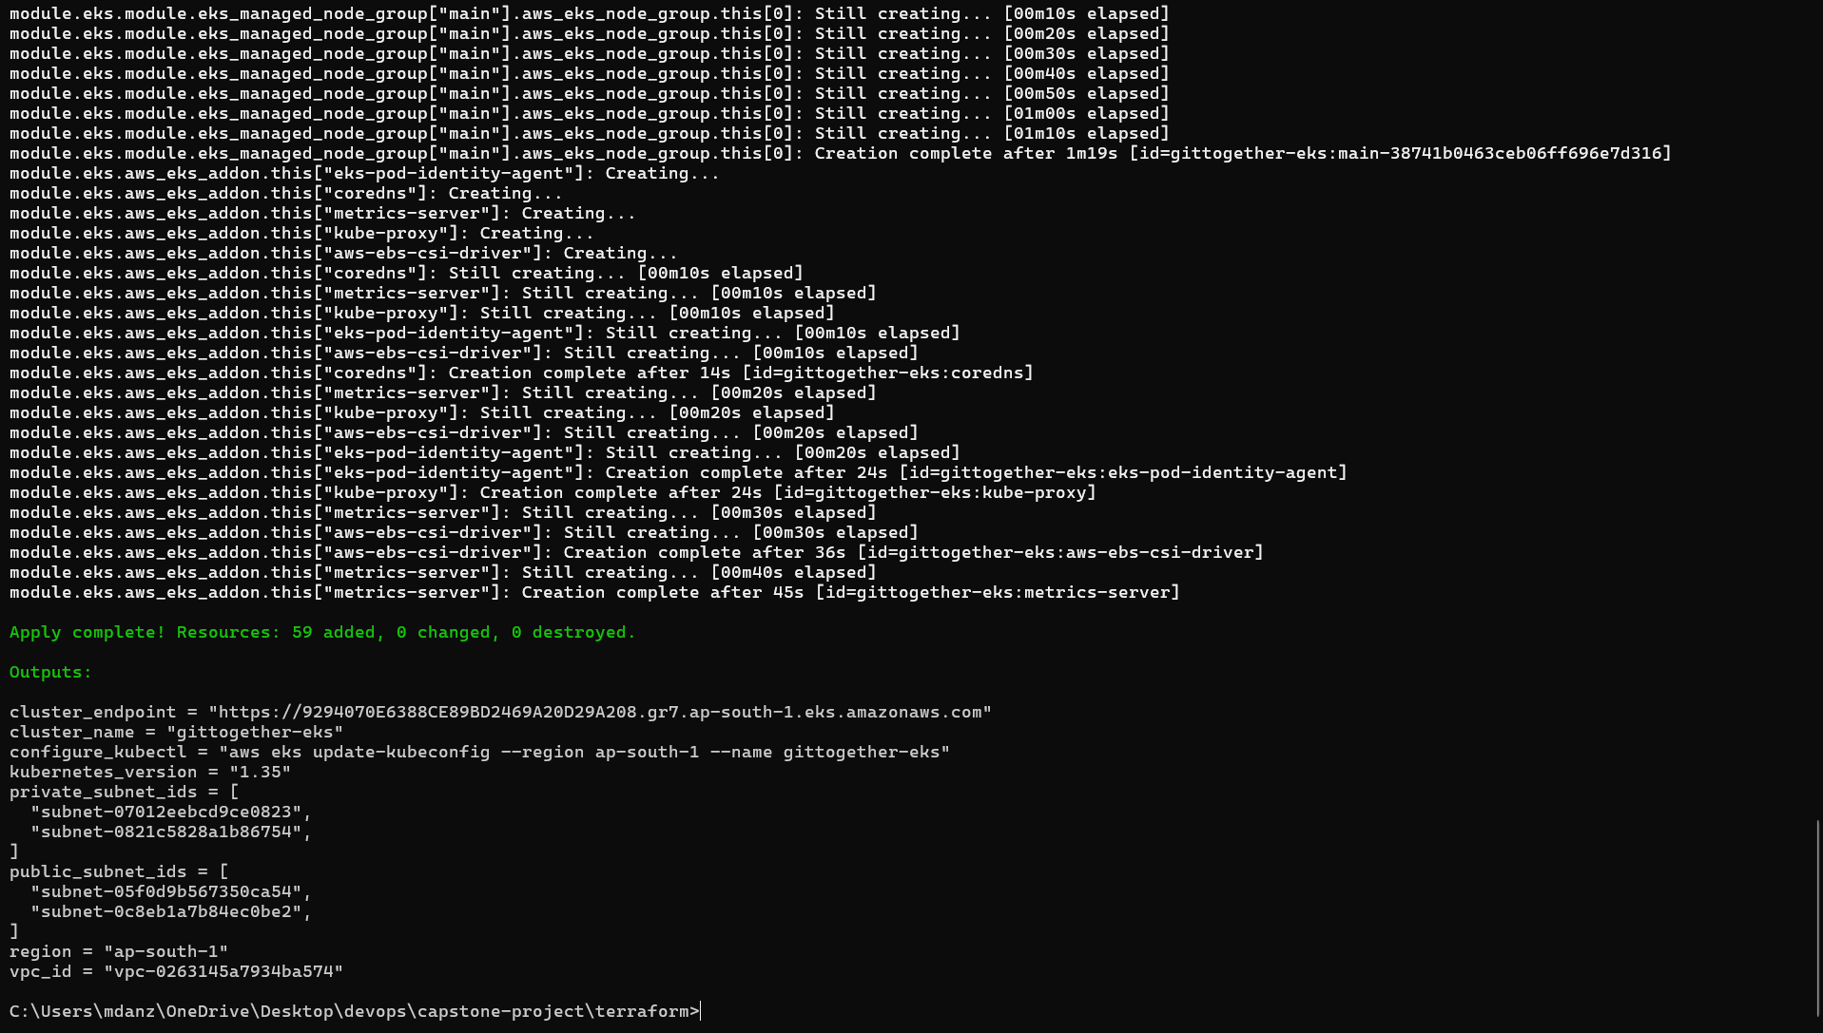
One terraform apply builds AWS
INFRASTRUCTURE
59 resources created in about 15 minutes: network, cluster, nodes, add-ons.
Notes:
Terraform builds the network and the cluster using the community VPC and EKS modules. The apply output ends with 59 resources added and the cluster name and endpoint.

Slide 15
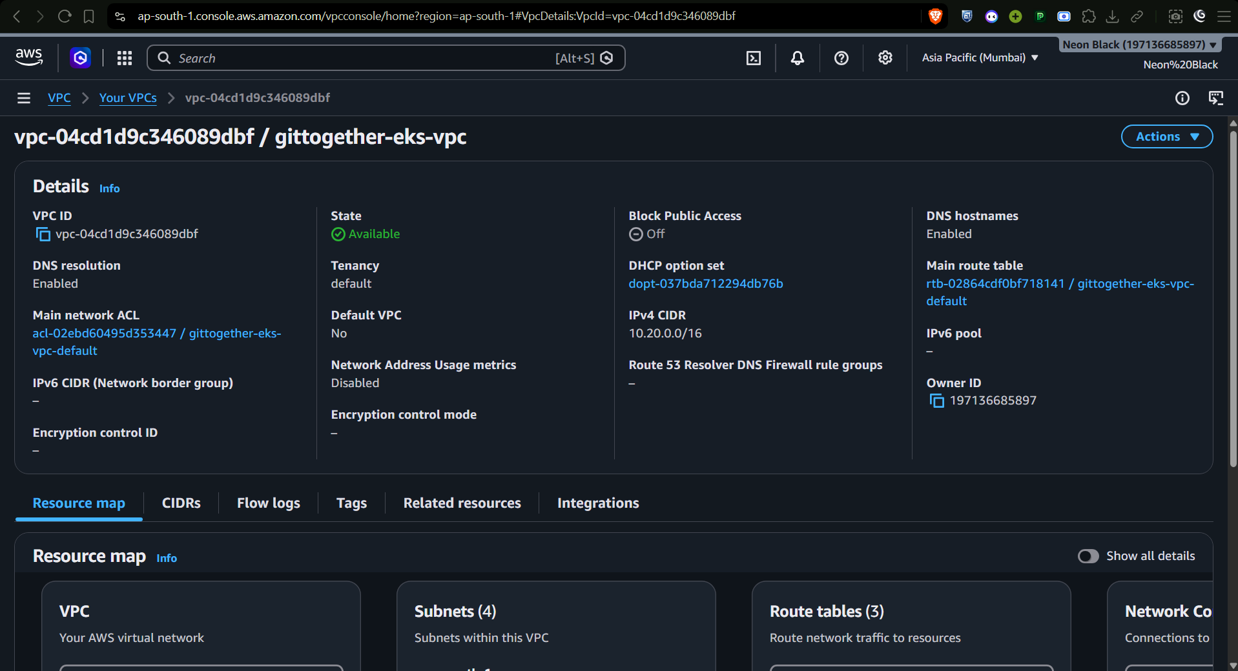
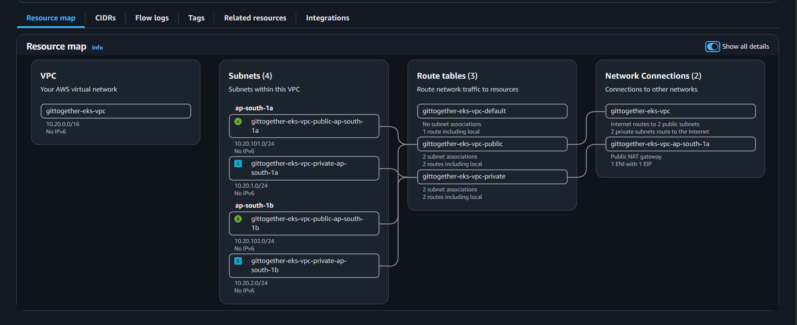
VPC and subnets
INFRASTRUCTURE
Public subnets for the load balancer and NAT, private subnets for the nodes.
Notes:
The VPC and its four subnets across two availability zones. Public subnets hold the load balancer and the NAT gateway, private subnets hold the worker nodes, which reach the internet through the single NAT gateway to keep the cost down.

Slide 16
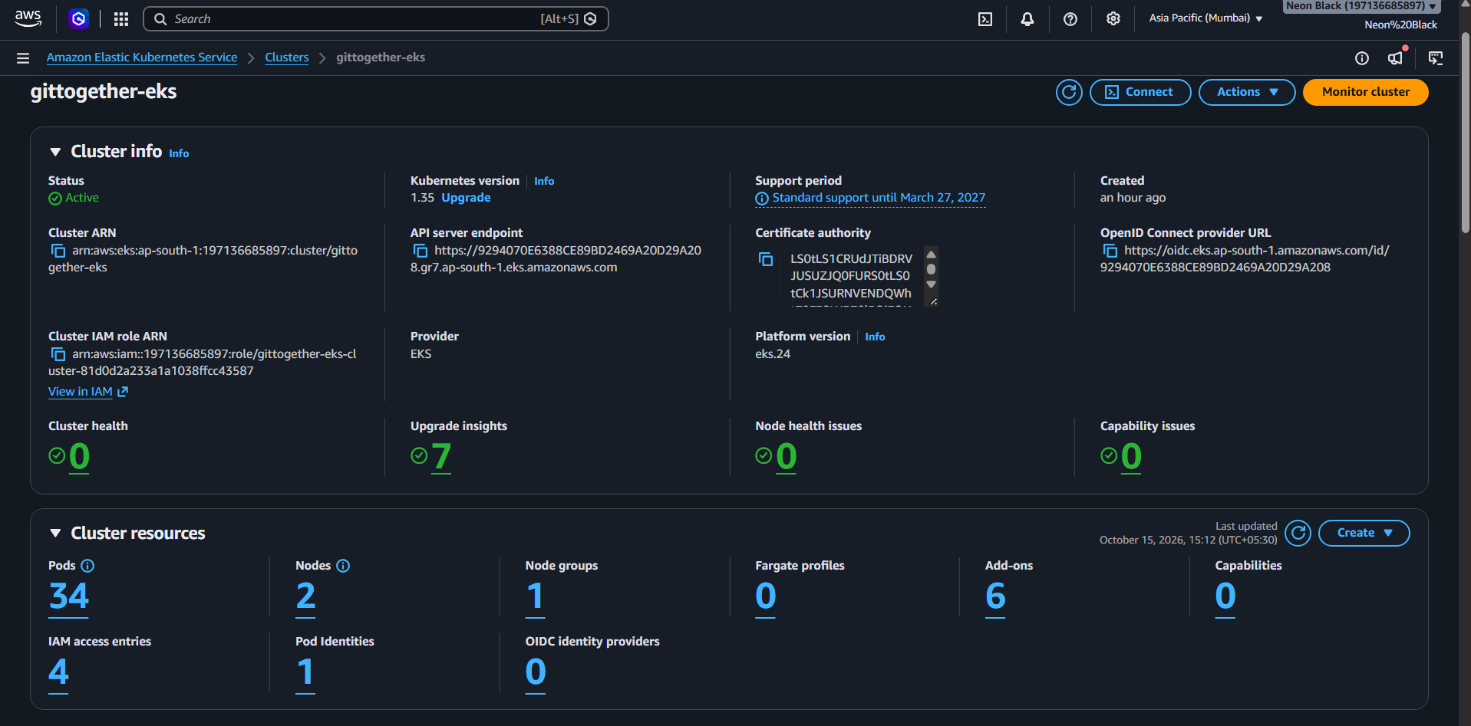
The EKS cluster
INFRASTRUCTURE
EKS 1.35, standard support, 0 health issues, 6 add-ons, KMS-encrypted secrets.
Notes:
The cluster is Active on Kubernetes 1.35, which is in standard support until March 2027. The AWS free plan only allows certain instance types and 5 vCPUs, so I used two m7i-flex.large nodes. The EBS driver gets its permissions through EKS Pod Identity.

Slide 17
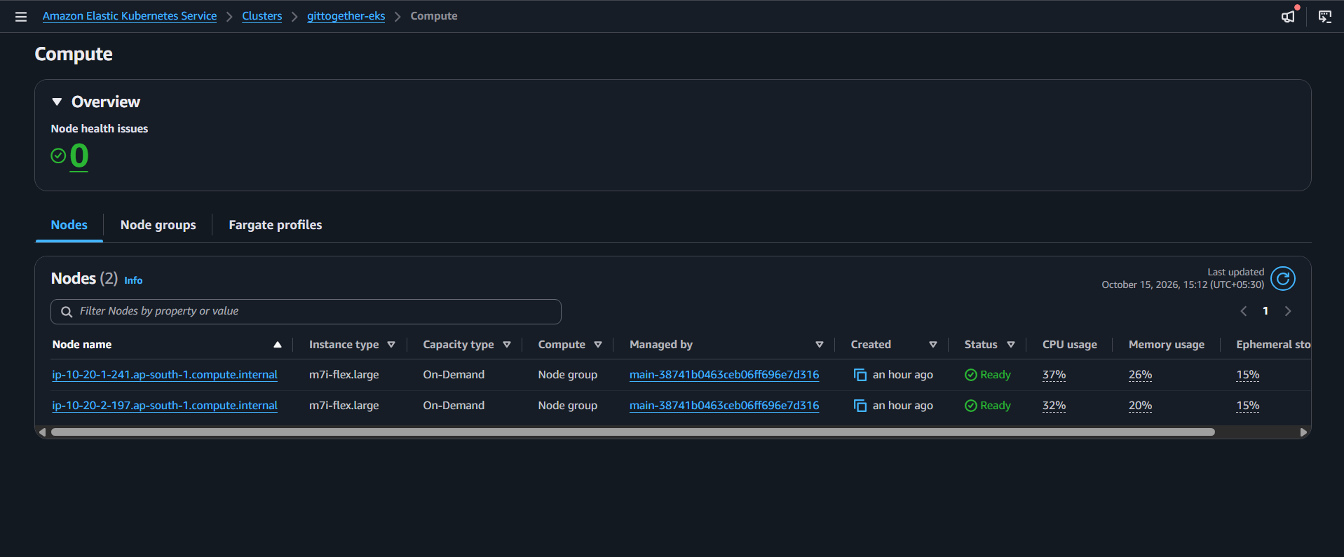
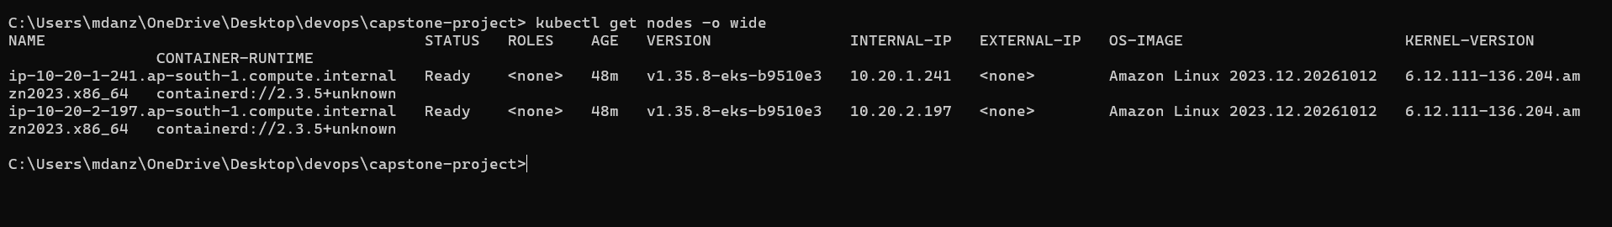
Two worker nodes
INFRASTRUCTURE
2 x m7i-flex.large, both Ready, running Kubernetes v1.35.
Notes:
The console and kubectl agree: two m7i-flex.large nodes, both Ready, on Kubernetes 1.35.

Slide 18
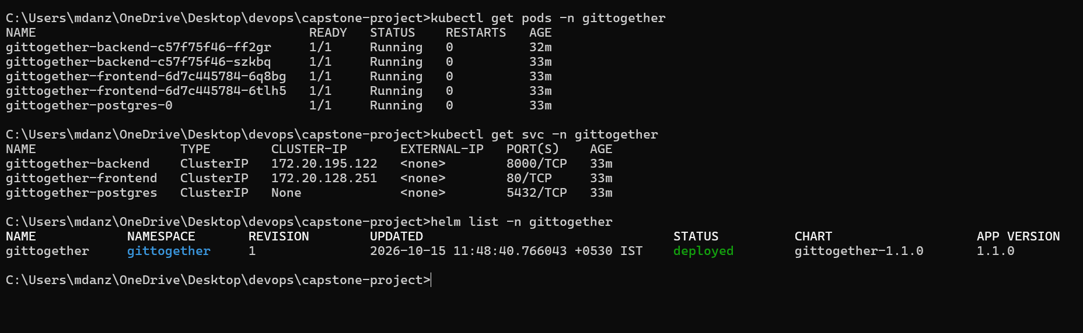
Everything running
KUBERNETES + HELM
2 backend, 2 frontend, 1 Postgres, deployed from one Helm chart.
Notes:
The whole app deploys from one Helm chart: backend and frontend with two replicas each, a Postgres StatefulSet with a persistent volume, services, ingress and disruption budgets. This is the first run, deployed with helm directly. Later runs let ArgoCD deploy the same chart.

Slide 19
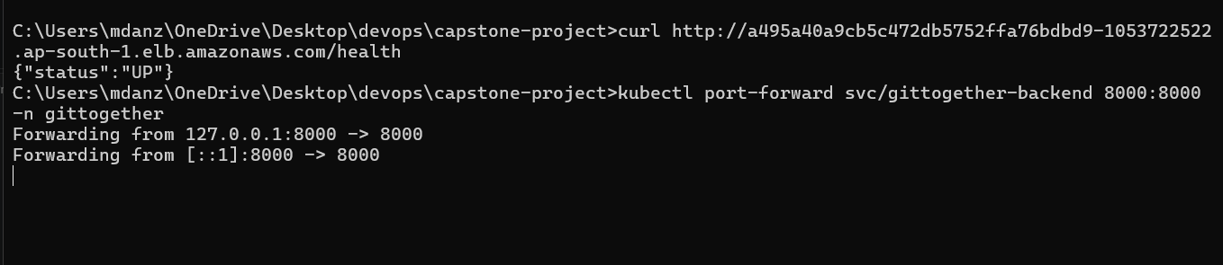
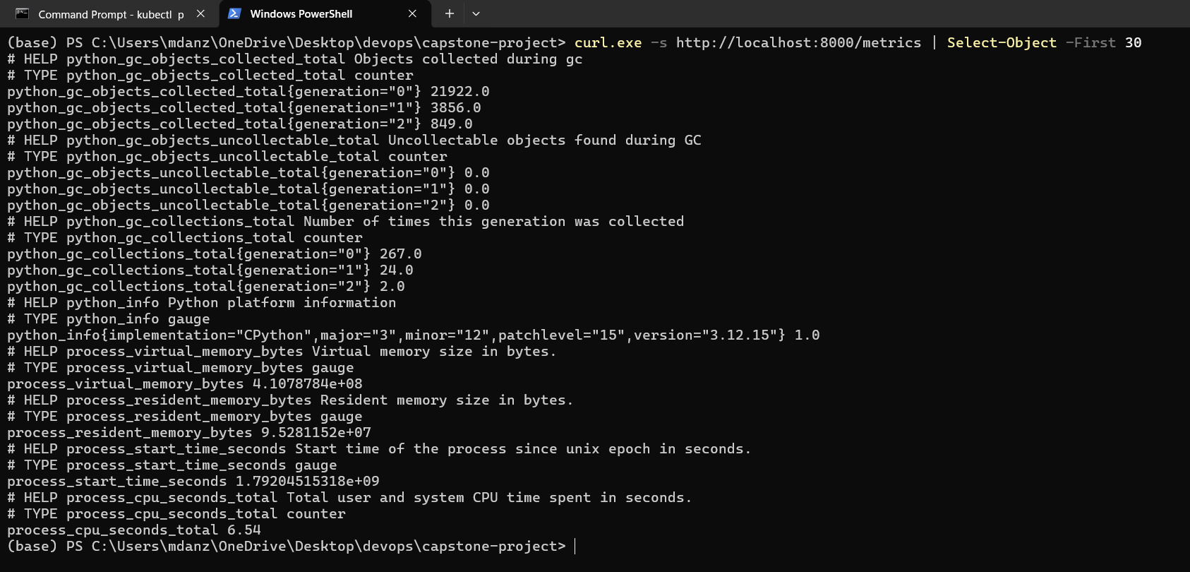
Health and metrics
KUBERNETES + HELM
/health is the liveness check, /metrics feeds Prometheus.
Notes:
The backend exposes slash health for the liveness probe, slash ready for readiness, and slash metrics in Prometheus format, with request counts and latency per endpoint. I checked health through the load balancer and metrics through a port-forward.

Slide 20
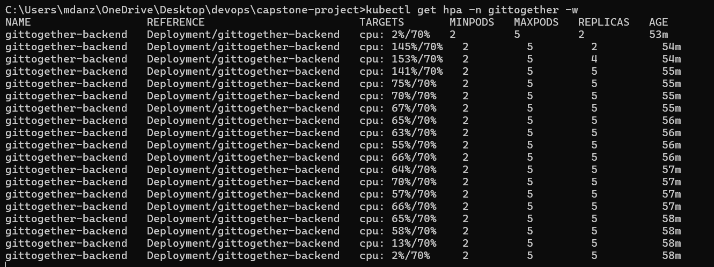
The backend scales under load
KUBERNETES + HELM
2 to 5 pods when CPU hit 153% of the 70% target, then back down when the load stopped.
Notes:
This is the autoscaler under a load test. CPU jumps to about 150 percent of the 70 percent target, the HPA grows the backend from 2 to 5 replicas, and CPU settles back. In the video I will run the same load test live.

Slide 21
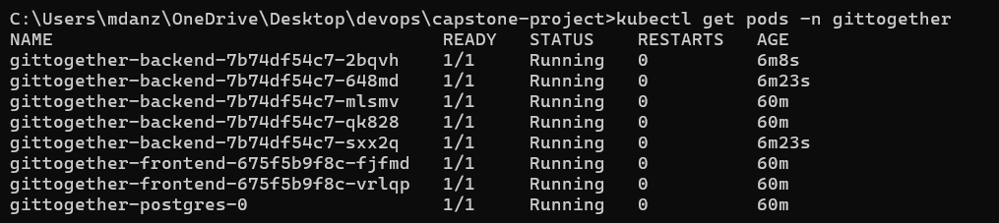
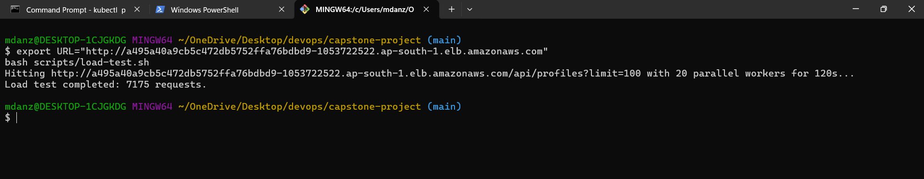
The pods the autoscaler created
KUBERNETES + HELM
3 new backend pods, created by the HPA while the load test ran.
Notes:
Three of the five backend pods are only a few minutes old: the autoscaler created them during the load test, which is the script on the bottom.

Slide 22
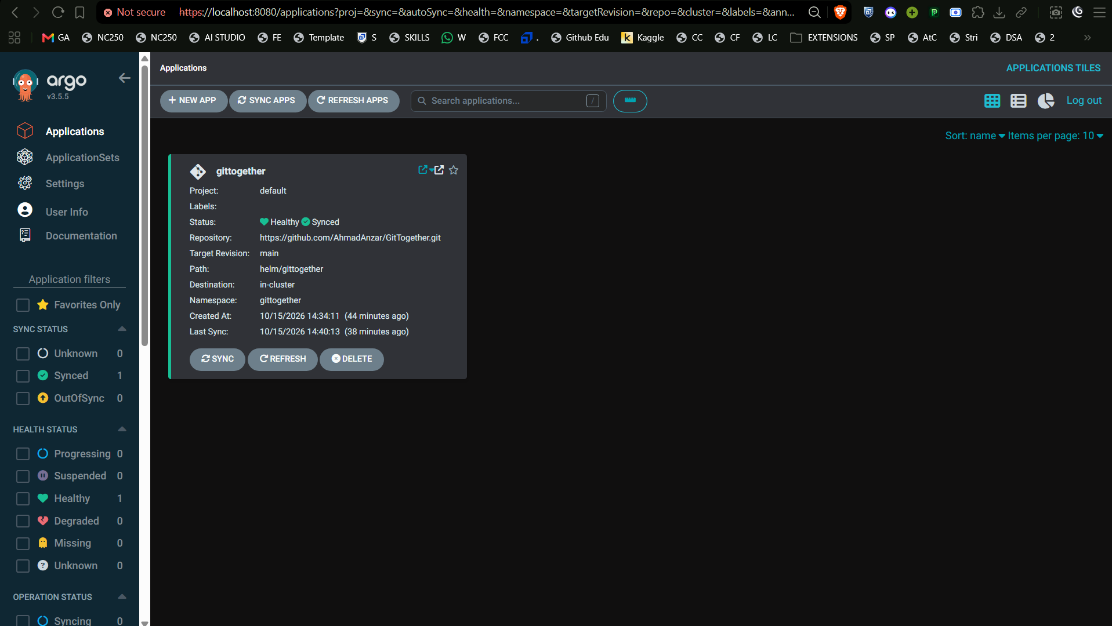
ArgoCD: Synced and Healthy
GITOPS
Auto-sync, prune and self-heal from the main branch of the repo.
Notes:
ArgoCD watches the Helm chart in the repo and applies it automatically, removes what is no longer in git, and reverts manual changes. I tested that by scaling the frontend to four replicas by hand, and ArgoCD set it back to two.

Slide 23
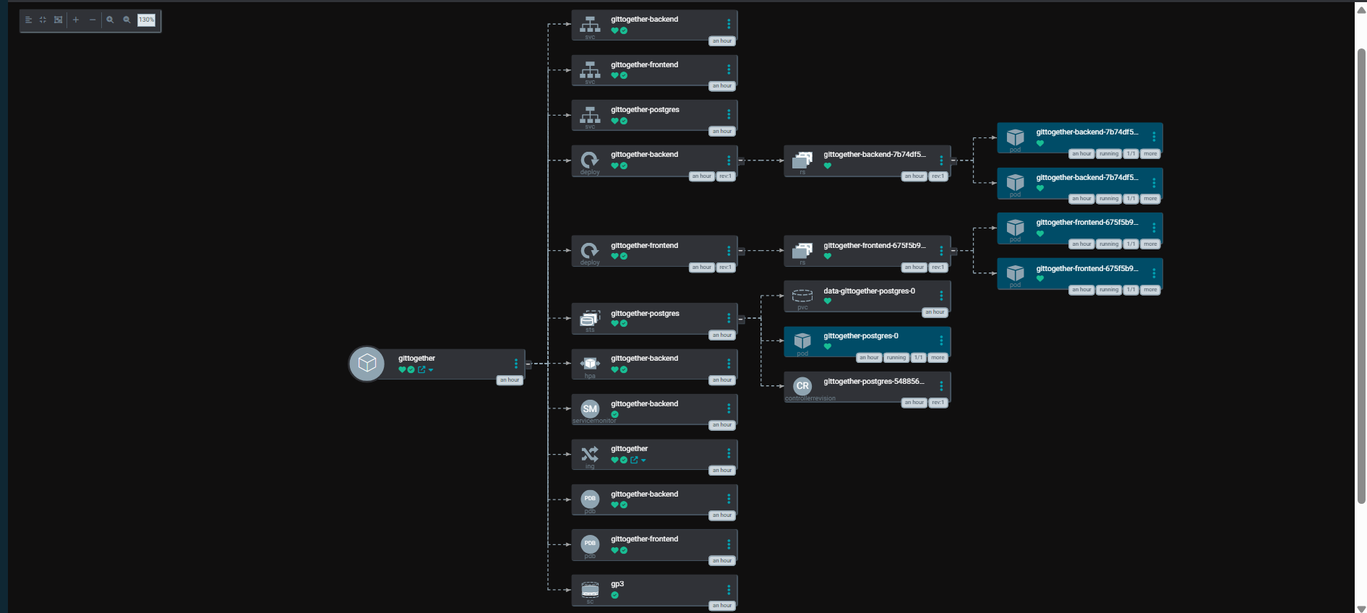
What ArgoCD manages
GITOPS
Every resource of the chart, from services to pods to the StorageClass, all green.
Notes:
The resource tree of the application. One honest detail: on EKS 1.35 and 1.36 the API server returns a 503 for the OpenAPI schema while the metrics APIs are registered, which stops ArgoCD from starting. Unregistering them while ArgoCD loads fixes it. That is in a script and in the README.

Slide 24
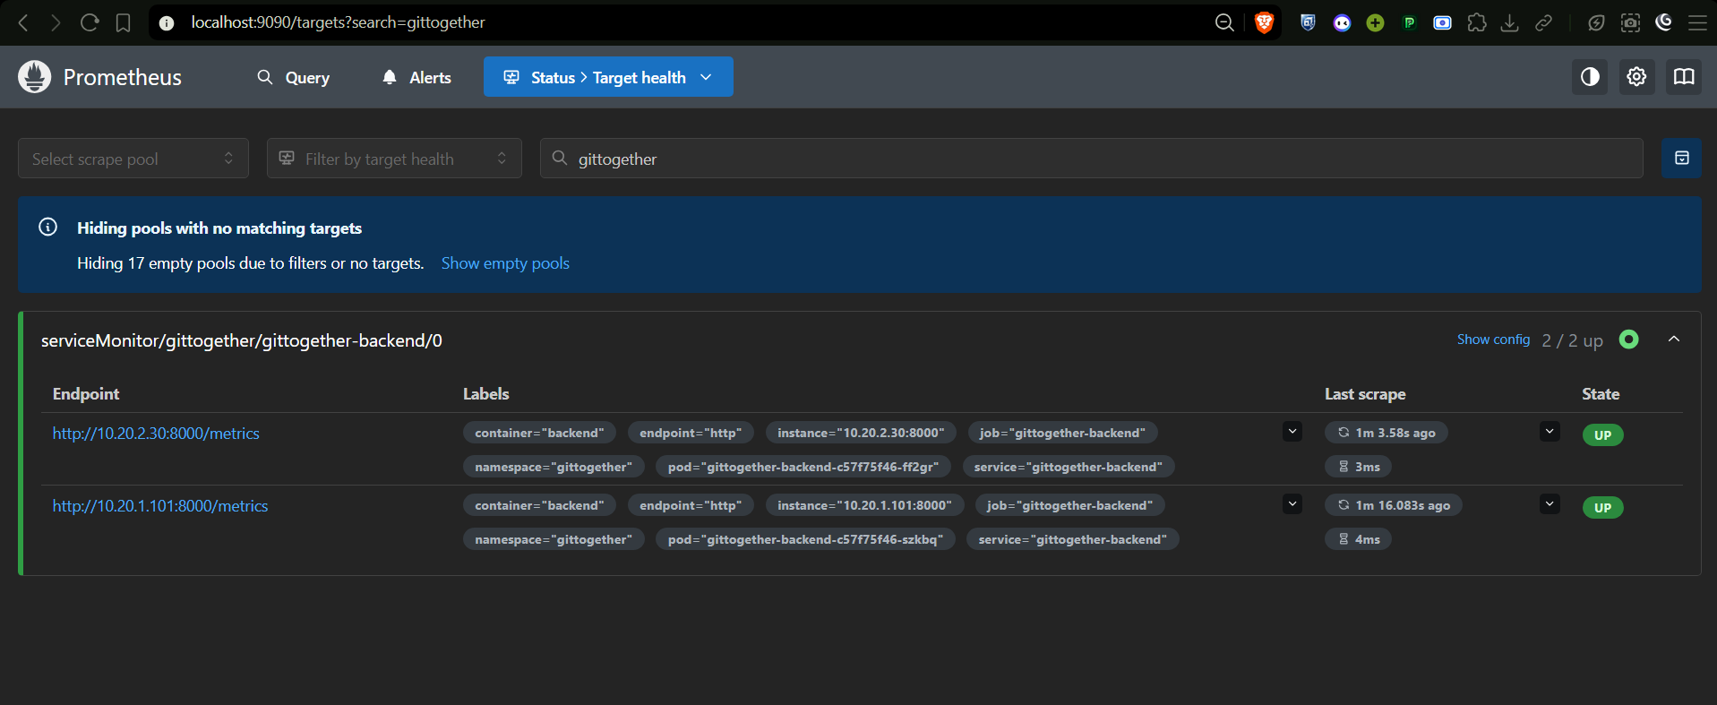
Prometheus targets
OBSERVABILITY
Both backend pods UP, scraped through a ServiceMonitor.
Notes:
A ServiceMonitor tells Prometheus to scrape every backend pod. On the targets page both pods are up, so adding replicas adds targets automatically.

Slide 25
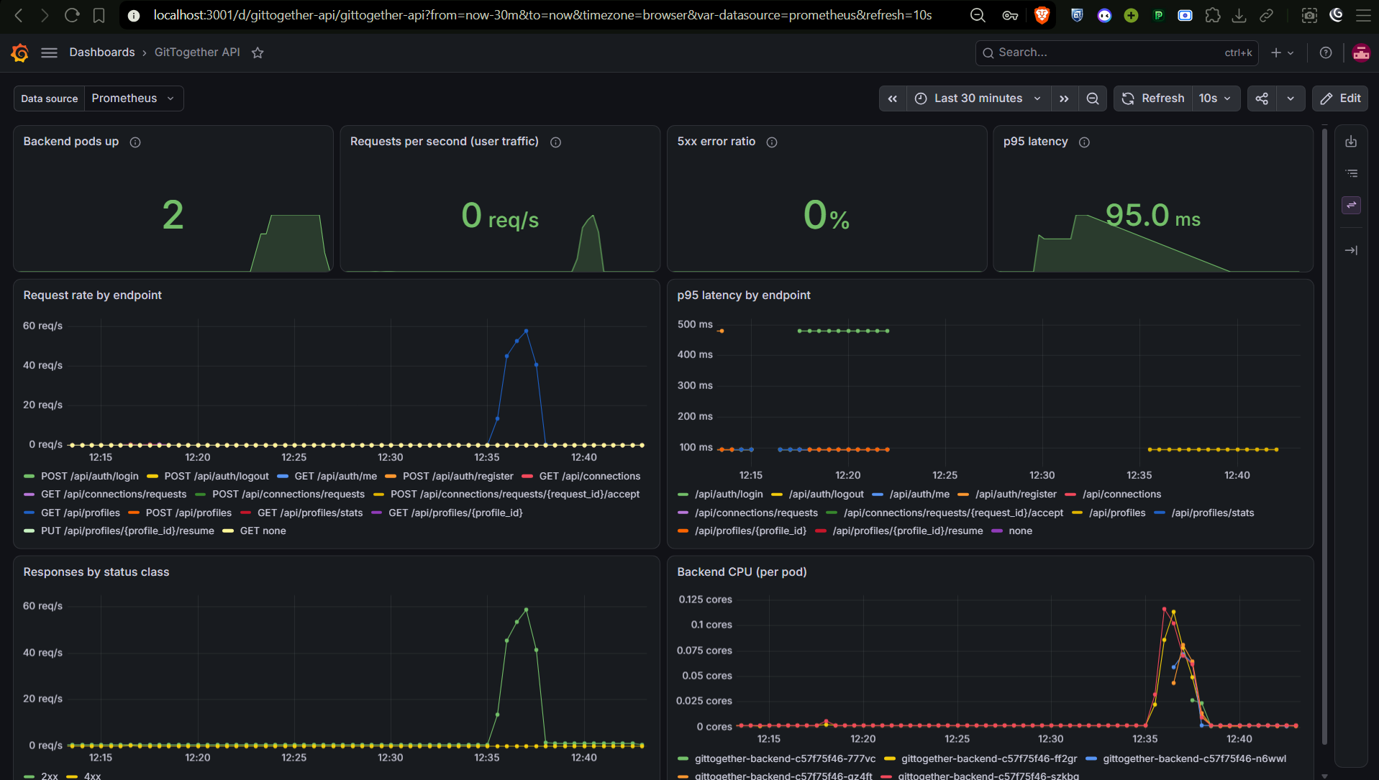
Grafana dashboard under load
OBSERVABILITY
Requests, errors, latency and CPU, provisioned from a ConfigMap in the repo.
Notes:
The Grafana dashboard is created from a ConfigMap, so it is part of the repo and appears automatically. This screenshot was taken during the load test, so you can see the request rate, latency and CPU respond.

Slide 26
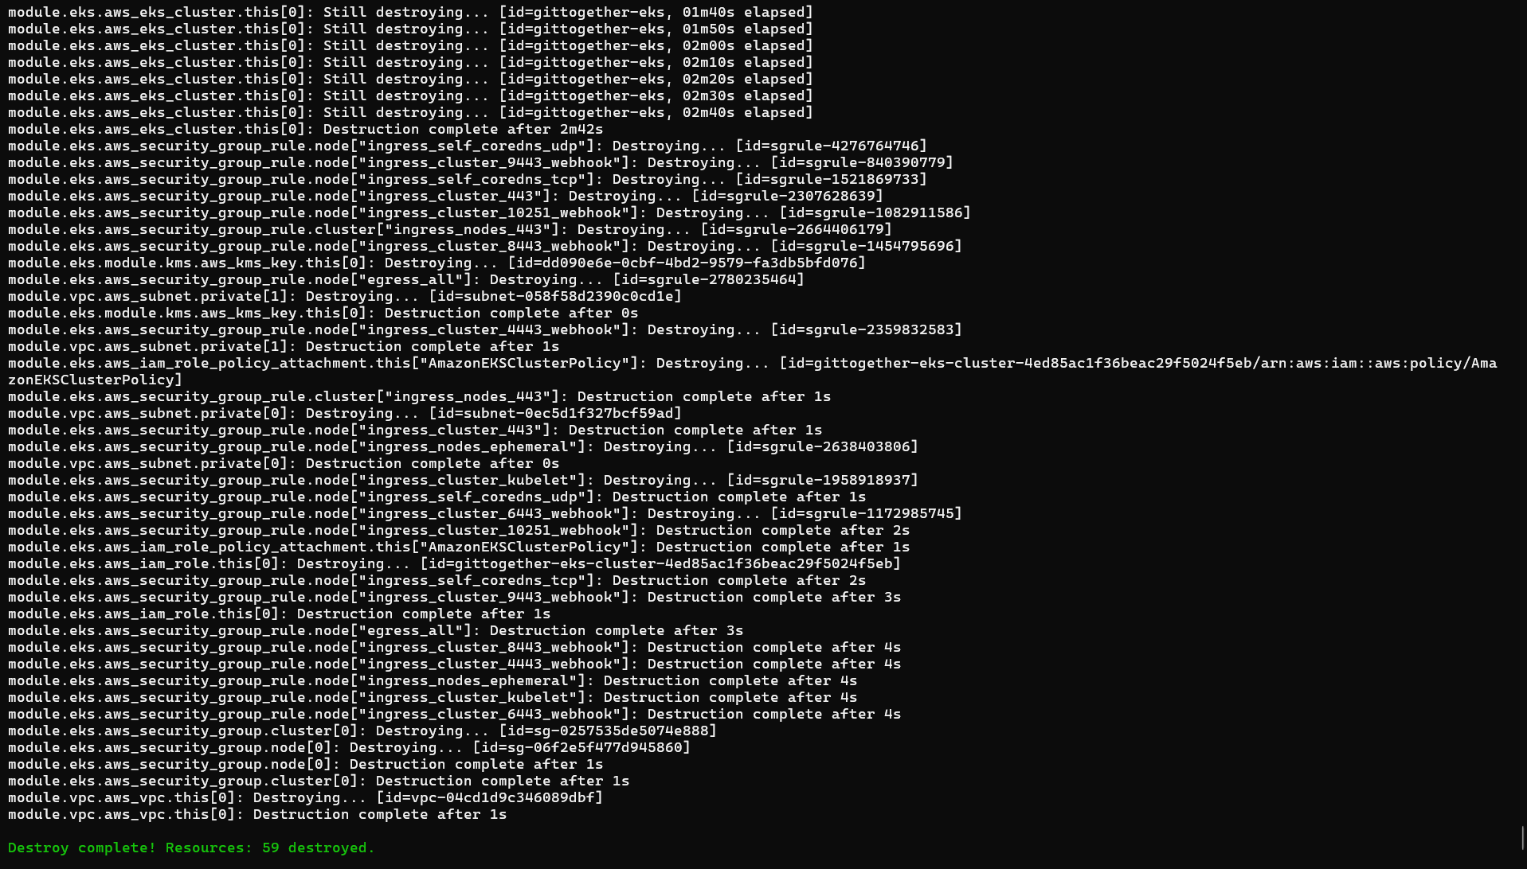
Destroyed the same day
CLEANUP
59 destroyed. The cluster costs about $0.40 an hour, so it only exists while I use it.
Notes:
After the demo I uninstall the load balancer and volumes first, then run terraform destroy and check the console for leftovers. This is the destroy output, 59 resources destroyed.

Slide 27
What went wrong, and what I learned
LESSONS
1
2
3
Free plan limits
EBS driver crash loop
ArgoCD on EKS
t3.medium was rejected and the account allows only 5 vCPUs. Fix: 2 x m7i-flex.large.
Pods could not use the node's credentials, so Postgres had no disk. Fix: EKS Pod Identity.
The API server returned 503 for the schema. Fix: unregister the two metrics APIs while ArgoCD starts.
Check quotas before designing.
Read the logs, don't guess.
Reproduce on a clean cluster.
Notes:
Three real problems. First, the free plan rejected t3.medium and capped the account at five vCPUs, so I used two m7i-flex.large nodes. Second, the EBS CSI driver crash-looped because pods cannot use the node metadata credentials, so I gave it its own IAM role through Pod Identity. Third, ArgoCD could not read the cluster schema on EKS. I rebuilt on 1.35 to prove it was not specific to 1.36, then found that removing the two aggregated metrics APIs while ArgoCD starts fixes it. The takeaway: change one thing at a time and reproduce on a clean setup.

Slide 28
NEXT STEPS
What I would do next
1
Managed database (Amazon RDS) with backups
2
HTTPS with a real domain and secure cookies
3
CI step that bumps the image tag automatically
4
Restrict the EKS API endpoint; add rate limiting
github.com/AhmadAnzar/GitTogether
Notes:
Close with what I would do next: a managed database, real HTTPS, automatic image-tag bumps in CI, and a restricted API endpoint. Then switch to the live demo on AWS.

