Slide 1
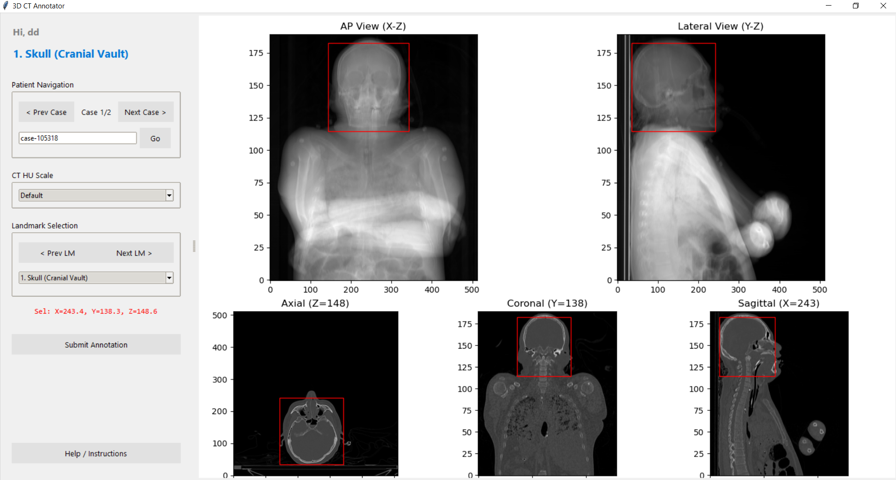
Orthogonal Average Intensity Projections
Navigate Patients
Control HU
Navigate Landmarks
Multi-Planar Reconstruction
Current selection
Save annotation
Instructions

