Slide 1
Chapter 4 Connect PHP to Database
Instructor
Ahmad Assaf
ahmadassaf@palumiv.edu.ps
Fall 2021

Slide 2
Outlines
Build MySQL Database
MySQLi vs. PDO
Connect to MySQL Database
Select Query
Insert
Delete
Update
Multi-Value Fields
CRUD Application
Prepared Statements
Security Notes
Notes:
https://www.tutorialrepublic.com/php-tutorial/php-mysql-introduction.php
PHP MySQL Introduction
PHP MySQL Connect
PHP MySQL Create Database
PHP MySQL Create Table
PHP MySQL Insert
PHP MySQL Prepared
PHP MySQL Last Inserted ID
PHP MySQL Select
PHP MySQL Where
PHP MySQL Limit
PHP MySQL Order By
PHP MySQL Update
PHP MySQL Delete
PHP MySQL CRUD Application
PHP MySQL Ajax Search
PHP MySQL Login System

Slide 3


MySQL
MySQL is an open-source relational database management system (RDBMS)

Slide 4
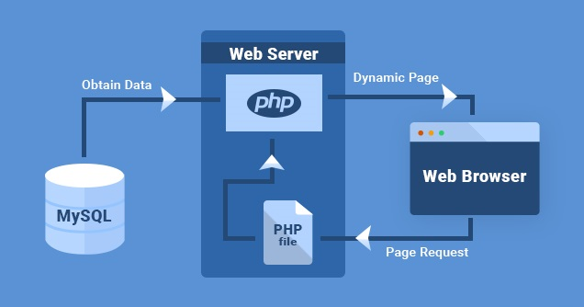

Slide 5

phpMyAdmin
phpMyAdmin is a free and open source administration tool for MySQL and MariaDB
To access phpMyAdmin:
http://localhost/phpmyadmin/

Slide 6
Charset
Collation
utf8mb4_general_ci
Charset
utf8mb4

Slide 7
Products Table
CREATE TABLE IF NOT EXISTS `products2` (
`id` int(10) NOT NULL AUTO_INCREMENT,
`name` varchar(250) NOT NULL,
`description` varchar(250) NOT NULL,
`price` double(9,2) NOT NULL,
`image` varchar(250) NOT NULL,
PRIMARY KEY (`id`),
) ENGINE=InnoDB DEFAULT CHARSET=utf8mb4;

Slide 8
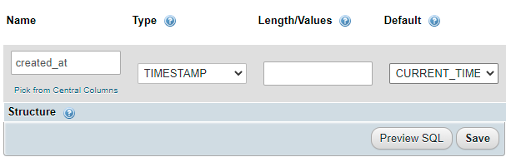
TIMESTAMP
Used to register date and time at insert or update record.

Slide 9
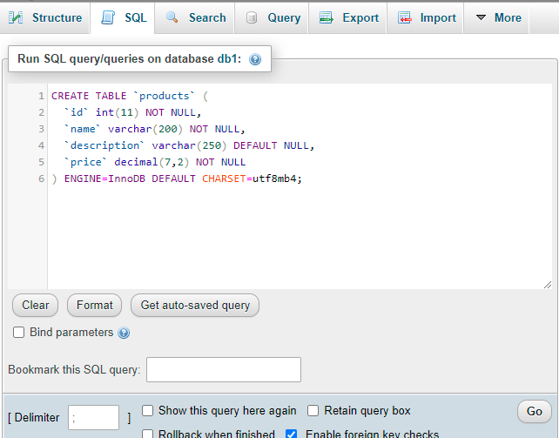
Run SQL Statements in MySQL

Slide 10
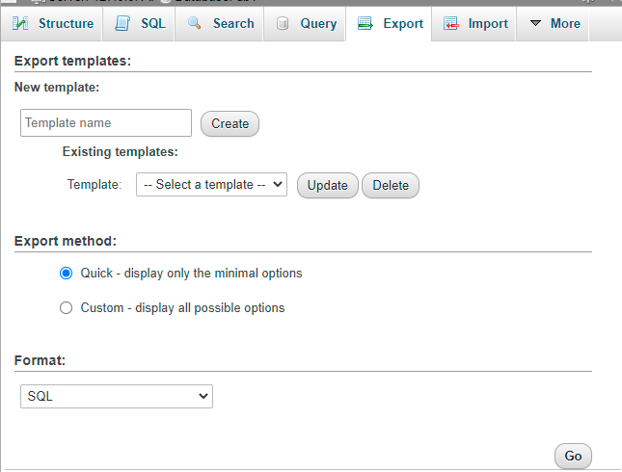
Export MySQL Database

Slide 11
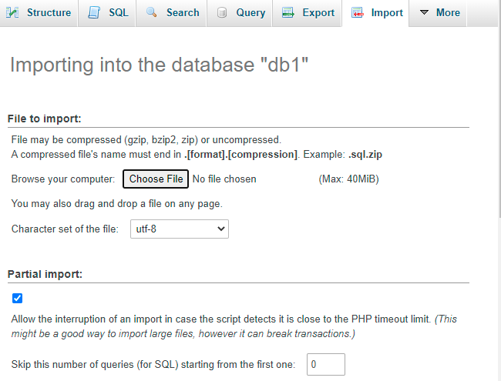
Import MySQL Database

Slide 12
Access MySQL from PHP
PHP 5 and later can access a MySQL database using two ways:
MySQLi extension
(the "i" stands for improved)
PDO (PHP Data Objects)

Slide 13

MySQLi vs. PDO
MySQLi is a relational database driver used in the PHP to provide an interface with MySQL databases.
PDO is a driver that implements the PHP Data Objects (PDO) interface to enable access from PHP to MySQL databases.
PDO will work on 12 different database systems,
MySQLi will only work with MySQL databases
Search about more advantages for both

Slide 14
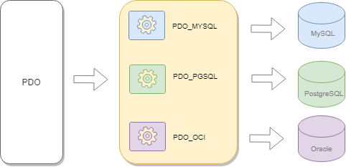
PDO
PDO simplifies the common database operations including:
Creating database connections
Executing queries using prepared statements
Calling stored procedures
Performing transactions
And handling errors

Slide 15
Open a Connection to MySQL using PDO
<?php $host = "localhost"; //server name $username = "username"; $password = "password";
$dbname= "dbname"; try { $pdo = new PDO("mysql:host=$host;dbname=$dbname", $username, $password);
// set the PDO error mode to exception $pdo->setAttribute(PDO::ATTR_ERRMODE, PDO::ERRMODE_EXCEPTION); echo "Connected successfully";
} catch(PDOException $e) { echo "Connection failed: " . $e->getMessage(); } ?>
To Close the Connection
$pdo = null;

Slide 16
SELECT Data
<?php
...
//select query
$sql = 'SELECT * FROM products';
$result = $pdo->query($sql);
// get all products as associative array
$products = $result->fetchAll(PDO::FETCH_ASSOC);
...
?>

Slide 17
#Example 4-1
Requirements:
Write a PHP script to connect to database and show all products table records.
See it on GitHub

Slide 18
#Example 4-2
Requirements:
Write a PHP script to connect to database and show all products table records in a table.
See it on GitHub

Slide 19
#Example 4-3
Requirements:
Create a categories table and make a relationship with products table
Write a PHP script to connect to database and show all products table records in a table order by category id.
See it on GitHub

Slide 20
INSERT Data

Slide 21
UPDATE Data

Slide 22
DELETE Data

Slide 23
config.php file
In PHP, you can create a config.php file and place the database parameters:
<?php
$host = 'localhost';
$db = 'bookdb';
$user = 'root';
$password = 'S@cr@t1!’;
?>
//then in any PHP file write
require 'config.php';

Slide 24
Connecting to MySQL using config.php file
<?php
require 'config.php';
$dsn = "mysql:host=$host;dbname=$db;charset=UTF8";
try {
$pdo = new PDO($dsn, $user, $password);
if ($pdo) {
echo "Connected to the $db database successfully!";
}
} catch (PDOException $e) {
echo $e->getMessage();
}

Slide 25
End

