Slide 1
Chapter 4 Connect PHP to Database
Instructor
Ahmad Assaf
ahmadassaf@palumiv.edu.ps
Fall 2021

Slide 2
Outlines
Build MySQL Database
MySQLi vs. PDO
Connect to MySQL Database
Select Query
Insert
Delete
Update
Multi-Value Fields
CRUD Application
Prepared Statements
Security Notes
Notes:
https://www.tutorialrepublic.com/php-tutorial/php-mysql-introduction.php
PHP MySQL Introduction
PHP MySQL Connect
PHP MySQL Create Database
PHP MySQL Create Table
PHP MySQL Insert
PHP MySQL Prepared
PHP MySQL Last Inserted ID
PHP MySQL Select
PHP MySQL Where
PHP MySQL Limit
PHP MySQL Order By
PHP MySQL Update
PHP MySQL Delete
PHP MySQL CRUD Application
PHP MySQL Ajax Search
PHP MySQL Login System

Slide 3


MySQL
MySQL is an open-source relational database management system (RDBMS)

Slide 4
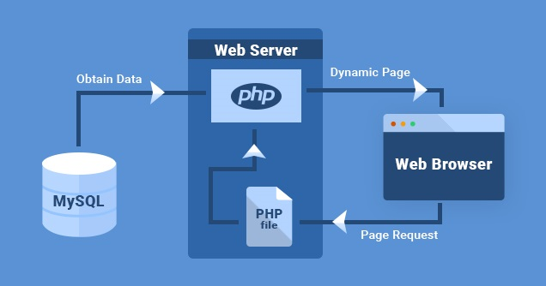
PHP & MySQL

Slide 5

phpMyAdmin
phpMyAdmin is a free and open source administration tool for MySQL and MariaDB
To access phpMyAdmin:
http://localhost/phpmyadmin/

Slide 6
Charset
Collation
utf8mb4_general_ci
Charset
utf8mb4

Slide 7
Products Table Example
CREATE TABLE IF NOT EXISTS `products` (
`id` int(10) NOT NULL AUTO_INCREMENT,
`name` varchar(250) NOT NULL,
`description` varchar(250) NOT NULL,
`price` decimal(7,2) NOT NULL,
`image` varchar(250) NOT NULL,
PRIMARY KEY (`id`),
) ENGINE=InnoDB DEFAULT CHARSET=utf8mb4;

Slide 8
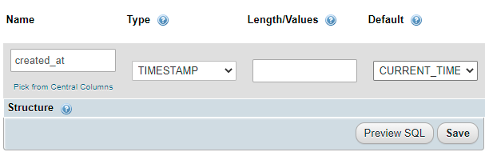
TIMESTAMP
Used to register date and time at insert or update record.

Slide 9
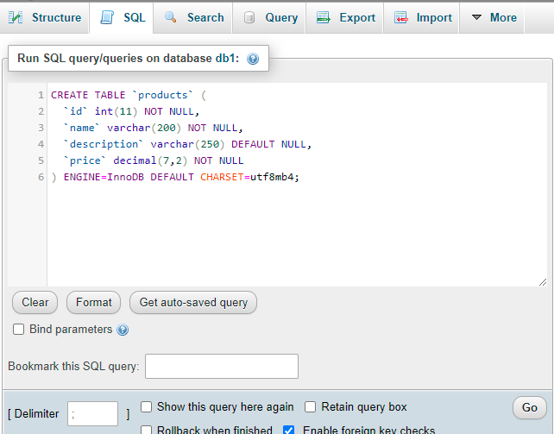
Run SQL Statements in MySQL

Slide 10
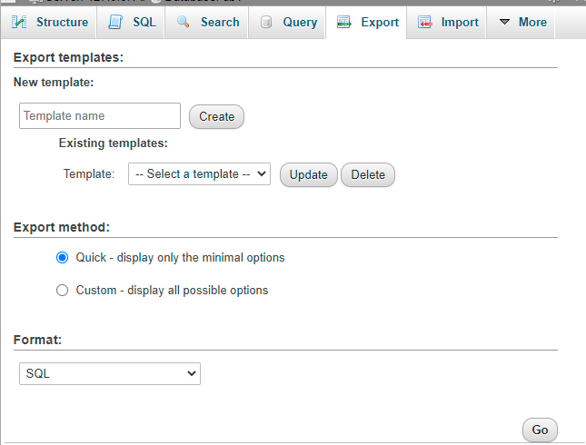
Export MySQL Database

Slide 11
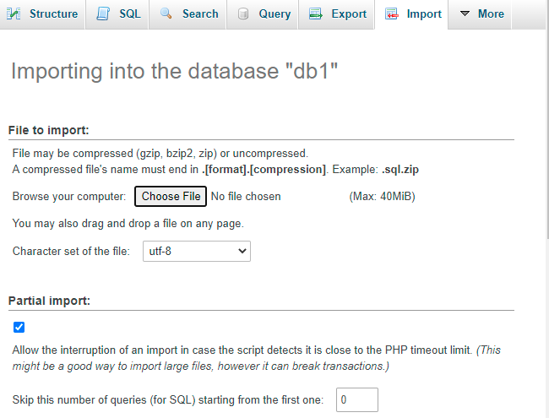
Import MySQL Database

Slide 12
Access MySQL from PHP
PHP 5 and later can access a MySQL database using two ways:
MySQLi extension (the "i" stands for improved)
PDO (PHP Data Objects)

Slide 13

MySQLi vs. PDO
MySQLi is a relational database driver used in the PHP to provide an interface with MySQL databases.
PDO is a driver that implements the PHP Data Objects (PDO) interface to enable access from PHP to MySQL databases.
PDO will work on 12 different database systems,
MySQLi will only work with MySQL databases
Search about more advantages for both

Slide 14
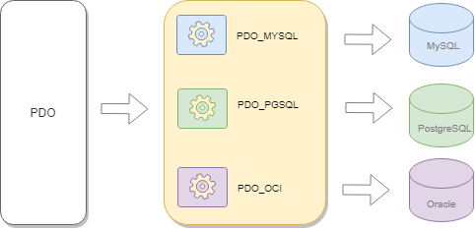
PDO
PDO simplifies the common database operations including:
Creating database connections
Executing queries using prepared statements
Calling stored procedures
Performing transactions
And handling errors

Slide 15
Open a Connection to MySQL using PDO
<?php $host = "localhost"; //server name $username = "username"; $password = "password";
$dbname= "dbname"; //database name try { $pdo = new PDO("mysql:host=$host;dbname=$dbname", $username, $password);
// set the PDO error mode to exception $pdo->setAttribute(PDO::ATTR_ERRMODE, PDO::ERRMODE_EXCEPTION); echo "Connected successfully";
} catch(PDOException $e) { echo "Connection failed: " . $e->getMessage(); } ?>
To Close the Connection
$pdo = null;

Slide 16
SELECT Data
<?php
...
//select query
$sql = 'SELECT * FROM products';
$result = $pdo->query($sql);
// get all products as associative array
$products = $result->fetchAll(PDO::FETCH_ASSOC);
...
?>

Slide 17
#Example 4-1
Requirements:
Write a PHP script to connect to database and show all products table records.
See it on GitHub

Slide 18
Example 4-2
Requirements:
Write a PHP script to connect to database and show all products table records in a HTML table.
See it on GitHub

Slide 19
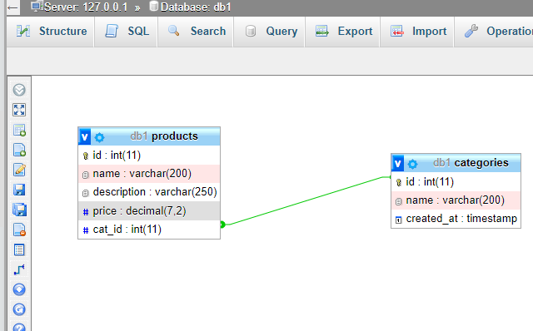
Tables Relationship
We can use the Designer tool in PhpMyAdmin to create a relationship between tables.

Slide 20
#Example 4-3
Requirements:
Add categories table to the database and make a correct relationship with products table.
Write a PHP script to connect to database and show all products table records ordered by category id.
See it on GitHub

Slide 21
SQL WHERE Clause
$sql = 'SELECT * FROM products WHERE cat_id = 3';
$result = $pdo->query($sql);
Or
$cid=3;
$sql = 'SELECT * FROM products WHERE cat_id =' .$cid;
$result = $pdo->query($sql);
$cid=3;
//select query
$sql = 'SELECT * FROM products WHERE cat_id = ?';
$result = $pdo->prepare($sql);
$result->execute([$cid]);

Slide 22
#Example 4-4
Requirements:
Write a PHP script to connect to database and show all product records that related to a selected category id.
See it on GitHub
Notes:
$sql = "SELECT * FROM Users
WHERE userID = ?";
$result = $pdo->prepare($sql);
$result->execute([$id]);
$stmt = $db->prepare("select userID from tblUsers where logged = '1' AND ip = :ip");
$stmt->execute(array('ip' => $ip));
$listArray = $stmt->fetchAll();
$count=$dbo->prepare("DELETE FROM pdo_admin WHERE id=:id");
$count->bindParam(":id",$id,PDO::PARAM_INT);
$count->execute();

Slide 23
Prepared Statement
A prepared statement is a feature used to execute the same SQL statements repeatedly with high efficiency.
Prepared statements basically work like this:
Prepare: An SQL statement template is created and sent to the database Certain values are left unspecified, called parameters (labeled "?")
The database parses, compiles, and performs query optimization on the SQL statement template without executing it
Execute: At a later time, the application binds the values to the parameters, and the database executes the statement.
The application may execute the statement as many times as it wants with different values
PDO::prepare() returns a PDOStatement object or false if the database server cannot successfully prepare the statement.

Slide 24
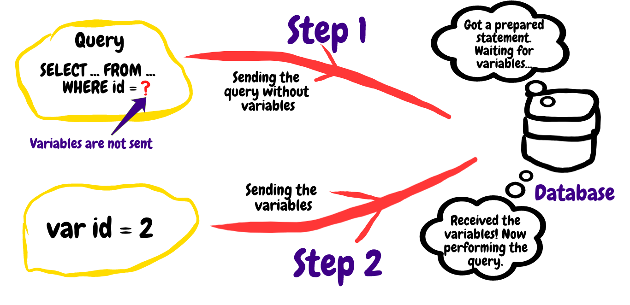

Slide 25
Prepared Statement /2
Example:
$cid=3;
$sql = 'SELECT * FROM products WHERE cat_id = ?';
$result = $pdo->prepare($sql);
$result->execute([$cid]);
Or
$sql = 'SELECT * FROM products WHERE cat_id = :cid';
$result = $pdo->prepare($sql);
$result->execute([[':cid' => $cid]);

Slide 26
Prepared Statement /3
Compared to executing SQL statements directly, prepared statements have three main advantages:
Prepared statements reduce parsing time as the preparation on the query is done only once while the statement is executed multiple times.
Bound parameters minimize bandwidth to the server as you need send only the parameters each time, and not the whole query
Prepared statements are very useful against SQL injections, because parameter values, which are transmitted later using a different protocol so SQL injection cannot occur.

Slide 27
#Example 4-5
Requirements:
Design two web pages
The first page shall show all category names with a link to second page.
The URL in the link shall include the cat_id value. example: localhost/product_list?cid=5
The second page shall show all products in a HTML table for one category depending on the cat_id value.
See it on GitHub
Notes:
$stmt = $db->prepare("select userID from tblUsers where logged = '1' AND ip = :ip");
$stmt->execute(array('ip' => $ip));
$listArray = $stmt->fetchAll();
$count=$dbo->prepare("DELETE FROM pdo_admin WHERE id=:id");
$count->bindParam(":id",$id,PDO::PARAM_INT);
$count->execute();

Slide 28
INSERT Data
//Insert new record
$sql = 'INSERT INTO products (name, price, cat_id) VALUES (:name, :price, :cid)' ;
$statement = $pdo->prepare($sql);
$result->execute([ ':name'=>'Laptop 3333’, ':price'=>7000, ':cid’=>1 ]);
//get last id
$id = $pdo->lastInsertId();
echo 'The product id ' . $id . ' was inserted';

Slide 29
UPDATE Data
//UPDATE SQL
$sql = ‘UPDATE products (name, price, cat_id) VALUES (:name, :price, :cid)' ;
$statement = $pdo->prepare($sql);
$result->execute([ ':name'=>'Laptop 3333’, ':price'=>7000, ':cid’=>1 ]);
//get last id
$id = $pdo->lastInsertId();
echo 'The product id ' . $id . ' was inserted';

Slide 30
#Example 4-6
Requirements:
Write a PHP script to connect to database and insert a new product record using HTML form and data validation.
See it on GitHub

Slide 31
#Example 4-7
Requirements:
Write a PHP script to connect to database and show all products table records with update button to update a selected product record using HTML form and data validation.
See it on GitHub

Slide 32
DELETE Data
//Update record 5
$id = 5;
$sql = 'UPDATE products SET name=:name, price=:price
WHERE id=:id';
$statement = $pdo->prepare($sql);
$res = $statement->execute([':id' => $id, ':name' => 'Laptop 8888’, ':price' => 7000]);
if ($res) {
echo "The product $id has been updated successfully!";
}

Slide 33
#Example 4-8
Requirements:
Write a PHP script to connect to database and show all products table records with delete button for each record to delete the record when the button have been pressed.
See it on GitHub

Slide 34
#Example 4-9
Visit and review news websites and make analysis to do:
Write requirements to have similar news website
Design and build a database
Build a CRUD system for the news portal

Slide 35
config.php file
In PHP, you can create a config.php file and place the database parameters:
<?php
$host = 'localhost';
$db = 'bookdb';
$user = 'root';
$password = 'S@cr@t1!’;
?>
//then in any PHP file write
require 'config.php';

Slide 36
Connecting to MySQL using config.php file
<?php
require 'config.php';
$dsn = "mysql:host=$host;dbname=$db;charset=UTF8";
try {
$pdo = new PDO($dsn, $user, $password);
if ($pdo) {
echo "Connected to the $db database successfully!";
}
} catch (PDOException $e) {
echo $e->getMessage();
}

Slide 37
Fetch Some Data
Get data by id in URL

Slide 38
End

