Slide 1
Chapter 4 Connect PHP to Database
Instructor
Ahmad Assaf
ahmadassaf@palumiv.edu.ps
Fall 2021

Slide 2
Outlines
Build MySQL Database
MySQLi vs. PDO
Connect to MySQL Database
Select Query
Insert
Delete
Update
Multi-Value Fields
CRUD Application
Prepared Statements
Security Notes
Notes:
https://www.tutorialrepublic.com/php-tutorial/php-mysql-introduction.php
PHP MySQL Introduction
PHP MySQL Connect
PHP MySQL Create Database
PHP MySQL Create Table
PHP MySQL Insert
PHP MySQL Prepared
PHP MySQL Last Inserted ID
PHP MySQL Select
PHP MySQL Where
PHP MySQL Limit
PHP MySQL Order By
PHP MySQL Update
PHP MySQL Delete
PHP MySQL CRUD Application
PHP MySQL Ajax Search
PHP MySQL Login System

Slide 3


MySQL
MySQL is an open-source relational database management system (RDBMS)

Slide 4
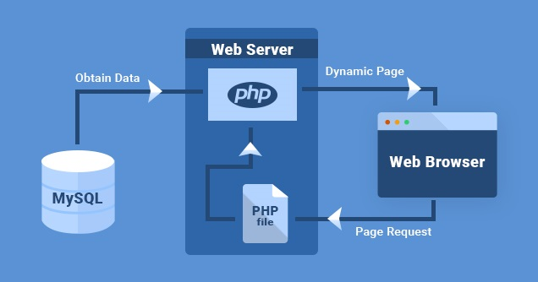
PHP & MySQL

Slide 5

phpMyAdmin
phpMyAdmin is a free and open source administration tool for MySQL and MariaDB
To access phpMyAdmin:
http://localhost/phpmyadmin/

Slide 6
Charset
Collation
utf8mb4_general_ci
Charset
utf8mb4

Slide 7
Products Table Example
CREATE TABLE IF NOT EXISTS `products` (
`id` int(10) NOT NULL AUTO_INCREMENT,
`name` varchar(250) NOT NULL,
`description` varchar(250) NOT NULL,
`price` decimal(7,2) NOT NULL,
`image` varchar(250) NOT NULL,
PRIMARY KEY (`id`),
) ENGINE=InnoDB DEFAULT CHARSET=utf8mb4;

Slide 8
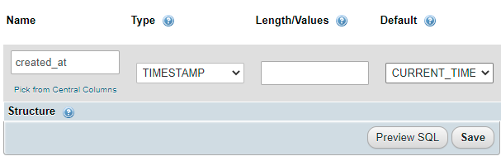
TIMESTAMP
Used to register date and time at insert or update record.

Slide 9
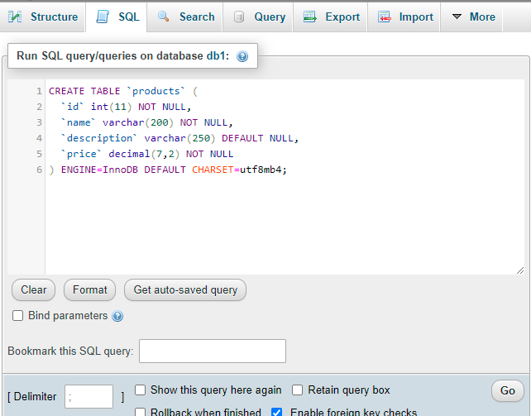
Run SQL Statements in MySQL

Slide 10
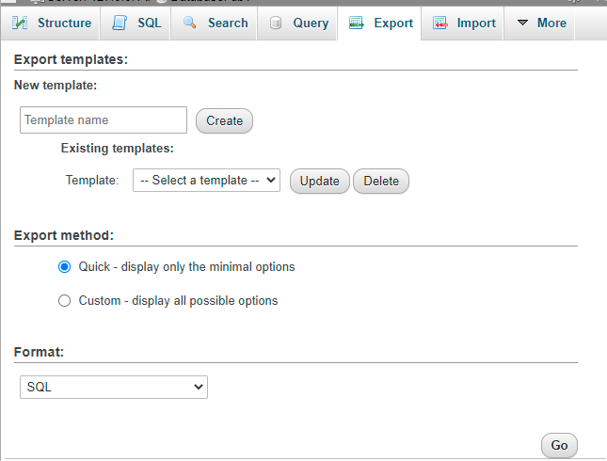
Export MySQL Database

Slide 11
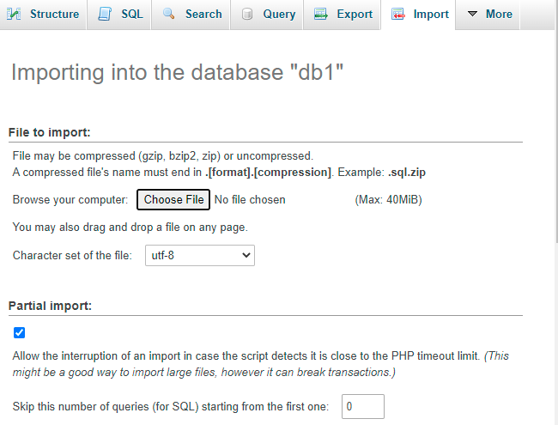
Import MySQL Database

Slide 12
Access MySQL from PHP
PHP 5 and later can access a MySQL database using two ways:
MySQLi extension (the "i" stands for improved)
PDO (PHP Data Objects)

Slide 13

MySQLi vs. PDO
MySQLi is a relational database driver used in the PHP to provide an interface with MySQL databases.
PDO is a driver that implements the PHP Data Objects (PDO) interface to enable access from PHP to MySQL databases.
PDO will work on 12 different database systems,
MySQLi will only work with MySQL databases
Search about more advantages for both

Slide 14
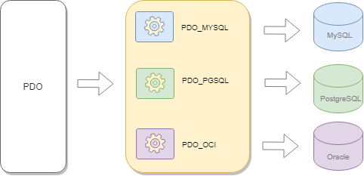
PDO
PDO simplifies the common database operations including:
Creating database connections
Executing queries using prepared statements
Calling stored procedures
Performing transactions
And handling errors

Slide 15
Open a Connection to MySQL using PDO
<?php $host = "localhost"; //server name $username = "username"; $password = "password";
$dbname= "dbname"; //database name try { $pdo = new PDO("mysql:host=$host;dbname=$dbname", $username, $password);
// set the PDO error mode to exception $pdo->setAttribute(PDO::ATTR_ERRMODE, PDO::ERRMODE_EXCEPTION); echo "Connected successfully";
} catch(PDOException $e) { echo "Connection failed: " . $e->getMessage(); } ?>
To Close the Connection
$pdo = null;

Slide 16
SELECT Data
<?php
...
//select query
$sql = 'SELECT * FROM products';
$result = $pdo->query($sql);
// get all products as associative array
$products = $result->fetchAll(PDO::FETCH_ASSOC);
...
?>

Slide 17
#Example 4-1
Requirements:
Write a PHP script to connect to database and show all products table records.
See it on GitHub

Slide 18
Example 4-2
Requirements:
Write a PHP script to connect to database and show all products table records in a HTML table.
See it on GitHub

Slide 19
#Example 4-3
Requirements:
Add categories table to the database and make a correct relationship with products table.
Write a PHP script to connect to database and show all products table records ordered by category id.
See it on GitHub

Slide 20
#Example 4-4
Requirements:
Write a PHP script to connect to database and show all product records that related to a selected category id.
See it on GitHub
$sql = "SELECT * FROM Users
WHERE userID = ?";
$result = $pdo->prepare($sql);
$result->execute([$id]);
Notes:
$stmt = $db->prepare("select userID from tblUsers where logged = '1' AND ip = :ip");
$stmt->execute(array('ip' => $ip));
$listArray = $stmt->fetchAll();
$count=$dbo->prepare("DELETE FROM pdo_admin WHERE id=:id");
$count->bindParam(":id",$id,PDO::PARAM_INT);
$count->execute();

Slide 21
#Example 4-5
Requirements:
Design two web pages
The first page shall show all category names with a link to second page.
The URL in the link shall include the cat_id value. example: localhost/product_list?cid=5
The second page shall show all products in a HTML table for one category depending on the sent cat_id value.
See it on GitHub
Notes:
$stmt = $db->prepare("select userID from tblUsers where logged = '1' AND ip = :ip");
$stmt->execute(array('ip' => $ip));
$listArray = $stmt->fetchAll();
$count=$dbo->prepare("DELETE FROM pdo_admin WHERE id=:id");
$count->bindParam(":id",$id,PDO::PARAM_INT);
$count->execute();

Slide 22
INSERT Data

Slide 23
#Example 4-6
Requirements:
Write a PHP script to connect to database and insert a new product record using HTML form and data validation.
See it on GitHub

Slide 24
UPDATE Data

Slide 25
#Example 4-7
Requirements:
Write a PHP script to connect to database and show all products table records with update button to update a selected product record using HTML form and data validation.
See it on GitHub

Slide 26
DELETE Data

Slide 27
#Example 4-8
Requirements:
Write a PHP script to connect to database and show all products table records with delete button for each record to delete the record when the button have been pressed.
See it on GitHub

Slide 28
#Example 4-9
Visit and review news websites and make analysis to do:
Write requirements to have similar news website
Design and build a database
Build a CRUD system for the news portal

Slide 29
config.php file
In PHP, you can create a config.php file and place the database parameters:
<?php
$host = 'localhost';
$db = 'bookdb';
$user = 'root';
$password = 'S@cr@t1!’;
?>
//then in any PHP file write
require 'config.php';

Slide 30
Connecting to MySQL using config.php file
<?php
require 'config.php';
$dsn = "mysql:host=$host;dbname=$db;charset=UTF8";
try {
$pdo = new PDO($dsn, $user, $password);
if ($pdo) {
echo "Connected to the $db database successfully!";
}
} catch (PDOException $e) {
echo $e->getMessage();
}

Slide 31
Fetch Some Data
Get data by id in URL

Slide 32
End

