Slide 1
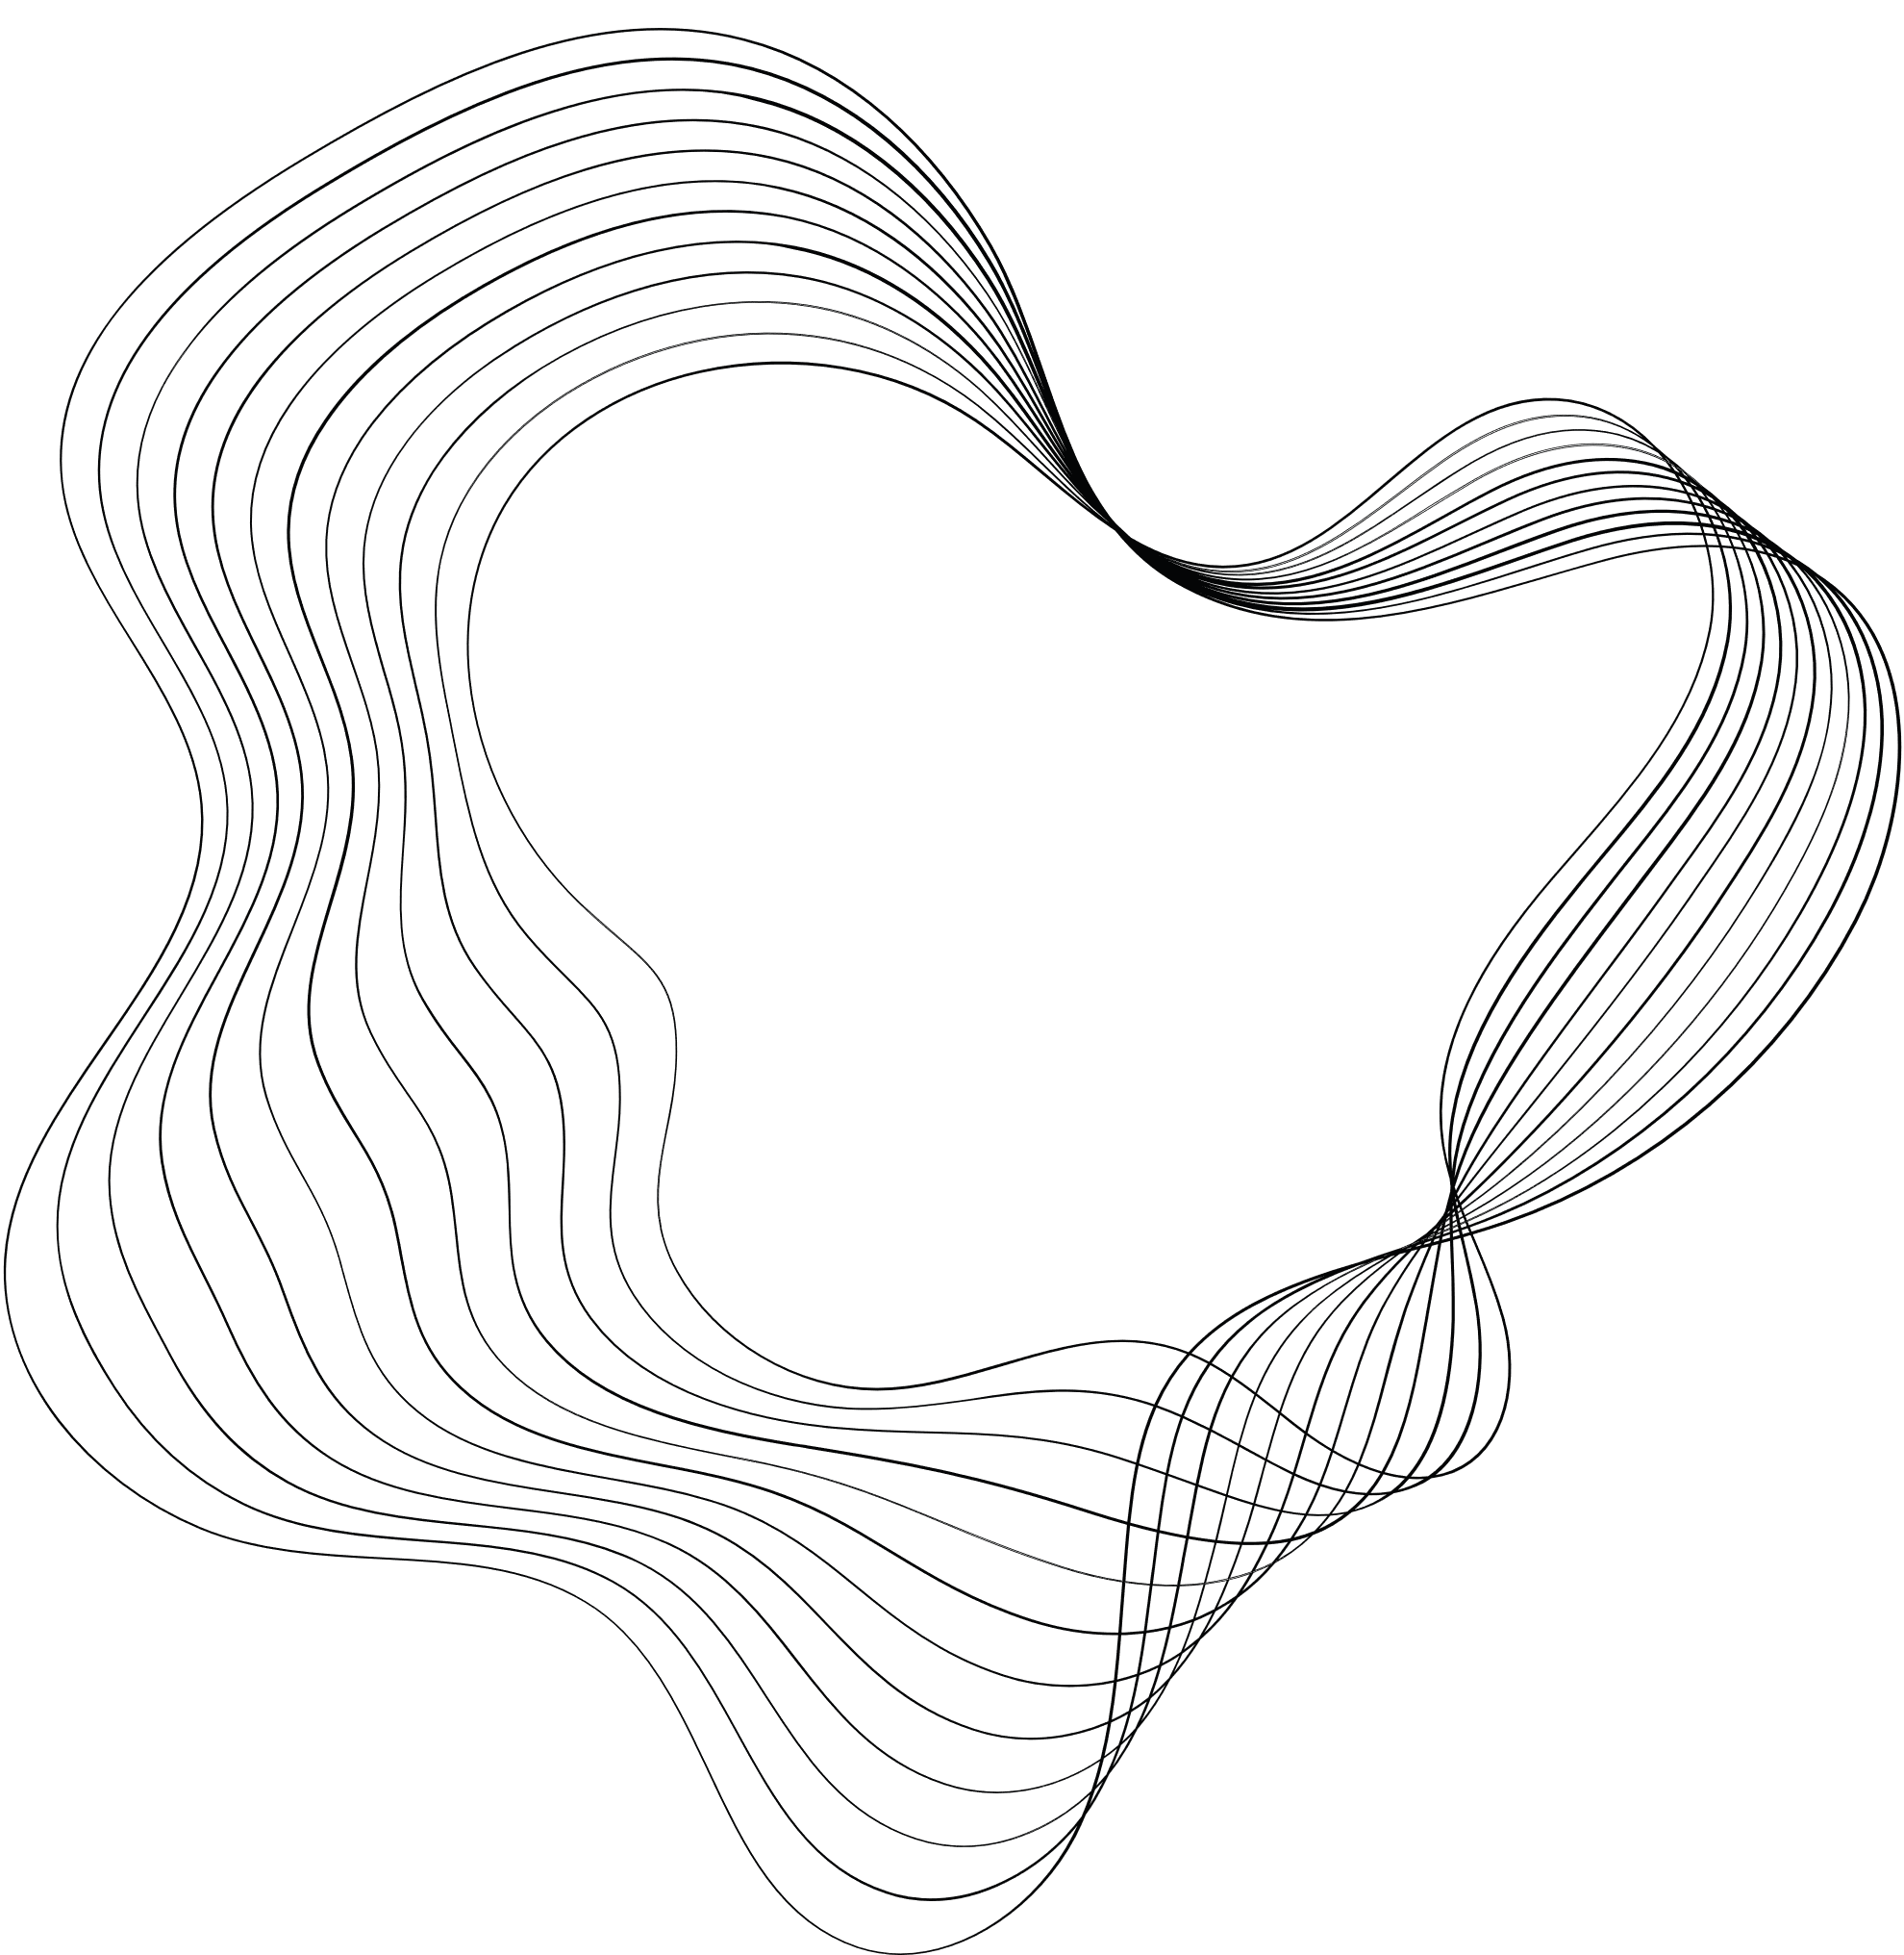

CNN PERFORMANCE IMPROVEMENT
PREPARED BY:
AHMAD HARAKEH
AHMAD ATWI
PRESENTED FOR:
D.PETROVSKA

Slide 2
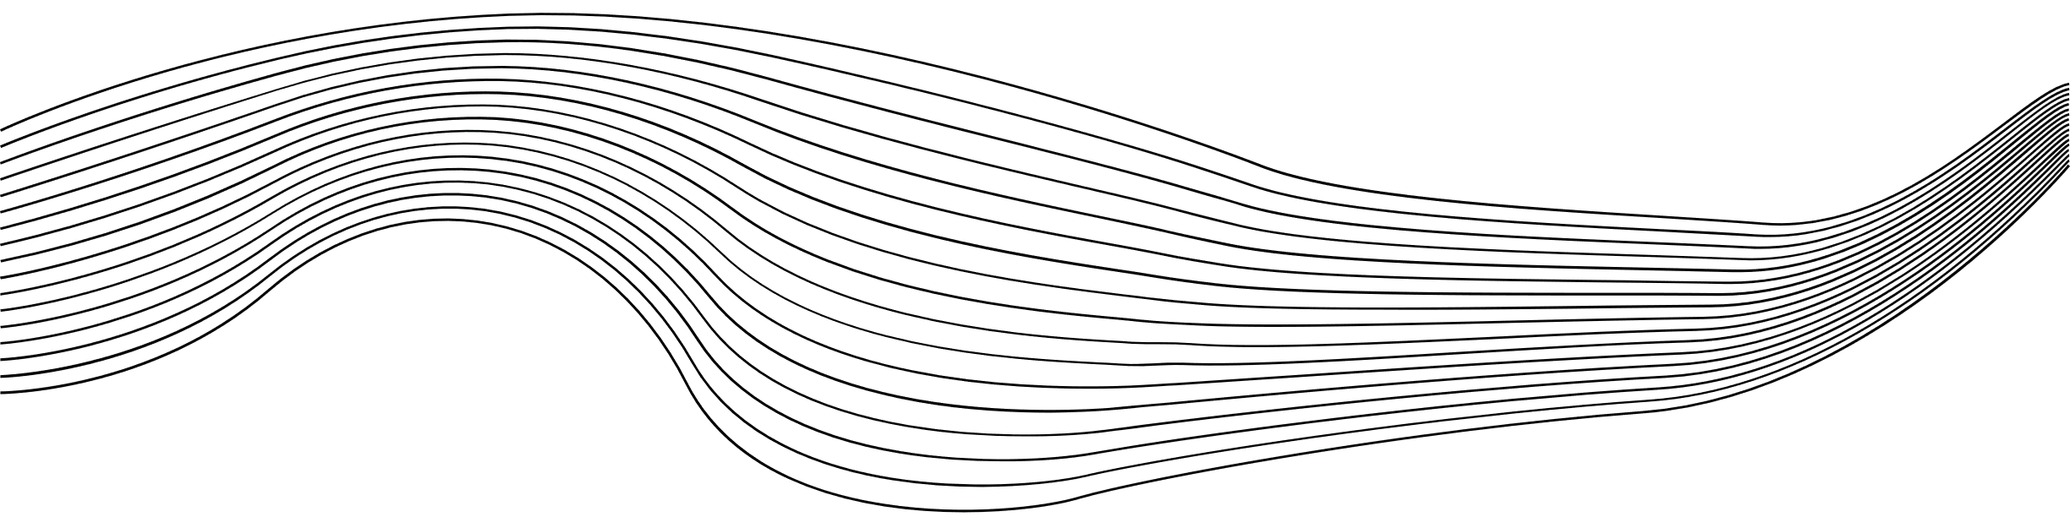
CONTENT
1
CNN OVERVIEW
2
OBJECTIVES
3
BASELINE PROJECT
4
CNN MODIFICATION
5
CONCLUSION

Slide 3
1. Convolutional Neural Network (CNN)
A class of deep neural networks, most commonly applied to analyzing visual imagery.
Comprised of multiple layers that automatically and adaptively learn spatial hierarchies of features from input images.
Why They're Used:
Feature Learning
Learn increasingly complex patterns using smaller and simpler patterns.
Recognizing objects
Dimensionality Reduction

Slide 4
2.OBJECTIVES
The project aims to enhance the accuracy of a Convolutional Neural Network (CNN) model by modifying its architecture.
The project focuses on making architectural adjustments to the CNN model, including adding or removing layers such as convolutional, pooling, and dense layers.
Testing different activation functions, such as ReLU, tanh, and sigmoid, to evaluate their impact on the model's performance.
Experimenting with the number and size of filters in convolutional layers to investigate their effect on feature extraction and representation.

Slide 5


3. BASELINE PROJECT
Training a basic Convolutional Neural Network for CIFAR-10 Image Classification
CIFAR-10 is a dataset composed of 10 classes each with 6000 image
Normalization of image pixels was done to eliminate the distortions caused by shadows and light in the image
For Feature learning:
Convolutional Layer of 32 filters (3,3) followed by ReLU activation function
2 Convolutional Layesr of 64 filters (3,3) followed by ReLU activation function
2 MaxPooling Layers
For Classification:
A dense layer of 64 outputs with a ReLU
A dense layer of 10 outputs with softmax

Slide 6
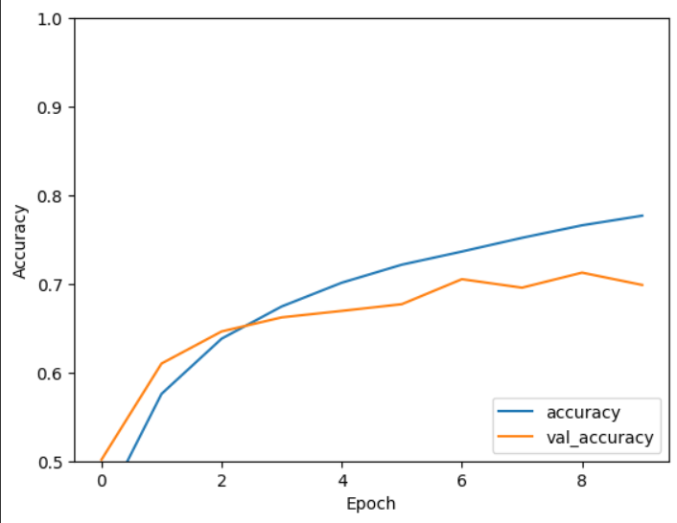

3. BASELINE PROJECT
The model was trained:
Using ‘’adam’’ optimizer
Using crossentroy_loss function
On 10 “epochs”
The Results obtained after training:

Slide 7
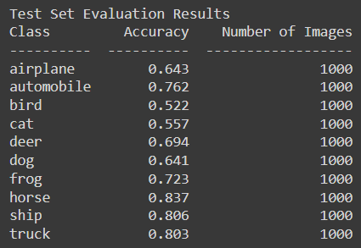
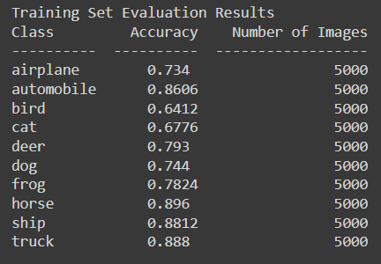
3. BASELINE PROJECT

Slide 8
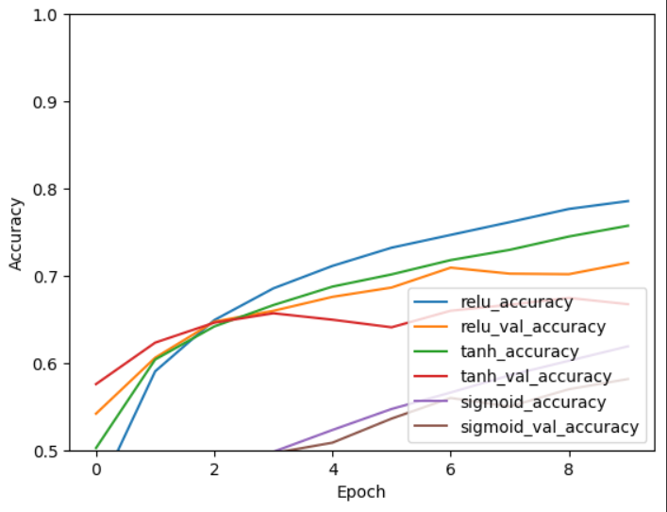
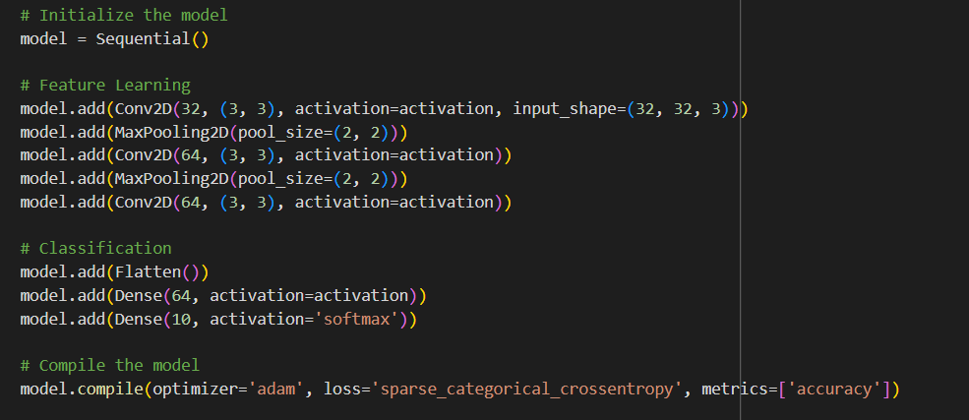
4. CNN MODIFICATIONS
4.1 Testing Different Activation Functions
Using the same Baseline model and testing it on different activation functions results with val_accuracy of :
ReLU → 0.69
Tanh → 0.6744
Sigmoid → 0.5814

Slide 9
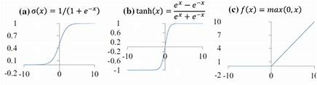
4. CNN MODIFICATIONS
4.1 Testing Different Activation Functions
As we can see ReLU results in a better performance of the model over tanh, sigmoid activation functions because:
ReLU introduce non-linearity→ allow NN to learn complex patterns in data
Faster Convergence
Better Generalization
Sparce Activation → only subset of neurons is activated → less likely to overfit

Slide 10
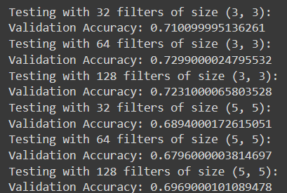
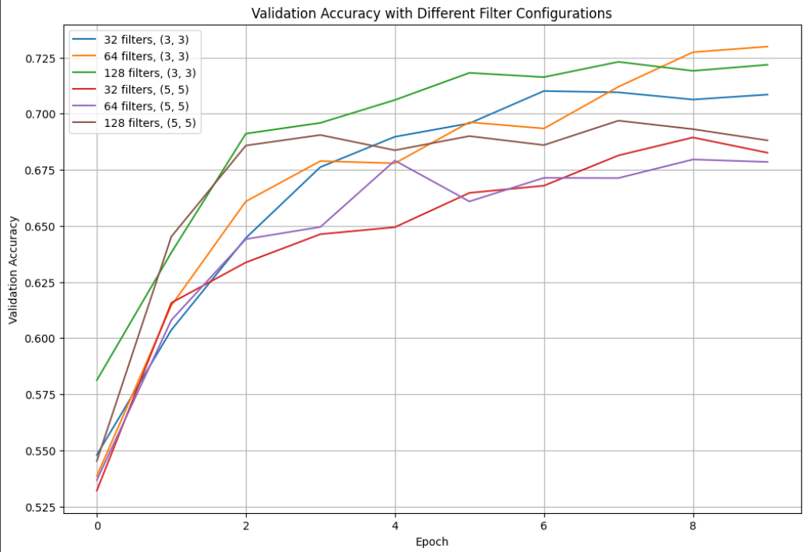
4. CNN MODIFICATIONS
4.2 – Testing different kernel sizes and numbers:
As we can see in the results obtained after training on the base model :
64 filters of size (3,3) results in the highest validation accuracy
64 filters of size (5,5) results in the lowest validation accuracy

Slide 11
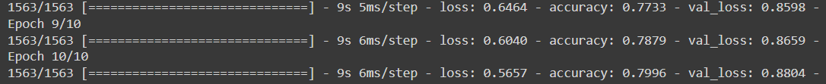
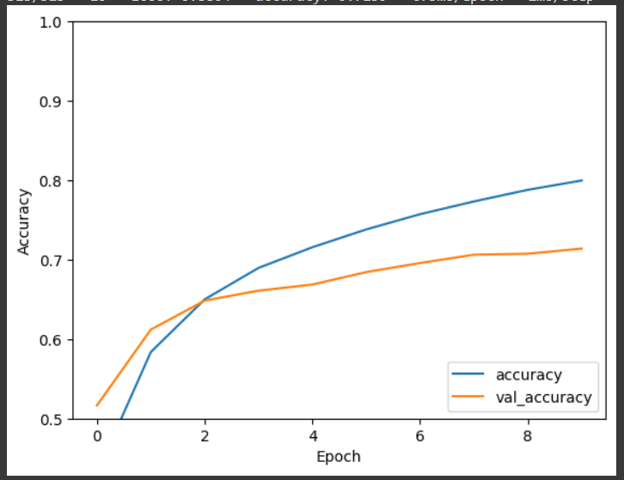
4. CNN MODIFICATIONS
4.3 – Addition of Layers
Adding:
One Convolutional Layer
One MaxPooling Layer
This Leads to :
Slightly increase with
Both accuracies
val_accuracy to 70%

Slide 12
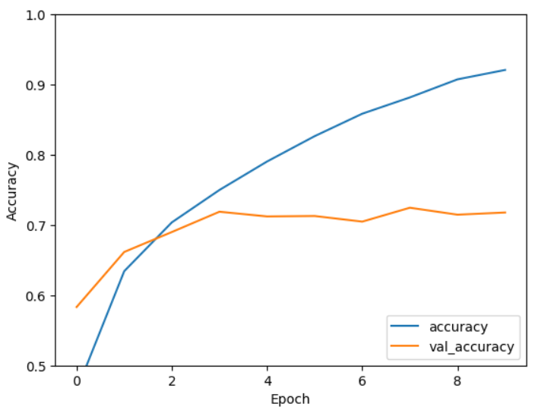
4. CNN MODIFICATIONS
4.3 – Addition of Layers
Having 3 Convolutional Layers and 2 MaxPooling Layers (padding used) Leads to a significant increase in the accuracy of the train dataset and overfitting is observed

Slide 13
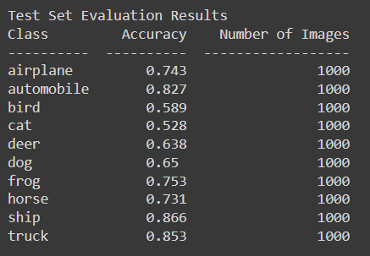
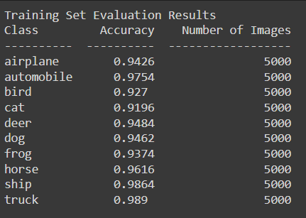
4. CNN MODIFICATIONS
4.3 – Addition of Layers
For this Reason Dropout, BatchNormalization could be used to reduce the overfitting issue

Slide 14

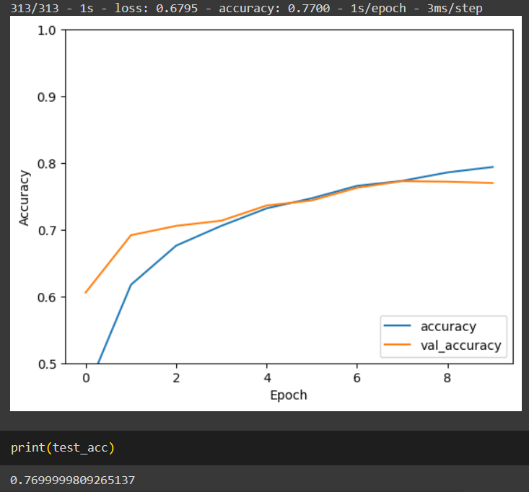
4. CNN MODIFICATIONS
4.3 – Addition of Layers
Using a Dropoutot 0.25 for the Convolutional Layers and 0.5 for the first Dense Layer
Val_accuracy quite similar to the
Train accuracy
Improved val_accuracy from 70 % to 77%
Overfitting Solved

Slide 15
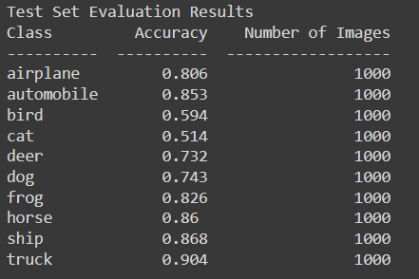
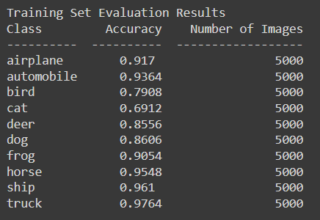
4. CNN MODIFICATIONS
4.3 – Addition of Layers

Slide 16
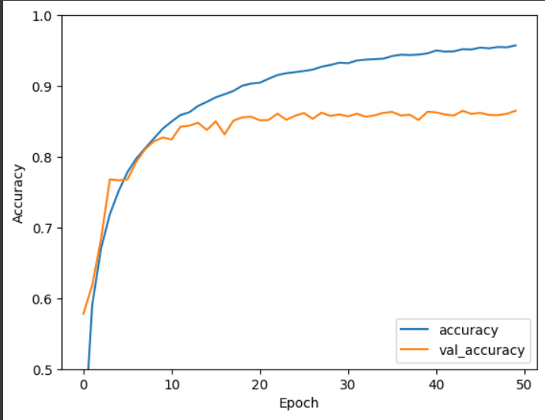

4. CNN MODIFICATIONS
The method combines motion estimation and frame synthesis into a single convolution process.
It estimates spatially-adaptive separable kernels for each output pixel.
It convolves input frames with the kernels to render the intermediate frame.
It uses 1D kernels to approximate full 2D ones to reduce the number of kernel parameters.
It enables full-frame synthesis and supports the use of perceptual loss.
The method compares favorably to state-of-the-art interpolation methods and produces high-quality results.
Now putting it all together :
Having the ReLU activation Function which results in higher validation accuracy
Having
6 Convolutional layers with 32, 64, 128 of (3,3) filters
6 BatchNormalization_Layers after each Convolutional Layer
3 MaxPooling2D Layers
Dropout of 0.25
Model Trained on 50 epoch

Slide 17
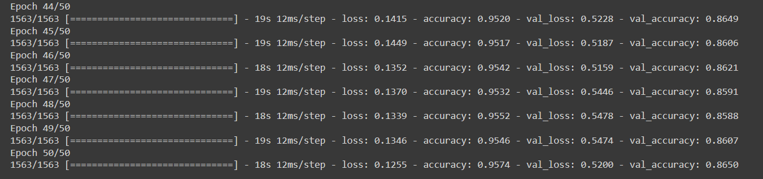
4. CNN MODIFICATIONS
The method combines motion estimation and frame synthesis into a single convolution process.
It estimates spatially-adaptive separable kernels for each output pixel.
It convolves input frames with the kernels to render the intermediate frame.
It uses 1D kernels to approximate full 2D ones to reduce the number of kernel parameters.
It enables full-frame synthesis and supports the use of perceptual loss.
The method compares favorably to state-of-the-art interpolation methods and produces high-quality results.

Slide 18
5.Conclusion
Different activation functions affects the accuracy of the Network
Different kernel numbers and sizes also affect the accuracy
Going deep in the Network increase its performance but it may leads for :
Vanishing gradients in case of some activation functions
Overfitting
Complexity
Optimization Challenges

Slide 19

THANK YOU!

