Slide 1

Flyweight Design Pattern
Clothing Store Inventory System
Design Patterns Project

Slide 2


Problem Analysis: Memory Exhaustion
Real-World Scenario
E-commerce systems managing millions of clothing items with identical core attributes.
The Challenge
Storing redundant data (Brand, Design, Material) for every instance wastes system RAM.
Redundant Objects = Resource Depletion
The Impact
Slow performance, high GC overhead, and failure to scale as inventory grows.

Slide 3

Pattern Selection: Flyweight vs. Composite
Feature
Flyweight Pattern
Composite Pattern
Primary Goal
Memory Optimization
Part-Whole Hierarchy
Best Used When
Many similar objects exist
Tree structures are needed
Memory Impact
Significant Reduction
Potential Increase
Justification: Flyweight was selected because it directly addresses the redundant data problem, enabling massive scalability.

Slide 4

Design Strategy: State Separation
Intrinsic State (Shared)
Extrinsic State (Unique)
Data constant across many objects and shareable.
Context-dependent data that varies per instance.
Brand, Material, Color, Design, Price, Image
Size, SKU, Location, Qty
The Factory Role: Manages a pool of shared "ClothingModel" objects to avoid duplicates.

Slide 5
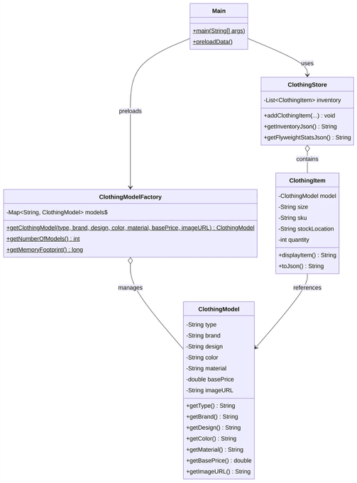
UML Class Diagram & Architecture
ClothingModel
The Flyweight: Stores shared intrinsic state (Brand, Material, Color).
ClothingModelFactory
The Factory: Manages the pool of shared models and ensures reuse.
ClothingItem
The Context: Stores unique extrinsic state (Size, SKU) and references a model.
ClothingStore
The Client: Orchestrates the inventory and interacts with the factory.

Slide 6

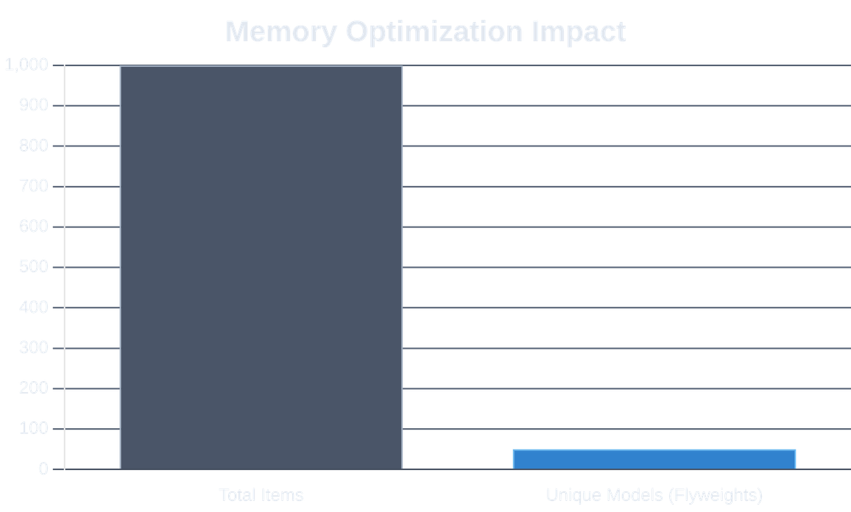


Implementation & Demo Metrics
Backend: Java HTTP Server with Flyweight Logic
Frontend: HTML5 / CSS3 / JavaScript Dashboard
Key Metric: Real-time Memory Efficiency %
Tech Stack: Java JDK 8+, HashMap Caching, RESTful APIs, Responsive Web UI.

Slide 7





Trade-offs & Team Management
Pattern Trade-offs
Team & Collaboration
Pros: Massive memory savings and better scalability for large inventories.
Member 1:
Architecture & UML Design
Cons: Increased complexity due to state separation and factory logic.
Member 2:
Backend & Flyweight Logic
Member 3:
Frontend & Documentation
Conclusion: Essential for high-volume systems where memory is a constraint.
Managed via GitHub Project Board & Issues
Thank you

