Slide 2
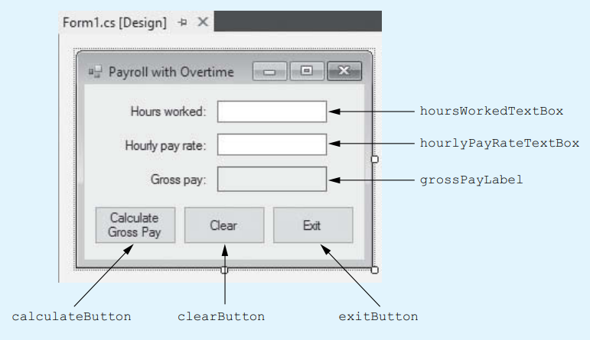
Payroll with Overtime application
If the hours worked is greater than 40:
base pay = hourly pay rate × 40
overtime hours = hours worked − 40
overtime pay = overtime hours × hourly pay rate × 1.5
gross pay = base pay + overtime pay
Else:
gross pay = hours worked × hourly pay rate

Slide 3
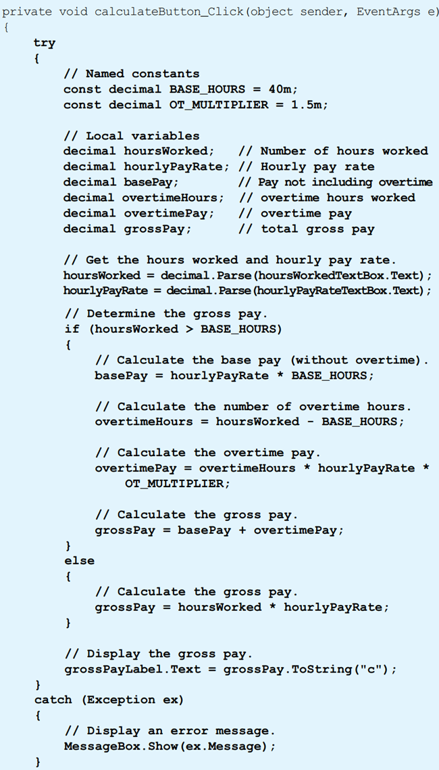

Slide 4
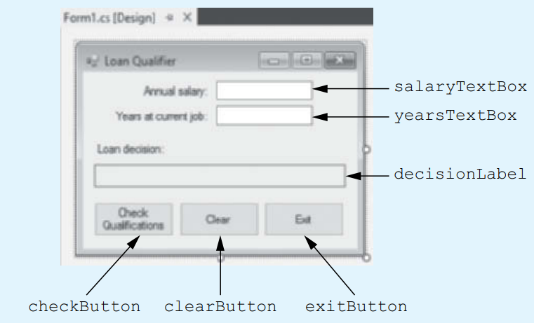
Example
Loan Qualifier application
Determine whether a person qualifies for a loan.
To qualify for the loan, the person must earn a salary of at least $40,000 and must have been employed at his or her current job for at least 2 years.

Slide 5
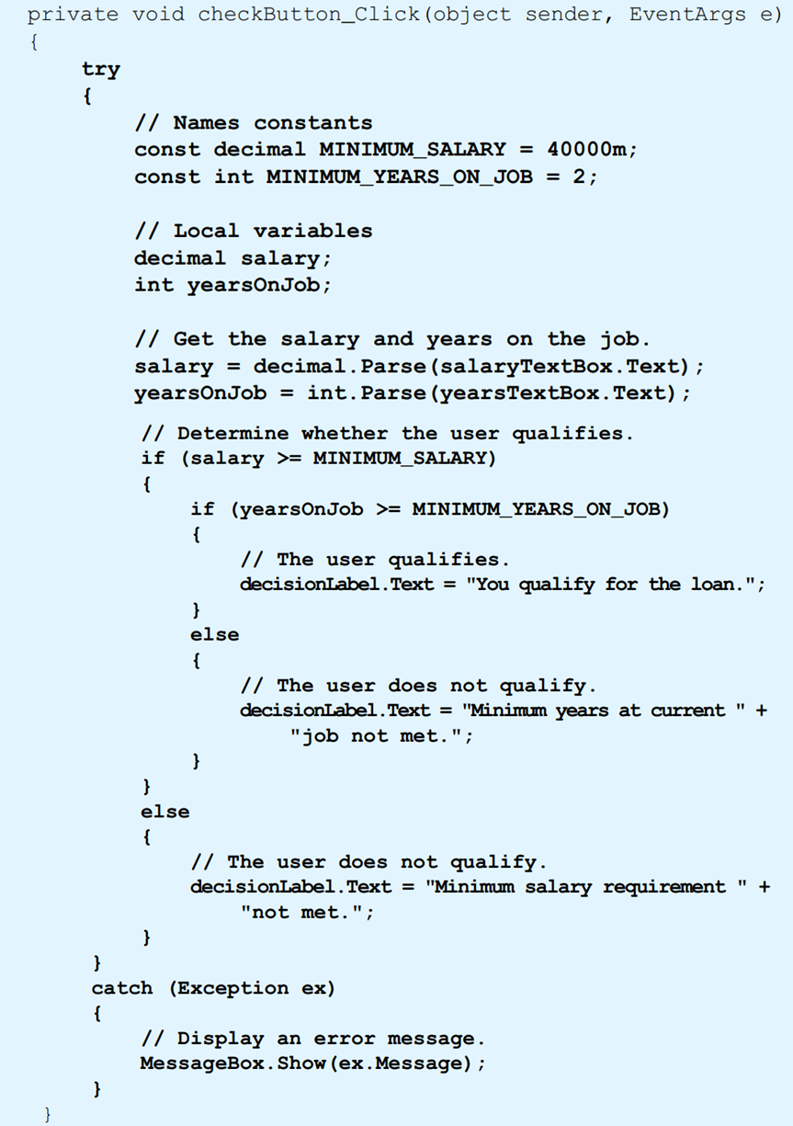

Slide 6
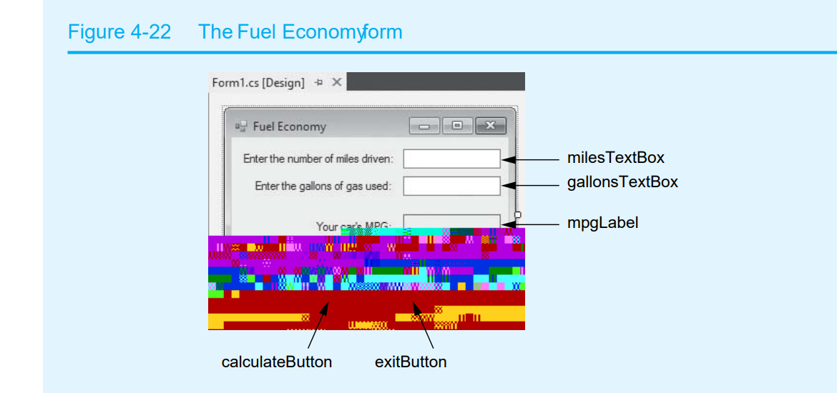

Slide 7
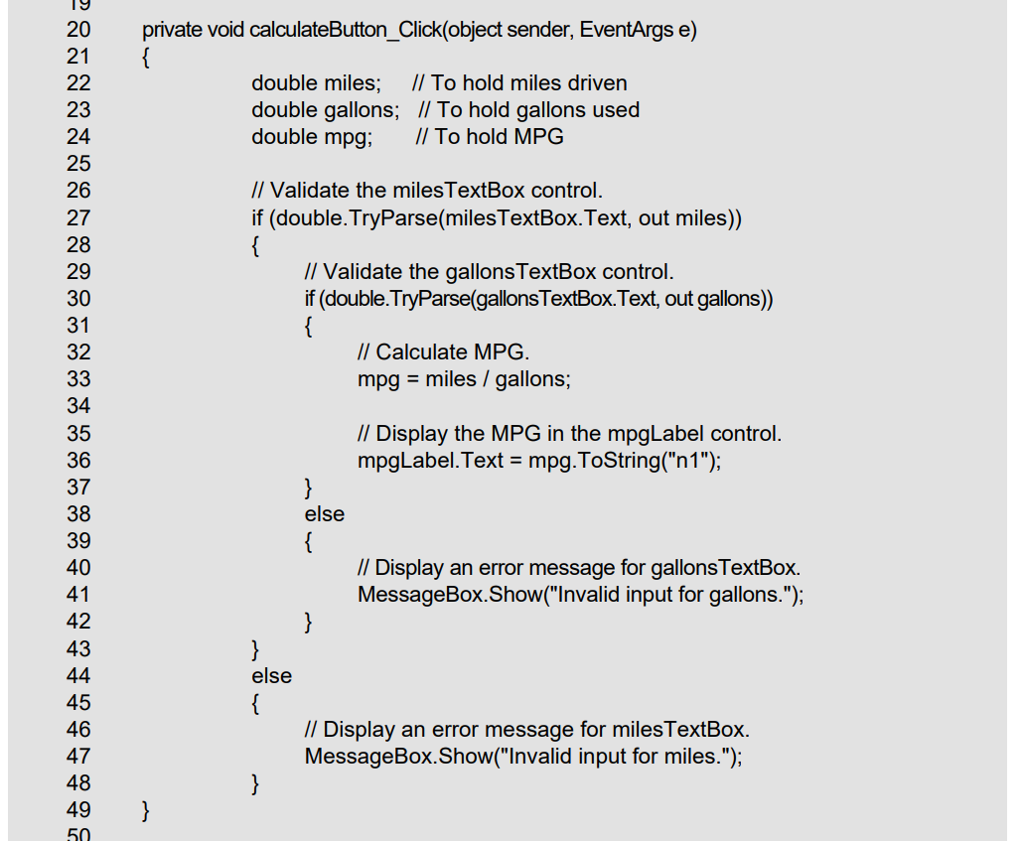

Slide 8
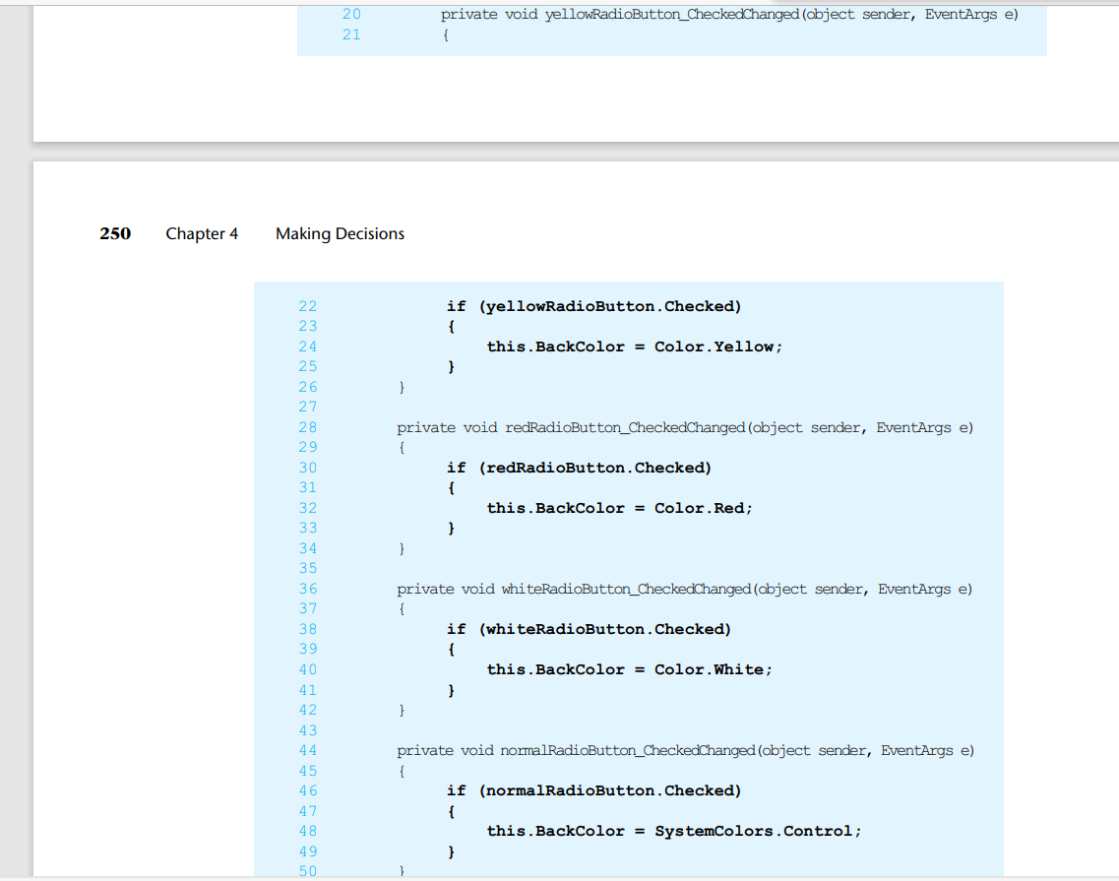

Slide 10
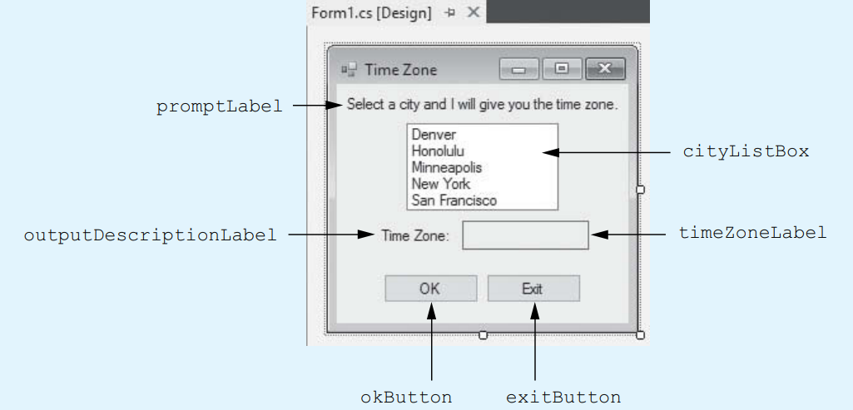
Example
Time Zone application
Create an application that allows the user to select a city from a ListBox control.
When the user clicks a button, the application displays the name of the city’s time zone.

Slide 11
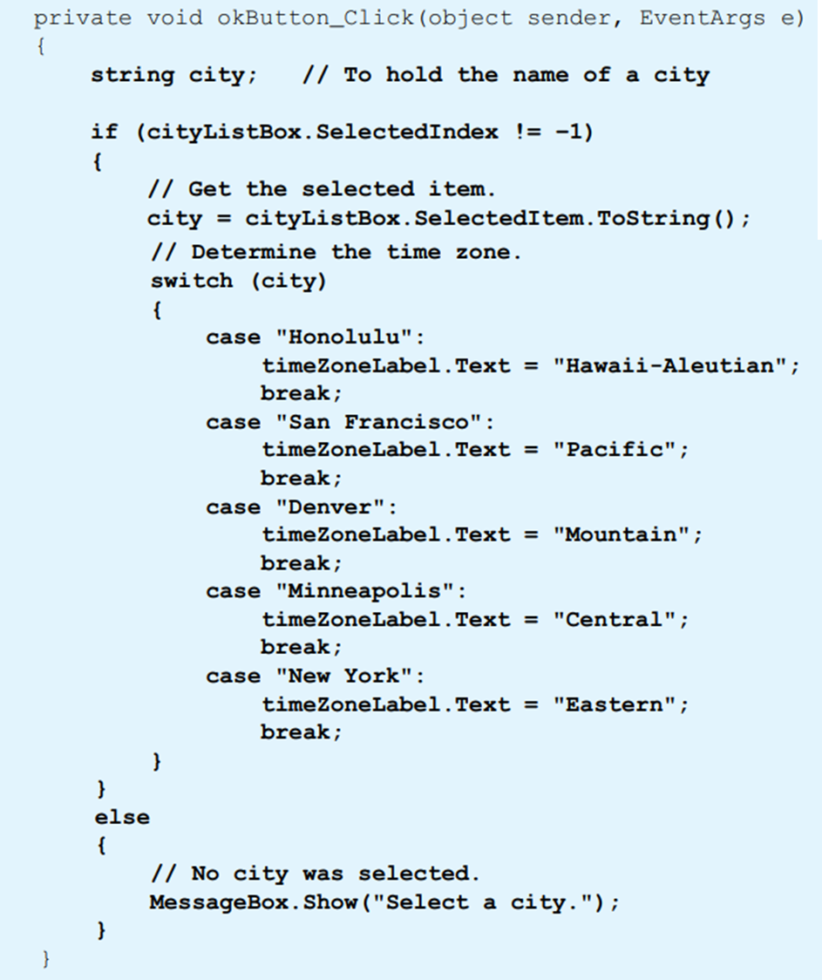

Slide 13
Color Mixer
The colors red, blue, and yellow are known as the primary colors because they cannot be made by mixing other colors. When you mix two primary colors, you get a secondary color, as shown here: • When you mix red and blue, you get purple. • When you mix red and yellow, you get orange. • When you mix blue and yellow, you get green. Create an application that lets the user select two primary colors from two different sets of Radio buttons. The form should also have a Mix button. When the user clicks the Mix button, the form’s background should change to the color that you get when you mix the two selected primary color

Slide 14
