Slide 1
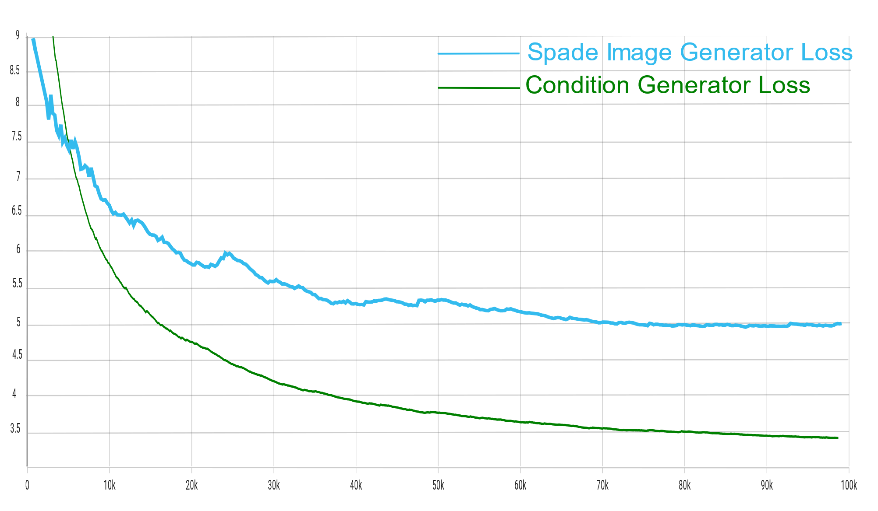
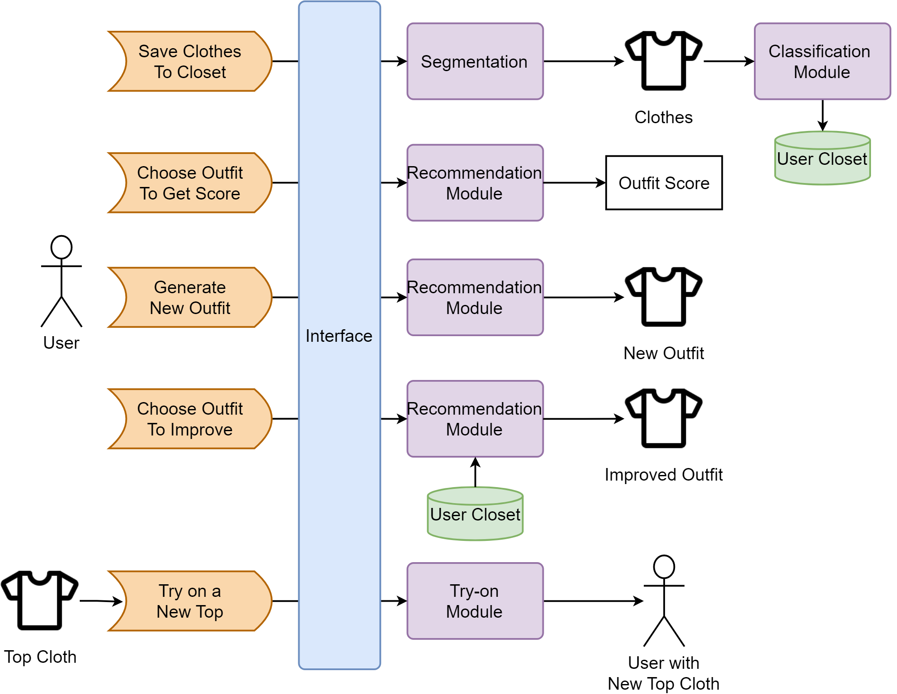








































StyleAIst
Ahmed Ayoub - 1180483
Ahmad Elsayed - 1180018
Manar Zakaria - 1180492
Moaz Tarek - 1180013
Dr. Michael Ibrahim
Technologies
What is StyleAIst ?
Fashion is a significant aspect of our lives, reflecting our individuality, cultural influences, and religious beliefs. AI-powered fashion apps alleviate the challenge of selecting suitable outfits, suggesting new styles, recommending comparable items, and enabling virtual try-ons. This report explores the app's technology, development process, findings, and features, showcasing its ability to enhance fashion choices and user experiences.
Outfit Recommendation
Outfit recommendation in our system can be used in one of two ways. The user provides an outfit and our recommendation system suggests an improvement to that outfit based on the underlying feature extraction layers in our network. The second way is for users who need full outfit recommendation. Our System generates full outfits from the user’s wardrobe based on compatibility measures.
Virtual Try On
The virtual try on module provides the user with the luxury of trying out new clothes with the click of a button. No need to visit brick and mortars stores. Using Generative Adversarial networks the try on module generates realistic images of users wearing their desired clothes. This is done by generating a fake segmentation map of the user’s image and warping clothes around the body of the user. Then a SPADE image generator is used to produce the final image of the user with the desired garment.
System Features
Personalized outfit recommendations.
Explore trendy styles.
Convenient comparable item recommendations.
Virtual try-on feature.
Stay ahead of fashion trends.
Revolutionize fashion selection process.
Results
Virtual Try On Losses
Technologies
System Architecture
Python
PyTorch
OpenCv
Tensorflow
Pillow
PySide2
ResNet
U2Net
SPADE
GANS
StyleAIst in Action!
Graphic Elements
Modules Details
Segmentation
Clothing segmentation using U2Net architectures to produce high quality clothes masks representing the upper, lower and full body clothes present in the target image.
Classification
Implementing the ResNet Architecture on three different models each to detect a different article of clothing which improves accuracy of the classification and in turn enhances user experience. Each model has its own custom head layers with global average pooling techniques.
Outfit Scoring
We deploy a multilayer comparison network that takes as an input an outfit consisting of a top, bottom and a shoe all from the user’s wardrobe. Our smart recommendation system assigns a score to the outfit based on the compatibility of the components of the outfit together.
.
Conclusion
In conclusion, our AI-powered fashion system is the key to unlocking your style potential. With personalized recommendations, trend suggestions, comparable items, and virtual try-ons, it revolutionizes your fashion choices. Step into the future of fashion and experience a whole new level of style and convenience.

