Slide 1
Diamond Price Prediction
Made by:
Ahmad Hammad
Sahar Al-Omari
Mohammad Dabash

Slide 2
Contents
Import Necessary Libraries
Import the Data and Understand its Features
Exploratory Data Analysis (EDA)
Data Cleaning & Preprocessing
Feature Engineering
Models Experiments
Diamond Price Predictor App (Demo)

Slide 3
Import Necessary Libraries

Slide 4
Import the Data and Understand its Features
Train data shape: (43040, 11)
Test data shape: (10900, 10)
The data has columns such as: price, carat weight, cut, color, clarity, x length, y width, z depth, total depth, table width.

Slide 5
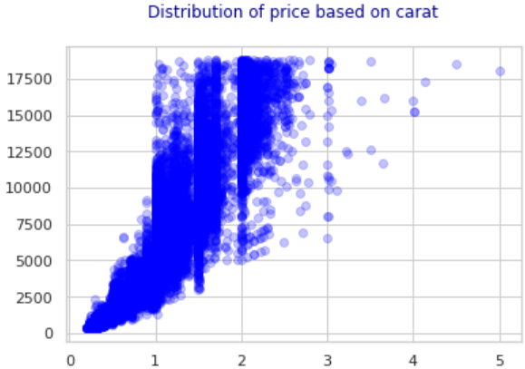
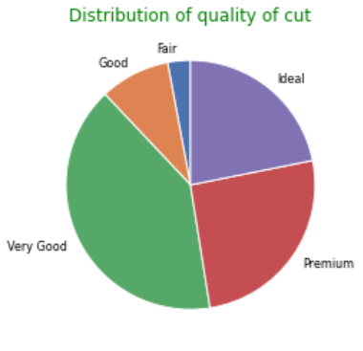
Exploratory Data Analysis (EDA)

Slide 6
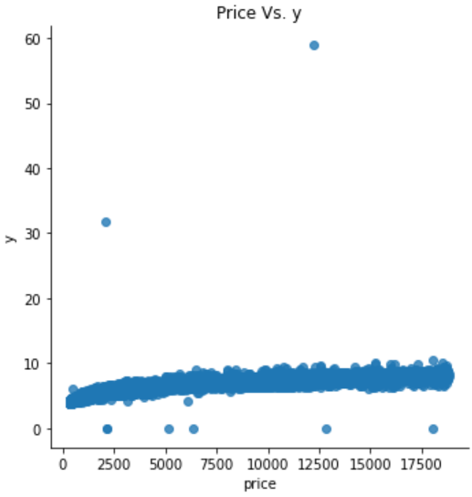
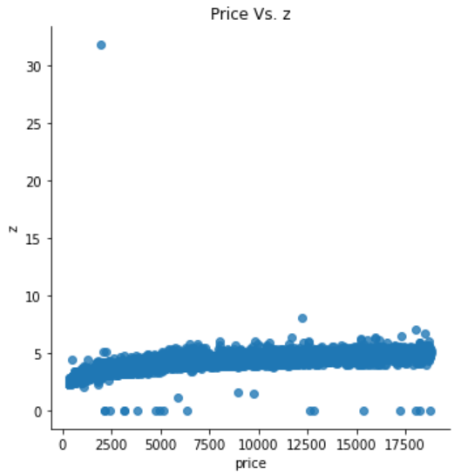
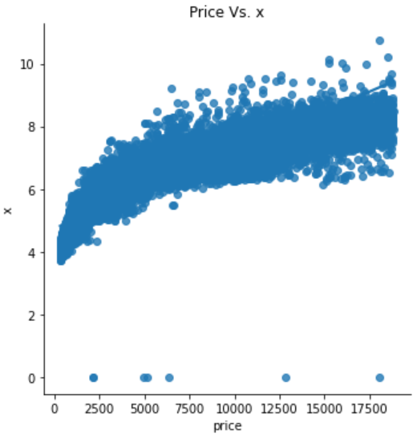
Exploratory Data Analysis (EDA)

Slide 7
Insights
We can see that this dataset has majority of “expensive cuts”, where the most frequent cuts are very good, premium and idea.
Carat, x, y, z are correlated with our dependent variable price. Thus, they have linear relation with the price.

Slide 8
Data Cleaning & Preprocessing
We removed outliers in x, y, z, depth, table features.
We used label encoder to decode the categorical variables (clarity, color and cut).
Split the data into X, and Y.

Slide 9
Feature Engineering
In this step we used polynomial features of degree two, but sadly there were not much an improvement.
We tried calculating the perimeter for the diamond, but there were no improvements.

Slide 10
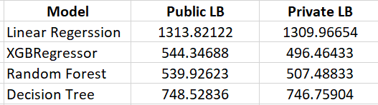
Models Experiments
Final public score was: 78.72
Private score: 31.2

Slide 11
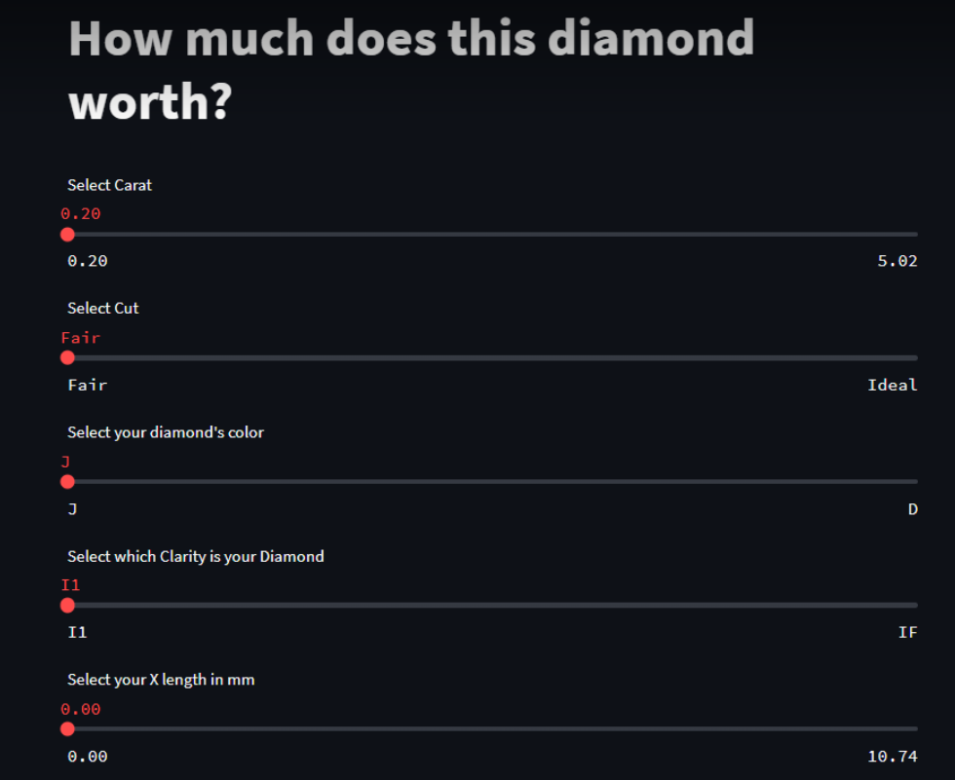
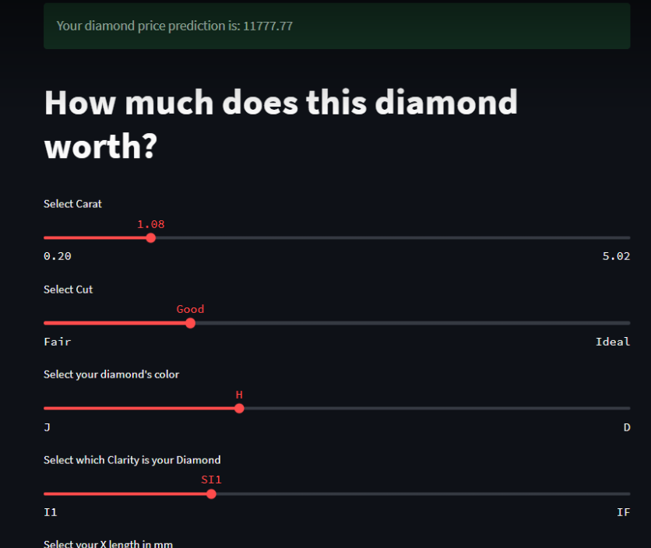
Diamond Price Predictor App (Demo)

Slide 12

The End

