Slide 1
COMPUTER VISION · OBJECT DETECTION
Electronic Component Detection
with YOLO11 — Laptop vs Raspberry Pi
8 components · auto-label + web validation · trained on RTX 3060 · deployed to Raspberry Pi 4 (NCNN) · full CSV + FPS logging
mAP50 0.98 · Pi NCNN ~6 FPS · Laptop ~80 FPS

Slide 2
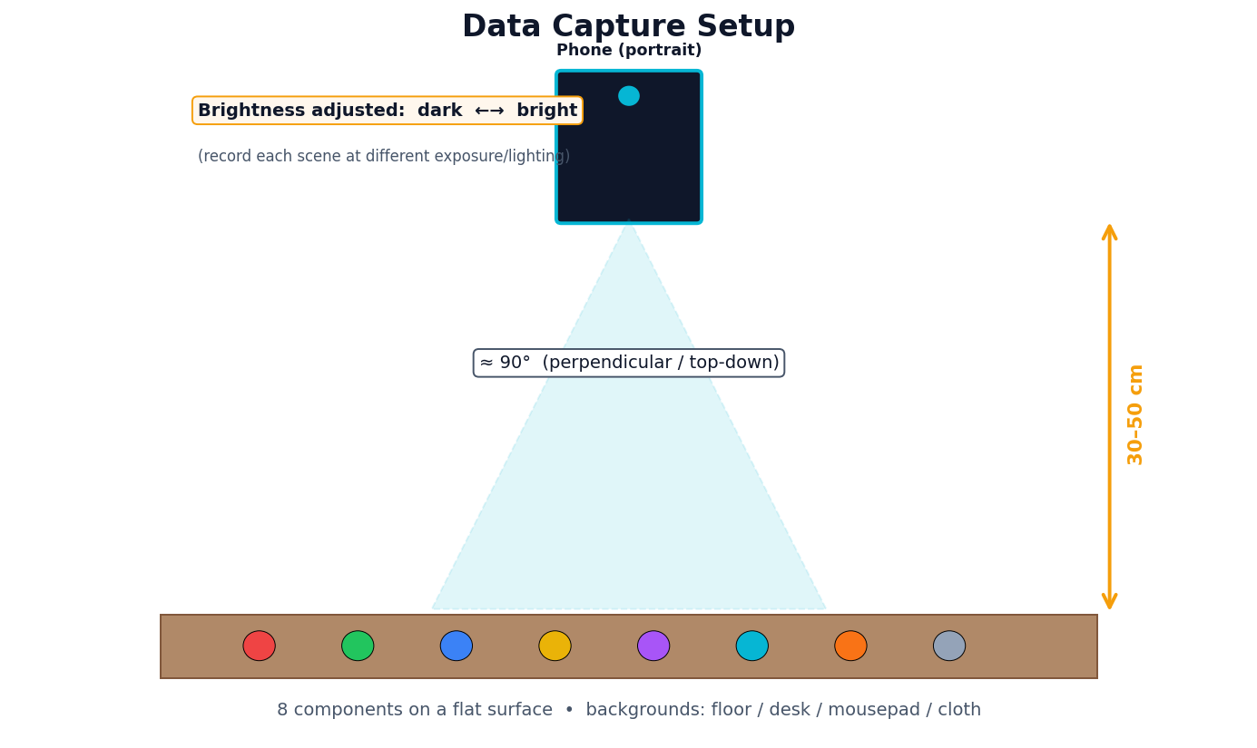
Objective & Components
Goal
Train one YOLO11 model to detect 8 electronic components in images, video, webcam, and on a Raspberry Pi — and compare laptop vs edge performance.
0 bldc_motor | 4 elco_capacitor
1 stm32f4 | 5 resistor
2 mpu6500 | 6 pin_header
3 ir_sensor | 7 xt30_female
2 / 16

Slide 3
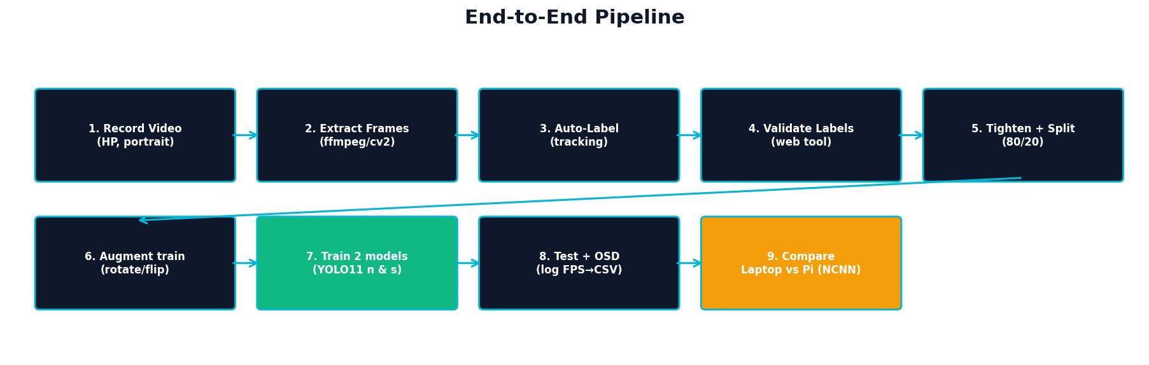
End-to-End Pipeline
Video → frames → auto-label → browser validation → tighten/split → augment → train (n & s) → test+log → compare laptop/Pi.
3 / 16

Slide 4
Step 1 — Data Capture
Protocol
Phone, portrait orientation
Top-down ≈90°, distance 30–50 cm
4 backgrounds: floor / desk / mousepad / cloth
Brightness adjusted dark → bright
Then frames extracted with a script (ffmpeg/cv2)
4 / 16

Slide 5
Steps 2-4 — Auto-label + Browser Validation
Auto-labeling
Initial boxes generated automatically (tracking / model-assisted), then a self-contained web tool (Python stdlib) lets you review every image, draw/move/resize boxes, set class, and validate one by one. An auto-tighten step (GrabCut) shrinks loose boxes to fit.
python tools/label_web/server.py --images labeling/images --labels labeling/labels --classes labeling/classes.txt
→ open http://localhost:8000 (A/D prev-next · 1-8 class · S save+validate · G copy to whole video)
200 images · 8 classes · stratified 80/20 split · rotation/flip augmentation on the train set.
5 / 16

Slide 6
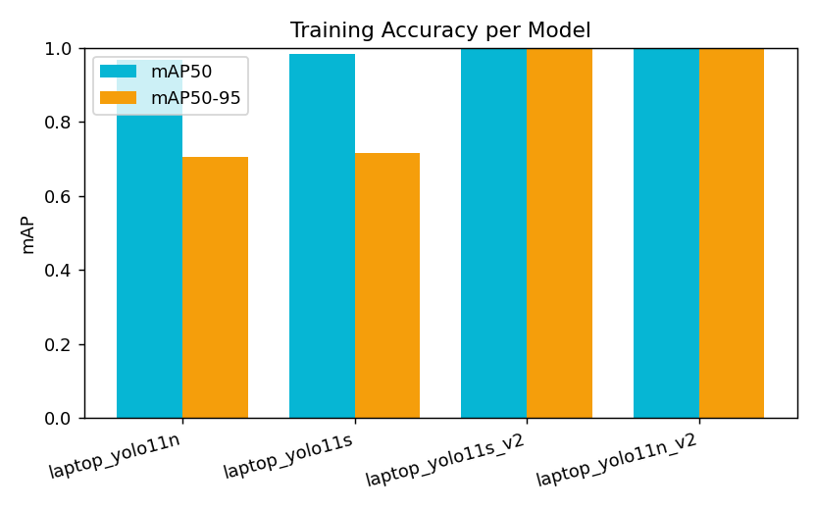
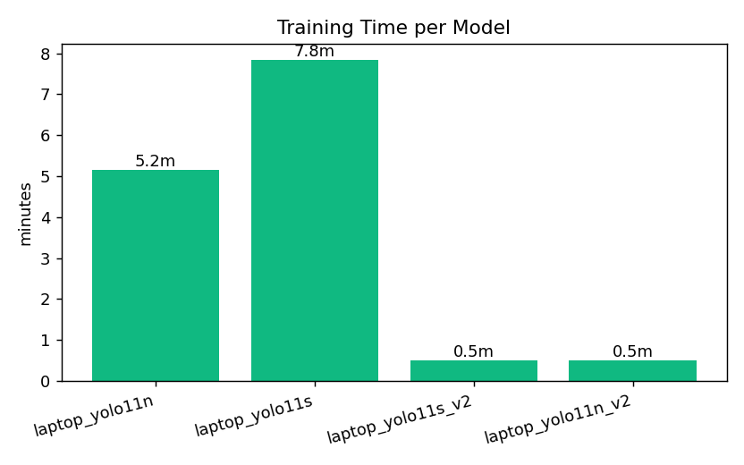
Training Results (RTX 3060, 120 epochs)
YOLO11n: mAP50 0.967 · 5.2 min | YOLO11s: mAP50 0.983 · 7.9 min (s = more accurate, n = faster/lighter).
6 / 16

Slide 7
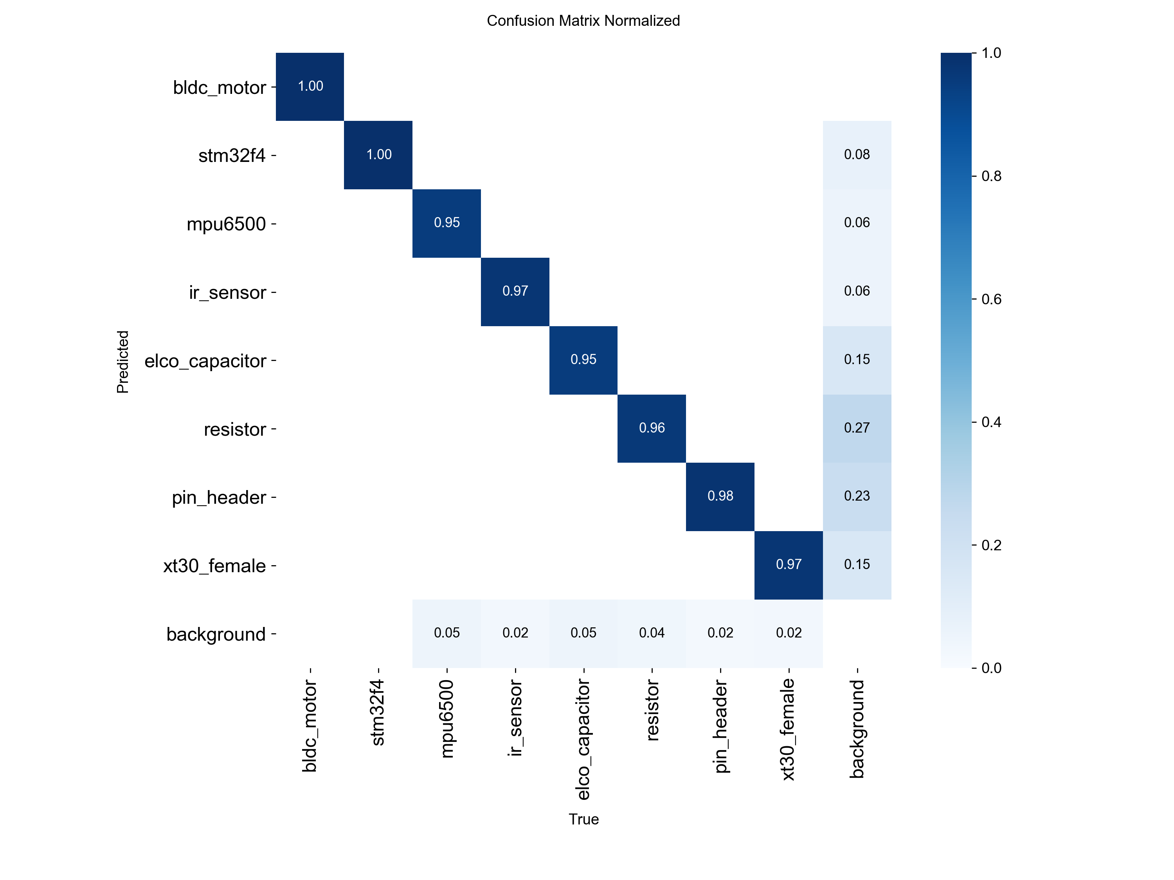
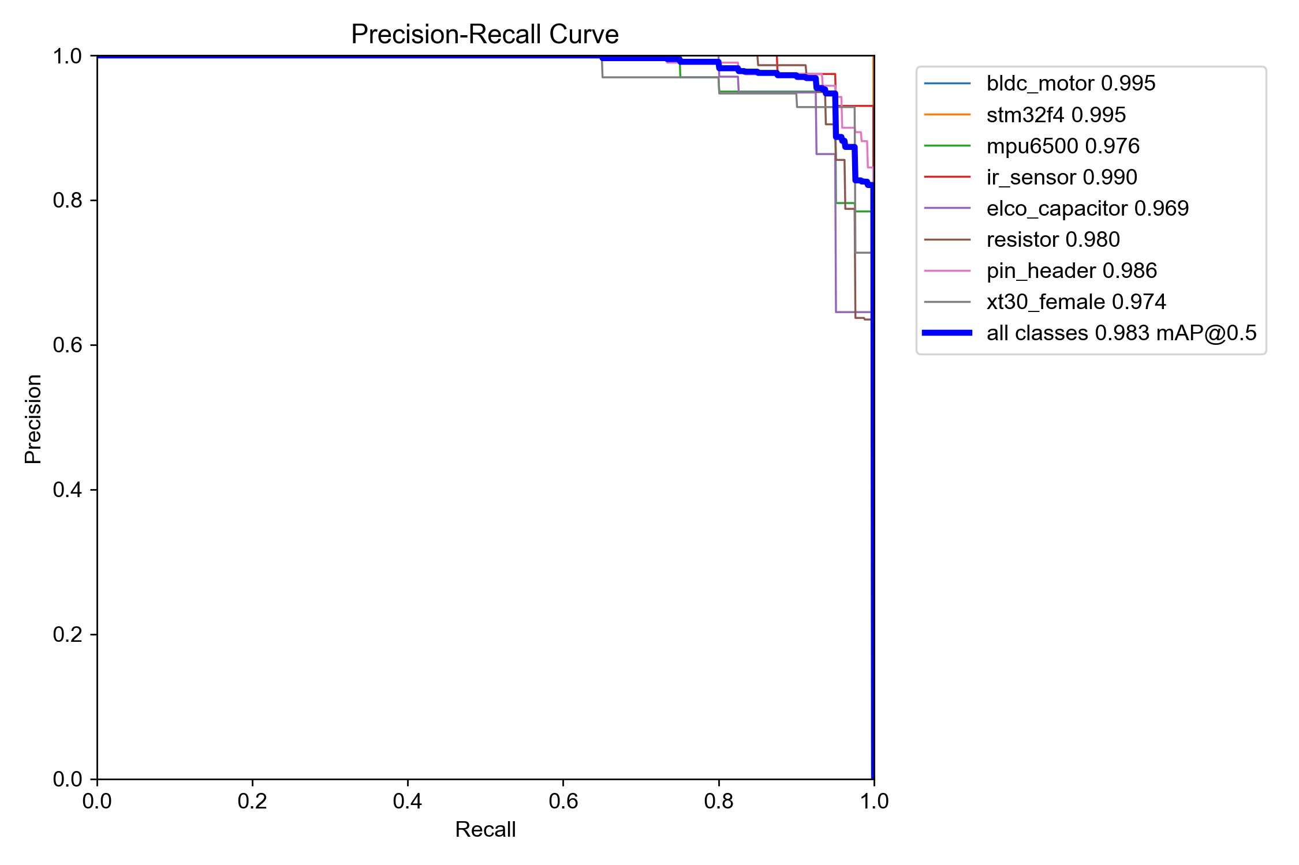
Evaluation — Confusion Matrix & PR
7 / 16

Slide 8
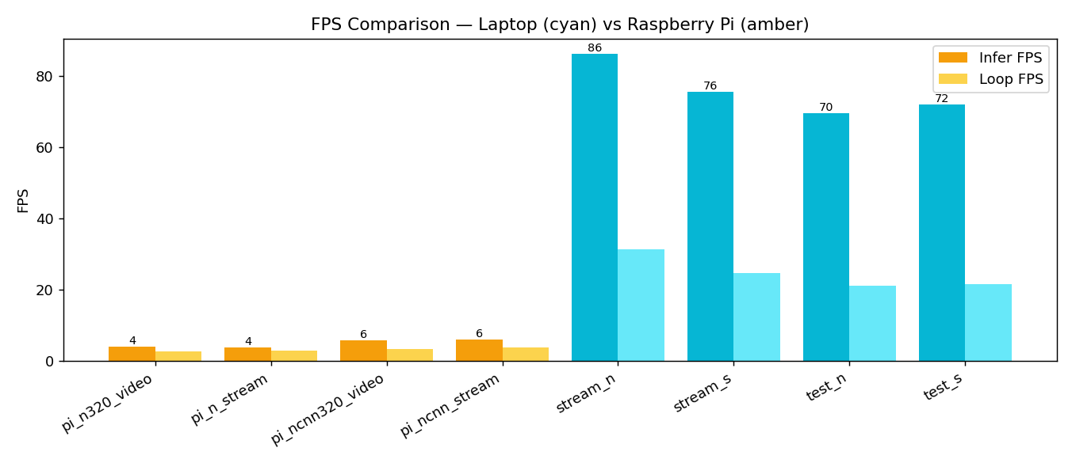
Speed — Laptop vs Raspberry Pi
Key findings
Laptop GPU: ~70–86 FPS
Pi .pt model: ~4 FPS
Pi NCNN: ~6 FPS (≈40% faster than .pt)
NCNN export is essential for the edge device.
8 / 16

Slide 9
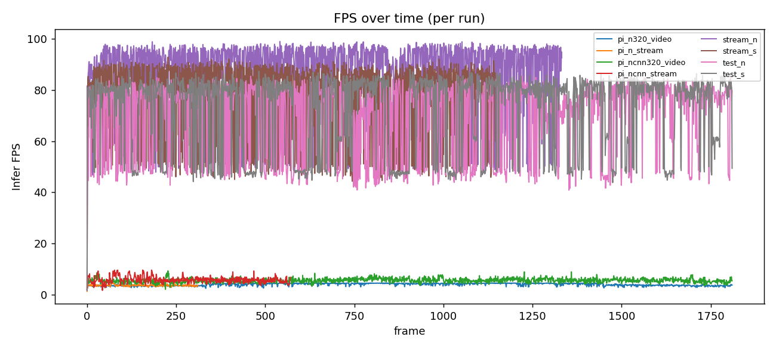
FPS Over Time (all runs)
9 / 16

Slide 10
Demo — Laptop · Test Video
▶
INSERT VIDEO HERE → videos/demo_laptop_video.mp4
PowerPoint: Insert ▸ Video ▸ This Device… (drag the .mp4 onto this box)
YOLO11s on RTX 3060 · ~70 FPS
10 / 16

Slide 11
Demo — Laptop · Camera Stream
▶
INSERT VIDEO HERE → videos/demo_laptop_stream.mp4
PowerPoint: Insert ▸ Video ▸ This Device… (drag the .mp4 onto this box)
YOLO11s webcam · ~76 FPS
11 / 16

Slide 12
Demo — Raspberry Pi · Test Video
▶
INSERT VIDEO HERE → videos/demo_pi_video.mp4
PowerPoint: Insert ▸ Video ▸ This Device… (drag the .mp4 onto this box)
YOLO11n NCNN on Pi 4 · ~6 FPS
12 / 16

Slide 13
Demo — Raspberry Pi · Camera Stream
▶
INSERT VIDEO HERE → videos/demo_pi_stream.mp4
PowerPoint: Insert ▸ Video ▸ This Device… (drag the .mp4 onto this box)
Pi reads laptop camera stream · ~6 FPS
13 / 16

Slide 14
Code, Dataset & Full Guide
Everything is reproducible — clone, install, run.
GitHub: https://github.com/AhmadHaniF1145/component-detection-yolo11
git clone <repo> && cd component-detection-yolo11
pip install -r requirements.txt
python tools/06_detect_log.py --model models/best_yolo11s.pt --source test/test3.mp4 --save
Paste this GitHub link into your slides; insert the demo videos on slides 10–13.

Slide 15
Conclusion & Future Work
Conclusion
8-class detector, mAP50 0.98; runs on laptop, webcam, and Raspberry Pi (NCNN).
NCNN makes edge deployment viable (~6 FPS on Pi 4).
Full reproducible pipeline + CSV/graph logging.
Future work
More diverse data (backgrounds, angles, lighting).
Bigger model (yolo11m) / INT8 / TensorRT for speed.
App: auto count & log detected components.
Thank you.

