Slide 1
Brain Tumor Classification in MRI Images
Using Transfer Learning
Techniques
By Ahmad Hudhud

Slide 2
Agendas
1
Introduction & Problem Statement
4
Methodology Highlights
2
Project Objective & Approach
5
Model Evaluations
3
The Dataset
6
Conclusion & Future Work

Slide 3

Objective and Approach
Primary Goal
Key Strategy: Transfer Learning
Achieve highest possible performance in classifying 44 brain tumor subtypes from MRI.
Leverage pre-trained knowledge, limited medical data, faster training

Slide 4
Explored Models
EfficientNetV2B0
2
ResNet50V2
4
InceptionV3
6
3
5
MobileNetV3S
DenseNet121
Xception

Slide 5
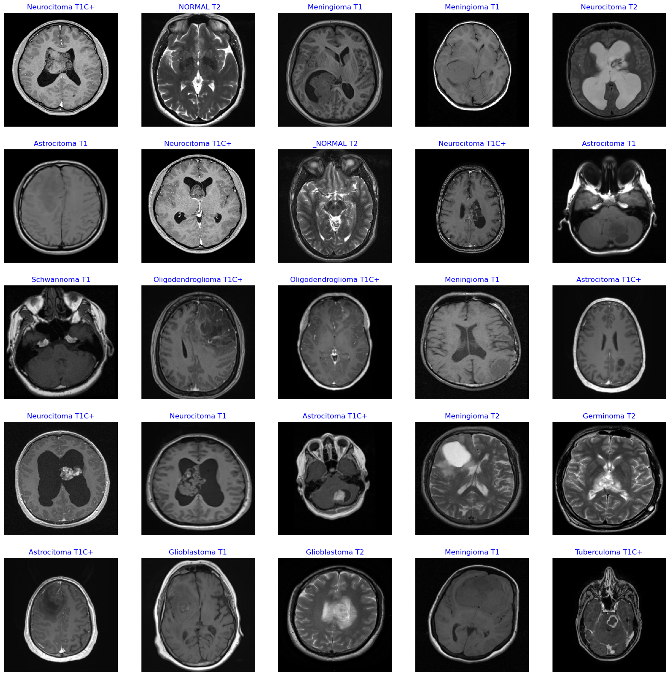
The Dataset
Multi-Class MRI Scans (44 Subtypes)
4,478 2D grayscale MRI slices.
44 distinct, imbalanced, tumor sub-classes.
Chosen 44 Sub-Classes Approach Rather than 14 Parent Class

Slide 6
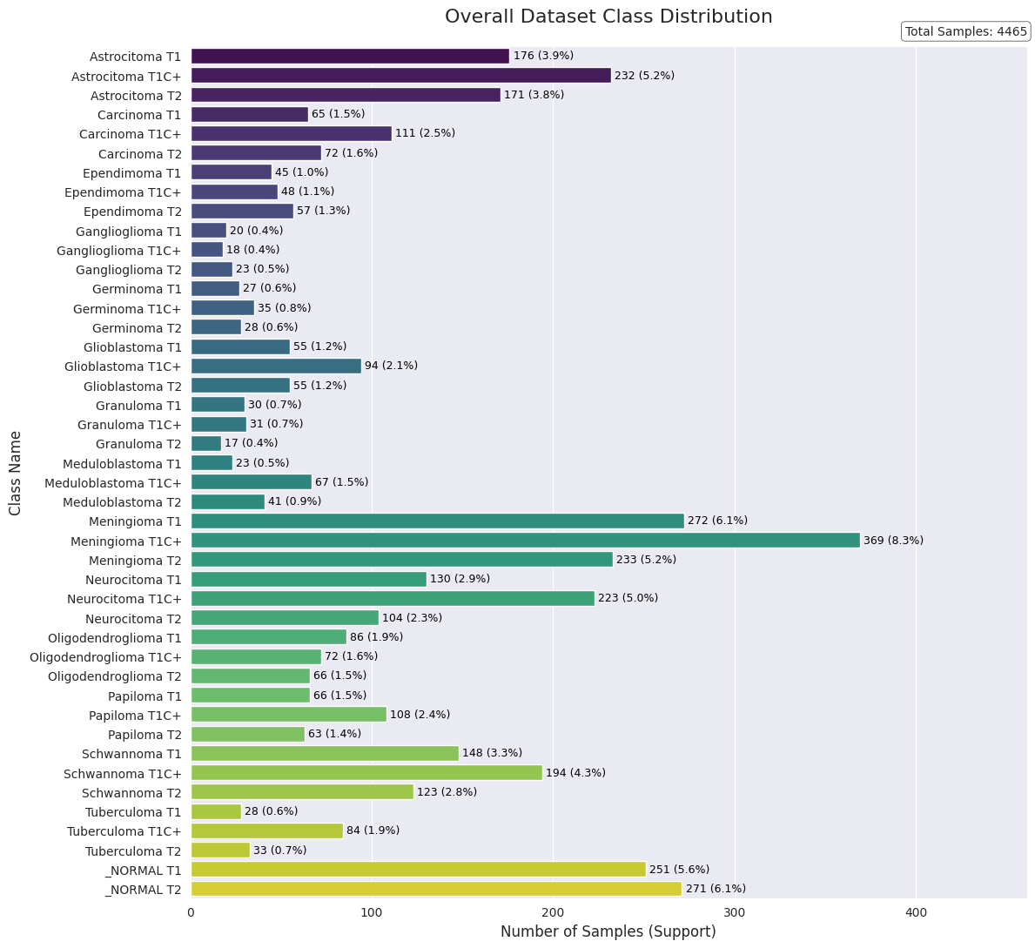
Sub Classes Distribution

Slide 7
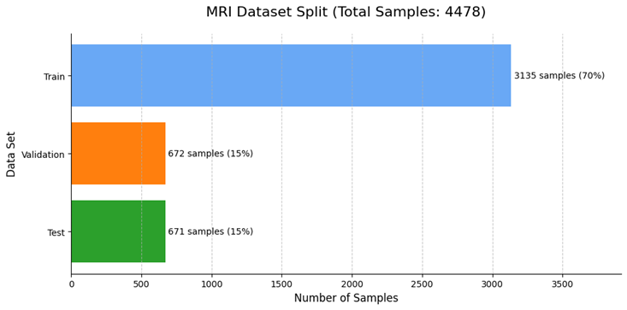
Methodology Highlights Data Preparation
Data Split
70% Train, 15% Val, 15% Test (Stratified sampling)
Preprocessing
Image resizing (224x224x3), TensorFlow Dataset pipeline.
Data Augmentation
More Data Samples & to Prevent Overfitting

Slide 8
Methodology Highlights Fine Tuning Strategy
Start with Frozen Backbone + Simple Head
Gradually unfreeze layers, adjust head complexity, apply regularization (dropout, L2).

Slide 9
Initial Model Evaluations The Struggles
Model Architecture | Key Tuning Attempts (Examples) | Best Val Accuracy | Core Issue
ResNet50V2 | Partial Fine-tuning (up to 75 layers), Deeper Head | 27.31% | Overfitting
Xception | Partial Fine-tuning (up to 12 layers), Deeper Head | 24.63% | Overfitting
InceptionV3 | Frozen/Fine-tuned Base, Deeper Head, Kernel Init | 21.79% | Overfitting
DenseNet121 | Frozen/Fine-tuned Base, Deeper Head, Kernel Init | 19.40% | Overfitting

Slide 10
MobileNetV3Small Performance
Fine-Tuning Strategy | Head Architecture | Test Accuracy | Key Finding
Fine-Tune (Top 30 Layers) | Simple | 89.7% | WINNER: Optimal balance of performance and generalization.
Fine-Tune (Top 57 Layers) | Simple | 88.1% | Good, but deeper fine-tuning led to slightly more overfitting.
Fine-Tune (Top 57 Layers) | Deeper | 79.4% | FAILURE: A complex head caused catastrophic overfitting.
Frozen Backbone | Simple | ~56% - 74% (Val) | INSUFFICIENT: Proved that fine-tuning is essential for good results.

Slide 11
EfficientNetV3B2 The Champion
Maximum Accuracy : Deep fine-tuning (unfreezing ~100+ layers) combined with a carefully designed, progressively regularized classification head. (This was the 94.48% result).
High Efficiency: Keeping the backbone completely frozen but training the classification head with a significantly higher learning rate (e.g., 0.02) achieved a strong 92.99% Test Accuracy.

Slide 12
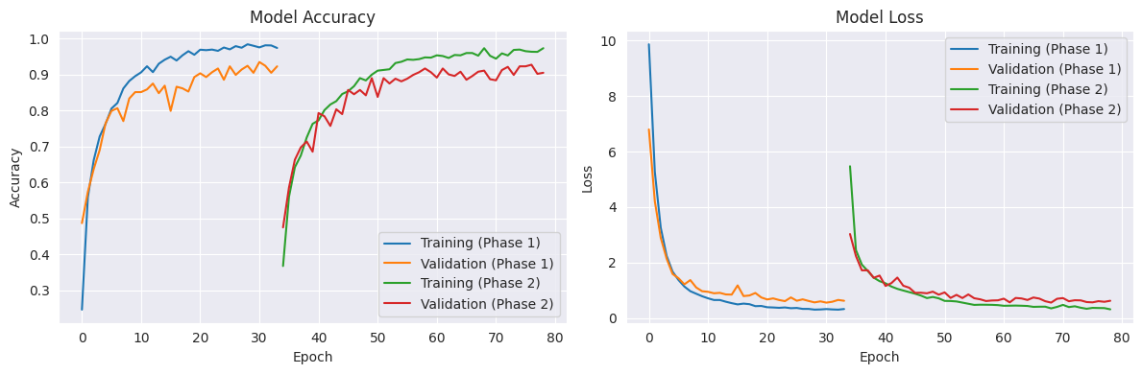
Learning Curves
Deep Tuned vs Base Tuned

Slide 13
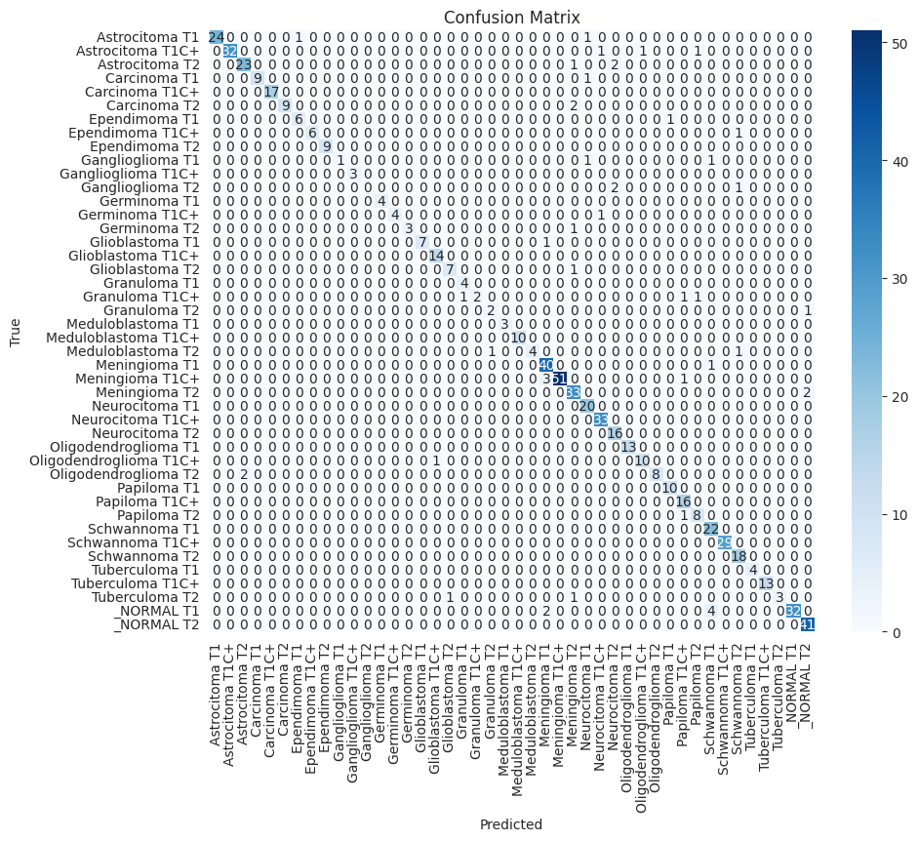
EfficientNetV3B2
Best Experiment Confusion Matrix

Slide 14
Conclusion
Complex CNNs (ResNet, Xception, Inception, DenseNet): Failed due to severe overfitting on this dataset.
MobileNetV3Small: Promising (89.70% Acc), but sensitive to head complexity.
EfficientNetV2-B0 (Champion): Achieved 94.48% Acc (Fine-tuned) & 92.99% Acc (Frozen, High LR).
Impact: Transfer learning enables high accuracy for complex medical image classification.
Future Work:
Explore Larger EfficientNets & Vision Transformers (ViTs).
Investigate more granular fine-tuning.
Expand dataset for broader applicability

Slide 15
Thanks For Watching
By Ahmad Hudhud

