Slide 1
Predicting Medical Malpractice Compensation
A Data-Driven Approach to Handling Outliers

Slide 2
Introduction
Agendas
01
Overview & Problem Statement
Importance
Dataset Overview
Methodology
02
Data Management
Preprocessing
Model Development
Evaluation Metrics
Results & Conclusion
03
Key Insights
Challenges
Future Directions

Slide 3
Overview
Medical Malpractice Costs in U.S
Annual Cost
$55.6 billion (2.4% of U.S. healthcare spending).
Frequency of Claims
7.4% of U.S. physicians had malpractice claims annually (1991–2005).
Impacts
Drives up healthcare costs.
Increases medical malpractice insurance premiums.

Slide 4
Problem Statement
Challenge
Impact
Medical malpractice compensation data is complex with numerous outliers.
The compensation value is influenced by various factors, many of which are not captured in the dataset.
Enhance justice by providing fair compensation predictions.
Improve risk management for insurance companies, reducing overall costs.
Objective
Develop an accurate model to predict medical malpractice compensation.
Address the challenges posed by outliers and data complexity.

Slide 5
Why It Matters
Economic Importance
Improves risk management for insurance companies.
Reduces costs associated with ill-considered decisions.
Contributes to lowering healthcare expenses by addressing malpractice claims effectively.
Ethical Importance
Ensures fair and appropriate compensation for victims.
Supports transparency in the compensation system.
Protects the rights of individuals affected by medical malpractice.

Slide 6
Dataset
0% missing values
0% missing values
0% missing values
0% missing values
Severity
Private Attorney
Specialty
Amount
1 (emotional trauma)
True
Family Practice
9 (Death)
False
…..
Internal Medicine
0% missing values
0% missing values
30% missing values
30% missing values
Age
Gender
Marital Status
Insurance
Numerical
Man
Divorced
Private
Woman
Widowed
….
Married
Unknown
Single
Unknown

Slide 7
Methodology : Data Management & Project Infrastructure
DVC for datasets versioning & Logging Training Process.
Git & GitHub for code collaboration and Version Control.
Cookiecutter for machine learning project structure.
Flask python API for Deployment.

Slide 8
Methodology : Data Preprocessing
Handling missing data: Treating missing values as a separate category for Insurance & Martial Status.
Encoding: One-Hot Encoding, Label Encoding, Target Encoding.
Preprocessing
Outlier handling: Log2, Square Root, Winsorization, Box-Cox.
Scaling : No Scale methods used for other features.

Slide 9
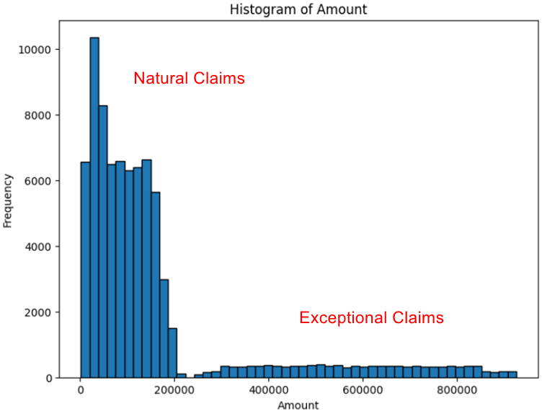
Figure 1 : Target Distribution

Slide 10
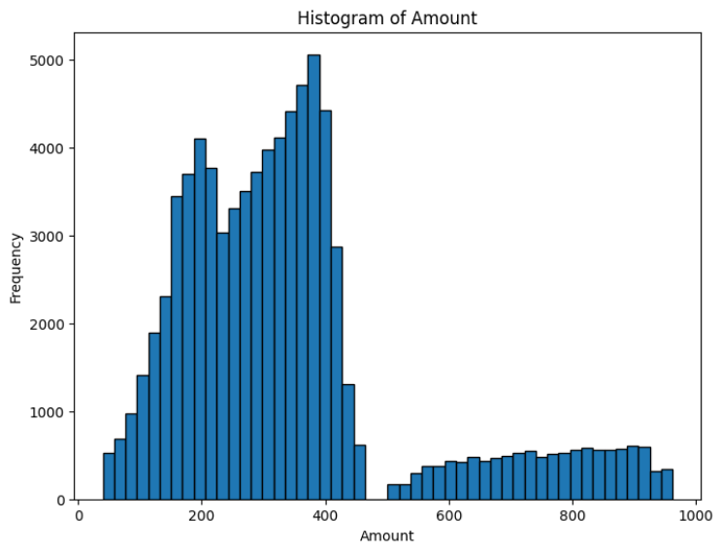
Figure 2 : Target Distribution After Sqrt Transformation

Slide 11
DVC Pipeline
Data Collection
Model Evaluation
Data Preprocessing
Model Building

Slide 12
Model Development
Models Used
Here
Linear Regression
XGBOOST
KNN
Ensemble Methods
Underfits
Good Performance
Good Performance
Good Performance
Linear Regression
Random Forest
(Slower Training Process)
KNN
Polynomial Regression
XGBOOST
Huber Regression
Decision Trees
(Overfits)
Random Forest
Elastic Net Regression

Slide 13
Evaluation Metrics
R² (Coefficient of Determination) 📊
MAE (Mean Absolute Error) ✅
Measures the model's ability to capture complex patterns in the data.
Used to assess overfitting by comparing training and test performance.
Provides a straightforward measure of overall accuracy.
Less sensitive to outliers, ensuring consistent predictions for typical claims.
RMSE (Root Mean Squared Error) ⚠️
Predicted vs. Actual Values Plot 📈
Penalizes larger errors more heavily.
Useful for identifying large discrepancies in high-value predictions (e.g., large malpractice claims).
Visualizes how well the model’s predictions match the actual values.
Helps identify bias, systematic deviations, or data distortions caused by transformations.

Slide 14
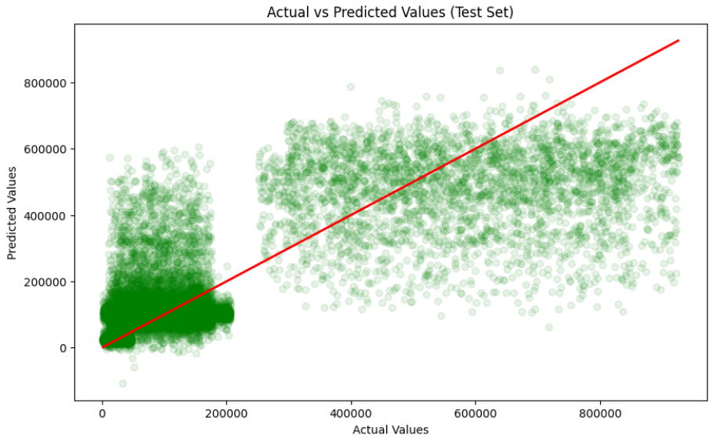
Figure 3 : Example of Actual vs Predicted Plot

Slide 15
Results
Model | R² (Train) | R² (Test) | MAE
Linear Regression | 0.2981 | 0.2967 | $113668.9094
KNN | 0.6825 | 0.6157 | $73749.9137
Decision Tree | 0.8258 | 0.4989 | $80000.0
Random Forest | 0.7964 | 0.5464 | $76866.4910
Ensemble (KNN + RF + XGB) | 0.6864 | 0.6077 | $75063.8808
Polynomial (Degree 2,3) | 0.4 | 0.45 | $110000.00
XGBoost | 0.7011 | 0.6605 | $70102.2202
XGBoost (sqrt transform) | 0.6894 | 0.6492 | $70658.57 (Rescaled)
XGBoost (log2 transform) | 0.588 | 0.546 | $72855.74 (Rescaled)
XGBoost (winsorization) | 0.7761 | 0.7414 | $8143094531247.487

Slide 16
Winsorization & Data Distortion
Winsorizing Target Variable
If the outliers represent real and important information for the model ,over-applying winorization may result in missing important information and thus the performance improvement may be considered inauthentic or "spurious".
This explains well the false performance assigned to the r2 score, since after reviewing the plot of expected to true values, strange and distorted patterns were discovered that express false performance, i.e. it is just ink on paper, which may be useful only in competitions.

Slide 17
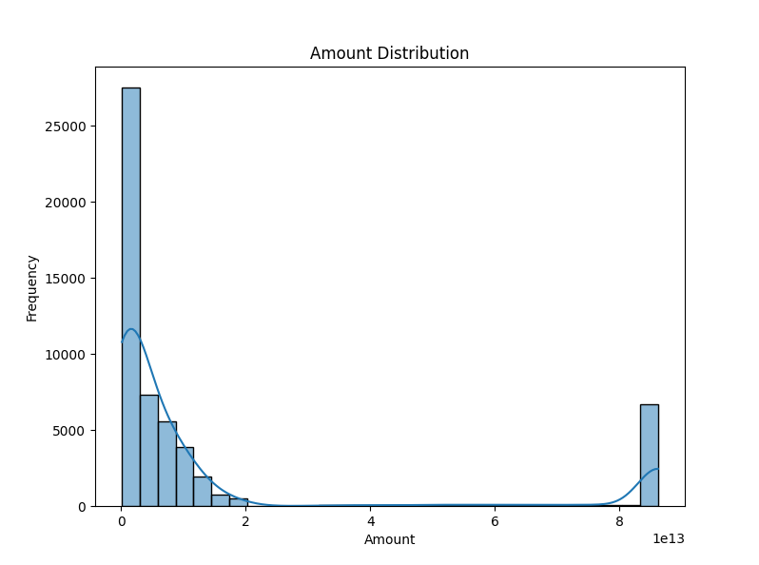
Figure 4 : Over-Winsorization Target Distribution

Slide 18
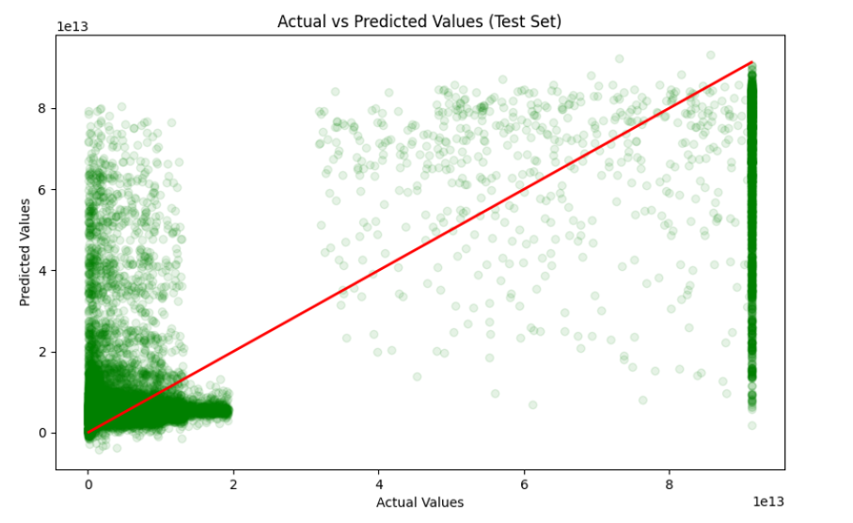
Figure 5: Over-Winsorization Predicted vs Actual Values Plot

Slide 19
Conclusion - Preprocessing
Removing extreme values (which made up ~50% of the dataset) led to underfitting and poor performance.
Removing Any Feature from the dataset will lead to high error loss.
One Hot Encoding achieved big improvements on Specialty Column , while Target Encoder led to data leakage which resulted an overfit.
Trying to replace “Unknown” Values on both Insurance Column & Marital Status leads to more training error , so keeping them was the best approach.
Adding More Features won’t improve anything to the model so its better to keep it as simple.

Slide 20
Conclusion – Models Evaluation
The use of linear regression and its derivatives involving regularization has always led to drift, due to the complex nature of the data.
Transformations of the target variable lead to large differences, especially in linear regression models, but ensemble tree’s based models wont be affected by transformations at best scenario.
The ensemble model did not lead to any additional improvements ,so relying on a single complex model is the best solution at present.
The XGBoost model has slightly better performance and way higher training speed compared to random forests and KNN (about 10x – 20x faster), so it was adopted as the base model for the project.

Slide 21
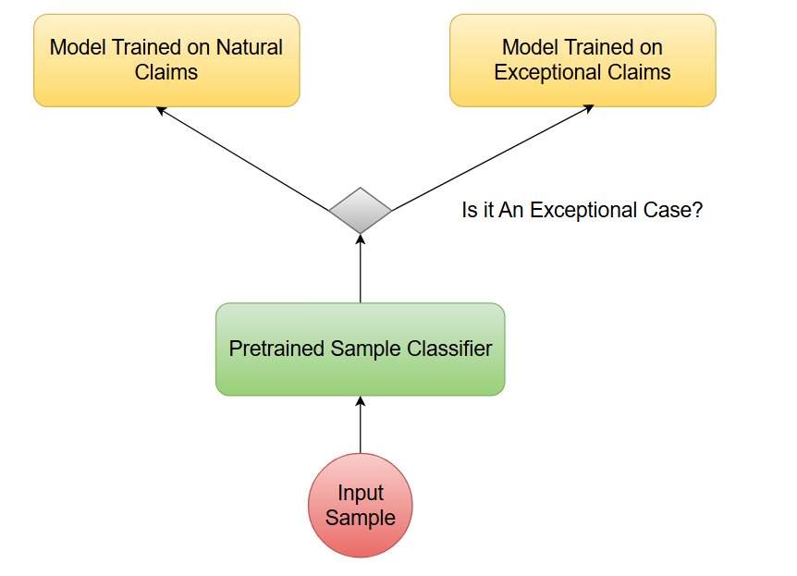
Future Work : Dual Models Approach

Slide 22
THANK YOU

