Slide 1
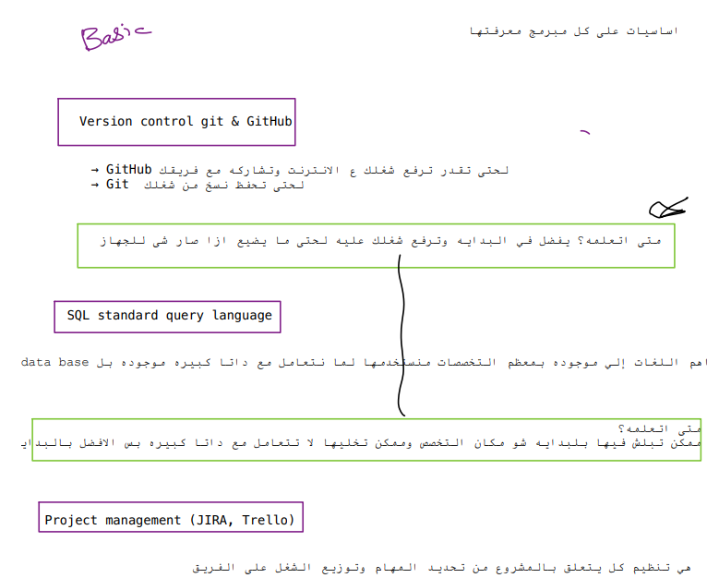

Basic Road Map

Slide 2
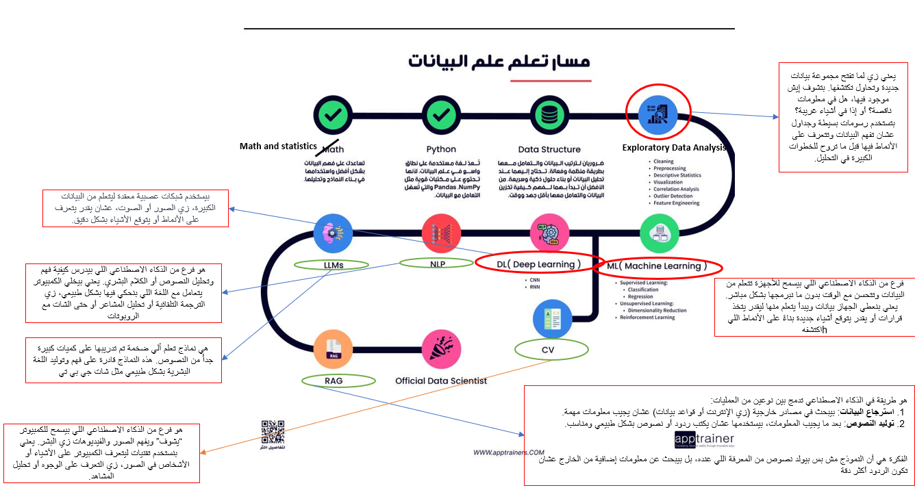
Data science Road Map

Slide 3
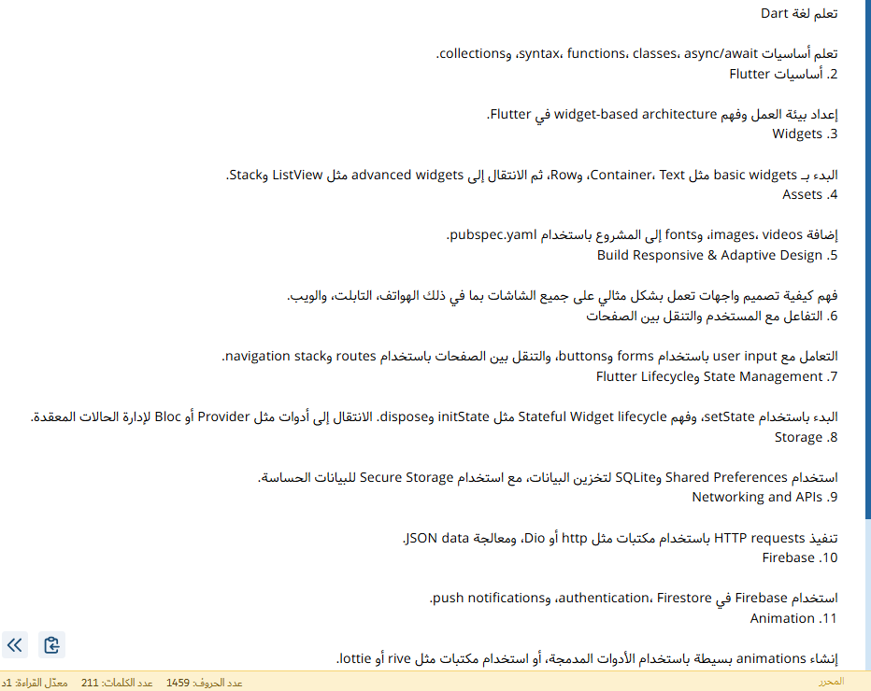
Flutter Road Map

Slide 4
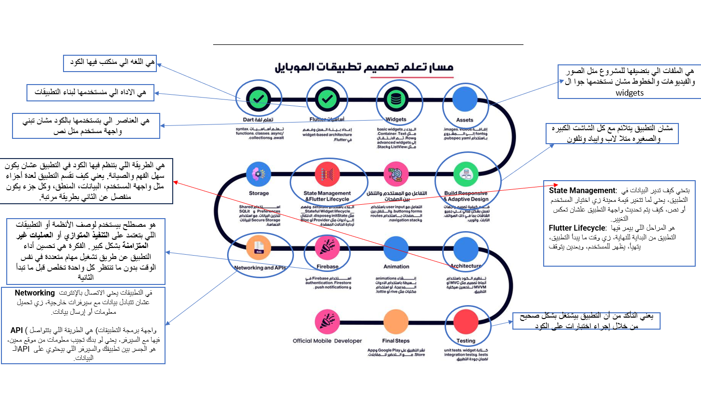
Flutter Road Map

Slide 5
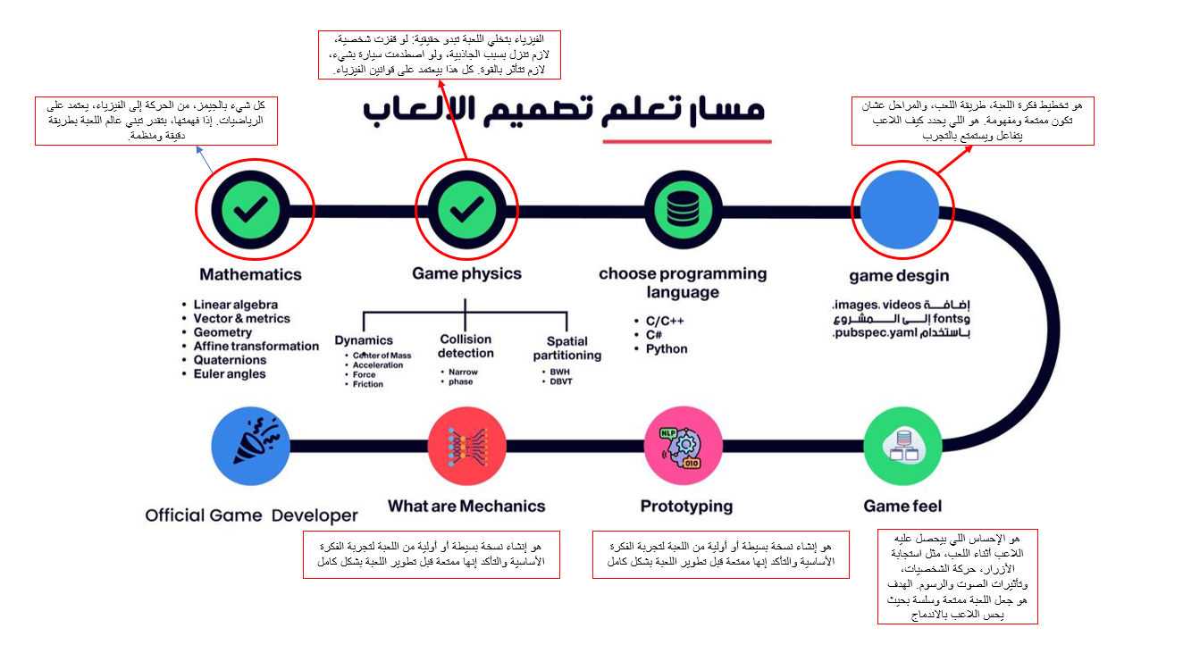
Gaming Road Map

Slide 6
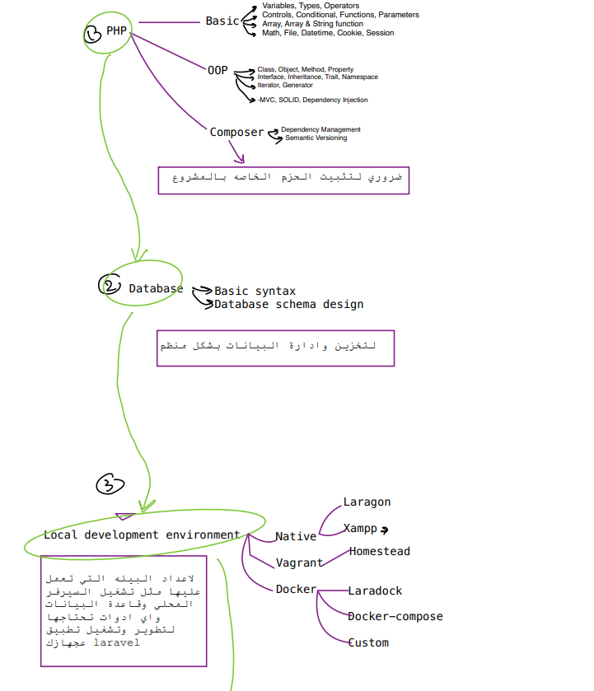
Laravel Road Map

Slide 7
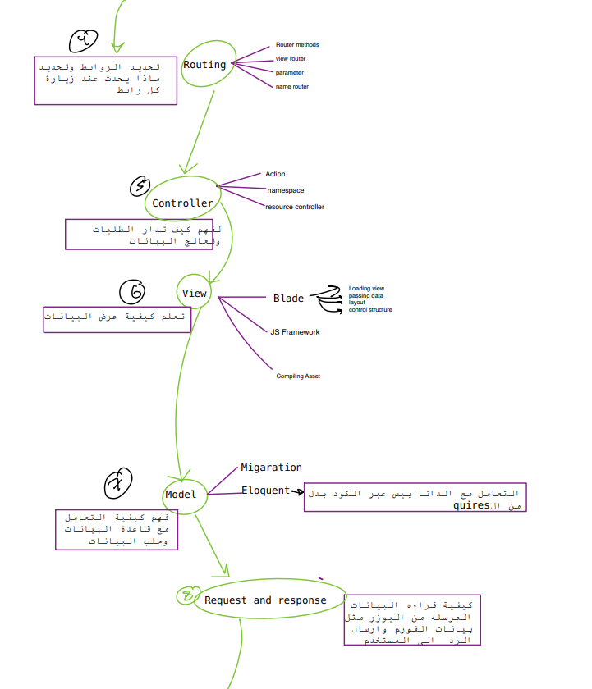
Laravel Road Map

Slide 8
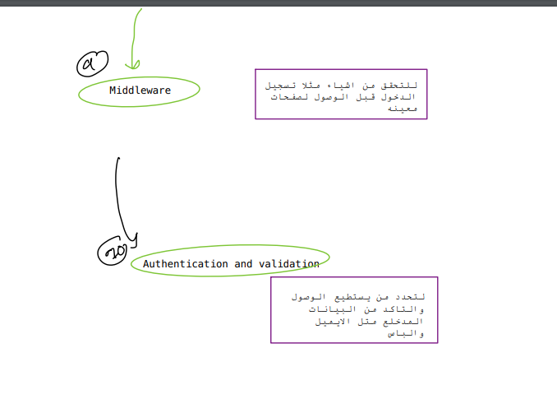
Laravel Road Map

Slide 9
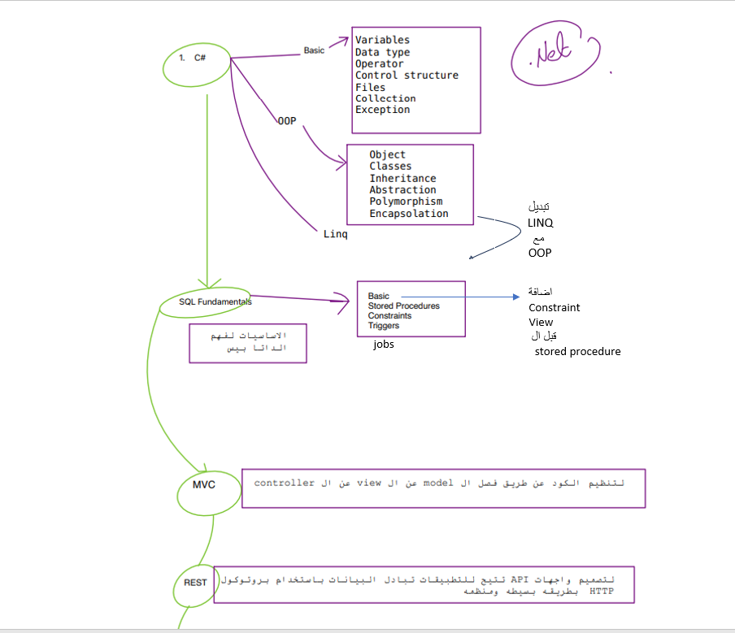
.NET Road Map

Slide 10
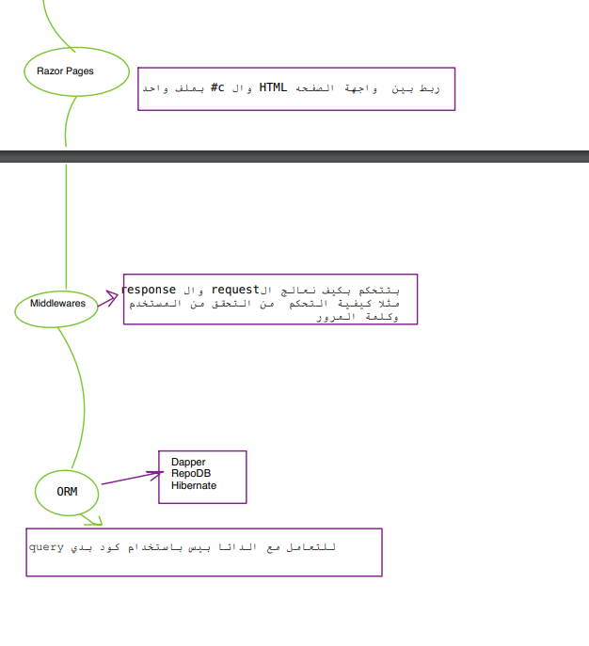
.NET Road Map

Slide 11
Frontend Road Map
Frontend roadmap
https://www.figma.com/file/tmEYdYoloXGNso4K5kuUH0?node-id=12-863&t=ebz9V2z6RYWSXPt1-0&type=whiteboard

