Slide 1
SE vs. ML
Survey

Slide 2
Approach
Collected ~1500 paper from top SE conf.
ICSE, ICST, FSE, ASE, ISSTA, ISSRE
Between years 2017, 2019
We then extracted their titles and abstracts
We then defined a ML bag of words:
train, training, learning, classify, classifier, cluster, clustering, regression, machine, deep, neural, network, networks
We scored papers based on the number of ML keywords appeared in their title and abstract
We sort papers in descending order of score

Slide 3
Top 100 papers skimming

Slide 4
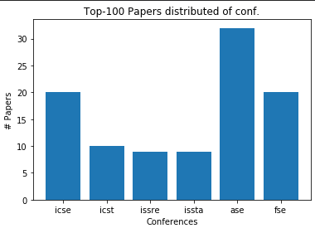
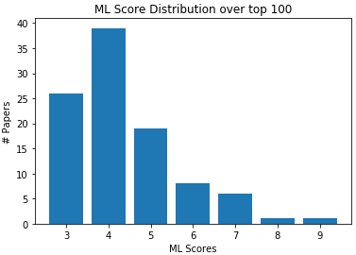
Distribution of top 100 papers

Slide 5
0- Template
Title:
Conf.:
ML Score:
Tags:
Abstract:

Slide 6
2- Feature Envy Detection
Title: Deep Learning Based Feature Envy Detection
Conf.: ASE’18
ML Score: 8
Tags: Software Refactoring, Software Quality, CNN.
Abstract: software refactoring is widely employed to improve software quality. A key step in software refactoring is to identify which part of the software should be refactored. To facilitate the identification, a number of approaches have been proposed to identify certain structures in the code (called code smells) that suggest the possibility of refactoring. Most of such approaches rely on manually designed heuristics to map manually selected source code metrics to predictions. However, it is challenging to manually select the best features, especially textual features. It is also difficult to manually construct the optimal heuristics. To this end, in this paper we propose a deep learning based novel approach to detecting feature envy, one of the most common code smells. The key insight is that deep neural networks and advanced deep learning techniques could automatically select features (especially textual features) of source code for feature envy detection, and could automatically build the complex mapping between such features and predictions. We also propose an automatic approach to generating labeled training data for the neural network based classifier, which does not require any human intervention. Evaluation results on open-source applications suggest that the proposed approach significantly improves the state-of-the-art in both detecting feature envy smells and recommending destinations for identified smelly methods.

Slide 7
2- Feature Envy Detection
Feature Envy: A smelly code that needs refactoring and defined by a method being interested in a class different from the class it belongs to.
Synopsis: The authors proposed to detect feature envy using neural networks. The generated training data automatically by moving methods between classes in high quality open source applications. Then trained a neural network to detect wither a method should be moved or not. The input is composed of method name, encapsulating class name, target class name, distance between encapsulating class and method, distance between method and targeted class. Claimed to beat state-of-the-art.
Notes: No ablation study! Needs more experiments. Might be invalid.

Slide 8
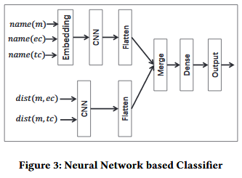
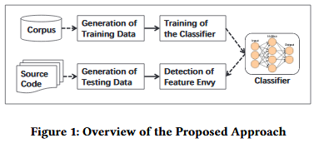
2- Feature Envy Detection

Slide 9
3- Specification Mining using RNN
Title: DSM: A Specification Mining Tool using Recurrent Neural Network Based Language Model
Conf.: FSE’18
ML Score: 7
Tags: Specification Generation, Formal specification, LSTM
Abstract: Formal specifications are important but often unavailable. Further-more, writing these specifications is time-consuming and requires skills from developers. In this work, we present Deep Specification Miner (DSM), an automated tool that applies deep learning to mine finite-state automaton (FSA) based specifications. DSM accepts as input a set of execution traces to train a Recurrent Neural Network Language Model (RNNLM). From the input traces, DSM creates a Prefix Tree Acceptor (PTA) and leverages the inferred RNNLM to extract many features. These features are then forwarded to clustering algorithms for merging similar automata states in the PTA for assembling a number of FSAs. Next, our tool performs a model selection heuristic to approximate F-measure of FSAs, and outputs the one with the highest estimated F-measure. Noticeably, our implementation of DSM provides several options that allows users to optimize quality of resultant FSAs. Our video demonstration on the performance of DSM is publicly available at https://goo.gl/Ju4yFS

Slide 10
3- Specification Mining using RNN
Formal Specification: Description of a software piece (class, object, module, …) using mathematical formal languages. One type is Finite State Machine (FSM).
Synopsis: The authors proposed to extract FSM that describes a software piece (a class) from method invocation sequences traces. They generate huge number of training traces using test generation tools. Then taught an LSTM-RNN model on traces. The model is used as a representation learning for states. Clustering algorithm is applied on states features to extract centroid states.

Slide 11
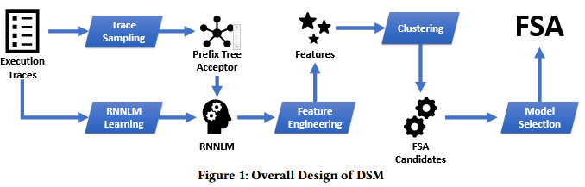
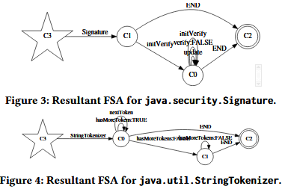
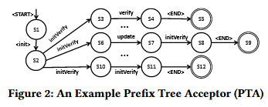
3- Specification Mining using RNN

Slide 12
4- Valid/Invalid Data Structure Detection
Title: Training Binary Classifiers as Data Structure Invariants
Conf.: ICSE’19
ML Score: 7
Tags: Test Generation, Bug Finding, FNN
Abstract: We present a technique that enables us to distinguish valid from invalid data structure objects. The technique is based on building an artificial neural network, more precisely a binary classifier, and training it to identify valid and invalid instances of a data structure. The obtained classifier can then be used in place of the data structure’s invariant, in order to attempt to identify (in)correct behaviors in programs manipulating the structure. In order to produce the valid objects to train the network, an assumed-correct set of object building routines is randomly executed. Invalid instances are produced by generating values for object fields that “break” the collected valid values, i.e., that assign values to object fields that have not been observed as feasible in the assumed-correct program executions that led to the collected valid instances. We experimentally assess this approach, over a benchmark of data structures. We show that this learning technique produces classifiers that achieve significantly better accuracy in classifying valid/invalid objects compared to a technique for dynamic invariant detection, and leads to improved bug finding.

Slide 13
4- Valid/Invalid Data Structure Detection
Class Invariants: When developing classes, developers always have implicit assumptions on how this data structure should be manipulated. One can’t figure those assumptions from class interface. class is a predicate inv that, given an object o of class C, states whether o is a valid representation of the concept that C captures or not. E.g. Input Validation Code (invariance is wider than this).
Synopsis: The authors developed an approach that can detect whether a given object is valid/invalid. Given assumed-correct object constructors and a finite scope for class fields. They generated valid objects by using provided object constructors methods. Then they take all these all valid objects to define a field extension (The possible values class filed can take) for the class and generated invalid objects by breaking the valid field extension. They represented objects by a vector where each cell represent a field value. They trained a feed forward network to detect valid/invalid objects. Claimed to perform better than SOTA.
Notes: unpractical as the neural network have to be specifically designed for each class interface! Can do better using NLP, I wonder.

Slide 14
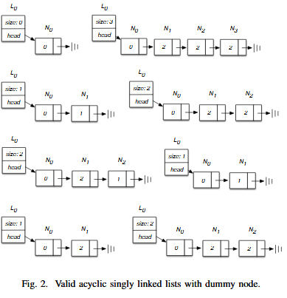
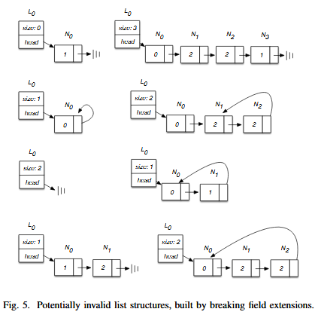
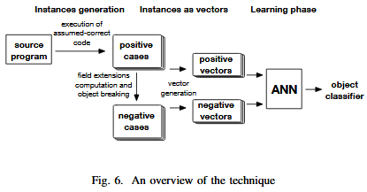
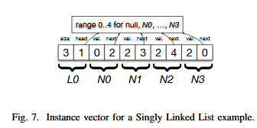
4- Valid/Invalid Data Structure Detection

