Slide 1
SE vs. ML
Survey

Slide 2
Approach
Collected ~1500 paper from top SE conf.
ICSE, ICST, FSE, ASE, ISSTA, ISSRE
Between years 2017, 2019
We then extracted their titles and abstracts
We then defined a ML bag of words:
train, training, learning, classify, classifier, cluster, clustering, regression, machine, deep, neural, network, networks
We scored papers based on the number of ML keywords appeared in their title and abstract
We sort papers in descending order of score

Slide 3
Top 100 papers skimming
Actually not skimming but reading--

Slide 4
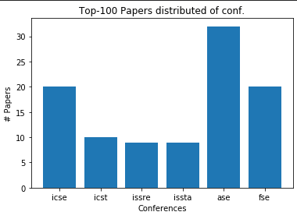
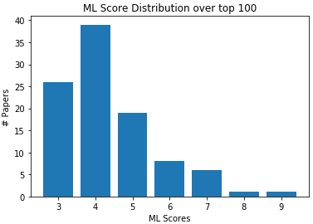
Distribution of top 100 papers

Slide 5
1- Automating Root Cause Analysis
To Be READ
Title: Automating Root Cause Analysis via Machine Learning in Agile Software Testing Environments
Conf.: ICST’2019
ML Score: 9
Tags:
Abstract: We apply machine learning to automate the root cause analysis in agile software testing environments. In particular, we extract relevant features from raw log data after interviewing testing engineers (human experts). Initial efforts are put into clustering the unlabeled data, and despite obtaining weak correlations between several clusters and failure root causes, the vagueness in the rest of the clusters leads to the consideration of labeling. A new round of interviews with the testing engineers leads to the definition of five ground-truth categories. Using manually labeled data, we train artificial neural networks that either classify the data or pre-process it for clustering. The resulting method achieves an accuracy of 88.9%. The methodology of this paper serves as a prototype or baseline approach for the extraction of expert knowledge and its adaptation to machine learning techniques for root cause analysis in agile environments.

Slide 6
2- Feature Envy Detection
Title: Deep Learning Based Feature Envy Detection
Conf.: ASE’18
ML Score: 8
Tags: Software Refactoring, Software Quality, CNN.
Abstract: software refactoring is widely employed to improve software quality. A key step in software refactoring is to identify which part of the software should be refactored. To facilitate the identification, a number of approaches have been proposed to identify certain structures in the code (called code smells) that suggest the possibility of refactoring. Most of such approaches rely on manually designed heuristics to map manually selected source code metrics to predictions. However, it is challenging to manually select the best features, especially textual features. It is also difficult to manually construct the optimal heuristics. To this end, in this paper we propose a deep learning based novel approach to detecting feature envy, one of the most common code smells. The key insight is that deep neural networks and advanced deep learning techniques could automatically select features (especially textual features) of source code for feature envy detection, and could automatically build the complex mapping between such features and predictions. We also propose an automatic approach to generating labeled training data for the neural network based classifier, which does not require any human intervention. Evaluation results on open-source applications suggest that the proposed approach significantly improves the state-of-the-art in both detecting feature envy smells and recommending destinations for identified smelly methods.

Slide 7
2- Feature Envy Detection
Feature Envy: A smelly code that needs refactoring and defined by a method being interested in a class different from the class it belongs to.
Synopsis: The authors proposed to detect feature envy using neural networks. The generated training data automatically by moving methods between classes in high quality open source applications. Then trained a neural network to detect wither a method should be moved or not. The input is composed of method name, encapsulating class name, target class name, distance between encapsulating class and method, distance between method and targeted class. Claimed to beat state-of-the-art.
Notes: No ablation study! Needs more experiments. Might be invalid.

Slide 8
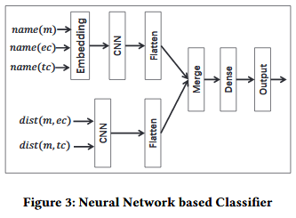
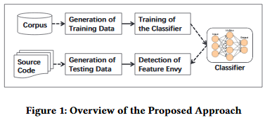
2- Feature Envy Detection

Slide 9
3- Specification Mining using RNN
Title: DSM: A Specification Mining Tool using Recurrent Neural Network Based Language Model
Conf.: FSE’18
ML Score: 7
Tags: Specification Generation, Formal specification, LSTM
Abstract: Formal specifications are important but often unavailable. Further-more, writing these specifications is time-consuming and requires skills from developers. In this work, we present Deep Specification Miner (DSM), an automated tool that applies deep learning to mine finite-state automaton (FSA) based specifications. DSM accepts as input a set of execution traces to train a Recurrent Neural Network Language Model (RNNLM). From the input traces, DSM creates a Prefix Tree Acceptor (PTA) and leverages the inferred RNNLM to extract many features. These features are then forwarded to clustering algorithms for merging similar automata states in the PTA for assembling a number of FSAs. Next, our tool performs a model selection heuristic to approximate F-measure of FSAs, and outputs the one with the highest estimated F-measure. Noticeably, our implementation of DSM provides several options that allows users to optimize quality of resultant FSAs. Our video demonstration on the performance of DSM is publicly available at https://goo.gl/Ju4yFS

Slide 10
3- Specification Mining using RNN
Formal Specification: Description of a software piece (class, object, module, …) using mathematical formal languages. One type is Finite State Machine (FSM).
Synopsis: The authors proposed to extract FSM that describes a software piece (a class) from method invocation sequences traces. They generate huge number of training traces using test generation tools. Then taught an LSTM-RNN model on traces. The model is used as a representation learning for states. Clustering algorithm is applied on states features to extract centroid states.

Slide 11
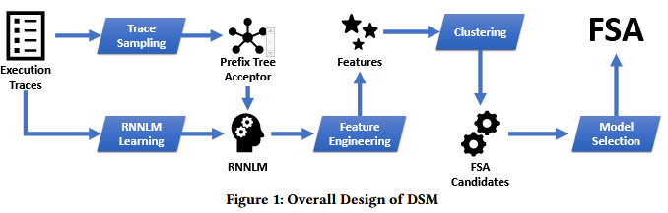
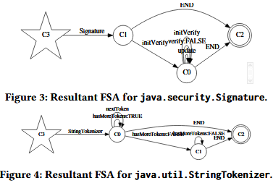
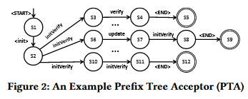
3- Specification Mining using RNN

Slide 12
4- Valid/Invalid Data Structure Detection
Title: Training Binary Classifiers as Data Structure Invariants
Conf.: ICSE’19
ML Score: 7
Tags: Test Generation, Bug Finding, FNN
Abstract: We present a technique that enables us to distinguish valid from invalid data structure objects. The technique is based on building an artificial neural network, more precisely a binary classifier, and training it to identify valid and invalid instances of a data structure. The obtained classifier can then be used in place of the data structure’s invariant, in order to attempt to identify (in)correct behaviors in programs manipulating the structure. In order to produce the valid objects to train the network, an assumed-correct set of object building routines is randomly executed. Invalid instances are produced by generating values for object fields that “break” the collected valid values, i.e., that assign values to object fields that have not been observed as feasible in the assumed-correct program executions that led to the collected valid instances. We experimentally assess this approach, over a benchmark of data structures. We show that this learning technique produces classifiers that achieve significantly better accuracy in classifying valid/invalid objects compared to a technique for dynamic invariant detection, and leads to improved bug finding.

Slide 13
4- Valid/Invalid Data Structure Detection
Class Invariants: When developing classes, developers always have implicit assumptions on how this data structure should be manipulated. One can’t figure those assumptions from class interface. class is a predicate inv that, given an object o of class C, states whether o is a valid representation of the concept that C captures or not. E.g. Input Validation Code (invariance is wider than this).
Synopsis: The authors developed an approach that can detect whether a given object is valid/invalid. Given assumed-correct object constructors and a finite scope for class fields. They generated valid objects by using provided object constructors methods. Then they take all these all valid objects to define a field extension (The possible values class filed can take) for the class and generated invalid objects by breaking the valid field extension. They represented objects by a vector where each cell represent a field value. They trained a feed forward network to detect valid/invalid objects. Claimed to perform better than SOTA.
Notes: unpractical as the neural network have to be specifically designed for each class interface! Can do better using NLP, I wonder.

Slide 14
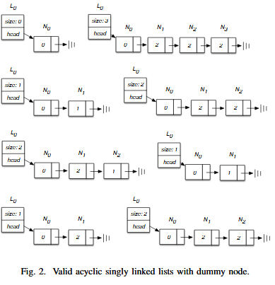
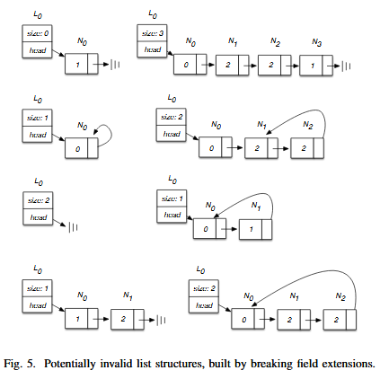
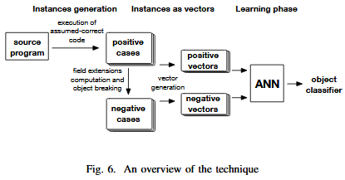
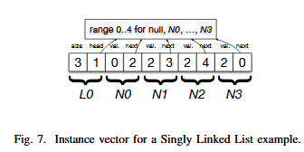
4- Valid/Invalid Data Structure Detection

Slide 15
5- Malware Analysis using Unsupervised Learning
To Be READ
Title: Graph embedding based familial analysis of Android malware using unsupervised learning.
Conf.: ISSRE’19
ML Score: 7
Tags:
Abstract: The rapid growth of Android malware has posed severe security threats to smartphone users. On the basis of the familial trait of Android malware observed by previous work, the familial analysis is a promising way to help analysts better focus on the commonalities of malware samples within the same families, thus reducing the analytical workload and accelerating malware analysis. The majority of existing approaches rely on supervised learning and face three main challenges, i.e., low accuracy, low efficiency, and the lack of labeled dataset. To address these challenges, we first construct a fine-grained behavior model by abstracting the program semantics into a set of subgraphs. Then, we propose SRA, a novel feature that depicts the similarity relationships between the Structural Roles of sensitive API call nodes in subgraphs. An SRA is obtained based on graph embedding techniques and represented as a vector, thus we can effectively reduce the high complexity of graph matching. After that, instead of training a classifier with labeled samples, we construct malware link network based on SRAs and apply community detection algorithms on it to group the unlabeled samples into groups. We implement these ideas in a system called GefDroid that performs Graph embedding based familial analysis of AnDroid malware using unsupervised learning. Moreover, we conduct extensive experiments to evaluate GefDroid on three datasets with ground truth. The results show that GefDroid can achieve high agreements (0.707-0.883 in term of NMI) between the clustering results and the ground truth. Furthermore, GefDroid requires only linear run-time overhead and takes around 8.6s to analyze a sample on average, which is considerably faster than the previous work.

Slide 16
6- From Software 1.0 to Software 2.0 (Keynote)
Not a paper but a keynote – interesting to be watched
Title: Behind Every Great Deep Learning Framework Is an Even Greater Programming Languages Concept (Keynote)
Conf.: fse’18
Abstract: In many areas, such as image recognition, natural language processing, search, recommendation, autonomous cars, systems software and infrastructure, and even Software Engineering tools themselves, Software 2.0 (= programming using learned models) is quickly swallowing Software 1.0 (= programming using handcrafted algorithms).Where the Software 1.0 Engineer formally specifies their problem, carefully designs algorithms, composes systems out of subsystems or decomposes complex systems into smaller components, the Soft-ware 2.0 Engineer amasses training data and simply feeds it into an ML algorithm that will synthesize an approximation of the function whose partial extensional definition is that training data. Instead of code as the artifact of interest, in Software 2.0 it is all about the data where compilation of source code is replaced by training models with data. This new style of programming has far-reaching consequences for traditional software engineering practices. Every-thing we have learned about life cycle models, project planning and estimation, requirements analysis, program design, construction, debugging, testing, maintenance and implementation, . . . runs the danger of becoming obsolete.

Slide 17
7- Detecting Text-Layout Bugs
To Be READ
Title: Textout: Detecting Text-Layout Bugs in Mobile Apps via Visualization-Oriented Learning
Conf.: ISSRE’19
ML Score: 7
Tags:
Abstract: Layout bugs commonly exist in mobile apps. Due to the fragmentation issues of smartphones, a layout bug may occur only on particular versions of smartphones. It is quite challenging to detect such bugs for state-of-the-art commercial automated testing platforms, although they can test an app with thousands of different smartphones in parallel. The main reason is that typical layout bugs neither crash an app nor generate any error messages. In this paper, we present our work for detecting text-layout bugs, which account for a large portion of layout bugs. We model text-layout bug detection as a classification problem. This then allows us to address it with sophisticated image processing and machine learning techniques. To this end, we propose an approach which we call Textout. Textout takes screenshots as its input and adopts a specifically-tailored text detection method and a convolutional neural network (CNN) classifier to perform automatic text-layout bug detection. We collect 33,102 text-region images as our training dataset and verify the effectiveness of our tool with 1,481 text-region images collected from real-world apps. Textout achieves an AUC (area under the curve) of 0.956 on the test dataset and shows an acceptable overhead. The dataset is open-source released for follow-up research.

Slide 18
8- On code search using supervised learning
Title: When Deep Learning Met Code Search
Conf.: FSE’19
ML Score: 7
Tags: Learning latent representations, Reusability, Code Search, LSTM, Encoder Decoder, NLP
Abstract: There have been multiple recent proposals on using deep neural networks for code search using natural language. Common across these proposals is the idea of embedding code and natural language queries into real vectors and then using vector distance to approximate semantic correlation between code and the query. Multiple approaches exist for learning these embeddings, including unsupervised techniques, which rely only on a corpus of code examples, and supervised techniques, which use an aligned corpus of paired code and natural language descriptions. The goal of this supervision is to produce embeddings that are more similar for a query and the corresponding desired code snippet. Clearly, there are choices in whether to use supervised techniques at all, and if one does, what sort of network and training to use for supervision. This paper is the first to evaluate these choices systematically. To this end, we assembled implementations of state-of-the-art techniques to run on a common platform, training and evaluation corpora. To explore the design space in network complexity, we also introduced a new design point that is a minimal supervision extension to an existing unsupervised technique. Our evaluation shows that: 1. adding supervision to an existing unsupervised technique can improve performance, though not necessarily by much; 2. simple networks for supervision can be more effective that more sophisticated sequence-based networks for code search; 3. while it is common to use doc strings to carry out super-vision, there is a sizable gap between the effectiveness of doc strings and a more query-appropriate supervision corpus.

Slide 19
8- On code search using supervised learning
Synopsis: The authors compared 4 different SOTA techniques for code search. They proved that simple bag-of-words models can suppress complex sequence model in this particular task. Showed the potentials of the compared model to improve when trained on idealized datasets rather than docstring-code aligned corpus.
Note: The paper is very interesting and practical.

Slide 20
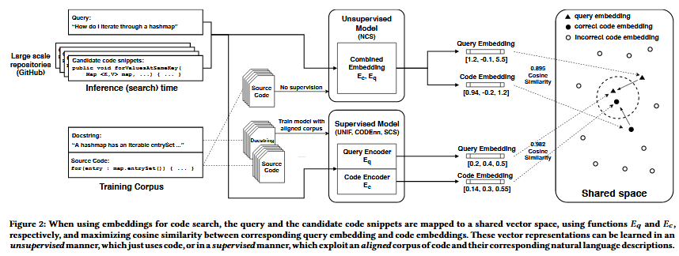
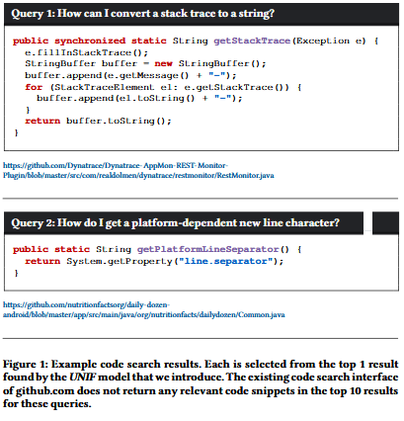
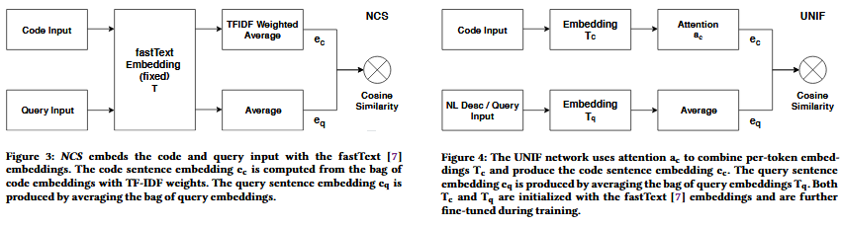
8- On code search using supervised learning

Slide 21
9- Clone detection using DNN embeddings
Title: Go-Clone: Graph-Embedding Based Clone Detector for Golang
Conf.: ISSTA’19
ML Score: 6
Tags: code clone detection, deep neural network, code similarity, go programming language
Abstract: Golang (short for Go programming language) is a fast and compiled language, which has been increasingly used in industry due to its excellent performance on concurrent programming. Golang redefines concurrent programming grammar, making it a challenge for traditional clone detection tools and techniques. However, there exist few tools for detecting duplicates or copy-paste related bugs in Golang. Therefore, an effective and efficient code clone detector on Golang is especially needed. In this paper, we present Go-Clone, a learning-based clone detector for Golang. Go-Clone contains two modules – the training module and the user interaction module. In the training module, firstly we parse Golang source code into llvm IR (Intermediate Representation). Secondly, we calculate LSFG (labeled semantic flow graph) for each program function automatically. Go-Clone trains a deep neural network model to encode LSFGs for similarity classification. In the user interaction module, users can choose one or more Golang projects. Go-Clone identifies and presents a list of function pairs, which are most likely clone code for user inspection. To evaluate Go-Clone’s performance, we collect 6,110 commit versions from 48 GitHub projects to construct a Golang clone detection data set. Go-Clone can reach the value of AUC (Area Under Curve)and ACC (Accuracy) for 89.61% and 83.80% in clone detection. By testing several groups of unfamiliar data, we also demonstrates the generality of Go-Clone. The address of the abstract demo video: https://youtu.be/o5DogtYGbeo

Slide 22
9 - Clone detection using DNN embeddings
Clone detection: The task of identifying code segments that are similar to each other - though and exactly similar.
Synopsis: The authors developed a ML/DL pipeline to detect clones in GO language. After building a dataset of cloned/not-cloned functions from GO GitHub repos. Cloned pairs are extracted from same functions that are not exactly similar between commits. They then transformed the code into and intermediary language using llvm and then then transformed them into Labeled Semantic Flow Graph (LSFG) a graph when nodes are basic blocks inside the function and the edges are data flow/control flow between them. Nodes are represented using a feature vector that counts different instructions types that existed in the corresponding basic block. Finally a DNN was trained to embed the graphs into a 64-dimensional vectors. And the trained model is used for real-time clone detection. The DNN is a specifically designed network to accommodate the special structure of LSFG and it is borrowed from another paper “Vulseeker.
Note: Interesting, Simple, The not trained model achieve a 70% Acc! Is using DNN an overkill? Can we achieve the same without using DNN?

Slide 23
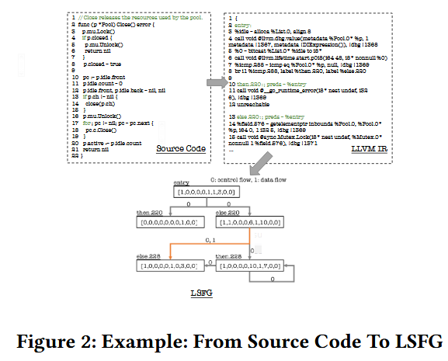
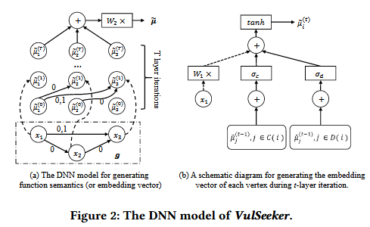
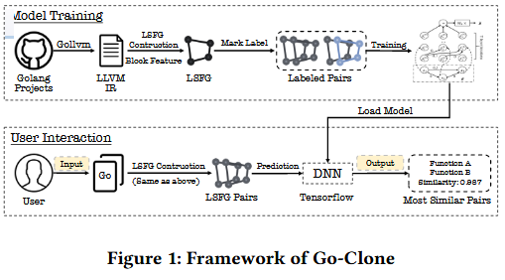
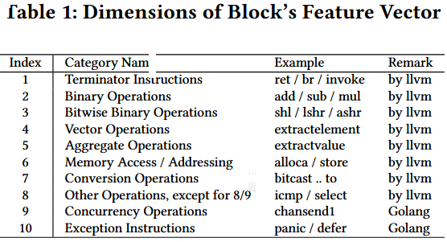
9 - Clone detection using DNN embeddings

Slide 24
10- Safety and Robustness for Deep Learning with Provable Guarantees (Keynote)
Not a paper but a keynote – very interesting. watch
Title: Safety and Robustness for Deep Learning with Provable Guarantees
Conf.: FSE’19
ML Score: 6
Tags:
Abstract: Computing systems are becoming ever more complex, with decisions increasingly often based on deep learning components. A wide variety of applications are being developed, many of them safety-critical, such as self-driving cars and medical diagnosis. Since deep learning is unstable with respect to adversarial perturbations, there is a need for rigorous software development methodologies that encompass machine learning components. This lecture will de-scribe progress with developing automated verification and testing techniques for deep neural networks to ensure safety and robust-ness of their decisions with respect to input perturbations. The techniques exploit Lipschitz continuity of the networks and aim to approximate, for a given set of inputs, the reachable set of network outputs in terms of lower and upper bounds, in anytime manner, with provable guarantees. We develop novel algorithms based on feature-guided search, games, global optimization and Bayesian methods, and evaluate them on state-of-the-art networks. The lecture will conclude with an overview of the challenges in this field

Slide 25
11- DNN to perform Code Automatic Repair based on AST difference
Title: DeepDelta: learning to repair compilation errors.
Conf.: FSE’19
ML Score: 6
Tags: compilation errors, program repair, neural machine translation
Abstract: Programmers spend a substantial amount of time manually repairing code that does not compile. We observe that the repairs for any particular error class typically follow a pattern and are highly mechanical. We propose a novel approach that automatically learns these patterns with a deep neural network and suggests program repairs for the most costly classes of build-time compilation failures. We describe how we collect all build errors and the human-authored, in-progress code changes that cause those failing builds to transition to successful builds at Google. We generate an AST di from the textual code changes and transform it into a domain-specific language called Delta that encodes the change that must be made to make the code compile. We then feed the compiler diagnostic information (as source) and the Delta changes that resolved the di-agnostic (as target) into a Neural Machine Translation network for training. For the two most prevalent and costly classes of Java compilation errors, namely missing symbols and mismatched method signatures, our system called DeepDelta, generates the correct repair changes for 19,314 out of 38,788 (50%) of unseen compilation errors. The correct changes are in the top three suggested fixes 86%of the time on average.
Notes:
We can collaborate with local software development corps to do studies similar to the present here!

Slide 26
11- DNN to perform Code Automatic Repair based on AST difference
Synopsis: The paper is long and dense. The authors generated a dataset of bug diagnosis along with the resolution changes. After that they formulated auto. bug repair as a Neural Machine Translation (NMT). The introduce a way to compute AST difference between faulty code and it’s connection then represented this difference as a Domain Specific Language (Delta). They defined a set of features for source code (Diagnosis, Faulty Node AST path, Symbol Type, Symbol Label) [specifically designed for cant.resolve / undefined symbol error]. And for target code [Delta Program]. Finally they trained an LSTM with Google Neural Machine Translation (GNMT) encoder network and evaluated the model. 50% of the model correction suggestions exactly matched the ground truth resolution changes.
Notes: The authors fine grained in progress code changes dataset is great (google proprietary). The paper is a comprehensive paper about the application of ML on SE pipeline. Recommended to be read.

Slide 27
12- False Positive Static Analysis Reports Classification
Title: An Empirical Assessment of Machine Learning Approaches for Triaging Reports of a Java Static Analysis Tool
Conf.: ICST’19
ML Score: 6
Tags:
Abstract: Despite their ability to detect critical bugs in software, developers consider high false positive rates to be a key barrier to using static analysis tools in practice. To improve the usability of these tools, researchers have recently begun to apply machine learning techniques to classify and filter false positive analysis reports. Although initial results have been promising, the long-term potential and best practices for this line of research are unclear due to the lack of detailed, large-scale empirical evaluation. To partially address this knowledge gap, we present a comparative empirical study of four machine learning techniques, namely hand-engineered features, bag of words, recurrent neural networks, and graph neural networks, for classifying false positives, using multiple ground-truth program sets. We also introduce and evaluate new data preparation routines for recurrent neural networks and node representations for graph neural networks, and show that these routines can have a substantial positive impact on classification accuracy. Overall, our results suggest that recurrent neural networks (which learn over a program's source code) outperform the other subject techniques, although interesting tradeoffs are present among all techniques. Our observations provide insight into the future research needed to speed the adoption of machine learning approaches in practice.

Slide 28
12- False Positive Static Analysis Reports Classification
Synopsis: The authors did a complete empirical analysis comparing 4 ML techniques applied on SA reports classification (i.e. detecting whether a code slice contains an cross script XSS vulnerability or not) [ bag of words BoW, hand engineered features HEF, RNN, GNN ]. They also created a real word dataset in comparison to the synthetic dataset used by the SOTA (OWASP). They found that RNNs (LSTM) are the best models for SA classification tasks.

Slide 29
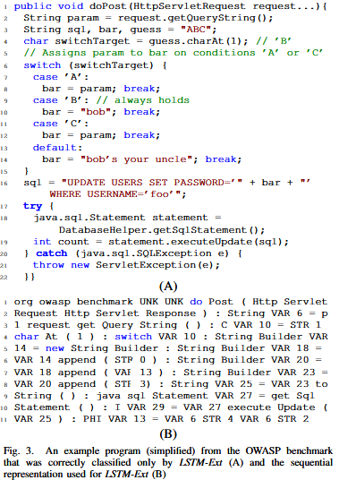
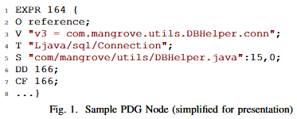

12- False Positive Static Analysis Reports Classification

Slide 30
13- FSA generation from execution traces (see 3)
Title: Deep specification mining.
Conf.: issta’18
ML Score: 6
Tags: Specification Mining, Deep Learning
Abstract: Formal specifications are essential but usually unavailable in soft-ware systems. Furthermore, writing these specifications is costly and requires skills from developers. Recently, many automated techniques have been proposed to mine specifications in various formats including finite-state automaton (FSA). However, more works in specification mining are needed to further improve the accuracy of the inferred specifications. In this work, we propose Deep Specification Miner (DSM), anew approach that performs deep learning for mining FSA-based specifications. Our proposed approach uses test case generation to generate a richer set of execution traces for training a Recurrent Neural Network Based Language Model (RNNLM). From these execution traces, we construct a Prefix Tree Acceptor (PTA) and use the learned RNNLM to extract many features. These features are subsequently utilized by clustering algorithms to merge similar automata states in the PTA for constructing a number of FSAs. Then, our approach performs a model selection heuristic to estimate F-measure of FSAs and returns the one with the highest estimated F-measure. We execute DSM to mine specifications of 11 target library classes. Our empirical analysis shows that DSM achieves an average F-measure of 71.97%, outperforming the best performing baseline by 28.22%. We also demonstrate the value of DSM in sandboxing Android apps.

Slide 31
13- FSA generation from execution traces (see 3)
Synopsis: A rewritten version of paper number “3”! The authors came up with a machine learning pipeline to automatically generate FSA based specifications for software pieces. They trained an RNN over method traces so that model states can be represented using the model internal features. They demonstrated how their model can push android malware detection further (This part have to be reread)
Notes: Test generation techniques and bug finding techniques requires this specification to exist.

Slide 32
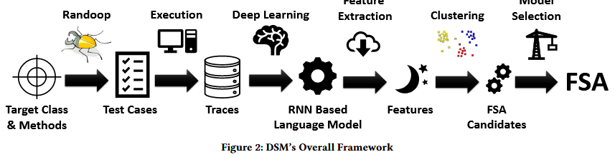
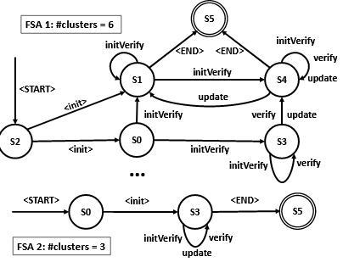
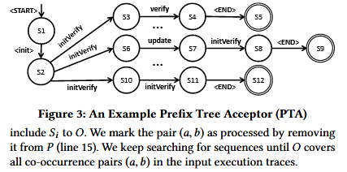
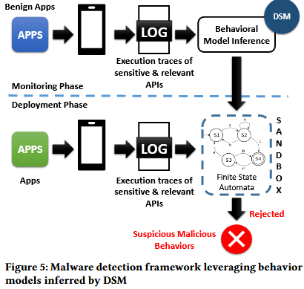
13- FSA generation from execution traces (see 3)

Slide 33
14- Documentation Type Classification
Title: On using machine learning to identify knowledge in API reference documentation.
Conf.: fse’19
ML Score: 6
Tags: API documentation, information needs, machine learning
Abstract: Using API reference documentation like Java Doc is an integral part of software development. Previous research introduced a grounded taxonomy that organizes API documentation knowledge in 12 types, including knowledge about the Functionality, Structure, and Quality of an API. We study how well modern text classification approaches can automatically identify documentation containing specific knowledge types. We compared conventional machine learning (k-NN and SVM) with deep learning approaches trained on manually-annotated Java and .NET API documentation (n= 5,574).When classifying the knowledge types individually (i.e., multiple binary classifiers) the best AUPRC was up to 87%. The deep learning and SVM classifiers seem complementary. For four knowledge types(Concept, Control, Pattern, and Non-Information), SVM clearly out-performs deep learning which, on the other hand, is more accurate for identifying the remaining types. When considering multiple knowledge types at once (i.e., multi-label classification) deep learning outperforms naïve baselines and traditional machine learning achieving a Macro AUC up to 79%. We also compared classifiers using embeddings pre-trained on generic text corpora and Stack-Overflow but did not observe significant improvements. Finally, to assess the generalizability of the classifiers, we retested them on a different, unseen Python documentation dataset. Classifiers for Functionality, Concept, Purpose, Pattern, and Directive seem to generalize from Java and .NET to Python documentation. We discuss our results and how they inform the development of tools for supporting developers sharing and accessing API knowledge

Slide 34
14- Documentation Type Classification
Synopsis: The authors solved the problem of identifying documentation types through different Machine Learning Techniques. The community have formulated a taxonomy of documentation types (directive, functionality, non_information, …). What I find interesting about the paper is not the task but they way they approached it since they tried traditional (KNN, SVM) vs deep learning ML (RNN_LSTM) and compared between them.
Notes: To train RNN embedding they used stack overflow repositories though they should have used widely available documentations! (Embedding training is unsupervised)

Slide 35
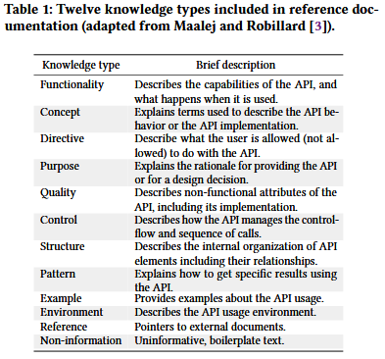
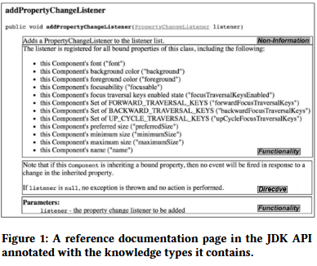
14- Documentation Type Classification

Slide 36
15- Performance Prediction using sparse FFN
Title: DeepPerf: performance prediction for configurable software with deep sparse neural network.
Conf.: ICSE’19
ML Score: 6
Tags: Performance Prediction, FFN, …
Abstract: Abstract—Many software systems provide users with a set of configuration options and different configurations may lead to different runtime performance of the system. As the combination of configurations could be exponential, it is difficult to exhaustively deploy and measure system performance under all possible configurations. Recently, several learning methods have been proposed to build a performance prediction model based on performance data collected from a small sample of configurations, and then use the model to predict system performance under anew configuration. In this paper, we propose a novel approach to model highly configurable software system using a deep feed forward neural network (FNN) combined with a sparsity regularization technique, e.g. theL1regularization. Besides, we also design a practical search strategy for automatically tuning the network hyper-parameters efficiently. Our method, called DeepPerf, can predict performance values of highly configurable software systems with binary and/or numeric configuration options at much higher prediction accuracy with less training data than the state-of-the art approaches. Experimental results on eleven public real-world datasets confirm the effectiveness of our approach.

Slide 37
15- Performance Prediction using sparse FFN
Synopsis: Many software are configurable, and the choice of different configuration combinations effect the performance of such software. The authors proposed a learning-based approach to predict software performance given a set of configurations. They used a regularized Feed Forward Network and claimed to beat the SOTA . They compared their approach to different SOTA and different variations of their approach.
Notes: The authors explained their FFN and the training procedure in details compared to other neural-network-based research in SE.

Slide 38
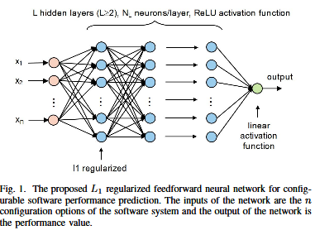
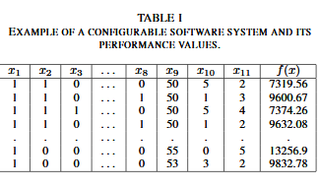
15- Performance Prediction using sparse FFN

Slide 39
16- Seq2Seq to predict memory access location
Title: RENN: Efficient Reverse Execution with Neural-Network-Assisted Alias Analysis.
Conf.: ase’19
ML Score: 6
Tags: Reverse Execution, Deep Learning, Memory Alias
Abstract: Reverse execution and core dump analysis have long been used to diagnose the root cause of software crashes. Each of these techniques, however, face inherent challenges, such as insufficient capability when handling memory aliases. Recent works have used hypothesis testing to address this drawback, albeit with high computational complexity, making them impractical for real world applications. To address this issue, we propose anew deep neural architecture, which could significantly improve memory alias resolution. At the high level, our approach employs a recurrent neural network (RNN) to learn the binary code pattern pertaining to memory accesses. It then infers the memory region accessed by memory references. Since memory references to different regions naturally indicate a non-alias relationship, our neural architecture can greatly reduce the burden of doing hypothesis testing to track down non-alias relation in binary code. Different from previous researches that have utilized deep learning for other binary analysis tasks, the neural network proposed in this work is fundamentally novel. Instead of simply using off-the-shelf neural networks, we designed a new recurrent neural architecture that could capture the data dependency between machine code segments. To demonstrate the utility of our deep neural architecture, we implement it as RENN, a neural network-assisted reverse execution system. We utilize this tool to analyze software crashes corresponding to40memory corruption vulnerabilities from the real world. Our experiments show that RENN can significantly improve the efficiency of locating the root cause for the crashes. Compared to a state-of-the-art technique, RENN has 36.25%faster execution time on average, detects an average of 21.35%more non-alias pairs, and successfully identified the root cause of 12.5% more cases.

Slide 40
16- Seq2Seq to predict memory access location
Synopsis: The paper proposes to use Neural Networks assisted reverse execution pipelines. In particular they used a bi-directional seq2seq model (GRU) to predict the memory access location for each instruction (heap, stack, global) and then use those predictions in alias analysis.
Notes: The papers requires a good background in assembly code analysis. So I could only understand the main points and couldn’t understand some details. I might come to this later.

Slide 41
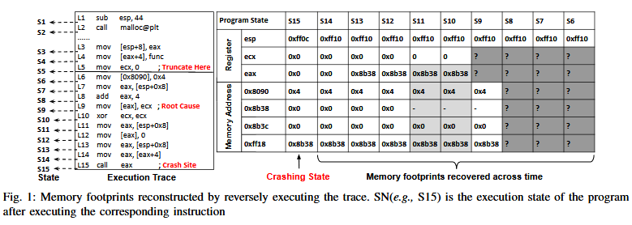
16- Seq2Seq to predict memory access location

Slide 42
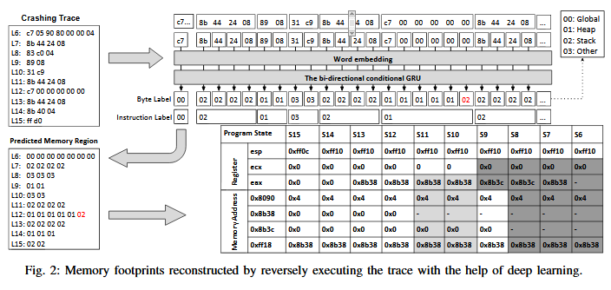
16- Seq2Seq to predict memory access location

Slide 43
17- Thread-Safety Classification using Graph Representation and SVM
Title: Is this class thread-safe? inferring documentation using graph-based learning.
Conf.: ase’18
ML Score: 5
Tags: Documentation, Automated static analysis, Object oriented development, Software maintenance tools.
Abstract: Thread-safe classes are pervasive in concurrent, object-oriented software. However, many classes lack documentation regarding their safety guarantees under multi-threaded usage. This lack of documentation forces developers who use a class in a concurrent program to either carefully inspect the implementation of the class, to conservatively synchronize all accesses to it, or to optimistically assume that the class is thread-safe. To overcome the lack of documentation, we present TSFinder, an approach to automatically classify classes as supposedly thread-safe or thread-unsafe. The key idea is to combine a lightweight static analysis that extracts a graph representation from classes with a graph-based classifier. After training the classifier with classes known to be thread-safe and thread-unsafe, it achieves an accuracy of 94.5% on previously unseen classes, enabling the approach to infer thread safety documentation with high confidence. The classifier takes about 3 seconds per class, i.e., it is efficient enough to infer documentation for many classes.

Slide 44
17- Thread-Safety Classification using Graph Representation and SVM
Thread-Safety: A class is said to be thread-safe if it’s methods and filed can be accessed concurrently from multiple threads.
Synopsis: The authors proposed a learning based approach to classify whether a class is thread safe or not. The data set included a balanced set of ~230 classes. They represented classes through a lightweight static analysis technique that represents classes as a field focused graphs. The represented graphs as vectors using graph kernels. They achieved a high recall and precision ~94%.
Notes: Representing Classes fields and methods as graphs that catches the read/write/call relations between them is an interesting idea.

Slide 45
18- Testing Criteria for Deep Learning
Title: DeepGauge: Multi-Granularity Testing Criteria for Deep Learning Systems
Conf.: ase’18
ML Score: 5
Tags: Deep learning, Software testing, Deep neural networks, Testing criteria
Abstract: Deep learning (DL) defines a new data-driven programming paradigm that constructs the internal system logic of a crafted neuron network through a set of training data. We have seen wide adoption of DL in many safety-critical scenarios. However, a plethora of studies have shown that the state-of-the-art DL systems suffer from various vulnerabilities which can lead to severe consequences when applied to real-world applications. Currently, the testing adequacy of a DL system is usually measured by the accuracy of test data. Considering the limitation of accessible high quality test data, good accuracy performance on test data can hardly provide confidence to the testing adequacy and generality of DL systems. Unlike traditional software systems that have clear and controllable logic and functionality, the lack of interpretability in a DL system makes system analysis and defect detection difficult, which could potentially hinder its real-world deployment. In this paper, we propose DeepGauge, a set of multi-granularity testing criteria for DL systems, which aims at rendering a multi-faceted portrayal of the testbed. The in-depth evaluation of our proposed testing criteria is demonstrated on two well-known datasets, five DL systems, and with four state-of-the-art adversarial attack techniques against DL. The potential usefulness of DeepGauge sheds light on the construction of more generic and robust DL systems.

Slide 46
18- Testing Criteria for Deep Learning
Synopsis: The authors proposed a system of testing criteria for Deep Learning Systems. DL are being deployed in safety critical applications which calls for more testing especially with the introduction of adversarial examples that fools networks. They proposed a neuron level testing criteria (k-multisection, boundaries, strong) and layer level testing criteria (top-k, top-k patterns). They have showed that adversarial testing data actually increase the coverage of their testing criteria.

Slide 47
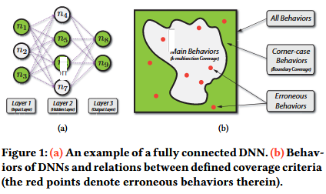
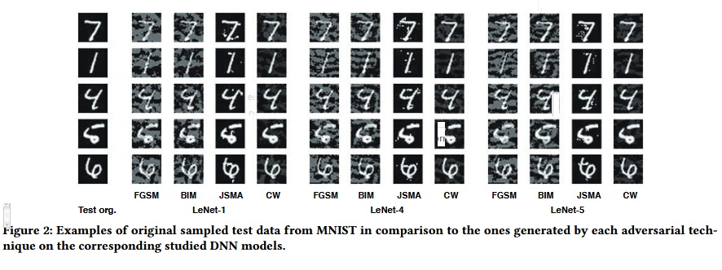
18- Testing Criteria for Deep Learning

Slide 48
19- Predicting SQLI vulnerabilities
Title: A Machine Learning Based Approach to Identify SQL Injection Vulnerabilities.
Conf.: ase’19
ML Score: 5
Tags: Deep learning, prediction model, SQL injection, vulnerability
Abstract: Abstract—This paper presents a machine learning classifier designed to identify SQL injection vulnerabilities in PHP code. Both classical and deep learning based machine learning algorithms were used to train and evaluate classifier models using input validation and sanitization features extracted from source code files. On ten-fold cross validations a model trained using Convolutional Neural Network(CNN) achieved the highest precision (95.4%), while a model based on Multilayer Perceptron(MLP) achieved the highest recall (63.7%) and the highest f-measure (0.746).

Slide 49
19- Predicting SQLI vulnerabilities
Synopsis: The author proposed a learning based approach to discover SQLI vulnerabilities from source code. The authors pipeline is the standard machine learning pipeline in which he collected ~950 vulnerable code and ~1880 un vulnerable ones. He proposed a set of features (existence of input validation keywords, Bag of Words, Word2Vec) and then trained off-the-shelf models (Traditional and Deep) on the dataset. He achieved a good precision and a moderate recall score.
Note: The paper was overly simplified!

Slide 50
20- Generating Comments from Source Code
Title: Improving automatic source code summarization via deep reinforcement learning.
Conf.: ase’2018
ML Score: 5
Tags: Code Summarization, Text Generation, Reinforced Deep Learning, LSTM, encoder-decoder
Abstract: Code summarization provides a high level natural language description of the function performed by code, as it can benefit the software maintenance, code categorization and retrieval. To the best of our knowledge, most state-of-the-art approaches follow an encoder-decoder framework which encodes the code into a hidden space and then decode it into natural language space, suffering from two major drawbacks: a) Their encoders only consider the sequential content of code, ignoring the tree structure which is also critical for the task of code summarization; b) Their decoders are typically trained to predict the next word by maximizing the likelihood of next ground-truth word with previous ground-truth word given. However, it is expected to generate the entire sequence from scratch at test time. This discrepancy can cause an exposure bias issue, making the learnt decoder suboptimal. In this paper, we incorporate an abstract syntax tree structure as well as sequential content of code snippets into a deep reinforcement learning framework (i.e., actor-critic network). The actor network provides the confidence of predicting the next word according to current state. On the other hand, the critic network evaluates the reward value of all possible extensions of the current state and can provide global guidance for explorations. We employ an advantage reward composed of BLEU metric to train both networks. Comprehensive experiments on a real-world dataset show the effectiveness of our proposed model when compared with some state-of-the-art methods.

Slide 51
20- Generating Comments from Source Code
Synopsis: The authors proposed a hybrid learning based approach to generate comment from source code. They fused multiple approaches from SOTA and formulated a hybrid one that beats SOTA. They represented source code through textual LSTM and a structural AST-LSTM. They added a hybrid attention module over representation. They included a reinforced Deep Learning module to resolve the problem of “exposure biases” that text generation encoder-decoder networks suffers from.
Notes: This paper approach is pretty complex though the complexity have paid off through considerable better results.

Slide 52
21- Fixing DLM with weight adaptation
Title: Apricot: A Weight-Adaptation Approach to Fixing Deep Learning Models.
Conf.: ase’19
ML Score: 5
Tags:
Abstract: A deep learning (DL) model is inherently imprecise. To address this problem, existing techniques retrain a DL model over a larger training dataset or with the help of fault injected models or using the insight of failing test cases in a DL model. In this paper, we present Apricot, a novel weight-adaptation approach to fixing DL models iteratively. Our key observation is that if the deep learning architecture of a DL model is trained over many different subsets of the original training dataset, the weights in the resultant reduced DL model (rDLM) can provide insights on the adjustment direction and magnitude of the weights in the original DL model to handle the test cases that the original DL model misclassifies. Apricot generates a set of such reduced DL models from the original DL model. In each iteration, for each failing test case experienced by the input DL model (iDLM), Apricot adjusts each weight of this iDLM toward the average weight of these rDLMs correctly classifying the test case and/or away from that of these rDLMs misclassifying the same test case, followed by training the weight-adjusted iDLM over the original training dataset to generate a new iDLM for the next iteration. The experiment using five state-of-the-art DL models shows that Apricot can increase the test accuracy of these models by 0.87%-1.55% with an average of 1.08%. The experiment also reveals the complementary nature of these rDLMs in Apricot.

Slide 53
21- Fixing DLM with weight adaptation
Synopsis: The authors proposed a to fix (increase accuracy) deep learning models using a set of reduced ones. Reduced Models are similar to the to-be-fixed model but trained on a smaller subset. Iteratively the authors algorithm feed training data to to-be-fixed DLM and rDLMs. If the RLM failed to predict some instances the model weights are adapted using the weights of rDLMs that correctly classified the instance and the avg. weights of ones that falsely predicted it. They applied their approach on 5 different models trained over CIFR10 dataset and consistently showed an improved accuracy.
Notes: I liked this paper it is interesting and practical, though I wonder if a simple ensemble of DLM can achieve a similar result or even adapting a model weight using an evolutionally algorithm can achieve similar result (I think it is the case). In other words the approach is complex and reach better results based on a simpler dynamics happening inside their complex system. The paper have a good set of citations related to DL with SE

Slide 54
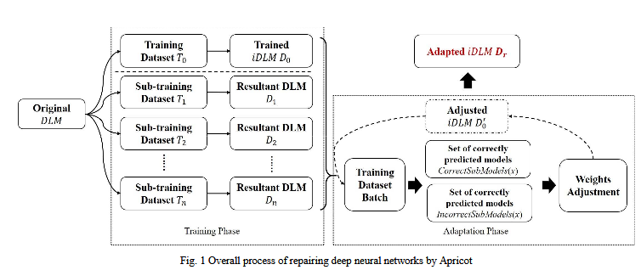
21- Fixing DLM with weight adaptation

Slide 55
22- Predicting breakdowns in cloud services (with SPIKE).
Title: Predicting breakdowns in cloud services (with SPIKE).
Conf.: fse’19
ML Score: 5
Tags: Cloud, optimization, data mining, parameter tuning
Abstract: Maintaining web-services is a mission-critical task where any down- time means loss of revenue and reputation (of being a reliable service provider). In the current competitive web services market, such a loss of reputation causes extensive loss of future revenue. To address this issue, we developed SPIKE, a data mining tool which can predict upcoming service breakdowns, half an hour into the future. Such predictions let an organization alert and assemble the tiger team to address the problem (e.g. by reconfiguring cloud hardware in order to reduce the likelihood of that breakdown). SPIKE utilizes (a) regression tree learning (with CART); (b) synthetic minority over-sampling (to handle how rare spikes are in our data); (c) hyper-parameter optimization (to learn best settings for our local data) and (d) a technique we called “topology sampling” where training vectors are built from extensive details of an individual node plus summary details on all their neighbors. In the experiments reported here, SPIKE predicted service spikes 30 minutes into future with recalls and precision of 75% and above. Also, SPIKE performed relatively better than other widely-used learning methods (neural nets, random forests, logistic regression).

Slide 56
22- Predicting breakdowns in cloud services (with SPIKE).
Synopsis: The authors presented their machine learning pipeline used to predict Web Service Response Time of a certain node on the cloud. The collected data from cloud monitoring routines. The compiled a set of features such as the current RT the historical RTs and some info. related to nodes upstreaming to the target node. The trained different models ranging from ANNs, Random forests, CART, Logistic Regression. They found the CART have interesting results along with they being interpretable. ANNs beat CART but not comprehensible. They used SMOT to handle unbalanced data (spike events are rare), they used hyper parameter optimizations (found to be very important), and focused on Recall as their metric. They also derived some recommendations regarding the human process involved.
Note: The paper is easy to read. It emphasizes the difference between research context and industrial context.

Slide 57
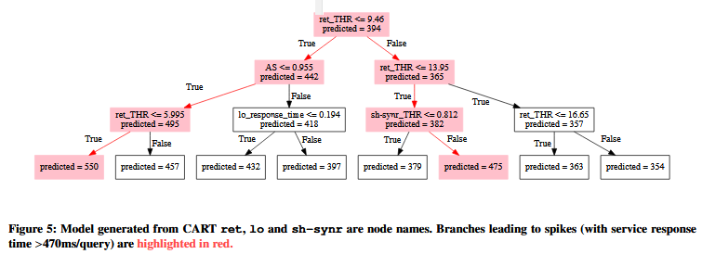
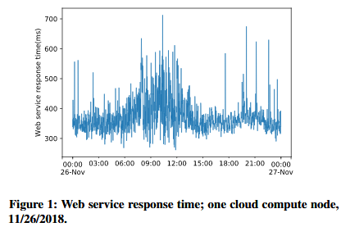
22- Predicting breakdowns in cloud services (with SPIKE).

Slide 58
23- Genetics for Anomaly Detection System
Title: Search-based test and improvement of machine-learning-based anomaly detection systems.
Conf.: issta’19
ML Score: 5
Tags: software testing, intrusion detection systems, clustering
Abstract: Machine-learning-based anomaly detection systems can be vulnerable to new kinds of deceptions, known as training attacks, which exploit the live learning mechanism of these systems by progressively injecting small portions of abnormal data. The injected data seamlessly swift the learned states to a point where harmful data can pass unnoticed. We focus on the systematic testing of these attacks in the context of intrusion detection systems (IDS). We propose a search-based approach to test IDS by making training attacks. Going a step further, we also propose searching for countermeasures, learning from the successful attacks and thereby increasing the resilience of the tested IDS. We evaluate our approach on a denial-of-service attack detection scenario and a dataset recording the network traffic of a real-world system. Our experiments show that our search-based attack scheme generates successful attacks bypassing the current state-of-the-art defenses. We also show that our approach is capable of generating attack patterns for all configuration states of the studied IDS and that it is capable of providing appropriate countermeasures. By co-evolving our attack and defense mechanisms we succeeded at improving the defense of the IDS under test by making it resilient to 49 out of 50 independently generated attacks.

Slide 59
23- Genetics for Anomaly Detection System
Synopsis: The authors developed a genetic algorithm based framework for 1- systemic testing of online anomaly detection system that is based on machine learning (clustering). 2- systemic search for more secure ADS based on finding fit setup for parallel D-streams instances. The two objective where fused together using a co-evolutionary algorithm. First genetic program produces efficient attacks and the second produces defenses to countermeasure the attacks.
Notes: The paper is not directly related to machine learning

Slide 60
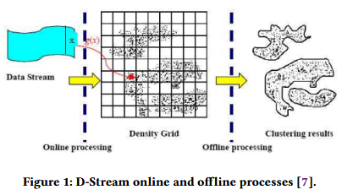
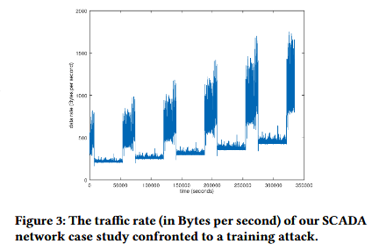
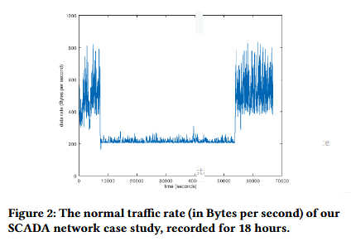
23- Genetics for Anomaly Detection System

Slide 61
24- Improving Software Defect Prediction Models With Class Overlap Resolution.
Title: Empirical Evaluation of the Impact of Class Overlap on Software Defect Prediction.
Conf.: ase’19
ML Score: 5
Tags: Class overlap, Software defect prediction, K-Means clustering, Machine learning
Abstract: Software defect prediction (SDP) utilizes the learning models to detect the defective modules in project, and their performance depends on the quality of training data. The previous researches mainly focus on the quality problems of class imbalance and feature redundancy. However, training data often contains some instances that belong to different class but have similar values on features, and this leads to class overlap to affect the quality of training data. Our goal is to investigate the impact of class overlap on software defect prediction. At the same time, we propose an improved K-Means clustering cleaning approach (IKMCCA) to solve both the class overlap and class imbalance problems. Specifically, we check whether K-Means clustering cleaning approach (KMCCA) or neighborhood cleaning learning (NCL) or IKMCCA is feasible to improve defect detection performance for two cases (i) within-project defect prediction (WPDP) (ii) cross-project defect prediction (CPDP). To have an objective estimate of class overlap, we carry out our investigations on 28 open source projects, and compare the performance of state-of-the-art learning models for the above-mentioned cases by using IKMCCA or KMCCA or NCL VS. without cleaning data. The experimental results make clear that learning models obtain significantly better performance in terms of balance, Recall and AUC for both WPDP and CPDP when the overlapping instances are removed. Moreover, it is better to consider both class overlap and class imbalance.

Slide 62
24- Improving Software Defect Prediction Models With Class Overlap Resolution.
Synopsis: The author shed light on the training data quality problem when training software defect predictions models. In such data the defect and non-defect classes overlap each others and imbalanced. The authors shows that resolving those problems through their approach IKMCCA improve models predictions. The validated their approach using 28 projects from different datasets and on different models.
Notes: Although the proposed approach showed good results. But the authors didn't mention if the class imbalance is due to erroneous labeling or actually the ground truth. If it is the ground truth then the actual problem resides in the choice of the features used to represent modules. i.e. chosen features aren’t discriminant.

Slide 63
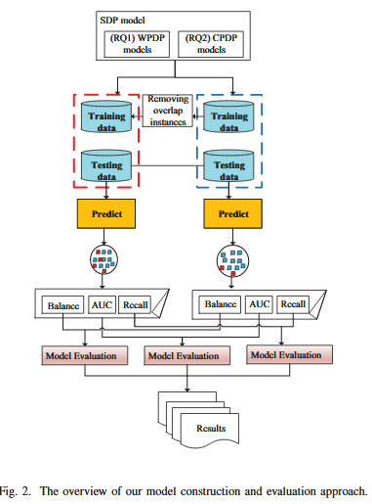
24- Improving Software Defect Prediction Models With Class Overlap Resolution.

Slide 64
25- End-to-End DL model to generate GUI skeleton from GUI design
Title: From UI design image to GUI skeleton: a neural machine translator to bootstrap mobile GUI implementation.
Conf.: icse’18
ML Score: 5
Tags: User interface, reverse engineering, deep learning
Abstract: A GUI skeleton is the starting point for implementing a UI design image. To obtain a GUI skeleton from a UI design image, developers have to visually understand UI elements and their spatial layout in the image, and then translate this understanding into proper GUI components and their compositions. Automating this visual understanding and translation would be beneficial for bootstrapping mobile GUI implementation, but it is a challenging task due to the diversity of UI designs and the complexity of GUI skeletons to generate. Existing tools are rigid as they depend on heuristically-designed visual understanding and GUI generation rules. In this paper, we present a neural machine translator that combines recent advances in computer vision and machine translation for translating a UI design image into a GUI skeleton. Our translator learns to extract visual features in UI images, encode these features' spatial layouts, and generate GUI skeletons in a unified neural network framework, without requiring manual rule development. For training our translator, we develop an automated GUI exploration method to automatically collect large-scale UI data from real-world applications. We carry out extensive experiments to evaluate the accuracy, generality and usefulness of our approach.

Slide 65
25- End-to-End DL model to generate GUI skeleton from GUI design
Synopsis: The authors tackled the problem of automatic generation of UI components from image based UI designs for Android Apps. By doing so the bridge the gap between UI designs and GUI skeletons. The proposed a CNN-RNN-RNN model to extract visual feature encode their spatial features and decode them into GUI skeletons. The formulated an automatic way for collecting the dataset resulting in 185,277 training pairs! The tested their model and found it to be accurate, generalizable, and useful.
Note: One of the papers that I enjoyed reading straight to the point and explained every single aspect of the complex work they have done in plain English.

Slide 66
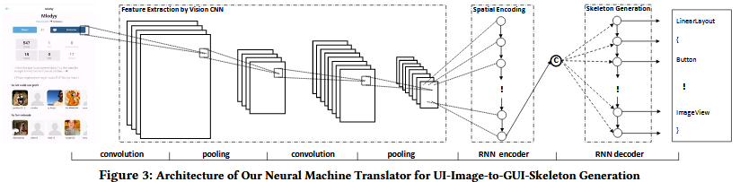
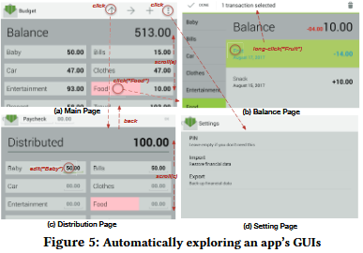
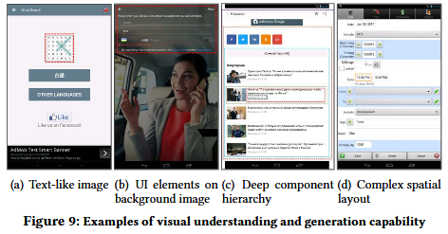
25- End-to-End DL model to generate GUI skeleton from GUI design

Slide 67
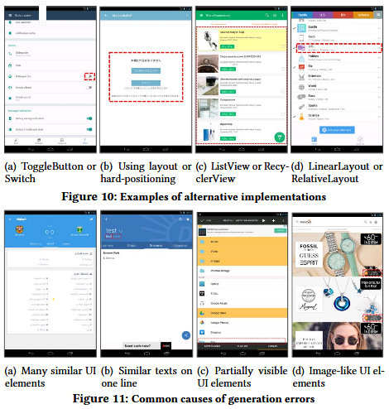
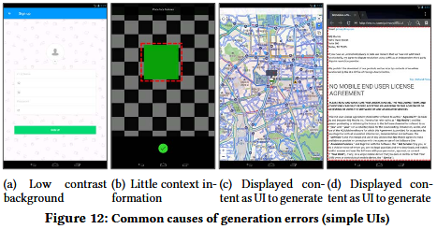
25- End-to-End DL model to generate GUI skeleton from GUI design

Slide 68
25- Search based discriminatory inputs generation to gauge ML models fairness
Title: Automated directed fairness testing.
Conf.: ase’18
ML Score: 5
Tags: Software Fairness, Directed Testing, Machine Learning
Abstract: Fairness is a critical trait in decision making. As machine-learning models are increasingly being used in sensitive application domains (e.g. education and employment) for decision making, it is crucial that the decisions computed by such models are free of unintended bias. But how can we automatically validate the fairness of arbitrary machine-learning models? For a given machine-learning model and a set of sensitive input parameters, our Aeqitas approach automatically discovers discriminatory inputs that highlight fairness violation. At the core of Aeqitas are three novel strategies to employ probabilistic search over the input space with the objective of uncovering fairness violation. Our Aeqitas approach leverages inherent robustness property in common machine-learning models to design and implement scalable test generation methodologies. An appealing feature of our generated test inputs is that they can be systematically added to the training set of the underlying model and improve its fairness. To this end, we design a fully automated module that guarantees to improve the fairness of the model. We implemented Aeqitas and we have evaluated it on six state of- the-art classifiers. Our subjects also include a classifier that was designed with fairness in mind. We show that Aeqitas effectively generates inputs to uncover fairness violation in all the subject classifiers and systematically improves the fairness of respective models using the generated test inputs. In our evaluation, Aeqitas generates up to 70% discriminatory inputs (w.r.t. the total number of inputs generated) and leverages these inputs to improve the fairness up to 94%.

Slide 69
25- Search based discriminatory inputs generation to gauge ML models fairness
Synopsis: The authors proposed an automatic approach to generate discriminatory [inputs that have different output though they are similar except for some discriminatory attributes gender race ethnicity …] inputs for ML models. They initially randomly search for discriminatory inputs (rand. Select input fix attribs change discr. attribs) and then search in the neighborhood of found discr. inputs to generate mode discr. Inputs. There approach was able to generate significantly mode inputs w.r.t. SOTA. And training models on found inputs increased their non-discrimination.
Notes: According to the authors the field of ML fairness is still in it’s early stages and referenced only paper that utilizes random based search. Though I think the domain is more mature but in the machine learning community not SE community. I liked the Law of Large Numbers Statistical Theorem.

Slide 70
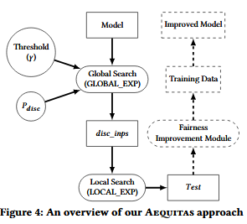
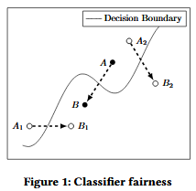
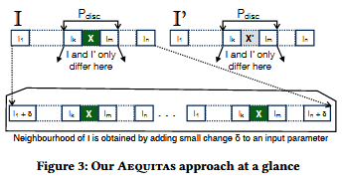
25- To Search based discriminatory inputs generation to gauge ML models fairness

Slide 71
26- Template
Title: Semantically enhanced software traceability using deep learning techniques.
Conf.: icse’17
ML Score: 5
Tags: Traceability, Deep Learning, Recurrent Neural Net-work, Semantic Representation
Abstract: In most safety-critical domains the need for traceability is prescribed by certifying bodies. Trace links are generally created among requirements, design, source code, test cases and other artifacts, however, creating such links manually is time consuming and error prone. Automated solutions use information retrieval and machine learning techniques to generate trace links, however, current techniques fail to understand semantics of the software artifacts or to integrate domain knowledge into the tracing process and therefore tend to deliver imprecise and inaccurate results. In this paper, we present a solution that uses deep learning to incorporate requirements artifact semantics and domain knowledge into the tracing solution. We propose a tracing network architecture that utilizes Word Embedding and Recurrent Neural Network (RNN) models to generate trace links. Word embedding learns word vectors that represent knowledge of the domain corpus and RNN uses these word vectors to learn the sentence semantics of requirements artifacts. We trained 360 different configurations of the tracing network using existing trace links in the Positive Train Control domain and identified the Bidirectional Gated Recurrent Unit (BI-GRU) as the best model for the tracing task. BI-GRU significantly out-performed state-of-the-art tracing methods including the Vector Space Model and Latent Semantic Indexing.

Slide 72
0- Template
Synopsis:
Notes:

Slide 73
0- Template

Slide 74
0- Template
To Be READ
Title:
Conf.:
ML Score:
Tags:
Abstract:

Slide 75
0- Template
To Be READ
To Be READ
Title:
Conf.:
ML Score:
Tags:
Abstract:

Slide 76
0- Template
To Be READ
Title:
Conf.:
ML Score:
Tags:
Abstract:

Slide 77
0- Template
To Be READ
Title:
Conf.:
ML Score:
Tags:
Abstract:

Slide 78
0- Template
To Be READ
Title:
Conf.:
ML Score:
Tags:
Abstract:

Slide 79
0- Template
To Be READ
To Be READ
Title:
Conf.:
ML Score:
Tags:
Abstract:

Slide 80
0- Template
To Be READ
Title:
Conf.:
ML Score:
Tags:
Abstract:

Slide 81
0- Template
To Be READ
Title:
Conf.:
ML Score:
Tags:
Abstract:

