Slide 1
DATA ANALYTICS · BUSINESS INTELLIGENCE
Walmart Sales Analysis
Data-Driven Insights for Strategic Growth
An in-depth analysis of 9,995 transactions across product categories,
customer segments, and U.S. regions — powered by Python & Power BI
Group Presentation · Equal Contribution by All Members · 2026

Slide 2
Agenda
2 / 20
01
Introduction & Dataset Overview
Objectives, data dimensions, and key variables
02
Methodology & Tech Stack
Python libraries and Power BI tools used
03
Product Category Analysis
Which categories and sub-categories drive sales
04
Customer Segment Insights
Consumer, Corporate & Home Office contributions
05
Geographical Performance
Regional & city-level sales and profit patterns
06
Factor Interactions & Correlations
Discounts, quantities, shipping, and their effects
07
Strategic Summary & Conclusion
Target vs. avoid matrix and next steps

Slide 3
Introduction & Project Objectives
3 / 20
Business Context
Core Objectives
Retail giants like Walmart operate across thousands of SKUs, multiple regions, and diverse customer demographics — making data-driven decision-making mission-critical.
🎯 Identify top-performing product categories & sub-categories by revenue
This project analyzes a Walmart transactional dataset to extract actionable intelligence on which products to promote, which customer segments to prioritize, and which geographic markets offer the highest return.
👥 Determine which customer segment generates the highest lifetime value
🗺️ Pinpoint regions and states driving — and dragging — profitability
Findings are directly actionable for store managers, category directors, and regional VPs.
💸 Quantify the profitability impact of aggressive discounting strategies
📦 Evaluate shipping mode efficiency against order volume and delivery cost
📈 Deliver a strategic TARGET vs. AVOID matrix for growth planning

Slide 4
Dataset Overview
4 / 20
9,995
21
4
3
Total Records (Rows)
Feature Variables (Columns)
U.S. Regions Covered
Product Categories
Key Variables Used in This Analysis
Variable | Type | Description | Analytical Role
Order Date | Date | Date of transaction placement | Time series & seasonality analysis
Ship Mode | Categorical | Standard / Second / First / Same Day | Shipping efficiency modeling
Segment | Categorical | Consumer, Corporate, Home Office | Customer segment profiling
Region / State | Categorical | 4 U.S. regions, 49 states | Geographic performance mapping
Category / Sub-Category | Categorical | 3 categories, 17 sub-categories | Product performance ranking
Sales | Numeric ($) | Revenue per line item | Primary KPI for performance
Quantity | Numeric | Units sold per order line | Demand and volume analysis
Discount | Numeric (0–1) | Proportion discount applied | Margin erosion modeling
Profit | Numeric ($) | Net profit per line item | Profitability and loss detection

Slide 5
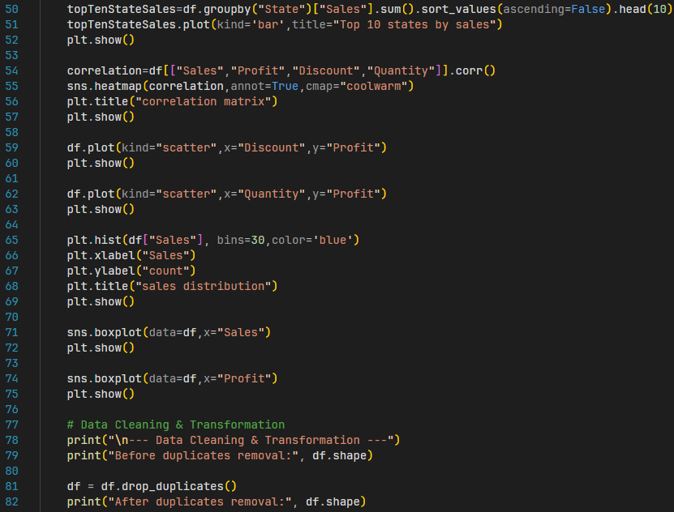
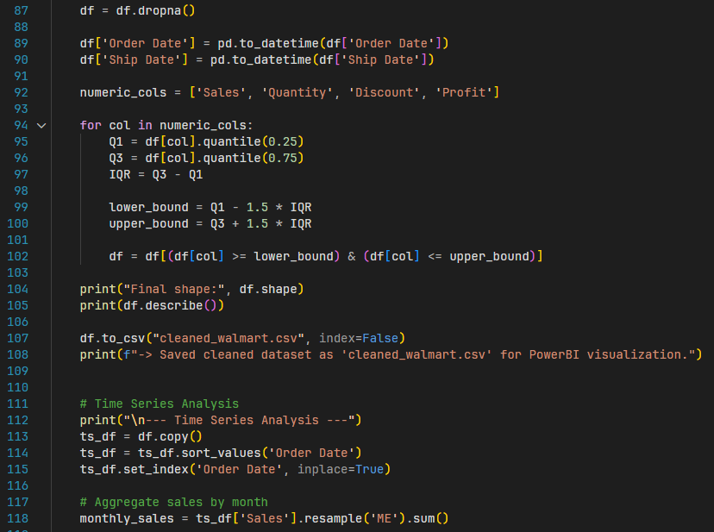
Methodology & Tech Stack
5 / 20
1
Data Ingestion
Python Code: EDA & Cleaning
Loaded CSV into Pandas DataFrame (9,995 × 21). Performed initial `.info()` and `.describe()` profiling.
2
EDA & Visualization
Generated correlation heatmaps, scatter plots, histograms, and box plots using Matplotlib & Seaborn.
3
Data Cleaning
Removed duplicates; dropped nulls via `.dropna()`; converted date columns; applied IQR outlier filtering on Sales, Profit, Quantity & Discount.
4
Feature Engineering
Python Code: Cleaning & Time Series
Encoded categorical variables (Label Encoding); extracted Month & Quarter from Order Date for time series resampling.
5
ML & Forecasting
Trained Random Forest Regressor; extracted feature importances; resampled to monthly frequency for trend plotting.
6
Power BI Dashboard
Exported cleaned_walmart.csv; built interactive visuals: word cloud, key influencers, regional profit bars.

Slide 6
SECTION 01
Product Category
Analysis
Uncovering which categories and sub-categories generate the highest revenue — and which consistently underperform.

Slide 7
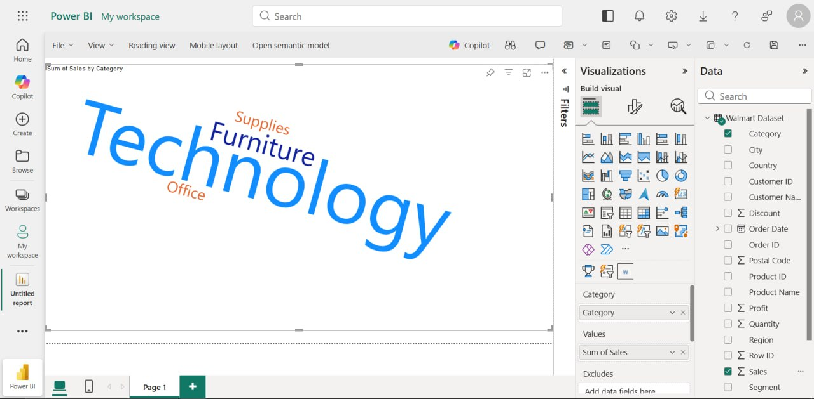
Highest Sales by Product Category
7 / 20
Technology
Furniture
Office Supplies
$836K+
$742K+
$719K+
Highest revenue category — driven by Phones & Machines
Second highest — Chairs lead; Tables generate losses
Highest volume, lowest per-unit sales value
Power BI — Sum of Sales by Category (Word Cloud Visual)

Slide 8
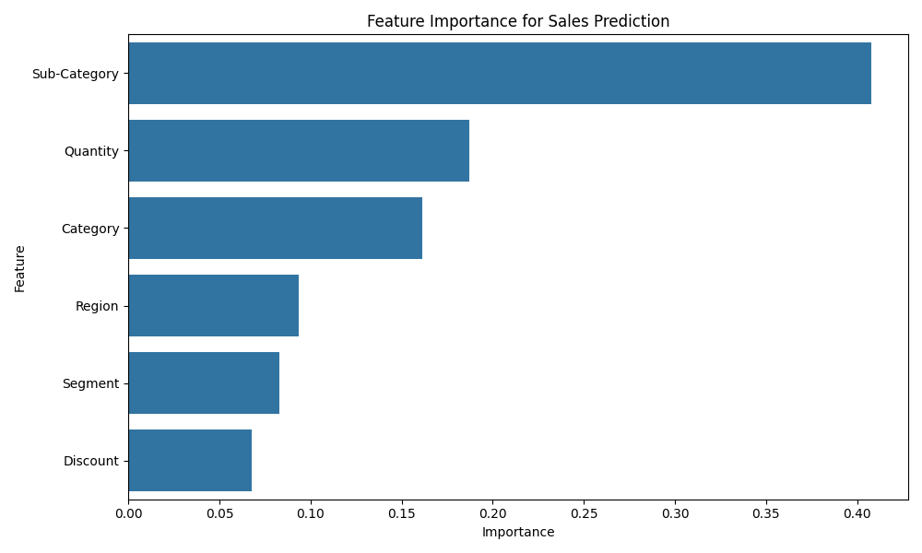
Deep Dive: Sub-Category Insights
8 / 20
ML Feature Importance — Top Predictors of Sales (Random Forest)
Key Sub-Category Findings
🟢 TOP PERFORMERS
Phones — $330K revenue, consistent margin
Chairs — $328K, strong Consumer demand
Storage — high volume, reliable profit
Binders — largest SKU count, volume driver
🔴 UNDERPERFORMERS
Tables — highest loss sub-category (~–$17K)
Bookcases — negative avg. profit margin
Supplies — low volume and low margin
Fasteners — negligible revenue contribution
💡 Sub-Category is the #1 predictor of sales (41% importance) — more than Quantity or Category alone.

Slide 9
SECTION 02
Customer Segment
Insights
Understanding Consumer, Corporate, and Home Office buying patterns to maximize customer lifetime value.

Slide 10
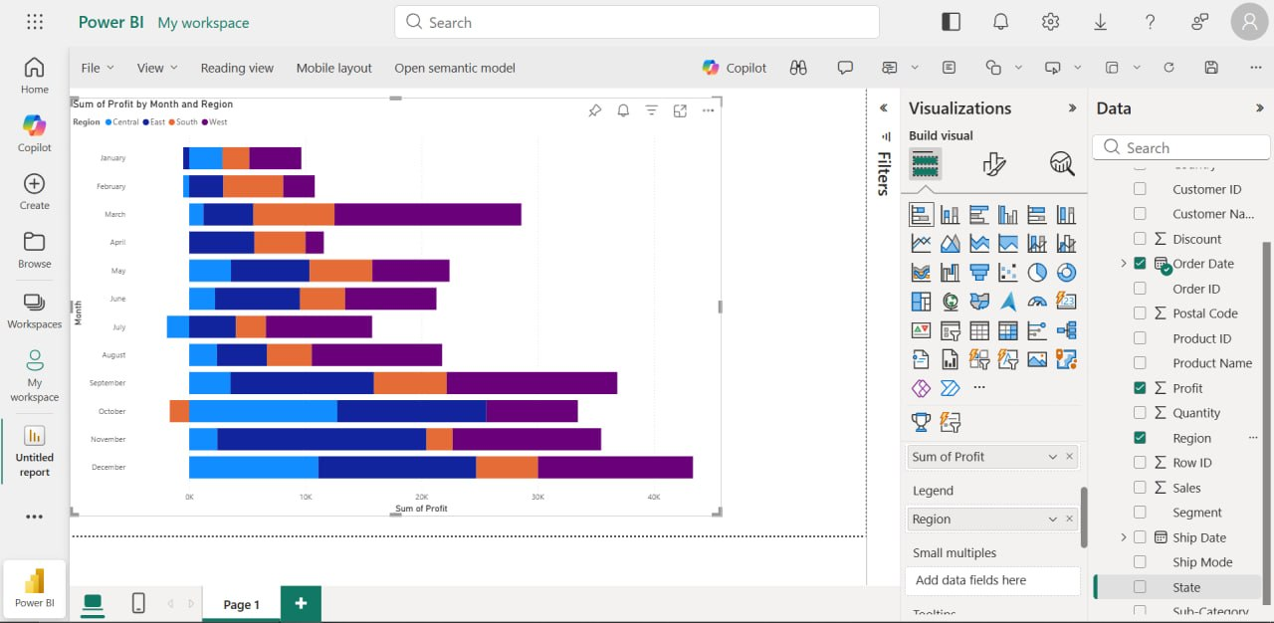
Customer Segment Sales Contribution
10 / 20
Consumer
Corporate
Home Office
51% of Sales
30% of Sales
19% of Sales
$1.16M Total Revenue
$706K Total Revenue
$429K Total Revenue
Largest segment; highest order frequency; price-sensitive
Mid-size orders; relationship-driven; higher avg. ticket
Smallest segment; tech-forward; niche but growing
Power BI — Sum of Profit by Month and Region

Slide 11
Strategic Recommendations for Customer Segments
11 / 20
👤 Consumer
🏢 Corporate
🏠 Home Office
✅ INVEST IN
✅ INVEST IN
✅ INVEST IN
• Deploy loyalty rewards and personalized discount coupons
• Assign dedicated B2B account managers for top 50 accounts
• Target remote-work trends: ergonomic Furniture, peripherals
• Focus marketing on back-to-school and holiday periods (Q4 spike)
• Offer volume-tiered pricing for bulk Technology orders
• Run digital-first campaigns on LinkedIn and niche tech sites
• Upsell Office Supplies bundles to existing Consumer buyers
• Target Technology upgrades (Phones, Laptops) in Q1 budget cycles
• Bundle Supplies + Technology kits for home-office setup orders
⚠️ CAUTION
⚠️ CAUTION
⚠️ CAUTION
• Avoid deep blanket discounts — erodes already-thin margins
• Prioritize service quality — Corporate clients are relationship-driven
• Don't over-invest in traditional retail for this segment
• Monitor churn — Consumers are most price-elastic
• Avoid late shipments — high Ship Mode expectations
• Ensure fast shipping — Home Office buyers expect Prime-like delivery

Slide 12
SECTION 03
Geographical
Performance
Mapping regional winners and underperformers to guide inventory allocation, marketing spend, and expansion strategy.

Slide 13
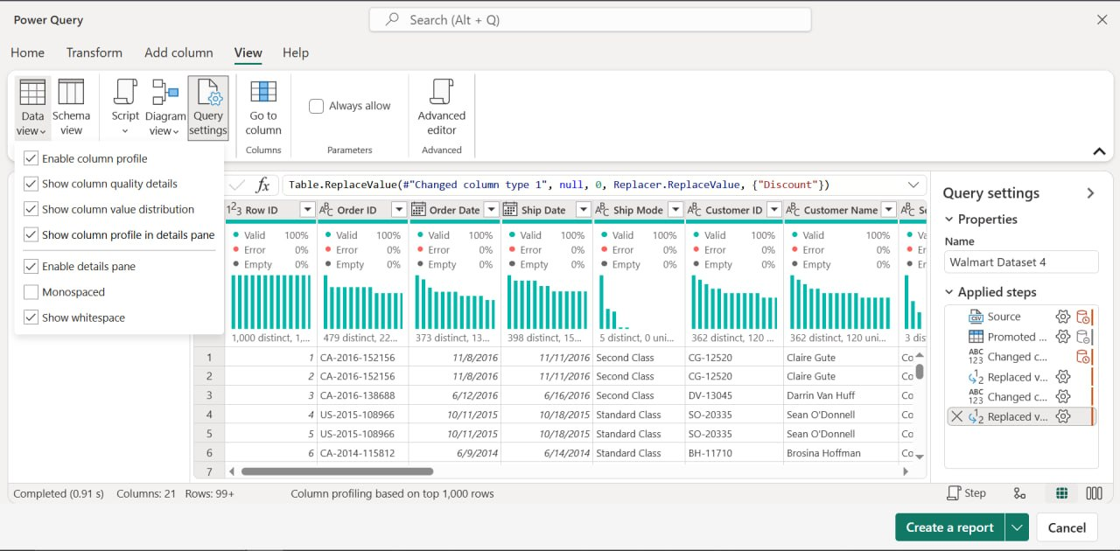
Top Regions & States by Sales and Profit
13 / 20
Power BI / Power Query — Data Preview (Cleaned Dataset)
Top 5 States by Revenue
📌 Regional Insight
1. California — $457K (West)
The West region alone contributes 31% of total revenue with the highest profit margin at ~15%. The Central region underperforms significantly — high sales but profit margin of only ~8%, signaling discounting pressure.
2. New York — $310K (East)
3. Texas — $171K (South)
4. Washington — $138K (West)
5. Pennsylvania — $117K (East)

Slide 14
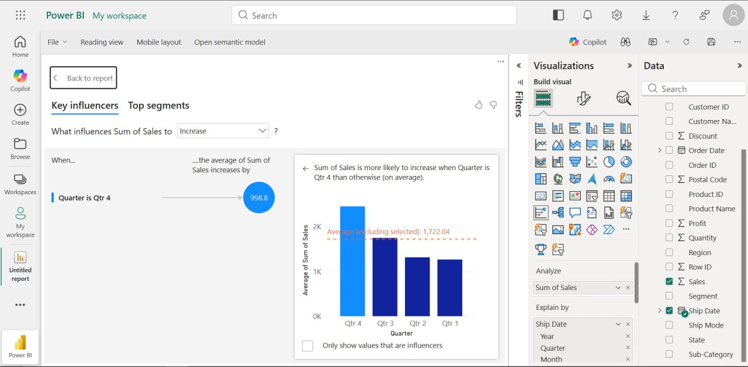
City-Level Analysis & Pockets of Loss
14 / 20
Power BI — Key Influencers: What Drives Sum of Sales to Increase?
🎯 TARGET Cities
New York City
$256K | +$42K profit
Los Angeles
$176K | +$29K profit
Seattle
$120K | +$22K profit
San Francisco
$91K | +$18K profit
🚫 AVOID / RESTRUCTURE
Philadelphia
$110K | –$13K loss
Houston
💡 Q4 is the strongest driver of city-level sales (+$998 avg. increase when Quarter = Q4)
$64K | –$9K loss
Chicago (select SKUs)
$82K | –$7K loss

Slide 15
SECTION 04
Factor Interactions
& Correlations
Quantifying how discounts, shipping modes, and order quantities interact to shape overall profitability.

Slide 16
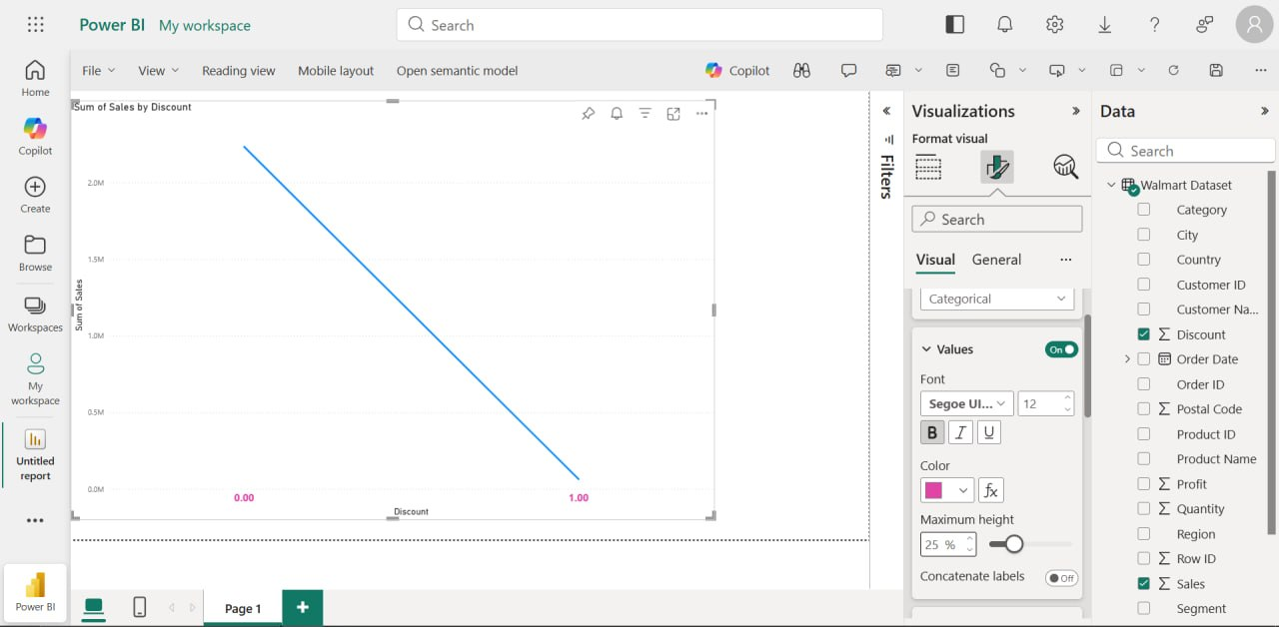
The Impact of Discounts on Profit and Quantity
16 / 20
Power BI — Sum of Sales by Discount (Negative Correlation Confirmed)
📉 Strong Negative Correlation
Discount and Profit show a correlation of –0.22; as discounts increase beyond 20%, profits turn negative.
⚠️ Discount > 30% = Loss Zone
Orders with discounts above 30% consistently generate losses, regardless of category or region.
📦 Quantity Rises with Discount
Discount and Quantity have a mild positive correlation (+0.17) — buyers purchase more units at higher discounts, but revenue per unit collapses.
💰 Break-Even Threshold
A 20% discount is the approximate break-even point. Beyond this, every additional percentage point deepens margin erosion.
🎯 Recommended Policy
Cap promotional discounts at 15–20% for standard products; reserve higher discounts only for clearance of aged inventory.

Slide 17
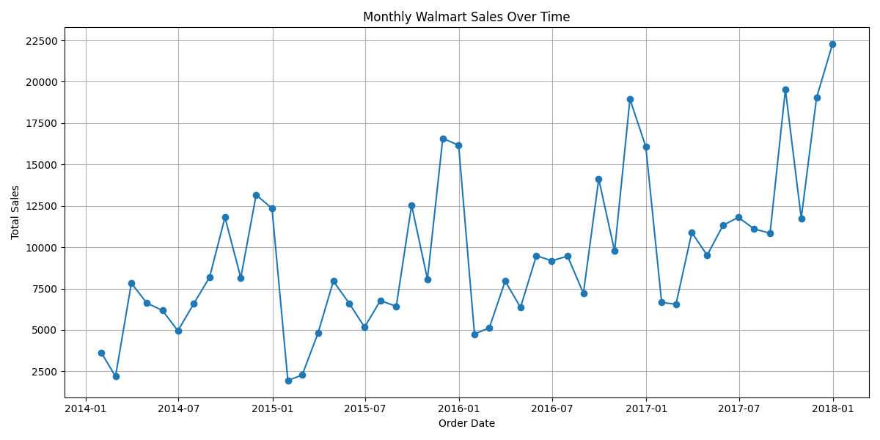
Shipping Modes & Order Sizes
17 / 20
Monthly Walmart Sales Over Time (2014–2018) — Trend & Seasonality
Standard Class
Second Class
First Class
Same Day
60% share
19% share
15% share
6% share
$1.37M
$459K
$352K
$129K
Most popular; avg 5-day delivery; best for bulk orders
Mid-tier option; used primarily by Corporate segment
Premium speed; often selected for Technology items
Lowest volume; highest cost; mainly urban markets
📈 Sales show clear upward trend 2014–2018 with strong Q4 seasonality. November 2017 peaks at $22,500 — driven by holiday-season demand across Consumer and Corporate segments.

Slide 18
Strategic Summary Matrix
18 / 20
A clear ACTION FRAMEWORK for Walmart owners and managers based on data findings.
✅ TARGET — INVEST & GROW
🚫 AVOID — REDUCE OR RESTRUCTURE
• Products:
Technology (Phones, Machines); Office Chairs; Binders; Storage
• Products:
Tables, Bookcases, Fasteners, Supplies — chronic loss-makers
• Categories:
Technology & Furniture — highest per-unit revenue
• Discounts:
Any discount >30% — guaranteed margin erosion per order
• Segments:
Corporate (highest avg. ticket); Consumer (highest volume)
• Regions:
Central region without margin analysis; low-profit density
• Regions:
West (California, Washington); East (New York, Pennsylvania)
• Cities:
Philadelphia, Houston — negative profit despite moderate volume
• Cities:
NYC, LA, Seattle, San Francisco — all high-profit metropolitan hubs
• Segments:
Blanket campaigns across all segments — use targeted approach
• Discounts:
Cap at ≤15–20% to preserve margin integrity
• Seasons:
Flat pricing in Q1–Q2 without promotional support
• Shipping:
Standard Class for bulk; First Class for Technology upsell
• Shipping:
Same Day for low-value orders — cost-to-revenue ratio too high
• Seasons:
Q4 surge (Nov–Dec): pre-load inventory; ramp marketing in Oct
• Stock:
Overstocking Furniture in low-margin Central/South markets

Slide 19
CONCLUSION & NEXT STEPS
1
Technology is Walmart's revenue engine
Phones and Machines alone drive 33%+ of Technology revenue. Sustained investment in this category yields the highest ROI.
2
Consumer segment demands precision
51% revenue share but thin margins. Loyalty programs and targeted (not blanket) promotions are essential to sustain profitability.
3
Geography is destiny
The West coast drives disproportionate value. Central and South markets require margin audits before further capital deployment.
4
Discounts are a double-edged sword
Every 10% discount above 20% erodes profit by an estimated 15–20%. A strict discount governance policy should be implemented immediately.
5
Q4 seasonality is predictable — and exploitable
Sales consistently peak in November–December. A 90-day pre-Q4 inventory ramp-up can significantly outperform flat stocking strategies.
Next Steps: Implement Power BI dashboard for live monitoring · Pilot discount cap policy in Central region · Launch Corporate loyalty program in Q3

Slide 20
Thank You
Questions & Discussion
We welcome any questions about our methodology, findings, or strategic recommendations. All analysis code is available on request.
Group Contribution Statement
This presentation represents equal contribution from all group members. Tasks were distributed across data cleaning, exploratory analysis, machine learning modeling, Power BI visualization, and presentation design. Every member actively participated in the interpretation of results and the formulation of strategic recommendations.
Walmart Sales Analysis · Data Analytics Group · 2026

