Slide 1
Introduction to Codexa
for Geeks
{
< G2: Areej Batool, Faizan Rabbani, Ali Huzaifa >
}
...

Slide 2
Table of Contents
Welcome to the world of Codexa!
Codexa Intro
Codexa Syntax
Codexa Variables
Codexa Data Types
Codexa Comments
Codexa Keywords
Codexa Operators
Codexa Selection
Codexa Loops
Codexa Strings
Codexa Arrays
Codexa Fuctions

Slide 3
Intro!
}
< Codexa inspired by “codex”, implying a comprehensive organized coding system. A high-level object oriented language used to develop adaptable applications. >
*

Slide 4
02
Syntax
{
..
< Set of rules to dictate how to write code in a programming language. >
}
..

Slide 5
Code Example 1
!include `library1`
<numeric> main()
Begin
<text> name;
write "Enter your name:";
# Output prompt
read name; .n # Read user input
write "Hello, " + name + "!"; # Output greeting
respond 0; # Return statement
End
*

Slide 6
03
Datatype
{
..
< Type of data a variable can store >
}
..

Slide 7
DataType
{
..
numeric 2/4 bytes
text
double 8 byte
Stores text, such as “Hello World”. String values are surrounded by double quotes.
Stores upto 8-byte floating point numbers, with decimals, such as 20.2 or -10.2
Stores integers (whole numbers) without decimal such as 12
symbol 1 byte
decimal 4 byte
Stores single characters, such as ‘a’ or ‘B’. Char values are surrounded by single quotes.
Stores upto 4-byte floating point numbers, with decimals, such as 20.2 or -10.2
flag 1 byte
Stores values with two states true or false.
*
}
..

Slide 8
04
Keywords
{
..
< Reserved words in a language having special purpose. >
}
..

Slide 9
Keywords
Sr. No | In C++ | Keyword
1. | && | alltrue
2. | || | anytrue
3. | break | halt
4. | bool | flag
5. | char | symbol
6. | continue | next
7. | catch | trap
8. | case | option
9. | do | ensure
{
}
*

Slide 10
Keywords
Sr. No | In C++ | Keyword
10. | double | double
11. | string | text
12. | default | bydefault
13. | else | otherwise
14. | const | fixed
15. | int | numeric
16. | if | check
17. | ! | ~
18. | return | respond
{
}
*

Slide 11
Keywords
Sr. No | In C++ | Keyword
19. | cin | write
20. | cout | read
21. | while | until
22. | for | repeat
23. | switch | switch
24. | unsigned | unsigned
25. | void | void
26. | true | yes
27. | false | no
{
}
*

Slide 12
05
Operators
{
..
< To perform various operations.>
}
..

Slide 13
Operators
Sr. No | In C++ | Keyword
1. | + | +
2. | - | -
3. | * | *
4. | / | /
5. | % | %
6. | = | =
7. | == | ==
8. | != | !=
9. | > | >
{
}
*

Slide 14
Operators
{
Sr. No | In C++ | Keyword
10. | < | <
11. | >= | >=
12. | <= | <=
13. | && | alltrue
14. | || | anytrue
15. | ! | ~
16. | pow() | ^
}
*

Slide 15
06
Variables
{
..
< Containers for storing data values. >
}
..

Slide 16
Variable Declaration Rules
{
Initialization (optional but recommended
✅ <numeric> count = 0; (Better practice)
❌ <numeric> count; (Uninitialized, may lead to garbage values)
Data type must match the value assigned
✅ <numeric> number = 10;
❌ <numeric> number = "hello"; (Invalid)
}
Must be declared before use (in statically typed languages like C, Java)
✅ <numeric> x; x = 10;
❌ y = 5; (Invalid, needs <numeric> y = 5;)
*

Slide 17
Code Example 2
Syntax:
<datatype> variableName = value;
Example:
<numeric> myNum = 17;
}
..

Slide 18
07
Comments
{
..
< Used to explain Codexa code, and make it more readable. >
}
..

Slide 19
Comments
Multi-line Comments
Starts with hash (#*...*#).
Any text between #*...*# is ignored by the compiler (will not be executed).
Example:
#* This is a muti-line comment. Below is the statement which prints Hello World *#
read "Hello World!";
{
Single-line Comments
Starts with hash (#).
Any text between # and the end of the line is ignored by the compiler (will not be executed).
Example:
# This is a comment
read "Hello World!";
}
*

Slide 20
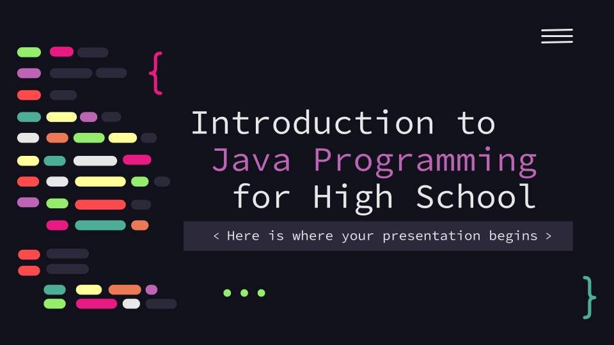
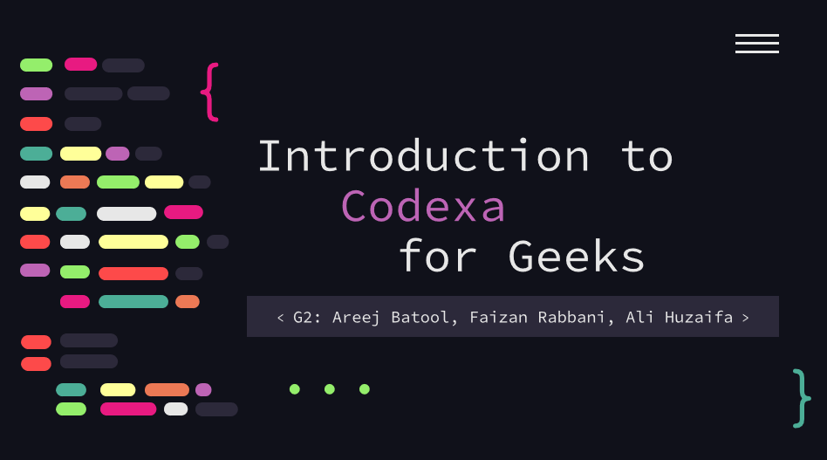
Variable Rules
{
You can replace the image on the screen with your own work. Just right-click on it and select “Replace image”
}
...

Slide 21
08
Selections
{
..
< Used to work according to some condition.>
}
..

Slide 22
If..else
!include `library1`
<numeric> main()
Begin
<text> age;
write "Enter your age:";
# Output prompt for age
read age; .n # Read user input for age
check age >= 18 then
Begin
write "Hello, " + name + "! You are an adult."; # If age is 18 or older
End
otherwise
Begin
write "Hello, " + name + "! You are a minor."; # If age is less than 18
End
respond 0; # Return statement
End
*

Slide 23
09
Loop
{
..
< Used to iterate.>
}
..

Slide 24
Repeat-until
*
!include `library1`
<numeric> main()
Begin
<numeric> counter;
counter = 0; # Initialize counter
repeat
Begin
write "Counter value: " + counter; # Output current counter value
counter = counter + 1; # Increment counter
End
until counter >= 5; # Stop when counter reaches 5
write "Loop ended."; # Output after loop ends
respond 0; # Return statement
End

Slide 25
10
Thankyou
{
..
< Can be extended.>
}
..

