Slide 1
Net Centric Programming Lecture 1
Adeel-ur-Rehman

Slide 2
About Me
Education
2014, M.S. (Computing), SZABIST
Work Experiences
Principal Scientific Officer, National Centre for Physics (NCP).
Offshore Developer, CERN (European Centre for Nuclear Research), Switzerland.
Visiting Faculty, QAU
Ex-Visiting Faculty Experience
SZABIST Islamabad Campus
PMAS-AAU Rawalpindi (CS and IT Departments)
TechnoEd institute (ORACLE partner in Pakistan)
Notes:
2
2

Slide 3
About Me
Research Interests
Programming Languages
Data Science and AI
Parallel & Distributed Computing
Emerging Technologies (DNA, Quantum Computing etc.)
My Google Scholar Profile (3 Journal, 8 Conference pubs.)
https://scholar.google.com.pk/citations?hl=en&user=URH5Zp0AAAAJ
Contact
adeelurrahman@protonmail.com
Notes:
3
3
3

Slide 4
Course Reference Books
Recommended Books
Java Network Programming. 4th ed., E. R. Harold, O’Reilly, 2014. ([JNP])
Java I/O, E. R. Harold, O’Reilly, ([JIO])
Java Network Programming and distributed computing, David Reilly, Michael Reilly (JNPD)
An Introduction to Network Programming in Java, by Jan Graba, Springer 2013 ([INPJ-JG])
Further Readings
“Java Distributed Computing”, J. Farley, O’Reilly, 1998, ISBN: 1-56592-206-9 [FAR].
“Java 2 Developer’s Handbook”, P. Heller and S. Roberts, Sybex, 1999, ISBN: 0- 7821-2179-9 [Java2H]
“Java 1.2 Unleashed”, J. Jaworski,: Macmillan Computer Publishing, 1998, ISBN: 1575213893 [Java2U]

Slide 5
Course Contents
Week | Book References | Lecture Topics
1st | JNP | Basic Networking Concepts Networks IP, TCP and UDP Internet Client Server Model
2nd & 3rd | JNP, JIO | Java I/O Sockets, Datagrams Java Streams Java.io package
4th | JNP, JIO | Java.io Inputstream, outputstram Reader, writers, File I/O streams
5th | JNP, JNPD | Streams
6th | JNP, JNPD | Threads

Slide 6
Course Contents
Week | Book References | Lecture Topics
7th | JNP | InternetAddresses
8th |  | MID Term
9th & 10th | JNP | URL, and URI
11th | JNP | HTTP
12th |  | URLConnection
13th | JNP, JNPD | Sockets for clients Sockets for servers
14th | [INPJ-JG, , JNPD] | RMI RMI Case Study
15th & 16^{tt} | [INPJ-JG, , JNPD] | CORBA

Slide 7
Grading Criteria
 | Marks
Quizzes | 5 - 10
Assignments | 5 – 10
Project/Presentation | 5 – 10
Class Behaviour/Attendance | 5 - 10
Midterm Exam | 25
Final Exam | 50

Slide 8
Introduction
Network programming
has become a core part of every developer’s toolbox.
Today, more programs are network aware than aren’t. Besides classic applications like email, web browsers, and remote login, most major applications have some level of networking built in.
Examples:
IDEs like Eclipse and IntelliJ IDEA communicate with source code repositories like Git (via GitHub) and Sourceforge.
Word processors like Microsoft Word open files from URLs.
Antivirus programs like Norton AntiVirus check for new virus definitions by connecting to the vendor’s website every time the computer is started.
Music players like iTunes and related services like Spotify sync and stream media files
Gamers playing multiplayer first-person shooters like Halo gleefully frag each other in real time.
Supermarket cash registers running IBM SurePOS ACE communicate with their store’s server in real time with each transaction.
Schedule applications like Microsoft Outlook automatically synchronize calendars among employees in a company.

Slide 9
Introduction
Java was the first programming language designed from the ground up for network applications.
One of the first two real Java applications was a web browser. As the Internet continues to grow, Java is uniquely suited to build the next generation of network applications.
One of the biggest secrets about Java is that it makes writing network programs easy.
In fact, it is far easier to write network programs in Java than in almost any other language.

Slide 10
Network
PC client
Internet Server
Local Area Network
PDA

Slide 11
Network
A network is a collection of:
Computers
and other devices
that can send data to and receive data from one another, more or less in real time.
Wired network
electromagnetic waves.
Wireless networks
transmit data using radio waves;
Optical network
Long distance transmissions are now carried over fiber-optic cables that send light waves through glass filaments.
Each machine on a network is called a node. Most nodes are computers, but printers, routers, bridges, gateways, dumb terminals, and vending machines (Coca-Cola™) can also be nodes.
Nodes that are fully functional computers are also called hosts.
I will use the word node to refer to any device on the network,
and the word host to refer to a node that is a general-purpose computer.

Slide 12
Network Addresses
Every network node has an address, a sequence of bytes that uniquely identifies it.
The more bytes there are in each address, the more addresses there are available and the more devices that can be connected to the network simultaneously.
Ethernet addresses (Mac addresses):
are attached to the physical Ethernet hardware.
Manufacturers of Ethernet hardware use preassigned manufacturer codes to make sure there are no conflicts between the addresses in their hardware and the addresses of other manufacturers’ hardware.
Internet addresses:
are normally assigned to a computer by the organization that is responsible for it.
However, the addresses that an organization is allowed to choose for its computers are assigned by the organization’s Internet service provider (ISP).
ISPs get their IP addresses from regional Internet registries.

Slide 13
Names
On some kinds of networks, nodes also have text names that help human beings identify them such as “www.elharo.com” or “Beth Harold’s Computer.”
At a set moment in time, a particular name normally refers to exactly one address.
However, names are not locked to addresses.
Names can change while addresses stay the same; likewise, addresses can change while the names stay the same.
One address can have several names and one name can refer to several different addresses.

Slide 14
Packets
All modern computer networks are packet-switched networks:
Data traveling on the network is broken into chunks called packets and each packet is handled separately.
Each packet contains information about who sent it and where it’s going (i.e. source and destination addresses).
Advantage:
The most important advantage of breaking data into individually addressed packets is that packets from many ongoing exchanges can travel on one wire, which makes it much cheaper to build a network: many computers can share the same wire without interfering.
In contrast, when you make a local telephone call within the same exchange on a traditional phone line, you have essentially reserved a wire from your phone to the phone of the person you’re calling (circuit-switching).

Slide 15
Protocol
A protocol is a precise set of rules defining how computers communicate: the format of addresses, how data is split into packets, and so on.
There are many different protocols defining different aspects of network communication.
For example, the Hypertext Transfer Protocol (HTTP) defines how web browsers and servers communicate; at the other end of the spectrum, the IEEE 802.3 standard defines a protocol for how bits are encoded as electrical signals on a particular type of wire.

Slide 16
Protocol…(2)
Open, published protocol standards allow software and equipment from different vendors to communicate with one another.
A web server doesn’t care whether the client is a Unix workstation, an Android phone, or an iPad, because all clients speak the same HTTP protocol regardless of platform.

Slide 17
Network Communication
Sending data across a network is a complex operation that must be carefully tuned to the physical characteristics of the network as well as the logical character of the data being sent.
Software that sends data across a network must understand how to avoid collisions between packets, convert digital data to analog signals, detect and correct errors, route packets from one host to another, and more.
The process is further complicated when the requirement to support multiple operating systems and heterogeneous network cabling is added.

Slide 18
Network Layers
To hide most of this complexity from the application developer and end user, the different aspects of network communication are separated into multiple layers.
Each layer represents a different level of abstraction between the physical hardware (i.e., the wires and electricity) and the information being transmitted.
In theory, each layer only talks to the layers immediately above and immediately below it.
Separating the network into layers lets you modify or even replace the software in one layer without affecting the others, as long as the interfaces between the layers stay the same.

Slide 19
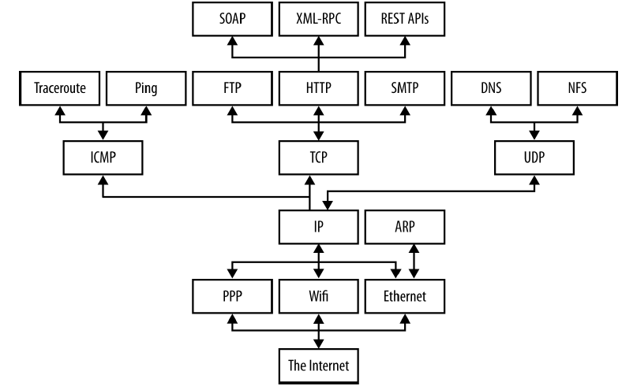
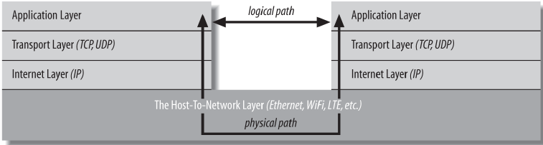
Protocols
TCP / IP Layers

Slide 20
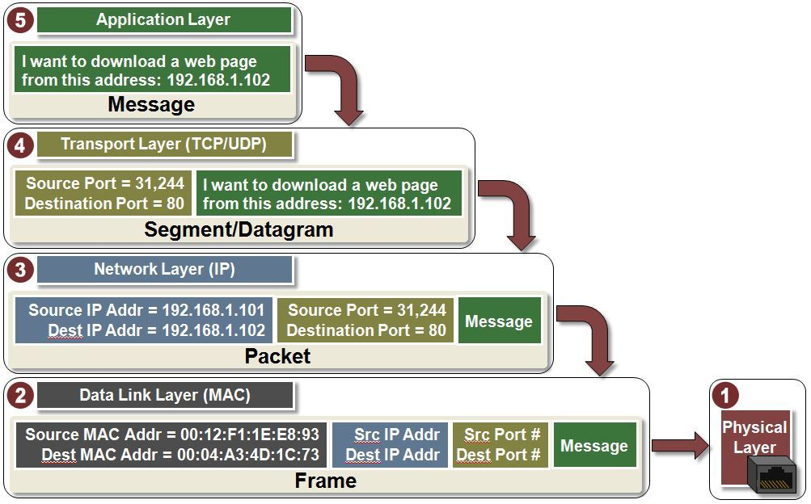

Slide 21
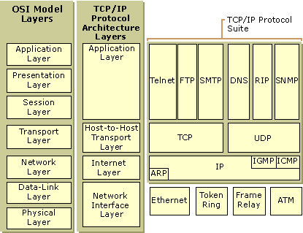
TCP / IP VS OSI Layers

Slide 22
TCP / IP Layers
In this model, applications in the application layer talk only to the transport layer. The transport layer talks only to the application layer and the Internet layer.
The Internet layer in turn talks only to the host-to-network layer and the transport layer, never directly to the application layer.
The host-to-network layer moves the data across the wires, fiber-optic cables, or other medium to the host-to-network layer on the remote system, which then moves the data up the layers to the application on the remote system.
For example, when a web browser sends a request to a web server to retrieve a page, the browser is actually talking to the transport layer on the local client machine.

Slide 23
TCP / IP Layers…(2)
The transport layer breaks the request into TCP segments, adds some sequence numbers and checksums to the data, and then passes the request to the local internet layer.
The internet layer fragments the segments into IP datagrams of the necessary size for the local network and passes them to the host-to-network layer for transmission onto the wire.
The host-to-network layer encodes the digital data as analog signals appropriate for the particular physical medium and sends the request out the wire where it will be read by the host-to-network layer of the remote system to which it’s addressed.

Slide 24
TCP / IP Layers…(3)
The host-to-network layer on the remote system decodes the analog signals into digital data, then passes the resulting IP datagrams to the server’s internet layer.
The internet layer does some simple checks to see that the IP datagrams aren’t corrupt, reassembles them if they’ve been fragmented, and passes them to the server’s transport layer.
The server’s transport layer checks to see that all the data arrived and requests retransmission of any missing or corrupt pieces.
This request actually goes back down through the server’s internet layer, through the server’s host-to-network layer, and back to the client system, where it bubbles back up to the client’s transport layer, which retransmits the missing data back down through the layers. This is all transparent to the application layer.

Slide 25
TCP / IP Layers…(4)
Once the server’s transport layer has received enough contiguous, sequential datagrams, it reassembles them and writes them onto a stream read by the web server running in the server application layer.
The server responds to the request and sends its response back down through the layers on the server system for transmission back across the Internet and delivery to the web client.

Slide 26
Host to-Network Layer
The hidden parts of the network belong to the host to-network layer (also known as the link layer, data link layer, or network interface layer).
The host-to-network layer defines how a particular network interface—such as an Ethernet card or a WiFi antenna—sends IP datagrams over its physical connection to the local network and the world.
The part of the host-to-network layer made up of the hardware that connects different computers (wires, fiber-optic cables, radio waves, or smoke signals) is sometimes called the physical layer of the network.
As a Java programmer, you don’t need to worry about this layer unless something goes wrong—the plug falls out of the back of your computer, or someone drops a backhoe through the T–1 line between you and the rest of the world.
In other words, Java never sees the physical layer.

Slide 27
Host to-Network Layer…(2)
The primary reason you’ll need to think about the host-to-network layer and the physical layer, if you need to think about them at all, is performance.
For instance, if your clients reside on fast, reliable fiber-optic connections, you will design your protocol and applications differently than if they’re on high-latency satellite connections
You’ll make still different choices if your clients are on a 3G data plan where they’re charged by the byte for relatively low bandwidth.
And if you’re writing a general consumer application that could be used by any of these clients, you’ll try to hit a sweet spot somewhere in the middle, or perhaps even detect and dynamically adapt to individual client capabilities.
However, whichever physical links you encounter, the APIs you use to communicate across those networks are the same. What makes that possible is the internet layer.

Slide 28
Internet Layer
A network layer protocol defines how bits and bytes of data are organized into the larger groups called packets, and the addressing scheme by which different machines find one another.
The Internet Protocol (IP) is the most widely used network layer protocol in the world and the only network layer protocol Java understands.
In fact, it’s two protocols: IPv4, which uses 32-bit addresses, and IPv6, which uses 128- bit addresses and adds a few other technical features to assist with routing.
IPv4 still accounts for more than 90% of Internet traffic, but IPv6 is catching on fast and may well surpass IPv4 in near future.

Slide 29
Internet Layer…(2)
Although these are two very different network protocols that do not interoperate on the same network without special gateways and/or tunneling protocols, Java hides almost all of the differences from you.
In both IPv4 and IPv6, data is sent across the internet layer in packets called datagrams.
Each IPv4 datagram contains a header between 20 and 60 bytes long and a payload that contains up to 65,515 bytes of data. (In practice, most IPv4 datagrams are much smaller, ranging from a few dozen bytes to a little more than eight kilobytes.)
An IPv6 datagram contains a larger header and up to four gigabytes of data.

Slide 30
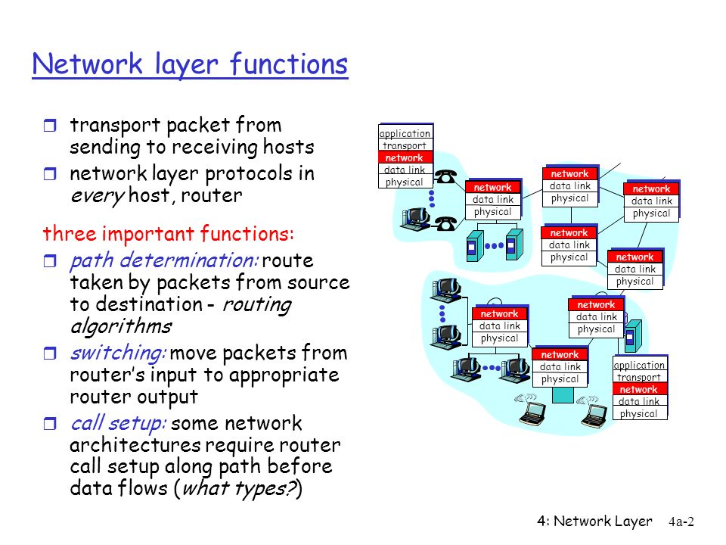
Internet Layer…(3)

Slide 31
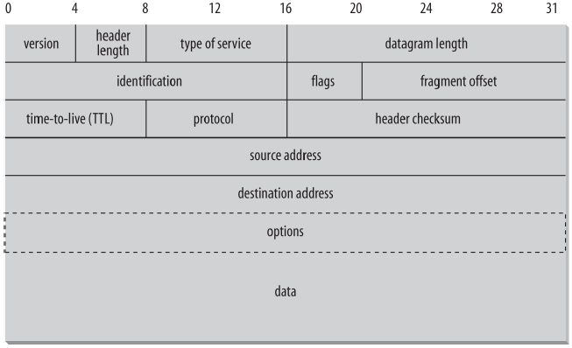
Internet Layer…(3)
Second purpose of the Internet layer is to enable different types of Host-to-Network layers to talk to each other.
Internet routers translate between WiFi and Ethernet, Ethernet and DSL, DSL and fiber-optic backhaul protocols, and so forth.
Without the internet layer, each computer could only talk to other computers that shared its particular type of network.
The internet layer is responsible for connecting heterogenous networks to each other using homogeneous protocols.

Slide 32
Transport Layer
Raw datagrams have some drawbacks.
Most notably, there’s no guarantee that they will be delivered.
Even if they are delivered, they may have been corrupted in transit.
The header checksum can only detect corruption in the header, not in the data portion of a datagram.
Finally, even if the datagrams arrive uncorrupted, they do not necessarily arrive in the order in which they were sent.

Slide 33
Transport Layer…(2)
Individual datagrams may follow different routes from source to destination.
Just because datagram A is sent before datagram B does not mean that datagram A will arrive before datagram B.
The transport layer is responsible for ensuring:
that packets are received in the order they were sent
that no data is lost or corrupted.
If a packet is lost, the transport layer can ask the sender to retransmit the packet.
IP networks implement this by adding an additional header to each datagram that contains more information.
Protocols of transport layer:
TCP:
UDP:

Slide 34
Application Layer
The layer that delivers data to the user is called the application layer.
The three lower layers all work together to define how data is transferred from one computer to another.
The application layer decides what to do with the data after it’s transferred.
For example, an application protocol like HTTP (for the World Wide Web) makes sure that your web browser displays a graphic image as a picture, not a long stream of numbers.

Slide 35
Application Layer…(2)
The application layer is where most of the network parts of your programs spend their time.
There is an entire alphabet soup of application layer protocols: in addition to HTTP for the Web, there are SMTP, POP, and IMAP for email; FTP, FSP, and TFTP for file transfer; NFS for file access; Gnutella and BitTorrent for file sharing; the Session Initiation Protocol (SIP) and Skype for voice communication; and many, many more.
In addition, your programs can define their own application layer protocols as necessary.

Slide 36
End of Lecture 1

