Slide 1
HTTP
Adeel-ur-Rehman

Slide 2
Normal web surfing uses these two steps:
The browser requests a page
The server sends the page
Data flows primarily from the server to the client.

Slide 3
Forms
There are times when the server needs to get data from the client rather than the other way around. The common way to do this is with a form like this one:

Slide 4
CGI
The user types the requested data into the form and hits the submit button.
The client browser then sends the data to the server using the Common Gateway Interface, CGI for short.
CGI uses the HTTP protocol to transmit the data, either as part of the query string or as separate data following the MIME header.

Slide 5
GET and POST
When the data is sent as a query string included with the file request, this is called CGI GET.
When the data is sent as data attached to the request following the MIME header, this is called CGI POST

Slide 6
MIME
MIME is an acronym for "Multipurpose Internet Mail Extensions".
an Internet standard defined in RFCs 2045 through 2049
originally intended for use with email messages, but has been been adopted for use in HTTP.

Slide 7
HTTP
Web browsers communicate with web servers through a standard protocol known as HTTP, an acronym for HyperText Transfer Protocol.
This protocol defines
how a browser requests a file from a web server
how a browser sends additional data along with the request (e.g. the data formats it can accept),
how the server sends data back to the client
response codes

Slide 8
An introduction to HTTP messages

Slide 9




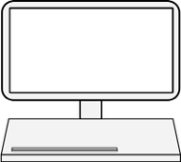





Web servers and clients
display
(1) HTTP request
execute
Process responses
music player
(2) HTTP response
Acrobat Reader
-
-
Servers wait for data requests Answer thousands of clients simultaneously
Host web resources
-
Clients are most often Web browsers
Telnet
-
-
Web resource: any kind of content with an identity, including static files (e.g. text, images, video), software programs, Web cam gateway, etc.

Slide 10
A Typical HTTP Connection
Client opens a socket to port 80 on the server.
Client sends a GET request including the name and path of the file it wants and the version of the HTTP protocol it supports.
The client sends a MIME header.
The client sends a blank line.
The server sends a MIME header
The server sends the data in the file.
The server closes the connection.

Slide 11
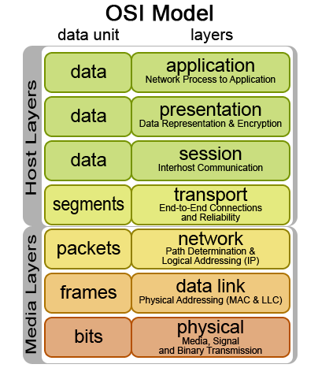


Network communication
•
Conceptual model Open Systems Interconnection (OSI)
•
Network protocols are matched to different “layers”
Many network protocols exist, three are of interest to us:
HTTP
•
IP: TCP: HTTP:
Internet Protocol Transmission Control Protocol Hypertext Transfer Protocol
TCP
IP
others include: SSH, IMAP, STMP, FTP ….
Image src: Wikipedia
HTTP uses reliable data-transmission protocols.

Slide 12
Browser Request MIME Header
When the browser sends a request to a web server, it also sends a MIME header.
MIME headers contain name-value pairs, essentially a name followed by a colon and a space, followed by a value.
Connection: Keep-Alive
User-Agent: Mozilla/3.01 (Macintosh; I; PPC)
Host: www.digitalthink.com:80
Accept: image/gif, image/x-xbitmap, image/jpeg, image/pjpeg, */*

Slide 13
Server Response MIME Header
When a web server responds to a web browser it sends a MIME header along with the response that looks something like this:
Server: Netscape-Enterprise/2.01
Date: Sat, 02 Aug 1997 07:52:46 GMT
Accept-ranges: bytes
Last-modified: Tue, 29 Jul 1997 15:06:46 GMT
Content-length: 2810
Content-type: text/html

Slide 14
HTTP request message
GET /
Host:
HTTP/1.1
plain text, line-oriented character sequences
www.google.com
User-Agent: Mozilla/5.0
(Macintosh; Intel Firefox/31.0
Mac OS X 10.9;
rv:31.0) Gecko/20100101 Accept:
text/html,application/xhtml+xml,application/
xml;q=0.9,*/*;q=0.8
Accept-Language: en-gb,en;q=0.5 Accept-Encoding: gzip, deflate DNT: 1
Cookie:
utma=1.20923577936111.16111.19805.2;utmcmd=(none);

Slide 15
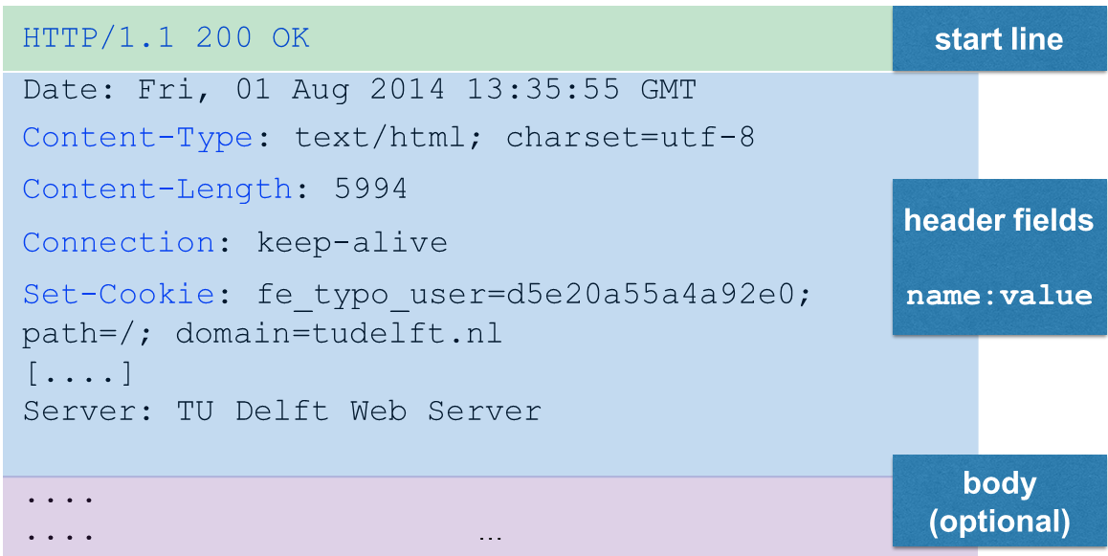
HTTP response message

Slide 16
Primary entity header fields
Content-Type | Entity type
Content-Length | Length/size of the message
Content-Language | Language of the entity sent (e.g. English)
Content-Encoding | Data transformations applied to the entity
Content-Location | Alternative location of the entity
Content-Range | For partial entities, range defines the pieces sent
Content-MD5 | Checksum of the content
Last-Modified | Date on which this entity was created/modified
Expires | Date at which the entity will become stale
Allow | Lists the legal request methods for the entity

Slide 17

Content-Type
•
MIME types are attached to all HTTP object data
Multipurpose Internet Mail Extensions
historic reasons
•
MIME type determines clients reaction to the received data
•
Pattern: [primary
object
type]/[subtype]
e.g. text/plain, text/html,
image/jpeg,
video/quicktime, powerpoint
application/vnd.ms-

Slide 18
Content types are diverse
Most popular
Least popular
text/html
application/pgp-keys
image/jpg
application/x-httpd-php4
text/xml
chemical/x-pdb
application/rss+xml
model/mesh
text/plain
application/x-perl
application/xml
text/calendar
audio/x_mpegurl
application/pdf
application/bib
application/atom+xml
application/postscript
unknown/unknown
application/x-msdos-program

Slide 19


Content-Length
•
Indicates the size of the entity body in the message
•
Essential for persistent connections to discover where one HTTP message ends and the next one begins
Persistent connections reuse the same TCP connection for multiple HTTP request/response messages.

Slide 20
Content-Encoding
•
Commonly either gzip, compress (Unix compression), deflate (zlib compression) or identity (no encoding)
•
Servers aim to use encodings that clients understand
•
Clients send a list of acceptable encodings in the
Accept-Encoding request header
•
Compression saves network bandwidth (fewer bits to transmit) but increases processing costs to decompress

Slide 21
Content-MD5
•
HTTP messages are sent via TCP/IP (ensuring reliable transport)
•
But: the Internet is huge, many servers interact to transport a message with different implementations of established protocols (which may be buggy)
•
Sanity check: Sender generates a checksum (MD5) of the content to detect unintended modifications of the content

Slide 22









Expires
Note: Web browsers also cache when possible.
•
Web caches keep copies of popular documents
yes
serve copy
valid local copy?
HTTP request
Web cache
no
forward
•
Advantages of Web caches
Reduction of redundant data transfer
Reduction of network bottlenecks
Reduced demand on origin servers
Reduced distance delay
Expires indicates when fetched resource is no longer valid and needs to be retrieved from the origin server
•

Slide 23
Expires & Cache-Control
•
Content on the origin server can change
Caches need to ensure that their copies are in sync with the origin server
Caches can revalidate their copies at any time with any frequency (but: this would not be efficient)
Expires in HTTP response header indicates a document’s expiration date in absolute terms — determines how long the content is fresh; cache revalidates at that date
Alternative to Expires is Cache-Control: indicates a document’s expiration date in relative terms (number of seconds since being sent)
•
•
•
•

Slide 24
Last-Modified
•
Contains the date when the document was last altered (in HTTP response)
No indication about the amount of changes in the document
Often used in combination with If-Modified-Since for cache revalidation requests — origin server only returns the document if it changed since the given date (returned is 304 Not Modified response)
Last-Modified dates are not always reliable (e.g. manipulated by origin servers to ensure high cache revalidation rates)
•
•
•

Slide 25
Remember: HTTP response message

Slide 26
Common status codes
1xx | Informational
2xx | Success (200 OK)
3xx | Redirected
4xx | Client error (404 Not Found)
5xx | Server error
In practice only a few codes per category are supported

Slide 27
HTTP methods

Slide 28
Common HTTP methods
GET | Get a document from the Web server.
HEAD | Get the header of a document from the Web server.
POST | Send data from the client to the server for processing.
PUT | Save the body of the request on the server.
TRACE | Trace the message through proxy servers to the server.
OPTIONS | Determine what methods can operate on a server.
DELETE | Remove a document from a Web server.

Slide 29



TCP & HTTP: displaying a simple HTML resource in the browser
domain name path
http:/ : /
port
Browser extract’s domain name from URL
Browser converts domain name into IP address
Browser extracts port number (default: 80)
Browser establishes a TCP connection with the Web server
Browser sends an HTTP request
Web server sends an HTTP response
The connection is closed, browser displays the document
HTTP is stateless. Each request/response occurs in isolation.
/www.microsoft.com
80
index.html

Slide 30






TCP & HTTP: displaying a simple HTML resource in the browser
TCP delivers
error-free data transportation
in-order delivery
an unsegmented data stream
domain name port
path
IP address
http:/
/www.microsoft.com
80
index.html
: /
http:/
/65.55.57.27
:80/index.html
32-bit IP address: four 8-bit numbers (0-255)

Slide 31




Authentication
So far: HTTP as anonymous, stateless request/response protocol. The same request, sent by different clients, is treated in exactly the same manner.
Now: identification via
HTTP headers
Client IP address tracking
User login (HTTP Basic Authentication)
Fat URLs

Slide 32
Fat URLs
<a href=“/browse/-/229220/ref=gr_gifts/002-1145265-8016838">Gifts</a>
<a href="/wishlist/ref=gr_pl1_/002-1145265-8016838">Wish List</a>
•
Tracking through the generation of unique URLs for each user
First time a user visits a page within a Web site, a unique ID is generated by the server
Server redirects client to the fat URL (recall status code 3**)
Server on the fly rewrites the HTML when an HTTP request with a fat URL is received (adds ID to all hyperlinks to maintain the knowledge)
•
•
•
•
Independent HTTP transactions can be tied into a single “session”
6
Question: what is a problem of fat URLs?

Slide 33
Fat URLs
•
Fat URLs are ugly
Fat URLs cannot be shared (URL may not exist later on or user inadvertently shares private information)
Fat URLs break caching mechanisms (one URL per user/page instead of one URL per page)
Extra server load (HTML page rewrites necessary)
Users can “escape” (ID is lost when user navigates outside the Web site, unless he bookmarks it)
•
•
•
•

Slide 34
HTTP basic authentication
•
Server explicitly asks the user for authentication (username and password)
•
HTTP has a built-in mechanism to pass user information to web sites: WWW-Authentication and Authorization headers
•
HTTP is stateless: once logged in, the browser sends the login information with each request

Slide 35











HTTP basic authentication
GET /index.html HTTP/1.1 host: www.microsoft.com
1
2
HTTP/1.1 401 Login
Required
WWW-Authenticate: Basic realm=“B&R”
security realm and authentication algorithm
Browser presents login screen
GET /index.html HTTP/1.1 host: www.microsoft.com
Authorization: Basic am910jRmdW4=
3
HTTP/1.1 200 OK
Content-length:
1234
Content-type:
…
text/html
base-64 encoding
In future HTTP requests to the site, the browser automatically issues the stored username/password when asked (or even without triggering)

Slide 36


HTTP basic authentication
•
Username and password are joined together by a colon and converted to base-64 encoding (e.g. john:mypwd)
•
Base-64 encoding ensures that only HTTP compatible characters are entered into the message (takes as input binary, text and international character data strings)
images can be encoded this way
Normandië Delft España
Tm9ybWFuZGnDqw== RGVsZnQ= RXNwYcOxYQ==

Slide 37
HTTP basic authentication: secure?
•
Username and password can be decoded trivially (sent over the network “in the clear”)
•
Users tend to reuse login/password combinations; a non- critical web site may use basic authentication without SSL that an opponent can capture and try on critical sites
•
No protection against counterfeit servers (that act instead of the original server)

Slide 38





HTTP basic authentication: overall
Basic authentication prevents accidental or casual access
by curious users (privacy is desired but not essential).
Basic authentication is useful for personalisation and access control within a “friendly” environment (intranet).
“In the wild”, basic authentication should always be used in combination with secure HTTP (e.g. https) — avoids sending username/password in the clear across the network.

Slide 39
Secure HTTP

Slide 40


Secure HTTP
•
So far: lightweight authentication
Not useful for purchasing, bank transactions or confidential data
Secure HTTP should provide
•
•
Server authentication (client is sure to talk to the right server)
Client authentication (server is sure to talk to the right client)
Integrity (client and server are sure their data is intact)
Encryption
Efficiency
Adaptability (to the current state of the art in encryption)

Slide 41
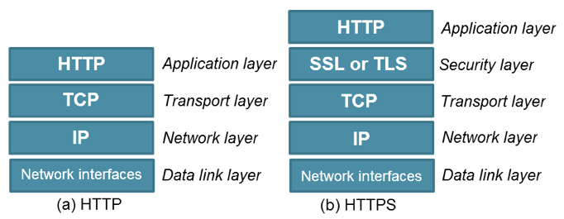


Secure HTTP: HTTPS
HTTPS is the most popular secure form of HTTP URL scheme is https:// instead of http://
•
•
•
Request and response data are encrypted before being sent across the network (SSL: Secure Socket Layer)
Client & server negotiate the cryptographic protocol to use.

Slide 42
Pointer: http://httpbin.org/
•
A HTTP request & response service
•
A very useful site to play around with the different features of the http protocol
•

