Slide 1
CORBA
Adeel-ur-Rehman

Slide 2
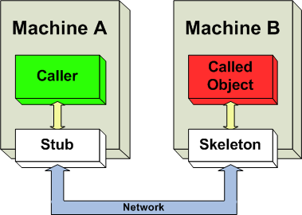
Distributed Object
Distributed objects refer to software modules that are designed to work together, but reside either in multiple computers connected via a network or in different processes inside the same computer
Distributed objects residing in different machines.

Slide 3
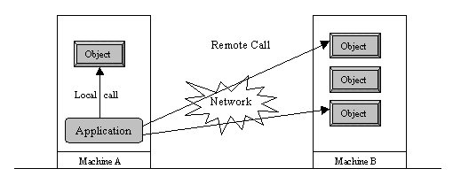
Distributed Computing
Local vs. Remote objects
An enterprise app is a collection of co-operating objects located on different machines

Slide 4
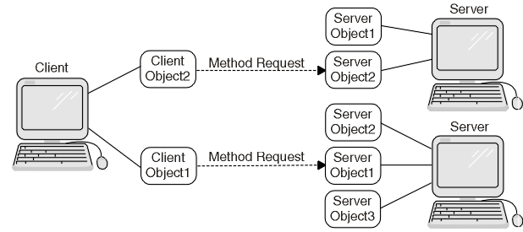
Working of Distributed Objects
Working of Distributed Objects

Slide 5
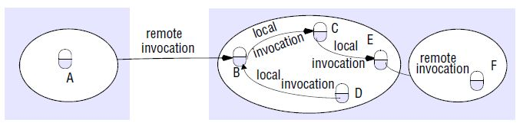
Remote Invocation
Remote Invocation & Local Invocation

Slide 6
CORBA
(COMMON OBJECT REQUEST BROKER ARCHITECTURE)

Slide 7
CORBA???
The Common Object Request Broker Architecture (CORBA) is a standard defined by the Object Management Group (OMG) that enables software components written in multiple computer languages and running on multiple computers to work together (i.e., it supports multiple platforms).
Focus on integration of systems and applications across heterogeneous platforms

Slide 8
CORBA
CORBA is just a specification for creating and using distributed objects
CORBA is not a programming language.
CORBA is a standard (not a product!)
Allows objects to transparently make requests and receive responses
Its architecture is based on the object model
Promotes design of applications as a set of cooperating objects
based on client/server concepts

Slide 9
CORBA Objects
It is important to note that CORBA objects differ from typical programming objects in three ways:
CORBA objects can run on any platform.
CORBA objects can be located anywhere on the network.
CORBA objects can be written in any language that has IDL mapping.

Slide 10
CORBA Architecture
The CORBA architecture is based on the object model.
A CORBA-based system is a collection of objects that isolates the requestors of services (clients) from the providers of services(servers) by a well-defined encapsulating interface.
CORBA is composed of five major components: ORB, IDL, dynamic invocation interface(DII), interface repositories (IR), and object adapters (OA).

Slide 11
CORBA Architecture
Client
Object Implementation
Interface
Repository
IDL Stubs
ORB Interface
Static IDL Skeleton
Dynamic Skeleton
Object
Implementation
Repository
Dynamic
Invocation
Adapter
ORB core

Slide 12
ORB
Client
Server
Client
ORB
Server
Client
Server

Slide 13
Object Request Broker (ORB)
Intercepts calls
Finds object
Invokes method
Passes parameters
Returns results or error messages
REGARDLESS OF THE OBJECTS LOCATION, ITS PROGRAMMING LANGUAGE OR EVEN THE OPERATING SYSTEMS INVOLVED!!

Slide 14
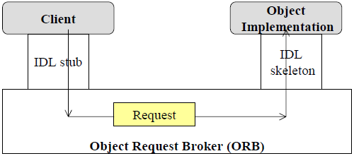
Object Request Broker (ORB)

Slide 15
IDL
Java
Implementation is Hidden behind interface
C++
C
VB
Service or Contract-oriented View
Ada

Slide 16
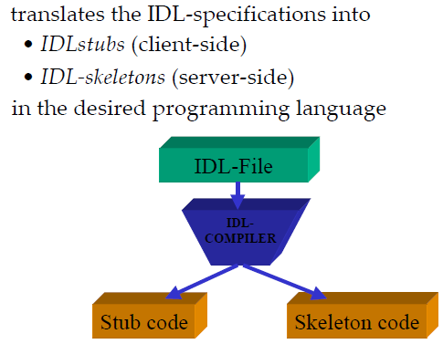
IDL Compiler

Slide 17
Interface Definition Language
CORBA allows the separation of definition and implementation
CORBA uses IDL for defining interfaces between clients and servers
IDL is a specification language used to describe a software component's interface.
IDLs describe an interface in a language-neutral way, enabling communication between software components that do not share a language.
ORB Vendors provide specific IDL compilers for supported languages
create target language stubs and skeletons for building CORBA clients and servers
C, C++, Smalltalk, Java, COBOL …

Slide 18
Client Stubs
Client side proxy for server.
Joins to the client at one end and to the ORB core at the other end.
Client-to-stub interface is decided by the standard OMG language mapping for the chosen programming language.
Clients actually invoke methods on stub objects.

Slide 19
Server Skeletons
Acts as client proxy for server implementation.
Connects
to the server object via the mapping defined for its programming language on .
To the Object Adapter via a proprietary interface.
Invocation pass through Object Adapter to skeletons, which in turn actually invoke methods on server object.

Slide 20
Object Adapter
Different kind of object implementations -
OA helps the ORB to operate with different type of objects.
An object adapter is the primary means for an object implementation to access ORB services such as object reference generation.
Most widely used OA - BOA (Basic OA)
Recently standardized - POA (Portable OA)

Slide 21
Interface Repository
Contains information regarding the interfaces to ORB objects.
Client objects can use it -
To manage installation and distribution of interface definitions around your network.
Language compilers may use them to generate stubs and skeletons.
Can be shared by more than one ORB or one ORB may refer to more than one interface repository.
The IR provides another way to specify the interfaces to objects.

Slide 22
Implementation Repository
Contains all the information regarding object implementation.
Provides a persistent record of how to activate and invoke operations on object implementations.
CORBA gives vendors free-hand in handling implementations.

Slide 23
Dynamic invocation interface
Invoking operations can be done through either static or dynamic interfaces.
Static invocation interfaces are determined at compile time, and they are presented to the client using stubs.
The DII, on the other hand, allows client applications to use server objects without knowing the type of those objects at compile time.
It allows a client to obtain an instance of a CORBA object and make invocations on that object by dynamically constructing requests.

Slide 24
Dynamic skeleton interface
Allows the ORB and OA to deliver requests to an object without the need of pre-compiled skeletons.
Its main purpose is to support the implementation of gateways between ORBs which utilize different communication protocols.

Slide 25
Steps of a CORBA-based App
The steps involved:
Define an interface(IDL file)
Map IDL to Java (idlj compiler)
Implement the interface
Write servant
Write a Server
Write a Client
Run the application

Slide 26
Tutorial
http://www.ejbtutorial.com/corba/tutorial-for-corba-hello-world-using-java
https://docs.oracle.com/javase/7/docs/technotes/guides/idl/jidlExample.html
Follow the steps of the tutorial above.

