Slide 1
Java I/O
Adeel-ur-Rehman

Slide 2
Sockets
Sockets provide an interface for programming networks at the transport layer.
Network communication using Sockets is very much similar to performing file I/O
In fact, socket handle is treated like file handle.
The streams used in file I/O operation are also applicable to socket-based I/O
Socket-based communication is programming language independent.
That means, a socket program written in Java language can also communicate to a program written in Java or non-Java socket program.

Slide 3
Socket Communication
A server (program) runs on a specific computer and has a socket that is bound to a specific port.
The server waits and listens to the socket for a client to make a connection request.
server
Connection request
port
Client

Slide 4
Socket Communication
If everything goes well, the server accepts the connection.
Upon acceptance, the server gets a new socket bound to a different port.
It needs a new socket (consequently a different port number) so that it can continue to listen to the original socket for connection requests while serving the connected client.
server
port
port
Client
port
Connection

Slide 5
Networking Classes in the JDK
Through the classes in java.net, Java programs can use TCP or UDP to communicate over the Internet.
The URL, URLConnection, Socket, and ServerSocket classes all use TCP to communicate over the network.
The DatagramPacket, DatagramSocket, and MulticastSocket classes are for use with UDP.

Slide 6
TCP/IP in Java
Accessing TCP/IP from Java is straightforward. The main functionality is in the following classes:
java.net.InetAddress : Represents an IP address (either IPv4 or IPv6) and has methods for performing DNS lookup.
java.net.Socket : Represents a TCP socket.
java.net.ServerSocket : Represents a server socket which is capable of waiting for requests from clients.

Slide 7
InetAddress
The InetAddress class is used to encapsulate both the numerical IP address and the domain name for that address.
We interact with this class by using the name of an IP host, which is more convenient and understandable than its IP address.
The InetAddress class hides the number inside.

Slide 8
Java I/O
Java I/O (Input and Output) is used to process the input and produce the output.
Java uses the concept of stream to make I/O operation fast.
The java.io package contains all the classes required for input and output operations.
We can perform file handling in java by Java I/O API.
Stream
A stream is a sequence of data. In Java a stream is composed of bytes. It's called a stream because it is like a stream of water that continues to flow.
In java, 3 streams are created for us automatically. All these streams are attached with console.
1) System.out: standard output stream
2) System.in: standard input stream
3) System.err: standard error stream

Slide 9
I/O Streams
OutputStream
Java application uses an output stream to write data to a destination, it may be a file, an array, peripheral device or socket.
InputStream
Java application uses an input stream to read data from a source, it may be a file, an array, peripheral device or socket.

Slide 10
Output Streams
Method | Description
1) public void write(int)throws IOException | is used to write a byte to the current output stream.
2) public void write(byte[])throws IOException | is used to write an array of byte to the current output stream.
3) public void flush()throws IOException | flushes the current output stream.
4) public void close()throws IOException | is used to close the current output stream.

Slide 11
Input Stream
Method | Description
1) public abstract int read()throws IOException | reads the next byte of data from the input stream. It returns -1 at the end of file.
2) public int available()throws IOException | returns an estimate of the number of bytes that can be read from the current input stream.
3) public void close()throws IOException | is used to close the current input stream.

Slide 12
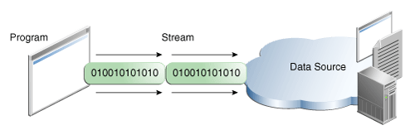
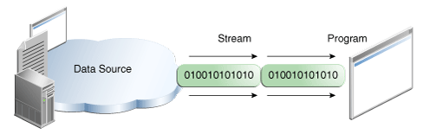
Streams
A stream is a continuous group of data or a channel through which data travels from one point to another.
Two kinds of streams:
Input stream receives data from a source into a program.
Output stream sends data to a destination from the program.

Slide 13
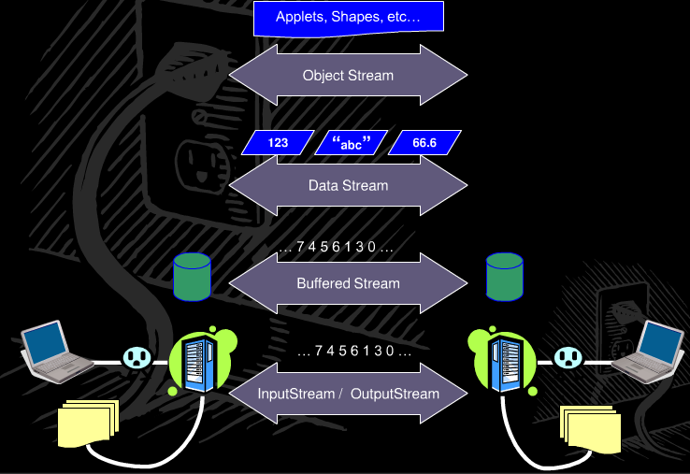
I/O Stream, ex

Slide 14
Stream - exception
When a stream is read/written, others threads are blocked.
Exception: while reading/writing in stream, errors may occur. IOException is thrown.
public static void main(String args[]) throws IOException
Using try/ catch block:
try {
copy(fi, fo);
} catch (IOException ex)
{ System.err.println(ex); }

Slide 15
Example Input/Output Stream
class SimpleIO {
public static void main(String args[]) {
byte bytearr[] = new byte[30];
try {
System.out.println("Enter a line: ");
// Reads up to len bytes of data from the //input stream into an array of bytes
System.in.read(bytearr,0,30);
System.out.print("The line typed was: ");
String str = new String(bytearr);
System.out.println(str);
} catch(Exception e) {
System.err.print("Error occurred:" + e);
}
}
}

Slide 16
The java.io package
There are two main categories of streams in Java :
Byte Streams –
Provide input/output method in byte
InputStream and OutputStream classes are at the top of their hierarchy.
Character Streams –
Provide input/output method in character.

Slide 17
Hierarchy of classes and interfaces
Object
File
DataInput
RandomAccessFile
DataOutput
InputStream
OutputStream
FileInput
Stream
ByteArray
InputStream
Filter
InputStream
FileOutput
Stream
Filter
OutputStream
ByteArray
OutputStream
DataInput
Stream
Buffered
InputStream
LineNumber
InputStream
PushBack
InputStream
DataOutput
Stream
Buffered
OutputStream
Print
Stream

Slide 18
I/O Stream Class
Methods of I/O Stream class:
Support sub classes
Sub Classes: (constructors, methods)
FileInputStream, FileOutputStream
ObjectInputStream, ObjectOutputStream
ByteArrayInputStream, ByteArrayOutputStream
FilterInputStream, FilterOutputStream
BufferedInputStream, BufferedOutputStream
DataInputStream, DataOutputStream

Slide 19
FileInputStream class
It is used to read data from file.
Constructors of this class :
FileInputStream(String filename): Creates an InputStream that we can use to read bytes from a filename (string).
FileInputStream(File filename): Creates an input stream that we can use to read bytes from a file where filename is a File object.
Exception: FileNotFoundException

Slide 20
Ex: Read and display data from file
import java.io.FileInputStream;
class Read_Disp_File {
public static void main(String args[]) throws Exception {
FileInputStream fis = new FileInputStream("a.txt");
// Read and display data (int type)
int i;
while ((i = fis.read()) != -1) {
System.out.print((char)i + " ");
}
fis.close();
}
}

Slide 21
Example: read from file
import java.io.*;
class FileDemo {
public static void main(String args[]) throws Exception {
InputStream f = new FileInputStream("a.txt");
int size= f.available();
System.out.println("Bytes available: " + size);
byte[] buff = new byte[size];
f.read(buff,0,size);
String s = new String(buff);
System.out.print(s);
f.close();
}
}
while (f.available() > 0) {
char ch = (char) f.read();
System.out.print(ch);
}

Slide 22
FileOutputStream class
It is used to write data into file.
Its constructors are:
FileOutputStream(String filename) :
Creates an OutputStream, to write bytes to a file.
FileOutputStream(File name) :
Creates an OutputStream, to write bytes to a file.
FileOutputStream(String filename, boolean flag) :
Creates an OutputStream, to write bytes to a file. If flag is true, file is opened in append mode.
Exception: FileNotFoundException

Slide 23
Example: write data (bytes) to file
import java.io.*;
class FileOutputDemo {
public static void main(String args[]) {
String s=“Testing file output stream";
byte b[] = s.getBytes();
try {
FileOutputStream fos = new FileOutputStream("aa.txt");
fos.write(b,0,b.length);
System.out.println(b.length + " bytes are written!");
} catch(IOException e) {
System.out.println("Error creating file!");
}
}
}
Notes:
Ok, TV

Slide 24
Ex:Copy a file with read(byte[] data) and write(byte[] data)
public class CopyFileTV_ex {
public static void main(String[] args) throws IOException {
FileInputStream fin = null;
FileOutputStream fout = null;
// File fil = new File("a1.txt");
fin = new FileInputStream("a1.txt");//or: (fil)
fout = new FileOutputStream("xyz.txt");
byte[] buffer = new byte[1024];
int bytesRead;
while ((bytesRead = fin.read(buffer)) > 0) {
fout.write(buffer, 0, bytesRead);
}
fin.close();
fout.close();
}
int size = 0;
try {
size = fin.available();
byte[] b = new byte[size];
fin.read(b,0,size);
fout.write(b,0,size);
} catch (IOException e) {
// TODO e.printStackTrace();
}
Notes:
Fix: Not TV.
Properties: Atribute: other: UTF-8

