Slide 1
Java I/O
Adeel-ur-Rehman

Slide 2
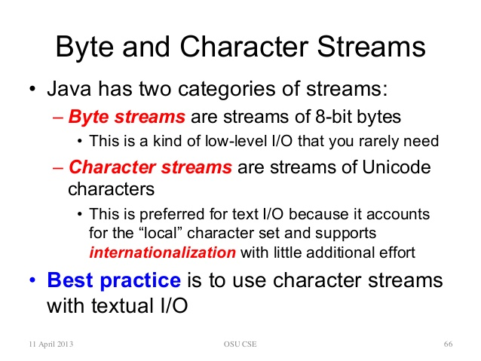
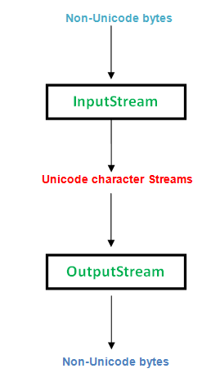
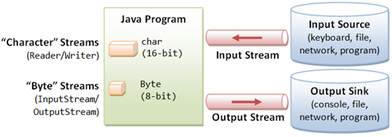

Slide 3
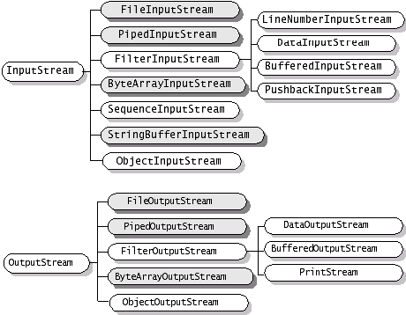
Byte Stream

Slide 4
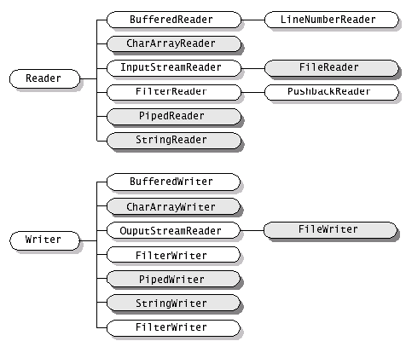
Character Stream

Slide 5
ByteArrayInputStream class
A ByteArrayInputStream contains an internal buffer that contains bytes that may be read from the stream
Methods : read(), skip(), reset(), available(), (from parent class)
Its constructors are :
ByteArrayInputStream(byte b[]):
Creates a ByteArrayInputStream with b as the input source.
ByteArrayInputStream(byte b[], int start, int num):
Creates a ByteArrayInputStream that begins with the character at start position and is num bytes long.

Slide 6
Ex: Convert string into InputStream using ByteArrayInputStream class
import java.io.*;
class ByteDemo {
public static void main (String []args) {
String str = “Testing Byte Array Input Stream.”;
byte[] b = str.getBytes();
InputStream bais = new ByteArrayInputStream(b,0,b.length);
int ch;
while((ch = bais.read()) != -1)
System.out.print((char) ch);
System.out.println();
bais.reset(); //using reset ( ) method and again reading
ch = 0;
while((ch = bais.read()) != -1)
System.out.print((char) ch);
}
}
Notes:
No TV

Slide 7
ByteArrayOutputStream
The ByteArrayOutputStream class stream creates a buffer in memory and all the data sent to the stream is stored in the buffer.
Two constructors.
ByteArrayOutputStream(int size)
used to set the output byte array to an initial size.
ByteArrayOutputStream()
sets the output buffer to a default size.
Additional methods like:
byte[] toByteArray() and
String toString()
convert the stream to a byte array and String object respectively.
size(): size of buffer

Slide 8
Ex: Convert OutputStream to String using ByteArrayOutputStream class
import java.io.*;
class ByteOutDemo {
public static void main (String []args) throws IOException {
String str = "Jack and Jill went up the hill";
byte[] b = str.getBytes();
ByteArrayOutputStream b1 = new ByteArrayOutputStream();
b1.write(b);
System.out.println("Writing the contents of a ByteArrayOutputStream");
System.out.println(b1.toString());
}
}

Slide 9
Ex ByteArrayIOStream
public class ByteArrayIOApp {
public static void main(String args[]) throws IOException {
ByteArrayOutputStream outStream = new ByteArrayOutputStream();
String s = "This is a test.";
for (int i = 0; i < s.length(); ++i)
outStream.write(s.charAt(i));
System.out.println("outstream: " + outStream);
System.out.println("size: " + outStream.size());
ByteArrayInputStream inStream;
inStream = new ByteArrayInputStream(outStream.toByteArray());
int inBytes = inStream.available();
System.out.println("inStream has" + inBytes + "available bytes");
byte inBuf[] = new byte[inBytes];
int bytesRead = inStream.read(inBuf, 0, inBytes);
System.out.println(bytesRead + " bytes were read");
System.out.println("They are: " + new String(inBuf));
}
}

Slide 10
Buffered IO Stream
The read()/write() method in InputStream/OutputStream are designed to read/write a single byte of data on each call.
This is grossly inefficient, as each call is handled by the underlying operating system (which may trigger a disk access, or other expensive operations).
Buffering, which reads/writes a block of bytes from the external device into/from a memory buffer in a single I/O operation, is commonly applied to speed up the I/O.
FileInputStream/FileOutputStream is not buffered. It is often chained to a BufferedInputStream or BufferedOutputStream, which provides the buffering.
To chain the streams together, simply pass an instance of one stream into the constructor of another stream.

Slide 11
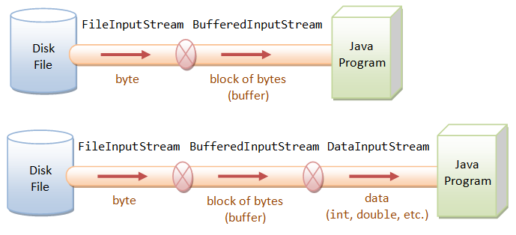
Filter IO Stream

Slide 12
Buffered IO Stream
FileInputStream fileIn = new FileInputStream("in.txt"); BufferedInputStream bufferIn = new BufferedInputStream (fileIn);
DataInputStream dataIn = new DataInputStream (bufferIn);
// or
DataInputStream in = new DataInputStream ( new BufferedInputStream ( new FileInputStream ("in.dat")));

Slide 13
Ex Read from String with BufferedInputStream
import java.io.BufferedInputStream;
public class BuffInput {
public static void main(String[] args) {
System.out.println("Enter a line:");
BufferedInputStream bi = new BufferedInputStream(System.in);
try {
for (int i=0; i<=bi.available(); i++ ){
int x = bi.read();
System.out.print((char)x + " ");}
} catch (Exception e) { e.printStackTrace();
}
}
}

Slide 14
BufferedInputStream
For faster reading you should use BufferedInputStream to wrap any InputStream
Ex,
FileInputStream fis = new FileInputStream(aFile); BufferedInputStream bis = new BufferedInputStream (fis);

Slide 15
Ex, Read from file with BufferedInputStream
public class BuffInput {
public static void main(String[] args) throws Exception {
byte[] buffer = new byte[1024];
BufferedInputStream bi =
new BufferedInputStream(new FileInputStream("b.txt"));
int bytesRead = 0;
while ((bytesRead = bi.read(buffer)) != -1)
{
String chunk = new String(buffer, 0, bytesRead);
System.out.print(chunk);
}
bi.close();
}
}

Slide 16
File Copy Without Buffer
public static void main(String[] args) {
String inFileStr = "ncp.jpg";
String outFileStr = "ncp-out.jpg";
long startTime, elapsedTime; // for speed benchmarking
// Check file length
File fileIn = new File(inFileStr);
System.out.println("File size is " + fileIn.length() + " bytes");
// "try-with-resources" automatically closes all opened resources.
try (FileInputStream in = new FileInputStream(inFileStr); FileOutputStream out = new FileOutputStream(outFileStr)) {
startTime = System.nanoTime();
int byteRead;
// Read a raw byte, returns an int of 0 to 255.
while ((byteRead = in.read()) != -1) {
out.write(byteRead);
}
elapsedTime = System.nanoTime() - startTime;
System.out.println("Elapsed Time is " + (elapsedTime / 1000000.0) + " msec");
} catch (IOException ex) {
ex.printStackTrace();
}
}

Slide 17
File Copy With Buffered Stream
public static void main(String[] args) {
String inFileStr = "ncp.jpg";
String outFileStr = "ncp-out.jpg";
long startTime, elapsedTime; // for speed benchmarking
// Check file length
File fileIn = new File(inFileStr);
System.out.println("File size is " + fileIn.length() + " bytes");
try (BufferedInputStream in = new BufferedInputStream(new FileInputStream(inFileStr)); BufferedOutputStream out = new BufferedOutputStream(new FileOutputStream(outFileStr))) {
startTime = System.nanoTime();
int byteRead;
while ((byteRead = in.read()) != -1) {
out.write(byteRead);
}
elapsedTime = System.nanoTime() - startTime;
System.out.println("Elapsed Time is " + (elapsedTime / 1000000.0) + " msec");
} catch (IOException ex) {
ex.printStackTrace();
}
}
}

Slide 18
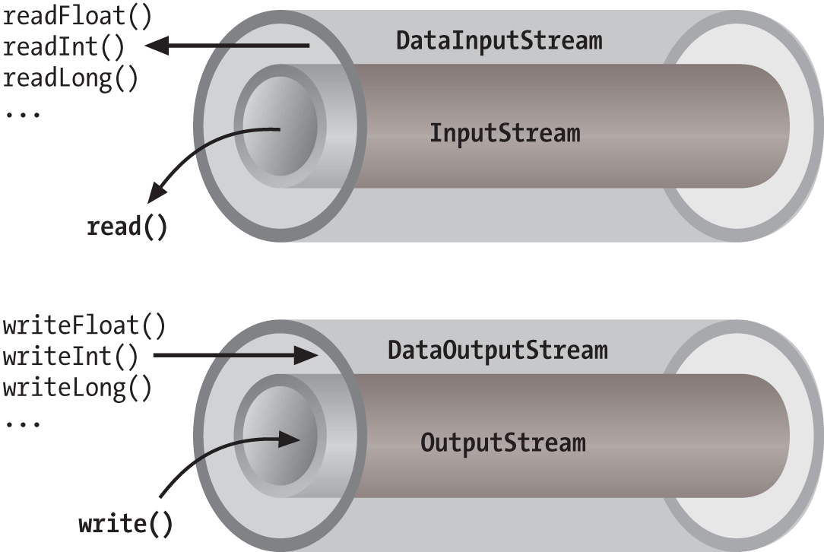
Data IO Stream
The DataInputStream and DataOutputStream can be stacked on top of any InputStream and OutputStream to parse the raw bytes so as to perform I/O operations in the desired data format, such as int and double.
To use DataInputStream for formatted input, you can chain up the input streams as follows:
DataInputStream in = new DataInputStream( new BufferedInputStream( new FileInputStream("in.txt")));

Slide 19
DataInputStream
DataInputStream implements DataInput interface, which provides methods to read formatted primitive data and String, such as:
// 8 Primitives
public final int readInt() throws IOExcpetion; // Read 4 bytes and convert into int
public final double readDoube() throws IOExcpetion; // Read 8 bytes and convert into double
public final byte readByte() throws IOExcpetion;
public final char readChar() throws IOExcpetion;
public final short readShort() throws IOExcpetion;
public final long readLong() throws IOExcpetion;
public final boolean readBoolean() throws IOExcpetion; // Read 1 byte. Convert to false if zero
public final float readFloat() throws IOExcpetion;
public final int readUnsignedByte() throws IOExcpetion; // Read 1 byte in [0, 255] upcast to int
public final int readUnsignedShort() throws IOExcpetion; // Read 2 bytes in [0, 65535], same as char, upcast to int
public final void readFully(byte[] b, int off, int len) throws IOException;
public final void readFully(byte[] b) throws IOException;
// Strings
public final String readLine() throws IOException; // Read a line (until newline), convert each byte into a char - no unicode support.
public final String readUTF() throws IOException; // read a UTF-encoded string with first two bytes indicating its UTF bytes length
public final int skipBytes(int n) // Skip a number of bytes

Slide 20
DataOutStream
DataOutputStream implements DataInput interface, which provides methods to write formatted primitive data and String.
// 8 primitive types
public final void writeInt(int i) throws IOExcpetion; // Write the int as 4 bytes
public final void writeFloat(float f) throws IOExcpetion;
public final void writeDoube(double d) throws IOExcpetion; // Write the double as 8 bytes
public final void writeByte(int b) throws IOExcpetion; // least-significant byte
public final void writeShort(int s) throws IOExcpetion; // two lower bytes
public final void writeLong(long l) throws IOExcpetion;
public final void writeBoolean(boolean b) throws IOExcpetion;
public final void writeChar(int i) throws IOExcpetion;
// String
public final void writeBytes(String str) throws IOExcpetion; // least-significant byte of each char
public final void writeChars(String str) throws IOExcpetion; // Write String as UCS-2 16-bit char, Big-endian (big byte first)
public final void writeUTF(String str) throws IOException; // Write String as UTF, with first two bytes indicating UTF bytes length
public final void write(byte[] b, int off, int len) throws IOException
public final void write(byte[] b) throws IOException
public final void write(int b) throws IOException // Write the least-significant byte

Slide 21
Ex, DataInput/OutputStream
public class DataIOStream {
public static void main(String[] args) throws Exception{
int idA = 1234;
String nameA = “Data I/O Stream";
FileOutputStream fos = new FileOutputStream("cities.txt");
DataOutputStream dos = new DataOutputStream(fos);
dos.writeInt(idA);
dos.writeUTF(nameA);
dos.close();
FileInputStream fis = new FileInputStream("cities.txt");
DataInputStream dis = new DataInputStream(fis);
int Id = dis.readInt();
System.out.println("Id: " + Id);
String Name = dis.readUTF();
System.out.println("Name: " + Name);
}
}

Slide 22
Example (Students)
public class Student {
private String name; private boolean gender; private int age;
private float grade;
public Student(String name, boolean gender, int age, float grade) {
this.name = name;
this.gender = gender;
this.age = age;
this.grade = grade;
}
public String getName() { return this.name;
}
public void setName(String name) { this.name = name;
}
public boolean getGender() { return this.gender;
}
public void setGender(boolean gender) { this.gender = gender;
}
public int getAge() { return this.age;
}
public void setAge(int age) { this.age = age;
}
public float getGrade() { return this.grade;
}
public void setGrade(float grade) { this.grade = grade;
}
}

Slide 23
Example (Students)
import java.util.*;import java.io.*;
public class StudentRecordWriter {
DataOutputStream dataOutput;
public StudentRecordWriter(String outputFile) throws IOException {
dataOutput = new DataOutputStream(new FileOutputStream(outputFile));
}
public void write(Student student) throws IOException {
dataOutput.writeUTF(student.getName());
dataOutput.writeBoolean(student.getGender());
dataOutput.writeInt(student.getAge());
dataOutput.writeFloat(student.getGrade());
}
public void save() throws IOException {
dataOutput.close();
}
public static void main(String[] args) throws Exception{
List<Student> listStudent = new ArrayList<>();
listStudent.add(new Student("Alice", false, 23, 80.5f));
listStudent.add(new Student("Brian", true, 22, 95.0f));
listStudent.add(new Student("Carol", false, 21, 79.8f));
StudentRecordWriter writer = new StudentRecordWriter("students.txt");
for (Student student : listStudent) {
writer.write(student);
}
writer.save();
}
}

Slide 24
Example (Students)
import java.util.*; import java.io.*;
public class StudentRecordReader {
DataInputStream dataInput;
public StudentRecordReader(String inputFile) throws IOException {
dataInput = new DataInputStream(new FileInputStream(inputFile));
}
public List<Student> readAll() throws IOException {
List<Student> listStudent = new ArrayList<>();
while (true) {
String name = dataInput.readUTF();
boolean gender = dataInput.readBoolean();
int age = dataInput.readInt();
float grade = dataInput.readFloat();
Student student = new Student(name, gender, age, grade);
listStudent.add(student);
}
} dataInput.close();
return listStudent;
}
public static void main(String[] args) throws Exception {
StudentRecordReader reader = new StudentRecordReader("students.txt";);
List<Student> listStudent = reader.readAll();
for (Student student : listStudent) {
System.out.print(student.getName() + "\t");
System.out.print(student.getGender() + "\t");
System.out.print(student.getAge() + "\t");
System.out.println(student.getGrade());
}
}
}

Slide 25
File & RandomAccess File

Slide 26
File class: Constructor and Methods
public File(String pathname)
public String getName()
public boolean exists()
public long length()
public long lastModified()
public boolean canRead()
public boolean canWrite()
public boolean isFile()
public boolean isDirectory()
public String[] list()
public boolean mkdir()
boolean renameTo(File dest)
public boolean delete()

Slide 27
Example
class FileInfo {
static void show(String s) {
System.out.println(s);
}
public static void main(String args[]){
String fi;
Scanner in= new Scanner(System.in);
fi=in.next();
File f1 = new File(fi);
show(f1.getName()+(f1.exists()?" exists" : " does not exist"));
show ("File size :"+f1.length()+" bytes");
show ("Is"+(f1.isDirectory()?" a directory":"not a directory"));
show (f1.getName()+(f1.canWrite()? " is writable" : " is not writable"));
show(f1.getName()+(f1.canRead()? " is readable" : " is not readable"));
show("File was last modified :" + f1.lastModified());
}
}

Slide 28
Ex: Creates a file and sets it to read-only
public class CreateFile_RO {
public static void main (String[] args) throws IOException {
// Create a new file, by default canWrite=true,
boolean readonly=false;
File file = new File ("test.txt");
if (file.exists ())
file.delete ();
file.createNewFile ();
System.out.println ("Before. canWrite? " + file.canWrite ());
// set to read-only, canWrite = false */
file.setWritable (false);
System.out.println ("After. canWrite? " + file.canWrite ());
}
}

Slide 29
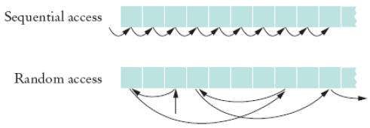
Random Access Files
Random access files are files in which records can be accessed in any order
Also called direct access files
More efficient than sequential access files

Slide 30
Need for Random Access Files
Real-time applications require immediate response
Example: respond to customer query about a bill
Sequencing through records for account is time-intensive
Random (immediate) access meets real-time need
Directly read from or write to desired record

Slide 31
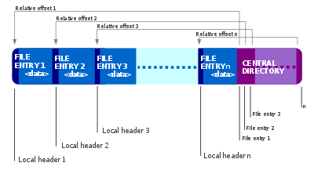
Example
Consider the zip format. A ZIP archive contains files and is typically compressed to save space.
It also contain a directory entry at the end that indicates where the various files contained within the ZIP archive begin

Slide 32
Accessing a specific file using sequential access
Open the ZIP archive.
Search through the ZIP archive until you locate the file you want to extract.
Extract the file.
Close the ZIP archive.
On an average, we have to read half of the zip archive to find the required file

Slide 33
Accessing a specific file using random access
Open the ZIP archive.
Seek to the directory entry and locate the entry for the file you want to extract from the ZIP archive.
Seek (backward) within the ZIP archive to the position of the file to extract.
Extract the file.
Close the ZIP archive.
This is more efficient as you read only the directory entry and file that you want to extract.

Slide 34
RandomAccessFiles class
The RandomAccessFile class contains the same read(), write() and close() methods as Input and OutputStream
Also contains seek() that lets you select a beginning position within the file before reading or writing data
Includes capabilities for reading and writing primitive-type values, byte arrays and strings

Slide 35
RandomAccessFile Class
NOT compatible with the stream/reader/writer models
With a random-access file, you can seek to the desired position and then read and write an amount of bytes
Only support seeking relative to the beginning of the file
Not relative to current position of file pointer
However there are methods that report the current position

Slide 36
Methods to support seeking
long getFilePointer() Returns the current offset in this file.
long length() Returns the length of this file.
void seek(long pos) Sets the file-pointer offset, measured from the beginning of this file, at which the next read or write occurs.

Slide 37
Constructor Summary
RandomAccessFile(File file, String mode)
Creates a random access file stream to read from, and optionally to write to, the file specified by the File argument.
RandomAccessFile(String name, String mode) Creates a random access file stream to read from, and optionally to write to, a file with the specified name.
The mode should be either “r” or “rw”
No “w”

Slide 38
Constructor Summary
When a RandomAccessFile is created in read-only mode a FileNotFoundException is generated
When a RandomAccessFile is created in read-write a zero length file will be created

Slide 39
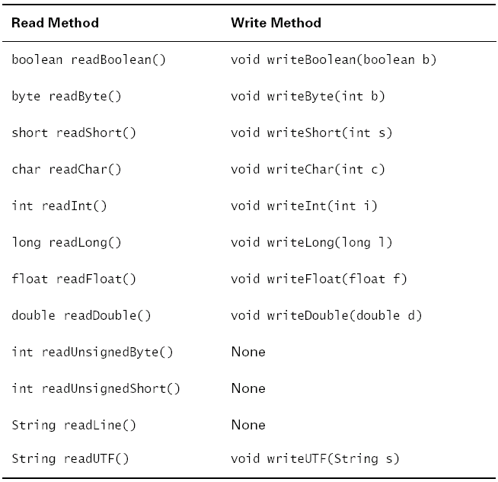
Methods

Slide 40
File Pointer
RandomAccessFile supports file pointer which indicates the current location in the file.
When the file is first created, the file pointer is set to 0, indicating the beginning of the file.
Calls to the read and write methods adjust the file pointer by the number of bytes read or written.

Slide 41
Manipulate file pointer
RandomAccessFile contains three methods for explicitly manipulating the file pointer.
int skipBytes(int) — Moves the file pointer forward the specified number of bytes
void seek(long) — Positions the file pointer just before the specified byte
long getFilePointer() — Returns the current byte location of the file pointer

Slide 42
Example
To move the file pointer to a specific byte f.seek(n);
To get current position of the file pointer.
long n = f.getFilePointer();
To find the number of bytes in a file
long filelength = f.length();

Slide 43
Writing Example
import java.io.*;
public class RandomAccess {
public static void main(String args[]) throws IOException
{
RandomAccessFile myfile = new RandomAccessFile("rand.dat", "rw");
myfile.writeInt(120);
myfile.writeDouble(375.50);
myfile.writeInt('A'+1);
myfile.writeBoolean(true);
myfile.writeChar('X');
}
}

Slide 44
// set pointer to the beginning of file and read next two items
myfile.seek(0);
System.out.println(myfile.readInt());
System.out.println(myfile.readDouble());
//set pointer to the 4th item and read it
myfile.seek(16);
System.out.println (myfile.readBoolean());
0
//(myfile.readBoolean());
// Go to the end and “append”
myfile.seek(myfile.length());
myfile.writeInt(2003);
// read 5th and 6th items
myfile.seek(17);
System.out.println(myfile.readChar());
System.out.println(myfile.readInt());
System.out.println("File length: "+myfile.length());
myfile.close();
}
}
Int
4
Double
12
Int
16
boolean
17
Char
19
Int
23

Slide 45
Ex, Write, modify and read file (byte)
import java.io.IOException;
import java.io.RandomAccessFile;
public class RAF_SaveRead {
public static void main(String[] args) throws IOException {
RandomAccessFile rf = new RandomAccessFile("test.dat", "rw");
for (int i = 0; i < 10; i++)
rf.writeByte(i );
rf.close();
rf = new RandomAccessFile("test.dat", "rw");
rf.seek(5); //seek at the byte 5th
rf.writeByte(100); //change value to 100
rf.close();
rf = new RandomAccessFile("test.dat", "r");
for (int i = 0; i < 10; i++)
System.out.println("Value " + i + ": " + rf.readByte());
rf.close();
}
}

Slide 46
Reading Example
RandomAccessFile creates random access files
Contains familiar read( ), write( ), open( ), close( )
seek( ) method selects start position within a file before read or write
Places a file pointer at the selected location
File pointer holds byte number of next file position
Ex: locate 32nd character in file, which may then be read

Slide 47
Reading a File using RandomAccessFile
import java.io.*;
public class AccessCharacter
{
public static void main(String[] args) throws IOException
{
int c;
RandomAccessFile inFile = new RandomAccessFile("test.txt","r");
int pos = 17;
try
{
inFile.seek(pos);
while( (c = inFile.read())!=-1)
System.out.print((char)c);
}
catch (IOException e)
{ System.out.println();
inFile.close();
}
}
}

Slide 48
Zip File Example
import java.util.*;
import java.util.zip.*;
import java.io.*;
public class ZipFileTest {
public static void main(String[] args) throws Exception{
ZipFile zipFile = new ZipFile("test.zip");
// Get a single entry from a zip file
ZipEntry zipEntry = zipFile.getEntry("test/test.txt");
InputStream inputStream = zipFile.getInputStream(zipEntry);
int i ;
while ((i=inputStream.read())!=-1)
System.out.print((char)i);
//list all entries in a zip file
Enumeration<? extends ZipEntry> entries = zipFile.entries();
while(entries.hasMoreElements()){
ZipEntry entry = entries.nextElement();
if(entry.isDirectory()){
System.out.println("dir : " + entry.getName());
} else {
System.out.println("file : " + entry.getName());
}
}
}
}

