Slide 1
Object Stream
Serialization
Serializable
ObjectInputStream
ObjectOutputStream
Example

Slide 2
Object Serialization
To read an entire object from or write an entire object to a file, Java provides object serialization.
A serialized object is represented as a sequence of bytes that includes the object’s data and its type information.
After a serialized object has been written into a file, it can be read from the file and deserialized to recreate the object in memory.

Slide 3
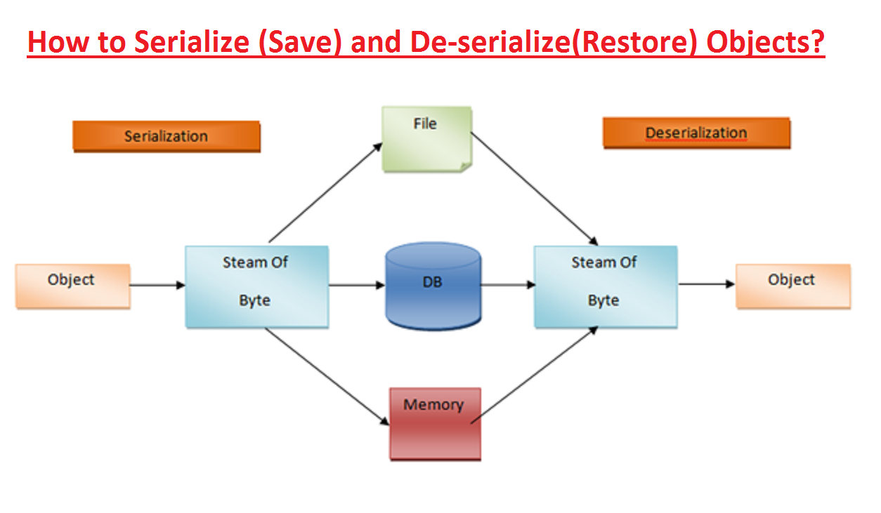
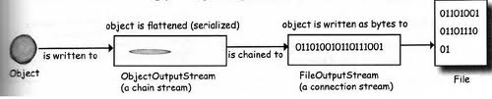
Serialization

Slide 4
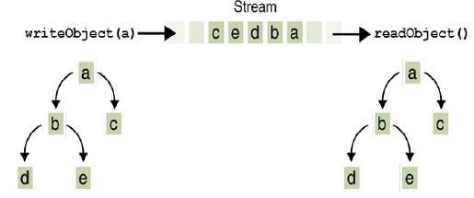
Object Stream
Object streams support I/O of objects
Like Data streams support I/O of primitive data types
The object has to be Serializable type
An object stream can contain a mixture of primitive and object values.
Input and Output of Complex Object:
Notes:
Invoking writeObject(a) writes not just a, but all the objects necessary to reconstitute a, so
the other four objects in this web are written also
When a is read back by readObject, the other four objects are read back as well, and all the
original object references are preserved.

Slide 5
Serialization
There are two streams in java.io: ObjectInputStream and ObjectOutputStream .
They are like any other input stream and output stream with the difference that they can read and write objects

Slide 6
ObjectInputStream
DataInput
InputStream
ObjectInput
Imp
ObjectInputStream
This class has methods that support object serialization.
ObjectInputStream is responsible for reading objects from a input stream.
Notes:
This class extends the InputStream class and implements the ObjectInput interface.
ObjectInput interface extends the DataInput interface and has methods that support object serialization.

Slide 7
ObjectOutputStream
DataOutput
OutputStream
ObjectOutput
Imp
ObjectOutputStream
ObjectOutputStream is responsible for writting objects to the output stream

Slide 8
When Using ObjectInputStream to Read Data from Files:
Input files are binary and contain any of the primitive data types (int, char, double, etc.) and the String type
The files can be read by Java programs but are not printable
The Java I/O library must be imported including the line: import java.io.*;
it contains ObjectInputStream and other useful class definitions
An IOException might be thrown

Slide 9
Some ObjectInputStream Methods
For every output file method there is a corresponding input file method
You can read data from an input file after it is connected to a stream class
Use methods defined in ObjectInputStream
readInt()
readDouble()
readBoolean()
etc.
See the text for more
Note that each write method throws IOException

Slide 10
Input File Exceptions
A FileNotFoundException is thrown if the file is not found when an attempt is made to open a file
Each read method throws IOException
we still have to write a catch block for it
If a read goes beyond the end of the file an EOFException is thrown

Slide 11
Avoiding Common ObjectInputStream File Errors
There is no error message (or exception)
if you read the wrong data type!
Input files can contain a mix of data types
it is up to the programmer to know their order and use the correct read method
As with an output file, close the input file when you are done with it

Slide 12
Example Serialization
import java.io.*;
public class writeObj {
public static void main(String[] args) throws Exception {
Junk obj1 = new Junk("Object 1");
Junk obj2 = new Junk("Object 2");
ObjectOutputStream objectOut = new ObjectOutputStream(new BufferedOutputStream(new FileOutputStream("b.txt")));
objectOut.writeObject(obj1); // Write object
objectOut.writeObject(obj2); // Write object
objectOut.writeUTF("testing");
objectOut.close(); // Close the output stream
ObjectInputStream objectIn = null;
int Count = 0;
Junk object = null;
objectIn = new ObjectInputStream(
new BufferedInputStream(new FileInputStream("b.txt")));
while (Count < 2) {
object = (Junk) objectIn.readObject(); Count++;
System.out.println("Object " + Count + ": " + object.toStr()); }
System.out.println(objectIn.readUTF());
objectIn.close();
}
}
class Junk implements Serializable {
String str;
public Junk(String s)
{ str = s; }
public String toStr(){
return str; }
}

Slide 13
Binary I/O of Class Objects
read and write class objects in binary file
class must be serializable
import java.io.*
implement Serializable interface
add implements Serializable to heading of class definition
methods used:
public class Species implements Serializable
to write object to file:
writeObject method in ObjectOutputStream
to read object from file: readObject method in ObjectInputStream

Slide 14
outputStream = new ObjectOutputStream(
new FileOutputStream("species.txt"));
...
Species oneRecord =
new Species("Calif. Condor, 27, 0.02);
...
outputStream.writeObject(oneRecord);
ClassIODemo Excerpts
inputStream = new ObjectInputStream(
new FileInputStream("species.txt"));
...
Species readOne = null;
...
readOne = (Species)inputStream.readObject();
readObject returns a reference to type Object so it must be cast to Species before assigning to readOne

Slide 15
The EOFException Class
Many (but not all) methods that read from a file throw an end-of-file exception (EOFException) when they try to read beyond the file
all the ObjectInputStream methods do throw it
The end-of-file exception can be used in an "infinite" (while(true)) loop that reads and processes data from the file
the loop terminates when an EOFException is thrown
The program is written to continue normally after the EOFException has been caught

Slide 16
Using EOFException
import java.io.*;
public class Snippet { public static void main (String arg[]){
try
{ObjectOutputStream outputStream = new ObjectOutputStream (new FileOutputStream ("numbers.txt"));
outputStream.writeInt(2); outputStream.writeInt(3); outputStream.close();
ObjectInputStream inputStream = new ObjectInputStream(new FileInputStream ("numbers.txt"));
int n;
System.out.println("Reading ALL the integers");
System.out.println("in the file numbers.txt.");
try{
while (true){
n = inputStream.readInt();
System.out.println(n);
}
}
catch(EOFException e)
{
System.out.println("End of reading from file.");
}
inputStream.close();
}
catch(FileNotFoundException e)
{
System.out.println("Cannot find file numbers.txt.");
}
catch(IOException e)
{
System.out.println("Problem with input from file numbers.txt.");
}}}
main method from
EOFExceptionDemo
Intentional "infinite" loop to process data from input file
Loop exits when end-of-file exception is thrown
Processing continues after EOFException: the input file is closed
Note order of catch blocks:
the most specific is first
and the most general last

