Slide 1
Character Streams

Slide 2
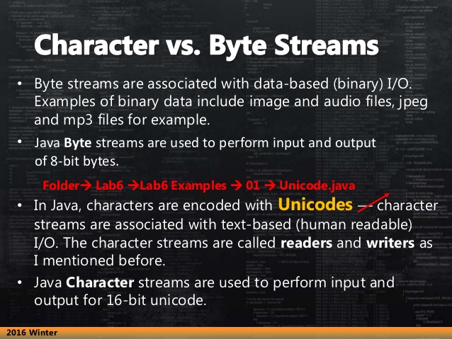
Streams

Slide 3
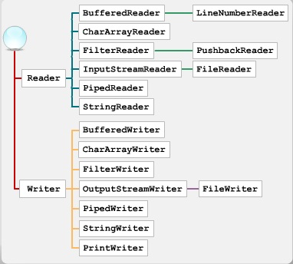

Slide 4
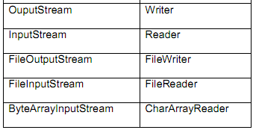
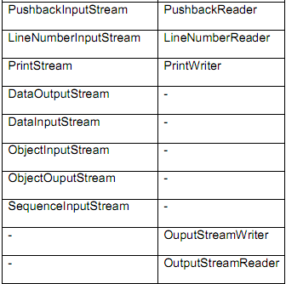
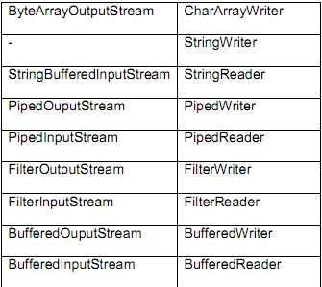
ByteStream & CharacterStream
InputStreamReader

Slide 5
Reader class
Used for reading character streams and is abstract.
Constructor:
protected Reader(), protected Reader(Object lock)
Some of the methods used are :
Method | Purpose
abstract void close() throws IOException | Closes the stream
int read() throws IOException | Reads one character
int read(char buf[]) throws IOException | Reads characters into an array
void reset() throws IOException | Resets the stream
long skip(long n) throws IOException | Skips n characters
boolean ready() throws IOException | Determines if the stream is ready to be run

Slide 6
Writer class
An abstract class , supports writing into streams
Constructor:
protected Writer(), protected Writer(Object obj)
Some of the methods used are :
Method | Purpose
abstract void close() throws IOException | Closes the stream
abstract void flush( ) throws IOException | Flushes the stream
void write(char[] c) throws IOException | Writes the specified array of characters
abstract void write(char [] c, int offset, int n) throws IOException | Writes the specified length of characters from offset position in the array

Slide 7
Ex, UTF-8 coding
import java.io.*;
public class ReadWrite_UTF {
public static void main(String[] args) {
try {
String st="test";
OutputStreamWriter wri = new OutputStreamWriter(
new FileOutputStream("b.txt"), "UTF-8");
char[] chars1 = st.toCharArray();
wri.write(chars1); //write
wri.close();
InputStreamReader rea = new InputStreamReader(
new FileInputStream("b.txt"), "UTF-8");
char[] chars2 = new char[50];
rea.read(chars2); // read
for (int i=0; i< chars2.length; i++)
System.out.print(chars2[i]);
} catch (IOException e) {
System.out.println(e.toString()); }
}
}

Slide 8
FileWriter Class
FileWriter provides a convenient way of writing characters to a file.
FileWriter uses your computer's default character encoding
Constructor:
public FileWriter (File file) public FileWriter (File file, boolean append) public FileWriter (String path) public FileWriter (String path, boolean append) public FileWriter (FileDescriptor fileDescriptor)

Slide 9
FileWriter Class
import java.io.*;
public class Read_Write_ex {
public static void main(String[] argv) throws Exception {
FileWriter fw = new FileWriter("aa.txt");
String strs[] = { "abc", "def", "ghi", "jkl" };
for (int i = 0; i < strs.length; i++) {
fw.write(strs[i] + “\r\n”);
}
fw.close();
}
}

Slide 10
FileDescriptor Class
import java.io.*;
public class FileDescriptorDemoOne {
public static void main(String[] args) throws IOException {
File file = new File("test.txt");
FileOutputStream fos1 = new FileOutputStream(file);
FileDescriptor fd = fos1.getFD();
//passing FileDescriptor to another FileOutputStream
FileOutputStream fos2 = new FileOutputStream(fd);
fos2.write("Hello World!".getBytes());
fos1.close();
fos2.close();
}
}

Slide 11
FileReader class
The FileReader class is a subclass of InputStreamReader
The FileReader class is a convenient class to read characters from a file.
The FileReader class uses default encoding.
Constructor:
public FileReader (File file) public FileReader (FileDescriptor fileDescriptor) public FileReader (String filePath)

Slide 12
Ex: Read from file, write out monitor
import java.io.*;
public class FileRW_ex {
public static void main(String[] args) throws IOException {
FileReader fr=new FileReader("a.txt");
FileWriter fw=new FileWriter(FileDescriptor.out);
char[] b=new char[256];
int num;
while((num=fr.read(b))>-1) {
String upper=new String(b,0,num).toUpperCase();
fw.write(upper);
fw.flush(); }
}
}

Slide 13
PrintWriter class
It is a character based class that is useful for console output.
Provides support for Unicode characters.
PrintWriter is a better alternative to OutputStreamWriter and FileWriter.
PrintWriter allows you to choose an encoding by passing the encoding information to one of its constructors
Notes:
Printed output is flushed and tested for any errors using checkError() method.
Supports printing primitive data types, character arrays, strings and objects.

Slide 14
PrintWriter class
Constructors
public PrintWriter (File file) public PrintWriter (File file, String characterSet) public PrintWriter (String filepath) public PrintWriter (String filepath, String characterSet) public PrintWriter (OutputStream out) public PrintWriter (Writer out)
Notes:
Printed output is flushed and tested for any errors using checkError() method.
Supports printing primitive data types, character arrays, strings and objects.

Slide 15
PrintWriter class: Write file text
Write text which used the specified encoding to file:
Create object based on FileWriter class
PrintWriter pw = new PrintWriter(new FileWriter(“Filename”)
Create object based on FileOutputStream class
PrintWriter pw = new PrintWriter(new FileOutPutStream(“Filename”)
Notes:
Printed output is flushed and tested for any errors using checkError() method.
Supports printing primitive data types, character arrays, strings and objects.

Slide 16
Ex: Write lines of text to file using a PrintWriter
import java.io.FileWriter;
import java.io.PrintWriter;
public class PW_ex{
public static void main(String[] args) throws Exception {
String filename = “aa.txt";
String[] linesToWrite = new String[] { "a", "b" };
boolean appendToFile = true;
PrintWriter pw = null;
if (appendToFile) {
pw = new PrintWriter(new FileWriter(filename, true));
} else {
pw = new PrintWriter(new FileWriter(filename)); }
for (int i = 0; i < linesToWrite.length; i++) {
pw.println(linesToWrite[i]); }
pw.format("This is a %s program", "test");
pw.flush(); pw.close();
}
}
Notes:
Printed output is flushed and tested for any errors using checkError() method.
Supports printing primitive data types, character arrays, strings and objects.

Slide 17
Output File Streams
PrintWriter
FileOutputStream
Memory
Disk
smileyOutStream
smiley.txt
PrintWriter smileyOutStream = new PrintWriter( new FileOutputStream(“smiley.txt”) );

Slide 18
Methods for PrintWriter
Similar to methods for System.out
Println()
outputStream.println(count + " " + line);
Print()
Format()
Flush(): write buffered output to disk
Close(): close the PrintWriter stream (and file)

Slide 19
TextFileOutputDemo Part 1
A try-block is a block:
outputStream would not be accessible to the rest of the method if it were declared inside the try-block
public static void main(String[] args)
{
PrintWriter outputStream = null;
try
{
outputStream =
new PrintWriter(new FileOutputStream("out.txt"));
}
catch(FileNotFoundException e)
{
System.out.println("Error opening the file out.txt. “
+ e.getMessage());
System.exit(0);
}
Opening the file
Creating a file can cause the FileNotFound-Exception if the new file cannot be made.

Slide 20
TextFileOutputDemo Part 2
System.out.println("Enter three lines of text:");
String line = null; int count;
Scanner keyboard = new Scanner(System.in);
for (count = 1; count <= 3; count++)
{
line = keyboard.nextLine();
outputStream.println(count + " " + line);
}
outputStream.close();
System.out.println("... written to out.txt.");
}
Writing to the file
Closing the file
The println method is used with two different streams: outputStream and System.out

Slide 21
Text File Input
To open a text file for input: connect a text file to a stream for reading
Goal: a BufferedReader object,
which uses FileReader to open a text file
FileReader “connects” BufferedReader to the text file
For example:
BufferedReader smileyInStream =
new BufferedReader(new FileReader(“smiley.txt"));
Similarly, the long way:
FileReader s = new FileReader(“smiley.txt");
BufferedReader smileyInStream = new BufferedReader(s);

Slide 22
Input File Streams
BufferedReader
FileReader
Memory
Disk
smileyInStream
smiley.txt
BufferedReader smileyInStream = new BufferedReader( new FileReader(“smiley.txt”) );

Slide 23
Methods for BufferedReader
readLine: read a line into a String
no methods to read numbers directly, so read numbers as Strings and then convert them (StringTokenizer later)
read: read a char at a time
close: close BufferedReader stream

Slide 24
Example: Reading a File Name from the Keyboard
reading a file name from the keyboard
using the file name read from the keyboard
closing the file
reading data from the file

Slide 25
Reading Words in a String: Using StringTokenizer Class
There are BufferedReader methods to read a line and a character, but not just a single word
StringTokenizer can be used to parse a line into words
import java.util.*
some of its useful methods are shown in the text
e.g. test if there are more tokens
you can specify delimiters (the character or characters that separate words)
the default delimiters are "white space" (space, tab, and newline)

Slide 26
Example: StringTokenizer
Display the words separated by any of the following characters: space, new line (\n), period (.) or comma (,).
String inputLine = keyboard.nextLine();
StringTokenizer wordFinder =
new StringTokenizer(inputLine, " \n.,"); //the second argument is a string of the 4 delimiters
while(wordFinder.hasMoreTokens())
{
System.out.println(wordFinder.nextToken());
}
Question 2b or !tooBee
Entering "Question,2b.or !tooBee." gives this output:

Slide 27
Testing for End of File in a Text File
When readLine tries to read beyond the end of a text file it returns the special value null
so you can test for null to stop processing a text file
read returns -1 when it tries to read beyond the end of a text file
the int value of all ordinary characters is nonnegative
Neither of these two methods (read and readLine) will throw an EOFException.

Slide 28
Example: Using Null to Test for End-of-File in a Text File
When using readLine
test for null
Excerpt from TextEOFDemo
When using read test for -1

Slide 29
Using Path Names
Path name—gives name of file and tells which directory the file is in
Relative path name—gives the path starting with the directory that the program is in
Typical UNIX path name:
/user/smith/home.work/java/FileClassDemo.java
Typical Windows path name:
D:\Work\Java\Programs\FileClassDemo.java
When a backslash is used in a quoted string it must be written as two backslashes since backslash is the escape character:
"D:\\Work\\Java\\Programs\\FileClassDemo.java"
Java will accept path names in UNIX or Windows format, regardless of which operating system it is actually running on.

Slide 30
Alternative with Scanner
Instead of BufferedReader with FileReader, then StringTokenizer
Use Scanner with File:
Scanner inFile =
new Scanner(new File(“in.txt”));
Similar to Scanner with System.in:
Scanner keyboard =
new Scanner(System.in);

Slide 31
Reading in int’s
Scanner inFile = new Scanner(new File(“in.txt"));
int number;
while (inFile.hasNextInt())
{
number = inFile.nextInt();
// …
}

Slide 32
Reading in lines of characters
Scanner inFile = new Scanner(new File(“in.txt"));
String line;
while (inFile.hasNextLine())
{
line = inFile.nextLine();
// …
}

Slide 33
Multiple types on one line
// Name, id, balance
Scanner inFile = new Scanner(new File(“in.txt"));
while (inFile.hasNext())
{
name = inFile.next();
id = inFile.nextInt();
balance = inFile.nextFloat();
// … new Account(name, id, balance);
}
--------------------
String line;
while (inFile.hasNextLine())
{
line = inFile.nextLine();
Scanner parseLine = new Scanner(line) // Scanner again!
name = parseLine.next();
id = parseLine.nextInt();
balance = parseLine.nextFloat();
// … new Account(name, id, balance);
}

Slide 34
Multiple types on one line
// Name, id, balance
Scanner inFile = new Scanner(new File(“in.txt"));
String line;
while (inFile.hasNextLine())
{
line = inFile.nextLine();
Account account = new Account(line);
}
--------------------
public Account(String line) // constructor
{
Scanner accountLine = new Scanner(line);
_name = accountLine.next();
_id = accountLine.nextInt();
_balance = accountLine.nextFloat();
}

Slide 35
BufferedReader vs Scanner (parsing primitive types)
Scanner
nextInt(), nextFloat(), … for parsing types
BufferedReader
read(), readLine(), … none for parsing types
needs StringTokenizer then wrapper class methods like Integer.parseInt(token)

Slide 36
BufferedReader vs Scanner (Checking End of File/Stream (EOF))
BufferedReader
readLine() returns null
read() returns -1
Scanner
nextLine() throws exception
needs hasNextLine() to check first
nextInt(), hasNextInt(), …

Slide 37
BufferedReader inFile = …
line = inFile.readline();
while (line != null)
{
// …
line = inFile.readline();
}
-------------------
Scanner inFile = …
while (inFile.hasNextLine())
{
line = infile.nextLine();
// …
}

Slide 38
BufferedReader inFile = …
line = inFile.readline();
while (line != null)
{
// …
line = inFile.readline();
}
-------------------
BufferedReader inFile = …
while ((line = inFile.readline()) != null)
{
// …
}

Slide 39
My suggestion
Use Scanner with File
new Scanner(new File(“in.txt”))
Use hasNext…() to check for EOF
while (inFile.hasNext…())
Use next…() to read
inFile.next…()
Simpler and you are familiar with methods for Scanner

Slide 40
My suggestion cont…
File input
Scanner inFile =
new Scanner(new File(“in.txt”));
File output
PrintWriter outFile =
new PrintWriter(new File(“out.txt”));
outFile.print(), println(), format(), flush(), close(), …

Slide 41
Writing a Character to a File: an Unexpected Little Complexity
The method writeChar has an annoying property:
it takes an int, not a char, argument
But it is easy to fix:
just cast the character to an int
For example, to write the character 'A' to the file opened previously:
outputStream.writeChar((int) 'A');
Or, just use the automatic conversion from char to int

Slide 42
Writing a boolean Value to a File
boolean values can be either of two values, true or false
true and false are not just names for the values, they actually are of type boolean
For example, to write the boolean value false to the output file:
outputStream.writeBoolean(false);

Slide 43
Writing Strings to a File: Another Little Unexpected Complexity
Use the writeUTF method to output a value of type String
there is no writeString method
UTF stands for Unicode Text Format
a special version of Unicode
Unicode: a text (printable) code that uses 2 bytes per character
designed to accommodate languages with a different alphabet or no alphabet (such as Chinese and Japanese)
ASCII: also a text (printable) code, but it uses just 1 byte per character
the most common code for English and languages with a similar alphabet
UTF is a modification of Unicode that uses just one byte for ASCII characters
allows other languages without sacrificing efficiency for ASCII files

