Slide 1
Client Server Programming
Sockets for Server
Adeel-ur-Rehman

Slide 2
Servers
There are two ends to each connection: the client, that is the host that initiates the connection, and the server, that is the host that responds to the connection.
Clients and servers are connected by sockets.
A server, rather than connecting to a remote host, a program waits for other hosts to connect to it.

Slide 3
Server Sockets
A server socket binds to a particular port on the local machine.
Once it has successfully bound to a port, it listens for incoming connection attempts.
When a server detects a connection attempt, it accepts the connection.
This creates a socket between the client and the server over which the client and the server communicate.

Slide 4
Multiple Clients
Multiple clients can connect to the same port on the server at the same time.
Incoming data is distinguished by the port to which it is addressed and the client host and port from which it came.
The server can tell for which service (like http or ftp) the data is intended by inspecting the port.
It can tell which open socket on that service the data is intended for by looking at the client address and port stored with the data.

Slide 5
Queueing
Incoming connections are stored in a queue until the server can accept them.
On most systems the default queue length is between 5 and 50.
Once the queue fills up further incoming connections are refused until space in the queue opens up.

Slide 6
The java.net.ServerSocket Class
The java.net.ServerSocket class represents a server socket.
A ServerSocket object is constructed on a particular local port. Then it calls accept() to listen for incoming connections.
accept() blocks until a connection is detected. Then accept() returns a java.net.Socket object that performs the actual communication with the client.

Slide 7
Constructors
There are three constructors that let you specify the port to bind to, the queue length for incoming connections, and the IP address to bind to:
  public ServerSocket(int port) throws IOException
  public ServerSocket(int port, int backlog) throws IOException
  public ServerSocket(int port, int backlog, InetAddress networkInterface) throws IOException

Slide 8
Constructing Server Sockets
Normally you only specify the port you want to listen on, like this:
  try {
  ServerSocket ss = new ServerSocket(80);
  }
  catch (IOException e) {
  System.err.println(e);
  }

Slide 9
When a ServerSocket object is created, it attempts to bind to the port on the local host given by the port argument.
If another server socket is already listening to the port, then a java.net.BindException, a subclass of IOException, is thrown.
No more than one process or thread can listen to a particular port at a time. This includes non-Java processes or threads.
For example, if there's already an HTTP server running on port 80, you won't be able to bind to port 80.

Slide 10
On Unix systems (but not Windows or the Mac) your program must be running as root to bind to a port between 1 and 1023.
0 is a special port number. It tells Java to pick an available port.
The getLocalPort() method tells you what port the server socket is listening on. This is useful if the client and the server have already established a separate channel of communication over which the chosen port number can be communicated.

Slide 11
Expanding the Queue
If you think you aren't going to be processing connections very quickly you may wish to expand the queue when you construct the server socket. For example,
    try {
    ServerSocket httpd = new ServerSocket(80, 50);
    }
    catch (IOException e) {
    System.err.println(e);
    }

Slide 12
Choosing an IP address
Many hosts have more than one IP address.
By default, a server socket binds to all available IP addresses on a given port.
You can modify that behavior with this constructor:
    public ServerSocket(int port, int backlog, InetAddress bindAddr)throws IOException

Slide 13
Example
    try {
    InetAddress ia = InetAddress.getByName("199.1.32.90");
    ServerSocket ss = new ServerSocket(80, 50, ia);
    }
    catch (IOException e) {
    System.err.println(e);
    }

Slide 14
On a server with multiple IP addresses, the getInetAddress() method tells you which one this server socket is listening to.
  public InetAddress getInetAddress()
The getLocalPort() method tells you which port you're listening to.
  public int getLocalPort()

Slide 15
The accept() and close() methods provide the basic functionality of a server socket.
    public Socket accept() throws IOException
    public void close() throws IOException
A server socket can’t be reopened after it’s closed

Slide 16
Reading Data with a ServerSocket
ServerSocket objects use their accept() method to connect to a client.
    public Socket accept() throws IOException
There are no getInputStream() or getOutputStream() methods for ServerSocket.
accept() returns a Socket object, and its getInputStream() and getOutputStream() methods provide streams.

Slide 17
Example
    try {
    ServerSocket ss = new ServerSocket(2345);
    Socket s = ss.accept();
    PrintWriter pw = new PrintWriter(s.getOutputStream());
    pw.println("Hello There!");
    pw.println("Goodbye now.");
    s.close();
    }
    catch (IOException e) {
    System.err.println(e);
    }

Slide 18
Better Example
    try {
    ServerSocket ss = new ServerSocket(2345);
    Socket s = ss.accept();
    PrintWriter pw = new PrintWriter(s.getOutputStream());
    pw.print("Hello There!\r\n");
    pw.print("Goodbye now.\r\n");
    s.close();
    }
    catch (IOException e) {
    System.err.println(e);
    }

Slide 19
Daytime Server
import java.net.*;
import java.io.*;
import java.util.Date;
public class DaytimeServer {
public final static int PORT = 13;
public static void main(String[] args) {
try (ServerSocket server = new ServerSocket(PORT)) {
while (true) {
try (Socket connection = server.accept()) {
Writer out = new OutputStreamWriter(connection.getOutputStream());
Date now = new Date();
out.write(now.toString() +"\r\n");
out.flush();
connection.close();
} catch (IOException ex) {}
}
} catch (IOException ex) {
System.err.println(ex);
}
}
}

Slide 20
Writing Data to a Client
try {
ServerSocket ss = new ServerSocket(port);
while (true) {
try {
Socket s = ss.accept();
PrintWriter pw = new PrintWriter(s.getOutputStream());
pw.print("Hello " + s.getInetAddress() + " on port "
+ s.getPort() + "\r\n");
pw.print("This is " + s.getLocalAddress() + " on port "
+ s.getLocalPort() + "\r\n");
pw.flush();
s.close();
}
catch (IOException e) {}
}
}
catch (IOException e) { System.err.println(e); }

Slide 21
Interacting with a Client
More commonly, a server needs to both read a client request and write a response.

Slide 22
Threading
No more than one server socket can listen to a particular port at one time.
Since a server may need to handle many connections at once, server programs tend to be heavily multi-threaded.
Generally the server socket passes off the actual processing of connections to a separate thread.

Slide 23
Adding Threading to a Server
It's better to make your server multi-threaded.
There should be a loop which continually accepts new connections.
Rather than handling the connection directly the socket should be passed to a Thread object that handles the connection.

Slide 24
Adding a Thread Pool to a Server
Multi-threading is a good thing but it's still not a perfect solution.
Look at this accept loop:
    while (true) {
    try {
    Socket s = ss.accept();
    ThreadedEchoServer tes = new ThreadedEchoServer(s) tes.start();
    }
    catch (IOException e) {}

Slide 25
Every request pass through this loop, a new thread gets created. Every time a connection is finished the thread is disposed of.
Spawning a new thread for each connection takes a non-trivial amount of time, especially on a heavily loaded server.
Too many simultaneous threads overload a VM.

Slide 26
Multithreaded Daytime Server
import java.net.*;
import java.io.*;
import java.util.Date;
public class MultithreadedDaytimeServer {
public final static int PORT = 13;
public static void main(String[] args) {
try (ServerSocket server = new ServerSocket(PORT)) {
while (true) {
try {
Socket connection = server.accept();
Thread task = new DaytimeThread(connection);
task.start();
} catch (IOException ex) {}
}
} catch (IOException ex) {
System.err.println("Couldn't start server");
}
}

Slide 27
Multithreaded Daytime Server…(2)
private static class DaytimeThread extends Thread {
private Socket connection;
DaytimeThread(Socket connection) {
this.connection = connection;
}
public void run() {
try {
Writer out = new OutputStreamWriter(connection.getOutputStream());
Date now = new Date();
out.write(now.toString() +"\r\n");
out.flush();
} catch (IOException ex) {
System.err.println(ex);
} finally {
try {
connection.close();
} catch (IOException e) {
// ignore;
}
}
}
}
}

Slide 28
Thread Pools
There’s actually a denial-of-service attack on the server in previous example.
Because it spawns a new thread for each connection
Numerous roughly simultaneous incoming connections can cause it to spawn an indefinite number of threads.
Eventually, the Java virtual machine will run out of memory and crash.
A better approach is to use a fixed thread pool to limit the potential resource usage.
Fifty threads should be plenty.

Slide 29
Thread Pools
Create a pool of threads when the server launches, store incoming connections in a queue, and have the threads in the pool progressively remove connections from the queue and process them.

Slide 30
Daytime Server using a Threadpool…(1)
import java.io.*; import java.net.*; import java.util.*; import java.util.concurrent.*;
public class PooledDaytimeServer {
public final static int PORT = 13;
public static void main(String[] args) {
ExecutorService pool = Executors.newFixedThreadPool(50);
try (ServerSocket server = new ServerSocket(PORT)) {
while (true) {
try {
Socket connection = server.accept();
Callable<Void> task = new DaytimeTask(connection);
pool.submit(task);
} catch (IOException ex) {}
}
} catch (IOException ex) {
System.err.println("Couldn't start server");
}
}

Slide 31
Daytime Server using a Threadpool…(2)
private static class DaytimeTask implements Callable<Void> {
private Socket connection;
DaytimeTask(Socket connection) {
this.connection = connection;
}
public Void call() {
try {
Writer out = new OutputStreamWriter(connection.getOutputStream());
Date now = new Date();
out.write(now.toString() +"\r\n");
out.flush();
} catch (IOException ex) {
System.err.println(ex);
} finally {
try {
connection.close();
} catch (IOException e) {
// ignore;
}
}
return null;
}
}
}

Slide 32
Writing to Servers with Sockets
In the examples so far, the server has only written to client sockets. It hasn’t read from them.
Most protocols, however, require the server to do both.
You’ll accept a connection as before, but this time ask for both an InputStream and an OutputStream.
Read from the client using the InputStream and write to it using the OutputStream.
The main trick is understanding the protocol: when to write and when to read.
In the echo protocol, the client opens a socket to port 7 on the echo server and sends data.
The server sends the data back. This continues until the client closes the connection.
The echo protocol is useful for testing the network to make sure that data is not mangled by a misbehaving router or firewall.

Slide 33
Echo Server
package lecture16;
import java.io.*;import java.net.*;
public class EchoServer{
public EchoServer(int portnum){
try{
server = new ServerSocket(portnum);}
catch (Exception err)
{System.out.println(err);}}
public void serve(){
try{
while (true){
Socket client = server.accept();
BufferedReader r = new BufferedReader(new InputStreamReader(client.getInputStream()));
PrintWriter w = new PrintWriter(client.getOutputStream(), true);
w.println("Welcome to the Java EchoServer. Type 'bye' to close.");
String line;
do{
line = r.readLine();
if ( line != null )
w.println("Got: "+ line);}
while ( !line.trim().equals("bye") );
client.close();}}
catch (Exception err){
System.err.println(err);
}}
public static void main(String[] args){
EchoServer s = new EchoServer(9999);
s.serve();
}private ServerSocket server;}

Slide 34
Echo Client
package lecture16;import java.io.*;import java.net.*;
public class EchoClient{
public static void main(String[] args){
try{
Socket s = new Socket("127.0.0.1", 9999);
BufferedReader r = new BufferedReader(new InputStreamReader(s.getInputStream()));
PrintWriter w = new PrintWriter(s.getOutputStream(), true);
BufferedReader con = new BufferedReader(new InputStreamReader(System.in));
String line;
do{
line = r.readLine();
if ( line != null )
System.out.println(line);
line = con.readLine();
w.println(line);}
while ( !line.trim().equals("bye") );}
catch (Exception err)
{
System.err.println(err);
}}
}

Slide 35
Local Port Scanner
import java.io.*;import java.net.*;
public class LocalPortScanner {
public static void main(String[] args) {
for (int port = 1; port <= 65535; port++) {
try {
// the next line will fail and drop into the catch block if
// there is already a server running on the port
ServerSocket server = new ServerSocket(port);
} catch (IOException ex) {
System.out.println("There is a server on port " + port + ".");
}}}}
Rather than attempting to connect to a server running on a given port, you instead attempt to open a server on that port.
If it’s occupied, the attempt will fail. Above example checks for ports on the local machine by attempting to create Server Socket objects on them and seeing on which ports that fails.

Slide 36
Logging
Servers run unattended for long periods of time. It’s often important to debug what happened when in a server long after the fact.
For this reason, it’s advisable to store server logs for at least some period of time.
There are two primary things you want to store in your logs:
  Requests
  Server errors

Slide 37
java.util.logging
you can load a logger on demand, it’s usually easiest to just create one per class like so:
  private final static Logger auditLogger = Logger.getLogger("requests");
This example outputs to a log named “requests.” Multiple Logger objects can output to the same log, but each logger always logs to exactly one log.
Once you have a logger, you can write to it using any of several methods.
The most basic is log(). For example, this catch block logs an unexpected runtime exception at the highest level:
catch (RuntimeException ex) {
  logger.log(Level.SEVERE, "unexpected error " + ex.getMessage(), ex);
}

Slide 38
DayTime server with logging
import java.io.*; import java.net.*; import java.util.Date; import java.util.concurrent.*;
import java.util.logging.*;
public class LoggingDaytimeServer {
public final static int PORT = 13;
private final static Logger auditLogger = Logger.getLogger("requests");
private final static Logger errorLogger = Logger.getLogger("errors");
public static void main(String[] args) throws SecurityException, IOException {
Handler handler = new FileHandler("test.txt");
handler.setFormatter(new SimpleFormatter());
auditLogger.addHandler(handler);
ExecutorService pool = Executors.newFixedThreadPool(50);
try (ServerSocket server = new ServerSocket(PORT)) {
while (true) {
try {
Socket connection = server.accept();
Callable<Void> task = new DaytimeTask(connection);
pool.submit(task);
} catch (IOException ex) {
errorLogger.log(Level.SEVERE, "accept error", ex);
} catch (RuntimeException ex) {
errorLogger.log(Level.SEVERE, "unexpected error " + ex.getMessage(), ex);
}
}
} catch (IOException ex) {
errorLogger.log(Level.SEVERE, "Couldn't start server", ex);
} catch (RuntimeException ex) {
errorLogger.log(Level.SEVERE, "Couldn't start server: " + ex.getMessage(), ex);
}}

Slide 39
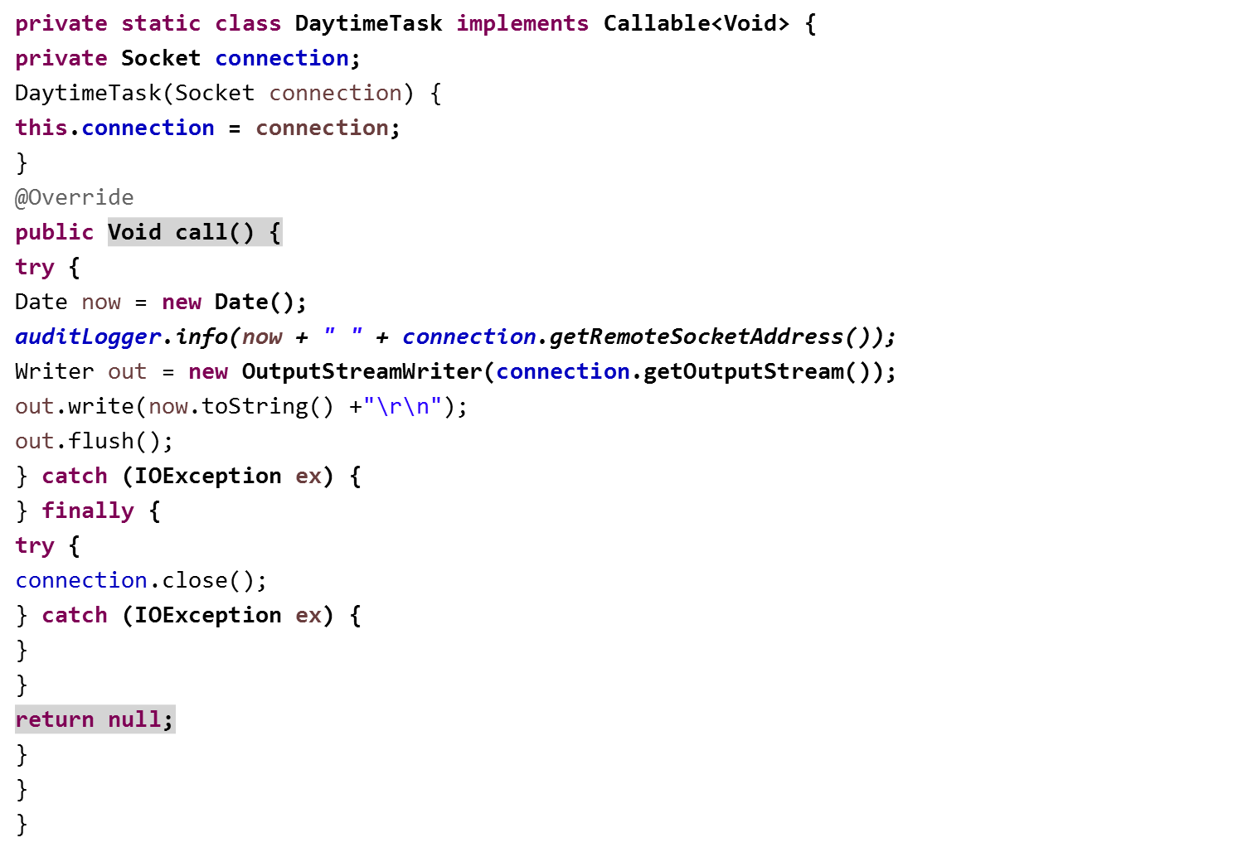
DayTime server with logging

