Slide 1
Natural Language Processing
Session 4: Tokenization and Stemming
Instructor: Dr.Nadia Saeed
Spring 2026,
Quaid-I-Azam University

Slide 2
Stemming

Slide 3
Stemming
Stemming: To group words that are derived from a common stem
e.g, “fish”, “fishes”, “fishing” could be mapped to “fish”
Generally produces small improvements in tasks effectiveness
Similar to stopping, stemming can be done aggressively, conservatively, or not at all
Aggressively: consider “fish” and “fishing” the same
Conservatively: just identifying plural forms using the letter “s”
issues: ‘Centuries’ → ‘Centurie”
Not at all: Consider all the word variants
In different languages, stemming can have different importance for effectiveness:
In Arabic, morphology is more complicated than English
In Chinese, stemming is not effective

Slide 4
Evaluation of Stemmers
There are three criteria for evaluating stemmers:
Correctness
Efficiency of the task
Compression performance
There are two ways in which stemming can be incorrect:
Over-stemming (too much of the term is removed)
Two or more words being reduced to the same wrong root
e.g., ‘centennial’, ‘century’, ‘center’: ‘cent’
Under-stemming (too little of the term is removed)
Two or more words could be wrongly reduced to more than one root word
e.g., ‘acquire’, ‘acquiring’, ‘acquired’: acquir ‘acquisition’: ‘acquis’

Slide 5
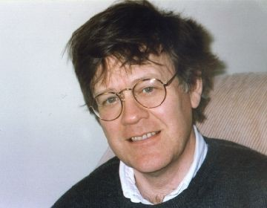
Porter Stemmer (1980)
The most common stemmer for English, introduced by Martin Porter A rule-based stemmer with rules for mostly suffix-stripping such as:
“ing”
“sses”
(m>0) “EED” → “EE” feed → feed agreed → agree
m=measure of word or word part, when represented in form (VC)
V= vowel and C=consonants
→ “-”
→ “ss”
connecting → connect caresses → caress
Advantage: Disadvantage:
It produces the best output as compared to other stemmers, and it has less error rate Morphological variants produced are not always real words (produces stems)
https://tartarus.org/martin/PorterStemmer/

Slide 6
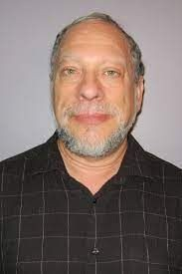
Krovetz Stemmer (1993)
Hybrid algorithmic-dictionary-based method introduced by Robert Krovetz Word checked in dictionary:
If present, either left alone (or replaced with “exception”)
If not present, word is checked for suffixes that could be removed
After removal, dictionary is checked again
Advantage: Produces words not stems
Disadvantage: Lower false positive rate, somewhat higher false negative FP: Policy → Police FN: noise/noisy

Slide 7
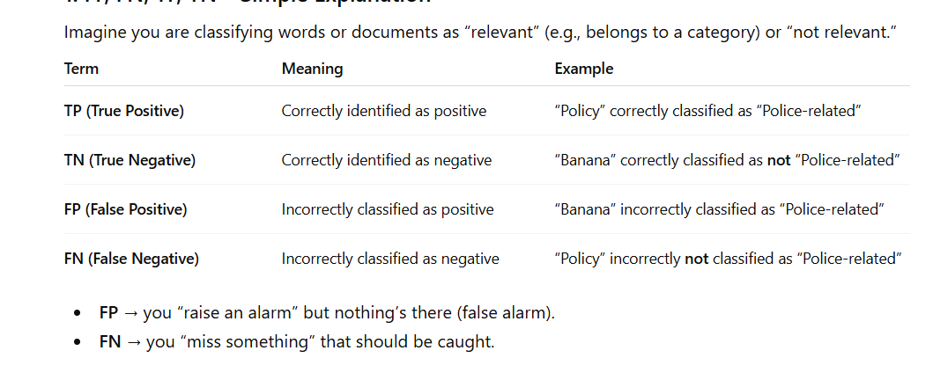
FP, FN, TP, TN – Simple Explanation

Slide 8
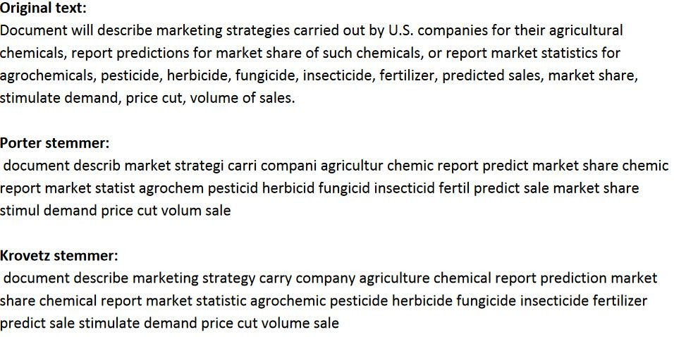
Example

Slide 9
Lemmatization

Slide 10
Lemmatization
Reduce inflectional/variant forms to base form
am, are, is → be
car, cars, car's, cars' → car
the boy's cars are different colors → the boy car be different color
Lemmatization implies doing “proper” reduction to dictionary headword form
e.g., WordNet is a lexical database of semantic relations between words in more than 200 languages
Stemming is a process that extract stems by removing last few characters from a word, often leading to incorrect meanings and spelling
Lemmatization considers the context and converts the word to its meaningful base form, which is called Lemma
37

Slide 11
Phrases

Slide 12
Phrases
In a task such as information retrieval, input queries can be 2-3 word phrases
Phrases can yield more precise queries
“University of Southern Maine”, “black sea”
Less ambiguous
“Red apple” vs. “apple”
Phrase is any sequence of n words: n-gram
unigram: one word bigram: sequence of 2 words trigram: sequence of 3 words
Generated by:
Choosing a particular value for ‘n’
Moving that “window” forward one unit word at a time
The more frequently a word n-gram occurs, the more likely it is to correspond to a meaningful phrase in the language

Slide 13
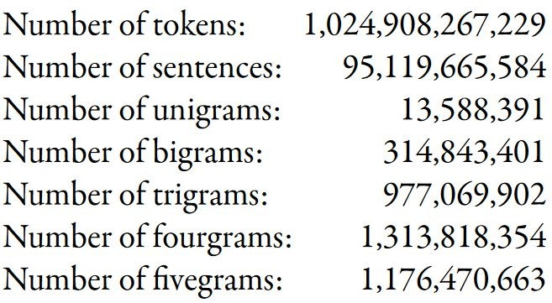
Google N-gram
https://ai.googleblog.com/2006/08/all-our-n-gram-are-belong-to-you.html

Slide 14
NLTK: Natural Language Toolkit https://www.nltk.org/

Slide 15
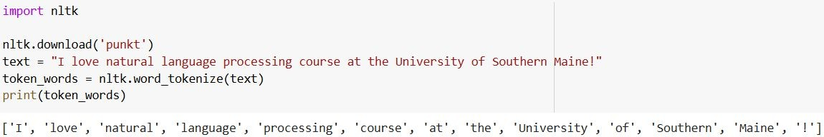
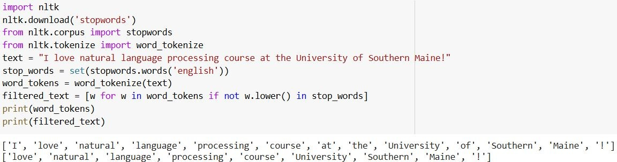
Tokenization & Stopword Removal

Slide 16
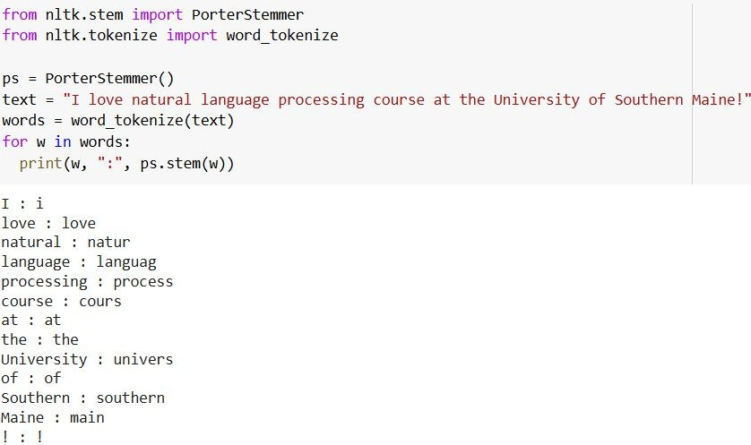
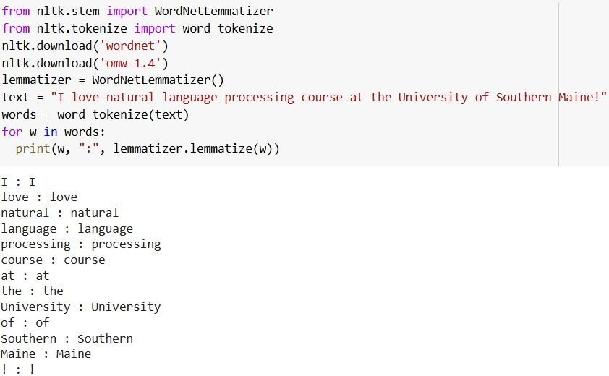
Stemming & Lemmatization

Slide 17
WE NEED TO LOOK CAREFULLY!
You should always make sure to look at the data and see what are the tokens after the tokenization → What is being indexed?
Use small input small and manually observe the output
In many researches, the default parameters have handled the input differently than expected
Using HTML files, how the tags are handled? What encoding is used?
Check what kind of normalization is applied.
Decided whether the stop-words are removed? (or should be removed)

Slide 18

Summary
We learned about:
Processing text with:
Tokenization
Stopword removal
Normalization
Stemming
Lemmetization

Slide 19
Word Embedding

Slide 20
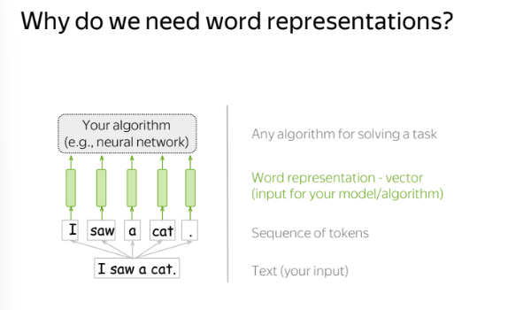

Slide 21
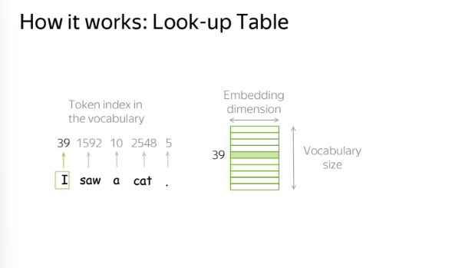

Slide 22
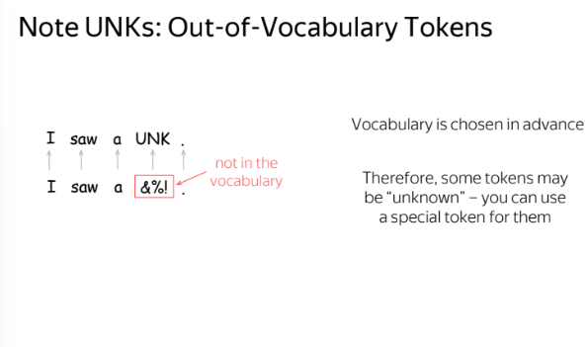

Slide 23
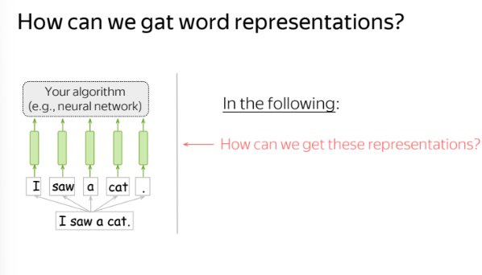

Slide 24
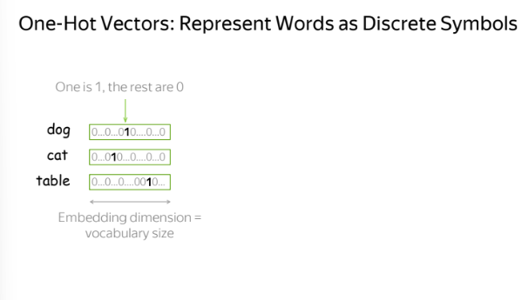

Slide 25
