Slide 1
Natural Language Processing
Session 6: Naïve Bayes and Sentiment Classification
Instructor: Dr. Nadia Saeed
Spring 2026,
Quaid-i-Azam University

Slide 2
Text Classification

Slide 3
Text Classification
Text Classification (Text Categorization) is the task of assigning a label or a category to an entire text or document
Some common text categorization tasks are:
Sentiment analysis
extraction of sentiment, positive or negative orientation that writer expresses toward an object
Spam detection
binary classification task of assigning an email to one of the two classes, spam or not-spam
Authorship identification
determining a text’s author
Age/gender identification
determining a text’s author characteristics like gender and age
Language Identification
finding the language of a text

Slide 4
Positive or Negative Movie Review?
...zany characters and richly applied satire, and some great plot twists
It was pathetic. The worst part about it was the boxing scenes…
...awesome caramel sauce and sweet toasty almonds. I love this place!
...awful pizza and ridiculously overpriced...

Slide 5
Simple Sentiment Analysis: Binary Classification, Positive or Negative
...zany characters and richly applied satire, and some great plot twists
+
It was pathetic. The worst part about it was the boxing scenes…
-
...awesome caramel sauce and sweet toasty almonds. I love this place!
+
...awful pizza and ridiculously overpriced…
-

Slide 6
Why Sentiment Analysis?
Movie: is this review positive or negative?
Products: what do people think about the new iPhone?
Public sentiment: how is consumer confidence?
Politics: what do people think about this candidate or issue?
Prediction: predict election outcomes or market trends from sentiment

Slide 7
Text Classification: Definition
Text classification can be defined as follows:
Input:
a document d
a fixed set of classes C = {c₁, c₂,..., c_{n}}
Output:
a predicted class c ∊ C

Slide 8
Classification Methods: Hand-coded Rules
The goal of classification is to take a single observation, extract some useful features, and thereby classify the observation into one of a set of discrete classes
One method for classifying text is to use hand-written rules Rules based on combinations of words or other features
spam: black-list-address OR (“dollars” AND “have been selected”)
Accuracy can be high if rules carefully are refined by experts
But building and maintaining these hand-written rules can be expensive
Rules can be fragile
It may require domain knowledge

Slide 9
Classification Methods: Supervised Machine Learning
Most cases of text classification in language processing are done via supervised machine learning methods
Input:
a document d
a fixed set of classes C = {c₁, c₂,..., c_{n}}
A training set of m hand-labeled documents (d₁, c₁), … , (d_{m}, c_{m})
Output:
a predicted class c ∊ C
A learned classifier: γ:d→c

Slide 10
Classification Methods: Supervised Machine Learning
Our goal is to learn a classifier that is capable of mapping from a new document d to its correct class c∊C
A probabilistic classifier additionally will tell us the probability of the observation being in the class Generative classifiers like Naïve Bayes build a model of how a class could generate some input data
Given an observation, they return the class most likely to have generated the observation
Discriminative classifiers like logistic regression instead learn what features from the input are most useful to discriminate between the different possible classes
Some classifiers:
Naïve Bayes
Logistic regression
Support-vector machines
k-Nearest Neighbors, ...

Slide 11
Naïve Bayes Classifier

Slide 12
Naïve Bayes Classifier
A Naïve Bayes Classifier is a Bayesian classifier (based on Bayes rule) that makes a simplifying (naïve) assumption about how the features interact
A text document is represented as a bag of words
i.e. a text document is represented as an unordered set of words with their position ignored, keeping only their frequency in the document

Slide 13
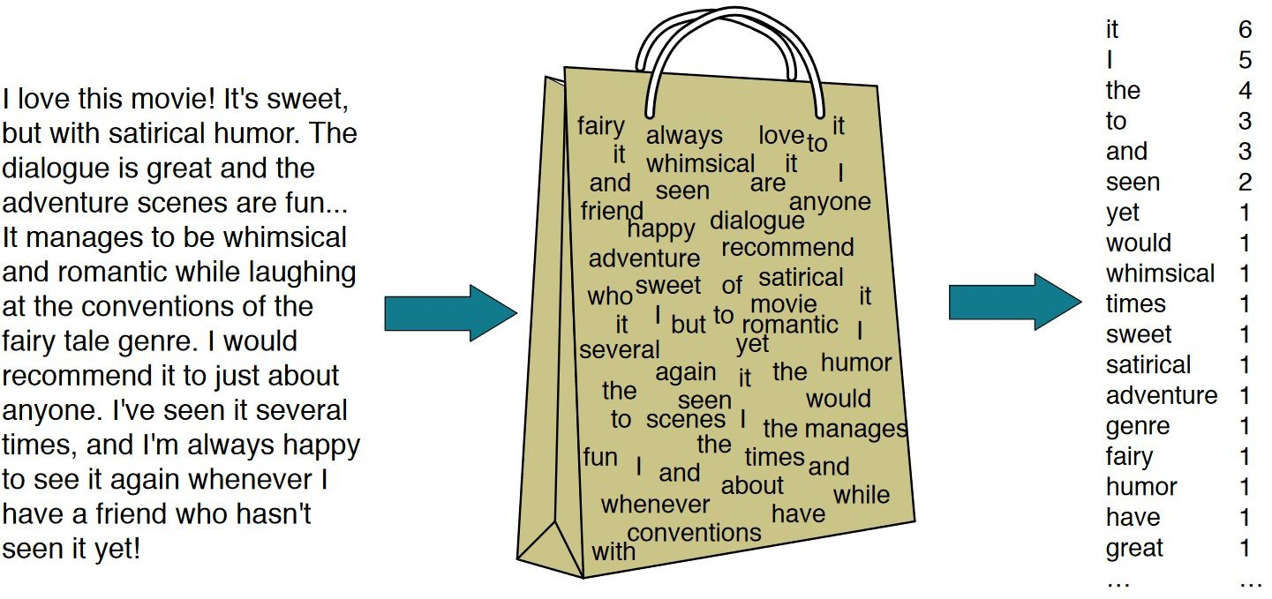
Bag of Words Representation

Slide 14
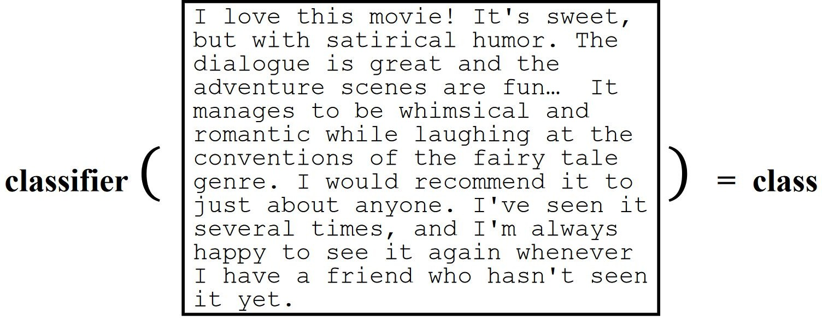
Bag of Words Representation
A Naïve Bayes classifier may use all words in the text as features

Slide 15
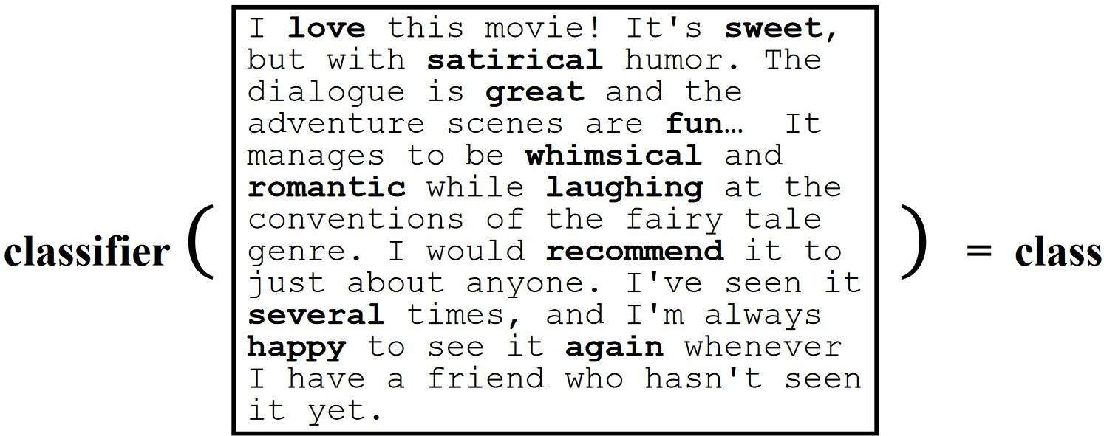
Bag of Words Representation
Or, a Naïve Bayes classifier may use a subset of words in the text as features

Slide 16
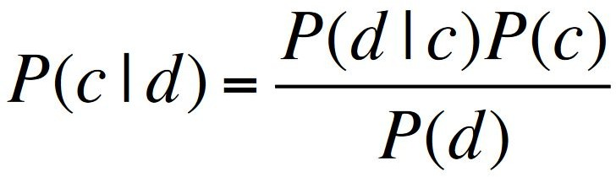

Bayes’ Rule Applied to Documents and Classes
Naïve Bayes is a probabilistic classifier, meaning that for a document d, out of all classes c∊C the classifier returns the class C_{MAP} which has the maximum posterior probability given the document
For a document d and a class c:
Most likely class (MAP: maximum a posteriori):

Slide 17
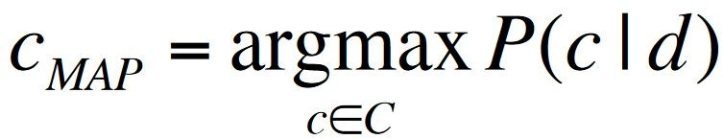
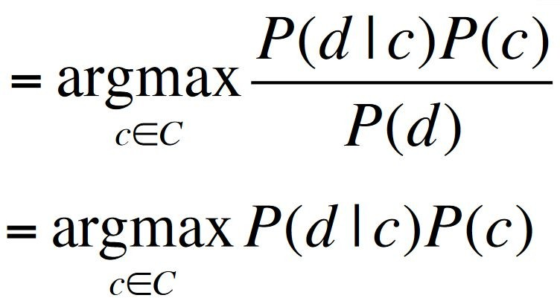
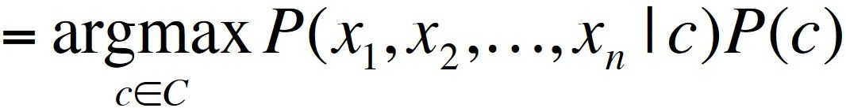
Naïve Bayes Classifier
MAP is “maximum a posteriori” = most likely class
Bayes Rule
Dropping the denominator
"Likelihood" "Prior"
Document d represented as features x₁ … x_{n}
Could only be estimated if a very, very large number of training examples was available
How often does this class occur?
We can just count the relative frequencies in a corpus

Slide 18

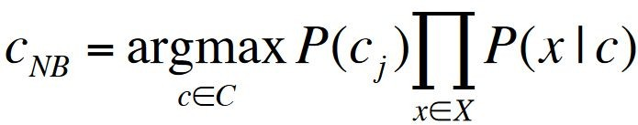
Multinomial Naïve Bayes Independence Assumptions
The first is the bag of words assumption: we assume position does not matter
The second is commonly called the naïve Bayes assumption: this is the conditional independence assumption that the probabilities P(x_{i}|c) are independent given the class c and hence can be ‘naïvely’ multiplied as follows:
Multinomial Naïve Bayes Classifier

Slide 19
Training Naïve Bayes Classifier

Slide 20
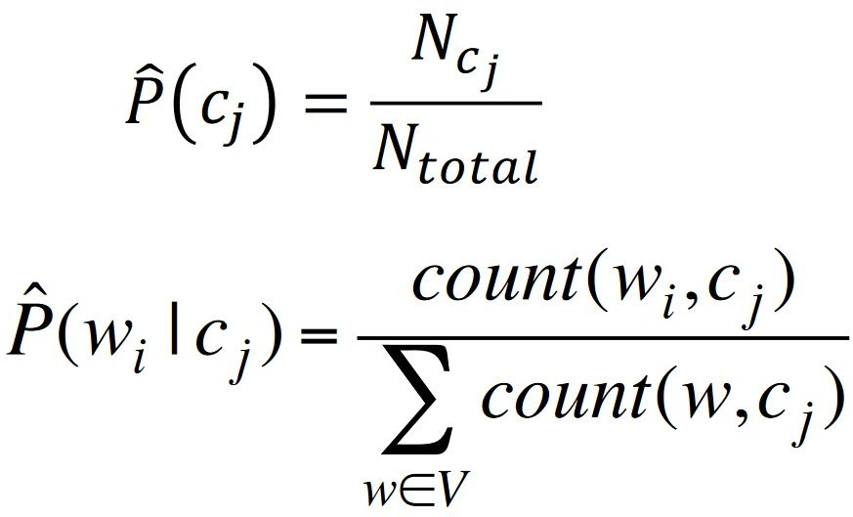
Maximum Likelihood Estimates
How can we learn the probabilities P(c) and P(x_{i}|c)?
First attempt: maximum likelihood estimates
Simply use the frequencies in the data
Create mega-document for topic j by concatenating all docs in this topic
#times word w appears among all
i
words in documents of topic c

Slide 21
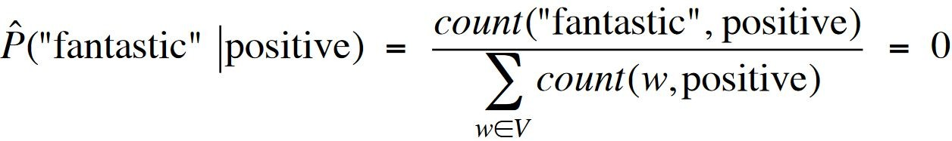
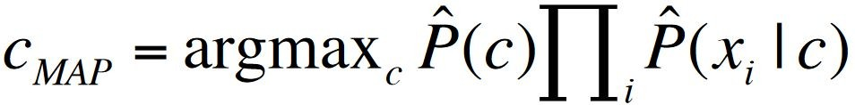
Problem with MLE
What if we have seen no training documents with the word fantastic and classified in the topic positive (thumbs-up)?
Zero probabilities cannot be conditioned away, no matter the other evidence!

Slide 22
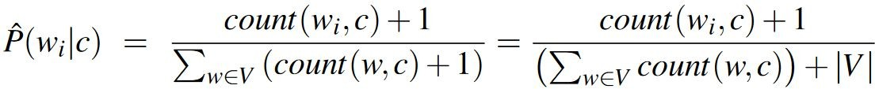
Laplace (add-1) smoothing for Naïve Bayes
The simplest solution is the add-one (Laplace) smoothing
What do we do about words that occur in our test data but are not in our vocabulary at all because they did not occur in any training document in any class?
Remove them from the test document

Slide 23
Stop Words
Some systems ignore stop words
Stop words: very frequent words like “the” and “a”
Sort the vocabulary by word frequency in training set
Call the top 10 or 50 words the stopword list
Remove all stop words from both training and test sets
As if they were never there
But removing stop words does not usually help
So in practice most NB algorithms use all words and do not use stopword lists

Slide 24
Sentiment and Binary Naïve Bayes

Slide 25
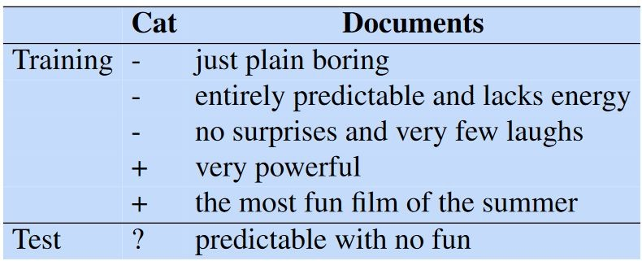
An Example
Let’s walk through an example of training and testing naïve Bayes with add-one smoothing
We will use a sentiment analysis domain with the two classes positive (+) and negative (-) Take the following miniature training and test documents simplified from actual movie reviews

Slide 26
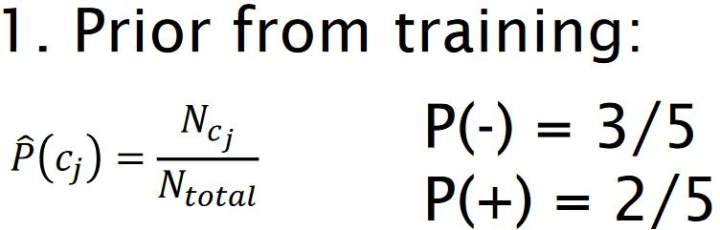
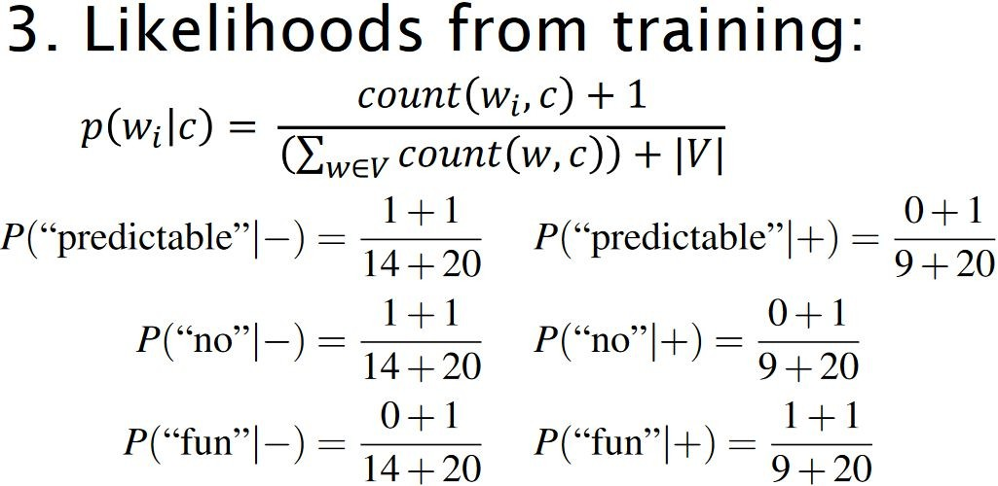

An Example

Slide 27
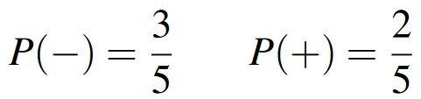
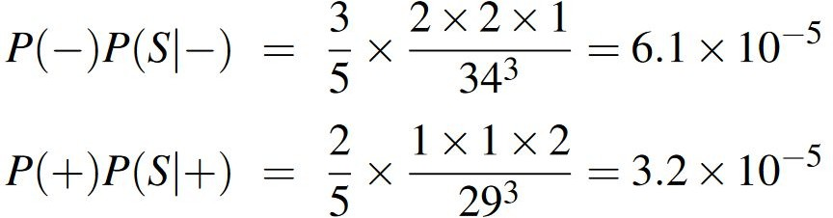
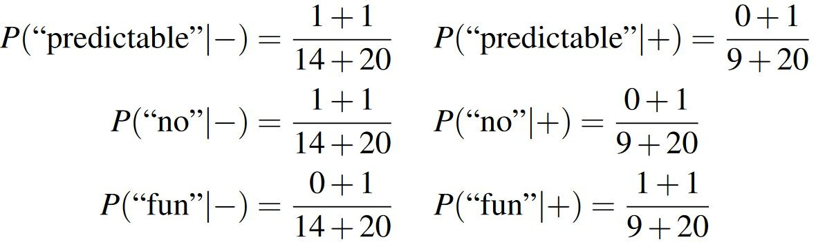
An Example
2
1
4
3

Slide 28
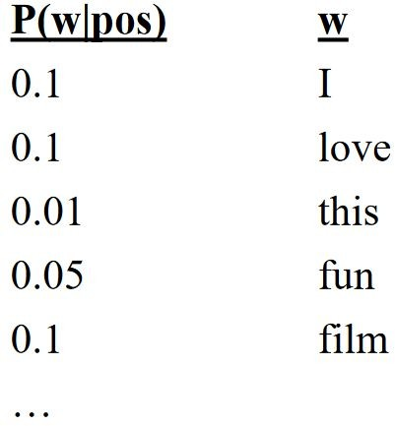
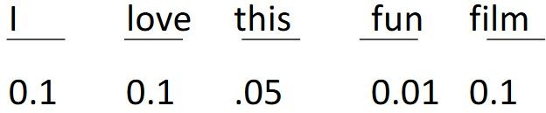

Naïve Bayes and Language Modeling
When we use all of the words in the text (not a subset), Naïve Bayes has an important similarity to language modeling
Each class = a unigram language model Assigning each sentence: P(s|c) = Π P(word|c)

Slide 29
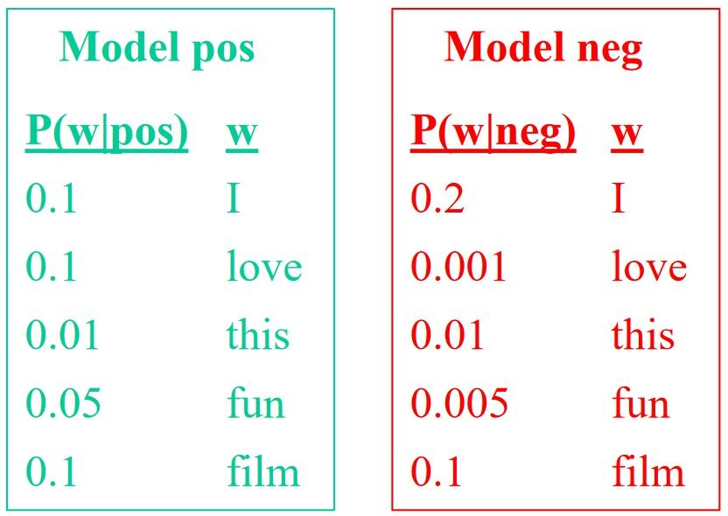
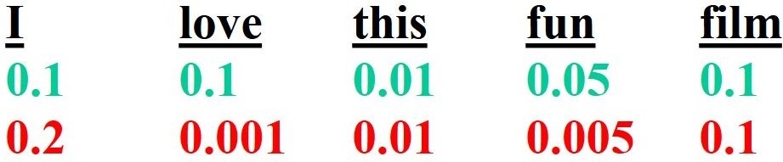
Naïve Bayes as a Language Model
Which class assigns the higher probability to s?

Slide 30
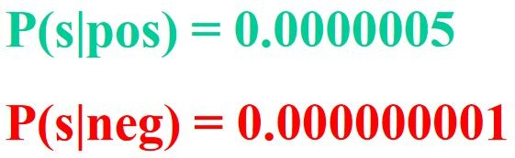

Naïve Bayes as a Language Model
Which class assigns the higher probability to s?

