Slide 1
Natural Language Processing
Session 6: Naïve Bayes and Sentiment Classification
Instructor: Dr. Nadia Saeed
Spring 2026,
Quaid-i-Azam University

Slide 2
Evaluation of Classifiers

Slide 3
Contingency Table, Precision, Recall, F-measure
In order to evaluate how good is our classifier, we can use different evaluation metrics
In evaluation, we compare the test set results of our classifier with gold labels (the human labels for the test set documents)
As a result of this comparison, first we build a contingency table before calculate our evaluation metrics

Slide 4
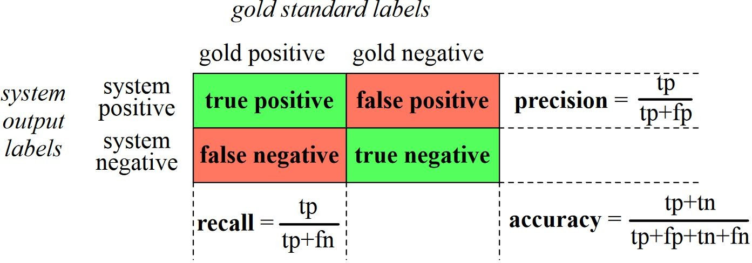
Confusion Matrix
A confusion matrix for visualizing how well a binary classification system performs against gold standard labels

Slide 5
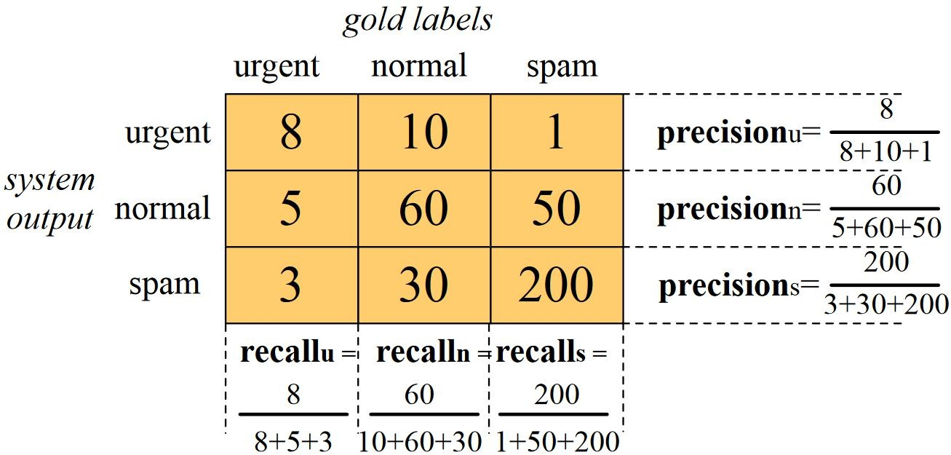
Evaluation for more than Two Classes
Spam
200 | 33
51 | 83
prediction
Macro-averaging:
Compute the performance for each class, and then average over classes
Micro-averaging:
Collect decisions for all classes into one confusion matrix
Compute precision and recall from that table
actual

Slide 6
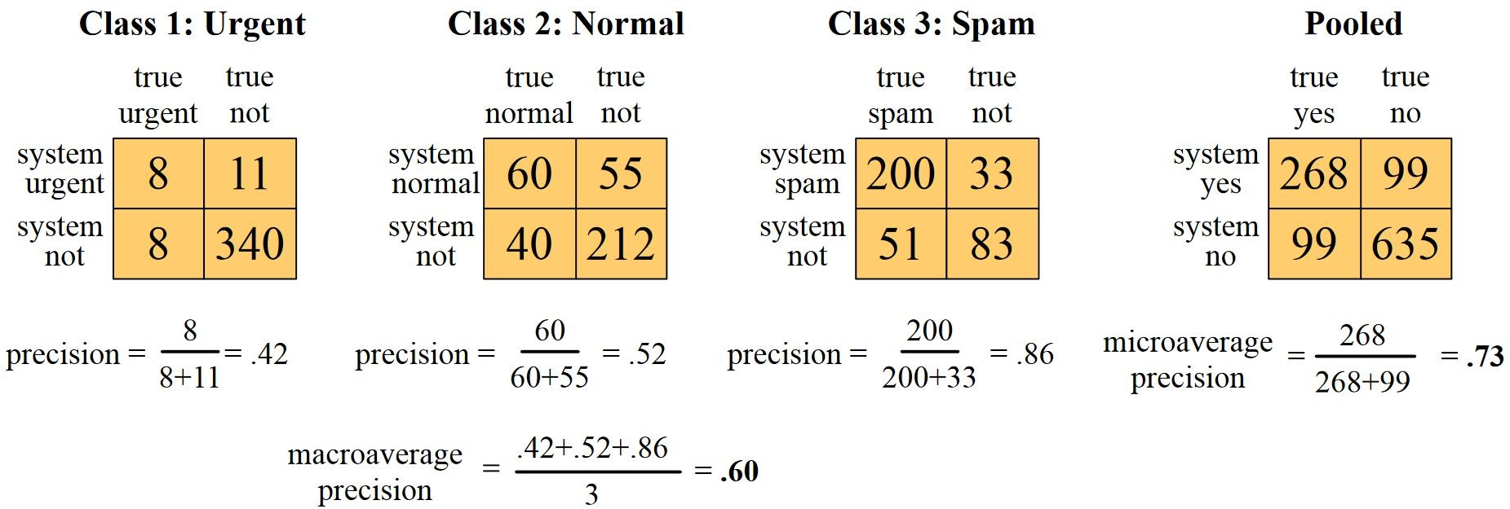
Example: Precision

Slide 7
Test sets and Cross-validation
In Language Modeling
Use the training set to train the model
Use the development test set (also called a devset) to perhaps tune some parameters
Run it on the test set to report its performance
But paradox: want as much data as possible for training, and as much for dev; how to split?

Slide 8
Cross-Validation
In cross-validation, we choose a number k, and partition our data into k disjoint subsets called folds
Choose one of those k folds as a test set, train our classifier on the remaining k−1 folds
Compute the error rate on the test set
Repeat with another fold as the test set, again training on the other k−1 folds
We do this sampling process k times and average the test set error rate from these k runs to get an average error rate
Cannot examine any of the data to suggest possible features because of peeking at the test set, and such cheating would cause us to overestimate the performance of our system

Slide 9
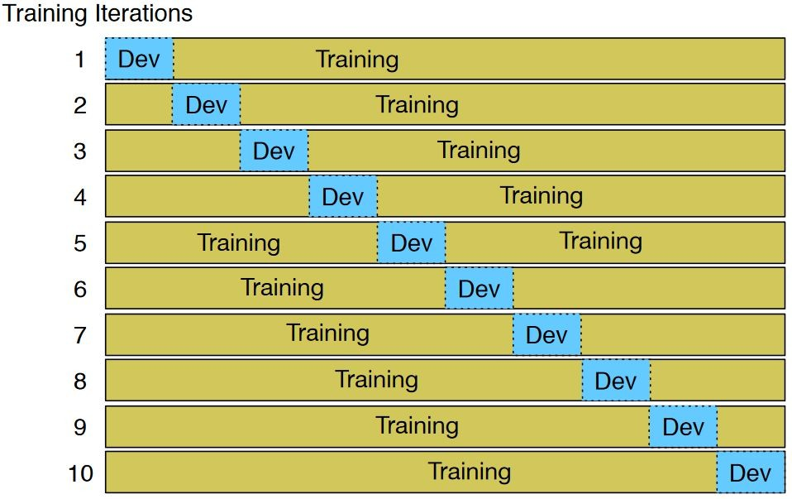
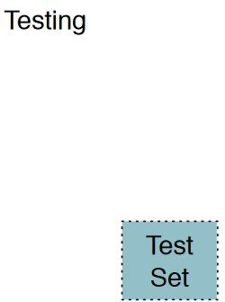
Cross-Validation
Create a fixed training set and test set, then do 10-fold cross-validation inside the training set, but compute error rate the normal way in the test set

Slide 10
Significance Test

Slide 11
Why Significance Test
Do you have a meaningful improvement?
0.05 (absolute) in precision might be noticed
0.10 (absolute) in precision makes a difference
If system B does better than system A in 90% of 200 instances
How confident are we that B is better than A?
Using significance tests
System B as a new model, System A is a baseline
Is System B better than A?
Null hypothesis:
Alternative hypothesis:
There is no difference in their effectiveness There is a difference

Slide 12
Significance Test
Significance Test enables us to reject the null hypothesis (or not reject it)
May produce two types of errors:
Type I:
Type II:
Increasing the number of instances will reduce the chance of Type I and II errors
Significance level shows the probability of rejecting the null hypothesis when it is true (e.g., significance level of 0.05 indicates 5% risk of Type I error)
We reject null hypothesis by mistake (false positive) We accept null hypothesis by mistake (false negative)
One-tailed or two-tailed:
Two-tailed: Whether two systems are different from one another
One-tailed: One system is better than the other
Null hypothesis: There is no difference in their effectiveness

Slide 13
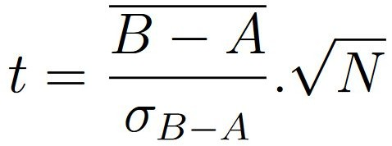
Paired Student’s T-Test
Statistical test that compares the averages/means and standard deviations of two systems
Each Significance test has a test statistic;
A quantity calculated to decide whether the null hypothesis should be rejected
In T-test
the mean of the differences N is the number of instances
the standard deviation of the differences
The t-distribution table is a table that shows the critical values of the t-distribution to get p-value

Slide 14
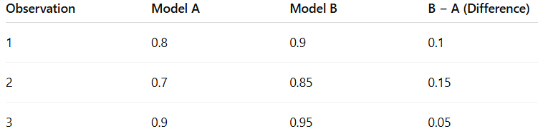
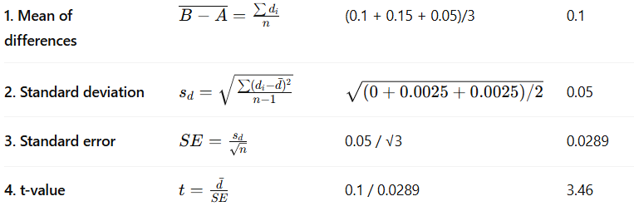
Paired t-test: Model B vs Model A
d - d | (d – d)²
0 | 0
0.05 | 0.0025
-0.05 | 0.0025

Slide 15
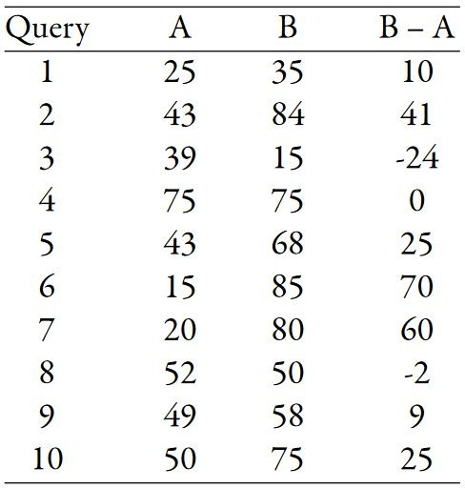
Example
For a one-tailed test, this gives a P-value of 0.02, which would be significant at a level of α = 0.05
The t-test enables us to reject the null hypothesis and conclude that ranking algorithm B is more effective than A
https://www.sjsu.edu/faculty/gerstman/StatPrimer/t-table.pdf

Slide 16

Summary
Today we learned about:

Slide 17

Summary
Today we learned about:
Text Classification Naïve Bayes Classifier
Evaluation and significance testing

