Slide 1
Natural Language Processing
Session 7: Logistic Regression
Instructor: Dr.Nadia Saeed
Spring 2026,
Quaid-I-Azam University

Slide 2

Previous Session
In the previous session, we learned about:
Text Classification Naïve Bayes Classifier
Evaluation and significance testing

Slide 3
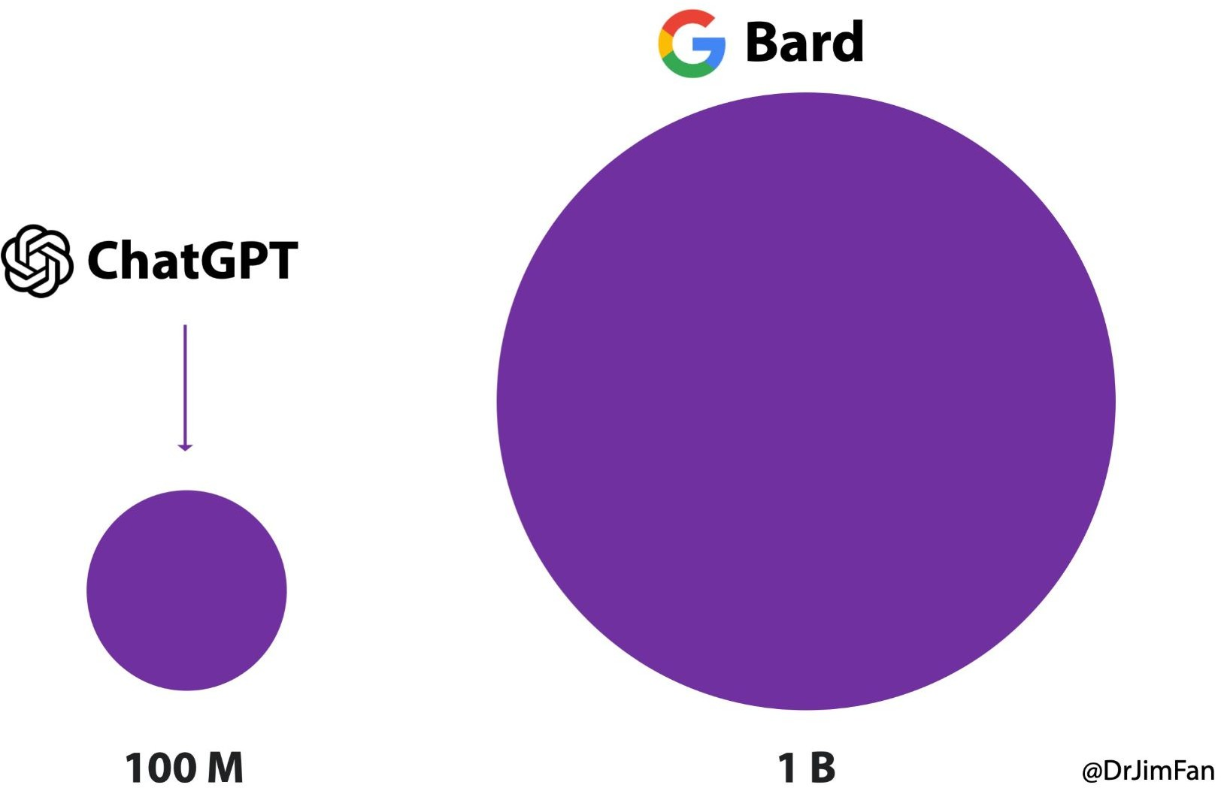
Google Brad and Bing
Bard is an AI chatbot made by Google, similar to ChatGPT, and it uses advanced technology (called transformers) that Google originally helped develop.
At first, Bard was not available to everyone—only some selected people could try it.
Microsoft added a chat feature into Bing, so users can search and talk to AI directly in the search engine.

Slide 4
Generative and Discriminative Classifiers

Slide 5
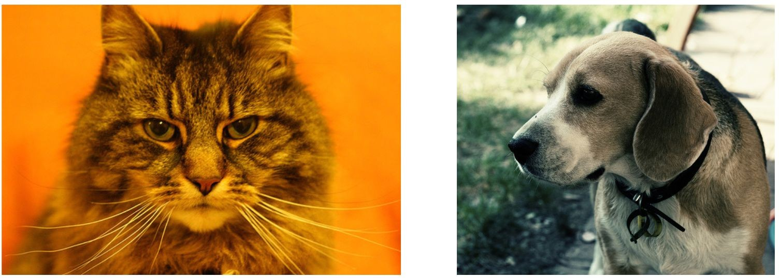

Generative vs. Discriminative
Suppose we are distinguishing cat from dog images

Slide 6
Generative Classifier
Build a model of what's in a cat image
Knows about whiskers, ears, eyes
Assigns a probability to any image:
how cat-y is this image? Also build a model for dog images
A generative model would have the goal of understanding what dogs look like and what cats look like
Now given a new image: Run both models and see which one fits better
A generative model (like naïve Bayes) makes use of likelihood term, which expresses how to generate the features of a document if we knew it was of class c

Slide 7
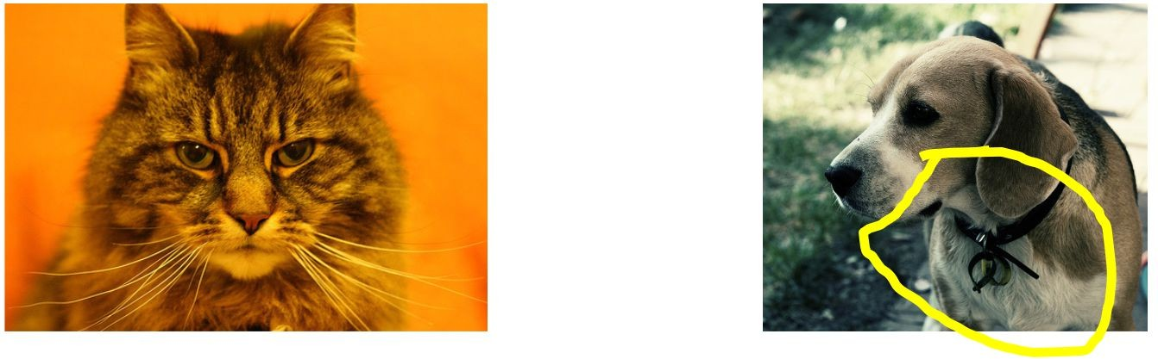
Discriminative Classifier
Just try to distinguish dogs from cats
dogs have collars?
A discriminative model, by contrast, is only trying to learn to distinguish the classes
A discriminative model (like logistic regression) in the text categorization scenario attempts to directly compute P(c|d)
It will learn to assign high weight to document features that directly improve its ability to discriminate between possible classes, even if it could not generate an example of one of the classes

Slide 8
Components of A Probabilistic Machine Learning Classifier
Machine learning classifiers require a training corpus of observations input/output pairs (x,y)
A machine learning system for classification has four components:
1. A feature representation of the input. For each input observation x, this will be a vector of features [x ,x ,...,x ]
1 2 n
A classification function that computes (the estimated class) via P(y|x). We will use sigmoid function in logistic regression
An objective function for learning, usually involving minimizing error on training examples. We will use cross-entropy loss function in logistic regression
An algorithm for optimizing the objective function. We will use stochastic gradient descent algorithm in logistic regression

Slide 9
The Two Phases of Logistic Regression
The goal of binary logistic regression is to train a classifier that can make a binary decision about the class of a new input observation
Training: We learn weights w and b using stochastic gradient descent and cross-entropy loss
Test: Given a test example x we compute p(y|x) using learned weights w and b, and return whichever label (y = 1 or y = 0) is higher probability

Slide 10
Logistic Regression

Slide 11

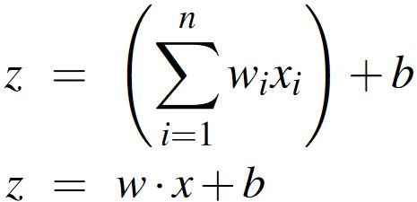
Logistic Regression Classifier
Given a series of input/output pairs: (x^{(i)} , y^{(i)})
For each observation x^{(i)}
We represent x^{(i)} by a feature vector [x , x ,..., x ]
1 2 n
We compute an output: a predicted class
For feature x_{i}, weight w_{i} tells is how important is x_{i}
Weights: one per feature W = [w₁, w₂, ..., w_{n}] (Sometimes represented as θ)
If this sum is high, we say y=1; if low, then y=0

Slide 12
Probabilistic Classifier
We need to formalize “sum is high”
The weighted sum of the evidence z is not a probability value, it ranges from -∞ to +∞
We’d like a principled classifier that gives us a probability, just like Naïve Bayes did
We want a model that can tell us:
p(y=1|x; θ) p(y=0|x; θ)

Slide 13
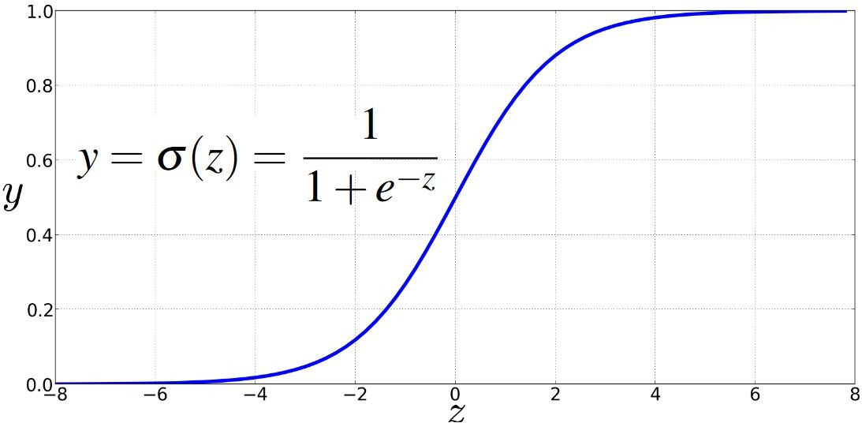
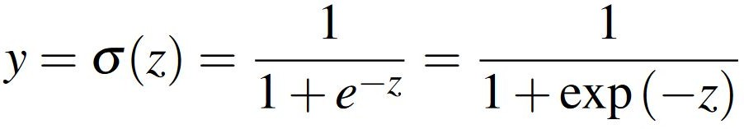
Sigmoid Function
Solution: use a function of z that goes from 0 to 1, sigmoid function, 𝝈(z) The sigmoid function is also called the logistic function

