Slide 1
Natural Language Processing
Session 7: Logistic Regression
Instructor: Dr.Nadia Saeed
Spring 2026,
Quaid-I-Azam University

Slide 2
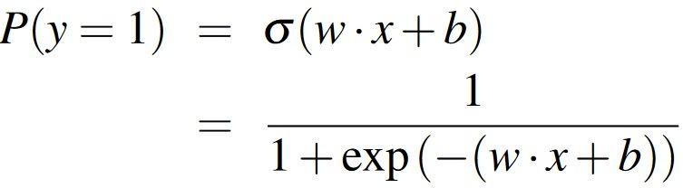
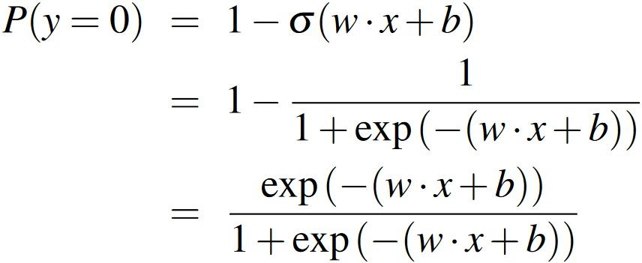
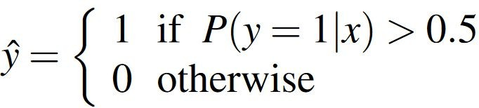
Classification with Logistic Regression
The sigmoid function has a number of advantages:
It maps a real-valued number into range [0,1], which is just what we want for a probability
It tends to squash outlier values toward 0 or 1
Turning a probability into a classifier
decision boundary
👉 It’s the remaining probability, not just flipping values.

Slide 3
Example: Sentiment Classification
** It's hokey. There are virtually no surprises, and the writing is second-rate. So why was it so enjoyable ? For one thing, the cast is great.
Another nice touch is the music. I was overcome with the urge to get off the couch and start dancing. It sucked me in, and it'll do the same to you.
𝑥1 ​: number of positive words
𝑥2 ​: number of negative words
𝑥3 ​: does “no” appear (0/1)
𝑥4 ​: pronoun count
𝑥5 ​: does “!” appear
𝑥6 ​: natural log(word count of doc)

Slide 4
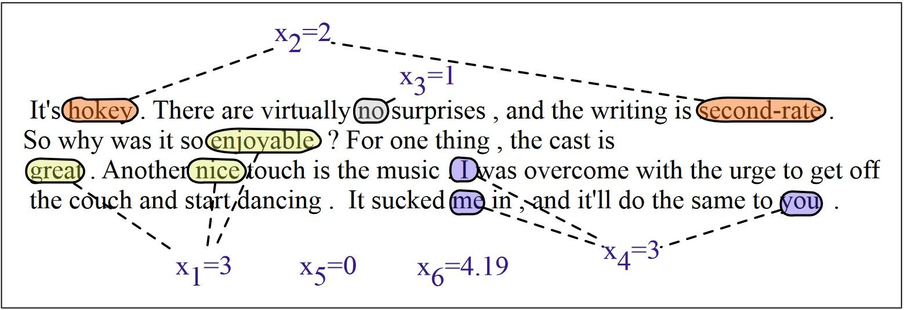
Example: Sentiment Classification
** It's hokey. There are virtually no surprises, and the writing is second-rate. So why was it so enjoyable ? For one thing, the cast is great.
Another nice touch is the music. I was overcome with the urge to get off the couch and start dancing. It sucked me in, and it'll do the same to you.

Slide 5
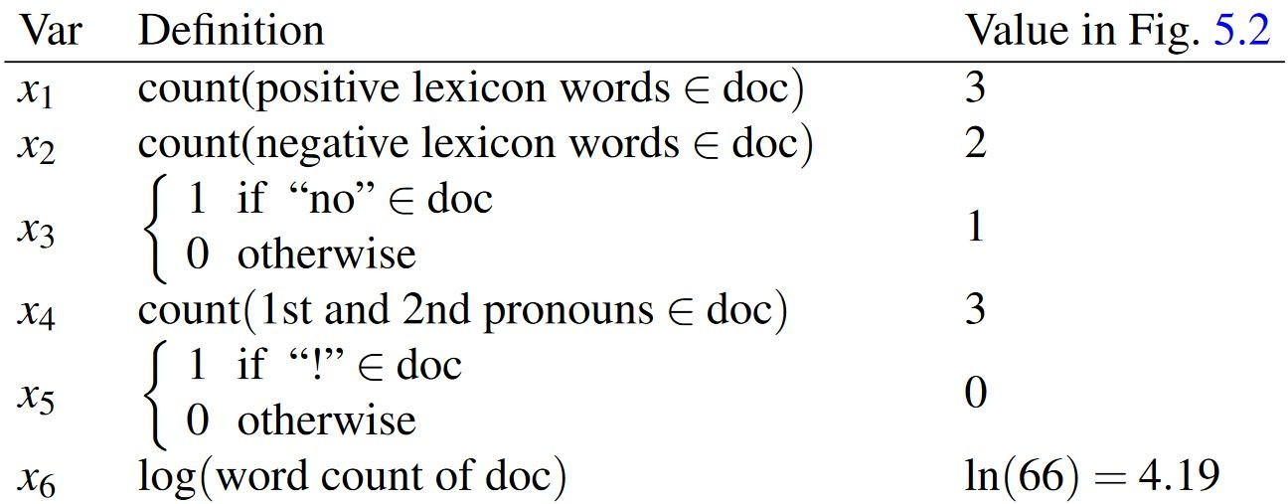
Example: Sentiment Classification

Slide 6
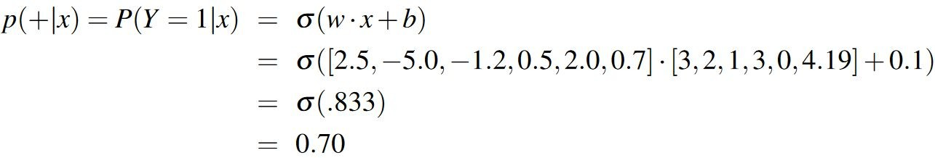
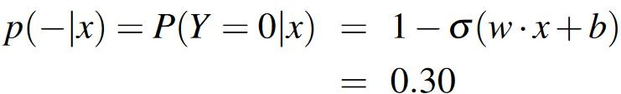
Example: Sentiment Classification

Slide 7
Learning Weights

Slide 8
How to Set Ws?
How are the weights w and bias b (the parameters of the model) learned?
Logistic regression is an instance of supervised classification in which we know the correct label y (either 0 or 1) for each observation x
The estimated value is the system’s estimate of the true y
We want to learn parameters (w and b) that make for each training observation as close as possible to the true y
In order to learn the parameters of the model, we require two things:
A metric for how close the current label is to the true gold label
An optimization algorithm for iteratively updating the weights to minimize this loss function

Slide 9
Learning Weights
A metric for how close the current label is to the true gold label
The distance between the system output and the gold truth is called as the loss function or the cost function
The loss function that is commonly used for logistic regression is the cross-entropy loss
An optimization algorithm for iteratively updating the weights to minimize this loss function
The standard algorithm for this is gradient descent (or stochastic gradient descent)

Slide 10
Cross Entropy Loss
We need a loss function that expresses, for an observation x, how close the classifier output is to the correct output:
For logistic regression, we will use a loss function known as conditional maximum likelihood estimation that prefers the correct class labels of the training example to be more likely
We choose the parameters w, b that maximize the log probability of the true y labels in the training data given the observations x
The resulting loss function is the negative log likelihood loss, generally called the cross entropy loss

Slide 11

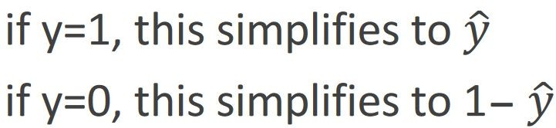
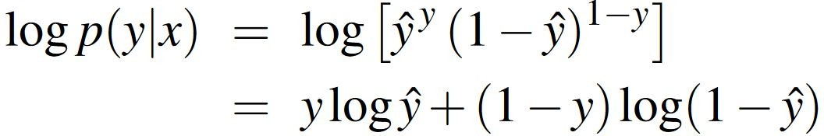
Cross Entropy Loss: For a Single Observation
Goal: maximize probability of the correct label p(y|x)
Since there are only two discrete outcomes (1 or 0), we can express the probability p(y|x) as follows:
Take the log of both sides (whatever values maximize a probability will also maximize the log of the probability):
Whatever values maximize log p(y|x) will also maximize p(y|x)

Slide 12
Cross Entropy Loss
In order to turn this into loss function (something that we need to minimize), we’ll just flip the sign on
A perfect classifier would assign probability 1 to the correct outcome (y=1 or y=0) and probability 0 to the incorrect outcome

Slide 13
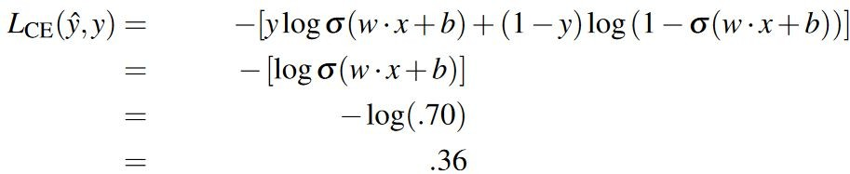
Example: Sentiment Classification
True value is y=1. How well is our model doing?
What's the loss?

Slide 14
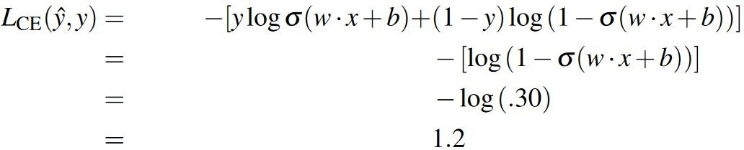
Example: Sentiment Classification
False value is y=0. How well is our model doing?
What's the loss?

