Slide 1
LINQ
AHMAD HAMMAD

Slide 2
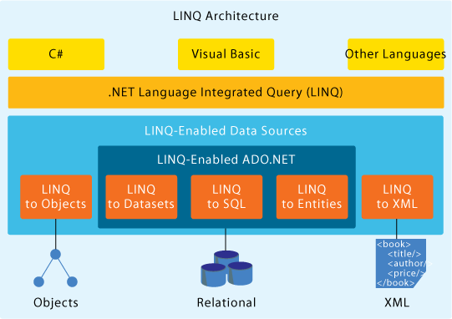
INTRODUCTION
LINQ Architecture

Slide 3
QUERY EXPRESSION
SQL-like:
  from s in names
  where s.Length == 5 orderby sselect s.ToUpper();
OO-style:
  names.Where(s => s.Length==5)
  .OrderBy(s => s)
  .Select(s => s.ToUpper());
Where, OrderBy, and Select are operators. The arguments to these operators are Lambda Expression.

Slide 4
LAMBDA EXPRESSIONS
Examples:
  s => s.Length == 5
Executable function
  Anonymous functional. Can be assigned to a delegate variable.
  No need to indicate the types
  Can be passed to methods as parameters.
Expression Tree
  Efficient in-memory data representations of lambda expressions
  Changing the behaviors of the expressions
  Applying your own optimization

Slide 5
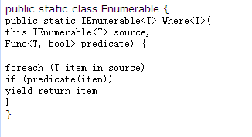
METHODS EXTENSION
You can control not only by Lambda Expression, but also by methods extension

Slide 6
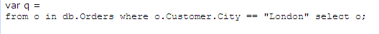
LINQ OPERATIONS
Join
  When there is relationship (e.g. foreign key) between two tables, no explicit join operation is needed
  Using dot notation to access the relationship properties, and navigate all the matching objects.
  To join any two data sources on any attribute, you need an explicit join operation.
    var query = names.Join(people, n => n, p => p.Name, (n,p) => p);
    The lambda expression for shaping (n, p) => p will be applied on each matching pairs.

Slide 7

LINQ OPERATIONS (CONT.)
Group Join
  The lambda expression for shaping is applied on the outer element and the set of all the inner elements that matches the outer one.
  Shape the result at a set level

Slide 8
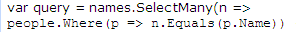

LINQ OPERATIONS (CONT.)
Select Many
  Each object in the result set may contain a collection or array
  Select many help decompose the structure and flatten the result
  All the elements could be traversed in one foreach loop.
Aggregation
  Standard aggregation operators.
  Min, Max, Sum, Average.
    Int totalLength=names.Sum(s => s.Length);
  General purpose (generic) operator.

Slide 9

SPOTLIGHT
IQueryable<T> interface will defer the evaluation of the query.
An expression tree will represent all the deferred queries as a whole.
Several operations could be “merged”,
only one SQL query will be generated
and sent to database (Similar to Django)
Multi-level defer

Slide 10
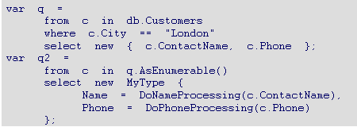
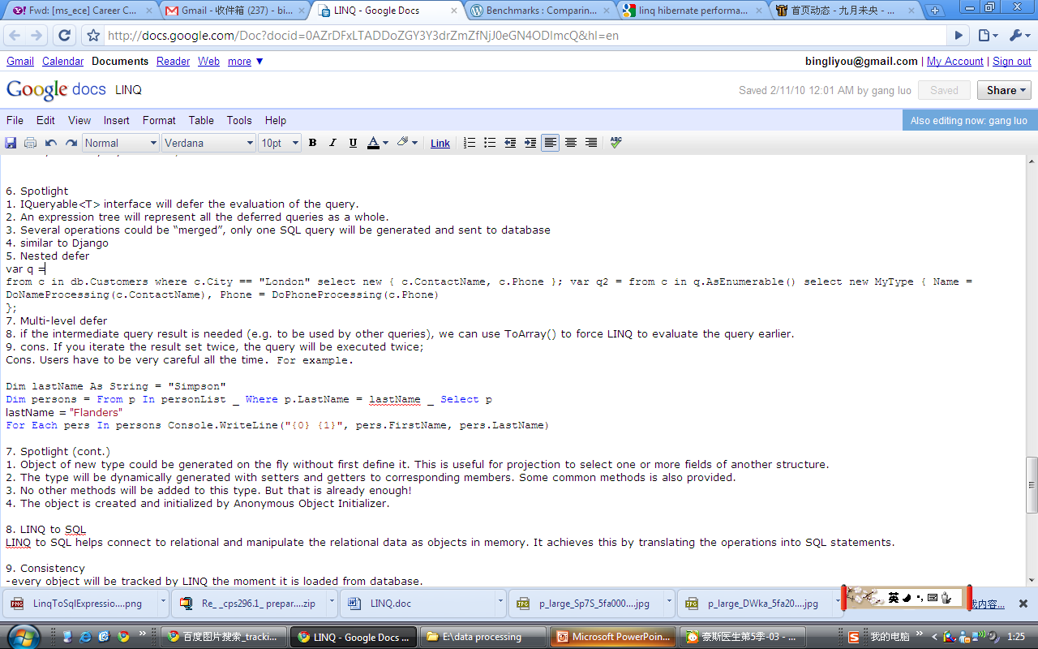
SPOTLIGHT (CONT.)
Nested defer
What if you want the intermediate result?

Slide 11
SPOTLIGHT (CONT.)
Defer Execution
  Advantages
    Performance!
    Query dependency!
  Disadvantages
    Divide one query into multiple ones
    You iterate the result set 100 times, the query will be executed 100 times.
    Users have to be very careful

Slide 12
SPOTLIGHT (CONT.)
Object of new type could be generated on the fly without first define it. This is useful for projection to select one or more fields of another structure.
The type will be dynamically generated with setters and getters to corresponding members. Some common methods is also provided.
No other methods will be added to this type.
But that is already enough!
The object is created and initialized by
Anonymous Object Initializer.

Slide 13
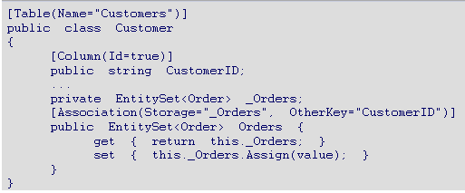
LINQ TO SQL
Data Model
LINQ to SQL helps connect to relational and manipulate the relational data as objects in memory. It achieves this by translating the operations into SQL statements.

Slide 14
CONSISTENCY
Every object will be tracked by LINQ the moment it is loaded from database.
The tracking mechanism monitor the manipulation on relationship properties. Once you modify one side of the relationship, LINQ will modify the other to keep it consistent.
When an object is deleted, it could still exist in memory, but it will not cause inconsistency.

Slide 15
CONCURRENCY
Optimistic concurrency
Conflict checking when SubmitChanges() is called
By default, transaction will abort and an exception will be thrown when a conflict is detected.
User can handle the conflict in the exception catch block.
User can set whether or not to detect the conflict when one column get updated.

Slide 16
TRANSACTION/UPDATE
When update, first check whether new object is added (by tracking mechanism) if yes, insert statement will be generated. What does Django do here?
Modification will not hit the database until the SubmitChanges() method is called
All operations will be translated into SQL statements
All modifications will be encapsulated into a transaction.

Slide 17
TRANSACTION/UPDATE (CONT.)
If an exception is throw during the update, all the changes will be rolled back
One SubmitChanges() is actually one transaction. (pros and cons?)
Users can also explicitly indicate a new transaction scope.

Slide 18
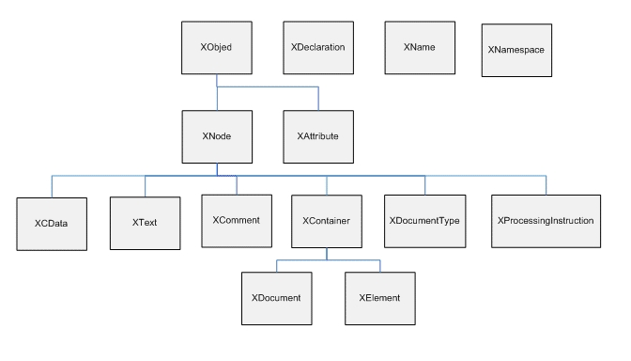
LINQ TO XML
Ddd
The LINQ to XML Class Hierarchy
http://msdn.microsoft.com/en-us/library/bb308960.aspx

Slide 19
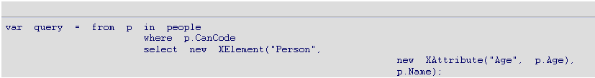
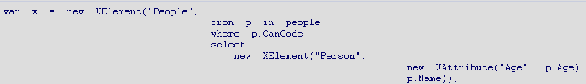
LINQ TO XML
LINQ to XML
XML to LINQ

Slide 20
PERFORMANCE
LINQ has more control and efficiency in O/R Mapping than NHibernate
  LINQ: Externl Mapping or Attribute Mapping
  NHibernate: Externl Mapping
Because of mapping, LINQ is lower than database tools such as SqlDataReader or SqlDataAdapter
  In large dataset, their performance are more and more similar

Slide 21
Thanks!

