Slide 1
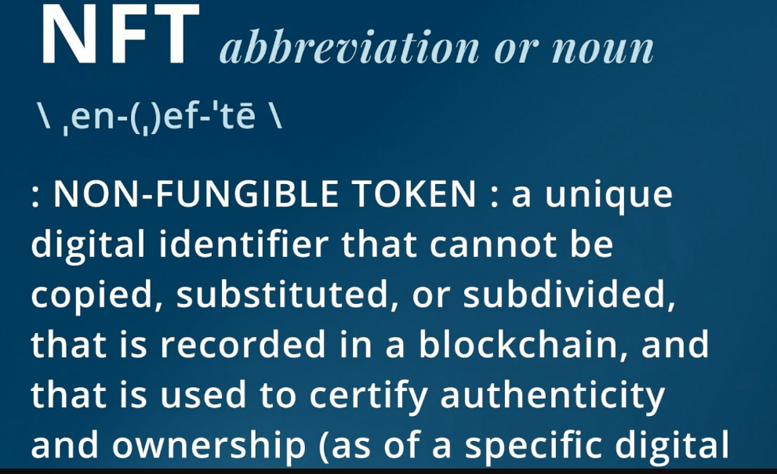

Slide 2
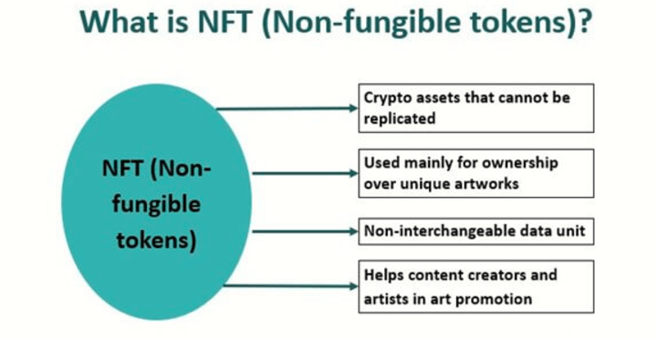

Slide 3
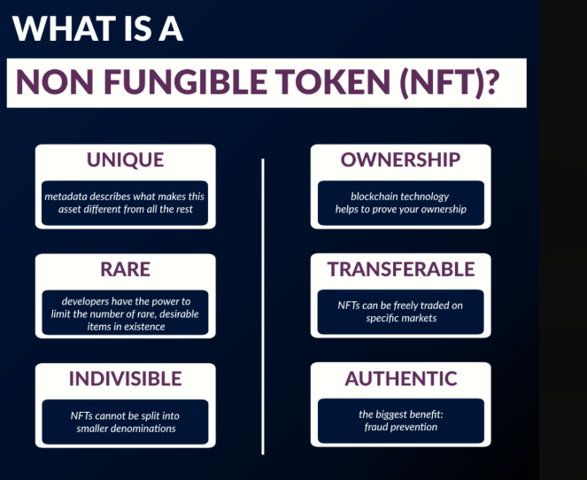

Slide 4
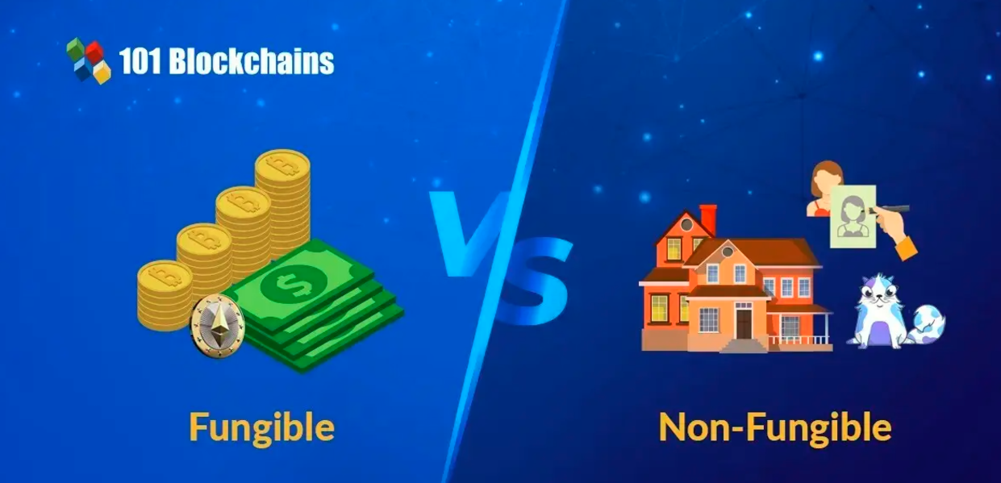

Slide 5
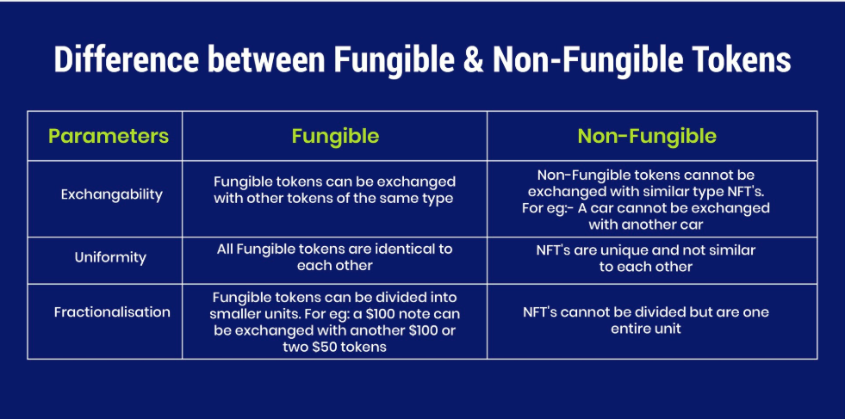

Slide 6
Definition and Characteristics
Unique Identifier: Each NFT has a distinct identifier that differentiates it from other tokens, making it non-fungible. This means that no two NFTs are identical, unlike cryptocurrencies such as Bitcoin, which are fungible and can be exchanged for one another.
Digital Certificate of Ownership: NFTs serve as digital certificates of authenticity and ownership for various assets, including digital art, music, videos, virtual real estate, and collectibles. They provide proof of ownership that is recorded on a blockchain, ensuring that the ownership history is transparent and tamper-proof.

Slide 7
How NFTs Work
Blockchain Technology: NFTs are built on blockchain networks, primarily Ethereum, which allows for the secure storage of ownership records. Each transaction involving an NFT is recorded on the blockchain, making it easy to verify the authenticity and ownership of the asset.
Minting Process: Creating an NFT involves a process called minting, where the digital asset is associated with a unique token through smart contracts. This process includes defining the token's properties and recording them on the blockchain.

Slide 8
Applications of NFTs
Digital Art and Collectibles: NFTs have gained immense popularity in the art world, allowing artists to tokenize their work and sell it directly to collectors. This has transformed how art is bought and sold.
Gaming: In gaming, NFTs can represent in-game items or characters, allowing players to own unique assets that can be traded or sold independently of the game itself.
Real Estate and Virtual Land: NFTs can also be used to represent ownership of physical properties or virtual land in online environments, facilitating transactions in these markets.

Slide 9
Steps to Create an NFT
1. Decide on Your Digital Asset
Choose the content you want to tokenize, such as digital art, music, videos, or other unique digital files.
2. Select a Blockchain
Pick a blockchain that supports NFTs. Popular choices include:Ethereum: The most widely used for NFTs.
Polygon: A layer-2 solution for Ethereum with lower fees.
Binance Smart Chain: Known for its speed and low transaction costs.
Solana: Offers high throughput and low fees.

Slide 10
Steps to Create an NFT
3. Set Up a Crypto Wallet
Create a digital wallet compatible with your chosen blockchain (e.g., MetaMask, Trust Wallet).
Fund your wallet with the necessary cryptocurrency to cover transaction fees.
4. Choose an NFT Marketplace
Select a platform to create and sell your NFT. Popular marketplaces include:OpenSea: The largest NFT marketplace.
Rarible: A community-driven platform.
Mintable: User-friendly for beginners.

Slide 11
Steps to Create an NFT
5. Create Your Account and Link Your Wallet
Sign up for an account on the chosen marketplace and connect your crypto wallet.
6. Mint Your NFT
Navigate to the “Create” or “Mint” section of the marketplace.
Upload your digital asset file (e.g., JPG, PNG, MP4).
Fill in details such as: Name: A unique title for your NFT.
Description: Information about the NFT.
Supply: Number of copies (set to 1 for a unique item).
Set any additional features like royalties for future sales.

Slide 12
Steps to Create an NFT
7. Confirm and Deploy
Review all details and confirm the transaction through your wallet. This will mint your NFT on the blockchain.
8. List Your NFT for Sale
If you wish to sell your NFT, find the option to list it on the marketplace.
Set your desired price and any sale conditions.

Slide 13
Additional Considerations
Testnets: Consider using test networks to practice minting without spending real cryptocurrency.
Royalties: Setting up royalties allows you to earn a percentage from future sales of your NFT.

