Slide 1
IDOR

Slide 2
What is IDOR?
Definition: IDOR is a Broken Access Control vulnerability where an application exposes internal object identifiers (IDs, record numbers, file names, UUIDs) and fails to verify the requesting user’s authorization, allowing an attacker to manipulate the identifier to access someone else’s data.
Why it matters: IDOR is:
Extremely common
Often high impact
Easy to exploit
Difficult for developers to detect
Where IDOR appears:
Web apps
Mobile apps
APIs (REST, GraphQL)
Microservices
Cloud storage objects (S3 keys, Azure blobs)
Common Targets of IDOR IDOR can affect many parts of a system: User Profiles Order Details / Purchase History Invoices & Reports Uploaded Files Student Results Tickets, Bookings, Appointments API Endpoints (REST, GraphQL, Mobile APIs)

Slide 3
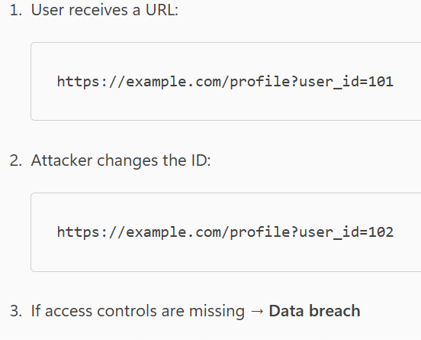
How IDOR Work?

Slide 4
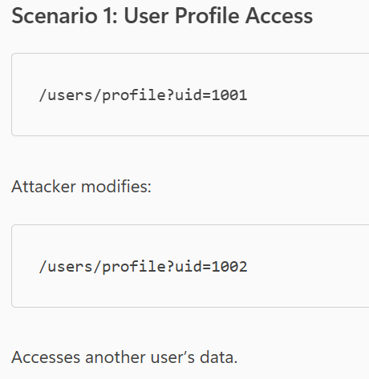
How IDOR Work?

Slide 5
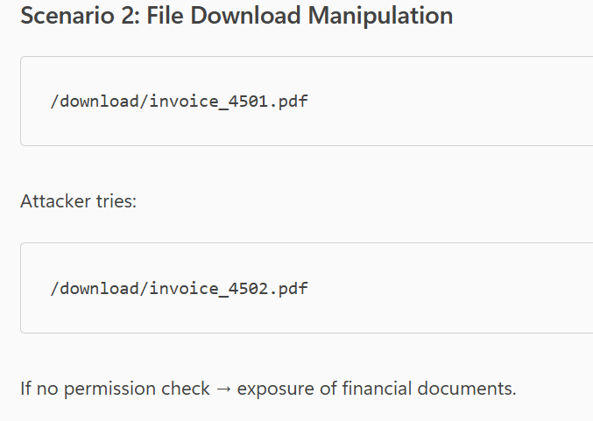
How IDOR Work?

Slide 6
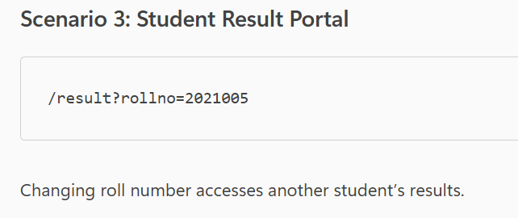
How IDOR Work?

Slide 7
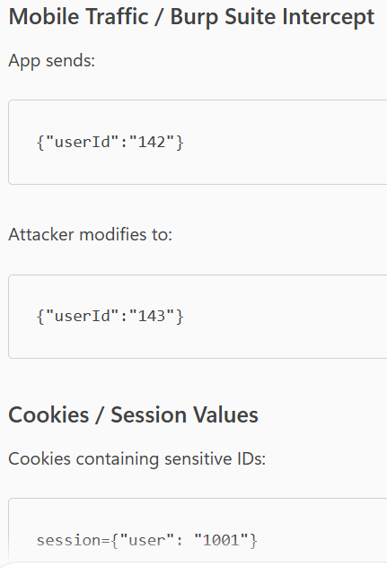
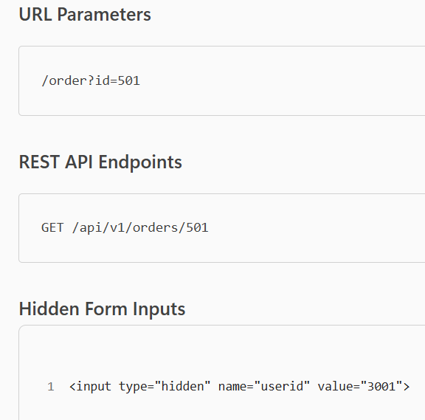
Attack Vectors
IDOR can occur in multiple locations:

Slide 8
Real‑World IDOR Attacks (Verified Incidents)
🟦 1. Instagram Private Photo Theft (Facebook Bug Bounty, 2019)
A researcher discovered that increasing a media ID number allowed access to private Instagram photos belonging to other users.
Impact:
Exposed private images
Facebook rewarded highest-level bounty
🟦 2. Uber Driver & Passenger Info Leak (2016)
An IDOR in the Uber API let attackers retrieve:
Trip history
Driver names
Driver phone numbers
Passenger data
Cause: predictable UUID-based ride IDs.
🟦 3. PayPal IDOR (2020)
Security researcher accessed other PayPal users' transaction information by manipulating the transaction ID in an API request.

Slide 9
Real‑World IDOR Attacks (Verified Incidents)
🟦 4. Government Portals (Multiple Countries)
Common IDOR cases included access to:
Student exam results
National ID documents
Medical lab reports
COVID test certificates
Often caused by simple URLs like:
/viewResult?rollno=2021001
🟦 5. Broadcom API IDOR (2022)
Allowed attackers to read support cases belonging to other companies by altering numeric case IDs.
🟦 6. TikTok IDOR Bug (2021)
Researchers accessed private TikTok user data (profile info, phone numbers) by modifying user IDs in API calls.
TikTok paid a reward and fixed the flaw.

Slide 10
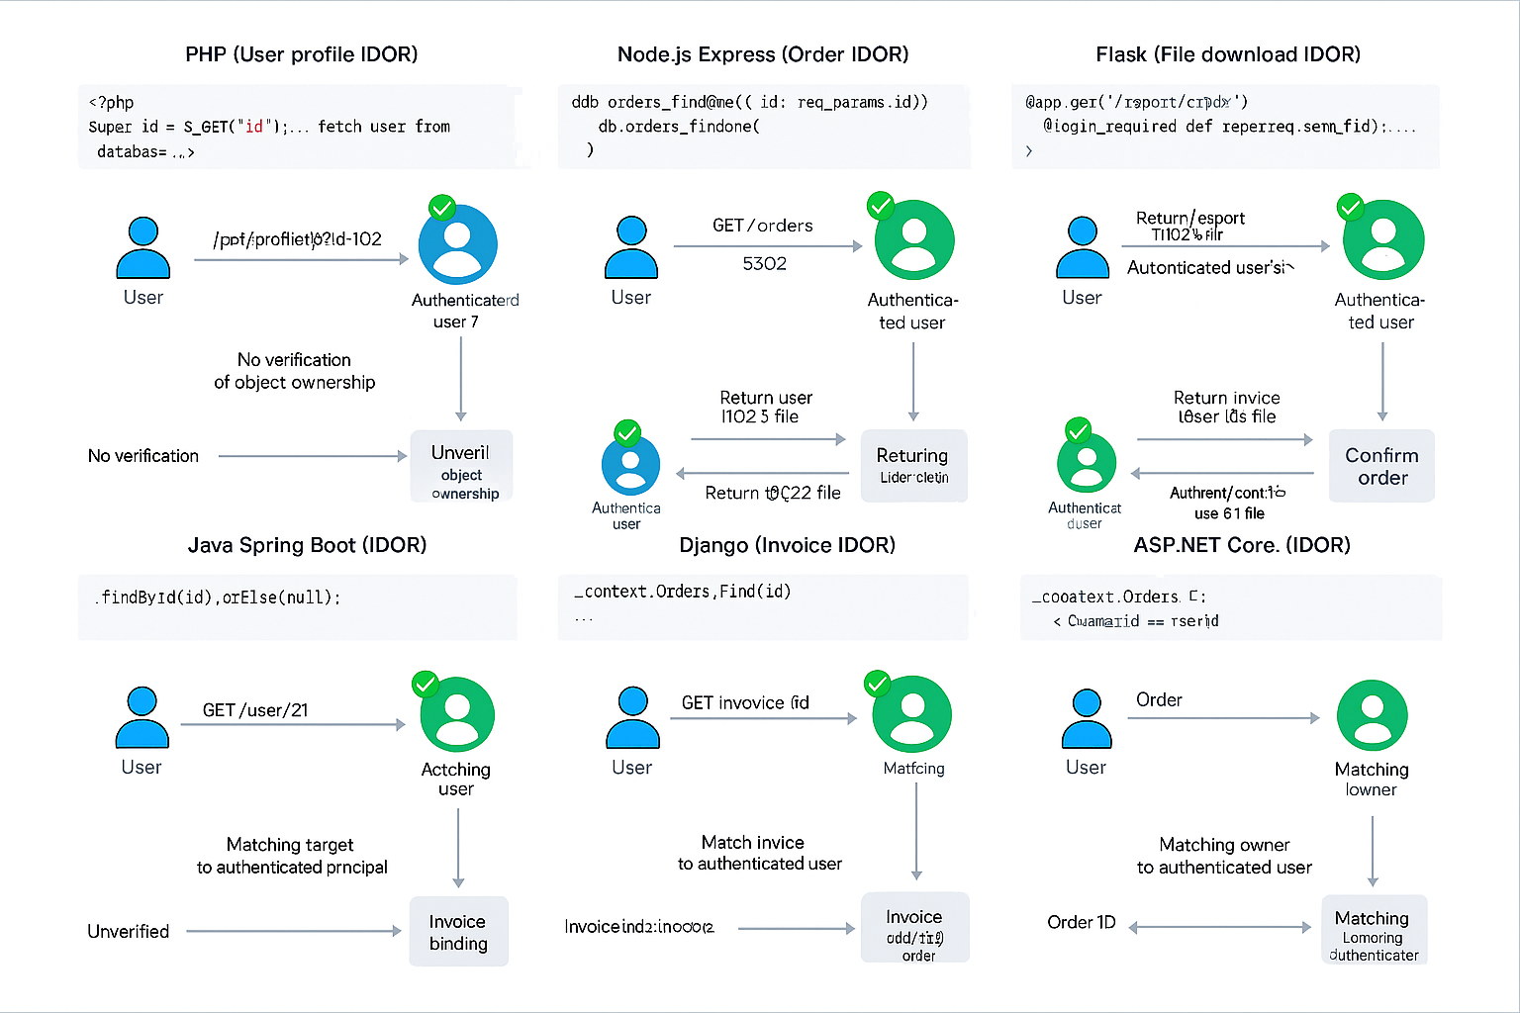

Slide 11
🧪 Code Deep Dive — Vulnerable → Secure
PHP – Profile Fetch
Vulnerable
<?php
// /profile.php?user_id=123
$user_id = $_GET['user_id'];
$row = mysqli_query($db, "SELECT id, email FROM users WHERE id = '$user_id'");
echo json_encode(mysqli_fetch_assoc($row))
Secure
<?php
session_start();
$myId = $_SESSION['uid']; // bind to authenticated session
$user = mysqli_query($db, "SELECT id, email FROM users WHERE id = '$myId'");
echo json_encode(mysqli_fetch_assoc($user))
Explanation Problem: The app trusts the user_id from the URL, allowing an attacker to change it. Fix: The server derives the user ID from the authenticated session and ignores user‑supplied IDs. That enforces ownership.

Slide 12
🧪 Code Deep Dive — Vulnerable → Secure
2) Node.js (Express) – Order Details
Vulnerable
app.get('/orders/:id', async (req, res) => {
const order = await db.orders.findOne({ id: req.params.id });
res.json(order); // could be someone else’s order
});
Secure
app.get('/orders/:id', authMiddleware, async (req, res) => {
const order = await db.orders.findOne({
id: req.params.id,
owner: req.user.id // bind object to current user
});
if (!order) return res.status(403).json({ error: 'Unauthorized' });
res.json(order);
});
Explanation Problem: No ownership check—anyone can request any id. Fix: Add an ownership predicate (owner: req.user.id) and return 403 if not found for that user

Slide 13
🧪 Code Deep Dive — Vulnerable → Secure
3) Python (Flask) – File Download
Vulnerable
@app.get("/download/<fid>")
def download(fid):
# Directly returns any file by ID!
return send_file(f"/srv/reports/{fid}.pdf"
Explanation Problem: Anyone who knows fid can download the file. Fix: Verify ownership (owner_id == current_user.id) before serving.
Secure
from flask_login import login_required, current_user
@app.get("/download/<fid>")
@login_required
def download(fid):
f = File.query.filter_by(id=fid, owner_id=current_user.id).first()
if not f:
abort(403)
return send_file(f.path

Slide 14
🧪 Code Deep Dive — Vulnerable → Secure
4) Java (Spring Boot) – User Endpoint
Vulnerable
Explanation Problem: Returns any user by id. Fix: Compare the target user to the authenticated principal. Only return if it’s the same user.
@GetMapping("/user/{id}")
public User getUser(@PathVariable int id) {
return userRepo.findById(id).orElse(null); // leaks arbitrary users
}
Secure
@GetMapping("/user/{id}")
public ResponseEntity<?> getUser(@PathVariable int id, Principal principal) {
User u = userRepo.findById(id).orElse(null);
if (u == null || !u.getEmail().equals(principal.getName())) {
return ResponseEntity.status(HttpStatus.FORBIDDEN).build();
}
return ResponseEntity.ok(u);
}

Slide 15
🧪 Code Deep Dive — Vulnerable → Secure
5) Django – Invoice API
Vulnerable
def invoice_detail(request, invoice_id):
invoice = Invoice.objects.get(pk=invoice_id)
return JsonResponse({'total': invoice.total, 'email': invoice.user.email})
Secure
Explanation Problem: No ownership filter. Fix: Restrict query to the logged-in user (user=request.user).
from django.contrib.auth.decorators import login_required
from django.http import HttpResponseForbidden
@login_required
def invoice_detail(request, invoice_id):
try:
invoice = Invoice.objects.get(pk=invoice_id, user=request.user)
except Invoice.DoesNotExist:
return HttpResponseForbidden("Unauthorized")
return JsonResponse({'total': invoice.total, 'email': invoice.user.email})

Slide 16
🧪 Code Deep Dive — Vulnerable → Secure
6) Ruby on Rails – Attachment Download
Vulnerable
def show
@doc = Document.find(params[:id]) # any ID
send_file @doc.path
end
Explanation Problem: Exposes any document by ID. Fix: Scope lookup through the current user
Secure
before_action :authenticate_user!
def show
@doc = current_user.documents.find_by(id: params[:id])
return head :forbidden unless @doc
send_file @doc.path
end

Slide 17
🧪 Code Deep Dive — Vulnerable → Secure
7) ASP.NET Core – Order API
Vulnerable
[HttpGet("orders/{id}")]
public async Task<IActionResult> GetOrder(int id)
{
var order = await _ctx.Orders.FindAsync(id);
return Ok(order);
}
Explanation Problem: No owner check. Fix: Enforce OwnerId == current user condition before returning data.
Secure
[Authorize]
[HttpGet("orders/{id}")]
public async Task<IActionResult> GetOrder(int id)
{
var userId = User.FindFirst("sub")?.Value;
var order = await _ctx.Orders
.FirstOrDefaultAsync(o => o.Id == id && o.OwnerId == userId);
if (order == null) return Forbid();
return Ok(order);
}

Slide 18
🧪 Code Deep Dive — Vulnerable → Secure
8) Go (Gin) – Ticket Endpoint
Vulnerable
Explanation Problem: Any ticket returned by ID. Fix: Filter by owner_id.
r.GET("/tickets/:id", func(c *gin.Context) {
id := c.Param("id")
var t Ticket
db.Where("id = ?", id).First(&t)
c.JSON(200, t) // leaks others' tickets
})
Secure
r.GET("/tickets/:id", Auth(), func(c *gin.Context) {
id := c.Param("id")
uid := c.GetString("userID")
var t Ticket
if err := db.Where("id = ? AND owner_id = ?", id, uid).First(&t).Error; err != nil {
c.Status(403); return
}

Slide 19
🧪 Code Deep Dive — Vulnerable → Secure
9) GraphQL – User Query
Vulnerable
Explanation Problem: Client supplies arbitrary id. Fix: Ensure the requested user equals the authenticated user.
# query
query {
user(id: "42") { email, orders { id total } }
// resolver
const resolvers = {
Query: {
user: (_, { id }, { db }) => db.User.findByPk(id) // no ownership check
}
};
Secure
const resolvers = {
Query: {
user: async (_, { id }, { db, user }) => {
if (!user) throw new AuthError();
if (String(user.id) !== String(id)) throw new ForbiddenError();
return db.User.findByPk(id);
} }};

Slide 20
🧪 Code Deep Dive — Vulnerable → Secure
10) REST – POST Body Tampering
Vulnerable
Explanation Problem: Client controls userId in the body → privilege escalation. Fix: Always derive the target identity from server-side auth context.
POST /api/v1/profile/update
Content-Type: application/json
{"userId":"105","email":"victim@example.com"}
// server
app.post('/profile/update', async (req, res) => {
await db.users.update({ email: req.body.email }, { where: { id: req.body.userId } });
res.sendStatus(200);
});
Secure
app.post('/profile/update', auth, async (req, res) => {
await db.users.update(
{ email: req.body.email },
{ where: { id: req.user.id } } // ignore userId from client
);
res.sendStatus(200);
});

Slide 21
🧪 Code Deep Dive — Vulnerable → Secure
11) File Names / Keys – Static Paths
Vulnerable
@app.get("/report/<name>")
def report(name):
# e.g., /report/statement_1002.pdf
return send_file(f"/srv/reports/{name}"
Explanation Problem: Predictable filename exposes others’ reports. Fix: Bind filename to owner in DB, verify before serving.
Secure
@app.get("/report/<name>")
@login_required
def report(name):
rpt = Report.query.filter_by(filename=name, owner_id=current_user.id).first()
if not rpt: abort(403)
return send_file(rpt.path

Slide 22
🧪 Code Deep Dive — Vulnerable → Secure
12) Mobile API – Hidden/Obfuscated Fields
Vulnerable (Server)
app.post('/wallet/balance', (req, res) => {
const userId = req.body.userId; // sent by mobile app (even if obfuscated)
db.wallet.findOne({ where: { userId } }).then(r => res.json(r));
});
Explanation Problem: Client-controlled userId even if the app hides it—attackers can still tamper via a proxy. Fix: Ignore user-supplied IDs; use authenticated req.user.id.
Secure
app.post('/wallet/balance', auth, (req, res) => {
db.wallet.findOne({ where: { userId: req.user.id } })
.then(r => r ? res.json(r) : res.sendStatus(403));
});

Slide 23
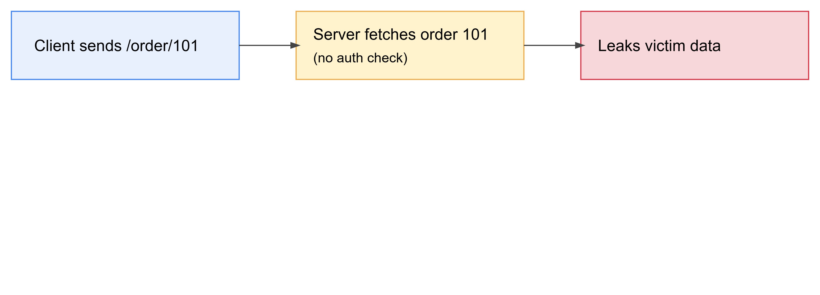
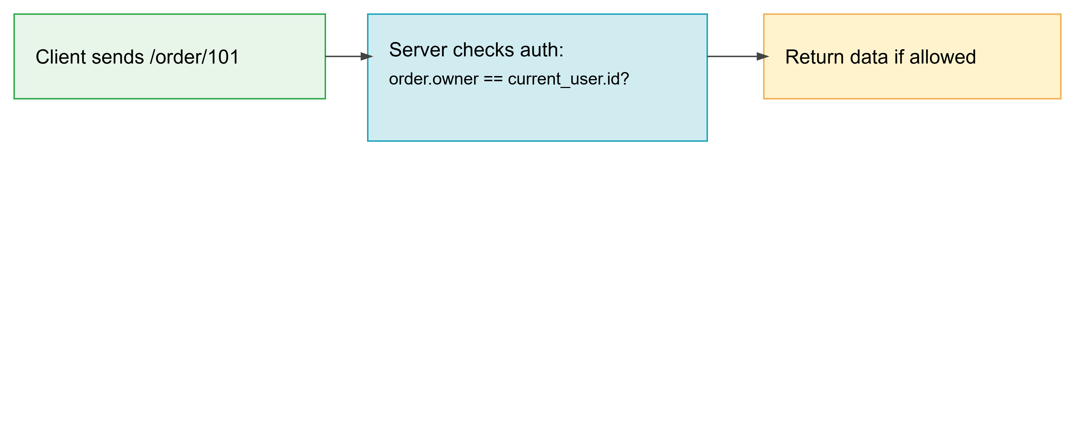
🧪 Code Deep Dive — Vulnerable → Secure
Vulnerable Flow
Secure Flow

Slide 24
🧪 Code Deep Dive — Vulnerable → Secure
Secure

