Slide 1
Introduction to Classes and Objects
Object Oriented Programming and Designing
(Slides include materials from The C Programming Language, 2nd edition, by Kernighan and Ritchie and from C: How to Program, 5th and 6th editions, by Deitel and Deitel)
Introduction to Classes and Objects

Slide 2
Reading
Deitel & Deitel, Chapter 19

Slide 3
Classes and Objects
Class Definitions and Objects
Member Functions
Data Members
  Get and Set functions
  Constructors
Placing Classes in Separate Files
Separating Interface from Implementation
Data Validation
  Ensures that data in an object is in a particular format or range.

Slide 4

C++ Program Structure
Typical C++ Programs consist of:–
  A function main
  One or more classes
    Each containing data members and member functions.

Slide 5
Introduction
Object-oriented programming (OOP)
  Encapsulates data (attributes) and functions (behavior) into packages called classes
Information hiding
  Implementation details are hidden within the classes themselves
Classes
  Classes are the standard unit of programming
  A class is like a blueprint – reusable
  Objects are instantiated (created) from the class
  For example, a house is an instance of a “blueprint class”

Slide 6
Implementing a Time Abstract Data Type with a Class
Classes
  Model objects that have attributes (data members) and behaviors (member functions)
  Defined using keyword class
  Have a body delineated with braces ({ and })
  Class definitions terminate with a semicolon
  Example:
Public: and Private: are member-access specifiers.
1 class Time {
2 public:
3 Time();
setTime, printMilitary, and printStandard are member functions.
Time is the constructor.
4 void setTime( int, int, int );
5 void printMilitary();
6 void printStandard();
7 private:
8 int hour; // 0 - 23
9 int minute; // 0 - 59
hour, minute, and second are data members.
10 int second; // 0 - 59
11 };

Slide 7
19.4 Defining a Class
With a Member Function
Class definition
  Tells the compiler what member functions and data members belong to the class.
  Keyword class followed by the class’s name.
  Class body is enclosed in braces ({})
    Specifies data members and member functions
    Access-specifier public:
      Indicates that a member function or data member is accessible to other functions and member functions of other classes.

Slide 8
Implementing a Time Abstract Data Type with a Class
Member access specifiers
  Classes can limit the access to their member functions and data
  The three types of access a class can grant are:
    Public — Accessible wherever the program has access to an object of the class
    private — Accessible only to member functions of the class
    Protected — Similar to private and discussed later
Data Members:
  Variables that store the state or attributes of an object.
Member Functions:
  Functions that define the behavior of the class.
Constructor
  Special member function that initializes the data members of a class object
  Cannot return values
  Have the same name as the class

Slide 9
General Structure of a Class
class ClassName {
private:
// Private members (data and functions)
// These are accessible only within the class
protected:
// Protected members (data and functions)
// These are accessible within the class and derived classes
public:
// Public members (data and functions)
// These are accessible from outside the class
// Constructor (special member function)
ClassName() {
// Initialization code }
// Destructor (special member function)
~ClassName() {
// Cleanup code }
// Member functions (methods)
void memberFunction() {
// Function implementation }
};
// Constructor (special member function)
ClassName() {
// Initialization code }
// Destructor (special member function)
~ClassName() {
// Cleanup code }
// Member functions (methods)
void memberFunction() {
// Function implementation }
CS-2303, C-Term 2010
Introduction to Classes and Objects

Slide 10
General Structure of a Class
#include <iostream>
#include <string>
using namespace std;
class Car {
private:
string brand;
string model;
int year;
public:
// Constructor
Car(string b, string m, int y) {
brand = b;
model = m;
year = y; }
// Member function to display car details
void displayDetails() {
cout << "Brand: " << brand << endl;
cout << "Model: " << model << endl;
cout << "Year: " << year << endl; }
// Setter for brand
void setBrand(string b) { brand = b; }
// Getter for brand
string getBrand() { return brand; } };
int main() {
// Create an object of the Car class
Car myCar("Toyota", "Corolla", 2020);
// Access public member functions
myCar.displayDetails();
// Modify private data using a setter
myCar.setBrand("Honda");
// Access private data using a getter
cout << "Updated Brand: " << myCar.getBrand() << endl;
return 0;
}
private:
string brand;
string model;
int year;
// Setter for brand
void setBrand(string b) { brand = b; }
// Getter for brand
string getBrand() { return brand; }
CS-2303, C-Term 2010
Introduction to Classes and Objects

Slide 11
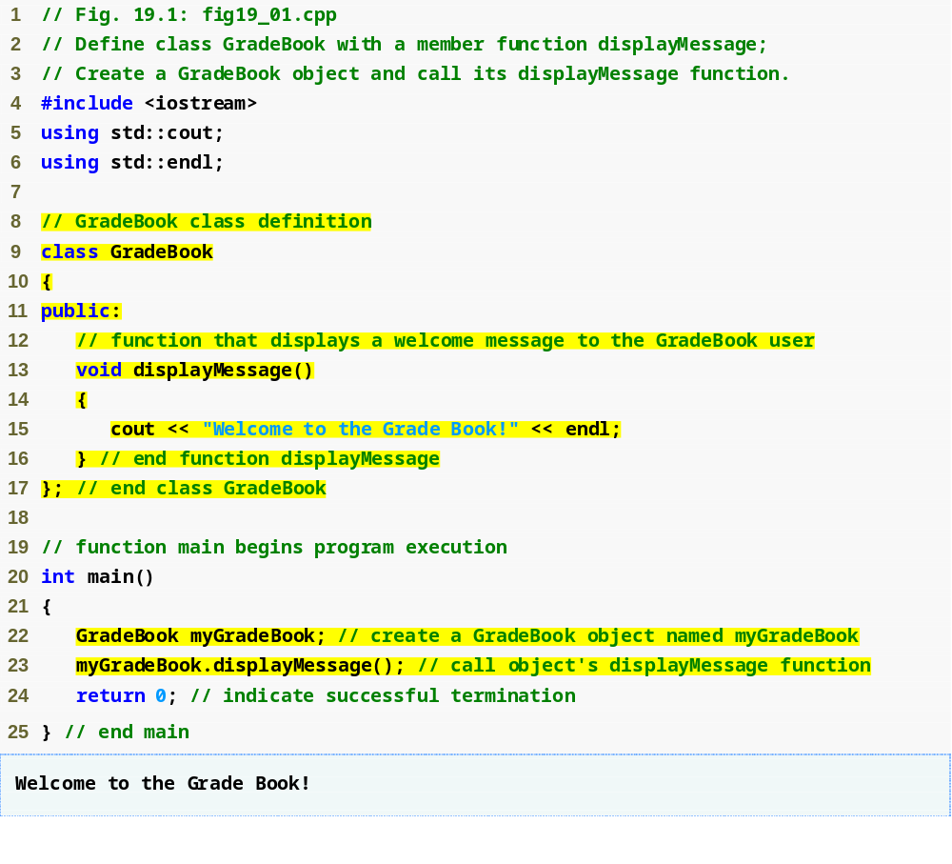
C++ Gradebook Example
Deitel & Deitel Fig 19.1
“using”:– add the name to the current scope

Slide 12
C++ Gradebook Example
Beginning of class definition for class GradeBook
Beginning of class body
Access specifier public; makes members available to the public
Member function displayMessage returns nothing
End of class body
Use dot operator to call GradeBook’s member function
Systems Programming: Classes and Objects

Slide 13
C++ Gradebook Example
Declaring an object of this class
as an automatic variable of main
I.e., allocated on The Stack

Slide 14
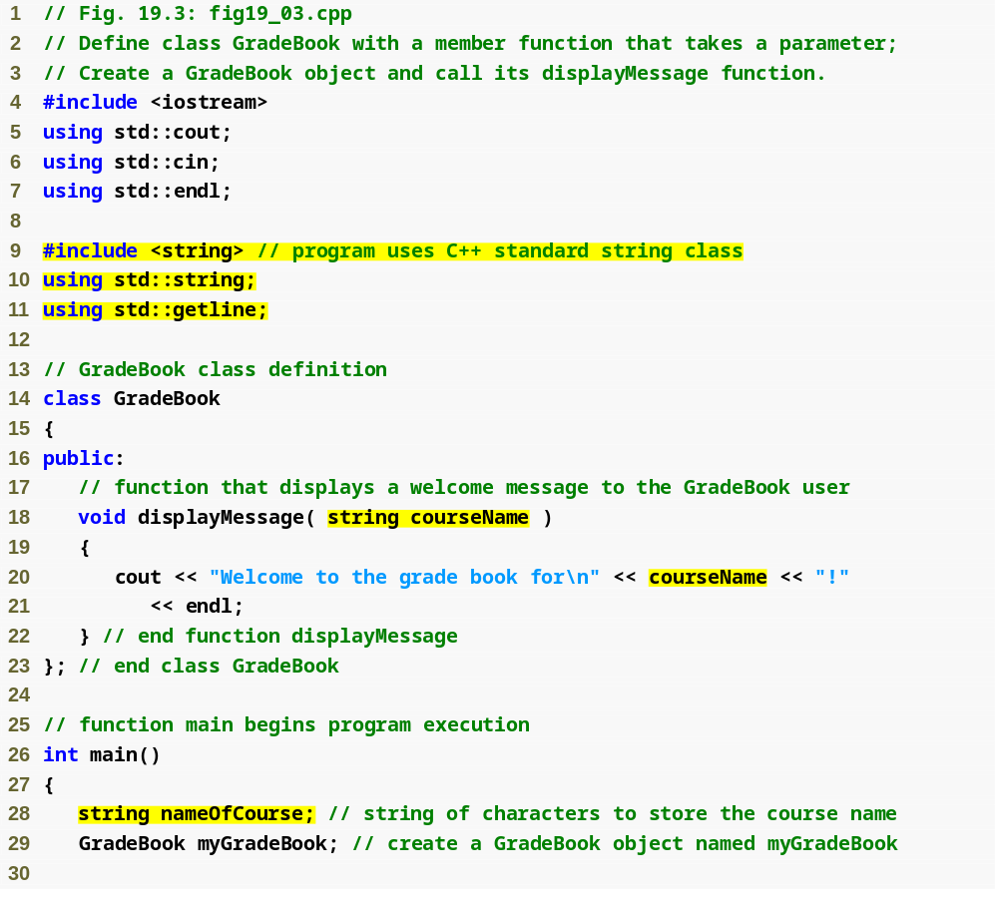
Member Functions with Parameters
Include string class definition
Member function parameter
Use the function parameter as a variable
Introduction to Classes and Objects

Slide 15
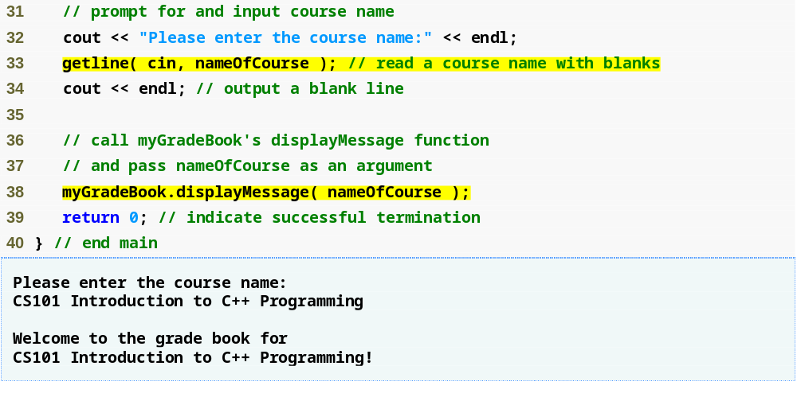
Member Functions with Parameters (cont.)
Passing an argument to the member function

Slide 16
Data Members of a Class
Declared in the body of the class
May be public or private
Exist throughout the life of the object.
Stored in class object.
Each object has its own copy.
    May be objects of any type

Slide 17
Access-specifier private
Makes any member accessible only to member functions of the class.
    May be applied to data members and member functions
Default access for class members
    Encourages “information hiding”

Slide 18
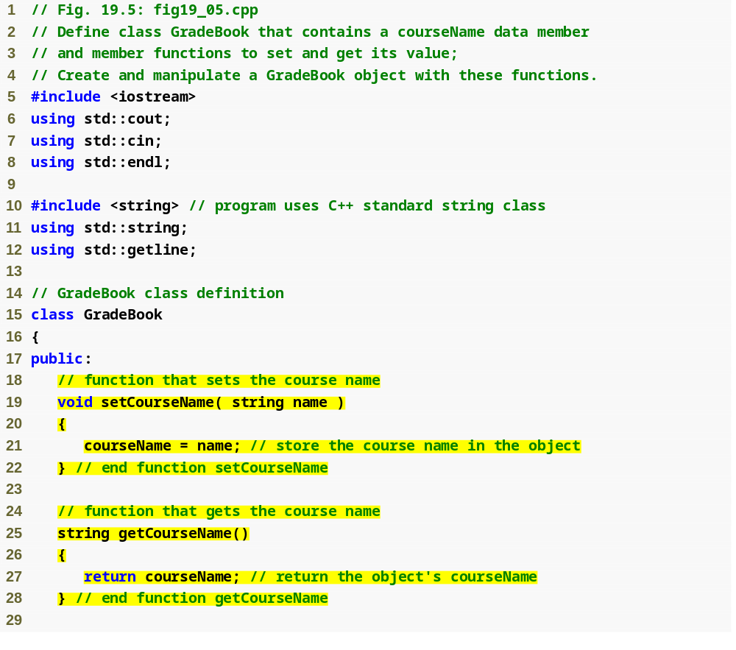
Public and Private Members
set function modifies private data
get function accesses private data

Slide 19
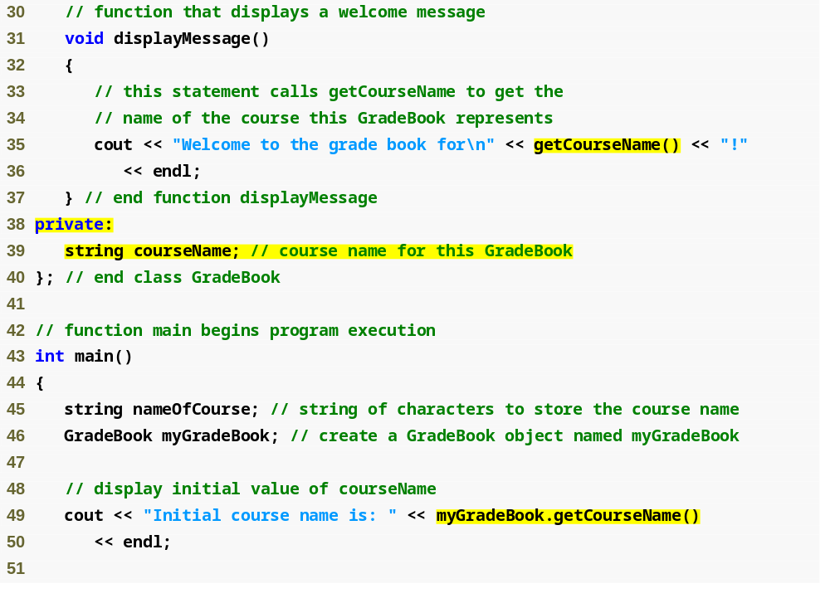
Public and Private Members (continued)
Use set and get functions, even within the class
private members accessible only to member functions of the class
default constructor
Accessing private data outside class definition

Slide 20
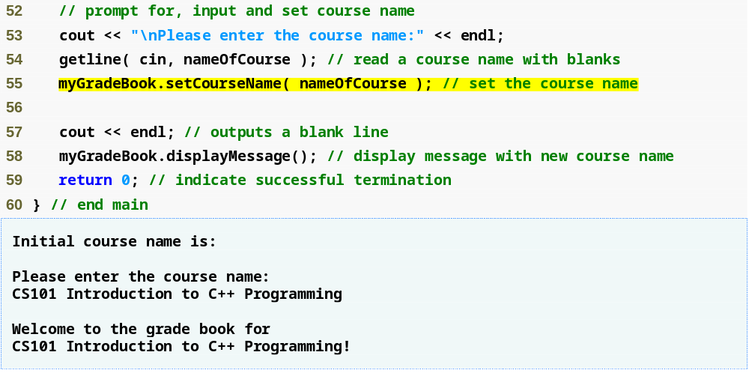
Public and Private Members (continued)
Modifying private data outside class definition
default setting from constructor
is an empty string!!

Slide 21
Software Engineering Observation 19.1
As a rule of thumb, data members should be declared private
Member functions should be declared public.
  Except member functions that are accessed only by other member functions of the class.
Often useful to have get and set functions
  To access private members in controlled ways

Slide 22
Constructors and Destructors
Constructor:– a function used to initialize the data of an object of a class
  Same name as class itself
  Cannot return anything, not even void
  A class may define more than one constructor
    With different parameter lists
    Default constructor has no parameters
Called automatically
  When class object is declared as automatic variable
  By new operator/object created
Compiler provides one
if you do not!
Compiler’s default simply calls constructors of data members of the class.

Slide 23
Constructors and Destructors (continued)
Destructor:– a function used to clean up an object of a class prior to deleting that object
  Class name preceeded by '~'
  No parameters, no result
Called automatically
  When function exits scope of automatic class object
  By delete operator
Compiler provides one
if you do not!
Compiler’s default simply calls destructors of data members of the class.

Slide 24
Constructors and Destructors (continued)
Constructors – Similar to Java
Destructors – No counterpart in Java
Purpose of Destructors
    Free dynamic storage pointed to only by members of object
    Reduce reference count when object disappears
    Safely close things – e.g., files
    …

Slide 25
Constructor and Destructor
class Example {
public:
//Constructor
Example() {
cout << "Constructor called!" << endl; }
//Destructor
~Example() {
cout << "Destructor called!" << endl; }
};
//Constructor
Example() {
cout << "Constructor called!" << endl; }
//Destructor
~Example() {
cout << "Destructor called!" << endl; }
int main() {
Example obj; // Constructor called
return 0; // Destructor called when obj goes out of scope
}

Slide 26
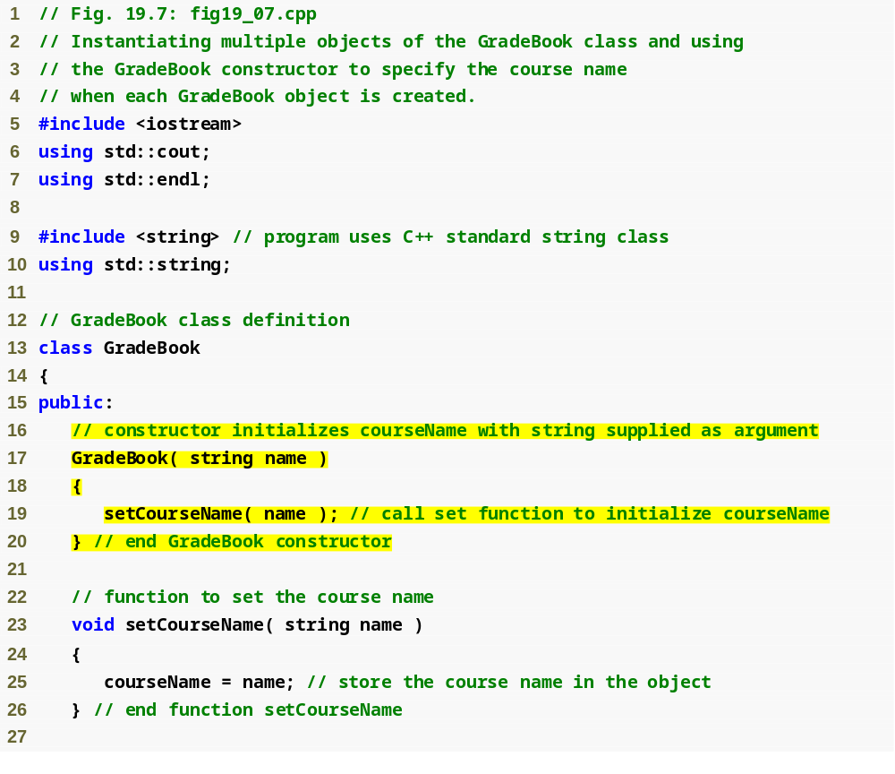
Constructor Example
Constructor has same name as class and no return type
Initialize data member
Introduction to Classes and Objects
CS-2303, C-Term 2010

Slide 27
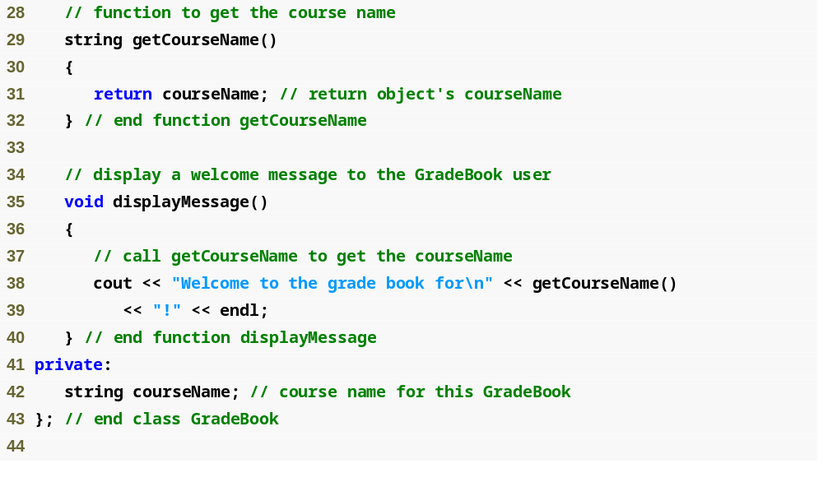
Constructor Example
Destructor need so this class object
can free dynamically allocated memory
Introduction to Classes and Objects

Slide 28
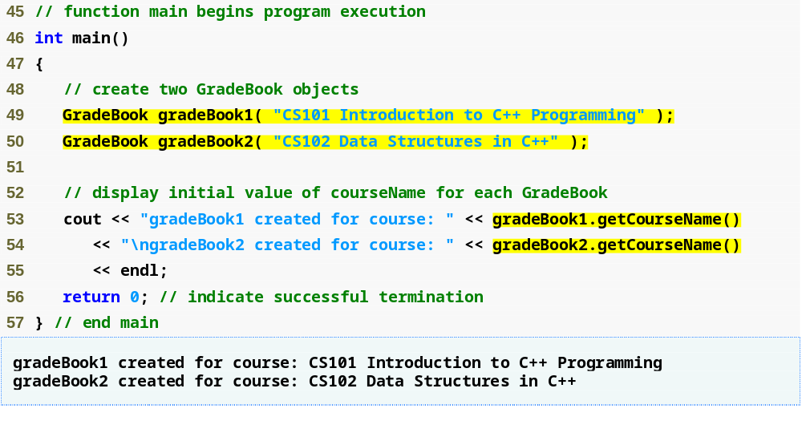
Constructor Example
Creating objects implicitly calls the constructor

Slide 29
Public, Private and Protected Members
class ClassName {
private:
// Private members (accessible only within the class)
protected:
// Protected members (accessible within the class and derived classes)
public:
// Public members (accessible from anywhere)
};

Slide 30
Public, Private and Protected Members
#include <iostream>
using namespace std;
class Base {
private:
int privateVar;
protected:
int protectedVar;
public:
int publicVar;
// Constructor
Base() : privateVar(1), protectedVar(2), publicVar(3) {}
// Member function to access private member
void displayPrivate() {
cout << "PrivateVar: " << privateVar << endl; } };
class Derived : public Base {
public:
void displayProtected() {
cout << "ProtectedVar: " << protectedVar << endl; // Accessible in derived class } };
int main() {
Base obj;
// Accessing public member
cout << "PublicVar: " << obj.publicVar << endl;
// Accessing private member (not allowed)
// cout << "PrivateVar: " << obj.privateVar << endl; // Error
// Accessing protected member (not allowed)
// cout << "ProtectedVar: " << obj.protectedVar << endl; // Error
// Accessing private member via public member function
obj.displayPrivate();
// Accessing protected member in derived class
Derived derivedObj;
derivedObj.displayProtected();
return 0;
}

Slide 31
Public, Private and Protected Members
Key Points
public Members:
  Can be accessed directly using the object of the class.
  Example: obj.publicVar.
private Members:
  Cannot be accessed directly from outside the class.
  Can only be accessed within the class or via public member functions.
  Example: obj.displayPrivate() accesses privateVar.
protected Members:
  Cannot be accessed directly from outside the class.
  Can be accessed within the class and its derived classes.
  Example: derivedObj.displayProtected() accesses protectedVar.

Slide 32
Encapsulation with Private and Public
#include <iostream>
using namespace std;
class BankAccount {
private:
double balance;
public:
// Constructor
BankAccount(double initialBalance) : balance(initialBalance) {}
// Public member function to deposit money
void deposit(double amount) {
if (amount > 0) { balance += amount;
cout << "Deposited: " << amount << endl; }
else { cout << "Invalid deposit amount!" << endl; } }
// Public member function to withdraw money
void withdraw(double amount) { if (amount > 0 && amount <= balance) { balance -= amount;
cout << "Withdrawn: " << amount << endl; }
else { cout << "Invalid withdrawal amount!" << endl; } }
// Public member function to check balance
double getBalance() {
return balance; } };
int main() {
BankAccount account(1000);
account.deposit(500);
account.withdraw(200);
cout << "Current Balance: " << account.getBalance() << endl;
// Cannot access private member directly
// cout << account.balance << endl; // Error
return 0;
}

Slide 33
Summary
Introduced class definitions and objects
  Public versus private access into class.
Syntax for member functions
Syntax data members
  Get and Set functions
  Constructors & Destructors
Placing classes in separate files

Slide 34
Questions?
Reading:–
Deitel & Deitel, Chapter 19
Introduction to Classes and Objects
CS-2303, C-Term 2010

