Slide 1
Recursion
CS 308 – Data Structures

Slide 2
What is recursion?
Sometimes, the best way to solve a problem is by solving a smaller version of the exact same problem first
Recursion is a technique that solves a problem by solving a smaller problem of the same type

Slide 3
When you turn this into a program, you end up with functions that call themselves (recursive functions)
int f(int x)
{
int y;
if(x==0)
return 1;
else {
y = 2 * f(x-1);
return y+1;
}
}

Slide 4
Problems defined recursively
There are many problems whose solution can be defined recursively
Example: n factorial
1 if n = 0
n!= (recursive solution)
(n-1)!*n if n > 0
1 if n = 0
n!= (closed form solution)
1*2*3*…*(n-1)*n if n > 0

Slide 5
Coding the factorial function
Recursive implementation
  int Factorial(int n)
  {
  if (n==0) // base case
  return 1;
  else
  return n * Factorial(n-1);
  }

Slide 6
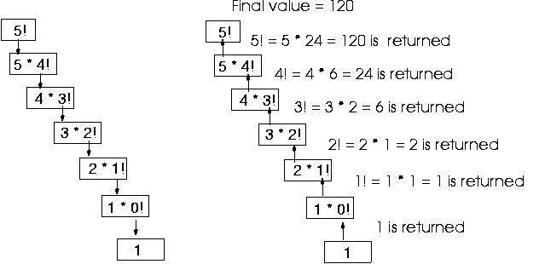

Slide 7
Coding the factorial function (cont.)
Iterative implementation
  int Factorial(int n)
  {
  int fact = 1;
  for(int count = 2; count <= n; count++)
  fact = fact * count;
  return fact;
  }

Slide 8
Another example: n choose k (combinations)
Given n things, how many different sets of size k can be chosen?
n n-1 n-1
= + , 1 < k < n (recursive solution)
k k k-1
n n!
= , 1 < k < n (closed-form solution)
k k!(n-k)!
with base cases:
n n
= n (k = 1), = 1 (k = n)
1 n

Slide 9
n choose k (combinations)
int Combinations(int n, int k)
{
if(k == 1) // base case 1
return n;
else if (n == k) // base case 2
return 1;
else
return(Combinations(n-1, k) + Combinations(n-1, k-1));
}

Slide 10
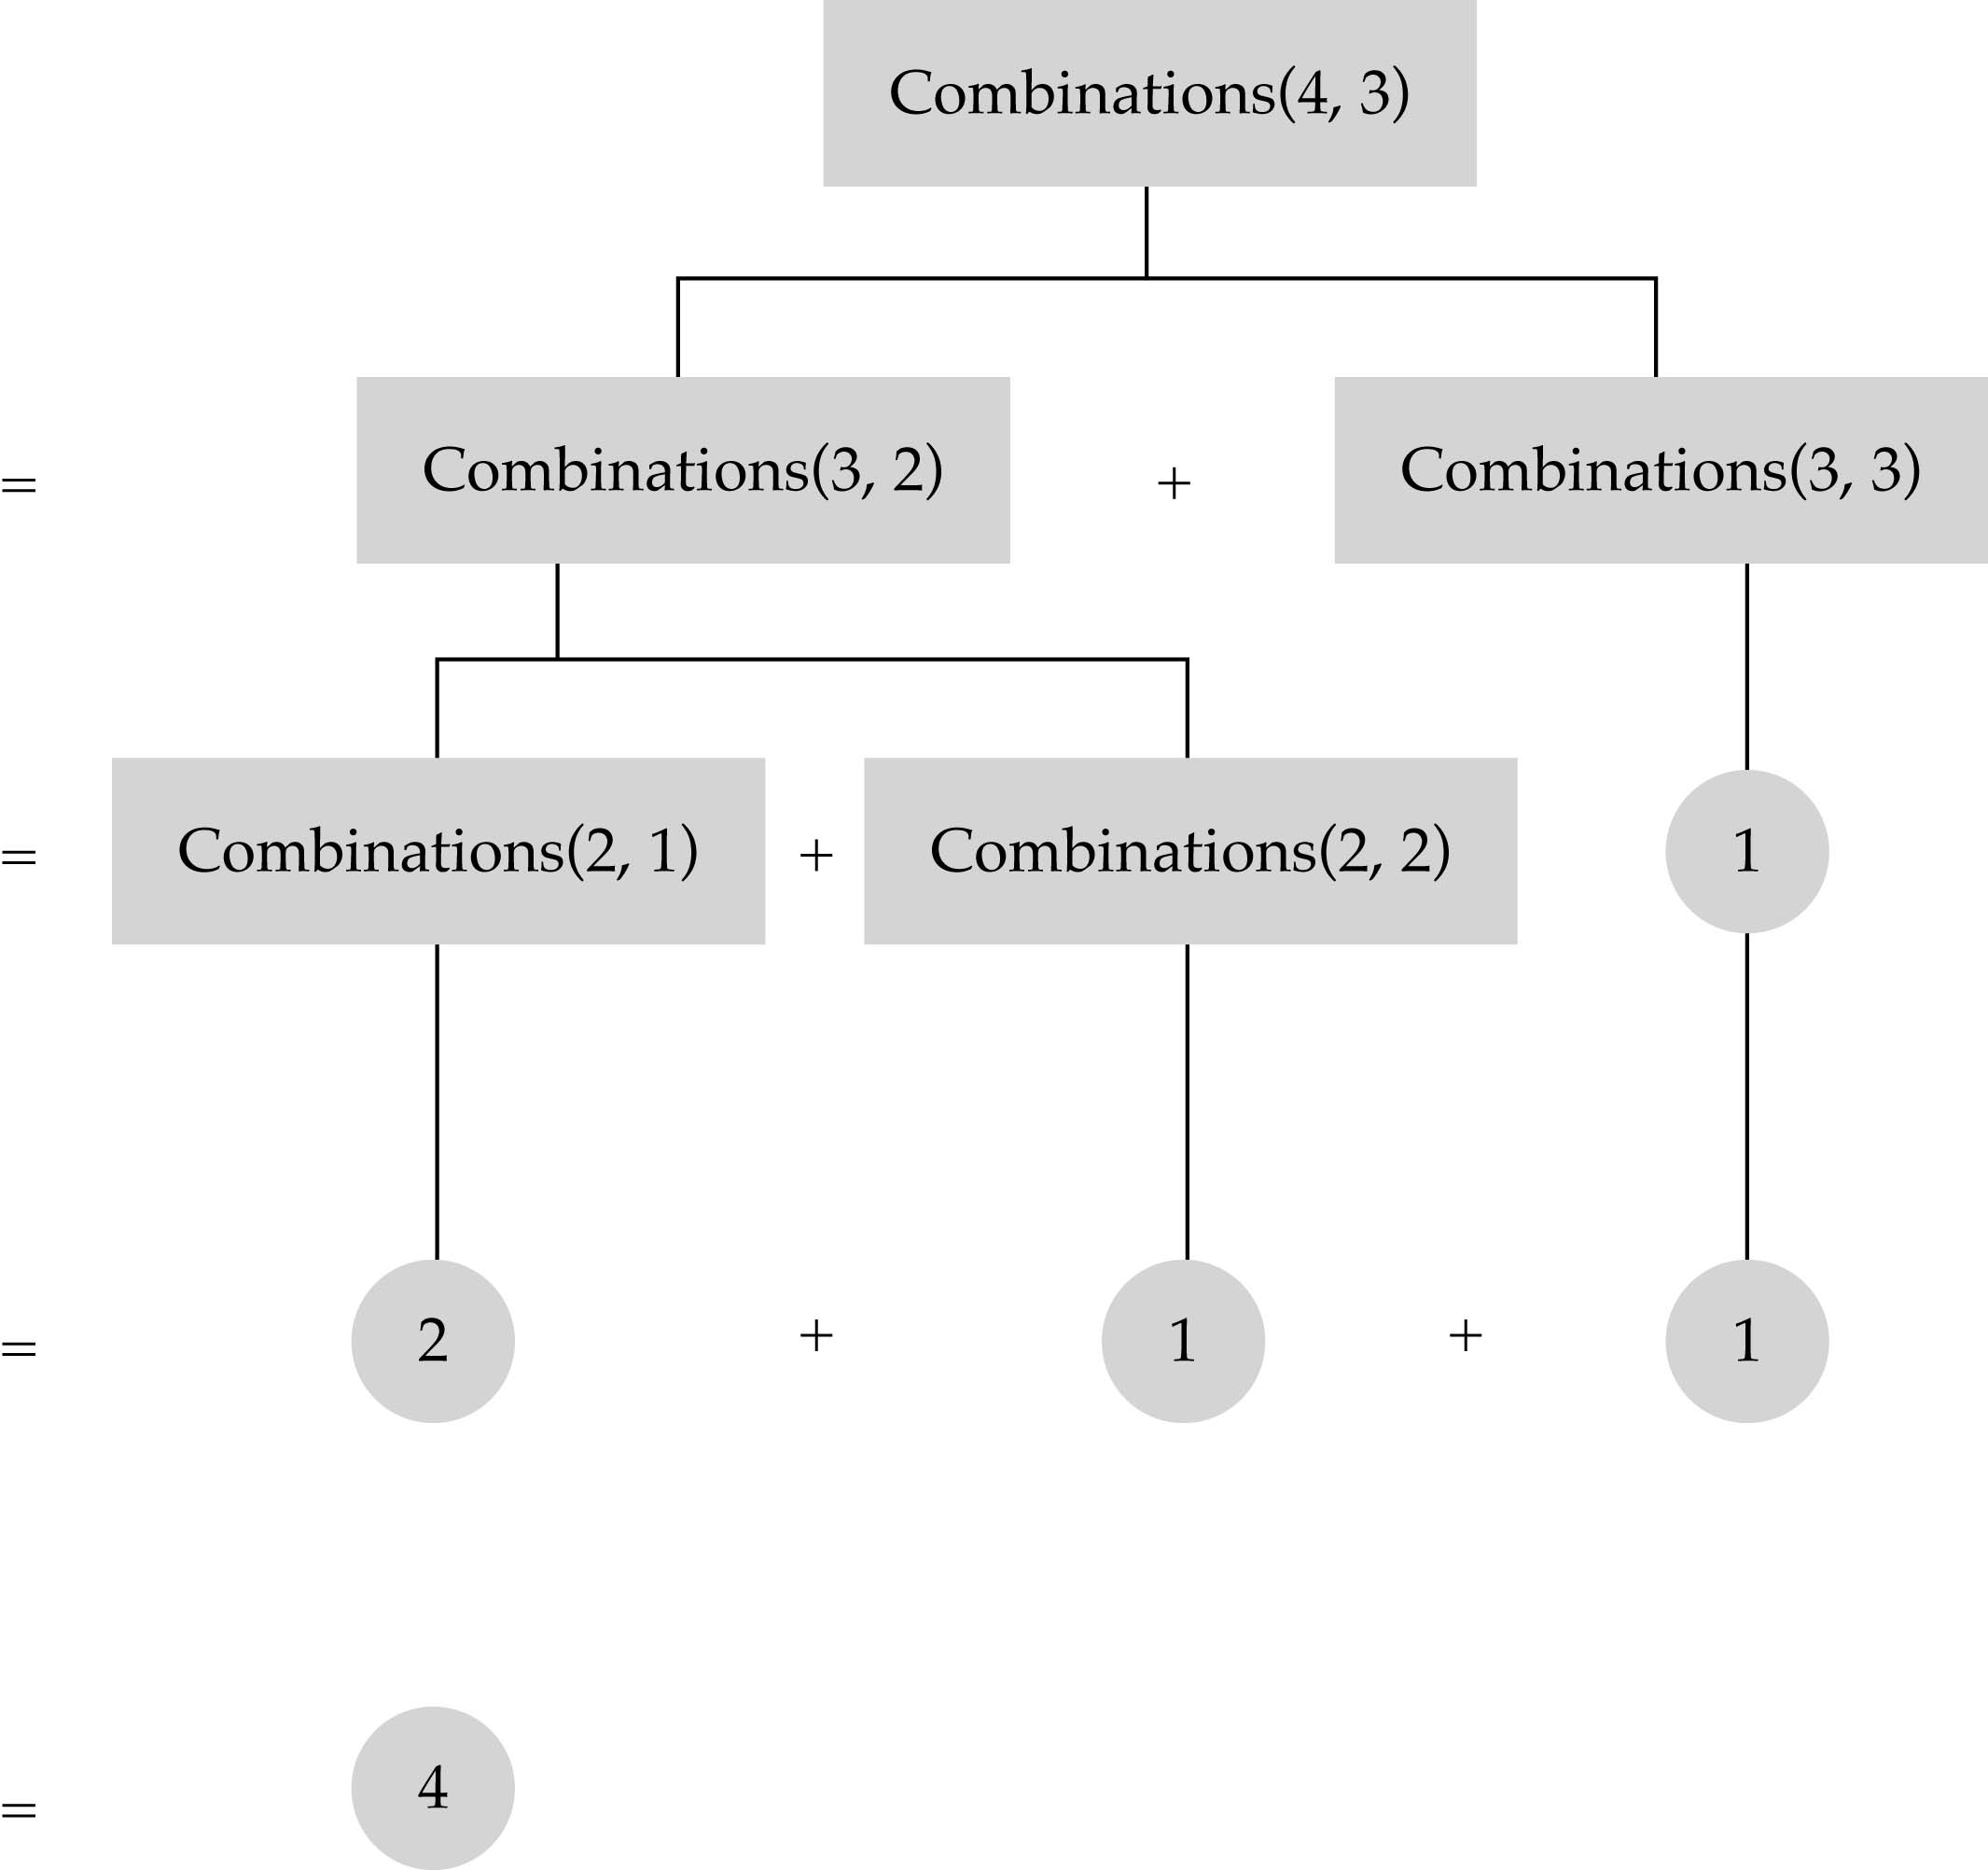

Slide 11
Recursion vs. iteration
Iteration can be used in place of recursion
  An iterative algorithm uses a looping construct
  A recursive algorithm uses a branching structure
Recursive solutions are often less efficient, in terms of both time and space, than iterative solutions
Recursion can simplify the solution of a problem, often resulting in shorter, more easily understood source code

Slide 12
How do I write a recursive function?
Determine the size factor
Determine the base case(s)
  (the one for which you know the answer)
Determine the general case(s)
  (the one where the problem is expressed as a smaller version of itself)
Verify the algorithm
  (use the "Three-Question-Method")

Slide 13
Three-Question Verification Method
The Base-Case Question:
Is there a nonrecursive way out of the function, and does the routine work correctly for this "base" case?
The Smaller-Caller Question:
Does each recursive call to the function involve a smaller case of the original problem, leading inescapably to the base case?
The General-Case Question:
Assuming that the recursive call(s) work correctly, does the whole function work correctly?

Slide 14
Recursive binary search
Non-recursive implementation
template<class ItemType>
void SortedType<ItemType>::RetrieveItem(ItemType& item, bool& found)
{
int midPoint;
int first = 0;
int last = length - 1;
found = false;
while( (first <= last) && !found) {
midPoint = (first + last) / 2;
if (item < info[midPoint])
last = midPoint - 1;
else if(item > info[midPoint])
first = midPoint + 1;
else {
found = true;
item = info[midPoint];
}
}
}

Slide 15
Recursive binary search (cont’d)
What is the size factor?
  The number of elements in (info[first] ... info[last])
What is the base case(s)?
  (1) If first > last, return false
  (2) If item==info[midPoint], return true
What is the general case?
  if item < info[midPoint] search the first half
  if item > info[midPoint], search the second half

Slide 16
Recursive binary search (cont’d)
template<class ItemType>
bool BinarySearch(ItemType info[], ItemType& item, int first, int last)
{
int midPoint;
if(first > last) // base case 1
return false;
else {
midPoint = (first + last)/2;
if(item < info[midPoint])
return BinarySearch(info, item, first, midPoint-1);
else if (item == info[midPoint]) { // base case 2
item = info[midPoint];
return true;
}
else
return BinarySearch(info, item, midPoint+1, last);
}
}

Slide 17
Recursive binary search (cont’d)
template<class ItemType>
  void SortedType<ItemType>::RetrieveItem (ItemType& item, bool& found)
  {
  found = BinarySearch(info, item, 0, length-1);
  }

Slide 18
How is recursion implemented?
What happens when a function gets called?
  int a(int w)
  {
  return w+w;
  }
  int b(int x)
  {
  int z,y;
  ……………… // other statements
  z = a(x) + y;
  return z;
  }

Slide 19
What happens when a function is called? (cont.)
An activation record is stored into a stack (run-time stack)
  The computer has to stop executing function b and starts executing function a
  Since it needs to come back to function b later, it needs to store everything about function b that is going to need (x, y, z, and the place to start executing upon return)
  Then, x from a is bounded to w from b
  Control is transferred to function a

Slide 20
What happens when a function is called? (cont.)
After function a is executed, the activation record is popped out of the run-time stack
All the old values of the parameters and variables in function b are restored and the return value of function a replaces a(x) in the assignment statement

Slide 21
What happens when a recursive function is called?
Except the fact that the calling and called functions have the same name, there is really no difference between recursive and nonrecursive calls
      int f(int x)
      {
      int y;
      if(x==0)
      return 1;
      else {
      y = 2 * f(x-1);
      return y+1;
      }
      }

Slide 22
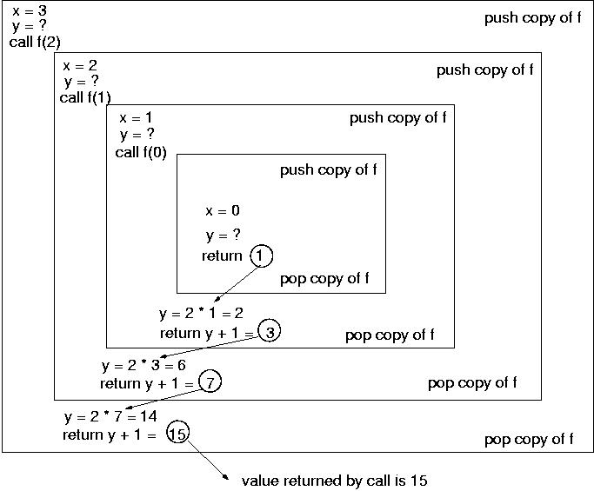
2*f(2)
2*f(1)
2*f(1)
=f(0)
=f(1)
=f(2)
=f(3)

Slide 23
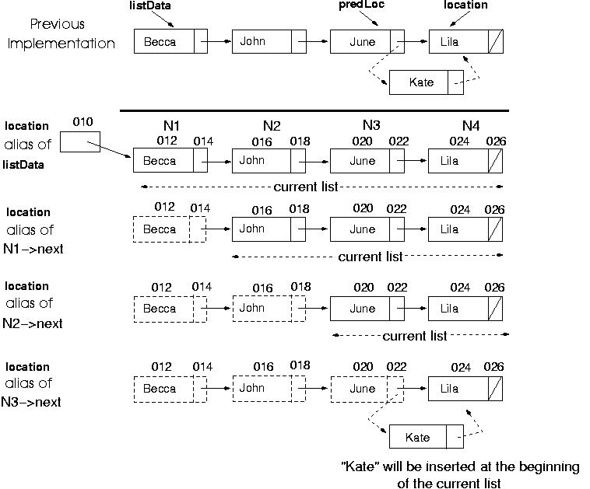
Recursive InsertItem (sorted list)
location
location
location
location

Slide 24
Recursive InsertItem (sorted list)
What is the size factor?
  The number of elements in the current list
  What is the base case(s)?
  If the list is empty, insert item into the empty list
  If item < location->info, insert item as the first node in the current list
What is the general case?
  Insert(location->next, item)

Slide 25
Recursive InsertItem (sorted list)
template <class ItemType>
void Insert(NodeType<ItemType>* &location, ItemType item)
{
if(location == NULL) || (item < location->info)) { // base cases
NodeType<ItemType>* tempPtr = location;
location = new NodeType<ItemType>;
location->info = item;
location->next = tempPtr;
}
else
Insert(location->next, newItem); // general case
}
template <class ItemType>
void SortedType<ItemType>::InsertItem(ItemType newItem)
{
Insert(listData, newItem);
}

Slide 26
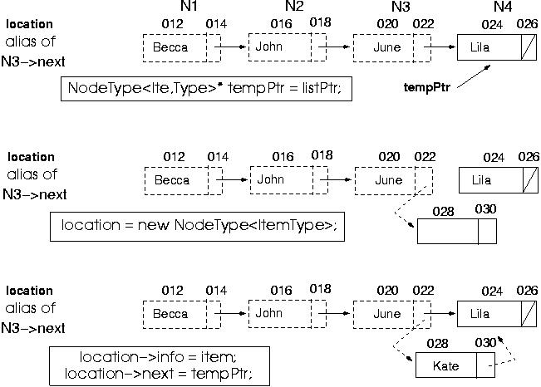
- No "predLoc" pointer is needed for insertion
location

Slide 27
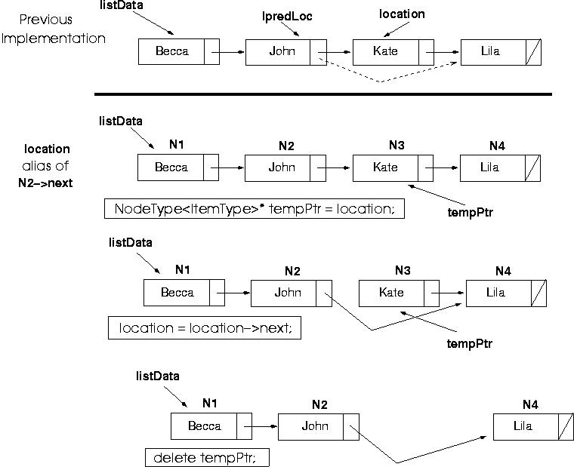
Recursive DeleteItem (sorted list)
location
location

Slide 28
Recursive DeleteItem (sorted list)
(cont.)
What is the size factor?
  The number of elements in the list
What is the base case(s)?
  If item == location->info, delete node pointed by location
What is the general case?
  Delete(location->next, item)

Slide 29
Recursive DeleteItem (sorted list)
(cont.)
template <class ItemType>
void Delete(NodeType<ItemType>* &location, ItemType item)
{
if(item == location->info)) {
NodeType<ItemType>* tempPtr = location;
location = location->next;
delete tempPtr;
}
else
Delete(location->next, item);
}
template <class ItemType>
void SortedType<ItemType>::DeleteItem(ItemType item)
{
Delete(listData, item);
}

Slide 30
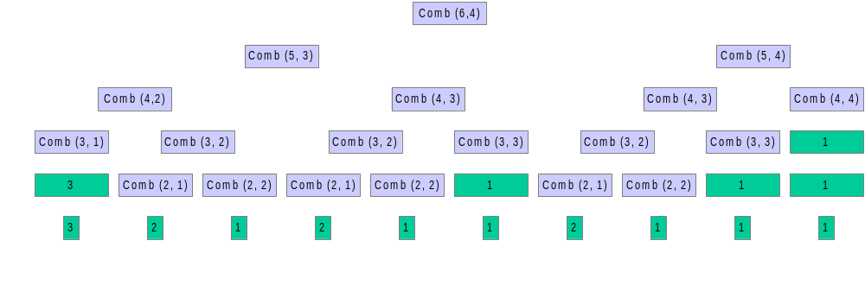
Recursion can be very inefficient is some cases
15

Slide 31
Deciding whether to use a recursive solution
When the depth of recursive calls is relatively "shallow"
The recursive version does about the same amount of work as the nonrecursive version
The recursive version is shorter and simpler than the nonrecursive solution

Slide 32
Exercises
7-12, 15

