Slide 1
Recursion
Chapter 11

Slide 2
Objectives
become familiar with the idea of recursion
learn to use recursion as a programming tool
become familiar with the binary search algorithm as an example of recursion
become familiar with the merge sort algorithm as an example of recursion

Slide 3
How do you look up a name in the phone book?

Slide 4
One Possible Way
Search:
  middle page = (first page + last page)/2
  Go to middle page;
  If (name is on middle page)
  done; //this is the base case
  else if (name is alphabetically before middle page)
  last page = middle page //redefine search area to front half
  Search //same process on reduced number of pages
  else //name must be after middle page
  first page = middle page //redefine search area to back half
  Search //same process on reduced number of pages

Slide 5
Overview
Recursion: a definition in terms of itself.
Recursion in algorithms:
Natural approach to some (not all) problems
A recursive algorithm uses itself to solve one or more smaller identical problems
Recursion in Java:
Recursive methods implement recursive algorithms
A recursive method includes a call to itself

Slide 6
Recursive Methods
Must Eventually Terminate
A recursive method must have
at least one base, or stopping, case.
A base case does not execute a recursive call
  stops the recursion
Each successive call to itself must be a "smaller version of itself”
  an argument that describes a smaller problem
  a base case is eventually reached

Slide 7
Key Components of a Recursive Algorithm Design
What is a smaller identical problem(s)?
  Decomposition
How are the answers to smaller problems combined to form the answer to the larger problem?
  Composition
Which is the smallest problem that can be solved easily (without further decomposition)?
  Base/stopping case

Slide 8
Examples in Recursion
Usually quite confusing the first time
Start with some simple examples
  recursive algorithms might not be best
Later with inherently recursive algorithms
  harder to implement otherwise

Slide 9
Factorial (N!)
N! = (N-1)! * N [for N > 1]
1! = 1
3!
  = 2! * 3
  = (1! * 2) * 3
  = 1 * 2 * 3
Recursive design:
  Decomposition: (N-1)!
  Composition: * N
  Base case: 1!

Slide 10
factorial Method
public static int factorial(int n)
{
int fact;
if (n > 1) // recursive case (decomposition)
fact = factorial(n – 1) * n; // composition
else // base case
fact = 1;
return fact;
}

Slide 11
public static int factorial(int 3)
{
int fact;
if (n > 1)
fact = factorial(2) * 3;
else
fact = 1;
return fact;
}

Slide 12
public static int factorial(int 3)
{
int fact;
if (n > 1)
fact = factorial(2) * 3;
else
fact = 1;
return fact;
}
public static int factorial(int 2)
{
int fact;
if (n > 1)
fact = factorial(1) * 2;
else
fact = 1;
return fact;
}

Slide 13
public static int factorial(int 3)
{
int fact;
if (n > 1)
fact = factorial(2) * 3;
else
fact = 1;
return fact;
}
public static int factorial(int 2)
{
int fact;
if (n > 1)
fact = factorial(1) * 2;
else
fact = 1;
return fact;
}
public static int factorial(int 1)
{
int fact;
if (n > 1)
fact = factorial(n - 1) * n;
else
fact = 1;
return fact;
}

Slide 14
public static int factorial(int 3)
{
int fact;
if (n > 1)
fact = factorial(2) * 3;
else
fact = 1;
return fact;
}
public static int factorial(int 2)
{
int fact;
if (n > 1)
fact = factorial(1) * 2;
else
fact = 1;
return fact;
}
public static int factorial(int 1)
{
int fact;
if (n > 1)
fact = factorial(n - 1) * n;
else
fact = 1;
return 1;
}

Slide 15
public static int factorial(int 3)
{
int fact;
if (n > 1)
fact = factorial(2) * 3;
else
fact = 1;
return fact;
}
public static int factorial(int 2)
{
int fact;
if (n > 1)
fact = 1 * 2;
else
fact = 1;
return fact;
}
public static int factorial(int 1)
{
int fact;
if (n > 1)
fact = factorial(n - 1) * n;
else
fact = 1;
return 1;
}

Slide 16
public static int factorial(int 3)
{
int fact;
if (n > 1)
fact = factorial(2) * 3;
else
fact = 1;
return fact;
}
public static int factorial(int 2)
{
int fact;
if (n > 1)
fact = 1 * 2;
else
fact = 1;
return 2;
}

Slide 17
public static int factorial(int 3)
{
int fact;
if (n > 1)
fact = 2 * 3;
else
fact = 1;
return fact;
}
public static int factorial(int 2)
{
int fact;
if (n > 1)
fact = 1 * 2;
else
fact = 1;
return 2;
}

Slide 18
public static int factorial(int 3)
{
int fact;
if (n > 1)
fact = 2 * 3;
else
fact = 1;
return 6;
}

Slide 19
Execution Trace (decomposition)
public static int factorial(int n)
{
int fact;
if (n > 1) // recursive case (decomposition)
fact = factorial(n – 1) * n; (composition)
else // base case
fact = 1;
return fact;
}
factorial(4)
factorial(3) 4

Slide 20
Execution Trace (decomposition)
public static int factorial(int n)
{
int fact;
if (n > 1) // recursive case (decomposition)
fact = factorial(n – 1) * n; (composition)
else // base case
fact = 1;
return fact;
}
factorial(4)
factorial(3) 4
factorial(2) 3

Slide 21
Execution Trace (decomposition)
public static int factorial(int n)
{
int fact;
if (n > 1) // recursive case (decomposition)
fact = factorial(n – 1) * n; (composition)
else // base case
fact = 1;
return fact;
}
factorial(4)
factorial(3) 4
factorial(2) 3
factorial(1) 2

Slide 22
Execution Trace (composition)
public static int factorial(int n)
{
int fact;
if (n > 1) // recursive case (decomposition)
fact = factorial(n – 1) * n; (composition)
else // base case
fact = 1;
return fact;
}
factorial(4)
*
factorial(3) 4
*
factorial(2) 3
*
factorial(1)->1 2

Slide 23
Execution Trace (composition)
public static int factorial(int n)
{
int fact;
if (n > 1) // recursive case (decomposition)
fact = factorial(n – 1) * n; (composition)
else // base case
fact = 1;
return fact;
}
factorial(4)
*
factorial(3) 4
*
factorial(2)->2 3

Slide 24
Execution Trace (composition)
public static int factorial(int n)
{
int fact;
if (n > 1) // recursive case (decomposition)
fact = factorial(n – 1) * n; (composition)
else // base case
fact = 1;
return fact;
}
factorial(4)
*
factorial(3)->6 4

Slide 25
Execution Trace (composition)
public static int factorial(int n)
{
int fact;
if (n > 1) // recursive case (decomposition)
fact = factorial(n – 1) * n; (composition)
else // base case
fact = 1;
return fact;
}
factorial(4)->24

Slide 26
Improved factorial Method
public static int factorial(int n)
{
int fact=1; // base case value
if (n > 1) // recursive case (decomposition)
fact = factorial(n – 1) * n; // composition
// else do nothing; base case
return fact;
}

Slide 27
Fibonacci Numbers
The Nth Fibonacci number is the sum of the previous two Fibonacci numbers
0, 1, 1, 2, 3, 5, 8, 13, …
Recursive Design:
  Decomposition & Composition
    fibonacci(n) = fibonacci(n-1) + fibonacci(n-2)
  Base case:
    fibonacci(1) = 0
    fibonacci(2) = 1

Slide 28
fibonacci Method
public static int fibonacci(int n)
{
int fib;
if (n > 2)
fib = fibonacci(n-1) + fibonacci(n-2);
else if (n == 2)
fib = 1;
else
fib = 0;
return fib;
}

Slide 29
Execution Trace (decomposition)
fibonacci(4)
fibonacci(3)
fibonacci(2)

Slide 30
Execution Trace (decomposition)
fibonacci(4)
fibonacci(3)
fibonacci(2)
fibonacci(2)
fibonacci(1)

Slide 31
Execution Trace (composition)
fibonacci(4)
+
fibonacci(3)
fibonacci(2)
+
fibonacci(2)->1
fibonacci(1)->0

Slide 32
Execution Trace (composition)
fibonacci(4)
+
fibonacci(3)->1
fibonacci(2)->1

Slide 33
Execution Trace (composition)
fibonacci(4)->2

Slide 34
Remember:
Key to Successful Recursion
if-else statement (or some other branching statement)
Some branches: recursive call
  "smaller" arguments or solve "smaller" versions of the same task (decomposition)
  Combine the results (composition) [if necessary]
Other branches: no recursive calls
  stopping cases or base cases

Slide 35
Template
… method(…)
{
if ( … )// base case
{
}
else // decomposition & composition
{
}
return … ; // if not void method
}

Slide 36
Template (only one base case)
… method(…)
{
… result = … ;//base case
if ( … ) // not base case
{ //decomposition & composition
result = …
}
return result;
}

Slide 37
What Happens Here?
public static int factorial(int n)
{
int fact=1;
if (n > 1)
fact = factorial(n) * n;
return fact;
}

Slide 38
What Happens Here?
public static int factorial(int n)
{
return factorial(n – 1) * n;
}

Slide 39
Warning: Infinite Recursion May Cause a Stack Overflow Error
Infinite Recursion
  Problem not getting smaller (no/bad decomposition)
  Base case exists, but not reachable (bad base case and/or decomposition)
  No base case
Stack: keeps track of recursive calls by JVM (OS)
  Method begins: add data onto the stack
  Method ends: remove data from the stack
Recursion never stops; stack eventually runs out of space
  Stack overflow error

Slide 40
Mistakes in recursion
No composition -> ?
Bad composition -> ?

Slide 41
Number of Zeros in a Number
Example: 2030 has 2 zeros
If n has two or more digits
  the number of zeros is the number of zeros in n with the last digit removed
  plus an additional 1 if the last digit is zero
Examples:
  number of zeros in 20030 is number of zeros in 2003 plus 1
  number of zeros in 20031 is number of zeros in 2003 plus 0
recursive

Slide 42
numberOfZeros Recursive Design
numberOfZeros in the number N
K = number of digits in N
Decomposition:
  numberOfZeros in the first K - 1 digits
  Last digit
Composition:
  Add:
    numberOfZeros in the first K - 1digits
    1 if the last digit is zero
Base case:
  N has one digit (K = 1)

Slide 43
numberOfZeros method
public static int numberOfZeros(int n)
{
int zeroCount;
if (n==0)
zeroCount = 1;
else if (n < 10) // and not 0
zeroCount = 0; // 0 for no zeros
else if (n%10 == 0)
zeroCount = numberOfZeros(n/10) + 1;
else // n%10 != 0
zeroCount = numberOfZeros(n/10);
return zeroCount;
}
Which is (are) the base case(s)? Why?
Decompostion, Why?
Composition, why?

Slide 44
public static int numberOfZeros(int n)
{
int zeroCount;
if (n==0)
zeroCount = 1;
else if (n < 10) // and not 0
zeroCount = 0; // 0 for no zeros
else if (n%10 == 0)
zeroCount = numberOfZeros(n/10) + 1;
else // n%10 != 0
zeroCount = numberOfZeros(n/10);
return zeroCount;
}
Execution Trace (decomposition)
Each method invocation will execute one of the if-else cases shown at right.
numberOfZeros(2005)
numberOfZeros(200) 5
numberOfZeros(20) 0
numberOfZeros(2) 0

Slide 45
public static int numberOfZeros(int n)
{
int zeroCount;
if (n==0)
zeroCount = 1;
else if (n < 10) // and not 0
zeroCount = 0; // 0 for no zeros
else if (n%10 == 0)
zeroCount = numberOfZeros(n/10) + 1;
else // n%10 != 0
zeroCount = numberOfZeros(n/10);
return zeroCount;
}
Execution Trace (composition)
Recursive calls return
numberOfZeros(2005)->2
numberOfZeros(200)->2 5->0
numberOfZeros(20)->1 0->1
numberOfZeros(2)->0 0->1
+
+
+

Slide 46
Number in English Words
Process an integer and print out its digits in words
  Input: 123
  Output: "one two three”
RecursionDemo class

Slide 47
inWords Resursive Design
inWords prints a number N in English words
K = number of digits in N
Decomposition:
  inWords for the first K – 1 digits
  Print the last digit
Composition:
  Execution order of composed steps [more later]
Base case:
  N has one digit (K = 1)

Slide 48
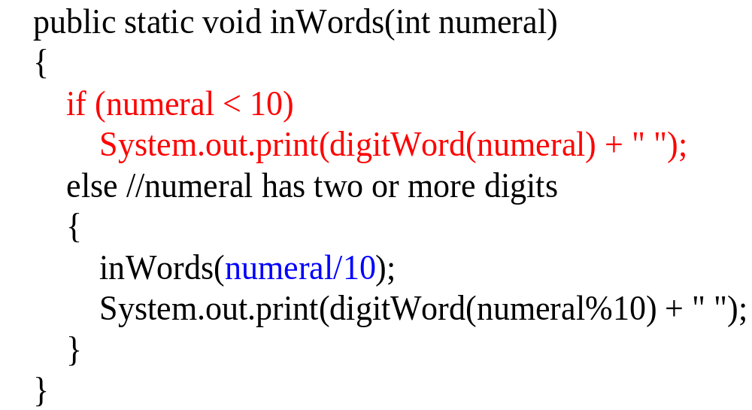
inWords method
Base case executes when only 1 digit is left
Size of problem is reduced for each recursive call

Slide 49
Execution Trace (decomposition)
inwords(987)
inwords(98) [print “seven”]
inwords(9) [print “eight”]
[print “nine”]
No output yet, why?

Slide 50
Execution Trace (composition)
inwords(987)
inwords(98) print “seven”
inwords(9) print “eight”
print “nine”
Output: nine eight seven

Slide 51
What Happens with a Recursive Call
1
inWords(987)
if (987 < 10)
// print digit here
else //two or more digits left
{
inWords(987/10);
// print digit here
}
inWords (slightly simplified) with argument 987

Slide 52
Execution
Trace
inWords(987)
if (987 < 10)
// print digit here
else //two or more digits left
{
inWords(987/10);
// print digit here
}
The argument is getting shorter and will eventually get to the base case.
2
inWords(98)
if (98 < 10)
// print digit here
else //two or more digits left
{
inWords(98/10);
// print digit here
}
Computation waits here until recursive call returns
The if condition is false
recursive call to inWords, with 987/10 or 98 as the argument

Slide 53
Execution Trace
inWords(987)
if (987 < 10)
// print digit here
else //two or more digits left
{
inWords(987/10);
// print digit here
}
inWords(98)
if (98 < 10)
// print digit here
else //two or more digits left
{
inWords(98/10);
// print digit here
}
inWords(9)
if (9 < 10)
// print digit here
else //two or more digits left
{
inWords(numeral/10);
// print digit here
}
3
the if condition is false
another recursive call is made.

Slide 54
Execution Trace
inWords(987)
if (987 < 10)
// print digit here
else //two or more digits left
{
inWords(987/10);
// print digit here
}
Output: nine
inWords(98)
if (98 < 10)
// print digit here
else //two or more digits left
{
inWords(98/10);
// print 98 % 10
}
4
inWords(9)
if (9 < 10)
// print nine
else //two or more digits left
{
inWords(numeral/10);
// print digit here
}
if condition is true (base case)
prints nine and returns
no recursive call

Slide 55
Execution Trace
inWords(987)
if (987 < 10)
// print out digit here
else //two or more digits left
{
inWords(987/10);
// print digit here
}
5
inWords(98)
if (98 < 10)
// print out digit here
else //two or more digits left
{
inWords(98/10);
// print out 98 % 10 here
}
Output: nine eight
executes the next statement after the recursive call
prints eight and then returns

Slide 56
Execution Trace
inWords(987)
if (987 < 10)
// print out digit here
else //two or more digits left
{
inWords(987/10);
// print 987 % 10
}
6
6
Output: nine eight seven
executes the next statement after the recursive method call.
prints seven and returns

Slide 57
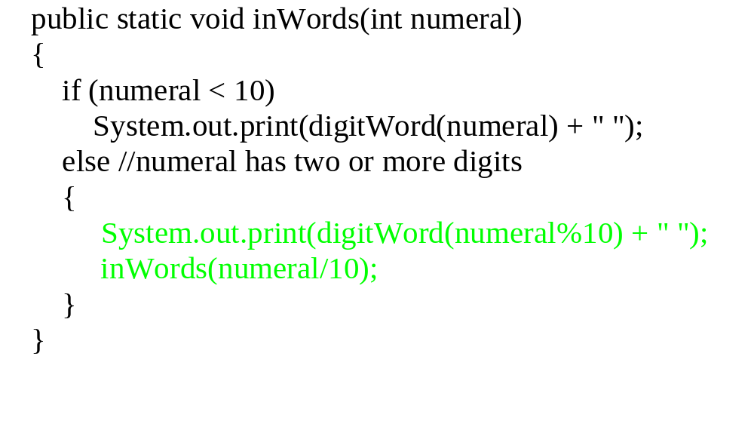
Composition Matters
Print before
making the recursive call
Recursive Design:
Print the last digit
inWords for the first K – 1 digits

Slide 58
Execution Trace (decomposition)
inwords(987)
print “seven” inwords(98)
Output: seven

Slide 59
Execution Trace (decomposition)
inwords(987)
print “seven” inwords(98)
print “eight” inwords(9)
Output: seven eight

Slide 60
Execution Trace (decomposition)
inwords(987)
print “seven” inwords(98)
print “eight” inwords(9)
print “nine”
Output: seven eight nine

Slide 61
Execution Trace (composition)
inwords(987)
print “seven” inwords(98)
print “eight” inwords(9)
print “nine”
No additional output

Slide 62
"Name in the Phone Book" Revisited
  Search:
    middle page = (first page + last page)/2
    Go to middle page;
    If (name is on middle page)
    done;//this is the base case
    else if (name is alphabetically before middle page)
    last page = middle page//redefine to front half
    Search//recursive call
    else //name must be after middle page
    first page = middle page//redefine to back half
    Search//recursive call

Slide 63
Binary Search Algorithm
Searching a list for a particular value
  sequential and binary are two common algorithms
Sequential search (aka linear search):
  Not very efficient
  Easy to understand and program
Binary search:
  more efficient than sequential
  but the list must be sorted first!

Slide 64
Why Is It Called "Binary" Search?
Compare sequential and binary search algorithms:
How many elements are eliminated from the list each time a value is read from the list and it is not the "target" value?
Sequential search: only one item
Binary search: half the list!
That is why it is called binary -
each unsuccessful test for the target value
reduces the remaining search list by 1/2.

Slide 65
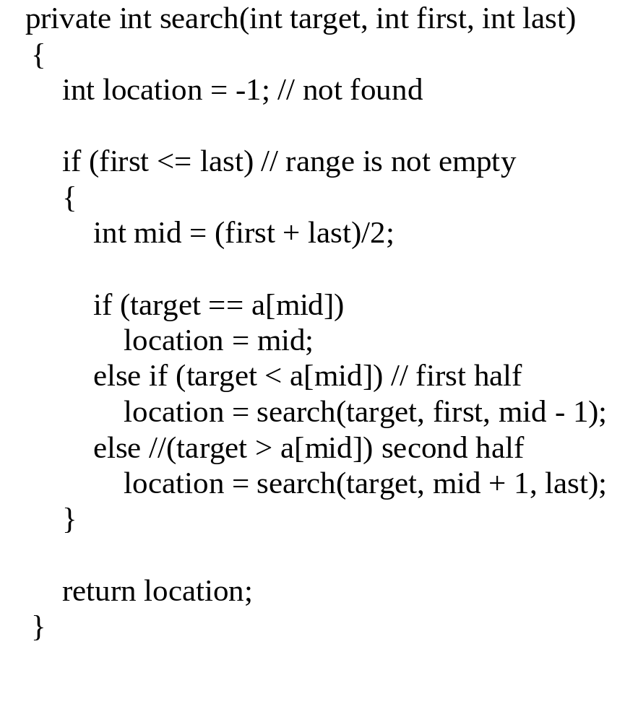
Binary Search Method
public find(target) calls private search(target, first, last)
returns the index of the entry if the target value is found or -1 if it is not found
Compare it to the pseudocode for the "name in the phone book" problem

Slide 66
Where is the composition?
If no items
  not found (-1)
Else if target is in the middle
  middle location
Else
  location found by search(first half) or search(second half)

Slide 67
Binary Search Example
target is 33
The array a looks like this:
Indices
Contents
0 1 2 3 4 5 6 7 8 9
5 7 9 13 32 33 42 54 56 88
mid = (0 + 9) / 2 (which is 4)
33 > a[mid] (that is, 33 > a[4])
So, if 33 is in the array, then 33 is one of:
5 6 7 8 9
33 42 54 56 88
Eliminated half of the remaining elements from consideration because array elements are sorted.

Slide 68
Binary Search Example
target is 33
The array a looks like this:
Indexes
Contents
0 1 2 3 4 5 6 7 8 9
5 7 9 13 32 33 42 54 56 88
mid = (5 + 9) / 2 (which is 7)
33 < a[mid] (that is, 33 < a[7])
So, if 33 is in the array, then 33 is one of:
Eliminate half of the remaining elements
5 6
33 42
mid = (5 + 6) / 2 (which is 5)
33 == a[mid]
So we found 33 at index 5:
5
33

Slide 69
Tips
Don’t throw away answers (return values)--need to compose the answers
  Common programming mistake: not capturing and composing answers (return values)
Only one return statement at the end
  Easier to keep track of and debug return values
  “One entry, one exit”
www.cs.fit.edu/~pkc/classes/cse1001/BinarySearch/BinarySearch.java

Slide 70
Worst-case Analysis
Item not in the array (size N)
T(N) = number of comparisons with array elements
T(1) = 1
T(N) = 1 + T(N / 2)

Slide 71
Worst-case Analysis
Item not in the array (size N)
T(N) = number of comparisons with array elements
T(1) = 1
T(N) = 1 + T(N / 2)
= 1 + [1 + T(N / 4)]

Slide 72
Worst-case Analysis
Item not in the array (size N)
T(N) = number of comparisons with array elements
T(1) = 1
T(N) = 1 + T(N / 2)
= 1 + [1 + T(N / 4)]
= 2 + T(N / 4)
= 2 + [1 + T(N / 8)]

Slide 73
Worst-case Analysis
Item not in the array (size N)
T(N) = number of comparisons with array elements
T(1) = 1
T(N) = 1 + T(N / 2) ←
= 1 + [1 + T(N / 4)]
= 2 + T(N / 4) ←
= 2 + [1 + T(N / 8)]
= 3 + T(N / 8) ←
= …

Slide 74
Worst-case Analysis
Item not in the array (size N)
T(N) = number of comparisons with array elements
T(1) = 1
T(N) = 1 + T(N / 2) ←
= 1 + [1 + T(N / 4)]
= 2 + T(N / 4) ←
= 2 + [1 + T(N / 8)]
= 3 + T(N / 8) ←
= …
= k + T(N / 2^{k} ) [1]

Slide 75
Worst-case Analysis
T(N) = k + T(N / 2^{k} ) [1]
T(N / 2^{k} ) gets smaller until the base case: T(1)
  2^{k} = N
  k = log₂N
Replace terms with k in [1]:
T(N) = log₂N + T(N / N)
= log₂N + T(1)
= log₂N + 1
“log₂N” algorithm
We used recurrence equations

Slide 76
Main steps for analysis
Set up the recurrence equations for the recursive algorithm
Expand the equations a few times
Look for a pattern
Introduce a variable to describe the pattern
Find the value for the variable via the base case
Get rid of the variable via substitution

Slide 77
Binary vs. Sequential Search
Binary Search
  log₂N + 1 comparisons (worst case)
Sequential/Linear Search
  N comparisons (worst case)
Binary Search is faster but
  array is assumed to be sorted beforehand
Faster searching algorithms for “non-sorted arrays”
  More sophisticated data structures than arrays
  Later courses

Slide 78
Recursive Versus Iterative Methods
All recursive algorithms/methods
can be rewritten without recursion.
Iterative methods use loops instead of recursion
Iterative methods generally run faster and use less memory--less overhead in keeping track of method calls

Slide 79
So When Should You Use Recursion?
Solutions/algorithms for some problems are inherently recursive
  iterative implementation could be more complicated
When efficiency is less important
  it might make the code easier to understand
Bottom line is about:
  Algorithm design
  Tradeoff between readability and efficiency

Slide 80
Pages 807 NOT a good tip [Programming Tip: Ask Until the User Gets It Right]
Recursion continues until user enters valid input.
public void getCount()
{
System.out.println("Enter a positive number:");
count = SavitchIn.readLineInt();
if (count <= 0)
{
System.out.println("Input must be positive.
System.out.println("Try again.");
getCount(); //start over
}
}
read a number
Use a recursive call to get another number.
No notion of a smaller problem for recursive design
Easily implemented using iteration without loss
of readability

Slide 81
Merge Sort—
A Recursive Sorting Algorithm
Example of divide and conquer algorithm
Recursive design:
  Divides array in half and merge sorts the halves (decomposition)
  Combines two sorted halves (composition)
  Array has only one element (base case)
Harder to implement iteratively

Slide 82
Execution Trace (decomposition)
3 | 6 | 8 | 2 | 5 | 4 | 7 | 1
3 | 6 | 8 | 2
5 | 4 | 7 | 1
3 | 6
8 | 2
5 | 4
7 | 1
3
6
8
2
5
4
7
1

Slide 83
Execution Trace (composition)
1 | 2 | 3 | 4 | 5 | 6 | 7 | 8
2 | 3 | 6 | 8
1 | 4 | 5 | 7
3 | 6
2 | 8
4 | 5
1 | 7
3
6
8
2
5
4
7
1

Slide 84
Merging Two Sorted Arrays
2
3 | 6
2 | 8

Slide 85
Merging Two Sorted Arrays
2 | 3
3 | 6
2 | 8

Slide 86
Merging Two Sorted Arrays
2 | 3 | 6
3 | 6
2 | 8

Slide 87
Merging Two Sorted Arrays
2 | 3 | 6 | 8
3 | 6
2 | 8

Slide 88
Merge Sort Algorithm
If array a has more than one element:
  Copy the first half of the elements in a to array front
  Copy the rest of the elements in a to array tail
  Merge Sort front
  Merge Sort tail
  Merge the elements in front and tail into a
Otherwise, do nothing

Slide 89
Merge Sort
public static void sort(int[] a)
{
if (a.length >= 2)
{
int halfLength = a.length / 2;
int[] front = new int[halfLength];
int[] tail = new int[a.length – halfLength];
divide(a, front, tail);
sort(front);
sort(tail);
merge(a, front, tail);
}
// else do nothing.
}
do recursive case if true, base case if false
recursive calls
make "smaller" problems by dividing array
Combine the two sorted arrays
base case: a.length == 1 so a is sorted and no recursive call is necessary.

Slide 90
Worst-case Theoretical Analysis
Comparisons of array elements
None during decomposition
Only during merging two sorted arrays (composition)
  To get an array of size N from two sorted arrays of size N/2
  N - 1 comparisons (worst case: the largest two elements are in different halves)

Slide 91
Analysis: Array of size N
Let T(N) be the number of comparisons
T(1) = 0
T(N) = 2 T(N / 2) + (N – 1)

Slide 92
Analysis: Array of size N
Let T(N) be the number of comparisons
T(1) = 0
T(N) = 2 T(N / 2) + (N – 1)
= 2 [2 T(N / 4) + (N / 2 – 1)] + (N – 1)

Slide 93
Analysis: Array of size N
Let T(N) be the number of comparisons
T(1) = 0
T(N) = 2 T(N / 2) + (N – 1)
= 2 [2 T(N / 4) + (N / 2 – 1)] + (N – 1)
= 4 T(N / 4) + (N – 2) + (N – 1)
= 4 [ 2 T(N / 8) + (N / 4 – 1) ] + (N – 2) + (N – 1)

Slide 94
Analysis: Array of size N
Let T(N) be the number of comparisons
T(1) = 0
T(N) = 2 T(N / 2) + (N – 1) ←
= 2 [2 T(N / 4) + (N / 2 – 1)] + (N – 1)
= 4 T(N / 4) + (N – 2) + (N – 1) ←
= 4 [ 2 T(N / 8) + (N / 4 – 1) ] + (N – 2) + (N – 1)
= 8 T(N / 8) + (N – 4) + (N – 2) + (N – 1) ←

Slide 95
Analysis: Array of size N
Let T(N) be the number of comparisons
T(1) = 0
T(N) = 2 T(N / 2) + (N – 1) ←
= 2 [2 T(N / 4) + (N / 2 – 1)] + (N – 1)
= 4 T(N / 4) + (N – 2) + (N – 1) ←
= 4 [ 2 T(N / 8) + (N / 4 – 1) ] + (N – 2) + (N – 1)
= 8 T(N / 8) + (N – 4) + (N – 2) + (N – 1) ←
= 8 T(N / 8) + 3N – (1 + 2 + 4)

Slide 96
Analysis: Array of size N
Let T(N) be the number of comparisons
T(1) = 0
T(N) = 2 T(N / 2) + (N – 1) ←
= 2 [2 T(N / 4) + (N / 2 – 1)] + (N – 1)
= 4 T(N / 4) + (N – 2) + (N – 1) ←
= 4 [ 2 T(N / 8) + (N / 4 – 1) ] + (N – 2) + (N – 1)
= 8 T(N / 8) + (N – 4) + (N – 2) + (N – 1) ←
= 8 T(N / 8) + 3N – (1 + 2 + 4)
= …
= 2^{k} T(N / 2^{k} ) + kN – (1 + 2 + … 2^{k-1} ) [1]

Slide 97
Analysis Continued
T(N) = 2^{k} T(N / 2^{k} ) + kN – (1 + 2 + … 2^{k-1} ) [1]
= 2^{k} T(N / 2^{k} ) + kN – (2^{k} - 1) [2]
T(N / 2^{k} ) gets smaller until the base case T(1):
  2^{k} = N
  k = log₂N
Replace terms with k in [2]:
T(N) = N T(N / N) + log₂N*N – (N – 1)
= N T(1) + Nlog₂N – (N – 1)
= Nlog₂N – N + 1
“Nlog₂N” algorithm

Slide 98
Geometric Series and Sum
1 + 2 + 4 + 8 + … + 2^{k}
  1 + 2 = 3
  1 + 2 + 4 = 7
  1 + 2 + 4 + 8 = 15

Slide 99
Geometric Series and Sum
1 + 2 + 4 + 8 + … + 2^{k}
  1 + 2 = 3 (4 – 1)
  1 + 2 + 4 = 7 (8 – 1)
  1 + 2 + 4 + 8 = 15 (16 – 1)

Slide 100
Geometric Series and Sum
1 + 2 + 4 + 8 + … + 2^{k}
  1 + 2 = 3 (4 – 1)
  1 + 2 + 4 = 7 (8 – 1)
  1 + 2 + 4 + 8 = 15 (16 – 1)
1 + 2 + 4 + 8 + … + 2^{k}
= 2^{k+1} - 1
1 + r + r² + r³ + … + r^{k}
= r⁰ + r¹ + r² + r³ + … + r^{k}
= (r^{k+1} – 1) / (r – 1) [for r > 1]

Slide 101
Merge Sort Vs. Selection/Insertion/Bubble Sort
Merge Sort
  “NlogN” algorithm (in comparisons)
Selection/Insertion/Bubble Sort
  “N²” algorithm (in comparisons)
“NlogN” is “optimal” for sorting
  Proven that the sorting problem cannot be solved with fewer comparisons
  Other NlogN algorithms exist, many are recursive

Slide 102
Real Data Set: Web Server Log
http://www.cs.fit.edu/~pkc/classes/writing/data/jan99.log
4.6 MB (44057 entries)
Example entry in log:
ip195.dca.primenet.com - - [04/Jan/1999:09:16:51 -0500] "GET / HTTP/1.0" 200 762
Extracted features
  remote-host names (strings)
  file-size (integers)
List size - 100 to 44000 entries

Slide 103
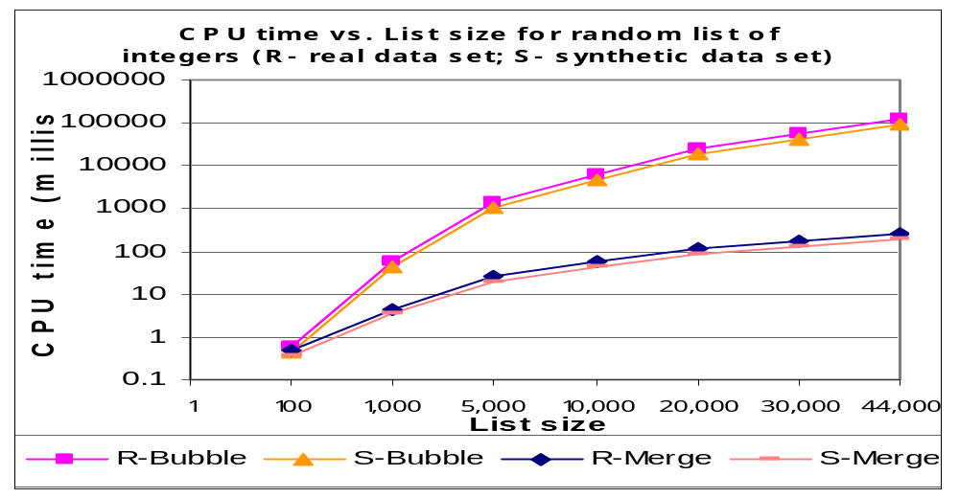
CPU Time: Randomly Ordered Integers

Slide 104
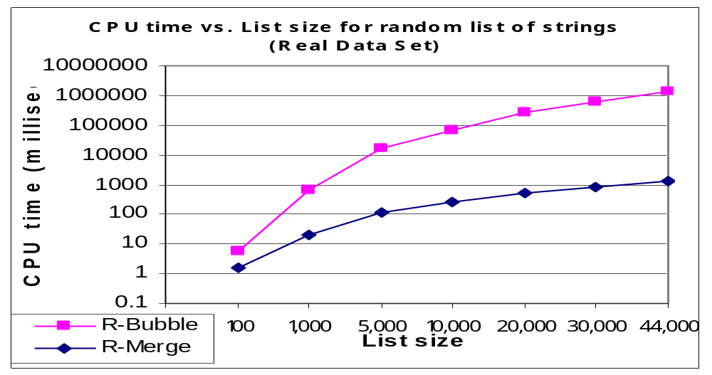
CPU Time: Randomly Ordered Strings

Slide 105
Google’s PageRank (1998)
PageRank(x) depends on:
  How many pages (y’s) linking to x
    how many incoming links (citations) from y’s to x
  How important those pages (y’s) are:
    PageRank(y)’s
How to determine PageRank(y)’s?
What is the base case?

Slide 106
Summary
Recursive call: a method that calls itself
Powerful for algorithm design at times
Recursive algorithm design:
    Decomposition (smaller identical problems)
    Composition (combine results)
    Base case(s) (smallest problem, no recursive calls)
Implementation
  Conditional (e.g. if) statements to separate different cases
  Avoid infinite recursion
    Problem is getting smaller (decomposition)
    Base case exists and reachable
  Composition could be tricky

Slide 107
Summary
Binary Search
  Given an ordered list
  “logN” algorithm (in comparisons)
  “Optimal”
Merge Sort
  Recursive sorting algorithm
  “NlogN” algorithm (in comparisons)
  “Optimal”

