Slide 1

Weather forecasting using machine learning models
Done by: Ahmad Obeid
Course mentor: Dr. mohammad yahya

Slide 2
Purpose statement
The purpose of this research is to create a machine learning model for weather forecasting that can predict air temperature. The objective of this research is to ascertain the optimal machine learning method for this particular task, as well as the characteristics and dataset required to produce precise predictions. This project aims to analyze air temperature forecasts in weather forecasting applications by examining several machine learning models.

Slide 3
List of objectives
To conduct qualitative research (interview) with an expert with the concept of weather forecasting.
Discuss with the expert what feature will affect the result of the prediction the most. Also, finding out what is the best regression-based machine learning model.
Understanding the process of weather forecasting using machine learning models and meet our research predictions by doing a comparison between different machine learning models.

Slide 4
Sources of Data and Data Collection Methods
Primary research: Secondary research:
Conducting interview Air temperature machine learning models dataset, literature . review

Slide 5
Data Analysis Tools
Thematic analysis method
Google Colab

Slide 6
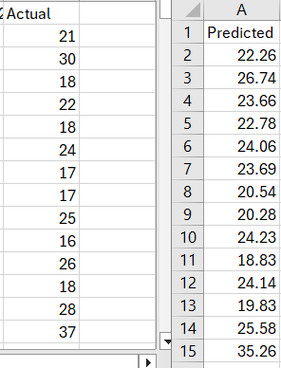

Main Findings and Results
Understanding the process of weather prediction using regression-machine learning models.
The weather forecasting process is depending on the past air temperature records.
Random forest regressor is the best model with 92% R2 and 6.16 MSE.
The predicted results and the actual results is proportional to the accuracy rate (R2) of the random forest model. Which confirmed the RF model result in the performance metrics.

Slide 7
Recommendations
Gathering more data by following mixed approaches.
Doing more preprocessing techniques on the dataset before i start training the models.
conducting more than one interview with another experts.
Expand the forecasting process.

Slide 8
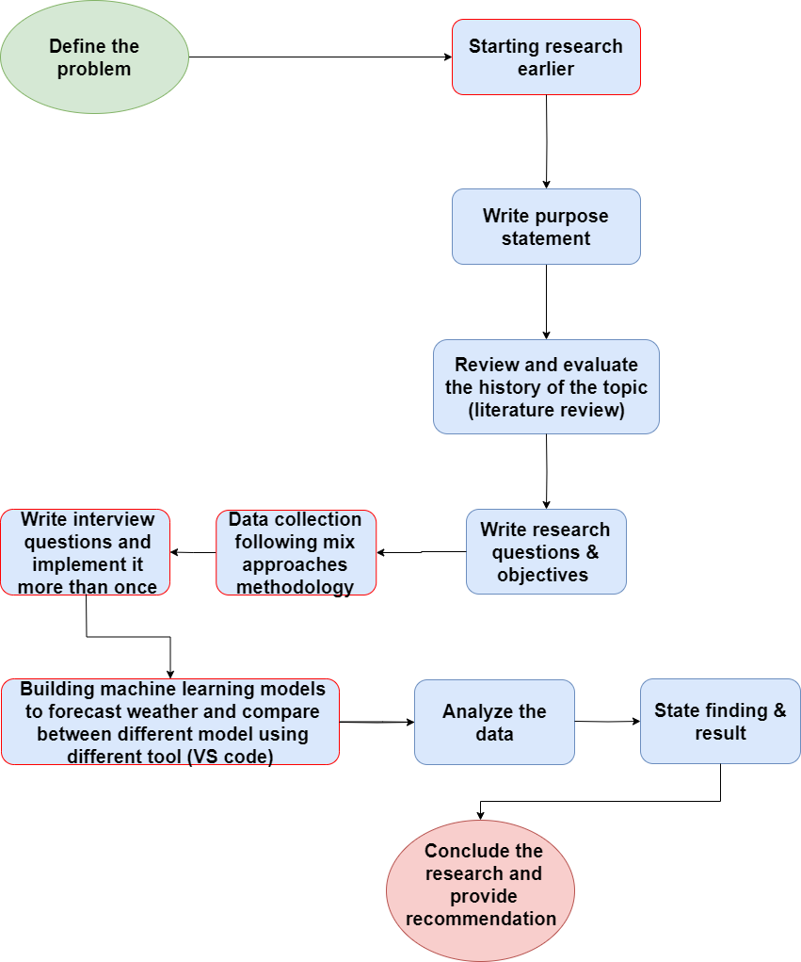
Action plan

