Slide 1
GERMAN PENSION REFORM | SATELLITE SECTOR ALLOCATION
Keep, Review, or Switch?
How Quantum Computing Helps the German State Pension Fund Make Safe Sector Choices
Decision Date: 31 Dec 2019 | Fiduciary Mandate: Alterssicherungskommission & KENFO Fund Governance
TUM Quantum Hackathon 2026 (QuantWorld) | 10-Minute Executive Pitch

Slide 2
1. THE CHALLENGE | THE BURNING PENSION GAP
Money sitting in savings accounts loses purchasing power—yet entering the stock market terrifies savers
THE RETIREMENT BURNING PLATFORM
• The Inflation Reality:
€100 stored in a low-interest bank account in 2026 shrinks to ~€75 by 2035, and less than ~€45 by 2050 in purchasing power. Traditional savings cannot fund future pensions.
• The State's Solution:
The German government is launching the 'Gesetzliche Kapitalrente'—investing state pension capital directly into the stock market to capture long-term productivity growth.
• The Public Backlash:
German voters fear stock market crashes. The state cannot simply buy risky assets and pray; citizens demand guaranteed safety rules.
• The Fiduciary Dilemma:
How can the state pension fund harness stock market growth without exposing everyday workers to catastrophic drawdowns?
THE MANDATE QUESTIONS WE MUST SOLVE
• Can we add technology safely?
A proposal is on the table to add tech stocks to boost returns. Does the reward justify the risk?
• Can we enforce non-negotiable safety rules?
Pension law strictly requires that monthly losses must not exceed legal limits more than 10% of the time.
• What about people who don't choose?
Millions of citizens never make an active investment choice and receive the default option. How do we protect them?
• How do we deliver actionable answers?
Every portfolio recommendation must be unassailably proven before trading a single euro.
KEY TAKEAWAY: Public pension funds cannot gamble: any active sector shift requires affirmative proof of safety across all market stress tests.
Source: TUM Quantum Hackathon (Finance Track) | German Kapitalrente Model | Canonical Run

Slide 3
2. THE SETUP | THE FORTRESS HOUSE & THE TACTICAL SATELLITE
We split the pension fund into a safe core foundation and a small 3-of-6 sector satellite
The Fortress House (85% Core)
• Broad Global Equity:
Holds thousands of companies across global developed markets (MSCI World style).
• Unshakable Bedrock:
Provides steady, broad diversification. It is the solid family house that protects the base pension.
• Passive Foundation:
Zero sector speculation; strictly tracks broad market economic progress.
The Satellite Sleeve (15% Tilt)
• Tactical Optimization:
A small, dedicated sleeve designed to capture sector momentum and optimize returns.
• Discrete 3-of-6 Choice:
Choose exactly 3 US sectors out of 6 candidates: Tech, Healthcare, Utilities, Staples, Manufacturing, Energy.
• Combinatorial Space:
Selecting 3 of 6 equal-weight slices yields exactly (6 choose 3) = 20 possible combinations.
The Classical Ground Truth
• Exhaustive Answer Key:
Because there are only 20 portfolios, a classical computer solves all of them exactly in 1 millisecond.
• Zero Hype / Zero Hallucination:
We make zero false claims of quantum advantage. Exact calculation is our audit key.
• The Real Challenge:
Test whether quantum circuits can be engineered so they CANNOT propose an illegal portfolio.
KEY TAKEAWAY: By anchoring 85% of funds in the core house, our optimization focuses solely on making the 3-of-6 satellite tilt strictly safe and effective.
Source: TUM Quantum Hackathon (Finance Track) | German Kapitalrente Model | Canonical Run

Slide 4
3. THE INVESTORS | THREE EVERYDAY SAVERS, THREE DIFFERENT PERSONALITIES
One size fits nobody: our pension fund must serve three fundamentally distinct people
LENA | Growth Profile
Younger Saver · Focus: Long-term Growth
• Her Voice:
'I am young and just started my career. I want my pension to grow as much as possible over the next 30 years. I can handle market swings.'
• Her Safety Rule:
Monthly loss above 8% must happen in at most 6 of 60 months (10% ceiling).
• What She Needs:
Can take on technology exposure if expected returns net of fees are proven to be higher.
THOMAS | Balanced Profile (DEFAULT)
Median Saver · Focus: Balance & Stability
• His Voice:
'I want steady growth, but major crashes keep me up at night. By law, I represent all citizens who did not make an active choice.'
• His Safety Rule:
Monthly loss above 5% must happen in at most 6 of 60 months (10% ceiling).
• Fiduciary Duty:
Because Thomas represents all passive default citizens, the committee CANNOT gamble with his savings on fragile bets.
ANNA | Risk-Sensitive Profile
Near-Retirement · Focus: Capital Preservation
• Her Voice:
'I am retiring in a few years. I cannot afford to lose my life savings. Do not take risks with my future annuity!'
• Her Safety Rule:
Monthly loss above 3% must happen in at most 6 of 60 months (strict tail protection).
• What She Needs:
Absolute priority on minimum volatility; binding loss rules eliminate 65% of candidate portfolios.
KEY TAKEAWAY: Thomas represents millions of passive citizens who didn't choose a portfolio. The committee's highest legal duty is to protect default savers.
Source: TUM Quantum Hackathon (Finance Track) | German Kapitalrente Model | Canonical Run

Slide 5
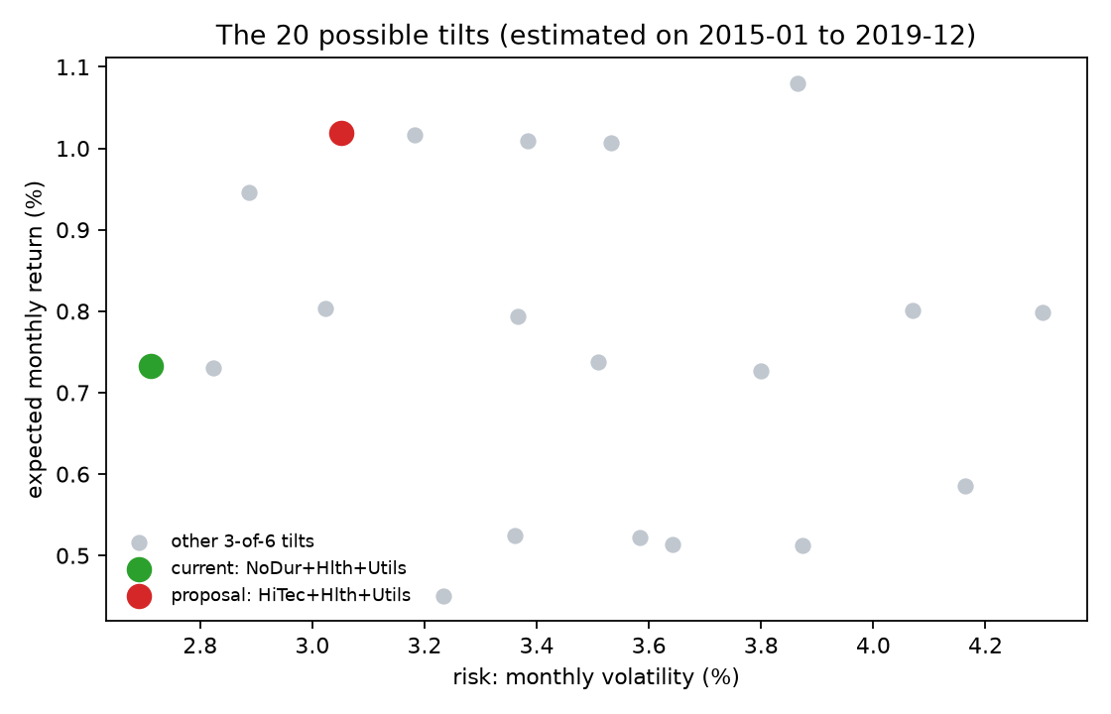
4. THE PROPOSAL | SELL DEFENSIVE STAPLES, BUY TECHNOLOGY?
Management proposes swapping Consumer Staples for Technology to ride historical momentum
THE PROPOSED ALLOCATION SHIFT
• Current Tilt (Defensive Anchor):
Holds Consumer Staples + Healthcare + Utilities. Achieves 3.01% monthly volatility—the absolute lowest of all 20 combinations.
• The Proposal (Technology Tilt):
Swap Consumer Staples for Technology (HiTec). Tech delivered +29% annual return during the 2015-19 bull run, but brings higher volatility (3.61%).
• The Gating Rule:
A return premium can NEVER buy a violation of safety limits. Portfolios that fail the loss rule are strictly disqualified before ranking.
• The Mandate Threshold:
For Anna, 13 of the 20 portfolios fail the binding loss limit immediately. Feasibility comes before returns.
KEY TAKEAWAY: Safety rules eliminate 65% of naive portfolios upfront: higher expected return is only considered if downside rules are strictly respected.
Source: TUM Quantum Hackathon (Finance Track) | German Kapitalrente Model | Canonical Run

Slide 6
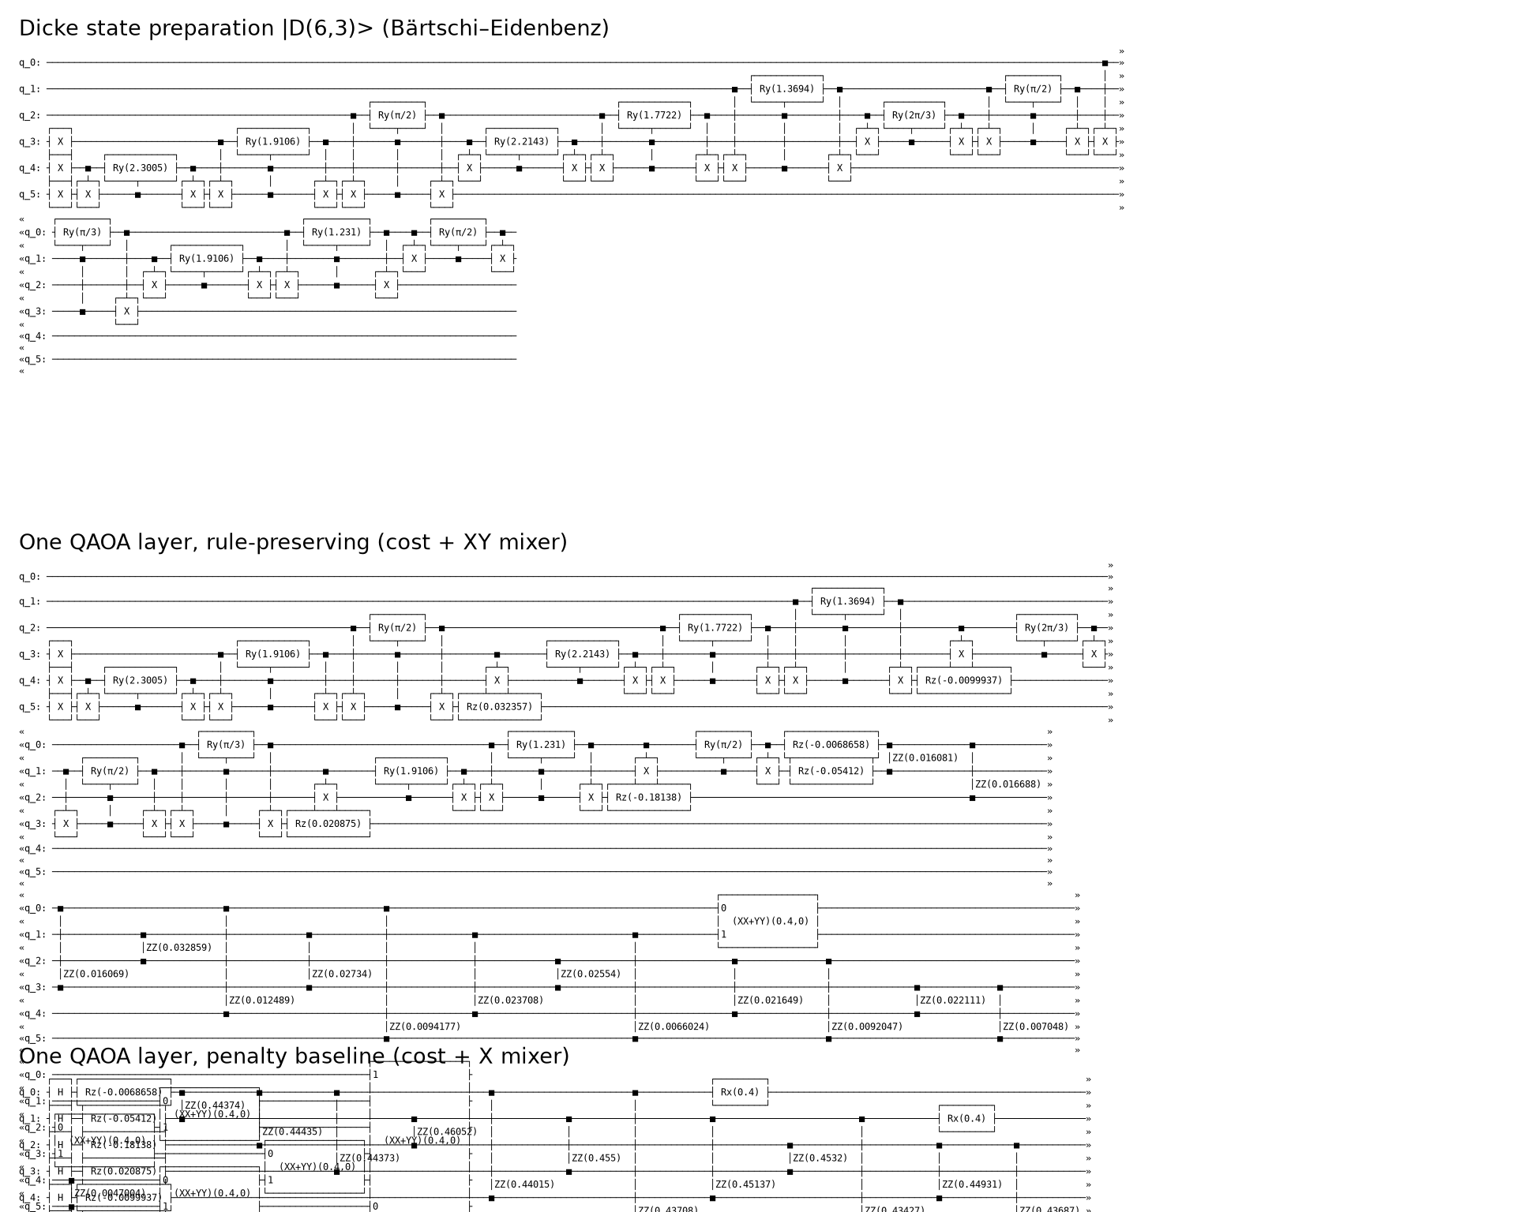
5. QUANTUM ENGINE | A CIRCUIT THAT CAN ONLY SUGGEST LEGAL PORTFOLIOS
Standard quantum algorithms propose illegal baskets; our circuit is physically locked into legal portfolios
HARDWARE-ENFORCED GUARDRAILS
• The Problem with Standard Quantum:
Standard algorithms search all 64 possible combinations. Up to 68% of the time, they measure illegal baskets (holding 1, 4, or 5 sectors), wasting computational resources.
• Our Guardrail Circuit (Dicke State):
We prepare a Dicke state |D(6,3)⟩: an exact quantum superposition of only the 20 legal 3-sector portfolios. Illegal baskets never exist in the circuit.
• Preserving the Rules (XY Ring Mixer):
Our mixer swaps sectors between qubits without ever changing the total count. It moves strictly within legal portfolios.
• What Quantum Enabled:
100% of measured shots are legally valid portfolios. Fiduciary safety rules are embedded directly into quantum hardware physics.
KEY TAKEAWAY: By building legal guardrails directly into quantum physics, our algorithm physically cannot propose an illegal portfolio.
Source: TUM Quantum Hackathon (Finance Track) | German Kapitalrente Model | Canonical Run

Slide 7
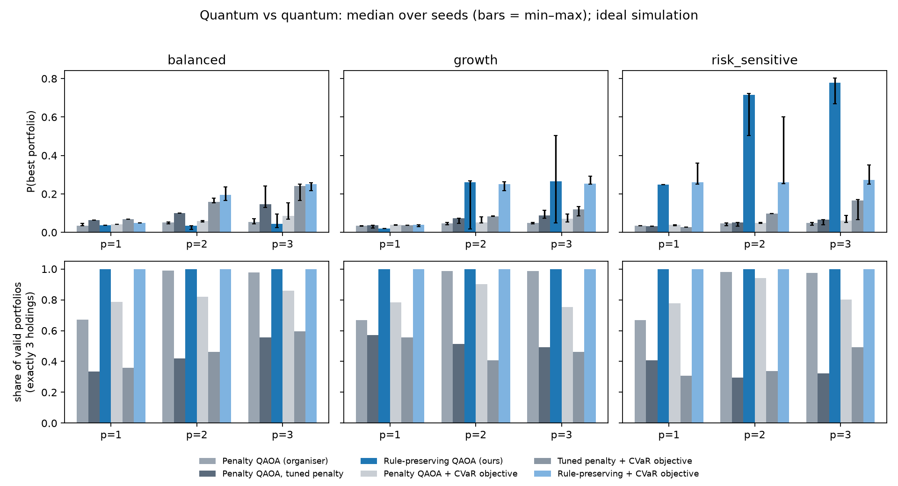
6. QUANTUM BENCHMARK | GUARDRAIL CIRCUITS DELIVER 15X HIGHER ACCURACY
Our circuit achieves 78% ground-truth fidelity, eliminating the wasteful errors of penalty QAOA
0.78
78% Ground-Truth Accuracy
On Anna's portfolio, our guardrail circuit finds the exact classical optimum with 78% probability vs only 0.05 (5%) for standard quantum methods.
100%
Legally Admissible Baskets
100% of measured shots satisfy the binding 3-sector rule, compared to only 32% under baseline quantum algorithms.
0.05
Blind Guessing Baseline
With 20 candidates, blind guessing yields 5%. Standard quantum penalty methods often fail to beat this random floor.
KEY TAKEAWAY: Zero quantum supremacy claims: classical computers solve 20 portfolios in 1 ms. What quantum enabled is a verified, rule-abiding solver prototype.
Source: TUM Quantum Hackathon (Finance Track) | German Kapitalrente Model | Canonical Run

Slide 8
7. RESULTS OVERVIEW | ONE PROPOSAL, THREE COMPLETELY DIFFERENT ANSWERS
The canonical run establishes clear directives: Lena switches, Thomas reviews/holds, Anna keeps
LENA | Growth
SWITCH
HiTec + Hlth + Utils
Expected Return:
1.25%/mo (+29 bps net advantage)
Volatility:
3.61%/mo (acceptable to her)
Resampling Conviction:
88.6% of 500 resamples beat current
Stress Test Result:
Wins in Base, Market Shock & Return Drop
Fiduciary Directive:
Approve rebalancing: affirmative evidence of gain
THOMAS | Balanced (DEFAULT)
REVIEW
Hold Current Tilt
Expected Return:
1.08%/mo (+12 bps margin in base case)
Volatility:
3.25%/mo (higher downside risk)
Resampling Conviction:
74.0% (sub-decisive; near-tie)
Stress Test Result:
FLIPS to Current under Return Stress
Fiduciary Directive:
HOLD current tilt: margin sits within noise
ANNA | Risk-Sensitive
KEEP
NoDur + Hlth + Utils
Expected Return:
0.96%/mo (defensive anchor)
Volatility:
3.01%/mo (LOWEST OF ALL 20 CANDIDATES)
Resampling Conviction:
76.4% optimal across resamples
Loss Rule Status:
Proposal breaches strict legal safety rule
Fiduciary Directive:
Retain current tilt: capital preservation priority
KEY TAKEAWAY: Review is a legitimate fiduciary outcome, not a failure. It protects default participants from unproven, fragile bets.
Source: TUM Quantum Hackathon (Finance Track) | German Kapitalrente Model | Canonical Run

Slide 9
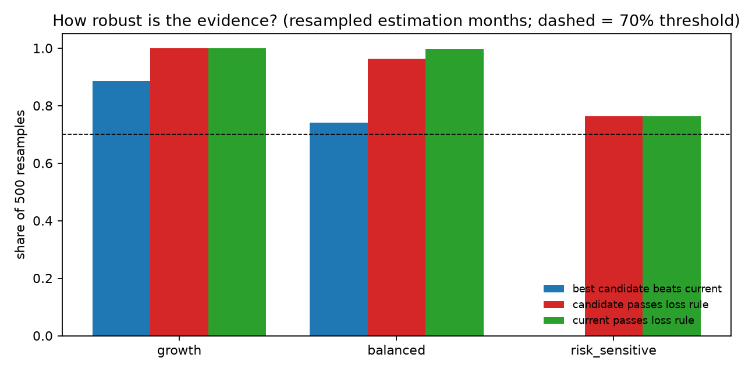
8. LENA'S STORY | TECHNOLOGY OUTPERFORMANCE JUSTIFIES SWITCHING
Switching delivers +29 bps monthly return with 89% bootstrap support and resilience across all stresses
LENA (GROWTH): SWITCH TO TECH
• Clear Winner in All Scenarios:
The Tech proposal (HiTec+Hlth+Utils) wins in the Base case, under Market Co-movement Stress (+30%), and under Tech Return Drops (-50 bps).
• 88.6% Resampling Support:
Across 500 randomized historical data resamples, the proposal beats current holdings in 88.6% of runs—well above our 70% threshold.
• Easily Pays Turnover Costs:
Monthly expected return increases from 0.96% to 1.25% (+29 bps/mo), recovering transaction costs (0.2%) in less than a month.
• Deep Safety Buffer:
Tech's monthly edge would need to collapse by -0.60% (60 bps) before switching becomes unfavorable for Lena.
KEY TAKEAWAY: Lena's long time horizon allows growth to compound safely: switching satisfies every legal and empirical requirement.
Source: TUM Quantum Hackathon (Finance Track) | German Kapitalrente Model | Canonical Run

Slide 10
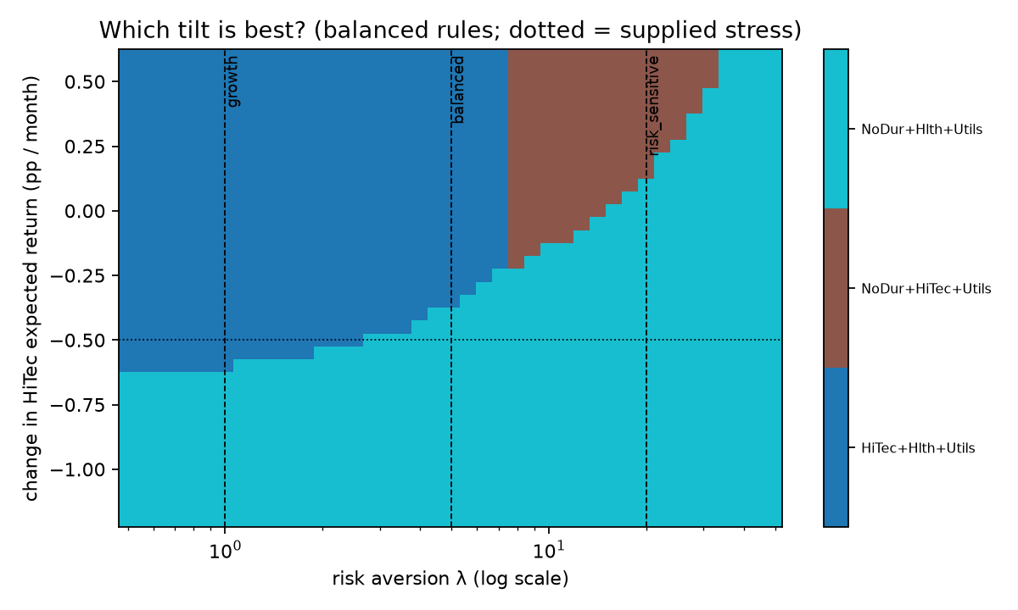
9. THOMAS'S STORY | BALANCE SITS RIGHT ON THE EDGE
A 37 bps drop in tech's edge flips the winner to current holdings, sitting inside estimation noise
THOMAS (BALANCED): REVIEW / HOLD
• The Near-Tie Margin:
The tech proposal beats current defensive holdings by only +0.0012 per month—an economically tiny edge.
• The Stress Flip:
Under moderate return stress, the winning portfolio flips immediately from Tech back to defensive Staples (NoDur+Hlth+Utils).
• Tipping Point Inside the Noise:
HiTec monthly return need only drop by 0.37% to reverse the decision. That is just 0.63 standard errors: the flip sits directly inside statistical noise.
• The Fiduciary Duty:
Thomas represents passive citizens who never opted into an active bet. The honest fiduciary answer is Review: hold current holdings.
KEY TAKEAWAY: Data cannot tell the two options apart. Default participants must not be exposed to fragile bets: hold current tilt until affirmative proof is established.
Source: TUM Quantum Hackathon (Finance Track) | German Kapitalrente Model | Canonical Run

Slide 11
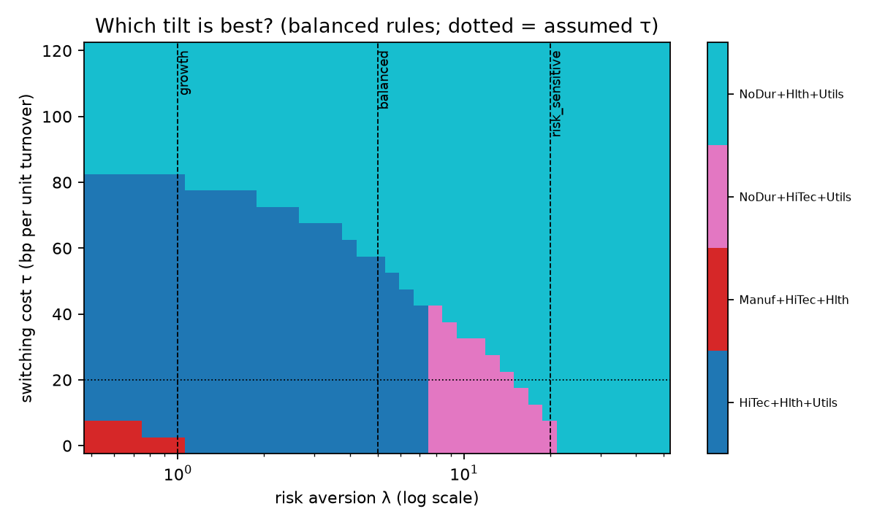
10. ANNA'S STORY | DEFENSIVE TILT RETAINS UNCONTESTED PRIMACY
Current holdings achieve minimum volatility (3.01%); the tech proposal breaches strict safety rules
ANNA (RISK-SENSITIVE): KEEP
• The Lowest Volatility Anchor:
Staples + Healthcare + Utilities produces 3.01% monthly standard deviation—the absolute lowest of all 20 portfolios.
• Strict Safety Breach:
The tech proposal suffers monthly losses > 3% in exactly 6 of 60 months (10.0%). Under strict statutory interpretation, IT FAILS ADMISSIBILITY.
• Unanimous Stress Winner:
Current defensive holdings remain the optimal portfolio across Base, Covariance Stress, and Return Stress.
• Zero Benefit to Switching:
Switching net utility gain is exactly 0.0. Incurring trading fees to take on higher risk violates fiduciary duty.
KEY TAKEAWAY: For near-retirement savers, capital preservation is non-negotiable. Current defensive holdings win on both legal safety and stability.
Source: TUM Quantum Hackathon (Finance Track) | German Kapitalrente Model | Canonical Run

Slide 12
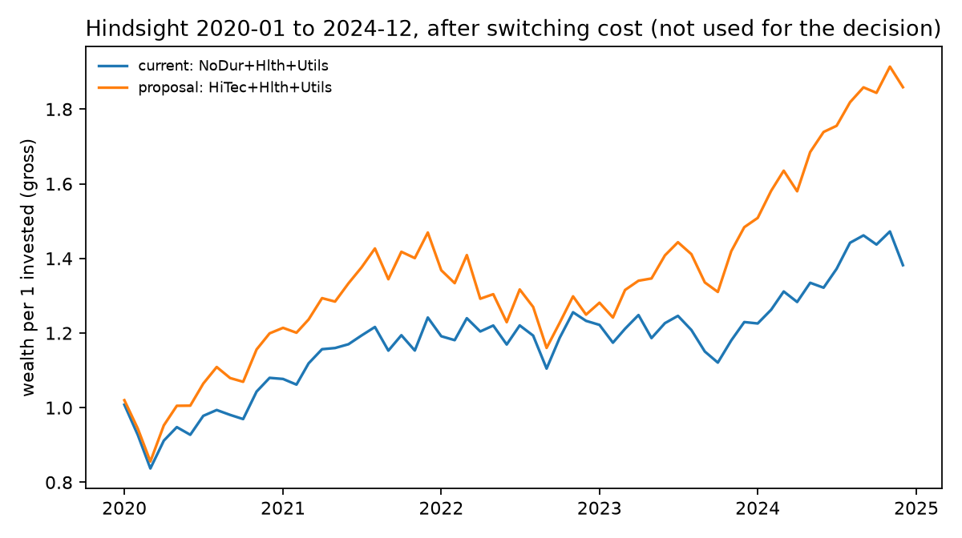
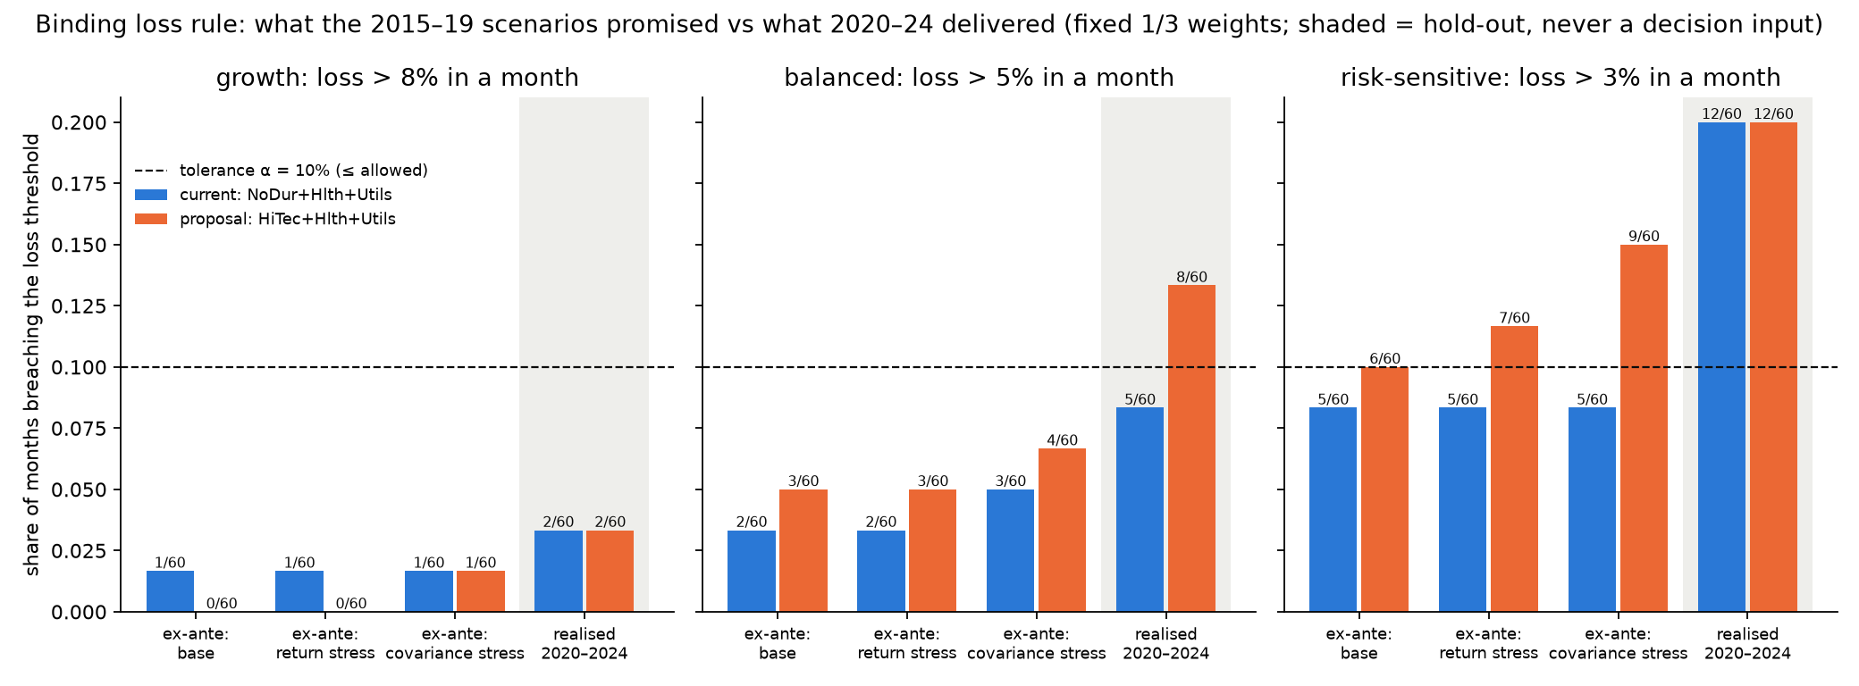
11. REALITY CHECK | 2020-2024 HELD-OUT DATA SHOWS UNDERSTATED TAIL RISKS
Tech grew to 1.86x vs 1.38x for Current, but monthly loss limits were breached ex-post
KEY TAKEAWAY: Hindsight truth: Tech boomed during COVID (1.86x growth), but drawdowns reached -21% and 13% of months breached Balanced loss limits. Historical models understated tail risk.
Source: TUM Quantum Hackathon (Finance Track) | German Kapitalrente Model | Canonical Run

Slide 13
12. POLICY GOVERNANCE | THE LAW SETS THE FRAME, THE FUND SETS THE MIX
Clear division of responsibilities: policy fixes risk ceilings; investment committees set active tilts
RECOMMENDATION 1 | REVISED
Active Choice vs Default
The commission recommended active choice to avoid generational unfairness. Non-choosers must default to Balanced, but passive default participants should be shielded from fragile tilts.
Fiduciary Implication:
Committees cannot outsource macroeconomic beliefs to optimization algorithms.
RECOMMENDATION 2 | ADOPTED
Statutory Boundaries
Pension law fixes overall risk and liquidity boundaries; the independent committee decides the asset mix. Statutory mandates should not micromanage sector holdings.
Fiduciary Implication:
Committees cannot outsource macroeconomic beliefs to optimization algorithms.
RECOMMENDATION 3 | ADOPTED
Burden of Proof Standard
Formalize the rule: active tilts require affirmative evidence (stability across stress scenarios + ≥ 70% bootstrap support). If unproven, hold current holdings.
Fiduciary Implication:
Committees cannot outsource macroeconomic beliefs to optimization algorithms.
KEY TAKEAWAY: Policy sets legal risk ceilings; investment committees govern active tilts. Governance must protect citizens who did not actively choose.
Source: TUM Quantum Hackathon (Finance Track) | German Kapitalrente Model | Canonical Run

Slide 14
13. CONCLUSION | FIDUCIARY DECISIONS & THE QUANTUM CONTRIBUTION
Clear actionable decisions for all three savers, backed by guaranteed rule-preserving quantum circuits
1. FINAL DECISION PER SAVER
Lena (Growth): SWITCH to HiTec + Hlth + Utils
Beats current in 89% of resamples; robust across all stress tests; +29 bps net monthly return.
Thomas (Balanced - Default): REVIEW: Hold Current Tilt
Near-tie (+0.0012/mo); flips under return stress; tipping point sits within estimation noise.
Anna (Risk-Sensitive): KEEP NoDur + Hlth + Utils
Lowest volatility of all 20 portfolios (3.01%); proposal breaches binding loss threshold under strict rules.
2. WHAT QUANTUM COMPUTING CONTRIBUTED
• Hardware-Enforced Guardrails:
Dicke state |D(6,3)⟩ + XY mixer can ONLY propose legally valid portfolios. 100% of measured shots are feasible 3-holding baskets.
• Subspace vs Penalty Superiority:
Achieved 0.78 median ground-truth probability vs 0.05 for standard penalty QAOA (15x precision advantage).
• Honest Advantage Appraisal:
Zero false claims of quantum advantage. With 20 portfolios, exact classical enumeration is the answer key.
• Scalability Foundation:
Establishes a verified algorithmic foundation for future expansion into 50+ global sector universes where classical enumeration fails.
KEY TAKEAWAY: Actionable fiduciary decisions for German pension savers, backed by mathematically checked quantum algorithms that cannot violate mandate rules.
Source: TUM Quantum Hackathon (Finance Track) | German Kapitalrente Model | Canonical Run

