Slide 1

Recurrent Neural Networks for object detection
Ahmad Bin Qasim, Arnd Pettirsch (03708414)
Technical University of Munich
Department of Informatics
Chair of Robotics, Artificial Intelligence and Real-time Systems
Seminar: Visual Feature Learning in Autonomous Driving
Supervisor: Prof. Dr.-Ing. habil. Alois Christian Knoll,
M.Eng. Emec Ercelik
Garching, June 28th 2019

Slide 2
Agenda
Intro
Feature-based Video Object Detection
Box-Level-based Video Object Detection
Flow-based Video Object Detection
Comparison of different approaches
Outro

Slide 3
Agenda
Intro
Image and Video Object Detection in general
Recurrent Neural Networks in general
Feature-based Video Object Detection
Box-Level-based Video Object Detection
Flow-based Video Object Detection
Comparison of different approaches
Outro

Slide 4
1.1 Image and Video Object Detection
Image object detection history.
Bayesian methods before deep learning
ImageNet challenge and VID
Deep Learning and AlexNet
Single stage and 2-stage image object detectors.
A two-stage pipeline firstly generates region proposals, which are then classified and refined. (R-CNN, Fast R-CNN, Faster R-CNN). Region Proposal Network.
A single-stage method is often more efficient but less accurate. Directly regress on bounding boxes and classes. (YOLOv3 and SSD)
Why is video object detection harder?
Large size
Motion blur
Quality of the dataset
Partial occlusion
Unconventional Poses

Slide 5
Agenda
Intro
Image and Video Object Detection in general
Recurrent Neural Networks in general
Feature-based Video Object Detection
Box-Level-based Video Object Detection
Flow-based Video Object Detection
Comparison of different approaches
Outro

Slide 6

1.2 Recurrent Neural Networks
Neural Network:
Recurrent Neural Network (RNN):
Bb & CP
Bb & CP
Bb & CP
Bb & CP
NN
NN
NN
NN
=> Processing sequences of data
t
Types of Recurrent Neural Networks:
Long-Short Term Memory Units (LSTM)
Gated Recurrent Unit (GRU)
Bb & CP
Bb & CP
Bb & CP
Bb & CP
Bb & CP
Bb & CP
LSTM
LSTM
GRU
GRU
[11]
[12]
[13]

Slide 7
Agenda
Intro
Feature-based Video Object Detection
Definition
Recurrent Multi-frame Single Shot Detector for Video Object Detection
Mobile Video Object Detection with Temporally aware Feature Maps
Feature Selective Small Object Detection via Knowledge-based recurrent attentive neural networks
Looking fast and slow: memory-guided mobile video object detection
Delving Deeper into Convolutional Networks for Learning Video Representations
Detect to track and track to detect
Box-Level-based Video Object Detection
Flow-based Video Object Detection
Comparison of different approaches
Outro

Slide 8
2.1 Definition
Feature Extractor
RNN
(Detection Unit)
Bounding boxes + class probabilities
Time t
Feature Extractor
RNN
Time t+1
Features feeded into the RNN

Slide 9
Agenda
Intro
Feature-based Video Object Detection
Definition
Recurrent Multi-frame Single Shot Detector for Video Object Detection
Mobile Video Object Detection with Temporally aware Feature Maps
Feature Selective Small Object Detection via Knowledge-based recurrent attentive neural networks
Looking fast and slow: memory-guided mobile video object detection
Delving Deeper into Convolutional Networks for Learning Video Representations
Detect to track and track to detect
Box-Level-based Video Object Detection
Flow-based Video Object Detection
Comparison of different approaches
Outro

Slide 10
2.2 Recurrent Multi-frame Single Shot Detector for Video Object Detection
Feature Extractor
GRU
Detection head
Bounding boxes + class probabilities
Time t
Feature Extractor
GRU
KITTI- (0.86 mAP) & Caltech Pedestrian- Dataset (29% miss rate) ▶︎ Camera Data
2.7% - 5% improvement in comparison to non-recurrent models
Based on SequeezeNet+ - Architecture (SSD-Network)
No Information on Loss-Function
Time t-1
Feature Extractor
GRU
Time t-2
Feature Extractor
GRU
Time t-3
Recurrent-Layer for Data fusion
[1]
[14]

Slide 11
Agenda
Intro
Feature-based Video Object Detection
Definition
Recurrent Multi-frame Single Shot Detector for Video Object Detection
Mobile Video Object Detection with Temporally aware Feature Maps
Feature Selective Small Object Detection via Knowledge-based recurrent attentive neural networks
Looking fast and slow: memory-guided mobile video object detection
Delving Deeper into Convolutional Networks for Learning Video Representations
Detect to track and track to detect
Box-Level-based Video Object Detection
Flow-based Video Object Detection
Comparison of different approaches
Outro

Slide 12
2.3 Mobile Video Object Detection with Temporally-Aware Feature Maps
Conv.
Conv. LSTM
Conv.
Conv. LSTM
Conv.
Conv. LSTM
Bounding boxes + class probabilities
Time t
Conv.
Conv. LSTM
Conv.
Conv. LSTM
Conv.
Conv. LSTM
Bounding boxes + class probabilities
Time t-1
Conv.
Conv. LSTM
Conv.
Conv. LSTM
Conv.
Conv. LSTM
Bounding boxes + class probabilities
Time t-2
13-Layers
Bottleneck-LSTMs
Bottleneck-LSTMs to increase the computation speed
Maximal 54.4 mAP on Imagent VID (15 fps, mobile device - Pixel Phone 2)
Based on SSD-Network, with different numbers of LSTMs after Conv. Layers
No Information on Loss-Function
[2]

Slide 13
Agenda
Intro
Feature-based Video Object Detection
Definition
Recurrent Multi-frame Single Shot Detector for Video Object Detection
Mobile Video Object Detection with Temporally aware Feature Maps
Feature Selective Small Object Detection via Knowledge-based recurrent attentive neural networks
Looking fast and slow: memory-guided mobile video object detection
Delving Deeper into Convolutional Networks for Learning Video Representations
Detect to track and track to detect
Box-Level-based Video Object Detection
Flow-based Video Object Detection
Comparison of different approaches
Outro

Slide 14
2.4 Feature Selective Small Object Detection via Knowledge-based Recurrent Attentive Neural Network
Conv. LSTM H1
Learned domain and intuitive knowledge
Frame
Compute feature maps using a modified SqueezeNet architecture.
Propagate the features through a Recurrent Attentive Neural Network, comprised of:
Attention Mechanism to detect key areas within the feature maps.
Convolutional LSTM for temporal feature propagation.
Reverse gaussian feature maps are combined with the maps obtained from Conv. LSTM.
These feature maps are based on learnable mean and covariance terms.
This prior knowledge is derived from the assumption that traffic signs are always located at the bias of the center.
Attention X1
Attention X2
Conv. LSTM H2
SqueezeNet
Softmax Regression
...
...
Bounding boxes + class probabilities
Attention XT
Conv. LSTM HT

Slide 15
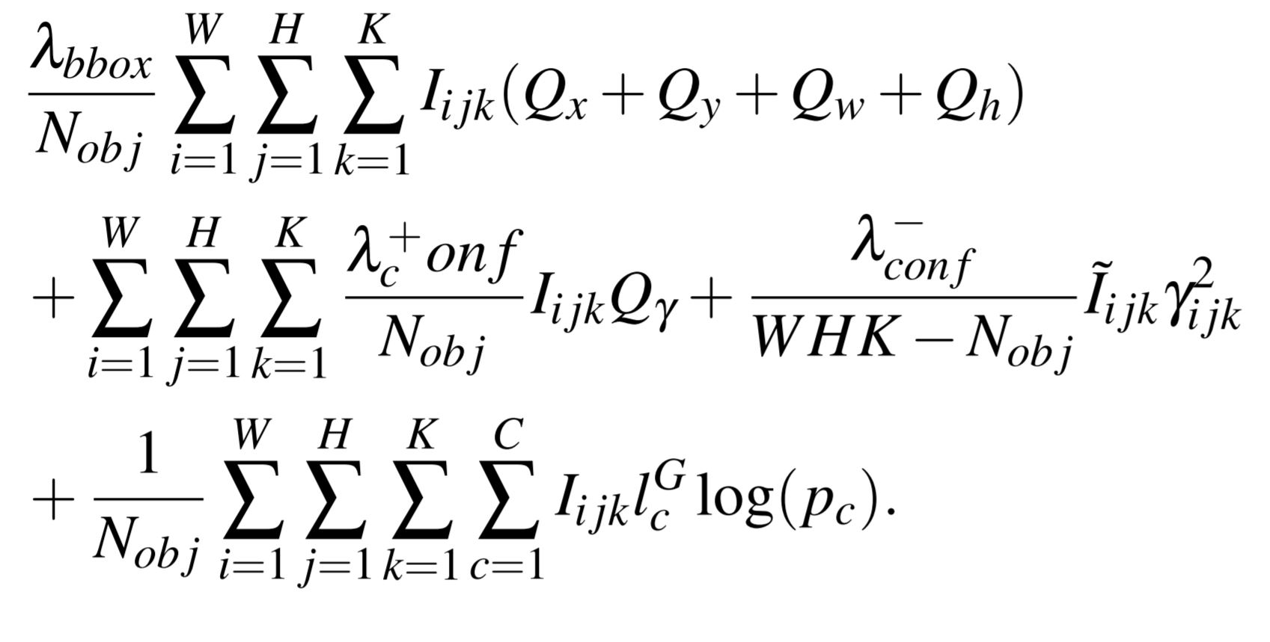
2.4 Feature Selective Small Object Detection via Knowledge-based Recurrent Attentive Neural Network
Loss Function:
The Loss function consists of three parts:
Bounding box regression
Confidence score regression
Cross entropy loss of classification
Results:
mAP of 81.3% at 30.8 FPS on KITTI dataset using Nvidia Titan X.
mAP of 57.8% at 37.5 FPS on COCO dataset (only the pedestrian class tested) using Nvidia Titan X.

Slide 16
Agenda
Intro
Feature-based Video Object Detection
Definition
Recurrent Multi-frame Single Shot Detector for Video Object Detection
Mobile Video Object Detection with Temporally aware Feature Maps
Feature Selective Small Object Detection via Knowledge-based recurrent attentive neural networks
Looking fast and slow: memory-guided mobile video object detection
Delving Deeper into Convolutional Networks for Learning Video Representations
Detect to track and track to detect
Box-Level-based Video Object Detection
Flow-based Video Object Detection
Comparison of different approaches
Outro

Slide 17
2.5 Looking Fast and Slow: Memory-Guided Mobile Video Object Detection
Architecture
Interleaving Policy
Frames (t) Feature Extractors LSTM States
Run multiple feature extractors sequentially or concurrently to obtain feature maps.
The idea is to use small and large feature extractors to optimize performance
Aggregate and refine these feature maps using convolutional LSTM based memory network.
To improve speed of LSTM network, add skip connections and LSTM state groups.
Apply SSD-style detection on refined features to obtain classification and bounding boxes.
Use a reinforcement learning based policy for selection of which feature extractor to run.
Large and small frame extractors can run in parallel using asynchronous mode.
MobileNetV2 (Small)
Conv. LSTM
Detection
C t-2
MobileNetV2 (Small)
Conv. LSTM
Detection
C t-1
Action ɑ
MobileNetV2 (Large)
Conv. LSTM
Detection
H t-2
MobileNetV2 (Small)
Conv. LSTM
Detection
H t-1
MobileNetV2 (Small)
Conv. LSTM
Detection

Slide 18
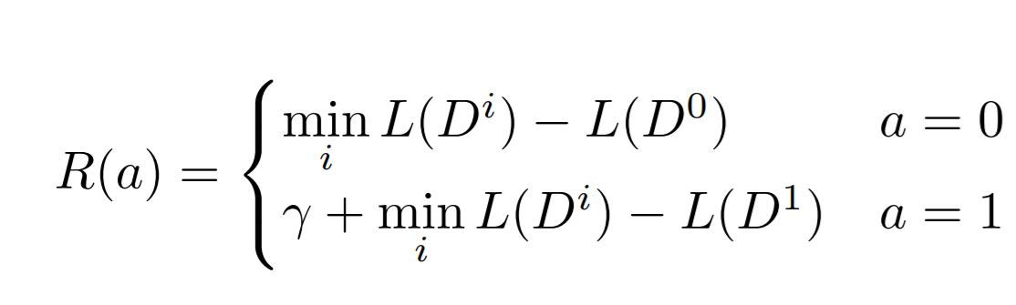
2.5 Looking Fast and Slow: Memory-Guided Mobile Video Object Detection
Loss Function:
Reinforcement Learning Policy
The Loss function consists of two parts:
Bounding box regression
Cross entropy loss of classification
Results:
mAP of 60.7% at 48.8 fps on ImageNet VID dataset using a Pixel 3 phone

Slide 19
Agenda
Intro
Feature-based Video Object Detection
Definition
Recurrent Multi-frame Single Shot Detector for Video Object Detection
Mobile Video Object Detection with Temporally aware Feature Maps
Feature Selective Small Object Detection via Knowledge-based recurrent attentive neural networks
Looking fast and slow: memory-guided mobile video object detection
Detect to track and track to detect
Box-Level-based Video Object Detection
Flow-based Video Object Detection
Comparison of different approaches
Outro

Slide 20
2.7 Detect to track and track to detect
Frame Loss
Time t
Time t+T
Compute Convolutional feature maps using a Resnet-101 architecture.
Use a RPN (region proposal network) to find candidate regions in the frame.
ROI Pooling layer, to classify boxes and refine their coordinates (regression).
Find correlation features between two frames’ feature maps and do ROI tracking.
Due to memory constraints, use tracklets, which are class-based optimal paths in video.
cls
Resnet-101 Backend
Region Proposal Network
ROI Pooling
Prediction
reg
Corr (*)
ROI tracking
track
cls
Resnet-101 Backend
Region Proposal Network
ROI Pooling
Prediction
reg

Slide 21
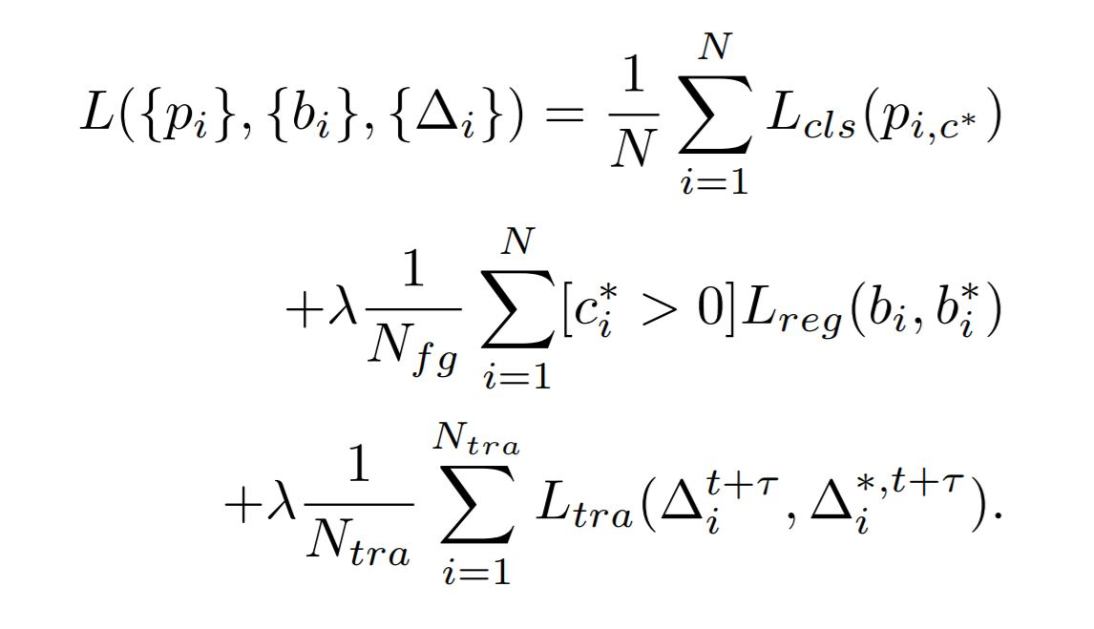
2.7 Detect to track and track to detect
Loss Function:
The Loss function consists of three parts:
The cross entropy classification loss.
The bounding box regression loss
The tracking regression loss.
Results:
mAP of 82.0% at 7 fps on ImageNet VID dataset using a Nvidia TITAN X or
mAP of 78.5% at 55 fps on ImageNet VID dataset using a Nvidia TITAN X

Slide 22
Agenda
Intro
Feature-based Video Object Detection
Box-Level-based Video Object Detection
Definition
Context Matters: Refining Object Detection in Video with Recurrent Neural Networks
Object Detection from Video Tubelets with Convolutional Neural Networks
Optimizing Video Object Detection via Scale-Time Lattice
Spatially Supervised Recurrent Convolutional Neural Networks for Visual Object Tracking
Flow-based Video Object Detection
Comparison of different approaches
Outro

Slide 23
3.1 Definition
Bounding boxes + class probabili
Bounding boxes + class probabilities
Video Object detection Network
Refined
bounding boxes + class probabilities
Bounding Boxes and Class probabilities are fed into the network and are refined temporally and/or spatially

Slide 24
Agenda
Intro
Feature-based Video Object Detection
Box-Level-based Video Object Detection
Definition
Object Detection from Video Tubelets with Convolutional Neural Networks
Optimizing Video Object Detection via Scale-Time Lattice
Context Matters: Refining Object Detection in Video with Recurrent Neural Networks
Spatially Supervised Recurrent Convolutional Neural Networks for Visual Object Tracking
Flow-based Video Object Detection
Comparison of different approaches
Outro

Slide 25
3.2 Object Detection from Video Tubelets with Convolutional Neural Networks
Image Object Proposal
Object Proposal
Rescoring
High Conf. Proposal Tracking
Tubelet box perturbation and max-pooling
Temporal convolution and re-scoring
Use selective search algorithm to generate around 2000 object proposals on each frame.
Use GoogleNet for feature extraction and then 30 SVMs for 30 VID classes to generate object proposal scores for each object proposal.
Track high confidence targets bi-directionally.
Two kinds of Perturbations:
The first method is to generate new boxes around each tubelet box on each frame by randomly perturbing the boundaries of the tubelet box.
The second perturbation method is to replace each tubelet box with original object detections that have overlaps with the tubelet box beyond a threshold.
Train a class-specific TCN using the tubelet features as input. The inputs are time series including detection scores, tracking scores and anchor offsets. The output values are probabilities whether each tubelet box contains objects of the class.
.

Slide 26
Agenda
Intro
Feature-based Video Object Detection
Box-Level-based Video Object Detection
Definition
Object Detection from Video Tubelets with Convolutional Neural Networks
Optimizing Video Object Detection via Scale-Time Lattice
Context Matters: Refining Object Detection in Video with Recurrent Neural Networks
Spatially Supervised Recurrent Convolutional Neural Networks for Visual Object Tracking
Flow-based Video Object Detection
Comparison of different approaches
Outro

Slide 27
3.3 Optimizing Video Object Detection via a Scale-Time Lattice
Time Scale Lattice
Propagation and Refinement Unit
Scale
B
(t,s)
B
(t,s+1)
Detection
B (t+T,s)
B (t+T,s+1)
Detection
B
(t+2T,s)
B
(t+2T,s+1)
Time
Apply object detection on keyframes extracted adaptively.
The extraction policy is based on number of objects and amount of movement in frames.
If higher number/movement of objects in frames then higher extraction rate.
Propagation and refinement unit, propagates the frames temporally and refines spatially.
For temporal propagation, use a small network such as resnet-18 to extract box features and a regressor to predict object movement from t to t + T.
For spatial refinement, use a regressor to refine the bounding boxes over increasing scale.

Slide 28
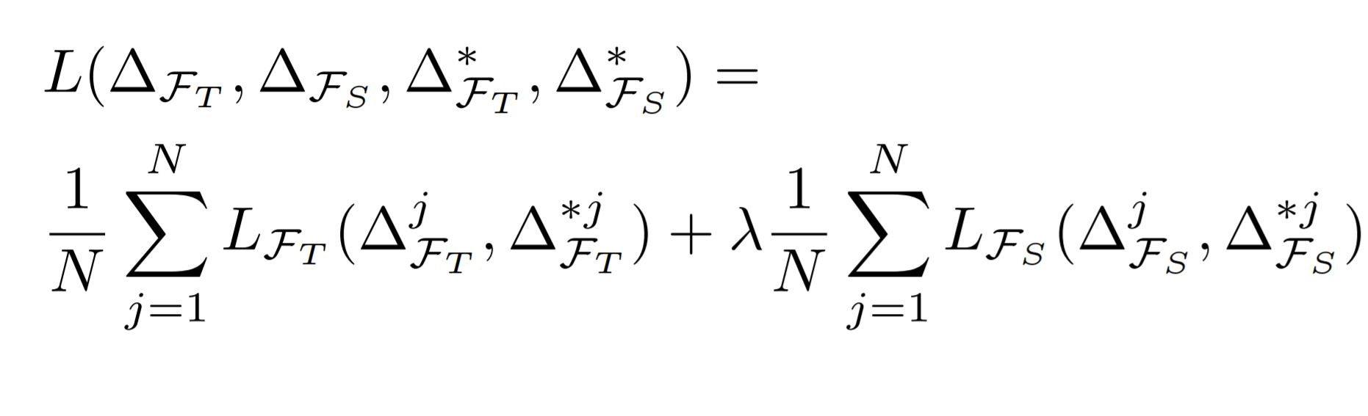
3.3 Optimizing Video Object Detection via a Scale-Time Lattice
Loss Function:
The Loss function consists of two parts:
Smooth L1 loss of temporal propagation.
Smooth L1 loss of spatial refinement.
Result:
mAP of 79.6% at 20 fps on ImageNet VID dataset using Nvidia Titan X or
mAP of 79% at 62 fps on ImageNet VID using Nvidia Titan X

Slide 29
Agenda
Intro
Feature-based Video Object Detection
Box-Level-based Video Object Detection
Definition
Object Detection from Video Tubelets with Convolutional Neural Networks
Optimizing Video Object Detection via Scale-Time Lattice
Context Matters: Refining Object Detection in Video with Recurrent Neural Networks
Spatially Supervised Recurrent Convolutional Neural Networks for Visual Object Tracking
Flow-based Video Object Detection
Comparison of different approaches
Outro

Slide 30
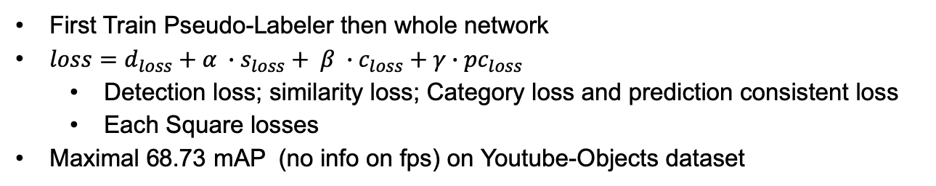
3.4 Context Matters: Refining Object Detection in Video with Recurrent Neural Networks
Pseudo- labeler
Pseudo labels
GRU
Bounding boxes + class probabilities
Pseudo-Labeler:
CNN
YOLO and RNN
Time t
Pseudo- labeler
Pseudo labels
GRU
Bounding boxes + class probabilities
Time t+1
Pseudo labels feed into GRU
…
Pseudo- labeler
Pseudo labels
GRU
Bounding boxes + class probabilities
Time t+T
[4]

Slide 31
Agenda
Intro
Feature-based Video Object Detection
Box-Level-based Video Object Detection
Definition
Object Detection from Video Tubelets with Convolutional Neural Networks
Optimizing Video Object Detection via Scale-Time Lattice
Context Matters: Refining Object Detection in Video with Recurrent Neural Networks
Spatially Supervised Recurrent Convolutional Neural Networks for Visual Object Tracking
Flow-based Video Object Detection
Comparison of different approaches
Outro

Slide 32
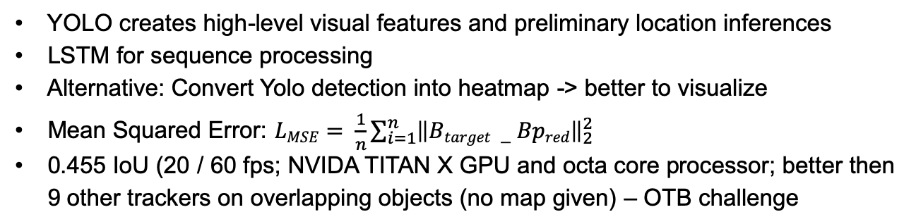
3.4 Spatially Supervised Recurrent Convolutional Neural Networks for Visual Object Tracking
YOLO
detection
LSTM
Bounding boxes + class probabilities
Time t
YOLO
detection
LSTM
Bounding boxes + class probabilities
Time t+1
…
YOLO
detection
LSTM
Bounding boxes + class probabilities
Time t+T
[5]

Slide 33
Agenda
Intro
Feature-based Video Object Detection
Box-Level-based Video Object Detection
Flow-based Video Object Detection
Definition
Deep Feature Flow for Video Recognition
Comparison of different approaches
Outro

Slide 34
4.1 Definition
F
Optical Flow
Uses Flow Network
Estimates the optical flow
Projects back location in current frame to location in an earlier frame
[3]

Slide 35
Agenda
Intro
Feature-based Video Object Detection
Box-Level-based Video Object Detection
Flow-based Video Object Detection
Definition
Deep Feature Flow for Video Recognition
Comparison of different approaches
Outro

Slide 36
4.2 Deep Feature Flow for Video Recognition
N_{feat}
N_{task}
Bounding boxes + class probabilities
Key frame
...
F
N_{task}
Bounding boxes + class probabilities
Current frame
3 different Networks:
N_{feat} -> Feature Network (ResNet): Provides FeatureMaps for Key frames
F -> Flow Network (FlowNet): Propagation of optical flow (feature maps)
N_{task} -> Classifies based on the feature maps (R-FCN)
Max. 73.9 % mAP on ImageNET VID Dataset (4.05 fps; 73.1% mAP – 20.25 fps); Max. 71.1% mIoU on Cityscapes Dataset (1.52 fps; 69.2& mIoU – 5.6 fps)
No information on loss function
Fixed Key frame scheduling => possible imporvement
[3]

Slide 37
Agenda
Intro
Feature-based Video Object Detection
Box-Level-based Video Object Detection
Flow-based Video Object Detection
Comparison of different approaches
General
Conclusion Computational power
Conclusion prediction quality
Outro

Slide 38
Results - KITTI Dataset
Model | MAP | FPS | Machine | Architecture
Recurrent Multi-frame Single Shot Detector for Video Object Detection | 86.0% | 50 | Nvidia Titan X | Feature - Level
Feature Selective Small Object Detection via Knowledge-based Recurrent Attentive Neural Network | 81.3% | 30.8 | Nvidia Titan X | Feature - Level

Slide 39
Results - ImageNet VID Dataset
Model | MAP | FPS | Machine | Architecture
Detect to track and track to detect | 82.0% | 7 | Nvidia TITAN X | Feature-Level
Optimizing Video Object Detection via a Scale-Time Lattice | 79.6% | 20 | Nvidia TITAN X | Box-Level
Optimizing Video Object Detection via a Scale-Time Lattice - Lightweight | 79% | 62 | Nvidia TITAN X | Box-Level
Detect to track and track to detect - Lightweight | 78.5% | 55 | Nvidia TITAN X | Feature-Level
DeepFeature Flow for Video Recognition | 73.9% | 3 |  | Flow-based
DeepFeature Flow for Video Recognition | 73.1% | 20.25 |  | Flow-based
Looking Fast and Slow: Memory-Guided Mobile Video Object Detection | 60.7% | 48.8 | Pixel 3 Phone | Feature-level
Mobile Video Object Detection with Temporally-Aware Feature Maps | 54.4% | 15 | Pixel 2 Phone | Feature-level

Slide 40
Results - COCO Dataset
Model | MAP | FPS | Machine
Feature Selective Small Object Detection via Knowledge-based Recurrent Attentive Neural Network | 57.8% | 37.5 | Nvidia Titan X

Slide 41
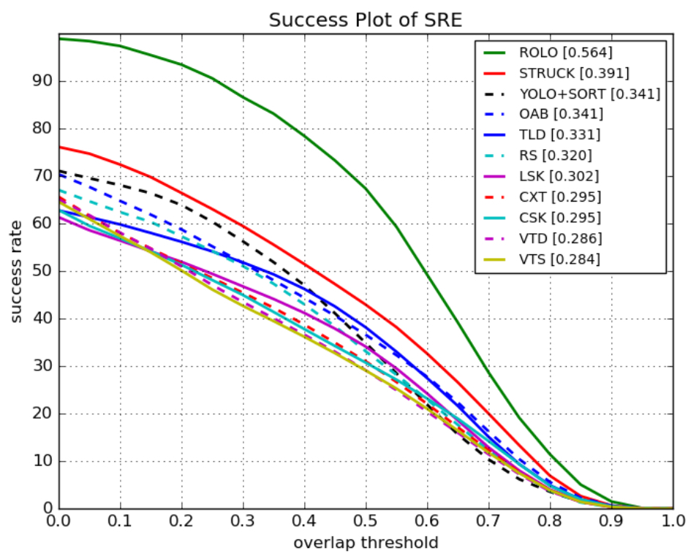
Results - OTB Challenge Dataset
Model | Success rate | IoU | FPS | Machine
Spatially Supervised Recurrent Convolutional Neural Networks for Visual Object Tracking | 0.564 | 0.455 | 20 / 60 fps | Nvidia Titan X
Succes plot of Spatial Robustness Evaluation on OTB-30 [5]

Slide 42
Agenda
Intro
Feature-based Video Object Detection
Box-Level-based Video Object Detection
Flow-based Video Object Detection
Comparison of different approaches
General
Conclusion Performance
Conclusion prediction quality
Outro

Slide 43
5.2 Conclusion Performance
Observation
Hypothesis
Networks with more convolutional aspects perform better and provide better results then recurrent [6], [10]
RNNs by definition have a recurrent nature and this can be a bottleneck for Video Object detection in real time
Networks employing an intelligent keyframe extraction policies gain performance benefits [7], [8]
Processing each and every frame of the video is not an efficient way of Video object detection
A lot of performance can be gained by compromising a little on the results [8], [10]
It is important to have a flexible network so that different aspects e.g. depth, keyframe extraction policy can be modified depending upon the application easily
Propagating multiple frames at the same time through the network results in better performance [8], [10]
Networks processing multiple frames at the same time can provide better flexibility on how to propagate them through the network

Slide 44
Agenda
Intro
Feature-based Video Object Detection
Box-Level-based Video Object Detection
Flow-based Video Object Detection
Comparison of different approaches
General
Conclusion Computational power
Conclusion prediction quality
Outro

Slide 45
5.3 Conclusion Prediction Quality
Observation
Hypothesis
[8] and [10] on ImageNet Vid and both processing on multiple frames
Very beneficial to use previous and future frames
[1] better prediction quality then [6] on KITTI
RNN processing on multiple frames better then RNNs processing on regions within a single frame
[10] good results
Beneficial to use RNNs to look also on different scales not only at different time steps
[2] with multiple LSTMs comparatively bad
one RNN module is enough
[3] comparatively low map on ImageNet Vid
better to use Box-level or Feature-level approaches instead of FlowNets
[5] leading results on OTB challenge dataset
Combination of Box-Level and Feature-Level approaches leads to promising results

Slide 46
Agenda
Intro
Feature-based Video Object Detection
Box-Level-based Video Object Detection
Flow-based Video Object Detection
Comparison of different approaches
Outro
Conclusion
Further work

Slide 47
6.1 Conclusion
RNN
Beneficial to use RNNs in comparisons to similar non-recurrent networks
Comparatively good results can also be reached with non-recurrent networks, but temporal context matters
General
Good to operate on multiple frames at the same time
Recurrent layers should not be to deep
Beneficial to operate on different scales
Import to use a intelligent key frame policy
[5]

Slide 48
Agenda
Intro
Feature-based Video Object Detection
Box-Level-based Video Object Detection
Flow-based Video Object Detection
Comparison of different approaches
Outro
Conclusion
Further work

Slide 49
6.2 Further Work
t-3
t-2
t-1
t
Video Object Detection Network
Region Bounding boxes + class probabilities
4-frame RPN
Affine Transformations
Bounding boxes + class probabilities
Overview
A region proposal network that is based on the N-Gram concept in Natural Language Processing.
Given a window of N previous frames propose the regions where the object bounding boxes could be detected from within the next frame.
The RPN (region proposal network) should be recurrent in nature for detecting the temporal dependencies and can be very lightweight.
Use only those region proposals and feed them to the video object detection network.
So rather than feeding the whole image, feed only the region proposals made by RPN.
Perform affine transformations to the output bounding boxes to overlay them over the image.
Potential drawbacks
Region proposals can be of different resolutions depending upon the objects.
The RPN and the detection network have to lightweight otherwise RPN is just a overhead.

Slide 50
Sources
[1] | Alexander Broad, Michael Jones, Teng-Yok Lee. Recurrent Multi-frame Single Shot Detector for Video Object Detection. 2018.
[2] | Mason Liu, Menglong Zhu. Mobile Video Object Detection with Temporally-Aware Feature Maps. 2018.
[3] | Xizhou Zhu, Yuwen Xiong, Jifeng Dai, Lu Yuan, Yichen Wei. Deep Feature Flow for Video Recognition. 2017.
[4] | Subarna Tripathi, Zachary C. Lipton, Serge Belongie, Truong Nguyen. Context Matters: Refining Object Detection in Video with Recurrent Neural Networks.
[5] | Guanghan Ning, Zhi Zhang, Chen Huang, Zhihai He, Xiaobo Ren, Haohong Wang. Spatially Supervised Recurrent Convolutional Neural Networks for Visual Object Tracking. 2016.

Slide 51
Sources
[6] | Kai Yi, Zhiqiang Jian, Shitao Chen, Nanning Zheng. Feature Selective Small Object Detection via Knowledge-based Recurrent Attentive Neural Network. 2019.
[7] | Mason Liu, Menglong Zhu, Marie White, Yinxiao Li, Dmitry Kalenichenko. Looking Fast and Slow: Memory-Guided Mobile Video Object Detection. 2019.
[8] | Christoph Feichtenhofer, Axel Pinz, Andrew Zisserman. Detect to Track and Track to Detect. 2017.
[9] | Kai Kang, Wanli Ouyang, Hongsheng Li, Xiaogang Wang. Object Detection from Video Tubelets with Convolutional Neural Networks. 2016.
[10] | Kai Chen, Jiaqi Wang, Shuo Yang, Xingcheng Zhang, Yuanjun Xiong, Chen Change Loy, Dahua Lin. Optimizing Video Object Detection via a Scale-Time Lattice. 2018.

Slide 52
Sources
[11] | Ian Goodfellow, Yoshua Bengio, Aaron Courville Deep Learning (Adaptive Computation and Machine Learning) 2017
[12] | https://colah.github.io/posts/2015-08-Understanding-LSTMs/ visited on 26.06.2019
[13] | https://medium.com/mlrecipies/deep-learning-basics-gated-recurrent-unit-gru-1d8e9fae7280 visited on 27.06.2019
[14] | Alexander Broad, Michael Jones, Teng-Yok Lee, Supplementary Material for Recurrent Multi-frame Single Shot Detector for Video Object Detection

Slide 53
Questions?

