Slide 1

Recurrent Neural Networks for object detection
Ahmad Bin Qasim (03693345), Arnd Pettirsch (03708414)
Technical University of Munich
Department of Informatics
Chair of Robotics, Artificial Intelligence and Real-time Systems
Seminar: Visual Feature Learning in Autonomous Driving
Supervisor: Prof. Dr.-Ing. habil. Alois Christian Knoll,
M.Eng. Emec Ercelik
Garching, June 28th 2019

Slide 2
Agenda
Intro
Feature-based Video Object Detection
Box-Level-based Video Object Detection
Flow-based Video Object Detection
Comparison of different approaches
Outro

Slide 3
Agenda
Intro
Image and Video Object Detection in general
Recurrent Neural Networks in general
Feature-based Video Object Detection
Box-Level-based Video Object Detection
Flow-based Video Object Detection
Comparison of different approaches
Outro

Slide 4
1.1 Image and Video Object Detection
Image object detection history.
Bayesian methods before deep learning
ImageNet challenge and VID [15]
Deep Learning and AlexNet [16]
Single stage and 2-stage image object detectors.
A two-stage pipeline firstly generates region proposals, which are then classified and refined. (R-CNN, Fast R-CNN, Faster R-CNN). [17]
A single-stage method is often more efficient but less accurate. Directly regress on bounding boxes and classes. (YOLOv3, SSD) [18], [19]
Why is video object detection harder?
Large size
Motion blur
Quality of the dataset
Partial occlusion
Unconventional Poses
Notes:
2:30
Image Object Detection methods used before advent of Deep Learning:
Bag of Visual Words (BOVW)
Part-based models
Discriminative Models (Logistic Regression, Support Vector Machines etc.)
Generative Models (Gaussian Mixture Models etc.)

Slide 5
Agenda
Intro
Image and Video Object Detection in general
Recurrent Neural Networks in general
Feature-based Video Object Detection
Box-Level-based Video Object Detection
Flow-based Video Object Detection
Comparison of different approaches
Outro

Slide 6

1.2 Recurrent Neural Networks
Neural Network:
Recurrent Neural Network (RNN):
Bb & CP
Bb & CP
Bb & CP
Bb & CP
NN
NN
NN
NN
=> Processing sequences of data
t
Types of Recurrent Neural Networks:
Long-Short Term Memory Units (LSTM)
Gated Recurrent Unit (GRU)
Bb & CP
Bb & CP
Bb & CP
Bb & CP
Bb & CP
Bb & CP
LSTM
LSTM
GRU
GRU
[11]
[12]
[13]
Notes:
4:00
· Neural Network
o Input (e.g. Image) -> NN -> Output (e.g. Bounding Boxes and Class probabilities
· Recurrent Neural Networks (RNN)
o Processing sequential data
o Core concept: Parameter sharing - developed in the 80s
o Parameter sharing over sequence e.g.: Time by adding cycles into the computational graph
o Cycles drawn in a time sequence “connections” between time steps
o Source: DeepLearning Book
· Lots of different approaches and versions -> introduce two popular recurrent units:
· Long-Short Term Memory Units (LSTM)
o RNNs helpful to get the context from previous information
§ E.g.: “the clouds are in the sky” -> easy to predict the word “sky”
o Sometimes relevant information further back
§ E.g.: I grew up in France… I can speak France fluently”
§ -> RNN not able to learn this
o LSTM addresses this problem -> long-term dependencies
o 4 repeating layers instead of 1
o Key of LSTM: cell state
§ LSTM can remove or add information to cell state; e.g.: France
§ Regulated by structures called gates -> e.g.: do not add information from the word “can”
o Source:https://colah.github.io/posts/2015-08-Understanding-LSTMs/
· Gated Recurrent Unit (GRU)
o Main difference to LSTM is that single gating unit simultaneously controls the forgetting factor and the decision to update the state unit
o Source: Deep Learning book

Slide 7
Agenda
Intro
Feature-based Video Object Detection
Definition
Recurrent Multi-frame Single Shot Detector for Video Object Detection
Mobile Video Object Detection with Temporally aware Feature Maps
Feature Selective Small Object Detection via Knowledge-based recurrent attentive neural networks
Looking fast and slow: memory-guided mobile video object detection
Delving Deeper into Convolutional Networks for Learning Video Representations
Detect to track and track to detect
Box-Level-based Video Object Detection
Flow-based Video Object Detection
Comparison of different approaches
Outro

Slide 8
2.1 Definition
Feature Extractor
RNN
(Detection Unit)
Bounding boxes + class probabilities
Time t
Feature Extractor
RNN
Time t+1
Features feeded into the RNN
Notes:
· Based on the paper: Recurrent Multi-frame Single Shot Detector for Video Object Detection which differs between feature-level approaches and box-level techniques
· Feature-level approaches use detectors which integrate features from multiple frames
· Sometimes detection unit integrated in RNN

Slide 9
Agenda
Intro
Feature-based Video Object Detection
Definition
Recurrent Multi-frame Single Shot Detector for Video Object Detection
Mobile Video Object Detection with Temporally aware Feature Maps
Feature Selective Small Object Detection via Knowledge-based recurrent attentive neural networks
Looking fast and slow: memory-guided mobile video object detection
Delving Deeper into Convolutional Networks for Learning Video Representations
Detect to track and track to detect
Box-Level-based Video Object Detection
Flow-based Video Object Detection
Comparison of different approaches
Outro

Slide 10
2.2 Recurrent Multi-frame Single Shot Detector for Video Object Detection
Feature Extractor
GRU
Detection head
Bounding boxes + class probabilities
Time t
Feature Extractor
GRU
Based on SSD
RNN best fusion unit
2.7% - 5% improvement in comparison to non-recurrent models
Based on SequeezeNet+ - Architecture (SSD-Network)
Time t-1
Feature Extractor
GRU
Time t-2
Feature Extractor
GRU
Time t-3
Recurrent-Layer for Data fusion
[1]
[14]
Notes:
· Single Shot Detector (SSD) meta-architecture two components
o Feature Extractor
§ Convolutional and pooling layer
§ Input: Image
§ Output: Feature maps
o Detection Head
§ Convolutional layer
§ Input: Feature Maps
§ Output: Bounding Boxes and Class probabilities
· Main difference: Fusion layer after feature extractor
o Can be simple element-wise operation (add or max), simple concatenation of feature maps or a recurrent layer
o Best results with recurrent layer => RNN good fusion technique
· Output fed into standard SSD detection head -> no extra labeled data necessary
· Input into RNN only feature maps of previous time-steps
· GRU; similar results then LSTM but faster
· SqueezeDet+ as baseline SSD -> because it achieves state-of-the-art results on KITTI
· Different baseline SSD improvement for all with recurrancy
· 2.7% improvement to baseline SSD => RNN improves detection quality
· No big lack in speed 55 fps to 50 fps
· No info on loss function even not in supplementary material
· Using SequeezeNet Training strategies. First Pretrain SSD and then fine tuing strategy for RMFSSD

Slide 11
Agenda
Intro
Feature-based Video Object Detection
Definition
Recurrent Multi-frame Single Shot Detector for Video Object Detection
Mobile Video Object Detection with Temporally aware Feature Maps
Feature Selective Small Object Detection via Knowledge-based recurrent attentive neural networks
Looking fast and slow: memory-guided mobile video object detection
Delving Deeper into Convolutional Networks for Learning Video Representations
Detect to track and track to detect
Box-Level-based Video Object Detection
Flow-based Video Object Detection
Comparison of different approaches
Outro

Slide 12
2.3 Mobile Video Object Detection with Temporally-Aware Feature Maps
Conv.
Conv. LSTM
Conv.
Conv. LSTM
Conv.
Conv. LSTM
Bounding boxes + class probabilities
Time t
Conv.
Conv. LSTM
Conv.
Conv. LSTM
Conv.
Conv. LSTM
Bounding boxes + class probabilities
Time t-1
Conv.
Conv. LSTM
Conv.
Conv. LSTM
Conv.
Conv. LSTM
Bounding boxes + class probabilities
Time t-2
13-Layers
Bottleneck-LSTMs
Developed for Mobile Devices
Based on SSD-Network (MobileNet)
Based on SSD-Network, with different numbers of LSTMs after Conv. Layers
Bottleneck-LSTMs to increase the computation speed
[2]
Notes:
8:00
· Joined recurrent convolutional layer
o Combining standard convolutional layer with recurrent unit
· Better then efficient single-frame baselines -> improvement must be due considering temporal context because no add of discriminative power
· On top of SSD network
· Bottleneck-LSTM with depthwise separable convolutions and bottleneck-design to reduce computational cost
o Reduces the number of input channels => bottleneck featuremap
o Fewer outputs then input channel
o More efficient then LSTM; and more efficient then GRU if there is more then one object in the frame
o More efficient comparable perfomance
· Mobilenet as baseline SSD
o Replaced all convolutions with depth wise separable convolutions
o Remove final layer
· Add LSTM directly in SSD -> both temporal and spatial information encoded
· LSTM state as features representing temporal context
· LSTM first after Conv Layer 13 -> loest spatial dimension -> save computational cost
· Multiplier to decrease channel size -> lower costs e.g. Output of LSTM 0.25 of input
· Only uses previous frames for detection
· Multiple LSTM small benefit to single LSTM
· Training
o RMSprop and asynchronous gradien descent
o First finetune SSD without LSTM up to Layer 13
Outperformance Mobilenet -> RNN good

Slide 13
Agenda
Intro
Feature-based Video Object Detection
Definition
Recurrent Multi-frame Single Shot Detector for Video Object Detection
Mobile Video Object Detection with Temporally aware Feature Maps
Feature Selective Small Object Detection via Knowledge-based recurrent attentive neural networks
Looking fast and slow: memory-guided mobile video object detection
Delving Deeper into Convolutional Networks for Learning Video Representations
Detect to track and track to detect
Box-Level-based Video Object Detection
Flow-based Video Object Detection
Comparison of different approaches
Outro

Slide 14
2.4 Feature Selective Small Object Detection via Knowledge-based Recurrent Attentive Neural
Network
Conv. LSTM H1
Learned domain and intuitive knowledge
Frame
Compute feature maps using a modified SqueezeNet architecture.
Propagate the features through a Recurrent Attentive Neural Network, comprised of:
Attention Mechanism to detect key areas within the feature maps.
Convolutional LSTM for temporal feature propagation.
Reverse gaussian feature maps are combined with the maps obtained from Conv. LSTM.
These feature maps are based on learnable mean and covariance terms.
This prior knowledge is derived from the assumption that traffic signs are always located at the bias of the center.
Attention X1
Attention X2
Conv. LSTM H2
SqueezeNet
Softmax Regression
...
...
Bounding boxes + class probabilities
Attention XT
Conv. LSTM HT
Notes:
SqueezeNet source: Forrest N. Iandola, Song Han, Matthew W. Moskewicz, Khalid Ashraf, William J. Dally, Kurt Keutzer. Squeezenet: Alexnet-level Accuracy With 50x Fewer Parameters and <.5mb Model Size. 2016
The modifications carried out to SqueezeNet in this paper where: (they call it SqueezeNet+)
The original 7 7 kernel size is replaced by two 3 3 kernel size.
Introduce the fully convolutional layer in backbone.
Add two Fire modules at the end of the original model, thus setting up a new fine-tuned backbone.
Attention source: Ashish Vaswani, Noam Shazeer, Niki Parmar, Jakob Uszkoreit, Llion Jones, Aidan N. Gomez, Lukasz Kaiser, Illia Polosukhin. Attention Is All You Need. 2017.
https://medium.com/syncedreview/a-brief-overview-of-attention-mechanism-13c578ba9129

Slide 15
Agenda
Intro
Feature-based Video Object Detection
Definition
Recurrent Multi-frame Single Shot Detector for Video Object Detection
Mobile Video Object Detection with Temporally aware Feature Maps
Feature Selective Small Object Detection via Knowledge-based recurrent attentive neural networks
Looking fast and slow: memory-guided mobile video object detection
Delving Deeper into Convolutional Networks for Learning Video Representations
Detect to track and track to detect
Box-Level-based Video Object Detection
Flow-based Video Object Detection
Comparison of different approaches
Outro

Slide 16
2.5 Looking Fast and Slow: Memory-Guided Mobile Video Object Detection
Architecture
Interleaving Policy
Frames (t) Feature Extractors LSTM States
Run multiple feature extractors sequentially or concurrently to obtain feature maps.
The idea is to use small and large feature extractors to optimize performance
Aggregate and refine these feature maps using convolutional LSTM based memory network.
To improve speed of LSTM network, add skip connections and LSTM state groups.
Apply SSD-style detection on refined features to obtain classification and bounding boxes.
Use a reinforcement learning based policy for selection of which feature extractor to run.
Large and small frame extractors can run in parallel using asynchronous mode.
MobileNetV2 (Small)
Conv. LSTM
Detection
C t-2
MobileNetV2 (Small)
Conv. LSTM
Detection
C t-1
Action ɑ
MobileNetV2 (Large)
Conv. LSTM
Detection
H t-2
MobileNetV2 (Small)
Conv. LSTM
Detection
H t-1
MobileNetV2 (Small)
Conv. LSTM
Detection
Notes:
MobileNetV2 source: Mark Sandler, Andrew Howard, Menglong Zhu, Andrey Zhmoginov, Liang-Chieh Chen. MobileNetV2: Inverted Residuals and Linear Bottlenecks. 2019.
The MobileNetV2 architecture is based on an inverted residual structure where the input and output of the residual block are thin bottleneck layers opposite to traditional residual models which use expanded representations in the input an MobileNetV2 uses lightweight depthwise convolutions to filter features in the intermediate expansion layer.
Changes in the Convolutional LSTM:
They adopt the bottlenecking proposed in and add a skip connection between the bottleneck and output so that the bottleneck is part of the output. They also divide the LSTM state into groups and use grouped convolutions to process each one separately.

Slide 17
Agenda
Intro
Feature-based Video Object Detection
Definition
Recurrent Multi-frame Single Shot Detector for Video Object Detection
Mobile Video Object Detection with Temporally aware Feature Maps
Feature Selective Small Object Detection via Knowledge-based recurrent attentive neural networks
Looking fast and slow: memory-guided mobile video object detection
Detect to track and track to detect
Box-Level-based Video Object Detection
Flow-based Video Object Detection
Comparison of different approaches
Outro

Slide 18
2.7 Detect to track and track to detect
Frame Loss
Time t
Time t+T
Compute Convolutional feature maps using a Resnet-101 architecture.
Use a RPN (region proposal network) to find candidate regions in the frame.
ROI Pooling layer, to classify boxes and refine their coordinates (regression).
Find correlation features between two frames’ feature maps and do ROI tracking.
Due to memory constraints, use tracklets, which are class-based optimal paths in video.
cls
Resnet-101 Backend
Region Proposal Network
ROI Pooling
Prediction
reg
Corr (*)
ROI tracking
track
cls
Resnet-101 Backend
Region Proposal Network
ROI Pooling
Prediction
reg
Notes:
An extension of R-FCN by extending the multi-task objective of R-FCN with a tracking loss that regresses object coordinates across frames.
R-FCN source: Jifeng Dai, Yi Li, Kaiming He, Jian Sun. R-FCN: Object Detection via Region-based Fully Convolutional Networks. 2016.
Drawbacks of using the ROI tracking on correlation maps:
Such an approach is that it does not exploit translational equivariance which means that the tracker has to learn all possible translations from training data. Thus such a tracker requires exceptional data augmentation (artificially scaling and shifting boxes) during training.
RoI Pooling:
It is a type of pooling layer which performs max pooling on inputs of non-uniform sizes and produces a small feature map of fixed size (say 7x7). The choice of this fixed size is a network hyper-parameter and is predefined.
RoI Tracking:
Correlation Maps:
They restrict correlation to a local neighbourhood.

Slide 19
Agenda
Intro
Feature-based Video Object Detection
Box-Level-based Video Object Detection
Definition
Object Detection from Video Tubelets with Convolutional Neural Networks
Optimizing Video Object Detection via Scale-Time Lattice
Context Matters: Refining Object Detection in Video with Recurrent Neural Networks
Spatially Supervised Recurrent Convolutional Neural Networks for Visual Object Tracking
Flow-based Video Object Detection
Comparison of different approaches
Outro

Slide 20
3.1 Definition
Bounding boxes + class probabili
Bounding boxes + class probabilities
Video Object detection Network
Refined
bounding boxes + class probabilities
Bounding Boxes and Class probabilities are fed into the network and are refined temporally and/or spatially

Slide 21
Agenda
Intro
Feature-based Video Object Detection
Box-Level-based Video Object Detection
Definition
Optimizing Video Object Detection via Scale-Time Lattice
Context Matters: Refining Object Detection in Video with Recurrent Neural Networks
Spatially Supervised Recurrent Convolutional Neural Networks for Visual Object Tracking
Flow-based Video Object Detection
Comparison of different approaches
Outro

Slide 22
3.2 Optimizing Video Object Detection via a Scale-Time Lattice
Scale
B
(t,s)
B
(t,s+1)
Detection
B (t+T,s)
B (t+T,s+1)
Detection
B
(t+2T,s)
B
(t+2T,s+1)
Time
Apply object detection on keyframes extracted adaptively.
The extraction policy is based on number of objects and amount of movement in frames.
If higher number/movement of objects in frames then higher extraction rate.
Propagation and refinement unit, propagates the frames temporally and refines spatially.
For temporal propagation, use a small network such as resnet-18 to extract box features and a regressor to predict object movement from t to t + T.
For spatial refinement, use a regressor to refine the bounding boxes over increasing scale.
Notes:
Temporal Propagation:
They adopt Motion History Image (MHI) as the motion representation which can be computed very efficiently and preserve sufficient motion information for the propagation.
They use a small network (ResNet-18 in our experiments) with RoIAlign layer to extract the features of each box region. On top of the RoI-wise features, a regressor is learned to predict the object movement from t to t+T.
RoIAlign:
Unlike the RoI pooling layer, RoI Align does not adjust the input proposal from RPN to fit the feature map correctly. It simply takes the object proposal and divides it into a certain number of bins. In each bin, a certain number of points are sampled and value at those points is determined using the bilinear interpolation.

Slide 23
Agenda
Intro
Feature-based Video Object Detection
Box-Level-based Video Object Detection
Definition
Optimizing Video Object Detection via Scale-Time Lattice
Context Matters: Refining Object Detection in Video with Recurrent Neural Networks
Spatially Supervised Recurrent Convolutional Neural Networks for Visual Object Tracking
Flow-based Video Object Detection
Comparison of different approaches
Outro

Slide 24
3.3 Context Matters: Refining Object Detection in Video with Recurrent Neural Networks
Pseudo-labeler
Bounding boxes + class probabilities
GRU
Bounding boxes + class probabilities
Time t
Pseudo-labeler
Bounding boxes + class probabilities
GRU
Bounding boxes + class probabilities
Time t+1
…
Pseudo-labeler
Bounding boxes + class probabilities
GRU
Bounding boxes + class probabilities
Time t+T
Pseudo-labeler (CNN, YOLO, …) assigns provisional labels to all frames
Pseudo labels fed into GRU to output refined predictions
First Train Pseudo-Labeler then whole network
Failure cases:
RNN can’t recover from incorrect pseudo-labels
Fail on localization when multiple instances of same object
[4]
Notes:
· First train pseudo labeler – CNN for object detection
· Pseudo-labeler
o Domain-adapted CNN – in this case YOLO
· Then RNN
·
· Detection loss; similarity loss; Category loss and prediction consistent loss
· Each Square losses
· Maximal 68.73 mAP (no info on fps) on Youtube-Objects dataset
· Wrong prediction fed into RNN -> can not recover
· Due to movement and close procimity failure case 2 wrong localization
· 7.1 improvement in comparison to DA-YOLO

Slide 25
Agenda
Intro
Feature-based Video Object Detection
Box-Level-based Video Object Detection
Definition
Optimizing Video Object Detection via Scale-Time Lattice
Context Matters: Refining Object Detection in Video with Recurrent Neural Networks
Spatially Supervised Recurrent Convolutional Neural Networks for Visual Object Tracking
Flow-based Video Object Detection
Comparison of different approaches
Outro

Slide 26
3.4 Spatially Supervised Recurrent Convolutional Neural Networks for Visual Object Tracking
YOLO
detection
LSTM
Bounding boxes + class probabilities
Time t
YOLO
detection
LSTM
Bounding boxes + class probabilities
Time t+1
…
YOLO
detection
LSTM
Bounding boxes + class probabilities
Time t+T
Combines Box-Level and Feature-Level approach
YOLO creates location proposals and high-level-features
Bounding boxes and high-level features fed into LSTM
Alternative: convert Bounding boxes into heat map -> better to visualize
[5]
Notes:
· Combines Feature and Box-level approach
· LSTM fed with High-level visual feature with region information
o YOLO to create features and region informations
· First pre-train yolo
· Only Bounding-boxes no class probabilities fed into LSTM
· Location prediction can be also converted into heat-map

Slide 27
Agenda
Intro
Feature-based Video Object Detection
Box-Level-based Video Object Detection
Flow-based Video Object Detection
Definition
Deep Feature Flow for Video Recognition
Comparison of different approaches
Outro

Slide 28
4.1 Definition
F
Optical Flow
Uses Flow Network
Estimates the optical flow
Projects back location in current frame to location in an earlier frame
[3]

Slide 29
Agenda
Intro
Feature-based Video Object Detection
Box-Level-based Video Object Detection
Flow-based Video Object Detection
Definition
Deep Feature Flow for Video Recognition
Comparison of different approaches
Outro

Slide 30
4.2 Deep Feature Flow for Video Recognition
N_{feat}
N_{task}
Bounding boxes + class probabilities
Key frame
...
F
N_{task}
Bounding boxes + class probabilities
Current frame
3 different Networks:
N_{feat} -> Feature Network (ResNet): Provides FeatureMaps
F -> Flow Network (FlowNet): Propagation of optical flow (feature maps)
N_{task} -> Classifies based on the feature maps (R-FCN)
Uses fixed Key frame scheduling => possible improvement
Not Recurrent
[3]
Notes:
24:00
· Feature Network
o Fully convolutional
o Outputs feature maps
o ResNet
· Task Network
o Recognition over the feature maps
o R-FCN
· Similarity in frames even stronger in deeper feature maps
· Flow Network
o Propagates back the location in current frame to lacation in key frame
o Flow network depends on
§ Feature warping (interpolation)
§ Flow field
§ Scale field
o State of the art CNN FLowNet

Slide 31
Agenda
Intro
Feature-based Video Object Detection
Box-Level-based Video Object Detection
Flow-based Video Object Detection
Comparison of different approaches
General
Conclusion Computational power
Conclusion prediction quality
Outro

Slide 32
5.1 Results - KITTI Dataset
Model | MAP | FPS | Machine | Architecture
Recurrent Multi-frame Single Shot Detector for Video Object Detection | 86.0% | 50 | Nvidia Titan X | Feature - Level
Feature Selective Small Object Detection via Knowledge-based Recurrent Attentive Neural Network | 81.3% | 30.8 | Nvidia Titan X | Feature - Level

Slide 33
Results - ImageNet VID Dataset
Model | MAP | FPS | Machine | Architecture
Detect to track and track to detect | 82.0% | 7 | Nvidia TITAN X | Feature-Level
Optimizing Video Object Detection via a Scale-Time Lattice | 79.6% | 20 | Nvidia TITAN X | Box-Level
Optimizing Video Object Detection via a Scale-Time Lattice - Lightweight | 79% | 62 | Nvidia TITAN X | Box-Level
Detect to track and track to detect - Lightweight | 78.5% | 55 | Nvidia TITAN X | Feature-Level
DeepFeature Flow for Video Recognition | 73.9% | 3 |  | Flow-based
DeepFeature Flow for Video Recognition | 73.1% | 20.25 |  | Flow-based
Looking Fast and Slow: Memory-Guided Mobile Video Object Detection | 60.7% | 48.8 | Pixel 3 Phone | Feature-level
Mobile Video Object Detection with Temporally-Aware Feature Maps | 54.4% | 15 | Pixel 2 Phone | Feature-level

Slide 34
Results - COCO Dataset
Results - Youtube-Video Objects Dataset
Model | MAP | FPS | Machine
Feature Selective Small Object Detection via Knowledge-based Recurrent Attentive Neural Network | 57.8% | 37.5 | Nvidia Titan X
Model | MAP | FPS | Machine
Context Matters: Refining Object Detection in Video with Recurrent Neural Networks | 68.73% | no info | no info
Improvement of 7.1% over strongest image-baseline

Slide 35
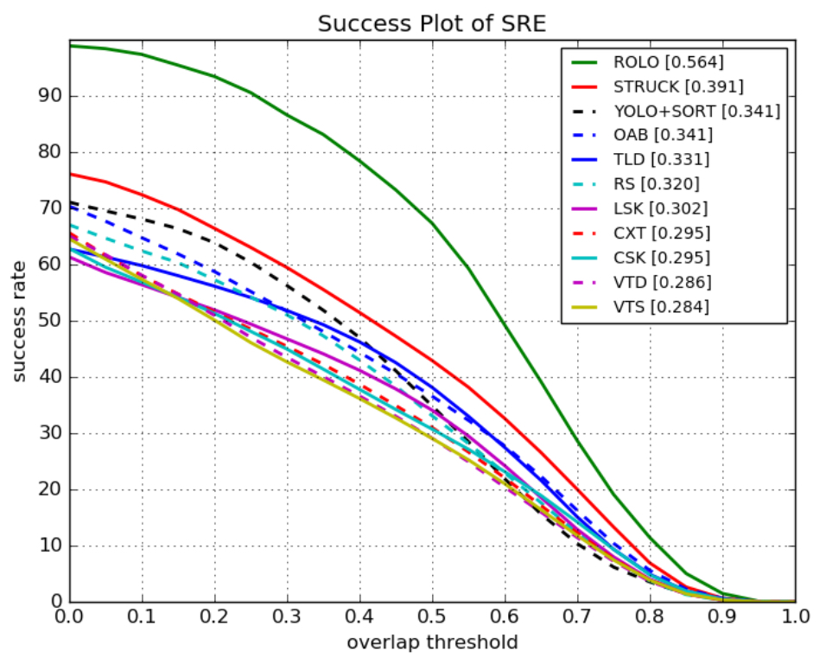
Results - OTB Challenge Dataset
Model | Success rate | IoU | FPS | Machine
Spatially Supervised Recurrent Convolutional Neural Networks for Visual Object Tracking | 0.564 | 0.455 | 20 / 60 fps | Nvidia Titan X
Succes plot of Spatial Robustness Evaluation on OTB-30 [5]
Notes:
25:30
· IOU – intersection-over-union
· Compared with top 9 trackers OTB-30
· TRE, the tracker is initialized on a different frame (i.e., with a temporal spread), and in SRE, the tracker is initialized with a noisy bounding box (i.e., with a spatial spread)

Slide 36
Agenda
Intro
Feature-based Video Object Detection
Box-Level-based Video Object Detection
Flow-based Video Object Detection
Comparison of different approaches
General
Conclusion Performance
Conclusion prediction quality
Outro

Slide 37
5.2 Conclusion Performance
Observation
Hypothesis
Networks with more convolutional aspects perform better and provide better results then recurrent [6], [10]
RNNs by definition have a recurrent nature and this can be a bottleneck for Video Object detection in real time
Networks employing an intelligent keyframe extraction policies gain performance benefits [7], [8]
Processing each and every frame of the video is not an efficient way of Video object detection
A lot of performance can be gained by compromising a little on the results [8], [10]
It is important to have a flexible network so that different aspects e.g. depth, keyframe extraction policy can be modified depending upon the application easily
Propagating multiple frames at the same time through the network results in better performance [8], [10]
Networks processing multiple frames at the same time can provide better flexibility on how to propagate them through the network
Notes:
27:00

Slide 38
Agenda
Intro
Feature-based Video Object Detection
Box-Level-based Video Object Detection
Flow-based Video Object Detection
Comparison of different approaches
General
Conclusion Computational power
Conclusion perfomance
Outro

Slide 39
5.3 Conclusion Perfomance
Observation
Hypothesis
[8] and [10] on ImageNet Vid and both processing on multiple frames
Very beneficial to use previous and future frames
[1] better prediction quality then [6] on KITTI
RNN processing on multiple frames better then RNNs processing on regions within a single frame
[10] good results
Beneficial to use RNNs to look also on different scales not only at different time steps
[2] with multiple LSTMs comparatively bad
one RNN module is enough
[3] comparatively low map on ImageNet Vid
better to use Box-level or Feature-level approaches instead of FlowNets
[5] leading results on OTB challenge dataset
Combination of Box-Level and Feature-Level approaches leads to promising results
Notes:
28:30
· [2] flow comparatevily slow
· Multiple LSTM small benefit to single LSTM in [2]

Slide 40
Agenda
Intro
Feature-based Video Object Detection
Box-Level-based Video Object Detection
Flow-based Video Object Detection
Comparison of different approaches
Outro
Conclusion
Further work

Slide 41
6.1 Conclusion
RNN
Beneficial to use RNNs in comparisons to similar non-recurrent networks
Comparatively good results can also be reached with non-recurrent networks, but temporal context matters
General
Good to operate on multiple frames at the same time
Recurrent layers should not be to deep
Beneficial to operate on different scales
Import to use a intelligent key frame policy
[5]
Notes:
29:00

Slide 42
Agenda
Intro
Feature-based Video Object Detection
Box-Level-based Video Object Detection
Flow-based Video Object Detection
Comparison of different approaches
Outro
Conclusion
Further work

Slide 43
3.2 Further Work
t-3
t-2
t-1
t
Video Object Detection Network
Region Bounding boxes + class probabilities
4-frame RPN
Affine Transformations
Bounding boxes + class probabilities
Overview
A region proposal network that is based on the N-Gram concept in Natural Language Processing.
Given a window of N previous frames propose the regions where the object bounding boxes could be detected from within the next frame.
The RPN (region proposal network) should be recurrent in nature for detecting the temporal dependencies and can be very lightweight.
Use only those region proposals and feed them to the video object detection network.
So rather than feeding the whole image, feed only the region proposals made by RPN.
Perform affine transformations to the output bounding boxes to overlay them over the image.
Potential drawbacks
Region proposals can be of different resolutions depending upon the objects.
The RPN and the detection network have to lightweight otherwise RPN is just a overhead.
Notes:
30-31

Slide 44
Sources
[1] | Alexander Broad, Michael Jones, Teng-Yok Lee. Recurrent Multi-frame Single Shot Detector for Video Object Detection. 2018.
[2] | Mason Liu, Menglong Zhu. Mobile Video Object Detection with Temporally-Aware Feature Maps. 2018.
[3] | Xizhou Zhu, Yuwen Xiong, Jifeng Dai, Lu Yuan, Yichen Wei. Deep Feature Flow for Video Recognition. 2017.
[4] | Subarna Tripathi, Zachary C. Lipton, Serge Belongie, Truong Nguyen. Context Matters: Refining Object Detection in Video with Recurrent Neural Networks.
[5] | Guanghan Ning, Zhi Zhang, Chen Huang, Zhihai He, Xiaobo Ren, Haohong Wang. Spatially Supervised Recurrent Convolutional Neural Networks for Visual Object Tracking. 2016.

Slide 45
Sources
[6] | Kai Yi, Zhiqiang Jian, Shitao Chen, Nanning Zheng. Feature Selective Small Object Detection via Knowledge-based Recurrent Attentive Neural Network. 2019.
[7] | Mason Liu, Menglong Zhu, Marie White, Yinxiao Li, Dmitry Kalenichenko. Looking Fast and Slow: Memory-Guided Mobile Video Object Detection. 2019.
[8] | Christoph Feichtenhofer, Axel Pinz, Andrew Zisserman. Detect to Track and Track to Detect. 2017.
[9] | Kai Kang, Wanli Ouyang, Hongsheng Li, Xiaogang Wang. Object Detection from Video Tubelets with Convolutional Neural Networks. 2016.
[10] | Kai Chen, Jiaqi Wang, Shuo Yang, Xingcheng Zhang, Yuanjun Xiong, Chen Change Loy, Dahua Lin. Optimizing Video Object Detection via a Scale-Time Lattice. 2018.

Slide 46
Sources
[11] | Ian Goodfellow, Yoshua Bengio, Aaron Courville Deep Learning (Adaptive Computation and Machine Learning) 2017
[12] | https://colah.github.io/posts/2015-08-Understanding-LSTMs/ visited on 26.06.2019
[13] | https://medium.com/mlrecipies/deep-learning-basics-gated-recurrent-unit-gru-1d8e9fae7280 visited on 27.06.2019
[14] [15] [16] | Alexander Broad, Michael Jones, Teng-Yok Lee, Supplementary Material for Recurrent Multi-frame Single Shot Detector for Video Object Detection Jia Deng, Wei Dong, Richard Socher, Li-Jia Li, Kai Li and Li Fei-Fei. ImageNet: A Large-Scale Hierarchical Image Database. Alex Krizhevsky, Ilya Sutskever, Geoffrey E. Hinton. ImageNet Classification with Deep Convolutional Neural Networks. 2012.

Slide 47
Sources
[17] | Shaoqing Ren, Kaiming He, Ross Girshick, Jian Sun. Faster R-CNN: Towards Real-Time Object Detection with Region Proposal Networks. 2016.
[18] | Joseph Redmon, Ali Farhadi. YOLOv3: An Incremental Improvement.
[19] | Wei Liu, Dragomir Anguelov, Dumitru Erhan, Christian Szegedy, Scott Reed, Cheng-Yang Fu, Alexander C. Berg. SSD: Single Shot MultiBox Detector. 2016.

Slide 48
Questions?

Slide 49
Backup Slides

Slide 50
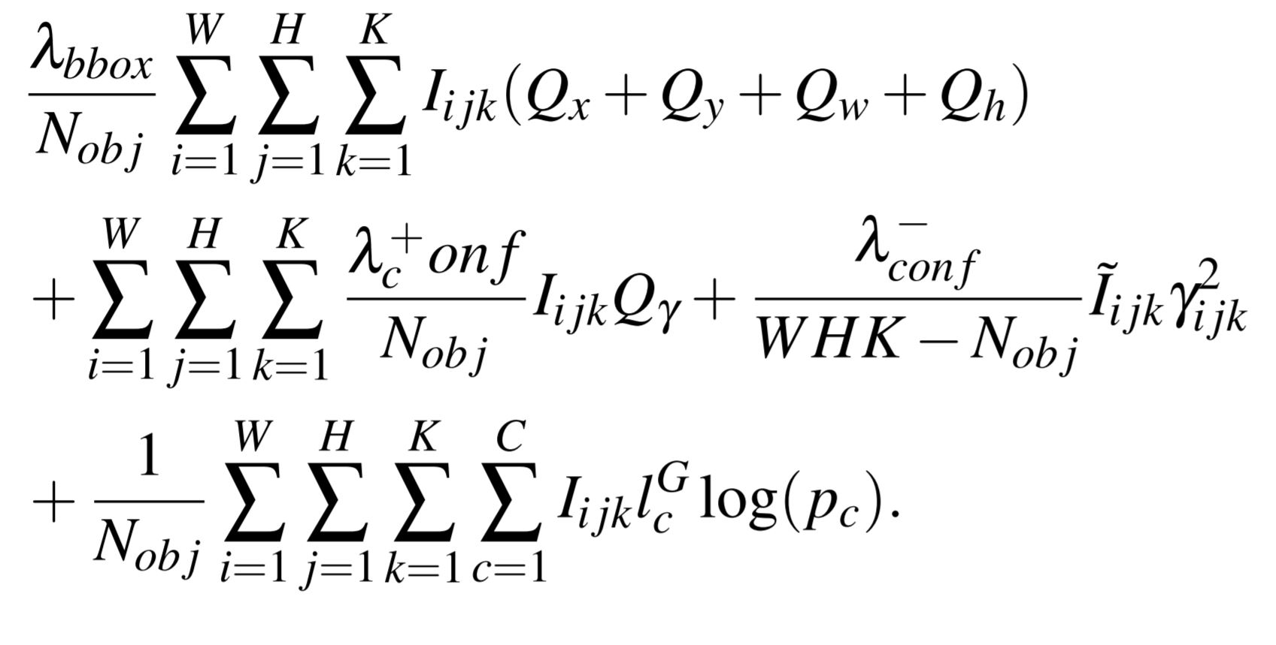
2.4 Feature Selective Small Object Detection via Knowledge-based Recurrent Attentive Neural Network
Loss Function:
The Loss function consists of three parts:
Bounding box regression
Confidence score regression
Cross entropy loss of classification
Results:
mAP of 81.3% at 30.8 FPS on KITTI dataset using Nvidia Titan X.
mAP of 57.8% at 37.5 FPS on COCO dataset (only the pedestrian class tested) using Nvidia Titan X.

Slide 51
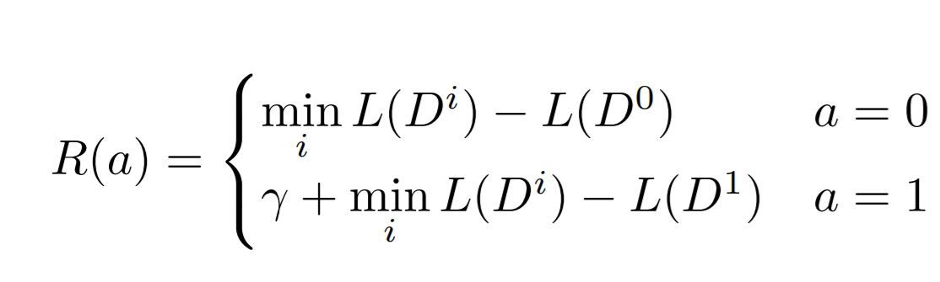
2.5 Looking Fast and Slow: Memory-Guided Mobile Video Object Detection
Loss Function:
Reinforcement Learning Policy
The Loss function consists of two parts:
Bounding box regression
Cross entropy loss of classification
Results:
mAP of 60.7% at 48.8 fps on ImageNet VID dataset using a Pixel 3 phone

Slide 52
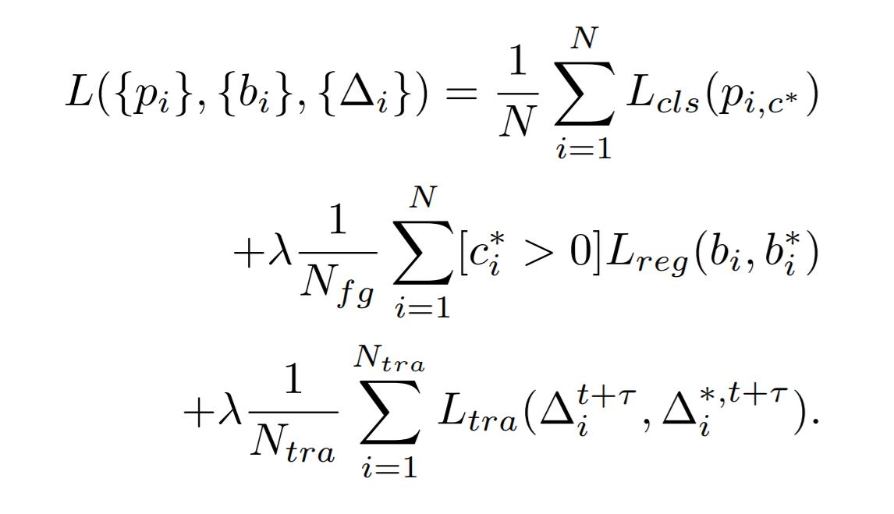
2.7 Detect to track and track to detect
Loss Function:
The Loss function consists of three parts:
The cross entropy classification loss.
The bounding box regression loss
The tracking regression loss.
Results:
mAP of 82.0% at 7 fps on ImageNet VID dataset using a Nvidia TITAN X or
mAP of 78.5% at 55 fps on ImageNet VID dataset using a Nvidia TITAN X

Slide 53
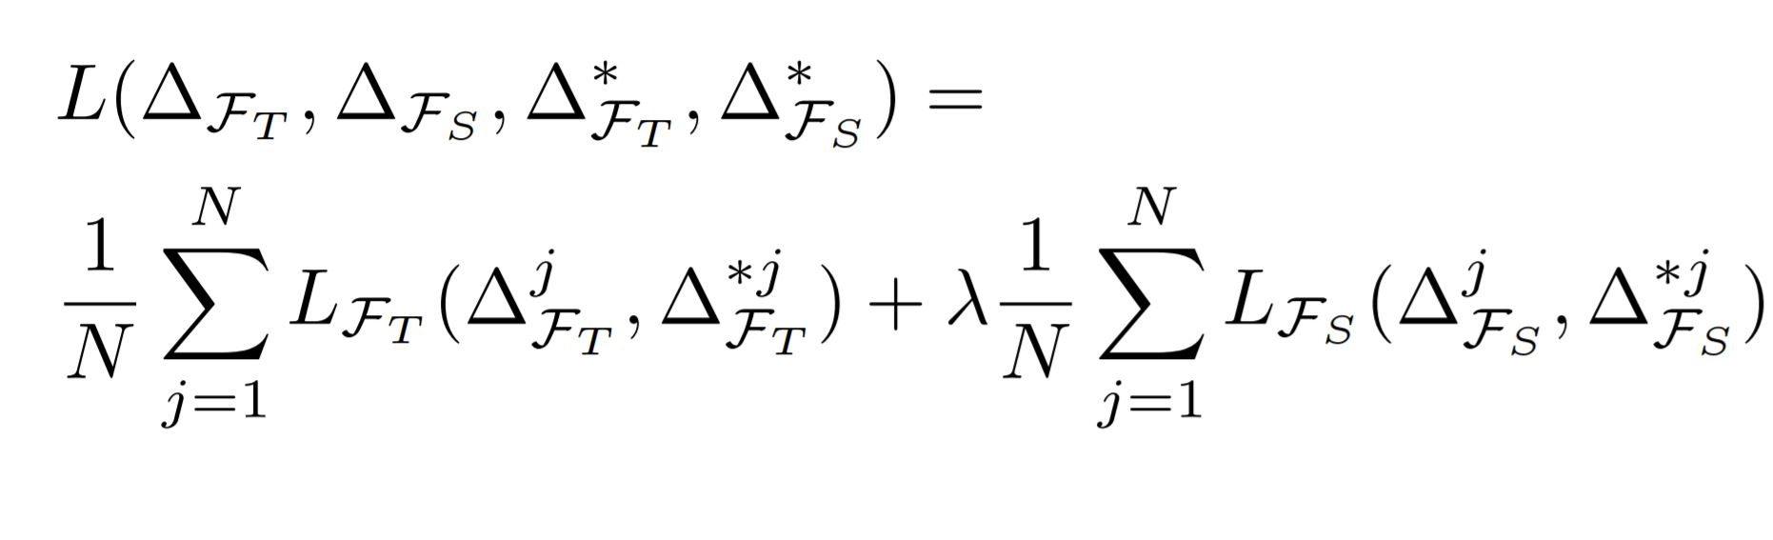
3.3 Optimizing Video Object Detection via a Scale-Time Lattice
Loss Function:
The Loss function consists of two parts:
Smooth L1 loss of temporal propagation.
Smooth L1 loss of spatial refinement.
Result:
mAP of 79.6% at 20 fps on ImageNet VID dataset using Nvidia Titan X or
mAP of 79% at 62 fps on ImageNet VID using Nvidia Titan X
Notes:
18:00

Slide 54
Agenda
Intro
Feature-based Video Object Detection
Box-Level-based Video Object Detection
Definition
Object Detection from Video Tubelets with Convolutional Neural Networks
Optimizing Video Object Detection via Scale-Time Lattice
Context Matters: Refining Object Detection in Video with Recurrent Neural Networks
Spatially Supervised Recurrent Convolutional Neural Networks for Visual Object Tracking
Flow-based Video Object Detection
Comparison of different approaches
Outro

Slide 55
3.2 Object Detection from Video Tubelets with Convolutional Neural Networks
Image Object Proposal
Object Proposal
Rescoring
High Conf. Proposal Tracking
Tubelet box perturbation and max-pooling
Temporal convolution and re-scoring
Use selective search algorithm to generate around 2000 object proposals on each frame.
Use GoogleNet for feature extraction and then 30 SVMs for 30 VID classes to generate object proposal scores for each object proposal.
Track high confidence targets bi-directionally.
Two kinds of Perturbations:
The first method is to generate new boxes around each tubelet box on each frame by randomly perturbing the boundaries of the tubelet box.
The second perturbation method is to replace each tubelet box with original object detections that have overlaps with the tubelet box beyond a threshold.
Train a class-specific TCN using the tubelet features as input. The inputs are time series including detection scores, tracking scores and anchor offsets. The output values are probabilities whether each tubelet box contains objects of the class.
.
Notes:
High Conf. Proposal Tracking is also renamed as Tubelet Proposal in the paper.

